Slide 1
Welcome New International Students

Slide 2
New International Student orientation

Slide 3
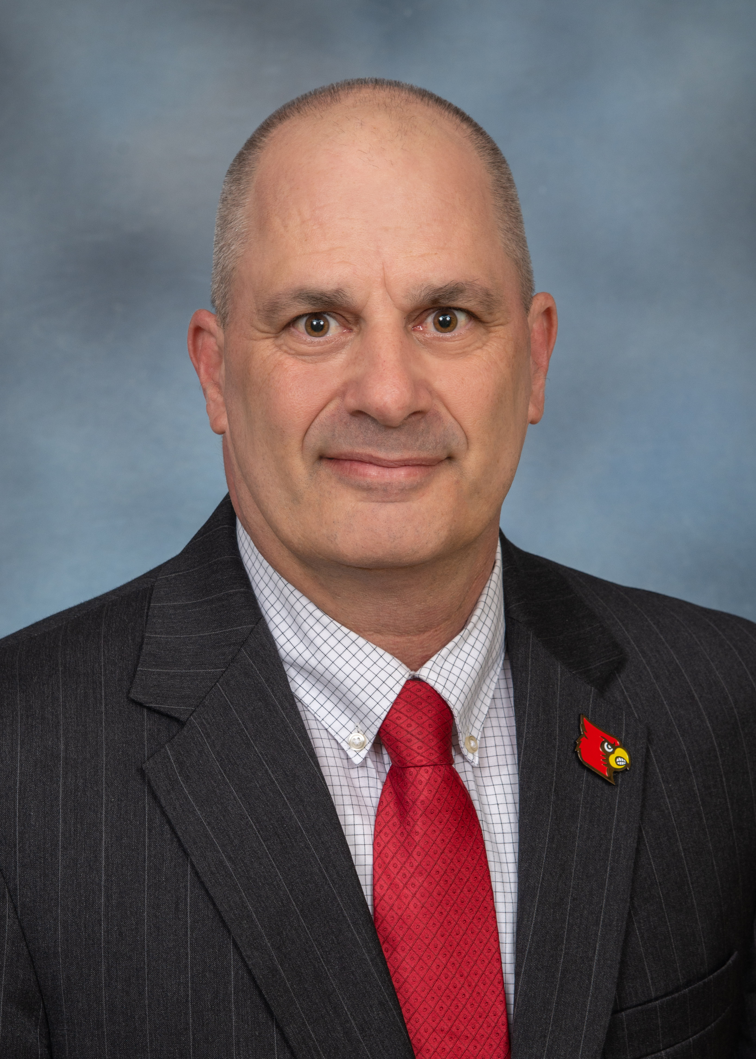
International Center Leadership
Dr. Paul Hofmann
Associate Vice Provost for International Affairs
paul.hofmann@louisville.edu

Slide 4
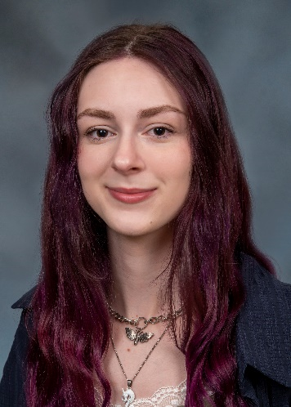
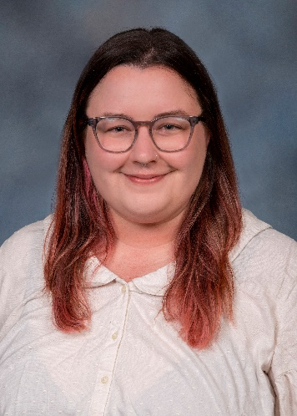
International Center Staff
Kristin Samer
Communication & Marketing Coordinator
Paige Tyson
Assistant to AVP

Slide 5
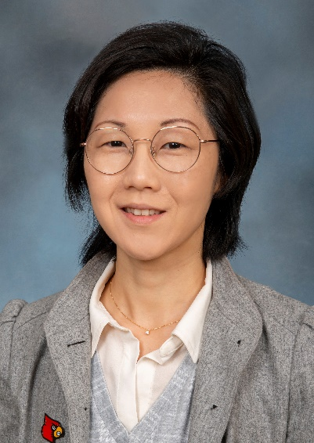
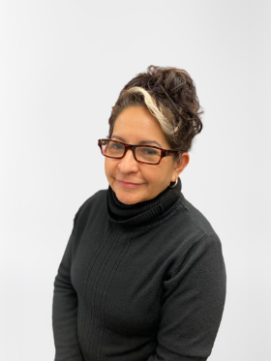
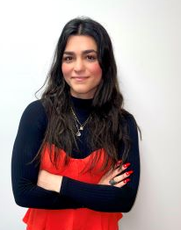
International Student & Scholar Services STAFF
Janice Kim
Director
Connie Martinez
Seyda Muratova

Slide 6
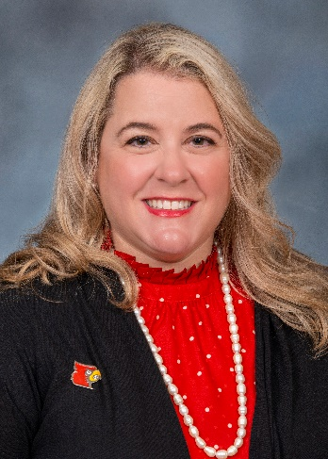
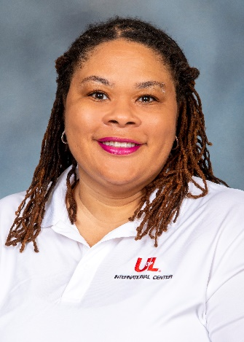
Study Abroad
The Passport Place & INTERNATIONAL TRAVEL
Dr. Elizabeth Liebschutz-Roettger
Manager of Global Initiatives
Melissa Lee
The Passport Place & Int’l Travels Manager

Slide 7
U.S. Immigration Laws for International Students on F1 and J1 Visa

Slide 8
Maintaining Status

Slide 9
Full Course of Study
A “full course of study” means that you maintain full-time enrollment.
12 credit hours for undergraduate students
9 credit hours for graduate students
* Note that new initial students must enroll full-time for their first term even if it is a summer session.

Slide 10
Online courses
No more than the equivalent of one class or three credits per term or semester may be counted toward the full course of study requirement if the class is taken on-line or through distance education and does not require the student's physical attendance for classes, examination or other purposes integral to completion of the class.

Slide 11
Reduced Course Load
Reasons | Guidelines
Illness or Medical Condition | Cannot exceed 12 month aggregate per program level May excuse a student from all classes Student must provide medical documentation from a licensed: Medical Doctor Doctor of Osteopathy Clinical Psychologist DSO must renew the RCL each term, based on new or continuing medical information May be used nonstop or at different times during a program level Start date should be the date DSO approved the RCL

Slide 12
Reasons | Guidelines
Academic Difficulties, including: Improper course level placement Initial difficulty with reading requirements Initial difficulty with the English language Unfamiliarity with U.S. teaching methods | Can only be used for the initial academic term Student must maintain a minimum six-credit course load, or half the clock hours required for a full course of study Student must begin a full course of study at the next offered term RCL start and end dates must correspond to the school session start and end dates
To Complete Course of Study in Current Term | Used in a student’s final term if he/she can complete the program with fewer classes Student must be enrolled in at least one required class RCL start and end dates must correspond to the school session start and end dates
Source

Slide 13
Program Extension
Must make the request prior to the expiration date indicated on the form I-20
Submit an explanation from academic advisor or unit dean with new expected date of completion
Submit financial documentation for the remainder of the program

Slide 14
Change of Educational Level
For F-1 students
May study at a higher or lower-level degree program
Must successfully obtain admission to the new program
Submit new financial documentation
For J-1 students
Exchange visitors may only matriculate to higher degree levels
Must successfully obtain admission to the new program
Submit new financial documentation

Slide 15
Completion of a Course of Study
After completing a program of study, an F-1 student has a 60-day grace period
During the grace period you are expected to depart the U.S. You may not re-enter the U.S. in F-1 status if you depart during the grace period.
Change Educational Level
Transfer to another institution (F-1 students only, J-1’s must transfer prior to starting a grace period)
If eligible, apply for Optional Practical Training (F-1), Academic Training (J-1)
Change to another non-immigrant status

Slide 16
Change of Address
International students have 10 days to report a change of address to a DSO.
You must also change your address on your Ulink account.

Slide 17
Maintaining Valid Documents

Slide 18
Passport must have at least six months of validity
Valid Visa
  http://travel.state.gov/
I-94
  https://i94.cbp.dhs.gov/
SEVIS Form I-20 (F-1)/Form DS-2019 (J-1)
  Maintain valid dates
  Do not lose this document

Slide 19
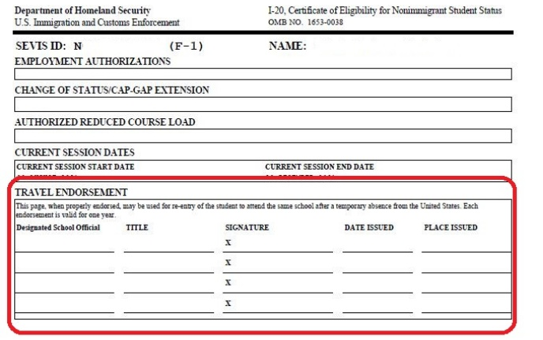
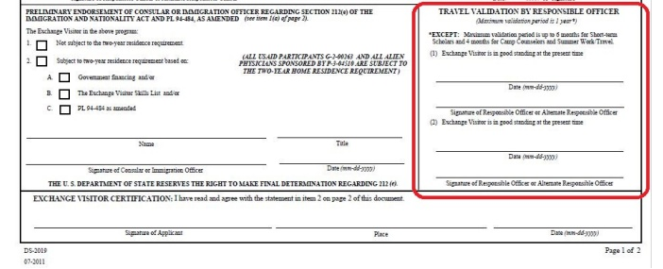
Travel Outside the U.S.
Unexpired passport valid at least 6 months into the future.
Ensure you have a Valid Visa
Obtain a signature of a P/DSO or a RO/ARO before you travel outside the U.S.

Slide 20
Employment

Slide 21
ON-CAMPUS EMPLOYMENT
must not exceed 20 hours a week while school is in session
may work on campus full-time when school is not in session or during the annual vacation
(J-1 Students) The responsible officer must approve the specific employment in advance and in writing.
  Such approval may be valid for up to 12 months, but is automatically withdrawn if the student's program is transferred or terminated.

Slide 22
Practical Training
F-1 Students
Curricular Practical Training (CPT)
Optional Practical Training (OPT)
J-1 Students
Academic Training (AT)

Slide 23
Social security
As an international student, you can only obtain a Social Security Number (SSN) if you are employed or getting paid through a GA, GTA, RA, GRA
You must have a letter from the employer
You must visit the International office to obtain the instructions and the forms needed to obtain your SSN
Driver's license
You must come to the International office to obtain the instructions and the USCIS Compliance form required to get obtain your license/ID Card.

Slide 24
Examples of Status Violation

Slide 25
Failing to be registered for a full course of study during the fall and spring semesters (or summer, if first semester) without receiving prior approval for a reduced course load or a temporary absence from one of the DSO/ARO.
A student who drops below full course of study without prior approval is considered out of status
Failing to apply for a program extension before the current Form I-20 or DS-2019 expired
Failing to request a Change of Education level during the 60-day grace period
Failing to leave the U.S. within 60 days of completing a degree program
Failing to provide changes to your personal information such as your name or address within 10 days
A student who has not received proper work authorization prior to engaging in practical training

Slide 26
Student Conduct & Student Care

Slide 27

Dean of Students Office
Angela B. Taylor
Associate Vice President for Student Affairs
Assistant Dean of Students
SAC W301 (502) 852-5787 dos@louisville.edu
louisville.edu/dos
Conduct, Crisis, Care, Complaints, and Advocacy

Slide 28

AGENDA
________________________________________________
  Overview of the Dean of Students Office
  Code of Student Conduct
  Code of Student Rights and Responsibilities
  Academic Grievance/Student Complaints
  Student Wellbeing

Slide 29










DOS OFFICE STAFF
Michael Mardis, Ph.D.
Vice President for Student Affairs and Dean of Students
Angela B. Taylor, Ph.D.
Associate Vice President for Student Affairs and Assist. Dean of Students
Byron Lightsy, M.A.Ed.
Director of Student Care and Conduct
Jessica Gernert, M.S.
Student Conduct Coordinator
Shirley Hardy, MSSW
Student Conduct Officer
Samantha MacKenzie, M.Ed.
Student Advocate
Geri Morgan, MSW
Student Care Manager
Aaron Roberts, M.Ed.
Student Care & Conduct Coordinator
Heather Gentry, M.A.
Administrative Services Coordinator
Wendy Morgan
Administrative Assistant
www.louisivlle.edu/dos dos@louisville.edu (502) 852-5787 SACW301

Slide 30
DEAN OF STUDENTS OFFICE
  A student should come see us if:
  Believe student rights have been violated.
  Dealing with a crisis situation.
  Have been hospitalized and need help notifying professors of absence.
  Friend who needs help; struggling with challenges in their life, depression, suicidal thoughts, eating disorders, etc.
  Need to file a written student complaint.
  Need assistance or advice on University policies and procedures.
  Need assistance but are uncertain where to go for help.
www.louisivlle.edu/dos dos@louisville.edu (502) 852-5787 SAC301W

Slide 31

DOS Support Services
Absence Notifications
Advocacy
Cards SPEAK *
Compassionate Withdrawals
Complaints & Grievances *
ConcernCenter *
Emergency Fund
Records Check
Report a Concern *
Speech & Distribution of Literature
Student Care Team
Student Pregnancy Policy
Student In Distress *
Title IX *
www.louisivlle.edu/dos dos@louisville.edu (502) 852-5787 SAC301W

Slide 32

DOS WEBSITE
www.louisville.edu/dos
www.louisivlle.edu/dos dos@louisville.edu (502) 852-5787 SAC301W

Slide 33

Code of Student Conduct

Slide 34
CODE OF STUDENT CONDUCT
  The Code of Student Conduct is the University's policy regarding non-academic misconduct of students and student organizations. Students have a responsibility to follow all regulations in this policy.
  http://louisville.edu/dos/students/codeofconduct
www.louisivlle.edu/dos dos@louisville.edu (502) 852-5787 SAC301W

Slide 35

11. Prohibited Conduct
Physical Harm: Intentionally or recklessly causing physical harm to another person
Weapons: Unauthorized use, possession, or storage of any weapon, ammunition, or realistic replica of a weapon on University premises
Disruption: Intentionally or recklessly disrupting or interfering in normal University functions and processes…
Underage Consumption: Providing alcoholic beverages to individuals under 21-years-of-age, or possession or use of alcoholic beverages by individuals under 21-years-of-age.
Open container: Unauthorized possession of an open container of an alcoholic beverage.
Falsification: Forging, altering, misrepresenting, counterfeiting, or misusing any university document, identification/authentication method/mechanism or access device or process.
Threatening: Threatening or endangering the health, well-being, property, or safety of any person(s).
Sexual Assault: Any forcible and non-forcible sex offenses to include rap, sodomy, sexual assault with an object, fondling, incest, and statutory rape.
www.louisivlle.edu/dos dos@louisville.edu (502) 852-5787 SAC301W

Slide 36

STUDENT RIGHTS & RESPONSIBILITIES

Slide 37
STUDENT RIGHTS AND RESPONSIBILITIES
Academic dishonesty is prohibited at the University of Louisville because it diminishes the quality of scholarship, prohibits independent thought that is essential to intellectual growth and development, makes accurate evaluation of student progress impossible, and defrauds those in society who must ultimately depend upon the knowledge and integrity of the institution and its students and faculty.
  http://louisville.edu/dos/students/rightsandresponsibilities
www.louisivlle.edu/dos dos@louisville.edu (502) 852-5787 SAC301W

Slide 38

Code of Student Rights and Responsibilities
  Classroom Rights and Responsibilities
    Right to be evaluated on demonstrated knowledge and academic performance, not on the basis of personal or political beliefs or on the basis of race, color, national origin, religion, sex, age, or handicap not affecting academic performance
    Students have the freedom of inquiry of legitimate classroom discussion and free expression of opinion.
    Responsibility to fulfill the stated requirements of all courses in which enrolled.
    Right to be provided, no later than the 2nd class meeting, with a syllabus explaining the course requirements, method of evaluation, and classroom expectations; informed in writing of any changes; and provided a sustentative academic evaluation before the withdrawal deadline.
www.louisivlle.edu/dos dos@louisville.edu (502) 852-5787 SAC301W

Slide 39


Student Grievance Officer & Student Advocate
Dr. Joy Hart
Student Grievance Officer
Informs students of grievance procedures
Informal and formal resolution process
Joy.hart@louisville.edu
Samantha MacKenzie, M.Ed
Student Advocate
Helps understand University policies and process
Thorough knowledge of the University
advocate@louisville.edu
www.louisivlle.edu/dos dos@louisville.edu (502) 852-5787 SAC301W

Slide 40
STUDENT COMPLAINT PROCESS
  All complaints begin by filling out the Student Complaint Form https://louisville.edu/dos/help/student-complaint-procedure
  Academic Complaints:
  Complaint will be forwarded to the appropriate Department Chair
  Student should speak with the Department Chair about their concerns
  Student may file an Academic Grievance if they do not feel the concerns were adequately addressed
  Non-Academic Complaints:
  Complaint will be forwarded to the appropriate process (if applicable) and/or appropriate Department/Employee Supervisor
  Resolution should be issued to the student within 21 business days
  If not satisfied by the resolution, a student may submit a written appeal as outlined in the UofL Redbook Chapter Six.
www.louisivlle.edu/dos dos@louisville.edu (502) 852-5787 SAC301W

Slide 41
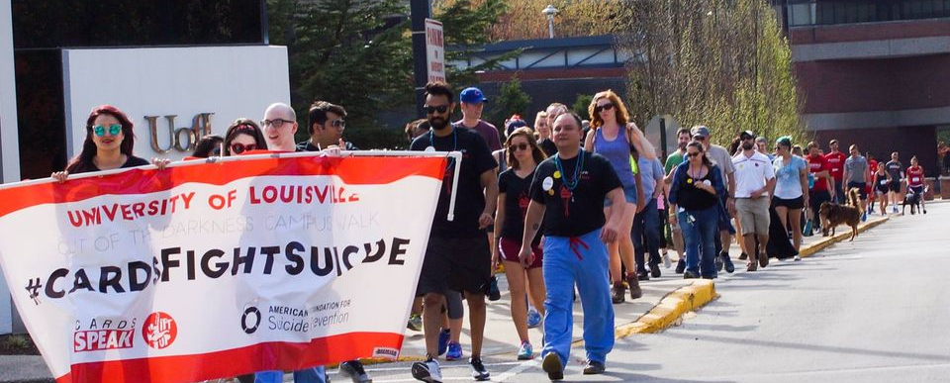
STUDENT WELLBEING

Slide 42
DEPRESSION & ANXIETY
    Depression and anxiety are major concerns because they can lead to suicide and are associated with;
        Poor physical health
        Substandard academic performance
        Risk-taking behaviors
    Students experiencing depression with anxiety are at higher risk for suicide.
    Depression and Anxiety are treatable, and suicide is one of the most preventable forms of death with the appropriate intervention and treatment.
    Why is this so important?
        A 2020 study found that depression symptoms were prevalent in about 48.30% of the students surveyed and anxiety symptoms were prevalent in 50% of these students [*]
        Suicide is the second-leading cause of death for college-aged students [*]
        The Jed Foundation found that nearly 50% of students turn to friends for support [*]
www.louisivlle.edu/dos dos@louisville.edu (502) 852-5787 SAC301W

Slide 43
CHARACTERISTICS OF STUDENTS IN DISTRESS
  Unusual or changed patterns of interactions
  Excessive anxiety
  Depressed, lethargic, rapid speech
  Swollen, red eyes
  Changes in personal dress and/or hygiene
  Repeated requests for special consideration
  Highly emotional
  Unusual or exaggerated emotional responses which appear inappropriate to the situations
  Irritability or outburst of anger
  What are other characteristics?
www.louisivlle.edu/dos dos@louisville.edu (502) 852-5787 SAC301W

Slide 44
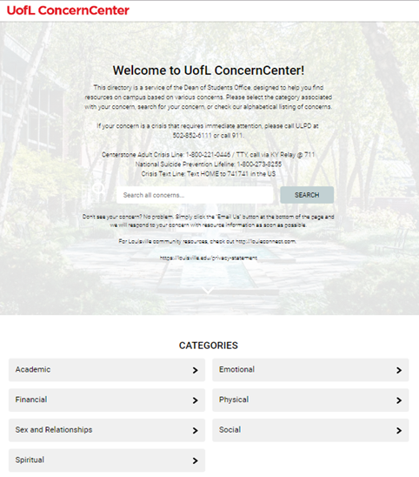
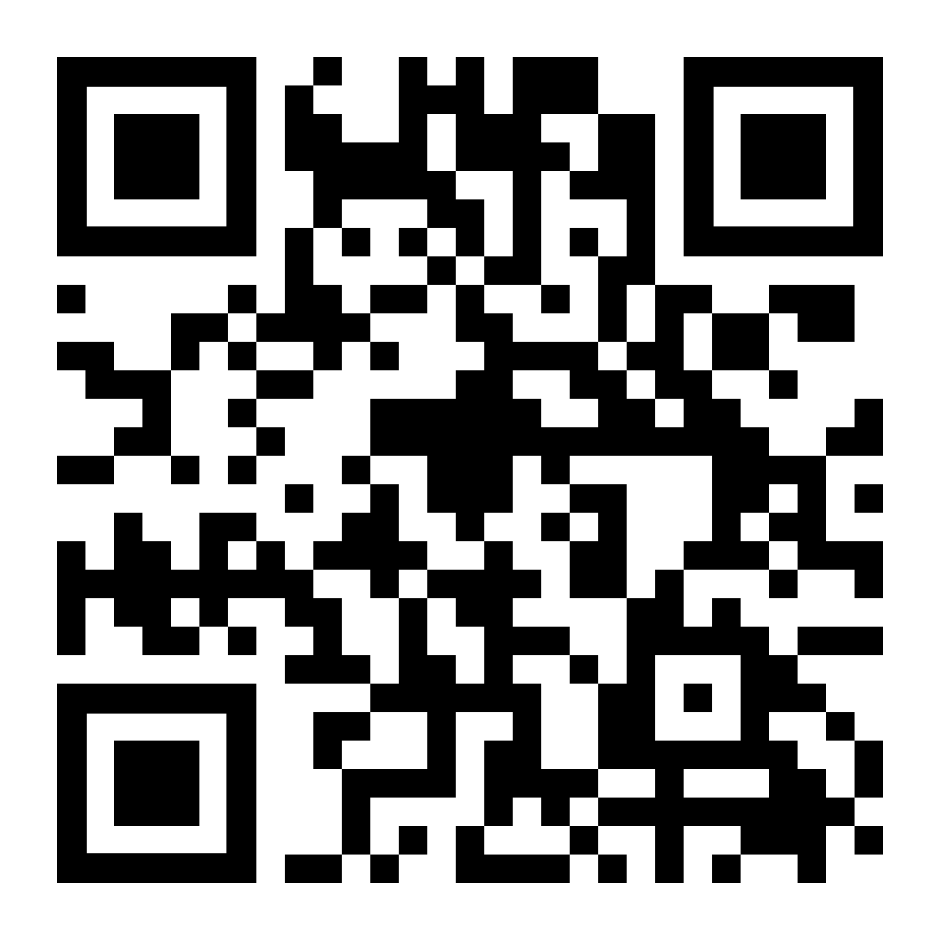
CONCERNCENTER
LOUISVILLE.CONCERNCENTER.COM
www.louisivlle.edu/dos dos@louisville.edu (502) 852-5787 SAC301W

Slide 45

COMMONWEALTH CREDIT UNION CARDINAL CUPBOARD FOOD PANTRY
3,316 uses by 902 unique users in Fall 2022
Renovation and expansion as a result of a gift from Commonwealth Credit Union
Partnerships with Kroger and Dare to Care
UofL students and employees
Located in the Student Activities Center, 3rd floor
*Academic Year 2021-2022

Slide 46

Services are covered by your student fees; we do not bill insurance. Currently enrolled students are eligible for a triage to determine services and/or referrals.
  Short-term Personal Counseling Individual and Couples*
  Support Groups and Workshops
  Crisis/urgent consultation: students in crisis can be seen briefly for an urgent consultation 9am-4pm
  Consultation for students and campus partners (e.g., how to help a student)
  Outreach
  LD/ADHD Testing (sliding scale fee applies)
  Referrals to on or off campus services
Licensed professional staff includes psychologists, counselors, therapists, and social workers; Graduate trainees also provide services (under licensed staff supervision)
*“Couple” is loosely defined as any two people; only one has to be a UofL student
louisville.edu/counseling coping@louisville.edu 502-852-6585 SAC W204

Slide 47

Disability Resource Center (DRC)
Who receives services from the DRC?
The disabilities represented among our student population include but are not limited to:
  Learning disabilities
  ADHD/ADD
  Mental health conditions
  Autism Spectrum Disorder
How do students request services?
Students with disabilities are encouraged to contact the DRC early to inquire about support services.
See Getting Started Checklist on DRC website for step-by-step instructions.
What do students need to provide to be eligible?
The DRC requires documentation of students’ disabilities in order to determine their eligibility for accommodations. Documentation Guidelines provided on the DRC website explain the points that should be covered.
Unlike K-12, students must self-disclose their disability and request specific accommodations once they reach college.
  Chronic health conditions
  Vision or hearing loss
  Physical disabilities
louisville.edu/disability askdrc@louisville.edu 502-852-6938 Stevenson Hall 119

Slide 48
REPORT A CONCERN FORM
www.louisville.edu/dos
www.louisivlle.edu/dos dos@louisville.edu (502) 852-5787 SAC301W

Slide 49

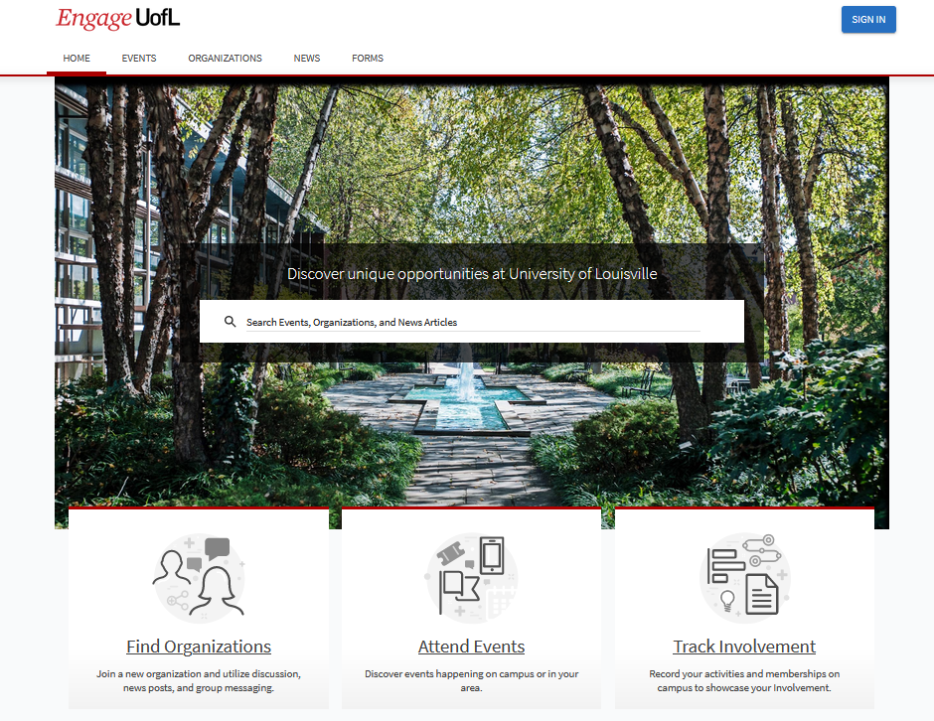
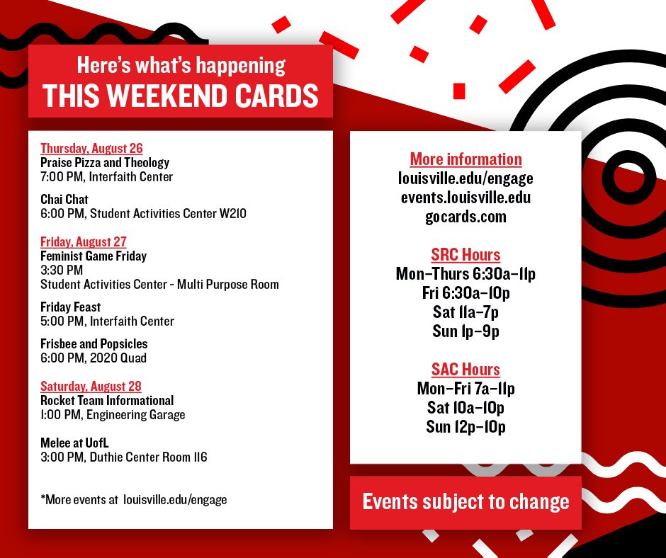
  Campus Calendar: www.louisville.edu/events
Notes:
Communication avenues

Slide 50

Dean of
Students Office
QUESTIONS?
www.louisivlle.edu/dos dos@louisville.edu (502) 852-5787 SAC301W

Slide 51
Managing Student Account and Billing

Slide 52

Paying Your Bill
What you need to know about the Bursar’s Office

Slide 53

What is a Bursar?
The term “Bursar” stems from the Latin word bursarius meaning “purse-bearer”.
The Bursar’s office is responsible for:
Student Billing
  Electronic billing
  View bill/account on Ulink or website 24/7
Payment Processing
  Cash, Check (personal or cashier’s) or money order accepted in office
  E-check or credit/debit card accepted online only
Refund Processing
Payment plans

Slide 54
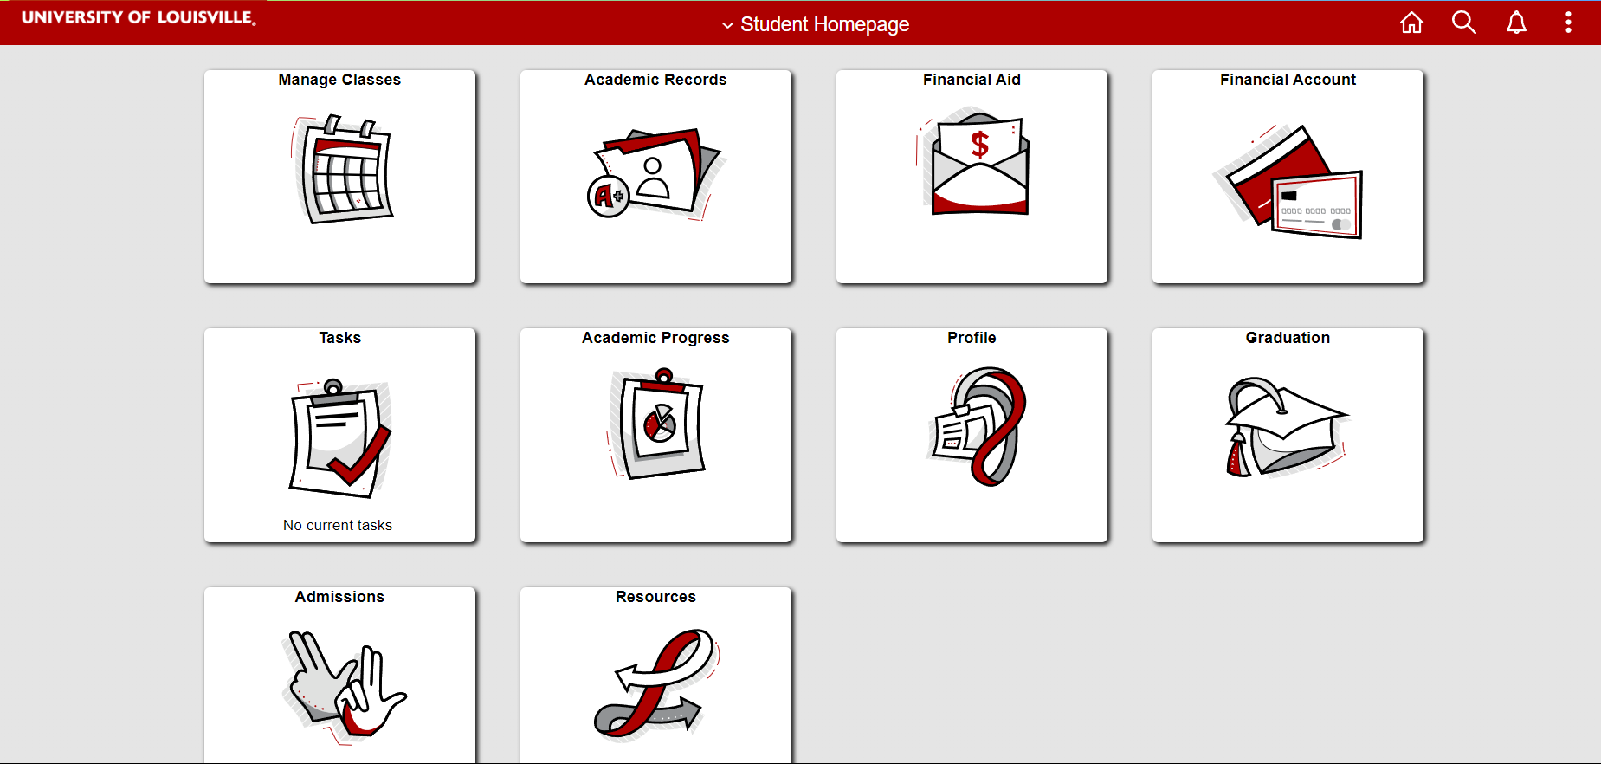

Slide 55
First Things First-
Set Up Your PIN!!
The Bursar’s Office uses the PIN to be compliant with FERPA policies.
Establishing a PIN allows the student to share the PIN with a parent or other individual, enabling them to have access to the student’s account. It also allows our office to speak about the account over the phone.
Please note the Bursar’s office cannot, and therefore will not, release information to anyone without a PIN.
You may set up your PIN via Ulink.

Slide 56
How do I set up the PIN?

Slide 57
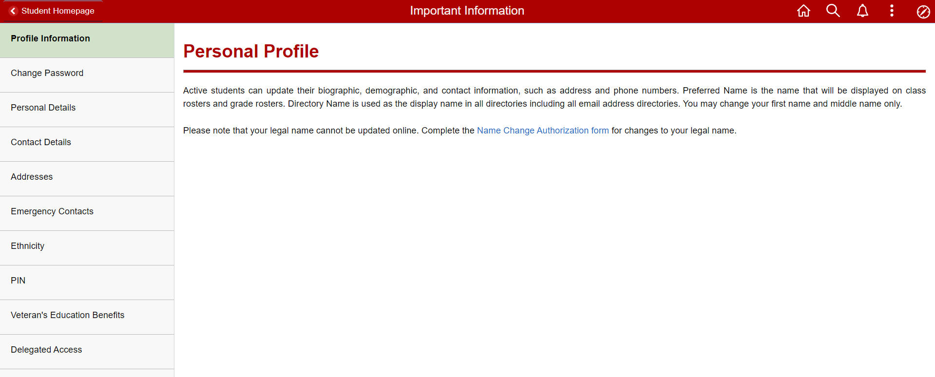
How do I set up the PIN?

Slide 58
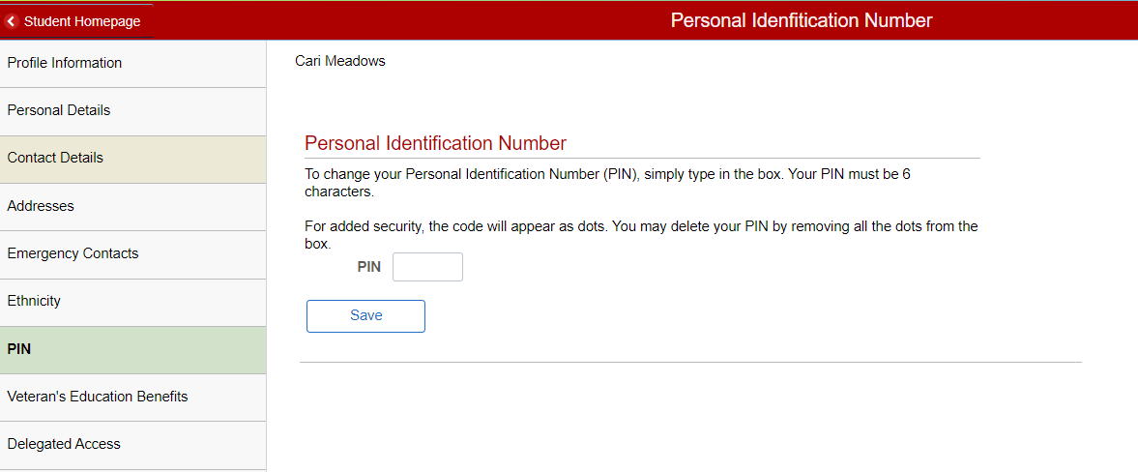
How do I set up the PIN?

Slide 59
Set Up Delegated Access!
We know that students often rely on the support and counsel of the people they trust to help navigate campus finances. We want to be able to talk with whoever you've chosen to represent you. At the same time, we're committed to honoring privacy rules, like FERPA.
Students, we need your permission to talk with anyone other than you about your University of Louisville account. UofL makes it easy for you to grant and maintain this permission through delegated access.
Add a delegate, or make changes, through Ulink.

Slide 60
Set Up Delegated Access!

Slide 61
Set Up Delegated Access!

Slide 62
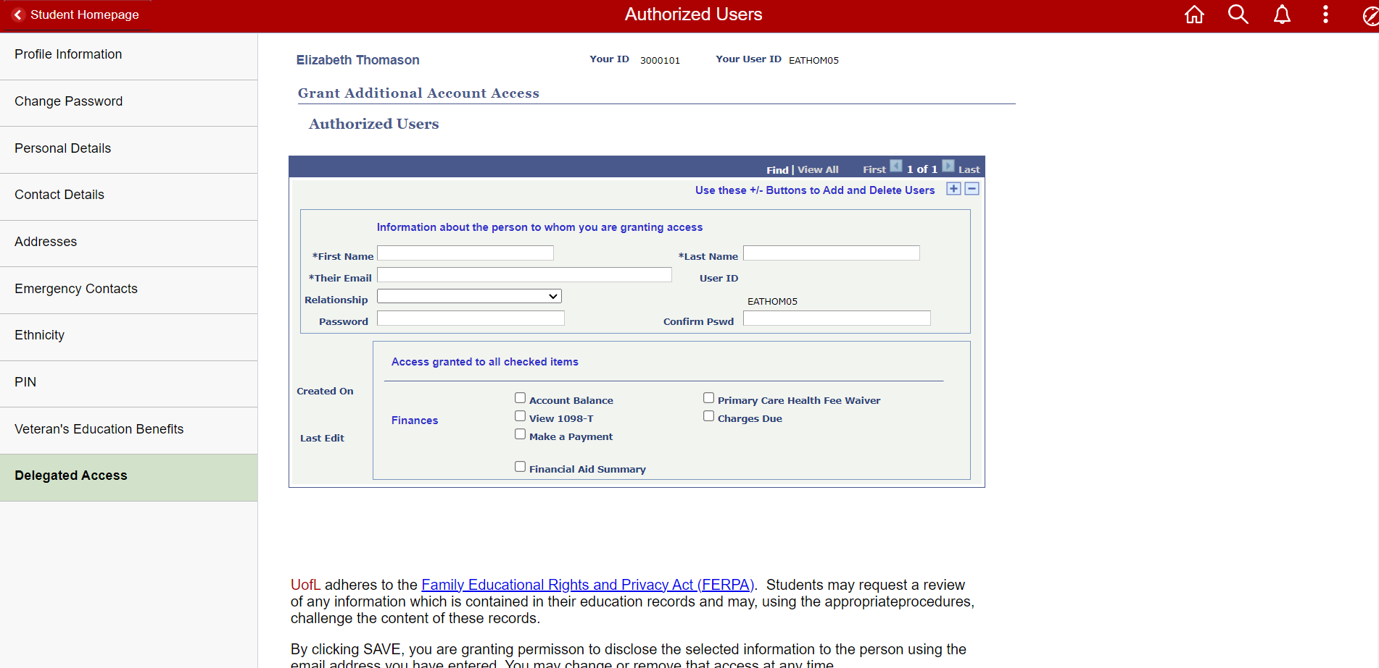
Set Up Delegated Access!

Slide 63
Email Notification Policy
The official method of communication with the University of Louisville Bursar's Office is via the University issued email account. In order to stay informed and aware, students are required to set up and maintain their email accounts. You should check your email frequently.
No paper billing statements will be issued.
We recommend that you add the following email address to your "safe" list within your email system's spam filters: bursar@louisville.edu
If our office does need to mail a check, document, form or notice, we will use the mailing address from your ULink account.

Slide 64
Review Student Account

Slide 65
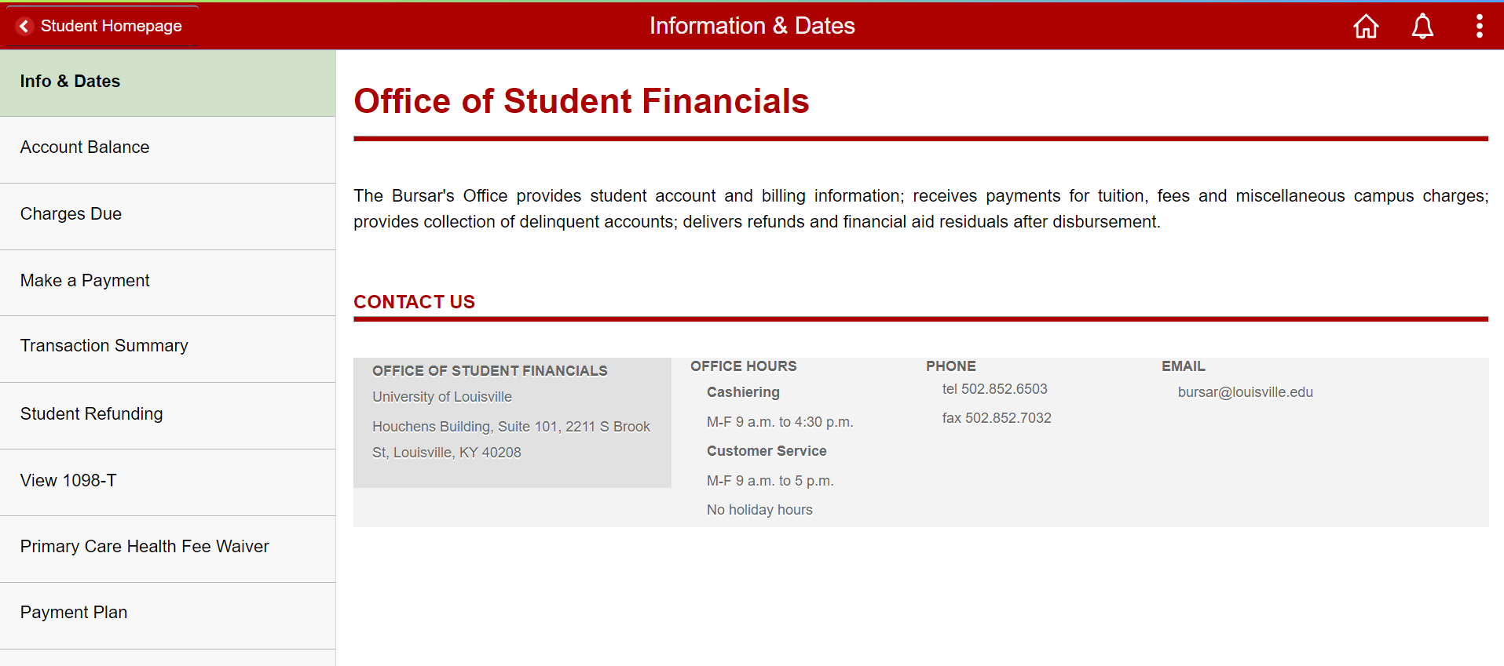
Review Student Account

Slide 66
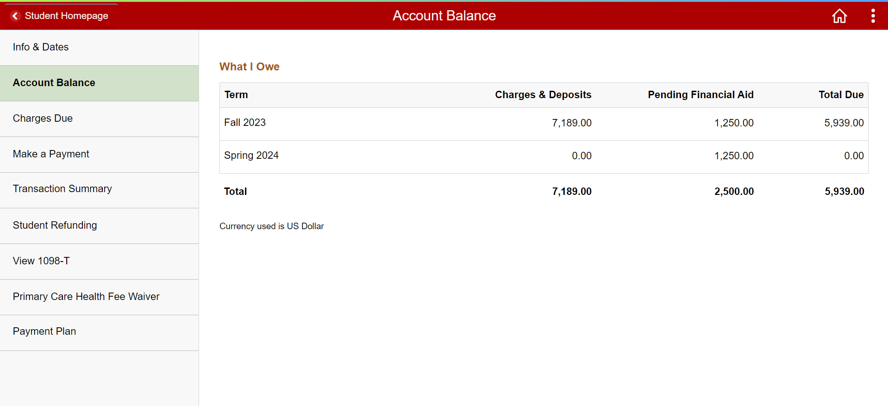
Review Student Account

Slide 67
Review Student Account

Slide 68
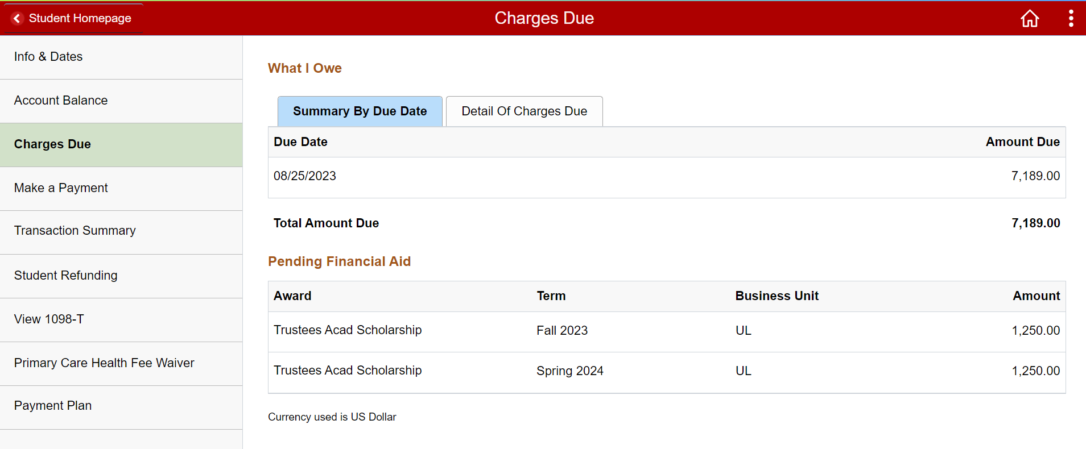
Review Student Account

Slide 69
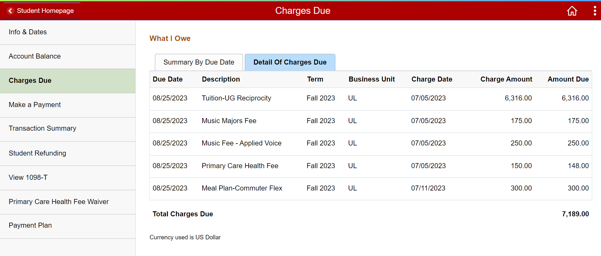
Review Student Account

Slide 70
Making Payments
Payment Methods
ONLINE: Go to Ulink>Student>Financial Account>Make A Payment (*TIP* Do NOT use the Safari browser and make sure your Pop-Up blockers are turned OFF) – You may pay either via Bank Account (FREE!) or pay by Credit/Debit card (NOTE: ALL CARD PAYMENTS ARE ASSESSED A 2.75% SERVICE FEE)
IN OFFICE: Our office is open Monday-Friday from 9:00am to 4:30 pm for payments. You may pay with Cash, Check, or Certified Funds (money orders, certified checks, etc.) Our office is unable to process credit/debit card in person. *Please note the Bursar’s office cannot assist students with the online credit card payment process due to Payment Card Industry-Data Security Standards regulations.*
WIRE TRANSFER: Use the Bursar’s website to acquire wire transfer instructions. https://louisville.edu/bursar/payment/wire
Mail: You may send a check or certified funds in the mail. Be sure to include your student ID number in the memo line! Our mailing address is:
Bursar Office
University of Louisville
Louisville, KY 40292

Slide 71
Making Payments

Slide 72
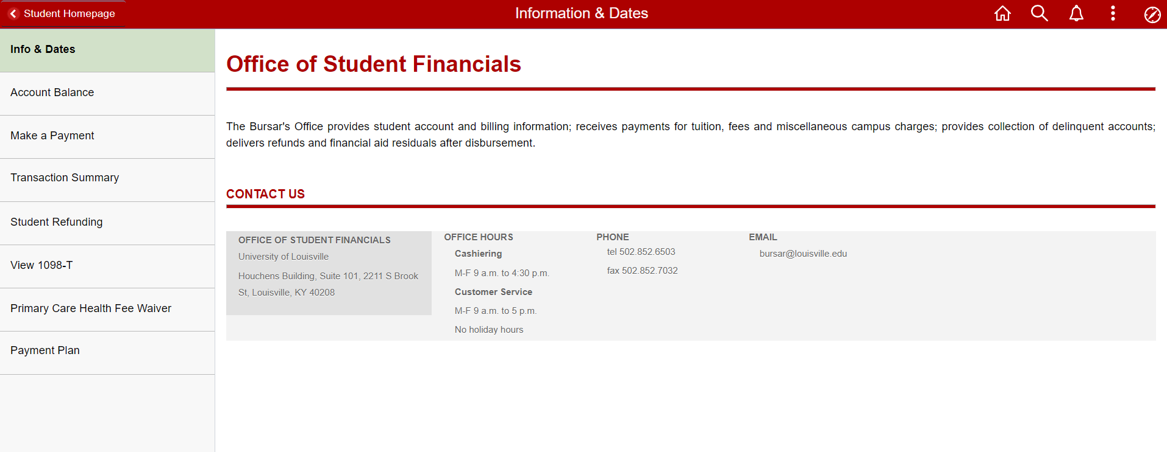
Making Payments

Slide 73
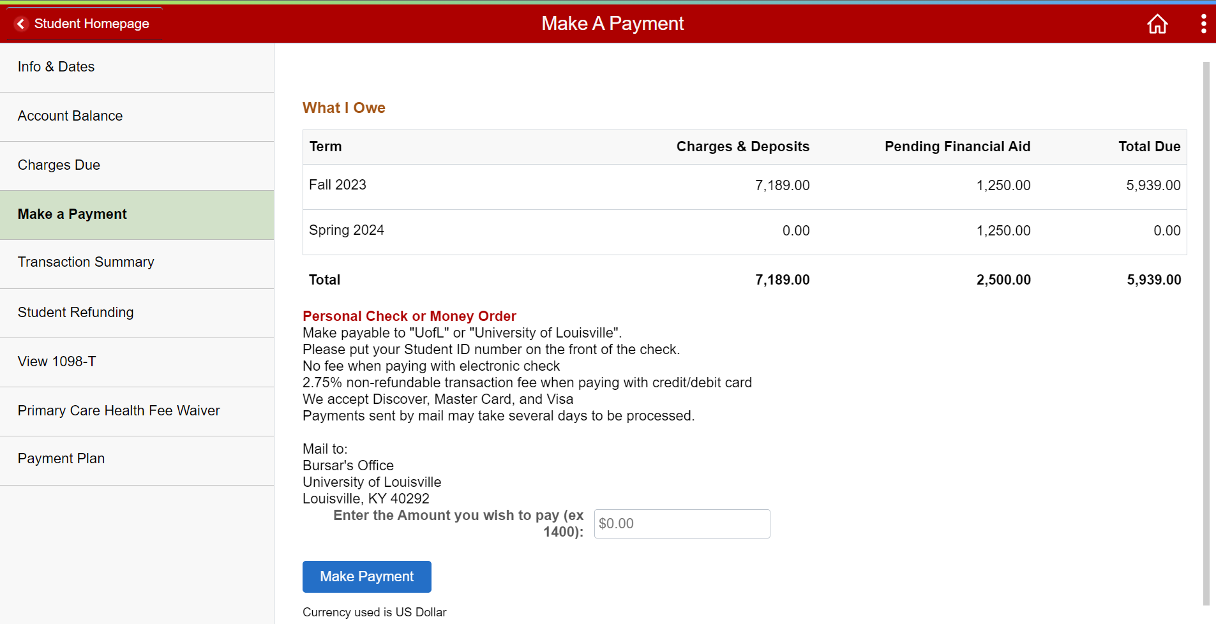
Making Payments

Slide 74
Making Payments
Fall 2023 Tuition Due Date | Spring 2024 Tuition Due Date
August 25, 2023 | January 12, 2024

Slide 75
Payment Plans
The University of Louisville offers interest-free monthly payment plan options for the current semester in which the student is enrolled for a nominal application fee.
We partner with Nelnet for our payment plans, and you are able to conveniently set it up through Ulink. You may choose from a 5-month plan (July-Nov) or a 4-month plan (Aug – Nov).

Slide 76
Payment Plans
PAYMENT METHODS | COST TO PARTICIPATE
Automatic Bank Payments (ACH) Credit Card/ Debit Card | $30 nonrefundable enrollment fee $30 returned payment fee, should a payment be returned by your financial institution

Slide 77
Payment Plans
FALL 2023
Payment plan available on July 12, 2023.
NOTE: All down payments and enrollment fees are processed immediately.
Last Day to Enroll | Required Down Payment | Number of Payments | Months of Payments | Enrollment Fee
July 31, 2023 | 20% | 4 | Aug - Nov | $30
Aug 25, 2023 | 25% | 3 | Sept - Nov | $30

Slide 78
Refunds
What is a Refund?
  As Financial Aid is credited to your account, it is applied to all the charges that exist on the account. If a credit balance remains after all charges are paid, you will be refunded the amount of the credit.
What is the difference between Disbursement and Refund?
  Disbursement is the process in which your aid is released to the school to pay toward you tuition and fees.
  A refund is the process in which any remaining funds not used for your tuition and fees are paid to you.
  Refunds will be released to the refund method that you have selected through Nelnet (Direct Deposit or Reloadable Debit Card).

Slide 79
Refunds
Who is Nelnet?
  Nelnet Financial Solutions is the company we partner with to provide the students their refunds.
  Nelnet offers two options for students to receive their refunds
    Direct Deposit
    Reloadable Debit Card

Slide 80

Refunds
How do I set up my Refund Preference?

Slide 81
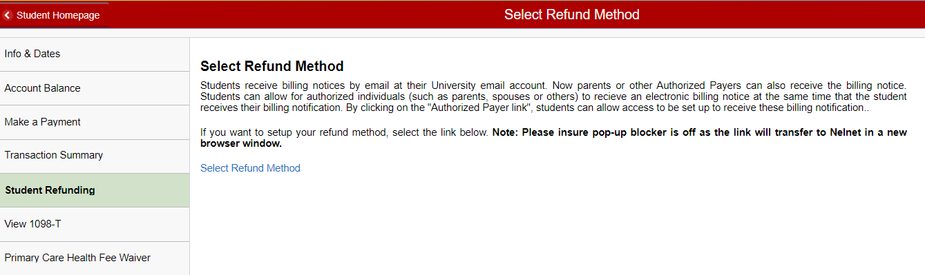
Refunds
Nelnet Student Choice Refunds
Click “Select Refund Method” to define your refund method.

Slide 82
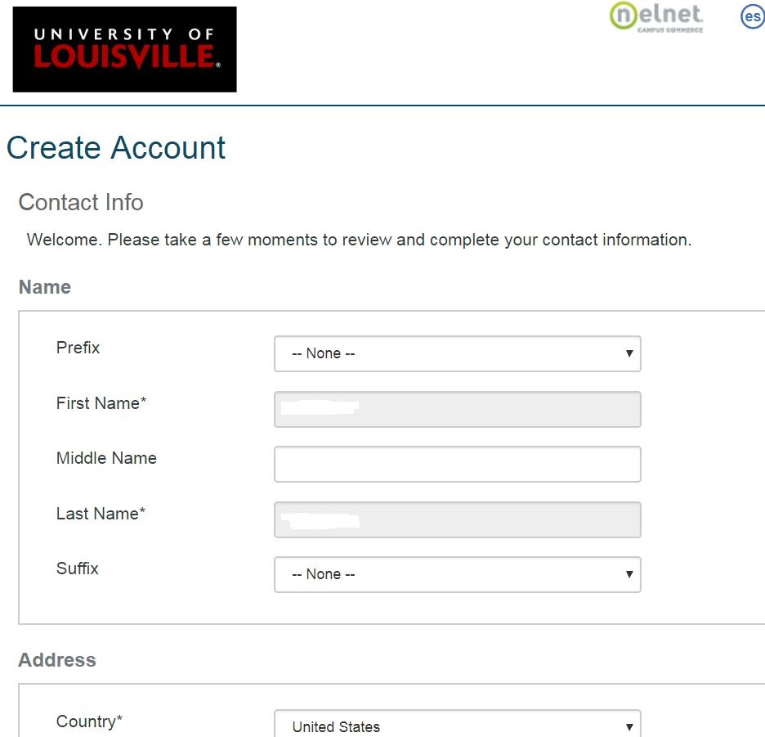
Refunds

Slide 83
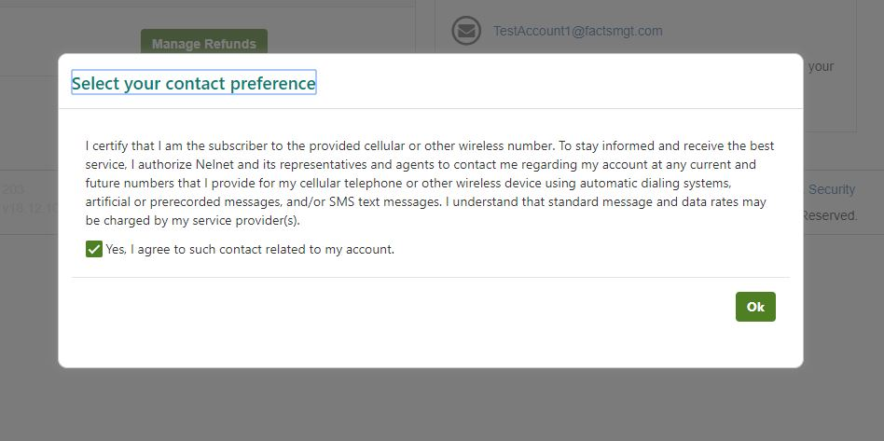
Refunds
Nelnet Student Choice Refunds

Slide 84
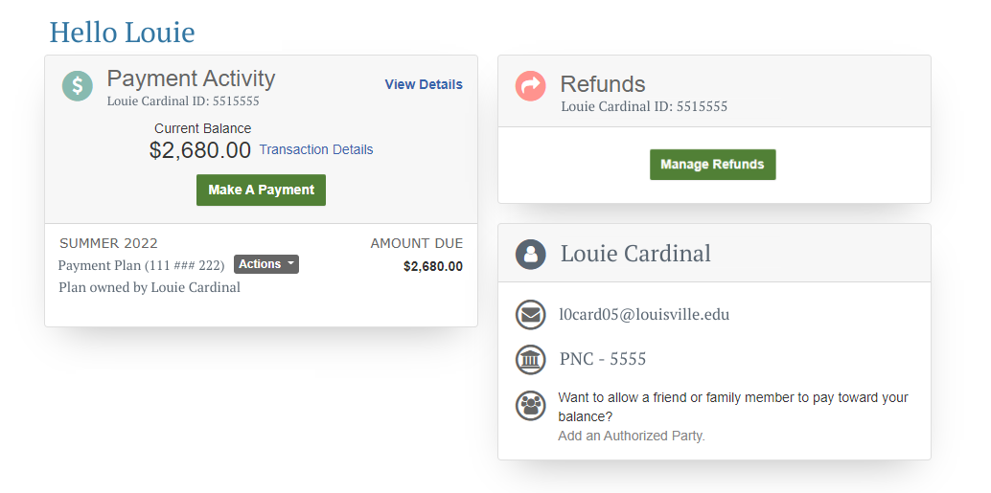
Refunds
Nelnet Student Choice Refunds

Slide 85
Contact Us
Office of the Bursar
Houchens Building
Room 101
Customer Service Lobby Hours Monday-Friday
9:00am– 5:00pm
Cashier Office Payment Hours and Customer Service Phone Hours Monday – Friday
9:00am – 4:30pm
Contact Information
Telephone
502-852-6503
Email
bursar@louisville.edu

Slide 86
Break

Slide 87
Health Insurance

Slide 88


STUDENT HEALTH INSURANCE ENROLLMENT

Slide 89

First things first!
Register for classes.

Slide 90
You have 2 Options
Option #1: Enroll in the Student Insurance Plan
OR
Option #2:Complete a waiver showing proof of your other accepted insurance plan
MEDICAL INSURANCE IS MANDATORY!

Slide 91
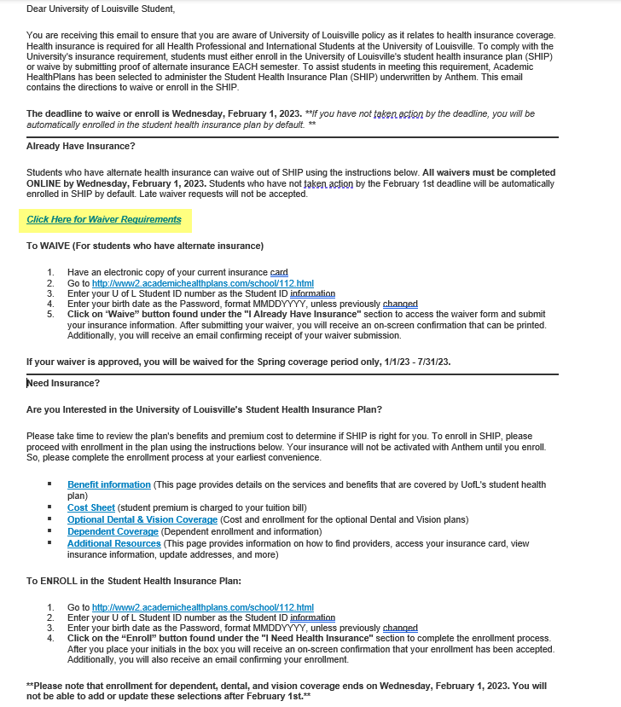
Option 2: SUBMIT WAIVER REQUEST to AHP
Email from AHP will come to your student email
Take Action ASAP
Confirmation Email after submitted
DEADLINE: 6/7/23
Check Tuition
Repeat Spring 2024
Remember if no action is taken by the waiver deadline you will be enrolled in SHIP and the Major medical fee will not be removed!!!

Slide 92


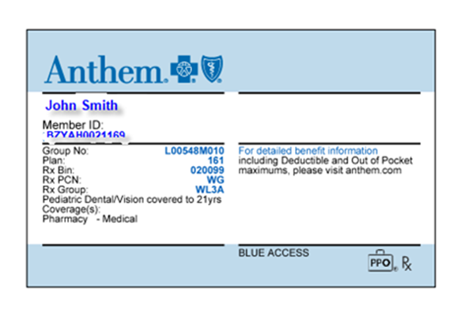
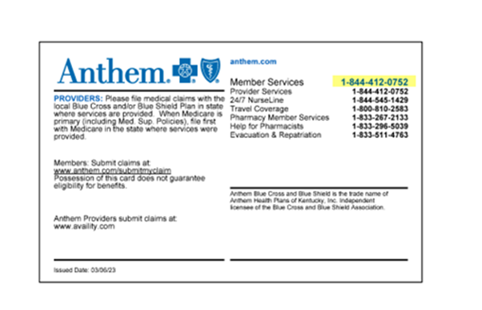
Insurance 101
Deductible: The Amount you pay for covered health care services before your insurance plan starts to pay
Coinsurance: The percentage of costs of a covered health care service you pay after your deductible
Claims: A formal request from the policyholder to their insurance company asking for payment after a covered incident.
Preferred, In, and Out of Network Providers
Where to go to for treatment?

Slide 93
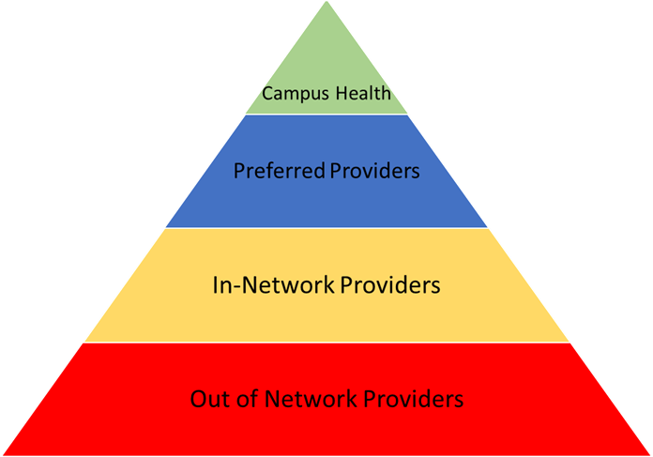

Additional Information
Dental &/ Vision Coverage
Spouse & Dependent coverage
Where to go for enrollment:
https://louisville.myahpcare.com/
Must be completed by open enrollment deadline. 8/31/23 for Fall 2023 & 2/1/24 for Spring 2024
Turning 26?
Continuation Coverage

Slide 94
ANY QUESTIONS OR NEED HELP?
Please don’t hesitate to reach out – we are here to help
Tamra Lambert
Insurance Advocate
Office at Cardinal Station Campus Health Suite 110
Stuins@louisville.edu
852-6519

Slide 95
Campus Safety
University of Louisville Police Department (ULPD)

Slide 96
Academic success/academic integrity
Writing Center

Slide 97



Louisville.edu/writingcenter writing@louisville.edu
(502)852-2173
x
Ekstrom Library Room 132

Slide 98


Who We Are
x
We are a free university service committed to helping all writers from any background or with any experience.
We are staffed by graduate students who have expertise in all kinds of writing and are also great at talking about things like time management, staying motivated, and resisting procrastination.
You can find us in the Learning Commons on the first floor of Ekstrom Library.

Slide 99
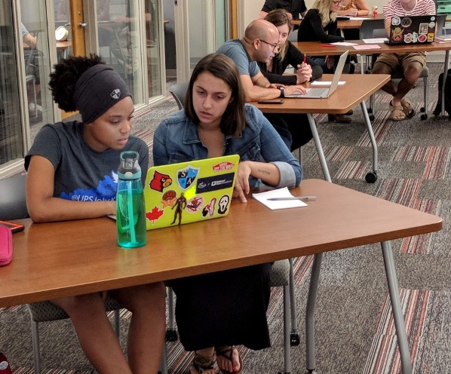
What We Do
X
We can help at any point in your writing, from just getting started to polishing a final draft – you can visit us without having anything written!
We can help at any point in your writing. You might work with us on:
Getting used to college writing
Understanding an assignment
Outlining a project
Organizing existing writing
Learning to edit a final draft
Using and citing sources
Reaching page length

Slide 100

We can help with:
01
02
03
04
05
06
Class assignments
Personal statements
Resumes
Job/ scholarship applications
Creative writing
Co-op or internship reports
…and more!

Slide 101


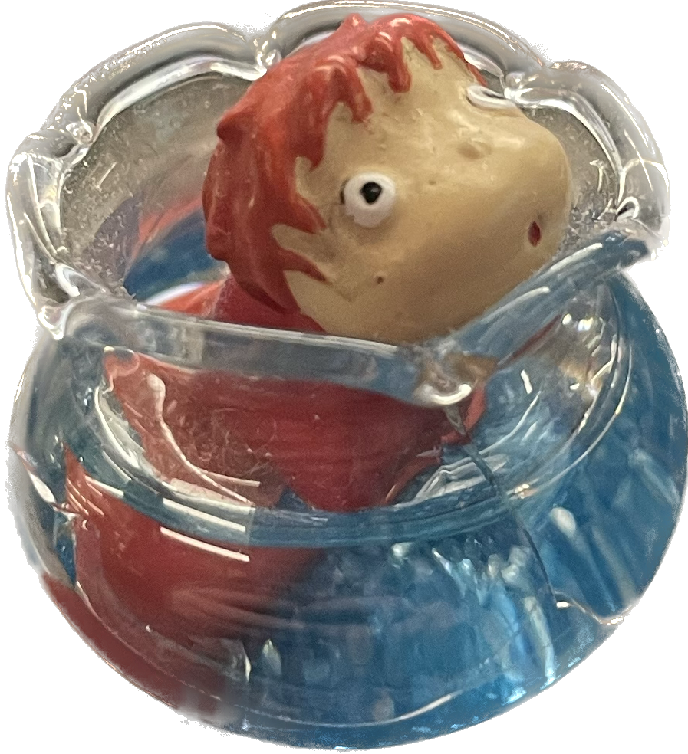

How It Works
Writing consultations are 50 minutes, but don’t worry! You don’t need to use the full time.
Come in with whatever writing project you are working on.
A consultant will have a conversation with you to figure out what you’re struggling with and determine the best way to spend your session.
We’ll probably read your writing along with you and stop and start to ask questions or offer advice.
We’ll help you develop a plan to revise and complete your writing.

Slide 102

How to Prepare
Bring to the session or attach to your appointment form:
The assignment sheet or any instructions and guidelines
Any information about assessment, such as rubrics
Any notes, squiggles, outlines, or drafts you have related to the project
Any sources you’re concerned about accurately paraphrasing, quoting, or citing

Slide 103



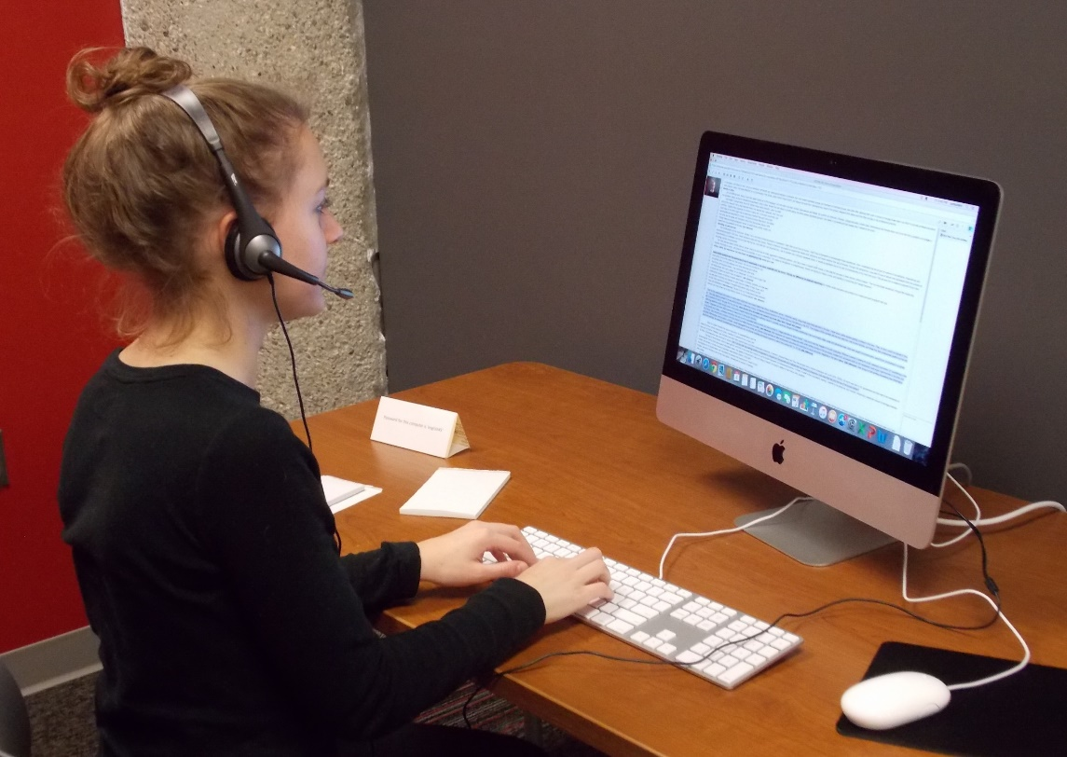

Virtual Writing Center
Live Video Chat
Talk with a consultant through a synchronous video chat and collaborative work on the document on a virtual white board.
Good for: writers who have a lot of questions about the assignment, writers who are feeling stuck, auditory learners, writers who are unable to come to campus
Written Feedback
Upload a draft to your appointment time and get asynchronous written feedback on your document.
Good for: writers who can easily summarize their goals for the assignment, visual learners, writers with busy schedules outside our normal hours

Slide 104


Writing Groups
Open Writing Times
Halloween and Valentine’s Day Open Mic Events
Writing Center Events
Collaborative Writing and Cultural Events

Slide 105
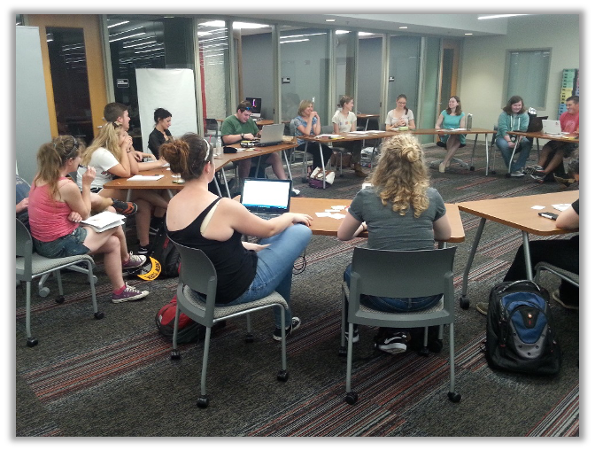
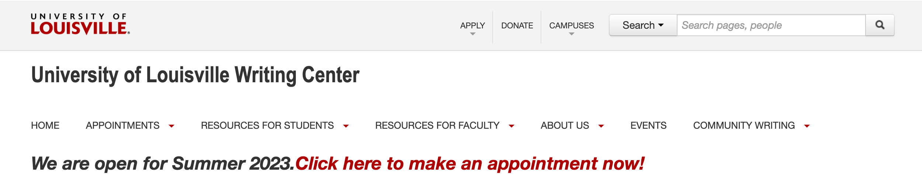
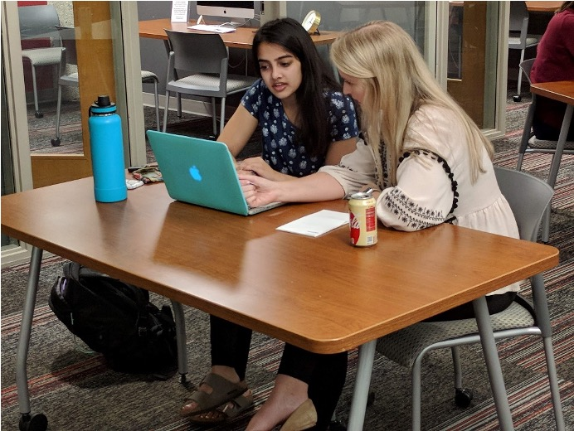

How to Make an Appointment
Visit the online schedule at Louisville.edu/writingcenter
If you have trouble logging in or making an appointment, contact us:
Email writing@Louisville.edu
Call 852-2173
Visit Ekstrom Library 132

Slide 106
Fast Facts
⏱️ | In a rush? We take walk ins!
📆 | Know you need more than one session? Book multiple appointments at a time, up to 3 per week!
📋 | Everything full? Join our waitlist!
🙋 | Vibe with a particular consultant? Book repeat appointments with them!
📞 | Get extra credit for visiting us? Ask your consultant to send a note to your professor!
✍️ | Like to plan? We’ll look over your syllabus and help you plan!

Slide 107


Slide 108
Lunch Break

Slide 109
Announcements

Slide 110
Resource Fair

Slide 111
New International Student orientation
Day 2
Undergraduate Students:
Check-in begins at 8:30 am
Graduate Students:
Check-in begins at noon

