Slide 1


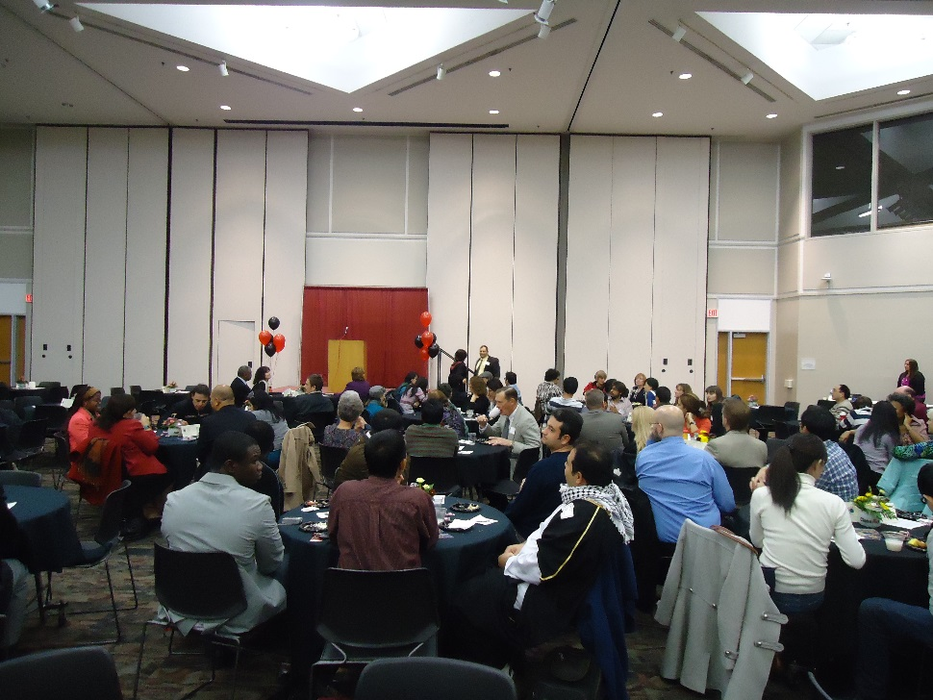
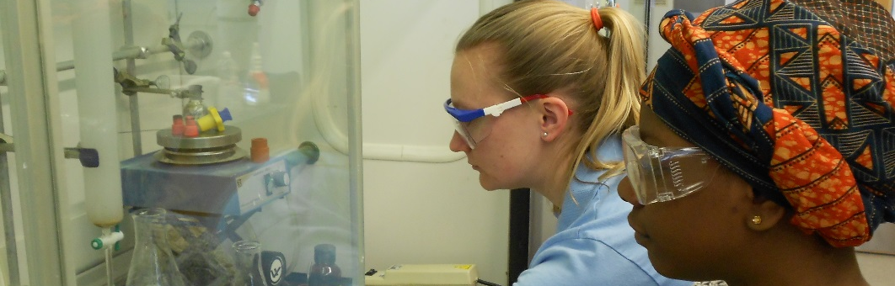
J-1 EXCHANGE VISITOR
Online Orientation
louisville.edu/internationalcenter/isss

Slide 2
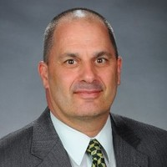
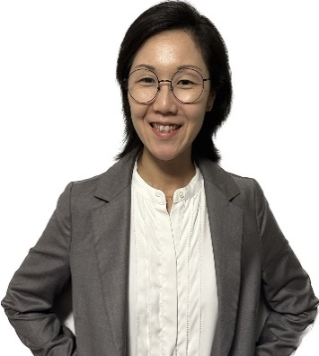
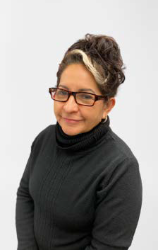

INTERNATIONAL STUDENT & SCHOLAR SERVICES
The International Office offers many support services to our international students and exchange visitors. One of which is to provide professional expertise and resources for all information related to F-1 and J-1 Visa Status. We assist with the issuance of documentation for nonimmigrant visas such as the Certificate of Eligibility form I-20 and DS2019 through the Student and Exchange Visitor Information System (SEVIS). We also work closely with various organizations around campus to help international students and exchange visitors acclimate to the University and to help connect them with others in the global community. Our dedicated staff at the International Office is here to assist our international community.
Dr. Paul Hofmann
Associate Vice Provost for International Affairs
P0hofman01@louisville.edu
Janice Kim
Director
STAFF
Connie Martinez
Seyda Muratova
jakim002@Louisville.edu
International Student Coordinator
International Student Coordinator
louisville.edu/internationalcenter/isss
mcmart01@Louisville.edu
skmura01@Louisville.edu
louisville.edu/internationalcenter/isss

Slide 3
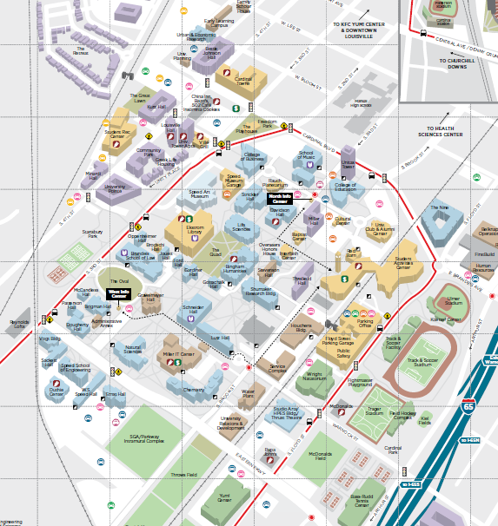
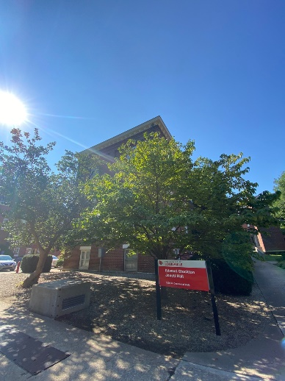
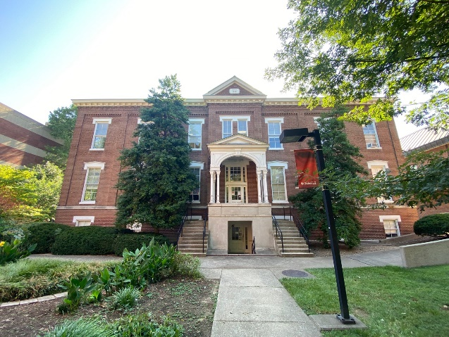
MAPS FOR BOTH CAMPUS
BELKNAP CAMPUS
Jouett Hall
International Center
Second Floor
Phone: (502) 852.6604
Monday-Friday
8:30 am - 5:00 pm
International Student & Scholar Services Office on Belknap Campus
Buildings nearby include the Ekstrom Library and the Louis D. Brandeis School of Law
MAPS
louisville.edu/internationalcenter/isss
louisville.edu/internationalcenter/isss

Slide 4
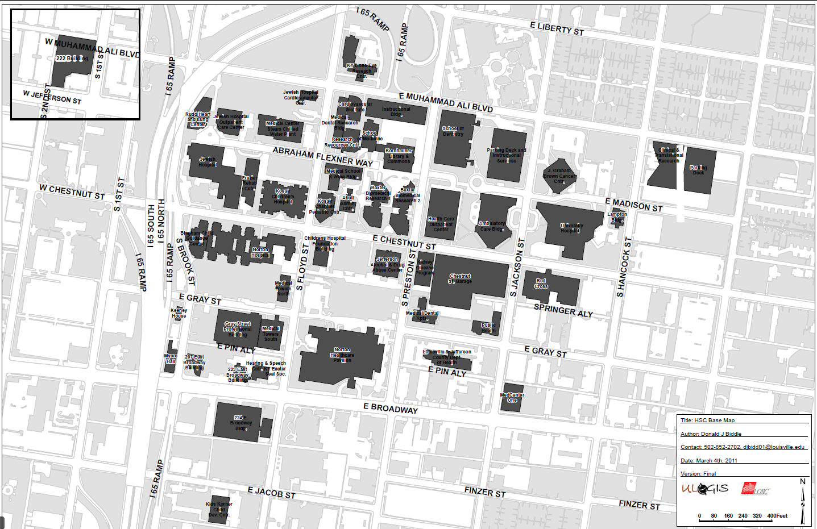
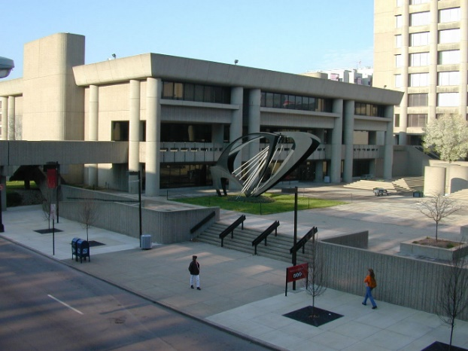
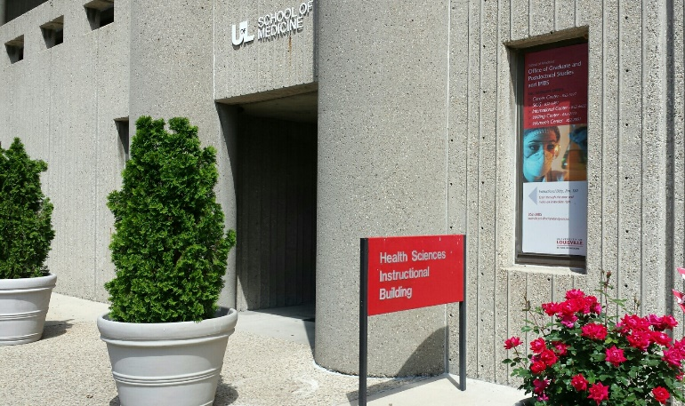
MAPS FOR BOTH CAMPUS
Health Sciences Center (HSC)
HEALTH SCIENCES CENTER
Instructional Bldg Rm. 218
The ISSS staff are willing to meet students and scholars on the HSC, if requested. Please contact ISSS if you need appointment or assistance.
H
S
C
MAP
louisville.edu/internationalcenter/isss
louisville.edu/internationalcenter/isss

Slide 5


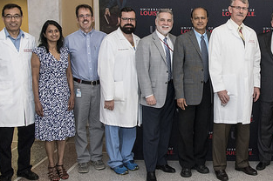

WHO IS A J-1 EXCHANGE VISITOR?
J-1
CATEGORIES
Research Scholars
They are individuals primarily conducting research, observing, or consulting in connection with a research project. Research scholars must have been awarded at least a Bachelor’s degree, and they can be in the U.S for a minimum of three weeks and a maximum of five years. They may also teach or lecture if allowed by sponsoring department.
Maximum stay: 5 Years
Professors
They are individuals who primarily teach, lecture, observe, or consult at a postsecondary educational institution while in the United States. Professors must have been awarded at least a Bachelor’s degree, and they can be in the U.S for a minimum of three weeks and a maximum of five years.
They may also conduct research if approved by sponsoring department.
Maximum stay: 5 Years
Short-Term Scholars
They are normally individuals who are professors or researchers in their country of residence who are coming to the United States for a short-term visit for the purpose of lecturing, observing, consulting, participating in seminars and professional activities. Short-term scholars must have been awarded at least a Bachelor’s degree.
Maximum stay: 6 Months
Student Interns
The primary objectives of the J-1 student intern programs are to enhance the skills and expertise of exchange visitors in their academic or occupational fields through participation in structured and guided work-based training and internship programs and to improve participants' knowledge of American techniques, methodologies, and technology.
Maximum stay:
3-week minimum -12 Months
louisville.edu/internationalcenter/isss
louisville.edu/internationalcenter/isss

Slide 6

MAINTAINING STATUS AS AN EXCHANGE VISITOR
It is critical that you maintain your legal status while in the United States. Please visit the International Student & Scholars Service’s (ISSS) website at: www.louisville.edu/internationalcenter/isss
Click here to visit Exchange Visitor Program Welcome Brochure
Please review the Exchange Visitor Program Welcome Brochure from the Department of State
STATUS
Exchange Visitors must be aware of and comply fully with these guidelines.
louisville.edu/internationalcenter/isss
louisville.edu/internationalcenter/isss

Slide 7

BEING A J-1 EXCHANGE VISITOR
Objectives of Being a J-1 Scholar
The U.S. Department of State requires you to pursue your original objective for coming to the United States. As an exchange visitor, therefore, you are normally not allowed to change your category, and you are expected to carry out the activity in the field described in section 4 of your Form DS-2019.
Coursework
A J-1 research scholar, professor, or short-term scholar may take courses. You may engage in incidental study, but research or teaching must remain your primary activity. If you should decide to become a full-time student as your primary objective, it would be necessary to change to a student immigration status. Also, you may not accept a graduate assistantship or fellowship unless you are on a J1 or F1 degree seeking student visa.
J
1
OBJECTIVES
Change of Host Department
It is sometimes possible to change to a different sponsoring department or institution if your primary objective remains the same. The ISSS office must approve such a change or transfer. Please consult the ISSS office if you are considering any change in your original program or site of activity.
For additional information please visit the following websites:
Department of State: www.state.gov
U.S. Citizenship and Immigration Services: www.uscis.gov
louisville.edu/internationalcenter/isss

Slide 8
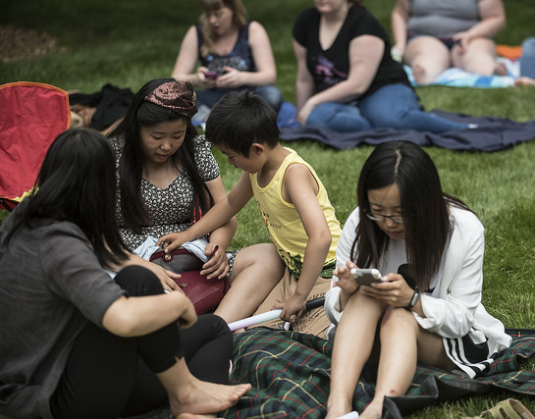
BRINGING A DEPENDENT J-2 TO THE U.S.
Your spouse and any child who is under the age of 21 may apply for a J-2 dependent visa status to accompany you to the United States. You must provide proof of financial ability which covers their expenses, and they must maintain the required insurance coverage mandated by the Department of State.
The University of Louisville requires a minimum of $7,500 additional funding per year for each accompanying dependent.
J-2
DEPENDENT
Obtaining a J-2 Visa for Dependents
If your sponsoring department has informed the international office that your dependents will be accompanying you to the U.S. at the time of requesting your original Form DS-2019, we will also complete a Form DS-2019 for each dependent that was listed on the request form. This will allow them to apply for a J-2 visa when you apply for your J-1 visa.
If you arrive in the U.S. alone and your spouse and/or a child decide to join you later, you may request a DS-2019 form for your dependent(s) from our office.
Please submit the completed Dependent Request along with a copy of their picture passport page and proof of sufficient funding. Please allow 3-5 days for processing of their DS-2019 forms. You will need to mail the DS-2019 to them.
Upon their arrival, you should immediately send copies of their J-2 Visa page, I94 information and proof of purchase of the three insurances required by the Department of State to isss@louisville.edu.
NOTE: Your dependent may come to the U.S. in an independent immigration status such as F-1 (student), H-1 (temporary worker) or even as an independent J-1 if he or she qualifies for that particular status.
louisville.edu/internationalcenter/isss

Slide 9
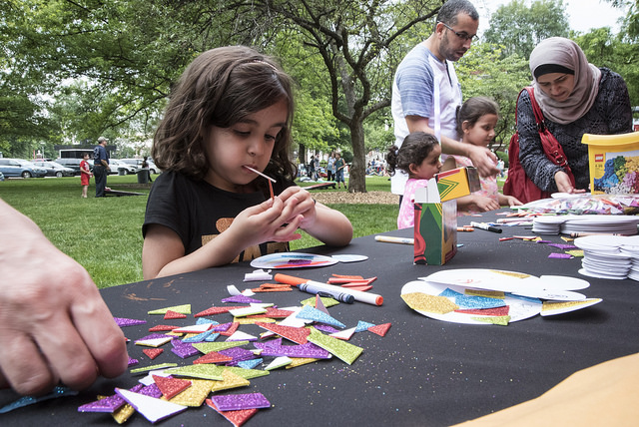
BRINGING A DEPENDENT J-2 TO THE U.S.
IMPORTANT THINGS TO REMEMBER FOR J-2 DEPENDENTS
When your J-1 program ends, the J-2 status ends as well.
If you travel outside the U.S. and leave your dependents in the U.S., you must return within a reasonable amount of time or the J-2 will be considered to be out of status. The Department of State indicates that a reasonable time of absence to be no more than 30 days.
J-2 dependents are required to maintain the same Department of State’s insurance coverage that is required of the J-1 visa holder.
J-2 dependents may apply for work authorization through U.S. Citizenship and Immigration Services. Instructions for applying are available here.
If you or your family members travel outside the U.S., you/they will need a DS-2019 form that has been signed for travel validation within the last 12 months of your/their return, a valid passport (valid 6 months in advance) and, in most cases, a valid J-1/J-2 entry visa in order to return to the U.S.
The J-2 dependent may apply for a change from J-2 status to any other nonimmigrant status or immigrant status if the conditions for that status are met, and if he/she is not subject to the two-year home residence requirement (212e).
The 212e applies to J-2 dependents as well, if the J-1 has that restriction.
J-2
DEPENDENT
Children that are of school age (5-17) will be eligible to attend the Jefferson County Public School (JCPS).
You should contact Berta at Jefferson County Public Schools at (502)485.3623. For additional information visit the JCPS website is: http://www.jefferson.k12.ky.us//
louisville.edu/internationalcenter/isss

Slide 10
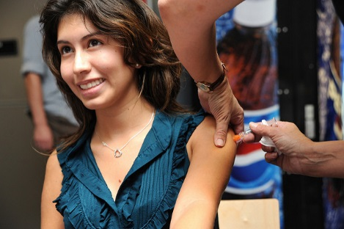
HEALTH INSURANCE
You are required to have the mandated Department of State’s insurance in effect for yourself (J-1) and any dependents (J-2) by the start date of your program and for the complete duration of your program.
Some paid U of L employees may be eligible to purchase medical insurance through the University. Should you purchase the University’s medical insurance you may only select EPO or PPO to meet the Department of State insurance requirement.
Others may need to identify options to purchase insurance. Please review the list of recommended companies in the next slide.
Minimum Insurance Coverage – Insurance must provide the following coverage:
(1) Medical benefits of at least $100,000 per person per accident or illness
(2) Repatriation of remains in the minimum amount of $25,000
(3) Expenses associated with medical evacuation in the minimum amount of $50,000
(4) Insurance requirements should not have a deductible that exceeds $500 per accident or illness
Maintenance of Insurance – Willful failure on your part to maintain the required insurance for yourself or any accompanying J-2 dependent throughout your stay in the United States will result in the termination of your exchange program.
HEALTH - INSURANCE
Your proof of purchase and summary of your insurance coverage for you and any J2 dependents must be submitted to the isss@louisville.edu upon arrival and no later than the start date of your program. Proof of insurance is also required to be submitted with any future DS2019 extension requests.
louisville.edu/internationalcenter/isss

Slide 11





HEALTH INSURANCE
Where To Find Insurance Information?
There are many insurance companies that offer the appropriate policies which you are free to select. The following websites are those companies that students and scholars at U of L buy from most frequently. Please go to their websites to review their policies and cost. Read the policy information carefully and don’t be afraid to ask questions before you buy.
HEALTH
INSURANCE
ISO
BETA
COMPASS
VISIT
INSUBUY
www.isoa.org
www.betins.com
www.compassbenefit.com
www.visitinsurance.com
www.insubuy.com
Insurance agents
An agent is an individual who represents one or several insurance companies and sells insurance to individuals and groups. When working with an agent you should feel free to ask questions and take the time to learn about and understand several choices before you make a decision. If you are uncertain or confused, don’t sign anything.
louisville.edu/internationalcenter/isss

Slide 12
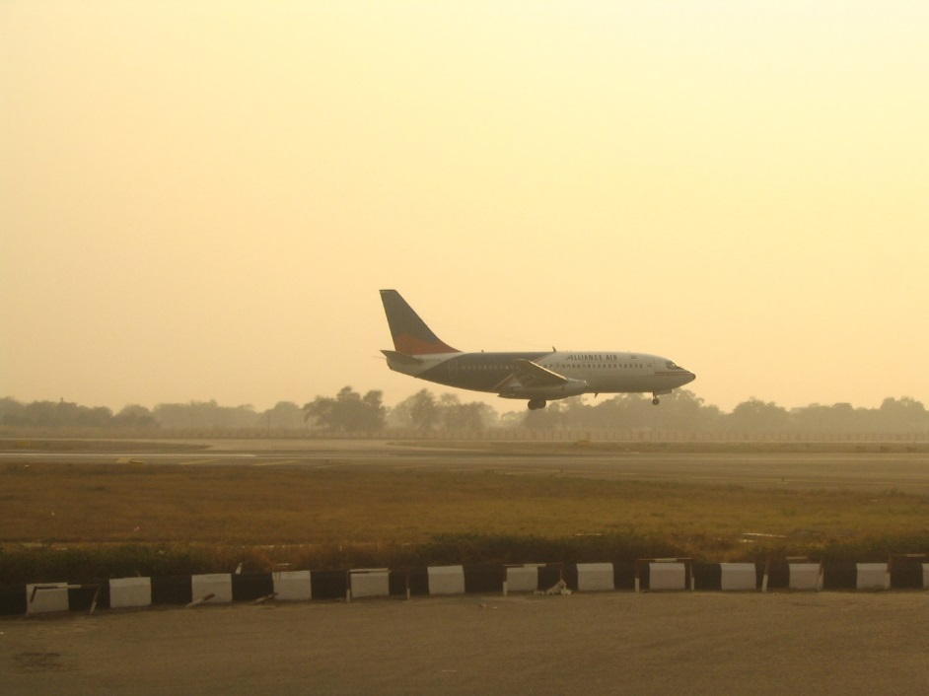
IMMIGRATION
A
These are important documents that you need
to have upon arrival
DS-2019 Form
Passport
Your passport must be valid for at least six months in advance at all times during your stay
IMMIGRATION
J VISA
Additional documentation recommended
Evidence of financial resources
Letter of acceptance as a participant in the Exchange Visitor Program
Paper receipt of payment for the SEVIS I-901 fee
Name and contact information for your sponsoring organization, including a 24-hour emergency contact number.
I-94 Form
ALWAYS HAND CARRY YOUR DOCUMENTS DURING YOUR TRAVEL
Link to obtain your I-94 form upon your entry into the United States: https://i94.cbp.dhs.gov/I94/#/home
Please, keep all DS-2019 immigration documents.
louisville.edu/internationalcenter/isss

Slide 13
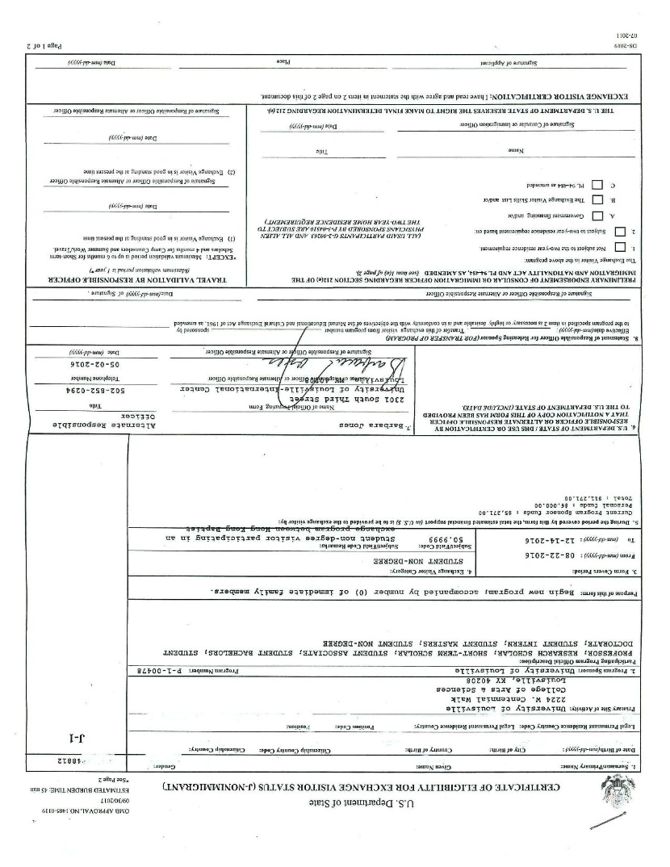
Example of the DS-2019 form
SAMPLE DS-2019
Scholar’s SEVIS Number
UofL Program Number
Program Start and End Dates
IMMIGRATION
Before you travel outside of the U.S. with the intention to re-enter under your J1 Program, you must obtain a travel validation signature from an international advisor at the ISSS. The travel signature is valid for up to 12 months.
Scholar’s Signature
louisville.edu/internationalcenter/isss

Slide 14
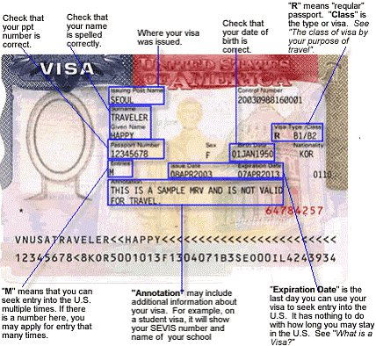
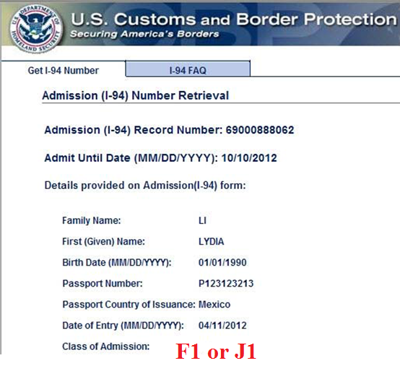
SAMPLE DOCUMENTS
Example of the Entry Visa
Example of I-94 Form
IMMIGRATION
212e DOES NOT APPLY
Upon arrival to the U.S., please print the I-94 form for
J1 and any J2 visa holders. These may be obtained from https://i94.cbp.dhs.gov/I94/#/home
Ruling to 212e two year home residency requirement
louisville.edu/internationalcenter/isss

Slide 15

IMMIGRATION
You may or may not need a Secondary Inspection
Before traveling to the U.S.
Arrival to the initial port of entry in the U.S.
Have a valid passport
Apply for entry visa
DS-2019 form (J-1 scholar and student)
SEVIS Receipt for I-901 fee
Complete a Customs Border Protection Declaration Form
Go to Inspection area
for Customs and Border Protection
IMMIGRATION
Pick up your luggage at carousel
Declaration form to CBP officer
(luggage may be inspected)
Exit or connect to your next flight
louisville.edu/internationalcenter/isss
Notes:
Let us review what you need to do before leaving your country. Before you leave your country, you must obtain travel documents like your passport, entrance visa, I-20 if you are an F-1 student or DS2019 if you are a J-1 student.
2 You will have to complete a CBP Declaration form. You will receive this form on-board the airplane. If you do not receive this form on the airplane, don’t worry—sometimes it happens. You will receive it in line for CBP.
3. The first thing that you will do as soon as you arrive in the USA is to go through the Customs and Border Protection and inspection area.
There can sometimes be a long line—all you need is patience.
4. Go to secondary inspection area if requested. This is an administrative process.
5. Proceed through final CBP checkpoint. You will show your declaration form to a CBP officer.
6. Go to find your next flight gate as soon as you finish with customs. You will be able to board your next flight.

Slide 16
IMMIGRATION / 30-DAY GRACE PERIODS
30
You may enter the U.S. as early as 30 days prior to the start date listed on your Form DS-2019. However, you are not allowed to begin working until your start date which is listed on your Form DS-2019.
You must depart the U.S. within 30 Days from the end date listed on your Form DS-2019. The end date listed on your Form DS-2019 is the last day you are allowed to work in your department.
You should be leaving the U.S. by the 30th day unless you have applied for a change of status with Immigration. Please note that travel outside the U.S. and return during this grace period is not allowed under the J-1 Program.
DAYS
IMMIGRATION
louisville.edu/internationalcenter/isss

Slide 17
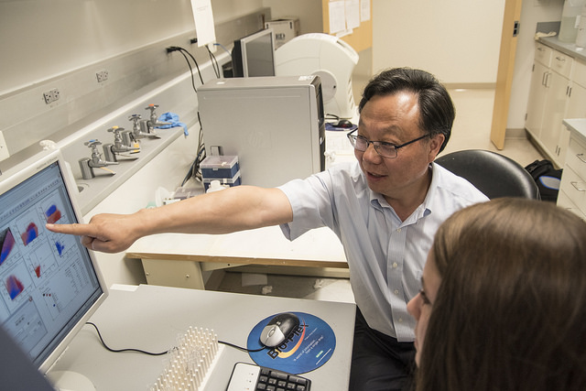
EMPLOYMENT
J-1 research exchange visitors: Employment opportunities are restricted. Unless you have received approval from the ISSS, you may only be employed by your sponsoring department at the University of Louisville and in the specialized field described on the Form DS-2019.
On-Campus Restriction
A student assistantship or fellowship is not appropriate employment for a J-1 Research Scholar, Professor, Short-Term Scholar or Student Intern.
Off-Campus Opportunities
It is possible to receive payment or reimbursement of expenses for short-term activities such as lecturing, consulting or conducting a seminar in your field at another institution with PRIOR approval from the ISSS office.
Procedures for approval to add a Second Site of Activity
You must provide the ISSS office with a letter that is on the company's letterhead and signed by the supervisor from the institution where you wish to teach, lecture, or consult, describing the activity, dates of employment, amount of compensation, and how this work supports your current objective listed on your Form DS-2019.
Your UofL departmental supervisor must notify the ISSS via email with their approval of this additional work opportunity.
The ISSS office will review your application and determine if this is an appropriate work opportunity. All work opportunities must be directly related to your primary objective listed on your Form DS-2019.
EMPLOYMENT
Unauthorized Employment
Unauthorized employment can lead to termination of your J-1 program participation. Because of the many employment restrictions, it is important to be sure before you come to the U.S. that you will have sufficient income for yourself and any dependents that accompany you.
ISSS must be consulted concerning any on and off campus employment.
louisville.edu/internationalcenter/isss

Slide 18
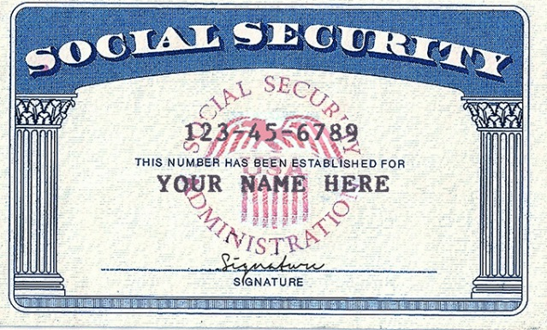
EMPLOYMENT/ SOCIAL SECURITY
If you are being paid by someone in the U.S., you are required to have a Social Security Card.
Research scholar, professor and short-term scholar categories may apply for a Social Security card, if they choose to even if they are not being paid.
Student categories may only apply for a Social Security card if they have a paid position.
Obtaining Your Social Security Card
You must complete the online orientation and submit copies of your immigration documents and proof of insurance PRIOR to applying for your Social Security Card. This will allow the ISSS to validate your SEVIS Record which is required to give the Social Security Office access to your immigration record. Going earlier may cause a delay in the processing of your card.
To obtain a Social Security application form and additional information go to louisville.edu/internationalcenter/isss/life-uofl/social-security.
PLEASE PRINT CLEARLY ON THE FORM and complete all sections. The address you provide on the form will be the address used to mail your Social Security card so be sure to provide a complete mailing address including apartment number and zip code.
You will need to take your passport, visa, I-94, and DS-2019 forms with you to the Social Security Office along with your completed application. Be sure that your SEVIS record has been validated prior to going.
HOURS AND DIRECTIONS
TO SOCIAL SECURITY OFFICE
Social Security Office is on the first floor in the Gene Snyder Building located at 601 West Broadway at the north side of the intersection of 6th Street and Broadway in downtown Louisville.
Office Hours are Monday, Tuesday, Thursday and Fridays 9 am- 4pm and Wednesdays 9 am-12:00 (noon). It is best if you do not go during the 12:00 – 2 pm as they are very busy during lunch hours. They are closed on most national holidays.
Telephone: 1-800-716-9671 www.socialsecurity.gov
EMPLOYMENT
louisville.edu/internationalcenter/isss

Slide 19
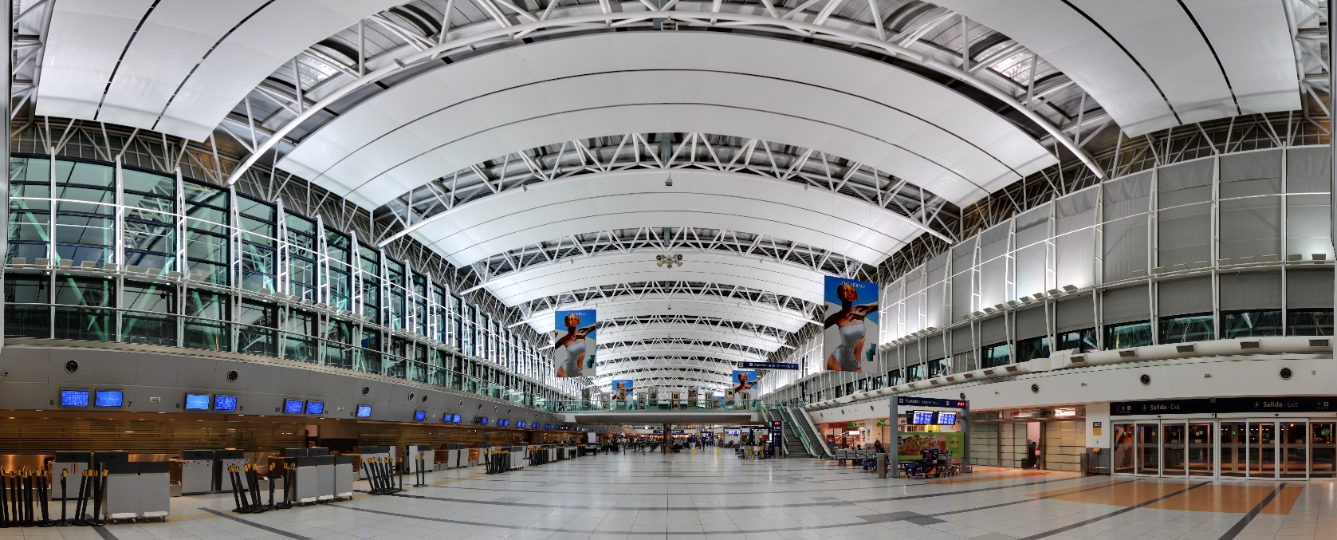
TRAVEL
Obtain Travel Signature Prior to Departing the U.S.: Scholars and their dependents should obtain an international advisor’s signature in the Travel Validation by Responsible Officer section on their Form DS-2019 form prior to traveling outside the U.S. if they intend to return to the U.S. under the same J-1 program. Once you have obtained a travel signature, it is valid for up to one year. Signatures are not required for travel within the United States.
TRAVEL
louisville.edu/internationalcenter/isss

Slide 20
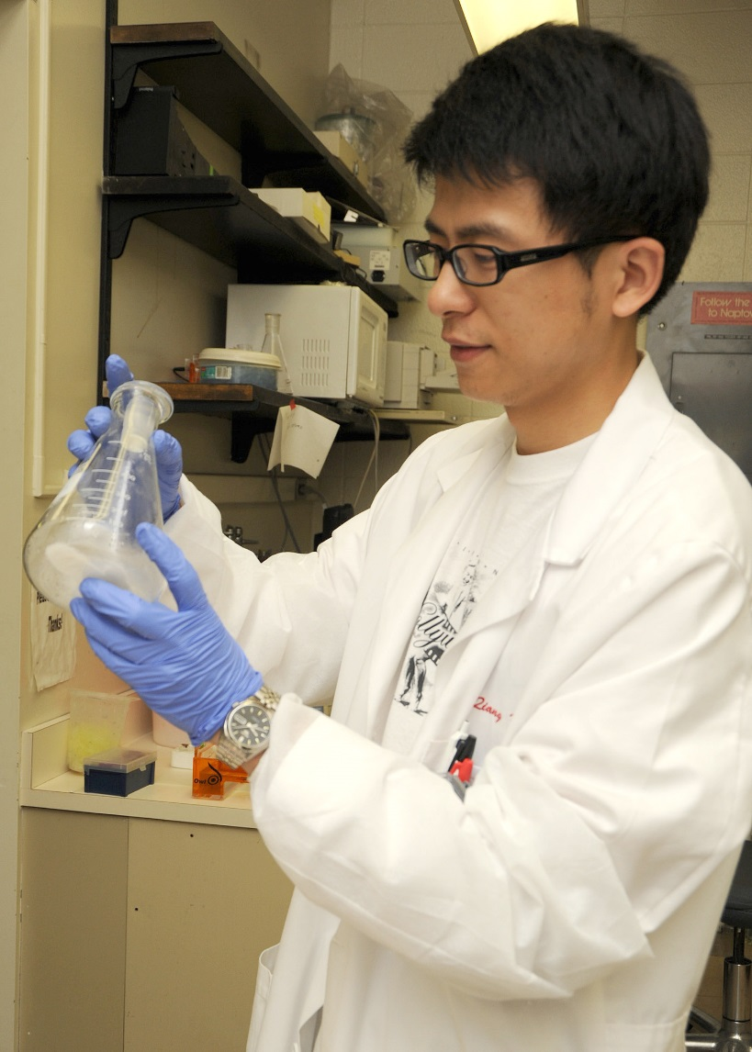
OTHER PROCEDURES - TRANSFER
Transferring to another U.S. Institution
If you wish to transfer to another U.S. institution under your current J1 Exchange Visitor Program, you must receive transfer authorization prior to leaving the University of Louisville:
Scholars should notify their current supervisor AND the ISSS international advisor at isss@louisville.edu before transferring within the University or to another institution.
If you are transferring to another institution, you will need to complete and submit to the ISSS a completed Transfer Out Form.
The international advisor at the new institution must contact the ISSS at isss@louisville.edu and confirm the scholar’s start date, that the position is the same objective as listed on the current Form DS-2019, and provide the new institution’s SEVIS Program Number.
OTHER
louisville.edu/internationalcenter/isss

Slide 21
OTHER PROCEDURES – CHANGE OF STATUS & NEW PROGRAM
Change Of Status
As described previously, being subject to the two-year home residence requirement greatly limits your possibilities for changing to another status. If you are not subject to this requirement or, if you were subject but obtained a waiver of this requirement, you may apply for a change to any other status for which you are qualified. Procedures for a change of status vary depending on the type of status you wish to obtain. A change of status must be applied before your
current J-1 status expires.
If you leave the U.S. and return in another status, this is not considered a change of status but a start of a new program.
OTHER
louisville.edu/internationalcenter/isss

Slide 22
OTHER PROCEDURES – NEW PROGRAM
Beginning A New J-1 Program
The 12 and 24 month bars are different from the two-year 212(e) home country residence requirement. Any indication below that there is “no wait” time refers only to the 12 and 24 month bars. It is possible that a J-1 visitor has no wait time related to the 12 and 24 month bars - but is subject to the two year home residency requirement.
The 12 and 24 month rule affects J-1 exchange visitors who have been in the U.S. on a J-1 visa previously, and wish to return, using the J-1 visa. The bars prohibit certain “repeat participation” in the Research Scholar or Professor categories only. Depending on what your previous J category was, you may be subject to a 12 month bar, a 24 month bar or have no bar at all. If you have never had J-1 visa sponsorship, then the bars do not apply to you.
Twenty-Four Month Bar Individuals in the J-1 Research Scholar or Professor category have a 24 month bar on repeat participation in those two categories regardless of the time under the J1 program. This bar applies to anyone in one of the two categories. The bar becomes effective when your program as a Research Scholar or Professor becomes inactive. This regulation applies to the J-2 dependent as well. This bar does not require you to live in your home country during the 24 month bar.
N
E
W
J
1
P
R
O
G
R
A
M

Slide 23
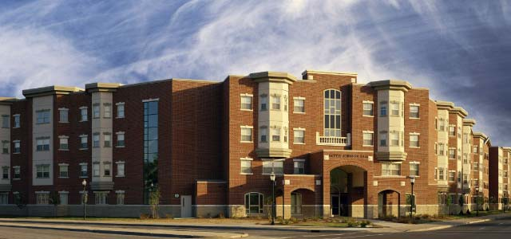
UOFL CAMPUS RESOURCES
Housing Information
IT Connect (Information Technology)
Contact Help Desk Phone: 502-852-7997. They are available to assist you with passwords issues and security software
Go to this link to set up your University email
Go to this link to set up your ULink account You may access on-campus WIFI on your phone and personal computer with your Ulink password
Report address updates through the ULInk
account and by email at isss@louisville.edu
University of Louisville Housing & Residence Experience Office
Additional help on applying for On-Campus housing can be found here: https://louisville.edu/housing/apply/how-to-application-videos
Phone: 502-852-6636
Phoenix Place Apartments
510 South Shelby Street Mall
Phone: 502-873-3615
The Quad Apartments
Corner of Hancock St. and Muhammad Ali Blvd
Phone: 502-515-2489
University Park Apartments
2207 James Pirtle Ct
Phone: 502-637-5265
Kentucky Tower Apartments
511 South 5th Street
Phone: 502-585-6300
RESOURCES
louisville.edu/internationalcenter/isss

Slide 24
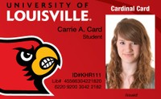
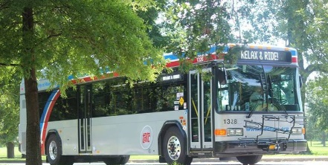
CARDINAL CAMPUS ID CARD
If you are an unpaid J-1 scholar, you will need to obtain a sponsor letter from your department to apply for a UofL Campus Card. The letter must be printed on departmental office letterhead and signed by the VP or dean of the department.
http://louisville.edu/campuscard
When you are ready to obtain your Campus ID Card, you should take the following documents to the Campus Card Office:
The departmental campus card sponsorship letter
Passport
A completed Cardinal Card Agreement
The Belknap Cardinal Card Office is located in the lower level of the Houchens Building in Room LL05
Open Monday to Friday 8:30 AM - 5:00 PM.
The HSC Cardinal Card Office is located in the Chestnut Street Parking Garage, 414 E. Chestnut St.
Open Tuesday, 9:30 am – 11:30 am.
If you are a UofL paid employee, you will receive your Campus ID Card as part of your University Human Resources Orientation.
SOME CAMPUS ID CARDS ALLOW YOU TO RIDE TARC, THE CITY BUS SYSTEM, FOR FREE
RESOURCES
BY SHOWING YOUR CAMPUS ID
louisville.edu/internationalcenter/isss

Slide 25
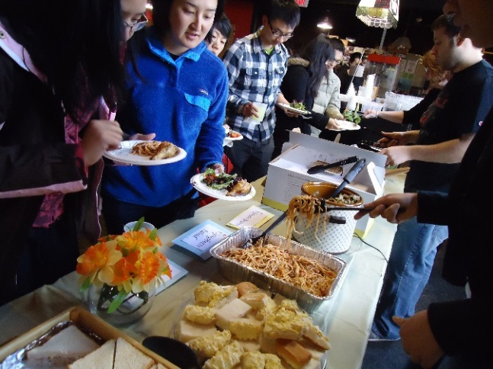

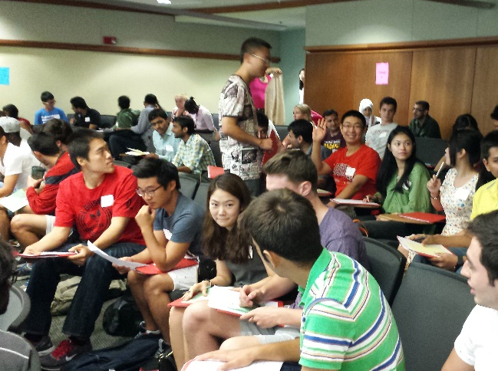
UNIVERSITY OF LOUISVILLE
EVENTS FOR EXCHANGE VISITOR
Events
International RSO
Immigration
Various events are held throughout each semester that offer time to meet new friends while you are at the University of Louisville. Stay updated by subscribing to the International Students and Scholars listserv
There are numerous international themed and international Recognized Student Organizations (RSOs) that promote diversity and the sharing of different cultures that scholars may also be able to join. For a complete list, please visit the following website.
Information for applying for H1B or LPR during your J-1 exchange program. The ISSS office offers outside resources to help you begin the process. Please visit the following website for a list of local immigration attorneys in the Louisville, KY area.
louisville.edu/internationalcenter/isss

Slide 26
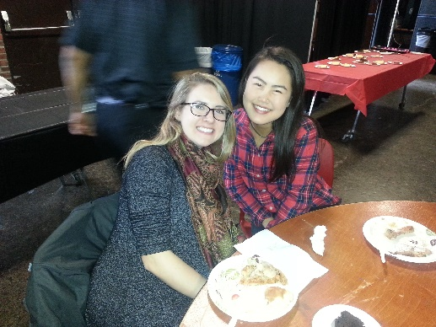

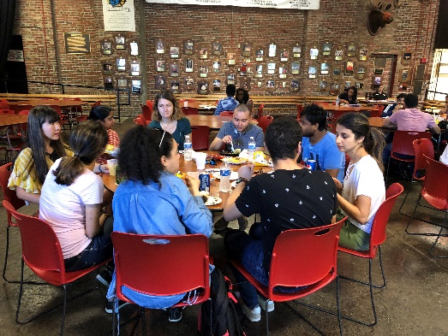
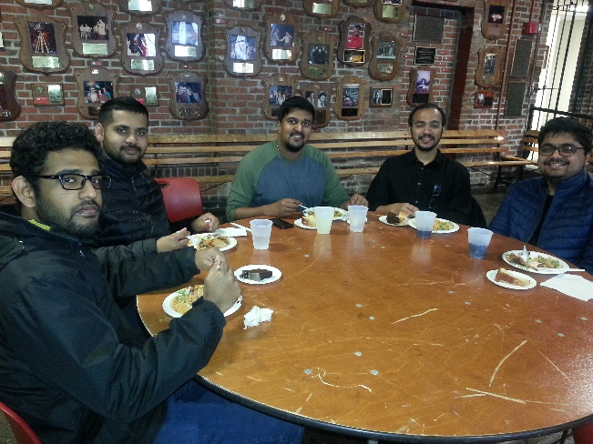
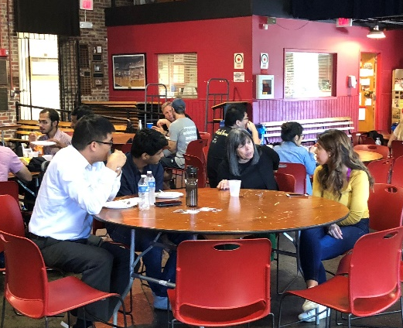
Social Media & Communications
Stay updated with our events through our social media pages: facebook @ IntlCenterUofL
instagram @ Internationalcenteruofl
SM&Communications
You can also subscribe to the listserv by visiting listserv.louisville.edu
?
Meet and greet
Luncheon
An invitation is extended to University students, scholars, faculty and staff. Join the International Student & Scholar Services and meet some of the Universities' non-immigrant student and scholar population representing over 90 countries
louisville.edu/internationalcenter/isss

Slide 27









Louisville
RESOURCES IN
Banking: These are some banks in Louisville where you can open a U.S. bank account.
Utilities: In Louisville, you need to contact Louisville Gas and Electric Company (LG&E) & Kentucky Utilities (KU) for gas, electric, and water. You can visit the following website for more information: https://lge-ku.com/
Cell Phone Carriers: T-Mobile : 502.364.1688
AT&T: 502.451.4949
Boost Mobile: 502.365-2252
Verizon
RESOURCES
louisville.edu/internationalcenter/isss

Slide 28



Louisville
RESOURCES IN
Schools: Visit the Jefferson County Public Schools Website for
J-2 dependents ages 5-17
Off-Campus Housing: Please understand that once you sign a lease, you are in a binding legal contract. Please DO NOT sign any lease or agreements until you are certain about leasing the property. Additionally, do not make more than one accommodation arrangement concurrently. If you choose to live off-campus, please highly consider an Affiliated Housing through UofL. Other helpful links:
http://www.apartmentfinder.com/Kentucky/Louisville-Apartments
http://www.apartmentguide.com/apartments/Kentucky/Louisville/
http://www.zillow.com/
Renters Insurance
If you rent or lease a property, it is recommended that you purchase a renters insurance policy to cover any unexpected damage that typically includes personal property, theft, and other expenses.
About Louisville http://www.gotolouisville.com/travel-tools/request-travel-guide/index.aspx
RESOURCES
Transportation: University students, staff and faculty can ride the TARC
(Transportation Authority of River City) for free by showing their UofL ID.
The routes can be found at www.ridetarc.org
Hotel and more: http://louisville.edu/admissions/visit/lodging
louisville.edu/internationalcenter/isss

Slide 29
OBTAINING A KENTUCKY DRIVER’S LICENSE
Please visit our website for more information:
Driver's License — International Student and Scholar Services (louisville.edu)
Information on obtaining a Kentucky Driver License can be license application form is under this link
Kentucky Driver's License Information
Effective January 1, 2019 all non-US Citizens applying for the KY ID card, instruction permit or driver license (including renewals) will be required to pay an application fee of $30.

Slide 30
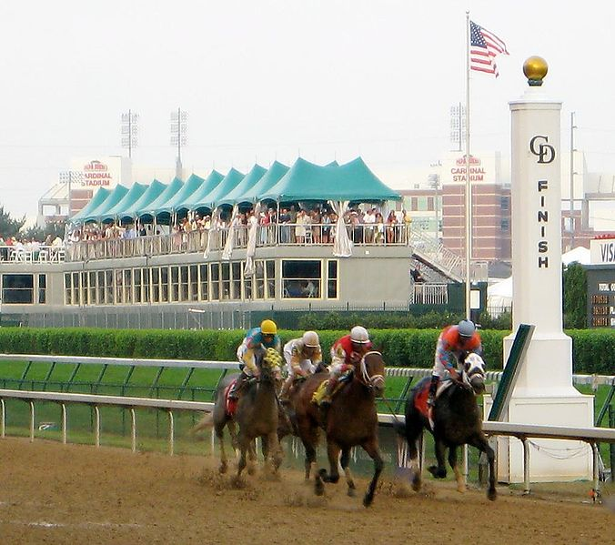
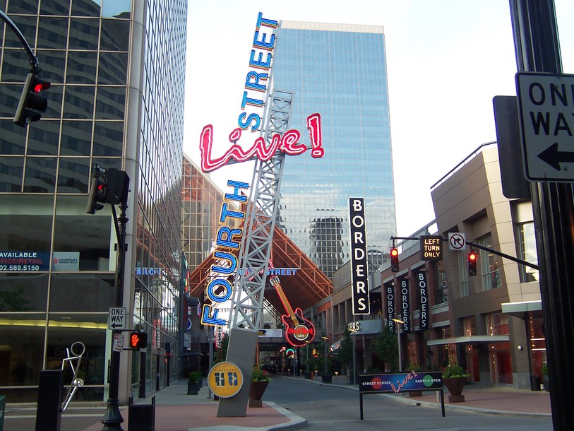
THINGS TO KNOW ABOUT
Louisville
The largest collection of Victorian homes in the United States and the 3rd largest historically preserved district in the United States is located in Old Louisville
Tourism is the third largest revenue-producing industry in Kentucky
The Kentucky Derby, one of the most famous horse races, is held at Churchill Downs on the first Saturday of May; located only three blocks from Belknap Campus
Sales tax collected in Kentucky is 6%
Kentucky has more miles of running water than any other state except Alaska. The numerous rivers and water impoundments provide 1,100 commercially navigable miles (1,770 kilometers).
Famous Kentuckians born or raised include explorer and legendary pioneer, Daniel Boone; one of the world’s most athletic and influential sports star, Muhammad Ali; actors George Clooney, Johnny Depp, Ashley Judd, Jennifer Lawrence and even some of America’s most significant political figures, Abraham Lincoln.
For more information on City of Louisville visit their website.
RESOURCES
louisville.edu/internationalcenter/isss

Slide 31
J1 SCHOLAR CHECKLIST Pre-Arrival
Before you arrive make sure to complete all these steps
Obtain your University of Louisville
Certificate of Eligibility form DS-2019
Schedule your trip to Louisville, KY
Have a valid passport (valid at least six months in advance at all times)
Enter the U.S. no earlier than 30 days prior of start. At the port of entry, present your passport, J-1 Scholar Visa and DS-2019 Form
Have a receipt for payment of SEVIS fee, the Form I-901
CHECKLIST
Become familiar with the requirements for maintaining your J-1 status
Complete visa application process
Demonstrate evidence of your financial support as indicated on Form DS-2019
louisville.edu/internationalcenter/isss

Slide 32
J1 SCHOLAR CHECKLIST Upon-Arrival
Upon your arrival make sure to complete all these steps
It is very important that upon your arrival at the University of Louisville, you complete the check-in procedure with ISSS. You must complete this process within 30 days of your program start date or your SEVIS record will be invalidated.
Check-In Procedure
Complete the mandatory J1 Exchange Visitor Online International Orientation.
Complete the Address and General Information Form.
Submit a copy of your visa, form I-94, and proof of insurance.
You may submit the above documents to the ISSS office by email, in person, or through the website.

Slide 33
J1 SCHOLAR CHECKLIST Upon-Arrival
Upon your arrival make sure to complete all these steps
Obtain your UofL Cardinal Campus ID Card. This ID will also let you use the city bus system TARC for free.
If you have any questions or need assistance, please contact the ISSS Office at isss@louisville.edu
CHECKLIST
Report to your University of Louisville Department and let them know you have arrived.
louisville.edu/internationalcenter/isss

Slide 34
J1 SCHOLAR REMINDERS
You are required to report any change of address within 10 days of moving to a new location.1) Go through the ULink to update your local address. 2) Send email to ISSS@louisville.edu and provide your new address.
Review this information to obtain a local driver’s license. Click here
Keep connected in our Facebook page www.facebook.com/UofL.ISSS and join our listserv
Log in to your UofL email, Blackboard, and ULink, as well as sign into UofL Wi-Fi. If you are unable to log in, contact the IT Helpdesk
CHECK
LIST
Review the completion date on your DS2019. The form must reflect your correct status and/or information.
  Keep your passport valid for six months into the future
  Get travel signatures prior to travel; good for one year on page one DS2019 if leaving the United States
Set-up and access your UofL e-mail account. All official communication from UofL will be sent to this account.
Attend other required orientations such as Graduate School, Human Resources and/or department orientations
louisville.edu/internationalcenter/isss

Slide 35

Congratulations, you have completed the
mandatory J-1 Online Orientation.
Please email us at isss@louisville.edu should you have any additional questions.
We look forward to meeting you soon and hope you will enjoy your stay at the University of Louisville!
Best Wishes,
From the ISSS Staff

