Slide 1
Welcome to the Optional Practical Training (OPT) Information Workshop

Slide 2
What is OPT?
Optional Practical Training (OPT) is defined as temporary employment that is directly related to a student’s major area of study. Eligible F-1 students can apply to receive up to 12 months of work authorization. STEM students may be eligible for a 24-month extension of their OPT.

Slide 3
Eligibility for Post-Completion OPT
Have not used 12 months or more of full-time Curricular Practical Training (CPT)
Have not already been approved for 12 months of OPT at the same degree level
Have an unexpired passport (Keep valid 6 months into the future)
Must have a recommendation from the DSO to be able to apply for OPT
You must submit the Form I-765 within 30 days of the date the DSO enters the recommendation for OPT in your SEVIS record.

Slide 4
Types of OPT
24 Month OPT
STEM-Extension
Must hold a STEM-qualifying degree, be in a valid period of standard post-completion OPT, and have an offer of paid employment for at least 20 hours per week from an employer enrolled in E-Verify
May work full-time
Would be subject to the unemployment provisions (90 days), plus the unused unemployment days from initial OPT (cannot surpass 150 days)
12 Month Post-Completion OPT
Authorized to be engaged after the program end date
May work part-time or full-time
Subject to the 90-day unemployment provisions
May apply for the STEM extension if eligible

Slide 5
OPT Information Workshop
Guidelines
OPT
You may be authorized for 12 months of OPT and become eligible for another 12 months if you change to a higher educational level
The work must be directly related to your field of study
You must apply 30 days within the recommended Form I-20 has been received
You can remain unemployed for an aggregate of no more than 90 days during the initial 12 months of the post-completion OPT period and 150 days during the entire 36 months on STEM Extension (if eligible)
The employment may be paid or unpaid (volunteer), but you are required to work at least 20 hours per week on post-completion OPT

Slide 6
OPT Information Workshop
Guidelines
OPT
Make sure you have health insurance coverage at all times during OPT
Full-time study is prohibited during post-completion OPT
You may study on an incidental basis (part-time, non-degree status, and not at a higher level than graduating degree)
You do not need to have a specific job offer to apply for post-completion OPT but be aware that you cannot recover portions of the OPT period that you may have spent searching for employment

Slide 7
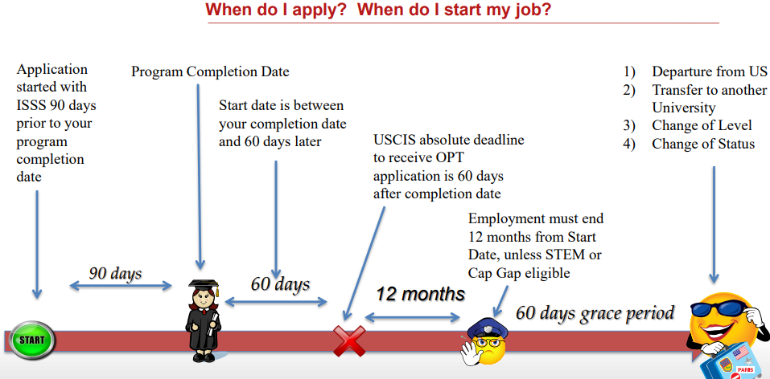
When do I apply? When do I start my job?

Slide 8
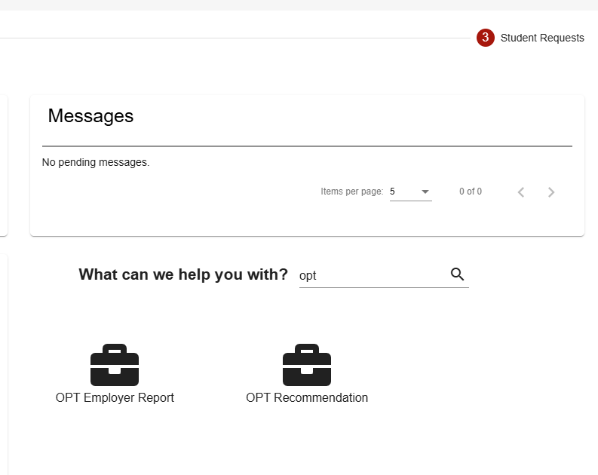
OPT Information Workshop
Application Materials Needed to Apply:
The first step when applying for OPT is to complete the OPT Recommendation form in Terradotta.
We will provide you with a new
I-20 recommending you for OPT.

Slide 9
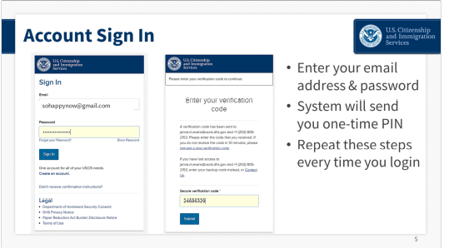
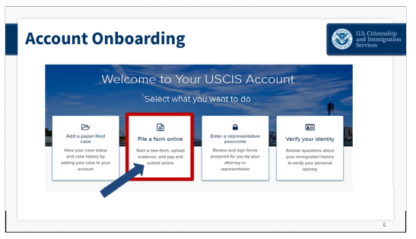
OPT APPLICATION PROCESS
All OPT applications are now being done online via www.uscis.gov/i-765
You will first create an account on USCIS and proceed to file online
There is a step-by-step walkthrough on our website.
OPT Application Fee ($410)
Now offering premium processing ($1685)

Slide 10
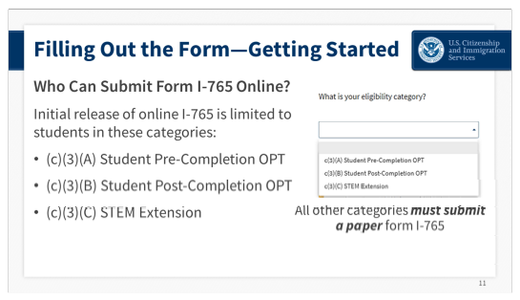
OPT APPLICATION PROCESS
Choose the type of OPT you will apply for:
(c)(3)(B) for post completion

Slide 11
OPT APPLICATION PROCESS
You will need a digital copy of the following:
Government identification (passport)
Passport Size photo-high resolution, square photo. Can be taken on your device
Any Form I-20 that has been endorsed for Curricular Practical Training (CPT)
Any Form I-20 and/or EAD card that you may have from a previous educational level OPT period
New Form I-20 recommending you for OPT

Slide 12
AFTER APPLYING
After completing the online application, you will receive:
Receipt notice, approval notice, EAD card
You will need to provide the ISSS Office with a copy of your EAD Card
After you start your OPT, you will receive an email to set up your SEVP Portal
You must report employment and/or biographical changes to SEVP within 10 days
Once you have access to the SEVP Portal, change your email address to your personal email address. UofL deactivates your student email address 2 years after you graduate.

Slide 13
OPT EMPLOYER FORM
You have 10 days to update your employer details in the SEVP Portal.
If it is past the 10 days, you can complete OPT Employer Report in Terradotta and a DSO will add the employer to your SEVIS and send you an updated I-20.
With every employer change, you will receive an updated Form I-20. If you update your employer on the SEVP portal, complete the Reprint I-20 form on Terradotta.

Slide 14
OPT STEM EXTENSION
OPT STEM EXTENSION
24-MONTH EXTENSION
Students awarded Bachelor’s, Master’s, and Doctoral degrees in specific STEM (Science, Technology, Engineering, Mathematics) fields are eligible for a 24-month extension of post-completion OPT
All employment with a non-E-Verify employer must cease when the student's standard post-completion OPT ends. Such employment cannot continue into any part of the 24-month STEM OPT period, including the 180-day interim period.
Eligible for up to two STEM extensions
Can apply for STEM extension using a previous STEM degree if not already previously used for the extension
The prior degree was conferred no more than 10 years before the DSO recommends the STEM OPT extension in SEVIS based on that degree;
Total Eligibility for qualified students cannot exceed 36 months total
Student’s employer must be registered and participating in the USCIS E-Verify employment verification program at the time of extension request and must supply form I-983 (training plan)

Slide 15
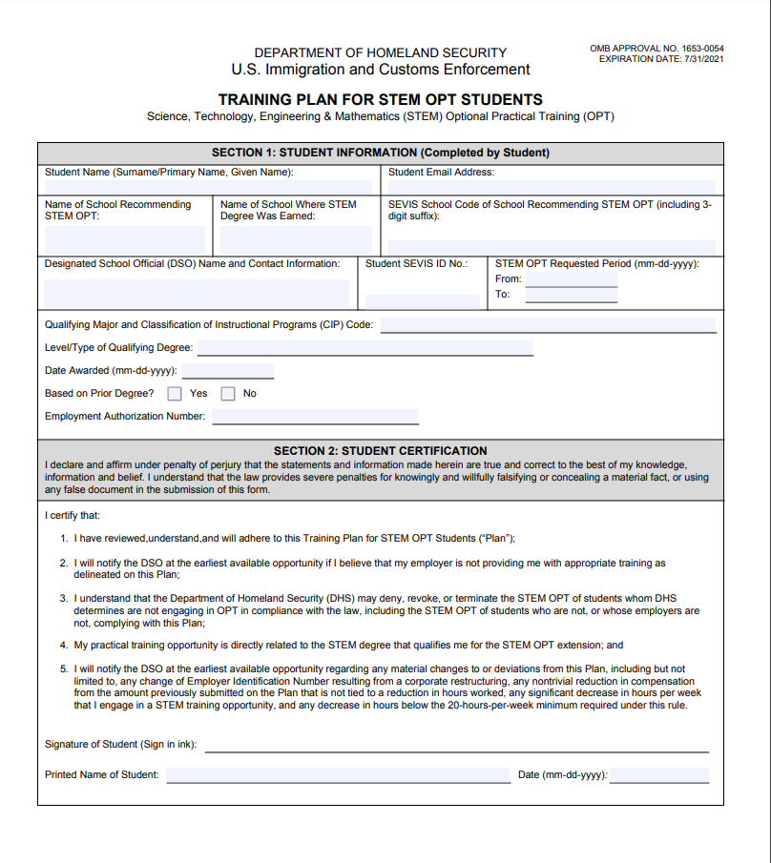
STEM APPLICATION PROCESS
To apply for STEM, provide your DSO with the Form I-983 so we can make you a new I-20 recommending you for Extension
YOU MUST APPLY 90 DAYS BEFORE YOUR END DATE. You cannot apply in the 60-day grace period
You will need to complete a new form I-983 for every employer you have while on STEM Extension

Slide 16
STEM APPLICATION PROCESS
Choose the type of OPT you will apply for:
(c)(3)(C) for STEM Extension

Slide 17
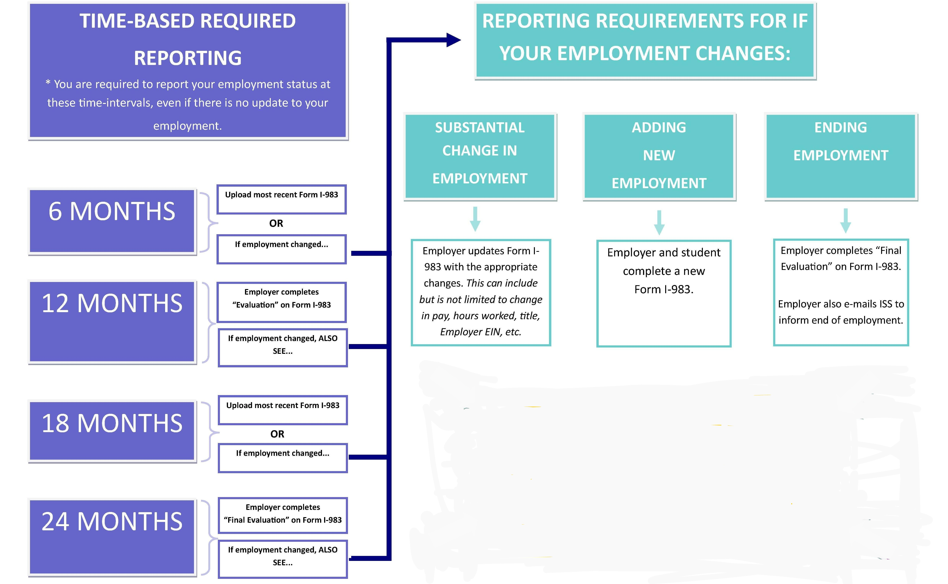
OPT STEM VALIDATION

Slide 18
OPT AND TRAVEL
While Pending OPT (Not recommended)
Form I-20 issued for OPT (signed last 6 months)
Visa
Passport (valid for 6 months)
Receipt Notice (if you have received)
Keep track of your application on USCIS.gov (Check My Status)
Approved OPT
Form I-20 issued for OPT (signed last 6 months)
Visa
Passport (valid for 6 months)
EAD Card
Offer letter from place of employment
Note: There is always a risk in traveling outside the US and/or applying for a new visa while on OPT

