Slide 1
Step by Step Instruction:
Filing OPT Application Online
International Student & Scholar Services

Slide 2
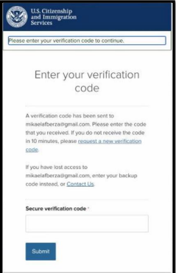
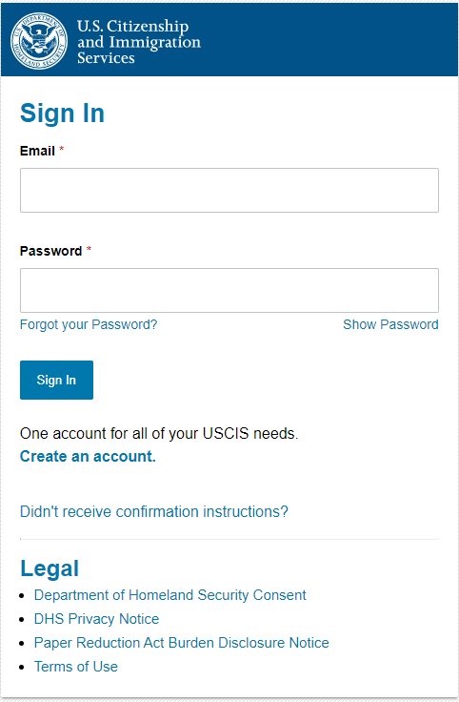
Application Website: I-765, Application for Employment Authorization (uscis.gov/I-765)
Create your account: https://myaccount.uscis.gov/users/sign_up
1. Go to https://myaccount.uscis.gov and sign in with the account you created
2. Enter your verification
code (sent to the method
you chose when creating
account) to authenticate
your login.

Slide 3
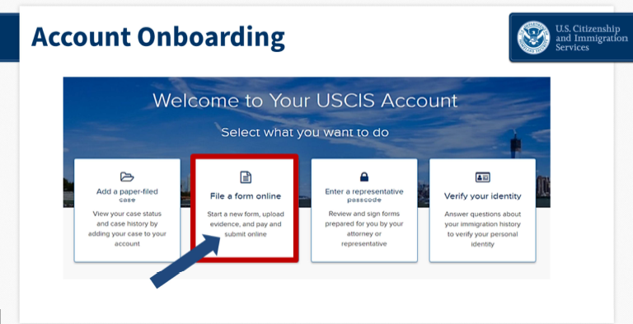
Onboarding
At the onboarding page, select “File a form online.”

Slide 4
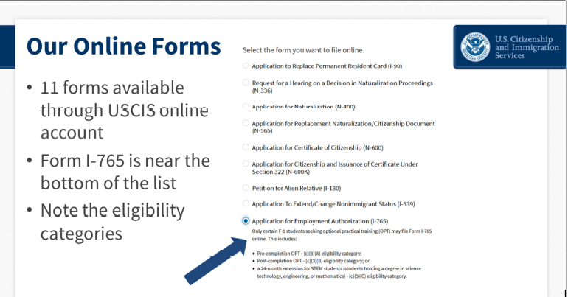
Form Selection
Next, select “Application for Employment Authorization (I-765).” Then select start form.

Slide 5
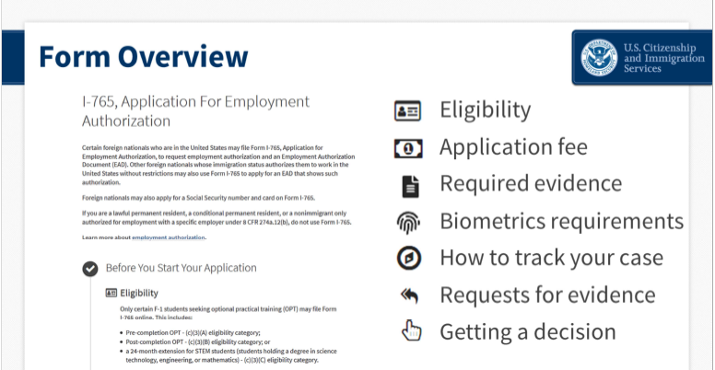
Form Overview
This is a comprehensive rundown of everything you will need to complete the form online.
Read over it and you can begin the application

Slide 6
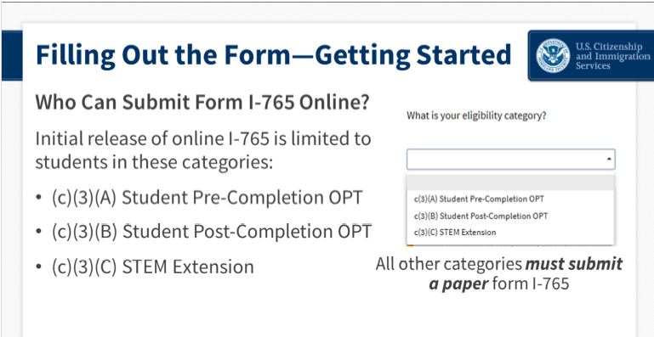
Eligibility Category
Select the category you will be applying for.
Most of you will be doing c(3)(B) Post-Completion or c(3)(C) STEM Extension

Slide 7
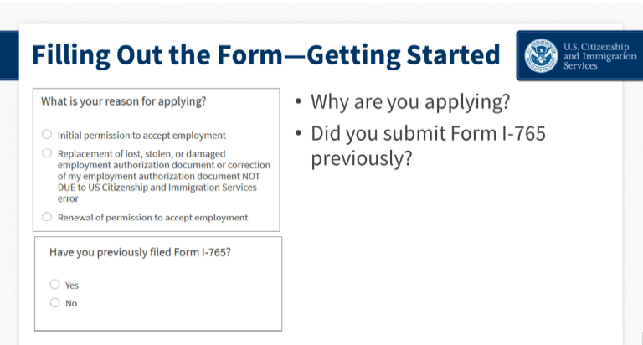
What is your reason for applying?
For Initial OPT, choose “initial permission for applying”
For STEM Extension OPT, choose “renewal of permission”
If you are filling STEM Extension or have done OPT in the past, select “YES”

Slide 8
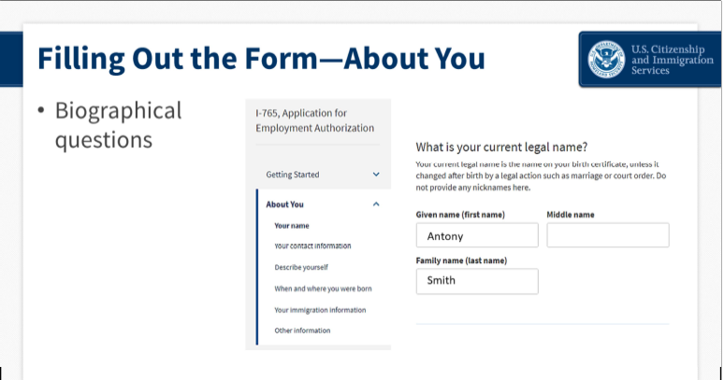
About You
This section asks for biographic details like your name, date of birth, country of nationality.
Make sure it matches what is on your passport.
Ex. If your middle name is with your first name on your passport, you would indicate it all together in the “given name” section.

Slide 9
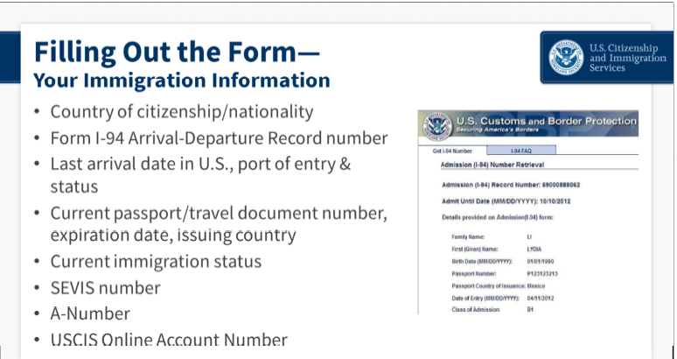
Your Immigration Information
The form will ask for:
Your country of citizenship/nationality
Your Form I-94 Arrival-Departure Record number (find your I-94 here)
The date you last entered the U.S., the port of entry, and your status at that time(F1). Can all be found in your I-94 history
Your most current passport or travel document number, expiration date, and the country that issued it
Your current immigration status (F1)
Your SEVIS number. Found on top of your I-20
Your A-Number if you have one. Check you do not have an A-Number
Your USCIS Online Account Number. Check "I do not have or know my USCIS Online Account Number”

Slide 10
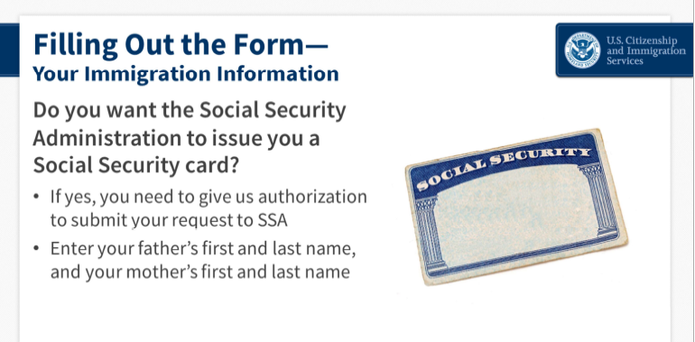
Social Security
“Have you ever had a Social Security card?”
If yes, they will as for your Social Security Number
If no, they will ask “Do you want a Social Security card to be issued to you now?” *
  If you answer YES, you want a Social Security card now, it will prompt additional questions.
*If you do not have an SSN, you will need one to work

Slide 11
Evidence for Post Completion
If you are applying for initial OPT, you will need to submit the following:
Government Identification; use your passport copy or a previous EAD card if you have been on OPT before
One passport-style photo, in either jpeg or png format; your passport photo must meet the Department of State’s passport photo specifications.
Copy of your electronic I-94 record
I-20’s for authorized CPT or OPT
The recommended I-20 from a DSO

Slide 12
Evidence for STEM Extension
If you are applying for STEM Extension OPT, you will need to submit the following:
Government Identification; use your EAD from your initial I-20
One passport-style photo, in either jpeg or png format; your passport photo must meet the Department of State’s passport photo specifications.
Copy of your electronic I-94 record
School Accreditation: If you seek a STEM OPT extension based on a previously earned STEM degree, provide evidence that your school is currently accredited by U.S. Department of Education and certified by SEVP
Degree: Evidence of degree that is basis for STEM OPT and is listed on STEM Designated Degree Program List. You can upload a copy of your diploma
The recommended I-20 from a DSO

Slide 13
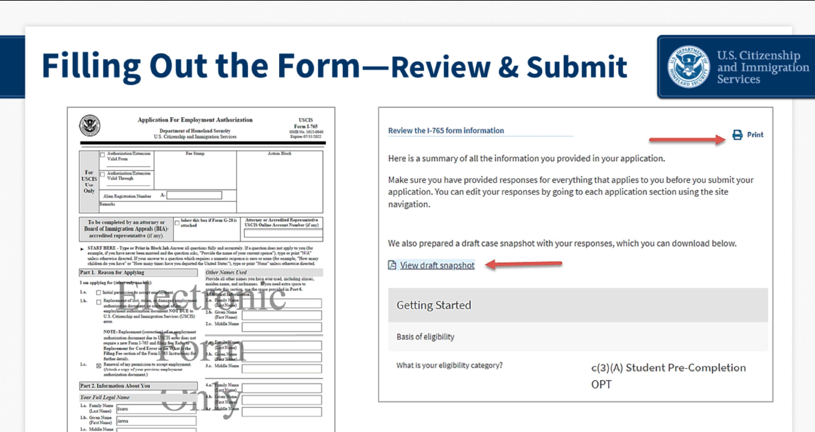
Review and Submit
The form summary page will provide a long vertical review of everything you entered.
You should always review your work and you can save and come back to it as many times as you want.
The only requirement is you must work on your form and make at least one edit or change every 30 days.
If everything in the review looks correct, you can proceed to pay and submit

Slide 14
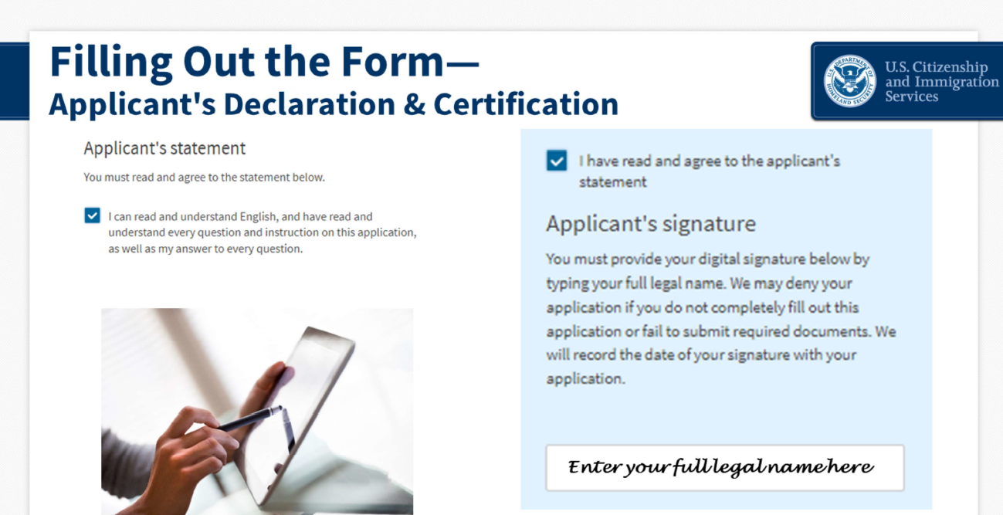
Applicant’s Declaration and Certification
We are just about done. In this section you need to attest to the fact that you understand English and that you understood all the questions and instructions in the online form.
You will also need to electronically sign a declaration that all of your answers are truthful.

Slide 15
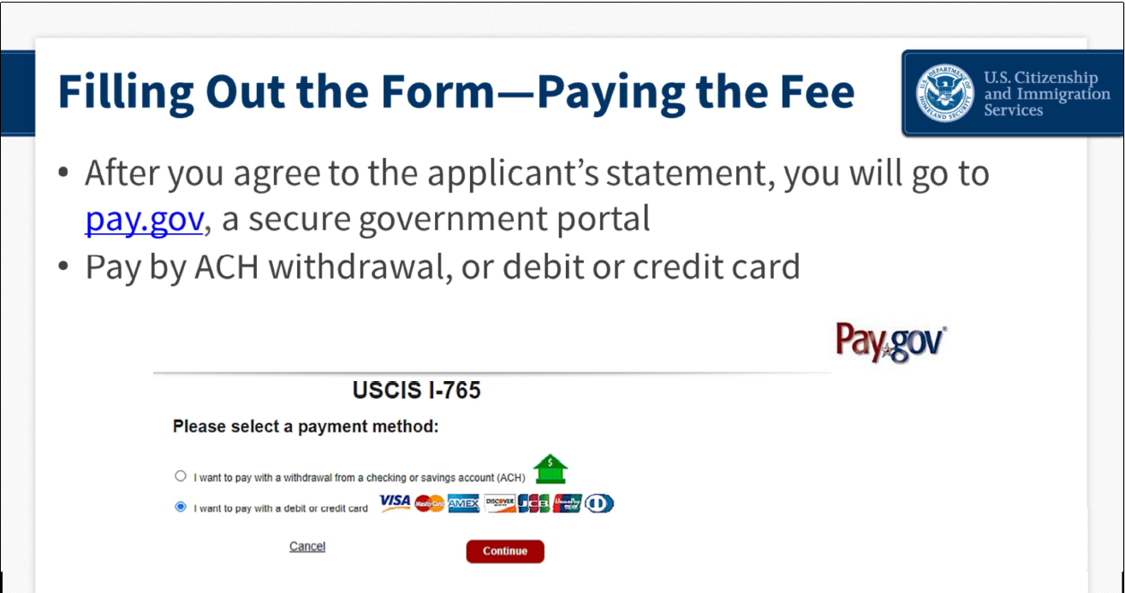
Paying the Fee
After you agree to the applicant statement and electronically sign your form, you will leave my.uscis.gov and be taken to pay.gov. Pay.gov is a secure government portal run by the Treasury Department.
Here you can pay your fee by bank information or with a debit or credit card.

Slide 16
If you have any questions or need clarification on the OPT application process, you can email us at ISSS@louisville.edu or call 502-852-6604

