Slide 1
Monday
Direct instruction
Vocabulary journal entries (word description, translation, & drawing)
Pictionary

Slide 2
Key vocabulary of the week
Reproductive potential
Limiting factor
Frequency
Rate
Volume
Percentage
Review words
Reproduction
Population growth
Biotic
Abiotic

Slide 3
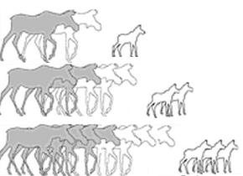
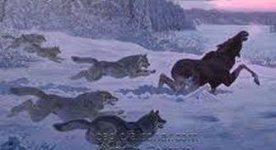
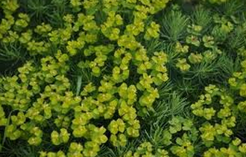
Key vocabulary of the week
Term: reproductive potential
Definition: the theoretical unlimited growth of a population over time
Draw:
Term: limiting factor
Definition: biotic or abiotic factors that control the size of the population.
Draw:

Slide 4
Key vocabulary of the week
Term: frequency (n)
Definition: how often does something happen
Draw:
Notes:
You could do your own tally & frequency ☺

Slide 5
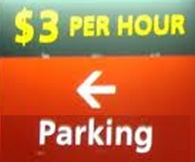
Key vocabulary of the week
Term: rate (n)
Definition: the number of times something happens during a particular period of time
Draw:

Slide 6
Key vocabulary of the week
Term: volume (n)
Definition: (three-dimensional) space that is taken by something
Draw:

Slide 7
Key vocabulary of the week
Term: percentage (n)
Definition: the number of parts out of 100
Draw:

Slide 8
Let’s come up with GESTURES/MOVEMENTS for each word
Reproductive potential
Limiting factor
Frequency
Rate
Volume
Percentage
Notes:
This could be used for choral reading—Eric did something like this.

Slide 9
At home
Study the words while thinking about GESTURES/MOVEMENTS that best describe/represent the word

Slide 10
Tuesday
Charade
Spelling pyramid
Working with a partner, write 1-2 sentences using the words

Slide 11
Charade
Use your arms, legs, and bodies to show that you know the meaning of the key word.
Option 1: Teacher calls the words, kids standing next to their desks show what the word means with their hands, motions, body language.
Option 2: Teacher give a word to each table, the table creates the charade, the class guesses.
Notes:
Materials for Option 2: 1 cut-out word per table

Slide 12
Spelling Pyramid
Using the example on your hand-out, build the Spelling pyramid for each key word:
Working with a partner, write 1-2 sentences using the words from the spelling pyramid
Amount
a
am
amo
amou
amoun
amount

Slide 13
At home
Study the word definitions

Slide 14
Wednesday
Card game

Slide 15
Card Game
Setp1: The Reader takes the card and reads the word
Step 2: Player #1 provides a definition, description, or an example of the target word
Step 3: The team decides if the answer is correct
Step 4: If the answer is correct, Player #1 keeps the card & becomes the Reader for the next Player.
Step 5: Continue until there is no more cards in the set.
The Player with the most card wins.

Slide 16
At home
Teach the words to someone else

Slide 17
Thursday
“Jeopardy”

Slide 18
Jeopardy: Round 1
Step 1: Form 2 teams & select a Host
Step 2: 1 person from each team approaches the host table
Step 3: The Host reads 1 word, the player who “hits” the Host’s table first, gets to provide a definition. The correct definition gets the team 1 point.
Step 4: Repeat Steps 2 & 3 with new players fro each team.

Slide 19
Jeopardy: Round 2
Step 1: Each team gets a set of 4 key words
Step 2: The teams develop and write sentences with the 4 words on blank sentence strips
Step 3: Each sentence that is accurate gets the team up to 2 points (1 science + 1 English).
The team with the most points from Rounds 1 & 2 wins.
Notes:
I am not sure this will work with this set of words.

Slide 20
At home
Get ready for the quiz

Slide 21
Friday
Quiz
Assess level of word understanding in the vocabulary journal

Slide 22
# | Sentence | Letter | Correct
1 | A kitten is the offspring of cats. | D.
2 | To get an “A” on this quiz I need get a large percentage of questions correct. | E.
3 | I call my friends back home with high frequency (often). | B.
4 | My heart rate gets faster when I run. | F.
5 | Plants and animals are examples of biotic factors. | A.
6 | No food or water for a long time are examples of limiting factors. | C.
7 | The theoretical unlimited growth of a population over time is called reproductive potential. | G.
8 | Space that is taken by three-dimensional objects is called volume. | H.

Slide 23
© Materials copyrighted by the University of Louisville.
Educators are free to use these materials with the proper acknowledgement of source.

