Slide 1
Monday
Direct instruction
Vocabulary journal entries (word description, translation, & drawing)
“Check” the level of word understanding in vocab journal
Homework: Spelling pyramid

Slide 2
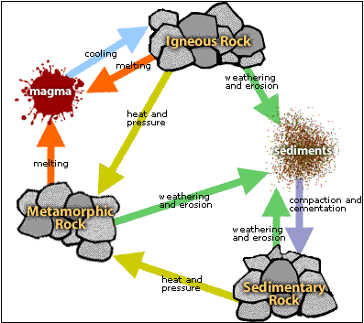
Key vocabulary of the week
Mineral
Form
Melt
Igneous
Fossil
Press
Sedimentary
Layer
Metamorphic
Stratum/strata

Slide 3
Key vocabulary of the week
Term: mineral
Draw:
Definition: the materials that make up a rock

Slide 4
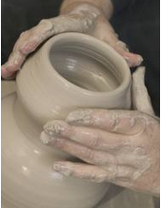
Key vocabulary of the week
Term: form (formation)
Definition: to cause (something) to have a particular shape (form); to make something over a period of time
Draw:

Slide 5
Key vocabulary of the week
Term: melt (melted)
Definition: to change or to cause (something) to change from a solid to a liquid usually because of heat
Draw:

Slide 6
Key vocabulary of the week
Term: igneous
Definition: formed when hot, liquid rock cools and becomes hard
Draw:

Slide 7
Key vocabulary of the week
Term: fossil
Definition: hardened remains (leaf, skeleton, footprint) of dead plants and animals found in some rocks
Draw:

Slide 8
Key vocabulary of the week
Term: press (pressure)
Definition:
to push (something) with strong or stable force
Term: sedimentary (sediment; sedimentation)
Definition: made from material that sinks to the bottom of a liquid

Slide 9
Key vocabulary of the week
Term: metamorphic
Definition: rock that was changed from another kind of rock through heat and pressure
Draw:

Slide 10
Key vocabulary of the week
Term: layer
Definition: material lying over or under another material; material spread over an area
Term: stratum/strata
Definition: one of usually many layers of a substance (such as rock)

Slide 11
Meet someone who speaks your language and…
Explain your definitions & drawings using your native language for the key words of the words:
Mineral
Form (formation)
Melt (melted)
Igneous
Fossil
Press (pressure)
Sedimentary (sediment, sedimentation)
Layer
Metamorphic
Stratum/strata
When back in your sit, mark your level of the word’s understanding with a

Slide 12
Homework: Spelling Pyramid
Using the example on your hand-out, build the Spelling pyramid for each key word:
Write 1-2 sentences using the words from the spelling pyramid
Abiotic
a
ab
abi
abio
abiot
abioti
abiotic

Slide 13
Tuesday
Spelling pyramid + sentences check

Slide 14
At home
Study the word definitions
Mineral
Form (formation)
Melt (melted)
Igneous
Fossil
Press (pressure)
Sedimentary (sediment, sedimentation)
Layer
Metamorphic
Stratum/strata

Slide 15
Wednesday
Whole class review
Picture match

Slide 16
Picture Match
Step 1: Take the words out from the envelop
Step 2: Read the words out loud & think about images that describe the words
Step 3: Match the words & the pictures
Step 4: Explain your match using the sentence starter below
I chose this picture because the word shows ___________
is ___________
an example of…
something that …
an object that…
Notes:
Materials:
Picture board (1 per 2 students)
Cut-off vocabulary words (1 set per 2 students)
Facilitation: Modeling (a) directions, (b) how to use the sentence starter, and (c) corrective feedback (re-phrasing student sentences during the whole class review of the picture match

Slide 17
At home
Teach the words to someone else
Mineral
Form (formation)
Melt (melted)
Igneous
Fossil
Press (pressure)
Sedimentary (sediment, sedimentation)
Layer
Metamorphic
Stratum/strata

Slide 18
Friday
Review:
Card game (or charades/jeopardy)
Quiz:
“Square” the level of word understanding (1- 4) in vocab journal

Slide 19
Card Game
Setp1: One person takes a Card and reads the word
Step 2: The first person who provides the best definition, description, or an example keeps the Card
The Player with the most Cards wins.

Slide 20
Jeopardy: Round 1
Step 1: Form 2 teams & select a Host
Step 2: 1 person from each team approaches the host table
Step 3: The Host reads 1 word, the player who “hits” the Host’s table first, gets to provide a definition. The correct definition gets the team 1 point.
Step 4: Repeat Steps 2 & 3 with new players fro each team.

Slide 21
Jeopardy: Round 2
Step 1: Each team gets a set of 4 key words
Step 2: The teams develop and write sentences with the 4 words on blank sentence strips
Step 3: Each sentence that is accurate gets the team 2 points (1 pt. science + 1pt. English)
The team with the most points from Rounds 1 & 2 wins.

Slide 22
© Materials copyrighted by the University of Louisville.
Educators are free to use these materials with the proper acknowledgement of source.

