Slide 1
Monday
Direct instruction
Vocabulary journal entries (word description, translation, & drawing)
Pictionary

Slide 2
Key vocabulary of the week
Population size
Population growth
Male
Female
Reproduction
Offspring
Eggs

Slide 3
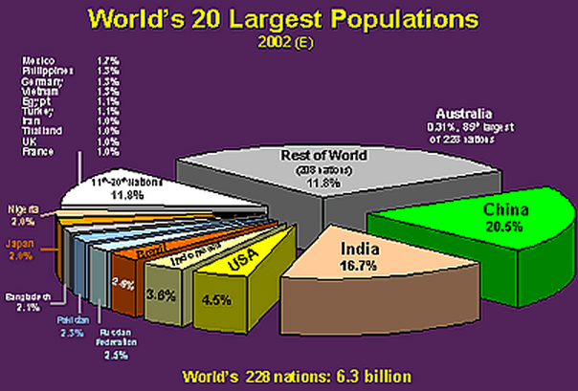
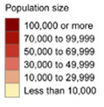
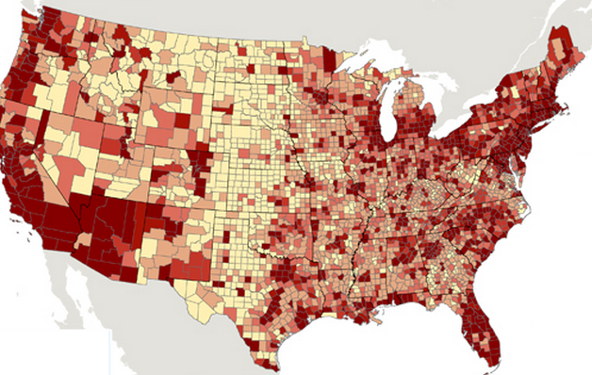
Key vocabulary of the week
Term: population size
Definition: the number of living things (animals, humans) living in an area
Draw:

Slide 4
Key vocabulary of the week
Term: population growth
Definition: increases in the population size
Draw:

Slide 5
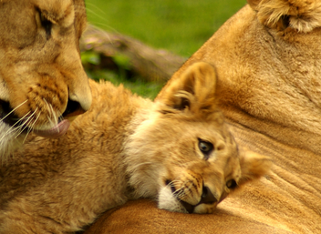
Key vocabulary of the week
Term: offspring (n)
Definition: the young of an animal or plant
Term: egg (n)
Definition: an oval thing from which young animals (such as birds, snakes, insects) are born

Slide 6
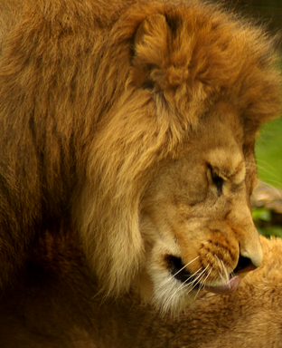
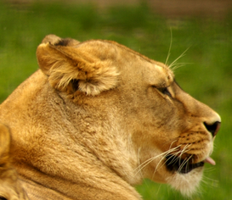
Key vocabulary of the week
Term: male (n)
Definition: not producing young or eggs
Draw:
Term: female (n)
Definition: producing young or eggs, such as lioness
Draw:

Slide 7
Key vocabulary of the week
Term: reproduction (n)
Definition: the process that produces babies, young animals, or new plants
Draw:

Slide 8
Pictionary
Working with a partner, find the word that best fits the picture.
Notes:
Materials for Pictionary:
Picture board (1 per 2 students)
Cut-off vocabulary words (1 set per 2 students)

Slide 9
Tuesday
Charades
Spelling pyramid
Working with a partner, write 1-2 sentences using the words

Slide 10
Charades
Use your arms, legs, and bodies to show that you know the meaning of the key word.
Option 1: Teacher calls the words, kids standing next to their desks show what the word means with their hands, motions, body language.
Option 2: Teacher give a word to each table, the table creates the charade, the class guesses.
Notes:
Materials for Option 2: 1 cut-out word per table

Slide 11
Spelling Pyramid
Using the example on your hand-out, build the Spelling pyramid for each key word:
Working with a partner, write 1-2 sentences using the words from the spelling pyramid
Abiotic
a
ab
abi
abio
abiot
abioti
aboitic

Slide 12
Wednesday
Card game

Slide 13
Card Game
Setp1: The Reader takes the card and reads the word
Step 2: Player #1 provides a definition, description, or an example of the target word
Step 3: If answer is correct, Player #1 keeps the card & becomes the Reader for the next Player.
Step 4: Continue until there is no more cards in the set.
The Player with the most card wins.

Slide 14
Thursday
“Jeopardy”

Slide 15
Jeopardy: Round 1
Step 1: Form 2 teams & select a Host
Step 2: 1 person from each team approaches the host table
Step 3: The Host reads 1 word, the player who “hits” the Host’s table first, gets to provide a definition. The correct definition gets the team 1 point.
Step 4: Repeat Steps 2 & 3 with new players fro each team.

Slide 16
Jeopardy: Round 2
Step 1: Each team gets a set of 4 key words
Step 2: The teams develop and write sentences with the 4 words on blank sentence strips
Step 3: Each sentence that is accurate gets the team 1 point.
The team with the most points from Rounds 1 & 2 wins.

Slide 17
Friday
Quiz
Assess level of word understanding in the vocabulary journal

Slide 18
# | Sentence | Letter | Correct
 | The population size of polar bears is getting smaller because of warmer weather. | H.
2. | Some plants do not need males and females to produce offspring. | C.
3. | A baby is the offspring of humans. | F.
4. | Birds, snakes, and insects are born from eggs. | B.
5. | Uncontrolled reproduction causes population growth. | G.
6. | Rain and sunlight are examples of abiotic factors. | A.
7. | Lion and lioness are examples of the male and female of the same species. | E.
8. | A place where animals live is called a habitat. | D.

Slide 19
© Materials copyrighted by the University of Louisville.
Educators are free to use these materials with the proper acknowledgement of source.

