Slide 1
Monday
Direct instruction
Vocabulary journal entries (word description, translation, & drawing)
“Check” the level of word understanding in vocab journal

Slide 2
Key vocabulary of the week
stimulus/i
response
reflex
estimate
brakes
stop watch
horizontal
vertical
graph
data table

Slide 3
Key vocabulary of the week
Term: stimulus/stimuli (n)
Definition: something that causes your senses to respond (light is the stimulus for sight; sound is the stimulus for hearing)
Term: response (n)
Definition: a reaction to stimuli

Slide 4
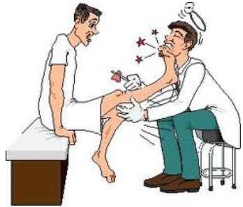
Key vocabulary of the week
Term: reflex (n)
Definition: an unconscious response to stimuli
Draw:

Slide 5
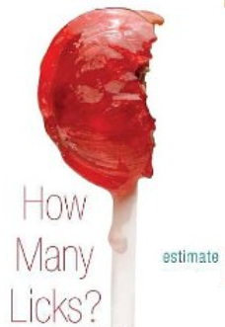
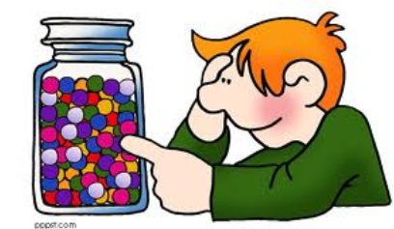
Key vocabulary of the week
Term: to estimate (v)
Definition: to make a thoughtful guess
Draw:

Slide 6
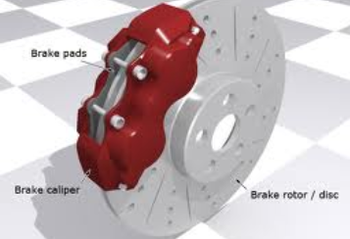
Key vocabulary of the week
Term: brakes (n, pl)
Definition: the part of a car or bicycle that you use to decelerate or stop
Draw:

Slide 7
Meet someone who speaks your language and…
Explain your definitions & drawings using your native language for these words:
stimulus/response
reflex
estimate
brakes

Slide 8
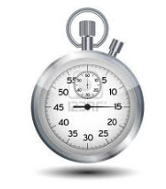
Key vocabulary of the week
Term: stop watch (n)
Definition: a clock or device that is used to measure time in hundredths of seconds
Draw:

Slide 9
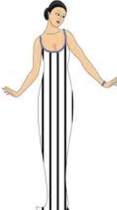
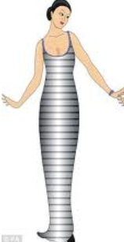
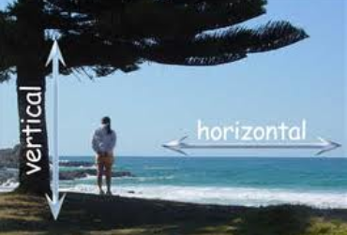
Key vocabulary of the week
Term: vertical
Definition: positioned up and down (going straight up)
Term: horizontal
Definition: positioned from side to side (parallel to the ground)

Slide 10
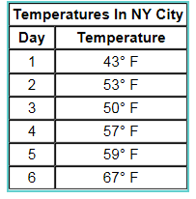
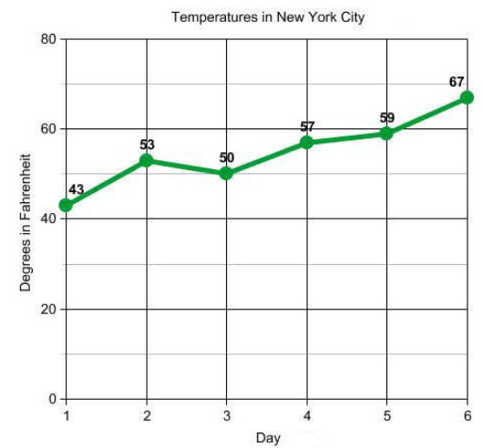
Term: graph (n)
Definition: a drawing showing how much or how quickly something changes
Term: data table (n)
Definition: a collection of information that is arranged in rows and columns

Slide 11
Meet someone who speaks your language and…
Explain your definitions & drawings using your native language for these words:
stop watch
horizontal
vertical
graph
data table

Slide 12
At home
Study the words while thinking about the images that best describe/represent the word

Slide 13
Tuesday
Whole class review (calling on volunteers)
Picture match

Slide 14
Picture Match
Step 1: Take the words out from the envelop
Step 2: Read the words out loud & think about images that describe the words
Step 3: Match the words & the pictures
Step 4: Explain your match using the sentence starter below
I chose this word because the picture shows__________
an example of…
something that …
an object that…
the formula for…
Notes:
Materials:
Picture board (1 per 2 students)
Cut-off vocabulary words (1 set per 2 students)
Facilitation: Modeling (a) directions, (b) how to use the sentence starter, and (c) corrective feedback (re-phrasing student sentences during the whole class review of the picture match

Slide 15
At home
Study the word definitions

Slide 16
Wednesday
Whole class review (tennis ball)
Card game

Slide 17
Card Game
Setp1: The Reader takes the card and reads the word
Step 2: Player #1 provides a definition, description, or an example of the target word
Step 3: The team decides if the answer is correct
Step 4: If the answer is correct, Player #1 keeps the card & becomes the Reader for the next Player.
Step 5: Continue until there is no more cards in the set.
The Player with the most card wins.

Slide 18
At home
Teach the words to someone else

Slide 19
Thursday
“Jeopardy”
Homework:
Spelling pyramid
Write 1-2 sentences using the words from the spelling pyramid
Get ready for the quiz

Slide 20
Jeopardy: Round 1
Step 1: Form 2 teams & select a Host
Step 2: 1 person from each team approaches the host table
Step 3: The Host reads 1 word, the player who “hits” the Host’s table first, gets to provide a definition. The correct definition gets the team 1 point.
Step 4: Repeat Steps 2 & 3 with new players fro each team.

Slide 21
Jeopardy: Round 2
Step 1: Each team gets a set of 4 key words
Step 2: The teams develop and write sentences with the 4 words on blank sentence strips
Step 3: Each sentence that is accurate gets the team 2 points (1 pt. science + 1pt. English)
The team with the most points from Rounds 1 & 2 wins.

Slide 22
Homework: Spelling Pyramid
Using the example on your hand-out, build the Spelling pyramid for each key word:
Write 1-2 sentences using the words from the spelling pyramid
Get ready for the quiz
amount
a
am
amo
amou
amoun
amount

Slide 23
Friday
Check homework
Quiz
“Square” the level of word understanding (1- 4)

Slide 24
# | Sentence | Letter | Correct
1 | As I was driving, a car jumped in front of me and I had to slam on (= hit) the brakes. | B
2 | I estimated the distance between two cars at about 3 km. | D
3 | Movement that is parallel to the ground is described as horizontal. | C
4 | My dog responds to the stimulus “roll over” by rolling over. | A
5 | Reflex body movements may occur such as brief arm or leg movement. | B
6 | She drew a graph showing the rise and fall in the car’s velocity over time. | A
7 | The time that it took the ball to stop was measured with a stop watch. | D
8 | When you knocked on the door, was there any response? | C

Slide 25
© Materials copyrighted by the University of Louisville.
Educators are free to use these materials with the proper acknowledgement of source.

