Slide 1
Monday
Direct instruction
Vocabulary journal entries (word description, translation, & drawing)
“Check” the level of word understanding in vocab journal
Notes:
Materials:
Vocabulary journal (hand outs)

Slide 2
Key vocabulary of the week
Velocity
Inertia
Mass
Weight
Friction
Additional words from previous weeks:
acceleration/deceleration
constant speed
elastic/inelastic collision

Slide 3
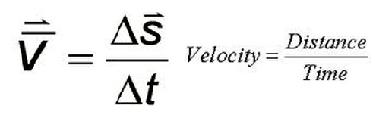
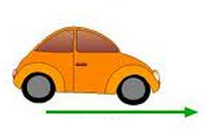
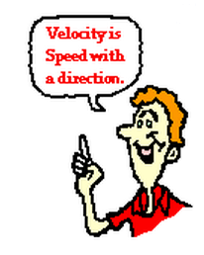
Key vocabulary of the week
Term: velocity (n)
Definition: the speed and direction of a moving object
Draw:
Notes:
A nice You Tube clip to demonstrate this: http://www.youtube.com/watch?v=DRb5PSxJerM

Slide 4
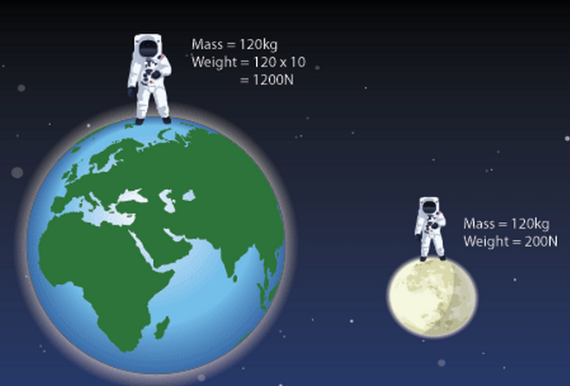
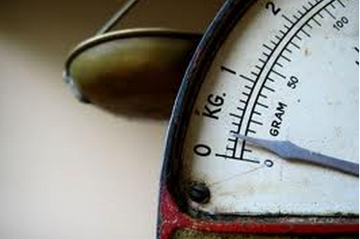
Term: mass (n)
Definition: the amount of matter in an object
expressed in Kilograms (kg)
Term: weight (n)
Definition: the force of gravity pulling the mass down
expressed in Newtons (N)
Notes:
Weight is often confused with mass: Weight is expressed in Kilograms, but it should be expressed in Newtons (N).

Slide 5
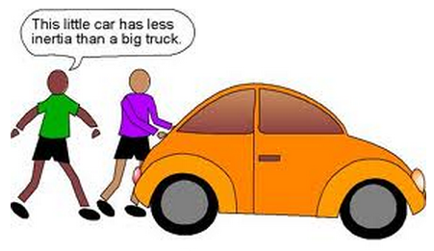
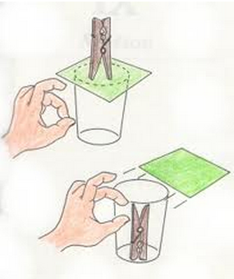
Key vocabulary of the week
Term: inertia (n)
Definition: an object’s resistance to changes in velocity
Draw:

Slide 6
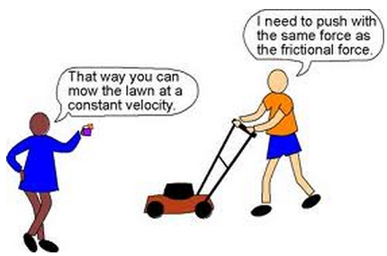
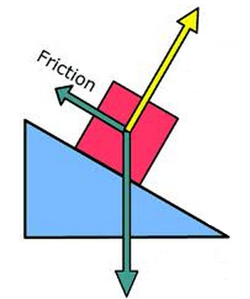
Key vocabulary of the week
Term: friction (n)
Definition: the force that is created when two surfaces rub together
Draw:

Slide 7
At home
Study the words while thinking about the images that best describe/represent the word

Slide 8
Tuesday
Whole class review (calling on volunteers)
Picture match
Notes:
Materials:
1 picture board per 2 students
1 set of cut out words per 2 students

Slide 9
Picture Match
Step 1: Take the words out from the envelop
Step 2: Read the words out loud & think about images that describe the words
Step 3: Match the words & the pictures
Step 4: Explain your match using the sentence starter below
I chose this word because the picture shows__________
an example of…
                something that …
                an object that…
                the formula for…
Notes:
Materials:
Picture board (1 per 2 students)
Cut-off vocabulary words (1 set per 2 students)
Facilitation: Modeling (a) directions, (b) how to use the sentence starter, and (c) corrective feedback (re-phrasing student sentences during the whole class review of the picture match

Slide 10
At home
Study the word definitions

Slide 11
Wednesday
Whole class review (tennis ball)
Card game
Notes:
Materials:
1 set of cards per 4 students

Slide 12
Card Game
Setp1: The Reader takes the card and reads the word
Step 2: Player #1 provides a definition, description, or an example of the target word
Step 3: The team decides if the answer is correct
Step 4: If the answer is correct, Player #1 keeps the card & becomes the Reader for the next Player.
Step 5: Continue until there is no more cards in the set.
The Player with the most card wins.

Slide 13
At home
Teach the words to someone else

Slide 14
Thursday
“Jeopardy”
Homework:
  Spelling pyramid
  Write 1-2 sentences using the words from the spelling pyramid
  Get ready for the quiz
Notes:
Materials
One set of words from the “Card Game”

Slide 15
Jeopardy: Round 1
Step 1: Form 2 teams & select a Host
Step 2: 1 person from each team approaches the host table
Step 3: The Host reads 1 word, the player who “hits” the Host’s table first, gets to provide a definition. The correct definition gets the team 1 point.
Step 4: Repeat Steps 2 & 3 with new players fro each team.

Slide 16
Jeopardy: Round 2
Step 1: Each team gets a set of 4 key words
Step 2: The teams develop and write sentences with the 4 words on blank sentence strips
Step 3: Each sentence that is accurate gets the team 1 point.
The team with the most points from Rounds 1 & 2 wins.

Slide 17
Homework: Spelling Pyramid
Using the example on your hand-out, build the Spelling pyramid for each key word:
Write 1-2 sentences using the words from the spelling pyramid
Get ready for the quiz
amount
a
am
amo
amou
amoun
amount

Slide 18
Friday
Check homework
Quiz
“Square” the level of word understanding (1- 4)

Slide 19
# | Sentence | Letter | Correct
1 | A car that is slowing down is decelerating. | C.
2 | We say that a car is accelerating because its velocity is increasing. | G.
3 | Smashing your face against the windshield when your car hits a wall is an example of inertia. | E.
4 | The amount of matter in an object is called mass. | F.
5 | A car moving with no change in speed is moving at constant speed. | B.
6 | On the moon, the weight of an astronaut is equal to his mass. | H.
7 | When you move furniture, friction makes it difficult to slide (move) heavy objects across a room. | D.
8 | A car that is increasing its speed is accelerating. | A.

Slide 20
© Materials copyrighted by the University of Louisville.
Educators are free to use these materials with the proper acknowledgement of source.

