Slide 1
Monday
Direct instruction
Vocabulary journal entries (word description, translation, & drawing)
“Check” the level of word understanding in vocab journal

Slide 2
Key vocabulary of the week
Air bag
Applied force
Interval
Impulse
Momentum
Effective/Effectiveness
Relate
Review:
Hypothesis
Stopping distance
Instantaneous

Slide 3
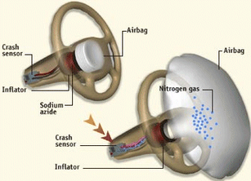
Key vocabulary of the week
Term: air bag
Definition: a bag that fills with air to protect a driver or passenger when a vehicle crashes
Draw:

Slide 4
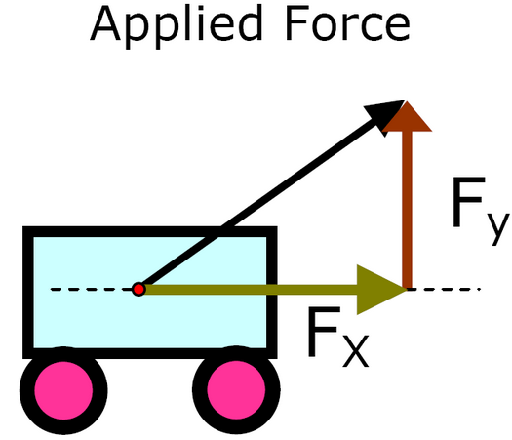
Key vocabulary of the week
Term: applied force
Definition: a (surface or body) force acting on an object
Draw:

Slide 5


Key vocabulary of the week
Term: interval
Definition: a period of time between events
Draw:

Slide 6

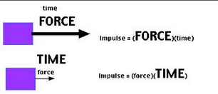
Key vocabulary of the week
Term: impulse
Definition: the product of the force applied and the time the force is applied; needed to stop an object
Draw:

Slide 7
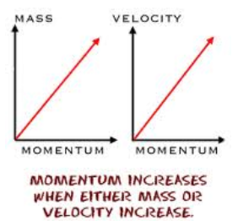
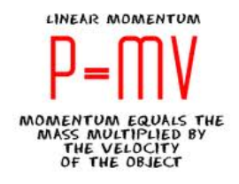
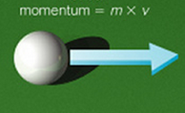
Key vocabulary of the week
Term: momentum (n)
Definition: the product of mass and velocity of an objet
Draw:

Slide 8



Key vocabulary of the week
Term: effective [effectiveness]
Definition: having an intended effect
Draw:

Slide 9
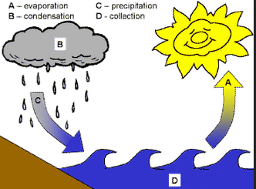
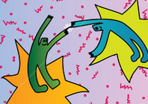
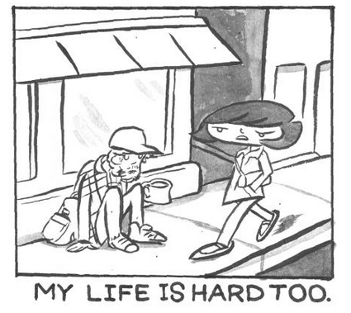
Key vocabulary of the week
Term: relate
Definition: to show or make a connection between (two or more things)
Draw:

Slide 10
Meet someone who speaks your language and…
Explain your definitions & drawings using your native language for these words:
Air bag
Applied force
Interval
Impulse
Momentum
Effective/Effectiveness
Relate
Also, make sure you understand:
Hypothesis
Stopping distance
Instantaneous

Slide 11
At home
Study the words while thinking about the images that best describe/represent the word

Slide 12
Tuesday
Whole class review (calling on volunteers)
Picture match
Homework:
  Spelling pyramid
  Write 1-2 sentences using the words from the spelling pyramid + sentence frames

Slide 13
Picture Match
Step 1: Take the words out from the envelop
Step 2: Read the words out loud & think about images that describe the words
Step 3: Match the words & the pictures
Step 4: Explain your match using the sentence starter below
I chose this word because the picture shows__________
an example of…
                something that …
                an object that…
                the formula for…
Notes:
Materials:
Picture board (1 per 2 students)
Cut-off vocabulary words (1 set per 2 students)
Facilitation: Modeling (a) directions, (b) how to use the sentence starter, and (c) corrective feedback (re-phrasing student sentences during the whole class review of the picture match

Slide 14
At home
Study the word definitions
Complete:
  Spelling pyramid
  Write 1-2 sentences using the words from the spelling pyramid + sentence frames

Slide 15
Wednesday
Whole class review (tennis ball)
Sentence review

Slide 16
Spelling pyramid + sentence check
With a partner…
Check each other’s pyramids + sentences
Find 1 positive thing about your partner’s sentences
Give 1 suggestion for improvement

Slide 17
At home
Teach the words to someone else

Slide 18
Thursday
“Card Game” OR “Jeopardy”
Homework:
  Get ready for the quiz

Slide 19
Card Game
Setp1: The Reader takes the card and reads the word
Step 2: Player #1 provides a definition, description, or an example of the target word
Step 3: The team decides if the answer is correct
Step 4: If the answer is correct, Player #1 keeps the card & becomes the Reader for the next Player.
Step 5: Continue until there is no more cards in the set.
The Player with the most card wins.

Slide 20
Jeopardy: Round 1
Step 1: Form 2 teams & select a Host
Step 2: 1 person from each team approaches the host table
Step 3: The Host reads 1 word, the player who “hits” the Host’s table first, gets to provide a definition. The correct definition gets the team 1 point.
Step 4: Repeat Steps 2 & 3 with new players fro each team.

Slide 21
Jeopardy: Round 2
Step 1: Each team gets a set of 4 key words
Step 2: The teams develop and write sentences with the 4 words on blank sentence strips
Step 3: Each sentence that is accurate gets the team 2 points (1 pt. science + 1pt. English)
The team with the most points from Rounds 1 & 2 wins.

Slide 22
Homework: Spelling Pyramid
Get ready for the quiz

Slide 23
Friday
Check homework
Quiz
“Square” the level of word understanding (1- 4)

Slide 24
© Materials copyrighted by the University of Louisville.
Educators are free to use these materials with the proper acknowledgement of source.

