Slide 1
Thinking skills in Science
Language functions to express the thinking skills

Slide 2
5 Thinking Skills
________________is _______________than ____________.
(something) COMPARATIVE (something)
_______________ the _____________ -est .
(something) SUPERLATIVE
________________ as ______________ as ______________.
(something is) ADJECTIVE (something)
______________, but [while, whereas] _________________.
(something is…) (something is opposite)
1. Making observations
(describing things)
2. Making a hypothesis
(asking questions)
3. Designing an experiment (procedure)
4. Conducting an experiment (procedural recount)
5. Drawing conclusions
(science report & explanation)
Because________________, __________________________.
(this happens) (this will happen)
Because of ______________, __________________________.
(this) (this will happen)
_________________ by ____________ ing _______________.
When __________________, then______________________.
If ______________________, then______________________.
Notes:
Review the 5 thinking skills that scientists use and the idea of language functions to serve these purposes

Slide 3
# 3
Science
Language function
Designing an experiment
Sequencing
Notes:
Intro 1 new thinking skill + 1 language function

Slide 4
Language Function:
Term: sequencing
Definition: putting things in order
Notes:
Have students enter the definition of sequencing into Vocabulary Journals

Slide 5
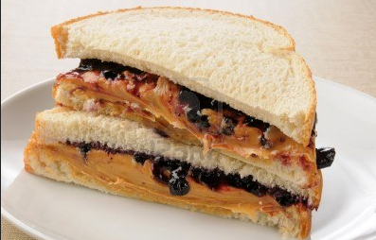
Example:
First, put two slices of bread on the plate.
Second, put some Peanut Butter on one slice of bread and some Jelly on the other slice.
Third, place the two slices of bread together.
Then, cut the sandwich diagonally.
Finally, enjoy!
Frame #1:
Frame #2:
First, ________________________________________.
Second [third, fourth, fifth], ______________.
Finally, _______________________________.
To begin with, __________________________.
Next [then, after that], ___________________.
Last, __________________________________.
Notes:
Model the sentence frame usage in a couple of real-life examples
Help ‘detect’ the sentence frame and highlight punctuation (comma, period)

Slide 6
Donnelly, 2010
Routine
Steps
Present the frame on a poster
Solicit examples from the students
Model the frame use by inserting student examples
Listen to me say the sentence
Say it with me
Say it to me
Notes:
Write the sentence frame on the POSTER + examples from the students + model using
1. Listen to me say the sentence
2. Say it with me
3. Say it to me

Slide 7
Application
Crash Test Keister
http://www.youtube.com/watch?v=F3PvhilgMS4
Notes:
Give students directions on how to work with the handout; have them complete the handout with a partner
Review as a whole class

