Slide 1
Monday
Direct instruction
Vocabulary journal entries (word description, translation, & drawing)
“Circle” the level of word understanding in vocab journal

Slide 2
Key vocabulary of the week
Draft/Giant planet
Habitable zone
Kuiper Belt
Astronomical unit
Speed of light
Review
Evolve
Tide
Phase
Fluctuate
Solar Eclipse

Slide 3
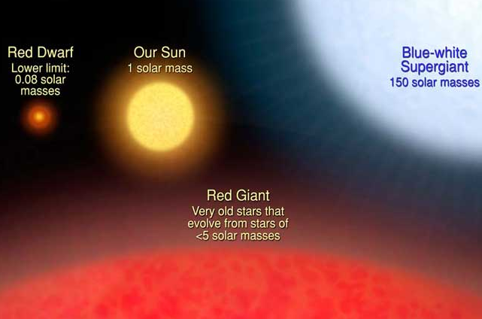
Key vocabulary of the week
Term: dwarf star
Definition: any star of average or low luminosity, mass, and size
Term: giant star
Definition: a star with much larger radius and luminosity than other stars of the same surface temperature
Notes:
Neutron Stars: stars that have collapsed (decreased in size), crushing their atoms until only the neutrons remain.

Slide 4
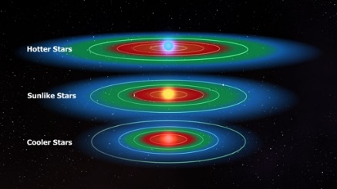
Key vocabulary of the week
Term: habitable zone
Definition: a proper distance from the Sun that allows for liquid water [astronomy]
Draw:

Slide 5
Key vocabulary
Term: Kuiper Belt
Definition: region of the Solar System beyond the planets
Draw:

Slide 6
Key vocabulary
Term: astronomical unit
Definition: the distance from the Earth to the Sun
= 93,000,000 miles
Draw:

Slide 7
Key vocabulary
Term: speed of light
Definition: the seed at which light travels in a vacuum [emptiness]
How long will take the Sun’s light to reach the Earth?
Draw:
= 186,000 miles/sec.
= 300,000 km/sec.

Slide 8
Meet someone who speaks your language and…
Explain your definitions & drawings using your native language for these words:
Draft/Giant planet
Habitable zone
Kuiper Belt
Astronomical unit
Speed of light
Also, make sure that you understand/remember:
Evolve
Tide
Phase
Fluctuate
Eclipse

Slide 9
At home
Study the words while thinking about the images that best describe/represent the word

Slide 10
Tuesday
Whole class review (calling on volunteers)
Picture match
Homework:
Spelling pyramid
Write 1-2 sentences using the words from the spelling pyramid + sentence frames

Slide 11
Picture Match
Step 1: Take the words out from the envelope
Step 2: Read the words out loud & think about images that describe the words
Step 3: Match the words & the pictures
Step 4: Explain your match using the sentence starter below
I chose this word because the picture shows__________
an example of…
something that …
an object that…
the formula for…
Notes:
Materials:
Picture board (1 per 2 students)
Cut-off vocabulary words (1 set per 2 students)
Facilitation: Modeling (a) directions, (b) how to use the sentence starter, and (c) corrective feedback (re-phrasing student sentences during the whole class review of the picture match

Slide 12
At home
Study the word definitions
Complete:
Spelling pyramid
Write 1-2 sentences using the words from the spelling pyramid + sentence frames

Slide 13
Wednesday
Sentence review
“Card Game”

Slide 14
Spelling pyramid + sentence check
With a partner…
Check each other’s pyramids + sentences
Find 1 positive thing about your partner’s sentences
Give 1 suggestion for improvement

Slide 15
Card Game
Setp1: The Reader takes the card and reads the word
Step 2: Player #1 provides a definition, description, or an example of the target word
Step 3: The team decides if the answer is correct
Step 4: If the answer is correct, Player #1 keeps the card & becomes the Reader for the next Player.
Step 5: Continue until there is no more cards in the set.
The Player with the most card wins.

Slide 16
At home
Teach the words to someone else

Slide 17
Thursday
“Charades” OR “Jeopardy”
Homework:
Get ready for the quiz

Slide 18
Charades
Step 1: Give table teams 10 minutes to develop charades for the key vocabulary of the week
Step 2: Give 1 word to a team at a random, ask them to perform their charade for the other teams to solve in 30 seconds. The team that provides the correct solution first gets 1 point.
Step 4: Repeat Step 2 with remaining key words of the week

Slide 19
Jeopardy
Step 1: Form 2 teams & select a Host (could be the teacher)
Step 2: 1 person from each team approaches the host table
Step 3: The Host reads 1 word, the player who “hits” the Host’s table first, gets to provide a definition. The correct definition gets the team 1 point.
Step 4: Repeat Steps 2 & 3 with new players fro each team.

Slide 20
Homework:
Get ready for the quiz

Slide 21
Friday
Quiz
“Square” the level of word understanding (1- 4)

