Slide 1
Accessibility and U of L
June, 2012

Slide 2
Global Definition
What is American Disabilities Act (ADA)
ADA is a wide-ranging civil rights law that prohibits discrimination based on disability.
The Department of Justice (DOJ) is the federal agency charged with enforcing ADA.

Slide 3
U of L Definition
How does ADA apply to U of L
Students, staff, faculty, administrators and visitors must be afforded the opportunity to acquire the same information, engage in the same interactions and enjoy the same services as people without disabilities.
Shirley C. Willihnganz
Executive Vice President and University Provost

Slide 4
Any Classroom Instructional Materials
What documents need to be compliant?
Word Documents
PDF Documents
PowerPoint Shows
Video
Other Useful Information

Slide 5
What To Do
Make Word Documents Compliant
Define Text
Title
Headings
Subtitle
Body Text
Images need “alt tags”
Don’t use an image if it doesn’t add anything to your teaching
Save As “PDF File”

Slide 6
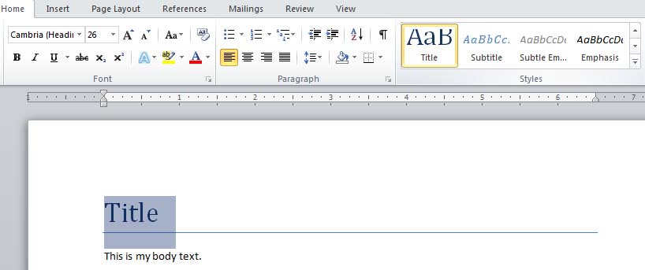
Define Text
How to do it
Highlight the text and then choose its definition; such as Title

Slide 7
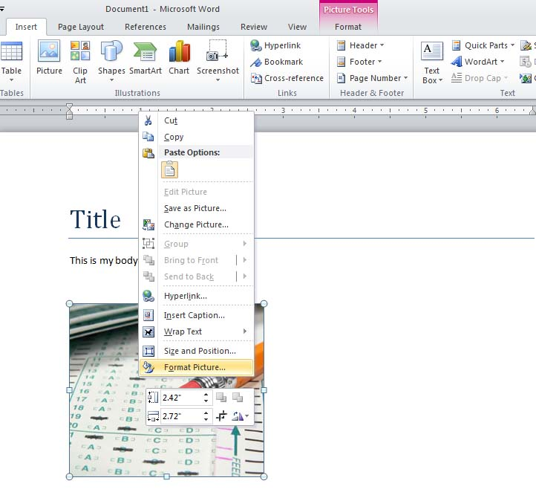
Alt Tags On Images
How to do it
First insert your image into Word.
Then right click your image and select format picture from the drop down menu.

Slide 8
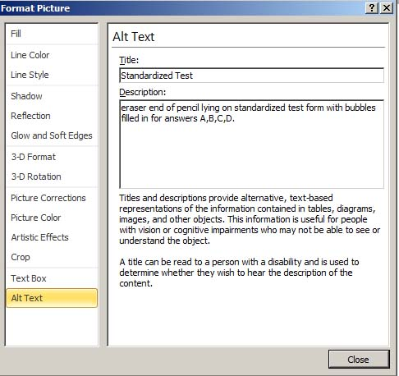
Alt Tags On Images
How to do it
Select Alt Text from the left menu
Type in a title and a detailed description

Slide 9
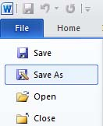
Save As PDF
How to do it
Select file
Save as from the drop down menu

Slide 10
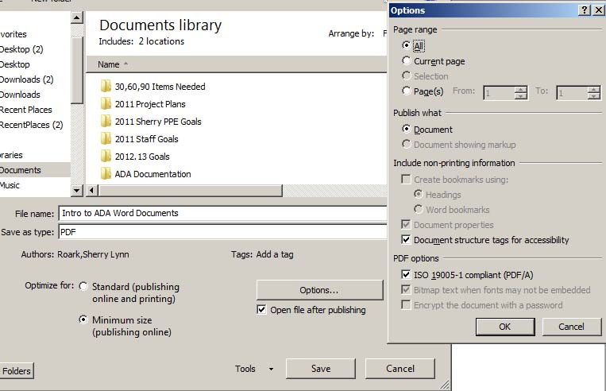
Save As PDF
How to do it
Select Options
Under Options: Select document structure tags for accessibility and ISO 19005-1 compliant
Press OK

Slide 11
What To Do
Make PDF Files Compliant
Full Version of Adobe Acrobat
Use the iTech Media Lab Computers West Wing Strickler Hall Basement
Purchase Acrobat from iTech Xpress $126.50
Run accessibility full check of pdf document
Fix identified issues provided by scan

Slide 12
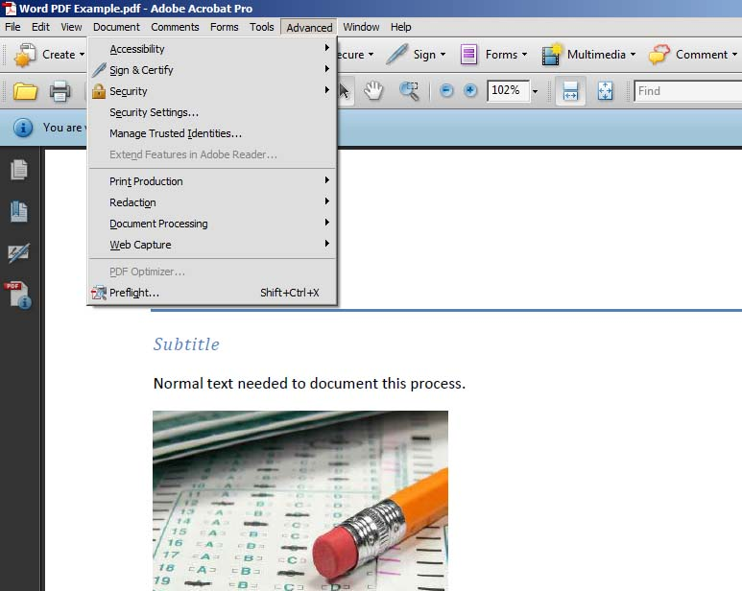
Run Accessibility Full Check
How to do it
Open Your PDF File
Select Advanced From The Top Menu

Slide 13
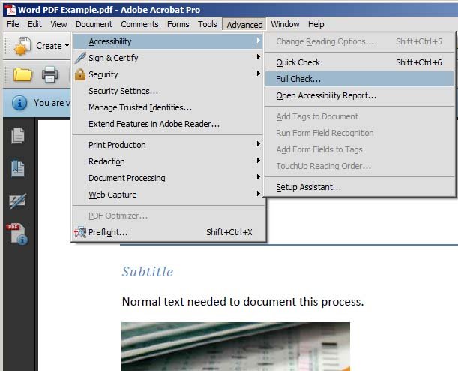
Run Accessibility Full Check
How to do it
Under Accessibility
Choose Run Full Check

Slide 14
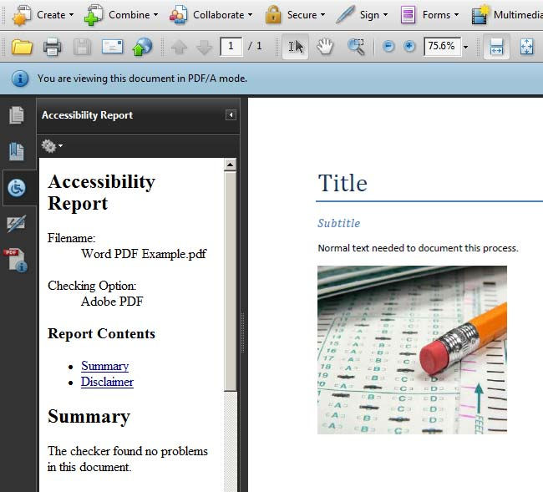
Report Of Issues Found
How to do it
Accessibility Report Will Outline Any Issues With How To Fix Issues Found.
Every PDF File Will Have Different Issues.

Slide 15
What To Do
Make PowerPoint Compliant
Define Text (self explanatory – add text)
Title
Headings
Subtitle
Body Text
Images need “alt tags”
Don’t use an image if it doesn’t add value

Slide 16
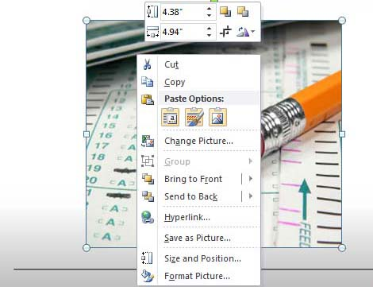
Put Alt Tags On Images
How to do it
Right Click Your Image
Select Format Picture On Bottom Menu

Slide 17
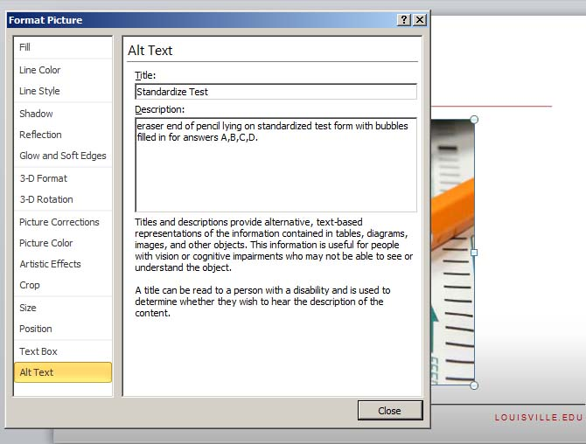
Right Click Your Image
How to do it
Select Alt Text From Menu
Add Title
Add Description

Slide 18
What To Do
Make Your Video Compliant
Text transcript of the visual and audio information
This is a tedious task. Many people have student workers do this task for them.
Caption video is more difficult and will be available with our Flash video system for websites.

Slide 19
Tips and Tricks
Keep It Simple
If you have difficulty making something
create two versions of your information. One for a sighted individual and one for ADA Compliance.
Create a text ONLY version of the material.
Take out images if the description has no meaning.

Slide 20
Things You Need To Know
Other Useful Information
Don’t use the color red or pale blue for text (in text, PP and other docs)
Don’t rely on color alone to transmit information
As eyes age, the first color that people notice a degradation in sight with is pale blue
Use colors that contrast
Remember people who are color blind will see things differently
Not relying on color doesn't mean you can't use it; it just means that if you do use color, make sure the document, including any images, still makes sense even if you couldn't see the colors.

Slide 21
Things You Need To Know
Other Useful Information
Use of flashing screens and items
This is known to trigger epileptic seizures in photosensitive individuals
Excessive downloads, plug-ins or mouse clicks
Downloads or plug-ins causes added work and stress on the user. Use them only when necessary.
If you must use them for instance when providing PDFs provide a link to the needed plug-in or download
Mouse clicks should be limited. Use the 3 maximum rule

Slide 22
Things You Need To Know
Other Useful Information
Don’t use the words “click here”
Design with Accessibility In Mind (AIM) on the front end

Slide 23
Who To Talk To
Need Help
Disability Resource Center Stevenson Hall, Room 119
IT Next Gen Media Lab West Wing, Strickler Hall Basement Email: Sherry.Roark@louisville.edu

Slide 24
IT NEXT GEN SERVICES
One Team. Many Solutions.

