Slide 1
communication is a 4 letter word--TALK
Communication For Today’s Professional

Slide 2
Program Model
1
Basic
Communi-
cation
7
2
Time
Management
Giving &
Receiving
Feedback
6
Teamwork
Skills
3
Conflict
Resolution
Group
Dynamics
5
4
Team
Problem
Solving
Team
Decision
Making
Career Builder - Module 3: Face-To-Face #1
© 360 Solutions L.L.C./The Center for Organizational Design

Slide 3
Worksmart, LLC
Founded in 2002
Lexington based business consulting firm specializing in:
Employee and organizational assessments
Diversity and Inclusion management and training, leadership and teambuilding
Corporate Coaching

Slide 4
What You Will Learn
Can We Talk?—basics of face to face communication
Before We Talk—listening skills
How We Talk—communication styles
Straight Talk—open and honest communication
Career Builder - Module 3: Face-To-Face #2
© 360 Solutions L.L.C./The Center for Organizational Design

Slide 5
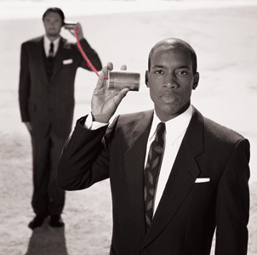
I. CAN WE TALK?

Slide 6
What is Communication?
Work with the person sitting next to you to come up with a good definition of communication.

Slide 7
What Happens?
What happens to a relationship or work environment when communication is not good?
What happens when communication is great?

Slide 8
Perception
DEFINITION:
Perception is the viewpoint from which one mentally recognizes, grasps, or comprehends an idea or event.
Career Builder - Module 3: Face-To-Face #3
© 360 Solutions L.L.C./The Center for Organizational Design

Slide 9
About Perception
“…We tend to see ourselves primarily in the light of our intentions, which are invisible to others, while we see others mainly in light of their actions, which are visible to us; we have a situation in which misunderstanding and injustice are the order of the day.”
E. F. Schumacher
A Guide for the Perplexed
Career Builder - Module 3: Face-To-Face #4
© 360 Solutions L.L.C./The Center for Organizational Design

Slide 10
Perception Key Points
We do not always “see” the same things, although we think we do.
Two people can view the same event and draw different conclusions.
We are “set up” to have different perceptions (because of differences in past experience, culture, values, etc.).
It is important to understand that another person can perceive something differently than you do and still be right.
Career Builder - Module 3: Face-To-Face #5
© 360 Solutions L.L.C./The Center for Organizational Design

Slide 11
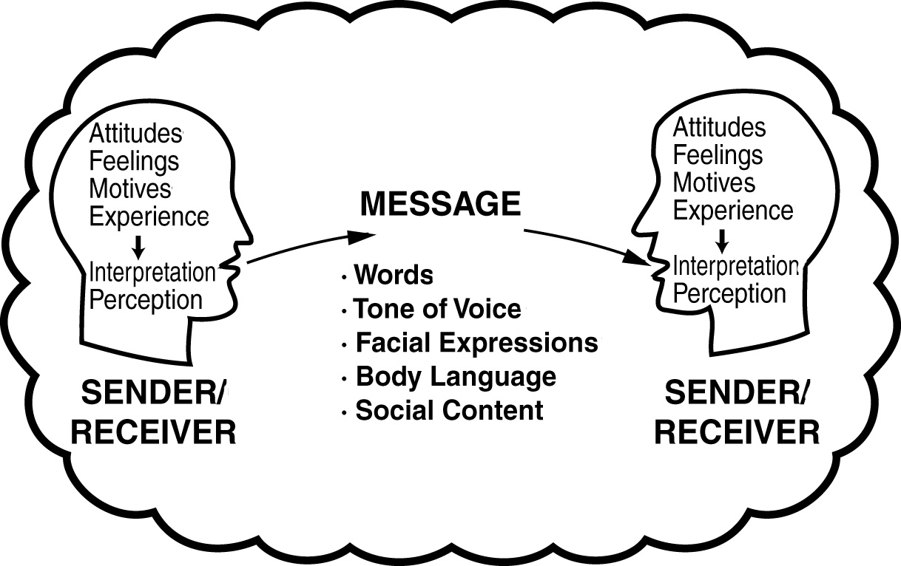
Face-to-face Communications (A)
Career Builder - Module 3: Face-To-Face #6
© 360 Solutions L.L.C./The Center for Organizational Design

Slide 12
Face-to-face Communications (B)
There are a lot of things going on in communication. It is a complex process.
It is difficult to put our internal perceptions, feelings, motives, etc. into meaning and words.
We often misunderstand messages from others because we interpret them through the filter of our own attitudes, feelings, motives, and experiences.
Nonverbal behaviors may communicate a different message than visual behaviors or words. This can be a source of mixed messages.
It is not easy to communicate effectively. It takes both effort and attention.
Career Builder - Module 3: Face-To-Face #7
© 360 Solutions L.L.C./The Center for Organizational Design

Slide 13
Your Reflections
Make notes on what you learned in this section of the workshop:

Slide 14
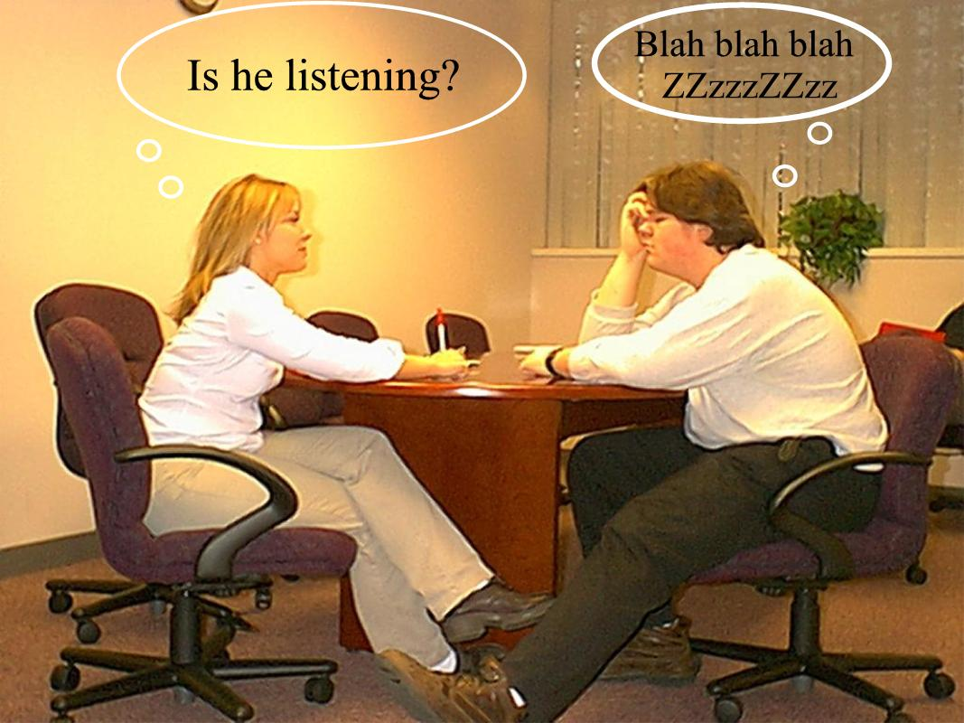
II. BEFORE WE TALK

Slide 15
Your Examples:
Good Listening Skills
Bad Listening Skills

Slide 16
What is Listening?
DEFINITION:
Listening is the ability to accurately perceive a message conveyed by another person.
It is far more than the exchange of information.
It is effectively used to create a “safe place” for others to explore their inner feelings.
It builds confidence and trust in relationships.
Career Builder - Module 3: Face-To-Face #8
© 360 Solutions L.L.C./The Center for Organizational Design

Slide 17
Active Listening Steps (A)
1. Create a Safe Place
• draw the other person out
• use door openers: “could you explain,” or “tell me more”
• be acknowledging: “I see,” “yes,” “go on”
2. Become Actively Involved
• focus your complete attention on the speaker
• make eye contact
• smile genuinely
• maintain open, relaxed posture
• sit or stand squarely
• lean forward
• avoid physical barriers
• tune out distractions
3. Avoid the Temptation to Evaluate
• don’t judge
• don’t criticize
Career Builder - Module 3: Face-To-Face #9
© 360 Solutions L.L.C./The Center for Organizational Design

Slide 18
Active Listening Steps (B)
4. Search for Meaning
• decode the message
• perceive speaker’s feelings
• discover the real message
5. Confirm Your Understanding
• acknowledge
• restate
• paraphrase
6. Bring Closure
• summarize
• state your position (if appropriate)
• agree on actions to be taken (as necessary)
Career Builder - Module 3: Face-To-Face #10
© 360 Solutions L.L.C./The Center for Organizational Design

Slide 19
Active Listening Worksheet
EXAMPLE
Employee Says: Possible Feelings: Response:
1. “I have too much unscheduled work. I can never get it all done.”
• anxious
• feels behind the 8-ball
• overwhelmed
• under a lot of pressure
“So you are having a tough time reacting to last-minute changes?”
Career Builder - Module 3: Face-To-Face #11
© 360 Solutions L.L.C./The Center for Organizational Design

Slide 20
Your Reflections
Make notes on what you learned in this section of the workshop:

Slide 21
III. HOW WE TALK

Slide 22
HOW WE TALK
Four communication styles:
Passive
Aggressive
Passive Aggressive
Assertive

Slide 23
Passive Style
The passive communicator avoids confrontation at all costs; never says what’s on his/her mind and puts their needs last in a desire to be liked or accepted by others.

Slide 24
Aggressive Style
The aggressive communicator shows no respect for others. His/her goal is to dominate, control and discount other people’s feelings. They use hurt, guilt and anger to manipulate others.

Slide 25
Passive Aggressive
The passive aggressive communicator avoids face to face contact; is deceitful and dishonest; wants to teach someone a lesson; gossips and talks behind people’s back. Passive aggressive communicators destroy the team environment.

Slide 26
Assertive
Assertive communicators rely on honesty, openness and a sense of responsibility for a positive outcome; have a high regard for themselves and a high regard for others.

Slide 27
Your Reflections
Make notes on what you learned in this section:

Slide 28
IV. STRAIGHT TALK

Slide 29
Exercise: Make a list of Expectations from Management and Staff. Share with those sitting at your table.
Management
Staff

Slide 30
Clear Expectations from Management
Vision
Objectives
Mission
Objectives
Creating a trusting culture
Daily Feedback
Timely performance reviews
Clear job descriptions
Clear roles
Departmental Meetings
Keeping staff informed
Coaching and Mentoring staff
Respect
Growth opportunities

Slide 31
Clear Expectations from Staff
Communicate openly and assertively with co workers and managers
Speak up in meetings and express your opinions
Respect your manager and co-workers
Deliver great customer service to clients
Find new and better ways to do things
Keep management abreast of any problems
Solve problems with other co-workers
Ask for growth opportunities
Look to lead

Slide 32
Summary
“We see the world not as it is, but as we are”--our perceptions are different.
Face to face communication is complicated. It requires good effort and attention.
Active listening skills allows us to search for meaning and bring closure to our conversations.

Slide 33
Summary
We generally use one of four communication styles—passive, aggressive, passive aggressive and assertive.
Open and honest communication is only possible when we choose to use an assertive communication style.

Slide 34
Key Learnings
I will do the following to improve my communication skills:

Slide 35
Key Learnings
I will improve my active listening with others by:

Slide 36
Thank You For Coming!!
Worksmart, LLC
1450 N. Broadway
Lexington, KY 40505
859-977-0121
Worksmart, LLC www.worksmartky.com
mclark@worksmartky.com

