Slide 1
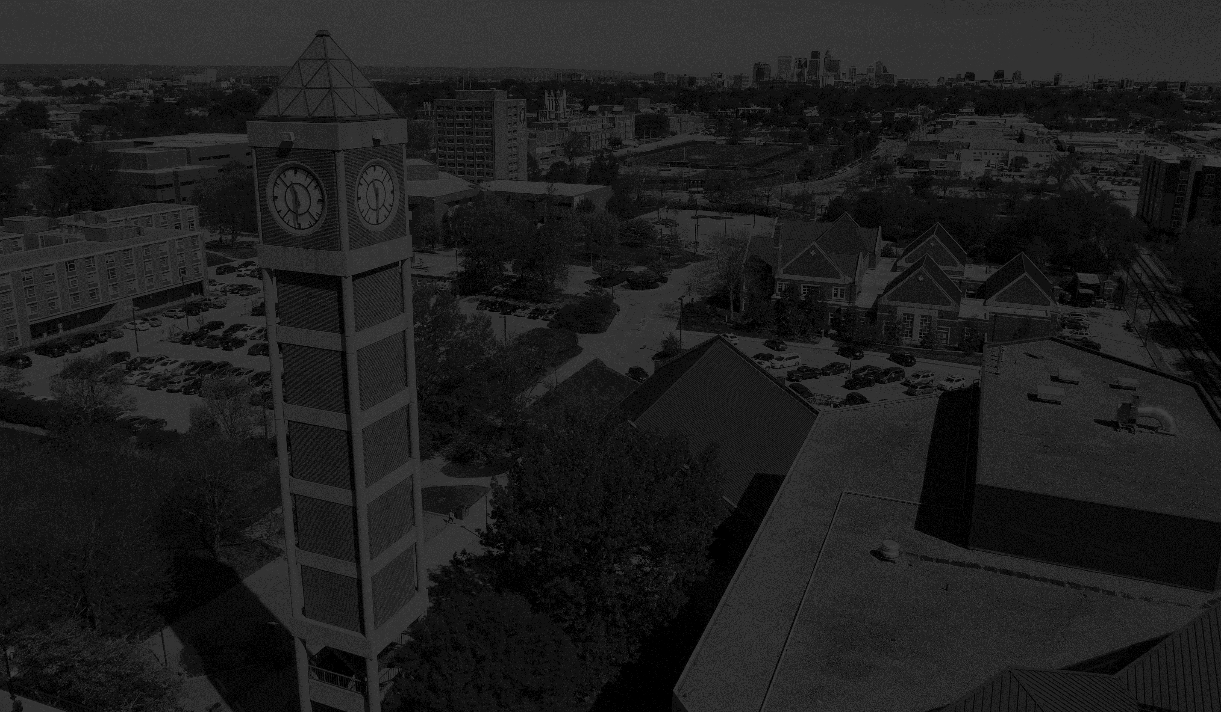

Welcome to
New Trustee Orientation
July 15, 2021

Slide 2
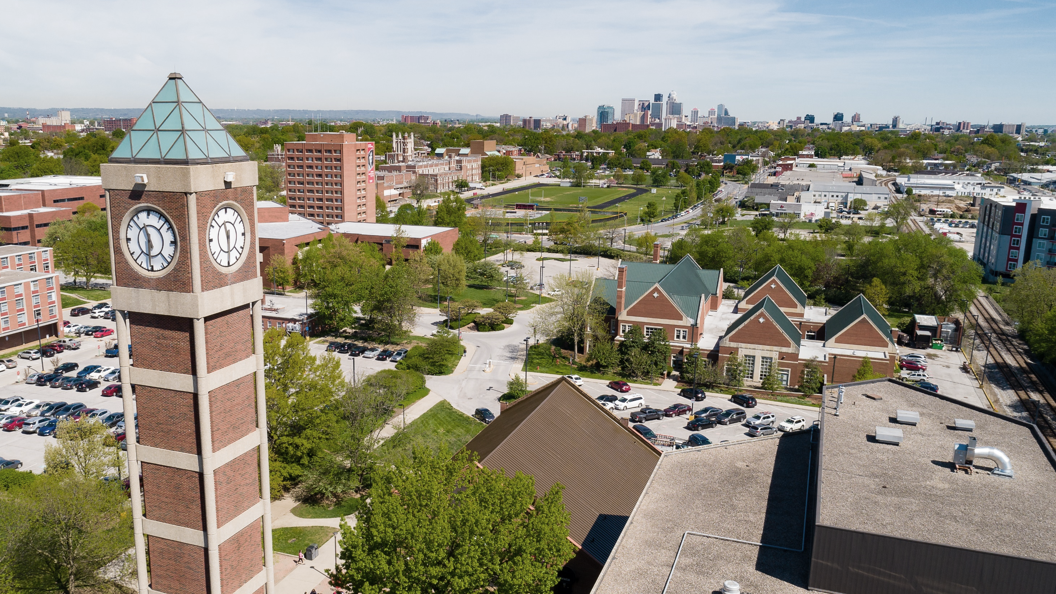
Welcome to
New Trustee Orientation
Oath of Office
I do solemnly swear that I will support the Constitution of the United States and the Constitution of this Commonwealth,
And be faithful and true to the Commonwealth of Kentucky so long as I continue as a citizen thereof,
And that I will faithfully execute, to the best of my ability, the office of Trustee of the University of Louisville according to law;
And I do further solemnly swear that, since the adoption of the present Constitution, I, being a citizen of this State, have not fought a duel with deadly weapons within this State, nor out of it,
Nor have I sent or accepted a challenge to fight a duel with deadly weapons, nor have I acted as second in carrying a challenge, nor aided or assisted any person thus offending, so help me God.

Slide 3


Slide 4
Welcome new and current trustees!

Slide 5
Welcome new and current trustees!
Brief Overview of the University
Membership and Powers of the Board
Fiduciary Responsibilities
Shared Governance
Administration and Operations
Policies and Procedures
Affiliated Organizations
Questions and Answers
Notes:
Introductions of host and participants – Pronouns are the words you may like others to use for you in place of your proper name. For example “she/her”.

Slide 6
Welcome new and current trustees!
Brief Overview of the University
Membership and Powers of the Board
Fiduciary Responsibilities
Shared Governance
Administration and Operations
Policies and Procedures
Affiliated Organizations
Questions and Answers
Notes:
Introductions of host and participants – Pronouns are the words you may like others to use for you in place of your proper name. For example “she/her”.

Slide 7
Dr. Neeli Bendapudi, UofL President

Slide 8
VISION
The University of Louisville will be recognized as a great place to learn, a great place to work and a great place in which to invest because we celebrate diversity, foster equity and strive for inclusion.

Slide 9
The University of Louisville pursues excellence and inclusiveness in its work to educate and serve its community through:
teaching diverse undergraduate, graduate, and professional students in order to develop engaged citizens, leaders, and scholars,
practicing and applying research, scholarship and creative activity, and
providing engaged service and outreach that improve the quality of life for local and global communities.
The University is committed to achieving preeminence as a nationally recognized metropolitan research university.
MISSION

Slide 10
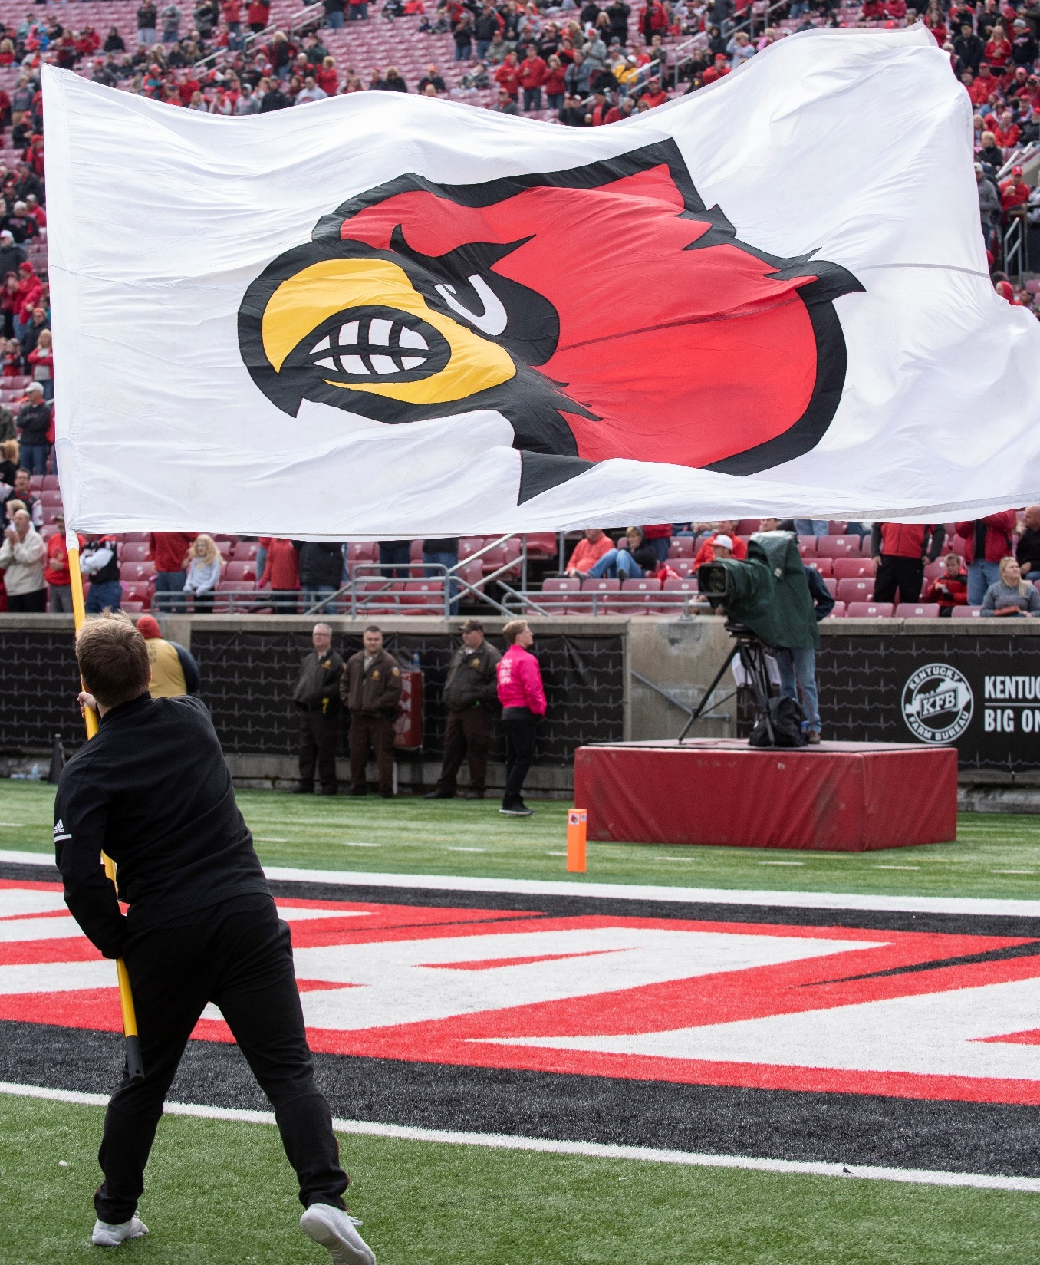
Quick facts
Premier metropolitan anti-racist research university
Home of the Louisville Cardinals
Member of the ACC conference
Over 23,000 students
Approximately 7,000 employees
Carnegie Classifications: Research 1 and Community Engagement

Slide 11
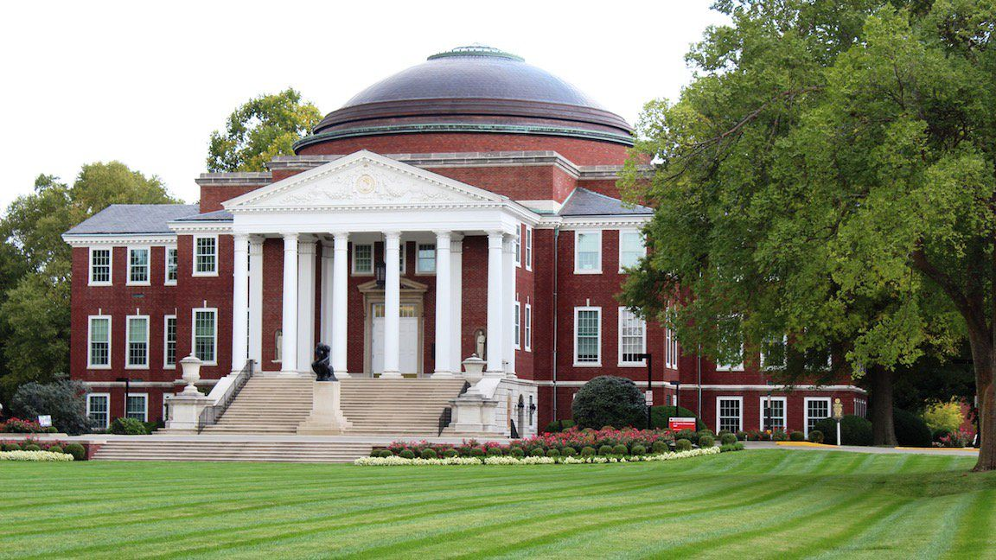
Quick facts
Three campuses across Louisville
Endowment of $707 million (FY 2020)
Operating budget of $1.2 billion
$169,501,528 in grant and contract awards
More than 159,000 alumni
Established in 1798

Slide 12
Points of Pride
PRIDE
Recognized multiple times as one of the most LGBT-welcoming in the country, and the highest ranked public university in the South
(Campus Pride)
Innovative ongoing COVID-19 research
The first successful hand transplantation in the United States
Recipient of “Tree Campus USA” designation
(Arbor Day Foundation)
Fulbright Scholarships
more than 140 UofL alums will have received Fulbright’s since 2003–more than all other Kentucky public institutions combined.
Recognized as one of only three universities among top universities in the United States that provides equal access to both Black and Latinx students
(Education Trust)

Slide 13
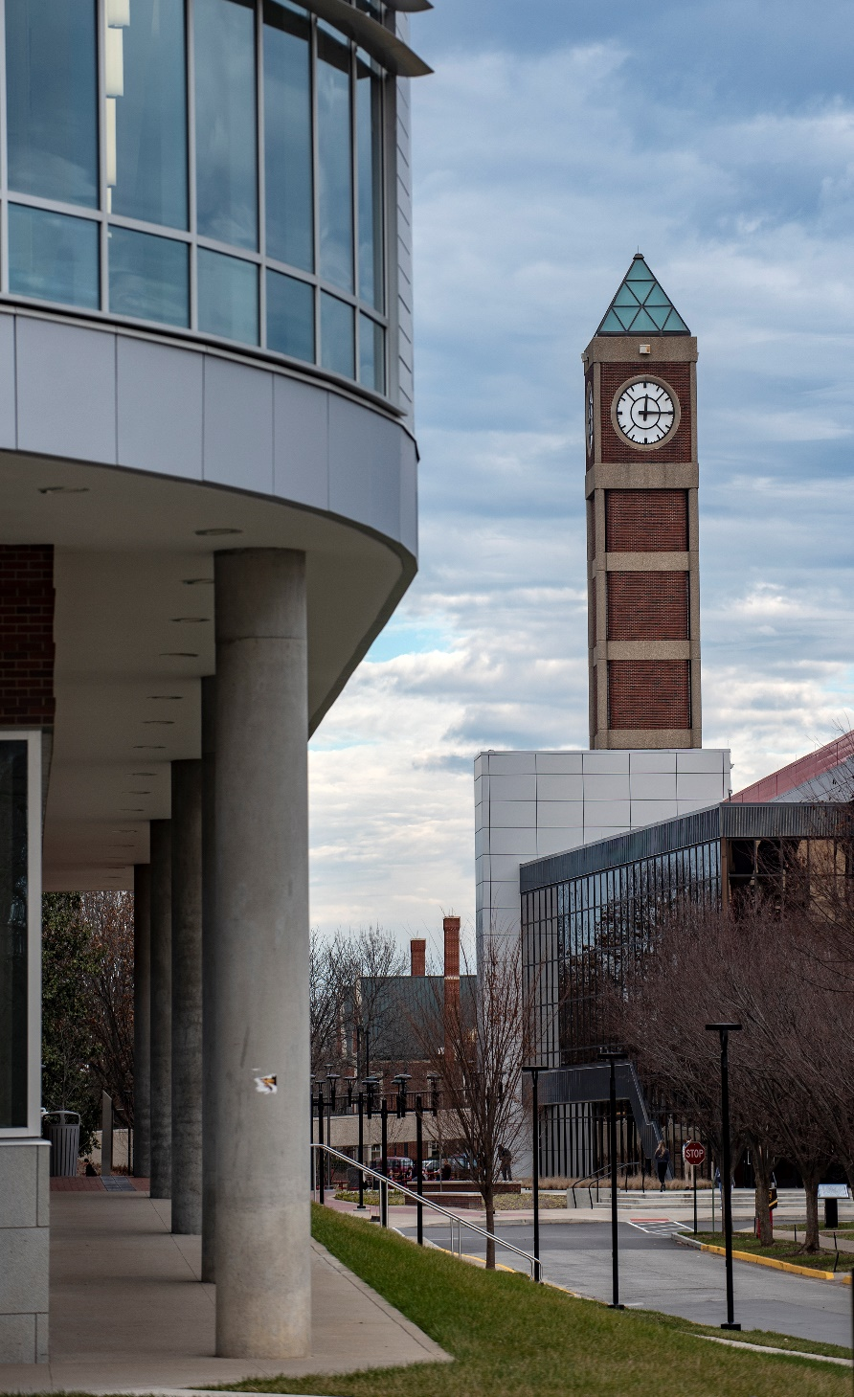
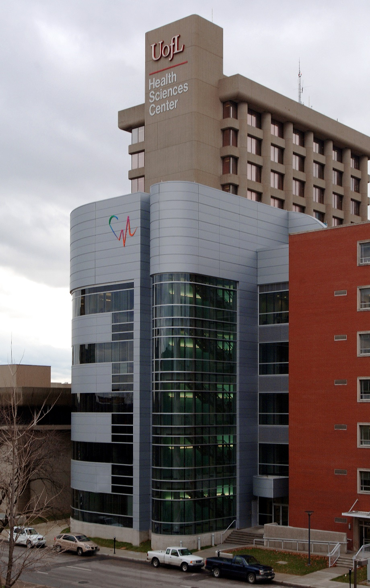
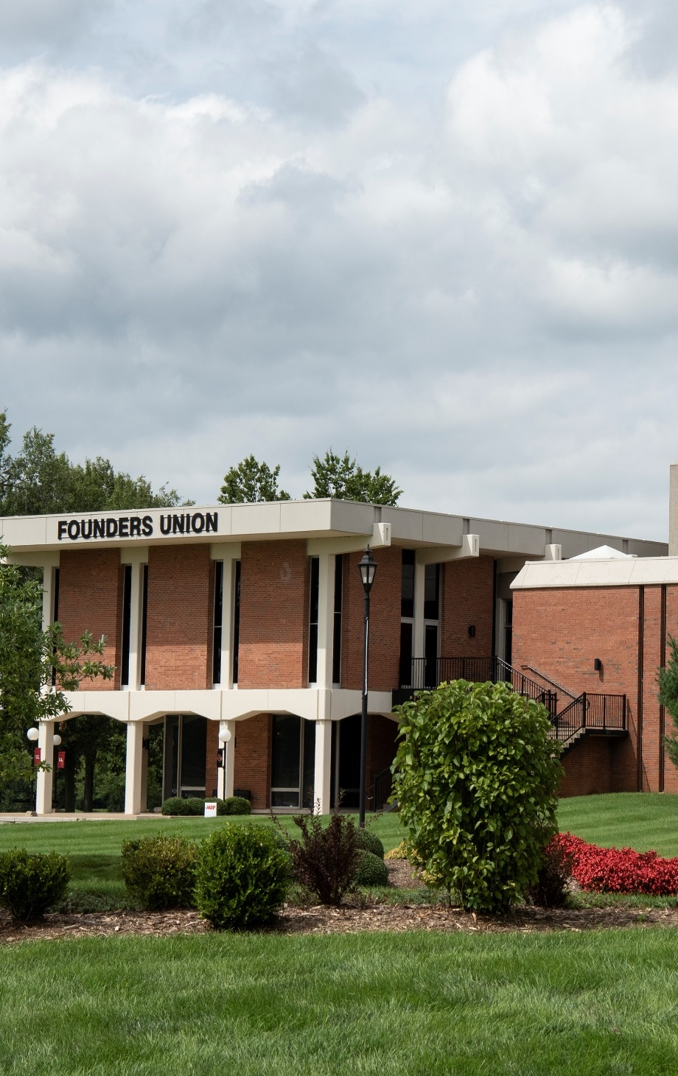
BELKNAP
HEALTH SCIENCES
SHELBYHURST
Notes:
Type in the chat which campus you are working on, if you know.

Slide 14
C A R D I N A L
Principles
The university follows a set of guiding principles that shape our community and our actions. Every member of the University of Louisville family is expected to follow these Cardinal Principles.

Slide 15
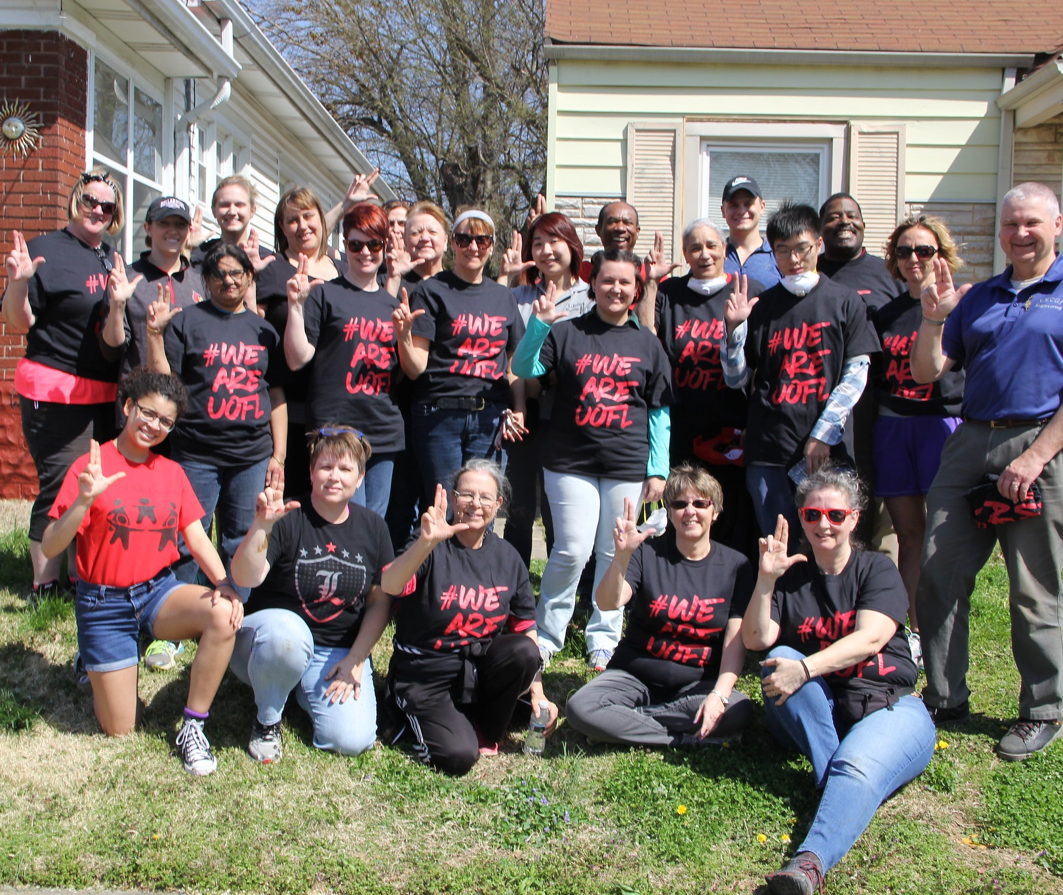
C ommunity of Care
Care for self, care for one another as the Cardinal Family and care for the community beyond.
We are a community – not just a collection of individuals.
We are a community – not just buildings connected by an HVAC system.

Slide 16
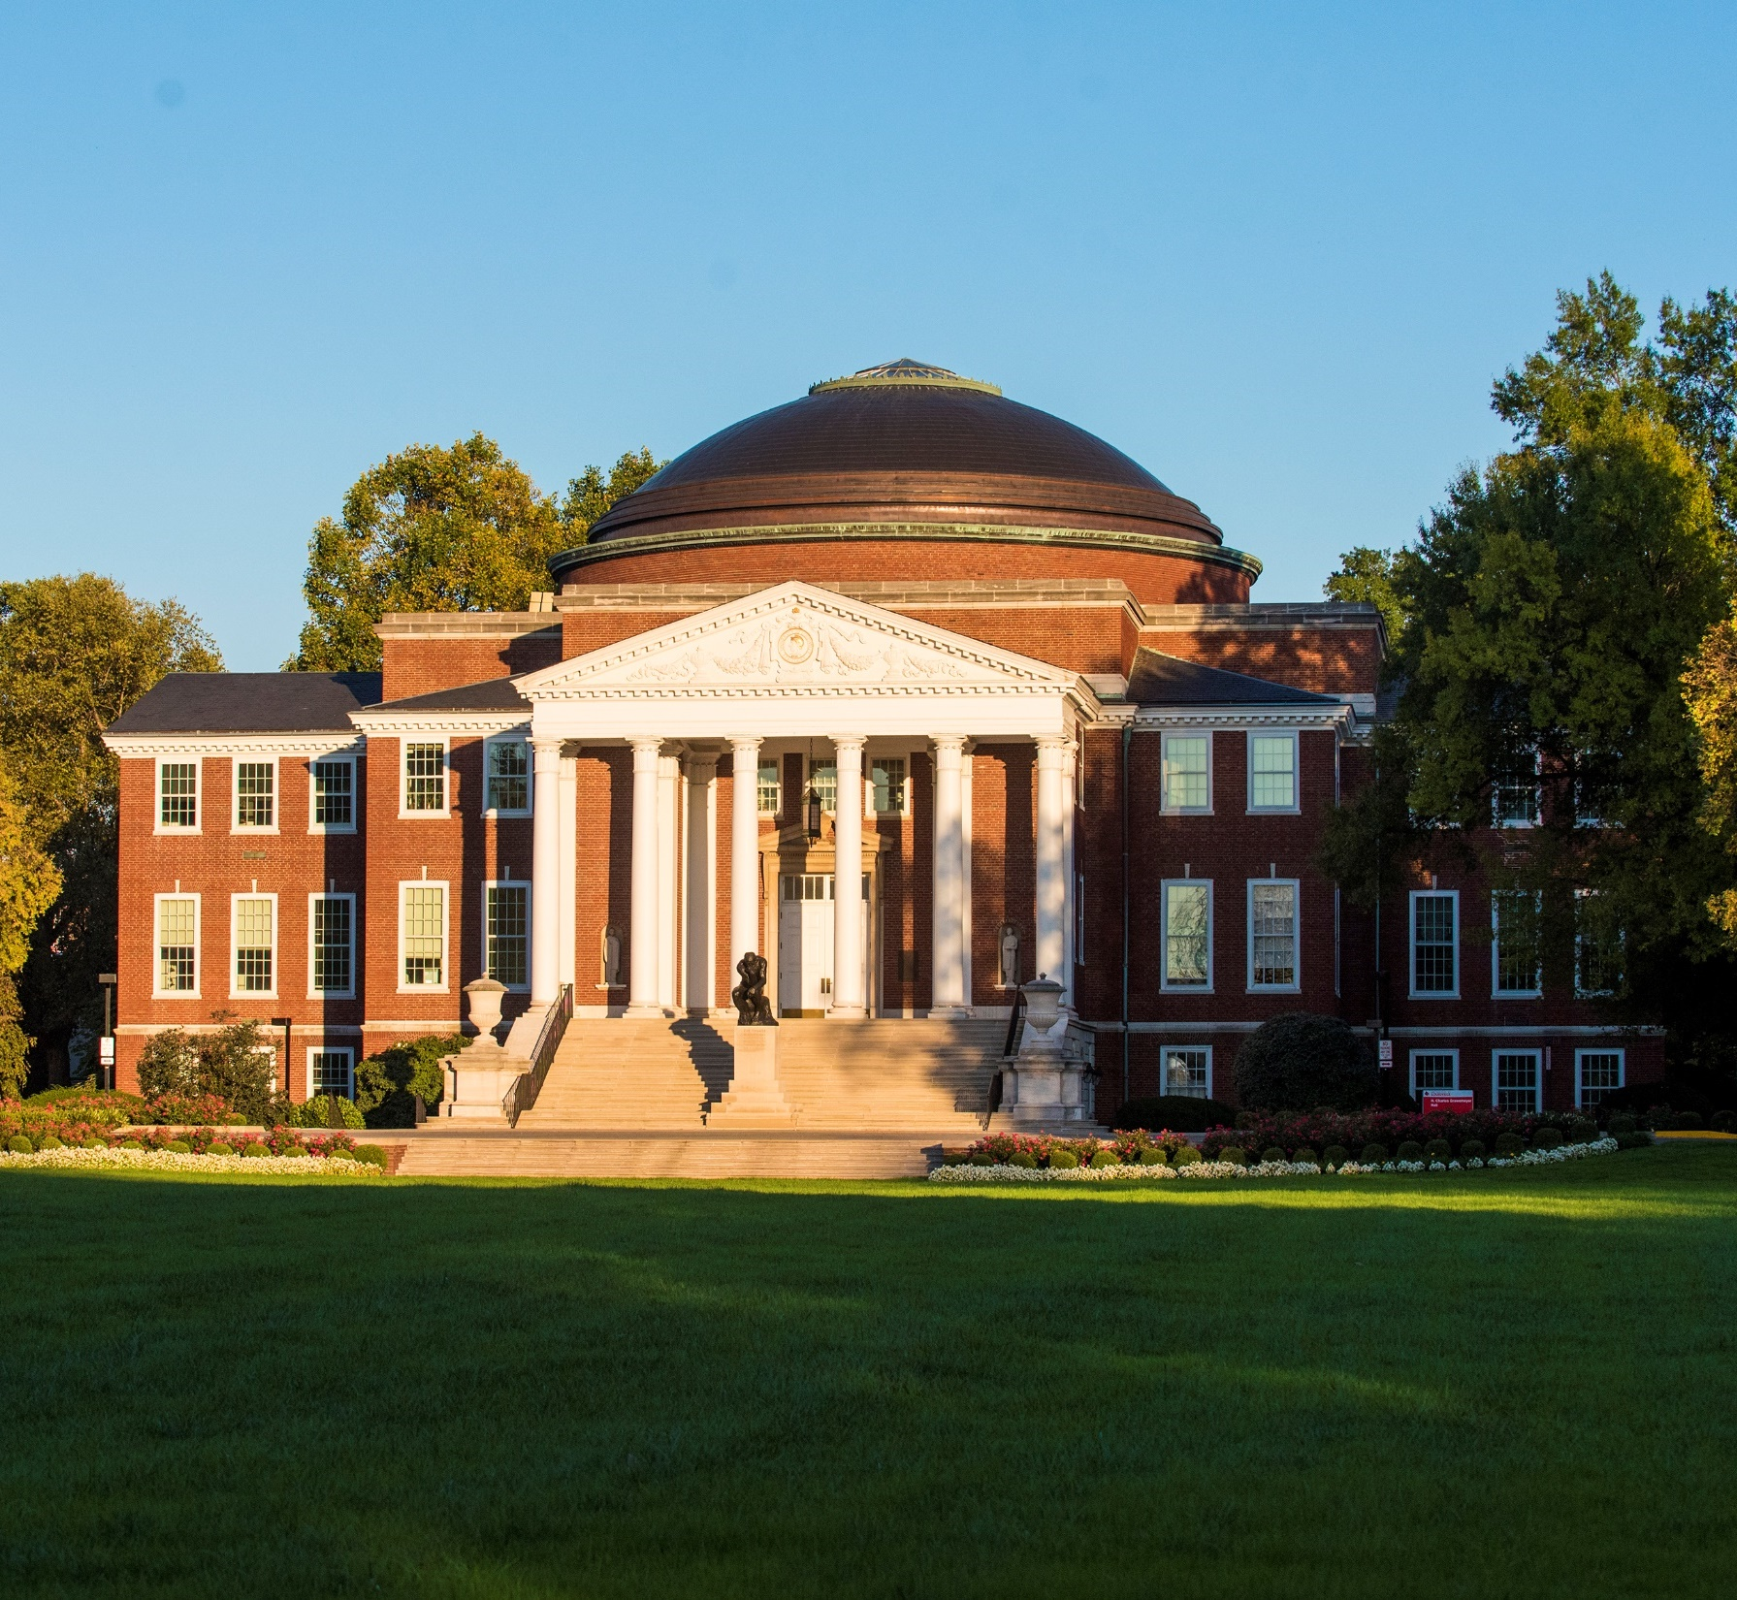
Accountability
We keep our promises.
We own mistakes.
We are accountable to the team.

Slide 17
Respect
Irrespective of position.
We respect each other’s humanity and dignity, no matter what our positions in the organization are.
We also respect our right to differing and conflicting positions on issues.
We will be a place that prepares students for ideas, not protects students from ideas.

Slide 18

Diversity and Inclusion
We celebrate diversity of thought, perspectives and life experiences.
As our state motto declares: United We Stand, Divided We Fall.
We want everyone, in the richness of all of their many unique and intersecting identities to feel included in the Cardinal fold.
* New Cultural Center on Belknap Campus currently under construction.

Slide 19
Integrity and Transparency
We will be true to our mission of an urban research university to create, disseminate and apply knowledge.
Integrity is our collective commitment to make decisions with the best interests of our university in mind and to share the decision making rationale and the outcomes.

Slide 20
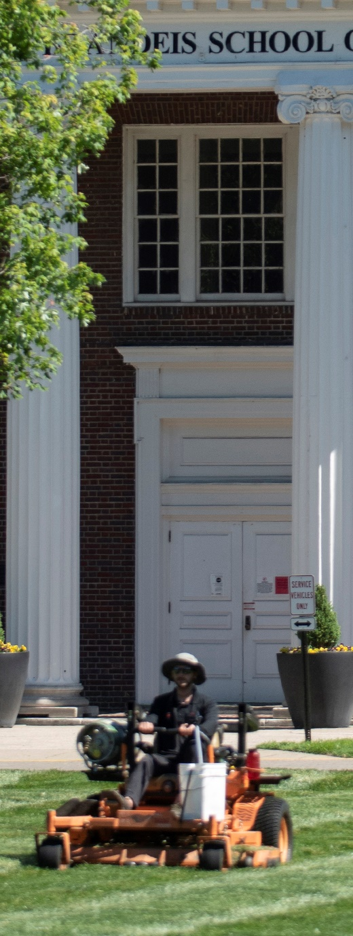


Noble Purpose
Each of us will identify for ourselves the way in which we make a difference.
We know we must solve the problems of access and affordability to give everyone the opportunity to find and pursue their own noble purpose.

Slide 21
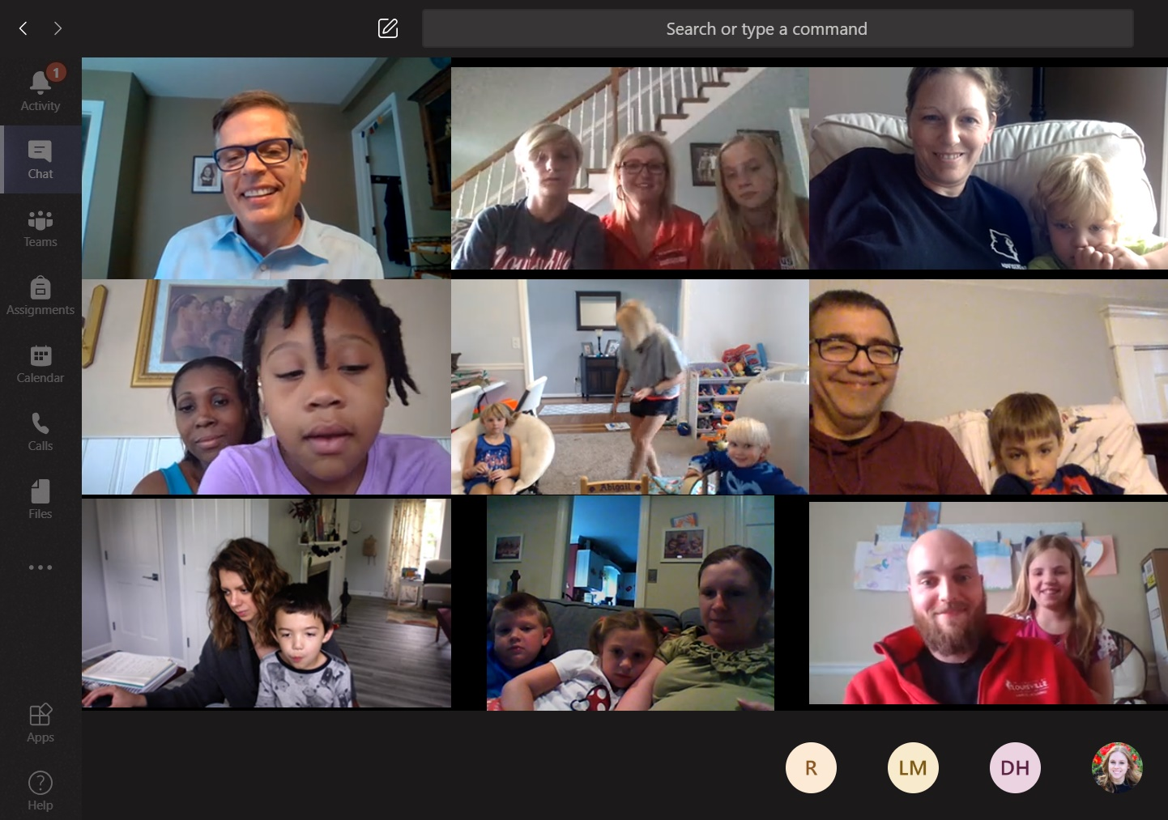
Agility
We will recognize that things change and when they do, we must change things.
We know that when adaptation in an organization does not keep pace with adaptation in the environment, the organization will not survive.
* Cardinal Kids Summer Reading Program

Slide 22
Leadership
We recognize that management is a position but leadership is an activity.
We will all behave as owners of the University of Louisville because we are.
“We are UofL” is not just a hashtag or a slogan. It is our declaration of leadership and ownership.

Slide 23
Statement on Diversity in the University Community
DIVERSITY
The University of Louisville strives to foster and sustain an environment of inclusiveness that empowers us all to achieve our highest potential without fear of prejudice or bias.
We commit ourselves to building an exemplary educational community that offers a nurturing and challenging intellectual climate, a respect for the spectrum of human diversity, and a genuine understanding of the many differences-including race, ethnicity, gender, socio-economic status, national origin, sexual orientation, disability, religion, diversity of thought and political ideology-that enrich a vibrant metropolitan research university.
We expect every member of our academic family to embrace the underlying values of this vision and to demonstrate a strong commitment to attracting, retaining, and supporting students, faculty, and staff who reflect the diversity of our larger society.

Slide 24
Presidential Commissions
Commission on the Status of Women (COSW)
Commission on Diversity and Racial Equality (CODRE)
Notes:
These presidential commissions advice the president of these issues. For example, you may have recently seen in the news that Dr. Bendapudi recently kicked off of the Cardinal Anti-Racism Agenda, which will guide us in becoming the premier anti-racist metropolitan research university in the country. She worked with CODRE to come up with this plan.

Slide 25


COSW
Vision: the University of Louisville offers institutional support so that each woman can achieve her goals. Diverse women are at every table, at every level, influencing ever endeavor undertaken at UofL.

Slide 26

CODRE
The University of Louisville seeks to promote and maintain an inclusive environment that allows us to reach our full potential without fear of prejudice or bias.
We are committed to building an exemplary educational community that offers a rigorous and cultivating intellectual climate that respects human diversity and has a deep understanding of the many differences that enrich a vibrant metropolitan research university.
The University of Louisville embodies the core values of this vision and demonstrates strong commitment to attract, retain and support students, teachers and employees who represent the diversity of our society.

Slide 27
Welcome new and current trustees!
Brief Overview of the University
Membership and Powers of the Board
Fiduciary Responsibilities
Shared Governance
Administration and Operations
Policies and Procedures
Affiliated Organizations
Questions and Answers
Notes:
Introductions of host and participants – Pronouns are the words you may like others to use for you in place of your proper name. For example “she/her”.

Slide 28
Welcome new and current trustees!
Brief Overview of the University
Membership and Powers of the Board
Fiduciary Responsibilities
Shared Governance
Administration and Operations
Policies and Procedures
Affiliated Organizations
Questions and Answers
Notes:
Introductions of host and participants – Pronouns are the words you may like others to use for you in place of your proper name. For example “she/her”.

Slide 29
KRS 164.821 Membership
The government of the University of Louisville is vested in a board of trustees appointed for a term set by law pursuant to Section 23 of the Constitution of Kentucky. The board shall consist of ten (10) members appointed by the Governor, at least one (1) of whom shall be a graduate of the university; one (1) member of the teaching faculty of the University of Louisville who shall be the chief executive of the ranking unit of faculty government; one (1) member of the permanent staff of the University of Louisville who shall be the chief executive of the staff senate; and one (1) student member who shall be the president of the student body during the appropriate academic year. The members appointed by the Governor shall be subject to confirmation by the Senate.

Slide 30
KRS 164.821
The student member shall serve a one (1) year term beginning on July 1 after being elected and sworn in as student body president and ending on the following June 30.
The faculty member and staff member shall serve one (1) year terms and cease to be eligible for membership on the board of trustees upon termination of their respective relationships with, or leadership positions within, the university.
The gubernatorial appointments shall serve a term of six (6) years and until their successors are appointed and qualified.

Slide 31
KRS 164.821
The Governor shall make his at-large appointments so as to divide the appointed representation upon the board to reflect:
    The proportional representation of the two (2) leading political parties in the Commonwealth based on the state's voter registration and the political affiliation of each appointee as of December 31 of the year preceding the date of his or her appointment; and
    No less than the proportional representation of the minority racial composition of the Commonwealth based on the total minority racial population using the most recent census or estimate data from the United States Census Bureau.

Slide 32
KRS 164.830 Powers
The board of trustees of the University of Louisville shall constitute a body corporate, with the usual corporate powers, and shall possess all the authorities, immunities, rights, privileges, and franchises usually attaching to the governing bodies of Kentucky public higher educational institutions. A majority of the voting members of the board shall constitute a quorum for the transaction of business. Powers of the board shall include the following:
  Appointment of a president, all faculty members, and other personnel and determination of the compensation, duties, and official relations of each. No relative of a board of trustee member shall be employed by the university.
  Suspension or removal of the president, officers, faculty,
  or agents, or other personnel that it is authorized to appoint.

Slide 33
KRS 164.830 Powers
  Election of a chairperson, a vice chairperson, and other officers including the annual election of a six (6) member executive committee.
  Receipt, retention, and administration of all revenues accruing from endowments, appropriations, allotments, grants or bequests, and all types of property.
  Requirement of reports from the president, officers, faculty, and employees as it deems necessary and proper from time to time.
  Granting degrees to graduates of the university and conferment of honorary degrees.
  Evaluate the institution's progress in implementing its missions, goals, and objectives to conform to the strategic agenda.
  Adoption of bylaws

Slide 34
BYLAWS
Article 1: Offices
Article 2: The Board of Trustees
    General Powers
    Meetings
    Notice of Meetings
    Quorum
    Organization of Meetings
    Executive Sessions
    Selection/Evaluation of President
    Roll Call Vote
    Committees
    Rules of Order
Article 3: Removal of Board of Trustees
    Individual Members
    Proportional Rep. Requirement
    Entire Membership
Article 4: Officers
Article 5: Miscellaneous Provisions
    Conflict of Interest
    Diplomas, Degrees, & Certificates
Article 6: Amendment of Bylaws
http://louisville.edu/president/boards/board-of-trustees/governance/bylaws

Slide 35
Welcome new and current trustees!
Brief Overview of the University
Membership and Powers of the Board
Fiduciary Responsibilities
Shared Governance
Administration and Operations
Policies and Procedures
Affiliated Organizations
Questions and Answers

Slide 36
Welcome new and current trustees!
Brief Overview of the University
Membership and Powers of the Board
Fiduciary Responsibilities
Shared Governance
Administration and Operations
Policies and Procedures
Affiliated Organizations
Questions and Answers

Slide 37
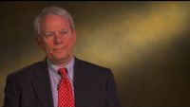
Your Role as a Fiduciary

Slide 38

As a Fiduciary, you have a duty:
Duty of care: You come to meetings prepared and engaged, and act reasonably and prudently according to the information you have.
Duty of loyalty: You put the university’s needs above your President’s or your own. You are not self-dealing and have no conflicts of interest that interfere with your board role.
Duty of obedience: You act in an ethical manner that aligns with your university’s mission.
Important to remember:
Act as a board upon properly adopted resolutions, not as individuals.

Slide 39
Welcome new and current trustees!
Brief Overview of the University
Membership and Powers of the Board
Fiduciary Responsibilities
Shared Governance
Administration and Operations
Policies and Procedures
Affiliated Organizations
Questions and Answers

Slide 40
Welcome new and current trustees!
Brief Overview of the University
Membership and Powers of the Board
Fiduciary Responsibilities
Shared Governance
Administration and Operations
Policies and Procedures
Affiliated Organizations
Questions and Answers

Slide 41
Staff Senate
Faculty Senate
Student Government Association

Slide 42
SHARED
One of higher education’s most distinctive values is its commitment to shared governance. It is a fundamental principle of inclusion in key areas of institutional responsibility and decision making.
GOVERNANCE
The University has many constituents: students, parents, faculty, staff, alumni, patients, state and local government, business partners, community partners, and citizens of the Commonwealth.

Slide 43
Core Principles
CORE PRINCIPLES
Accountability
Regular communication and shared data – creating a culture of evidence
Transparency
Disclosure

Slide 44
Core Principles
CORE PRINCIPLES
Recognition of and respect for the many and varied roles that members of the academic community perform.
Timely disclosure of information needed to participate meaningfully in the discourse that makes good policy and practice.
Opportunities for members of the academic community to provide input for decisions that will affect them before decisions are made.
Respect for the principle of dissent - it is imperative that dissent from the majority view is respected by all.

Slide 45
THE REDBOOK
https://louisville.edu/provost/redbook
The official statement of the organizational structure, governance rules and procedures, and the university-wide policies of the University of Louisville.
Recognizes the complicated network of relationships between the Board of Trustees, the president and the executive vice presidents, vice presidents, deans, chairs and other administrators, faculty, staff and students, and establishes a system of shared governance.
Establishes the Faculty Senate, the Staff Senate, and the Student Government Association as the official representatives of the faculty, staff and student bodies, and each senate is responsible for eliciting and expressing the opinions of its constituency on matters of concern to the whole.
The principle of administrative consultation with appropriate individuals, groups and organizations is explicit throughout The Redbook.

Slide 46
Welcome new and current trustees!
Brief Overview of the University
Membership and Powers of the Board
Fiduciary Responsibilities
Shared Governance
Administration and Operations
Policies and Procedures
Affiliated Organizations
Questions and Answers

Slide 47
Welcome new and current trustees!
Brief Overview of the University
Membership and Powers of the Board
Fiduciary Responsibilities
Shared Governance
Administration and Operations
Policies and Procedures
Affiliated Organizations
Questions and Answers

Slide 48
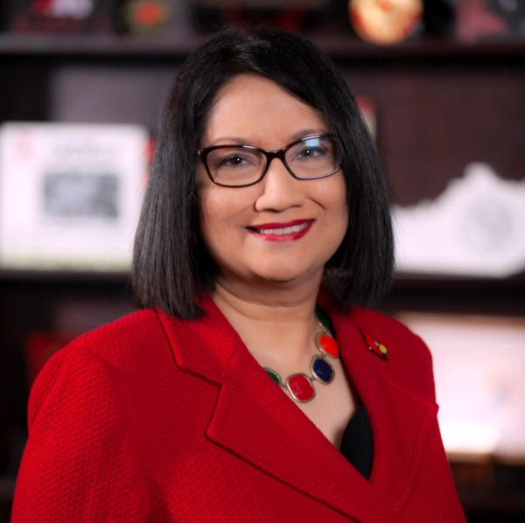



Our president
Dr. Neeli Bendapudi
Named president on April 3, 2018
18th president
First woman and first person of color to be president of UofL
@UofLPresNeeli
The University of Louisville has a mission to deliver high-quality higher education. I am excited to lead our team of students, staff, faculty, alumni and community members as we honor that mission and invest in our future.

Slide 49
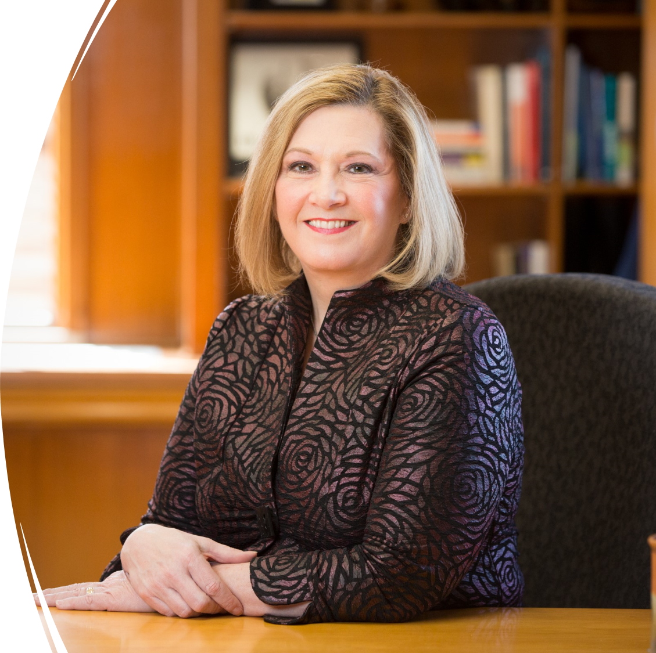
Our executive vice president and provost
Dr. Lori Stewart Gonzalez
Serving as provost since April 1, 2021
Professor of Speech-Language Pathology
I see academics as our core mission. It is why we are here. I’m committed to making sure that our students are successful and supporting and developing our faculty and staff.

Slide 50
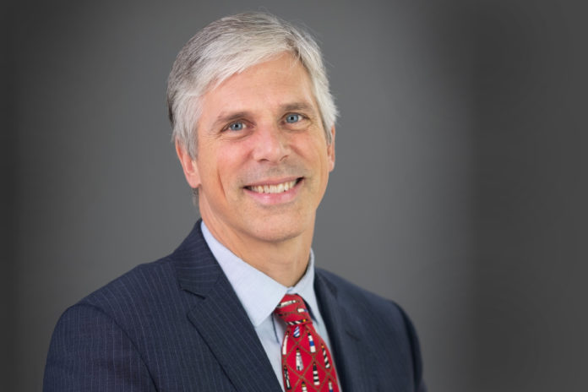


Our executive vice president for research and innovation
Dr. Kevin Gardner
Serving as EVPRI since January 2020
Professor of Civil Engineering
It is important for the university and its many stakeholders to understand the value of UofL research. The Grand Challenge effort is exactly the type of work that needs to occur so that the whole UofL community understands the unique contributions that the university’s research makes.

Slide 51
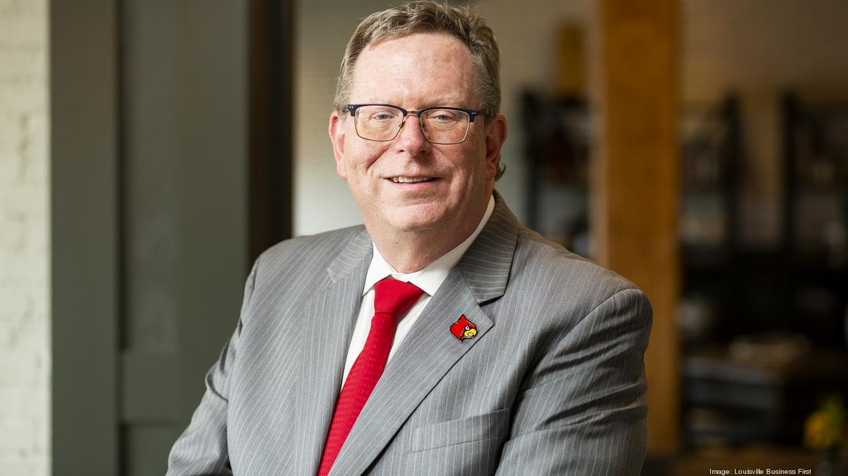
Our executive vice president for finance and administration
Mr. Dan Durbin
Serving as EVPFA since April 2021
At UofL since 2017, former CFO of Health Sciences Center
I feel particularly blessed to lead the UofL team through problems in an open, candid and participatory way that delivers a solution that is in the best interests of the university and those it serves.

Slide 52
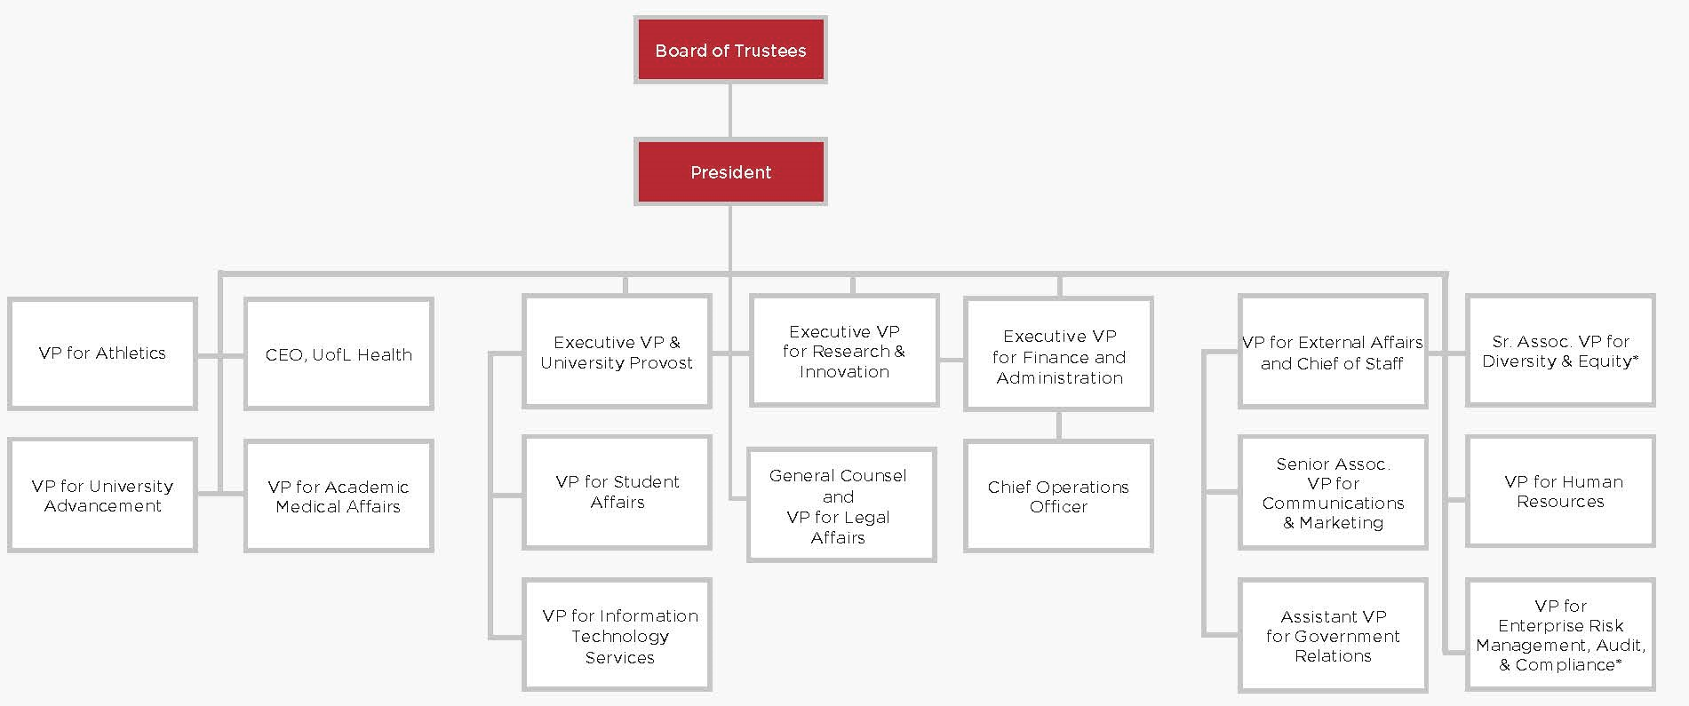

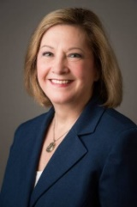




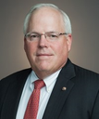
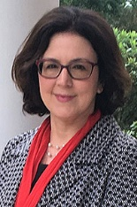
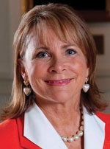





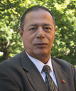
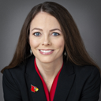

Organizational Chart
Vince Tyra
Tom Miller
Lori Gonzalez
Kevin Gardner
Dan Durbin
Michael Wade Smith
V. Faye Jones
VP
VP
Jasmine Farrier
Toni Ganzel
Michael Mardis
Mark Watkins
John Drees
Mary Elizabeth Miles
Angela Curry
Rehan Khan
Shannon Rickett
Sandy Russell
* denotes interim appointment

Slide 53

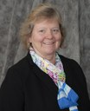







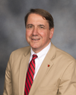

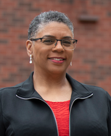

Deans
Craig H. Blakely
School of Public Health and Information Sciences
Beth Boehm
Graduate School
Gerry Bradley
School of Dentistry
Emmanuel Collins
J.B. Speed School of Engineering
Robert Fox Jr.
University Libraries
Toni Ganzel
School of Medicine
Sonya Hardin
School of Nursing
David Jenkins
Kent School of Social Work
Amy Lingo*
College of Education and Human Development
Michael Mardis
Dean of Students
Todd A. Mooradian
College of Business
David S. Owen*
College of Arts and Sciences
Teresa Reed
School of Music
Lars S. Smith*
Louis D. Brandeis
School of Law
* denotes interim appointment

Slide 54
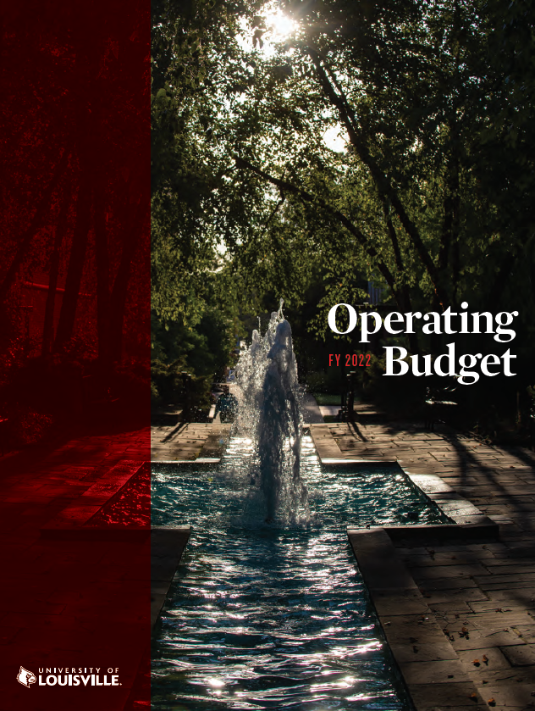
Budget and Finances
The Office of Budget and Financial Planning is responsible for the preparation and oversight of the University’s General Fund, Foundation, Research, Plant, and Athletic budgets.
The Position Management Office operates under the purview of Budget and Financial Planning. This Office, along with Budget & Financial Planning, is responsible for maintaining the integrity and accuracy of the university’s personal services positions.
The Office is committed to the effective and efficient stewardship of university resources through the use of timely and diverse evidence-based data. This commitment shall support and enhance the university’s enduring tenets of fiscal responsibility, scholastic excellence, community and global involvement, and institutional effectiveness.

Slide 55
Budget and Finances
Core Values
Fiscal Responsibility – We understand our fiduciary duty to the citizens of the Commonwealth to utilize resources responsibly, efficiently, and ethically in a transparent manner. Our business practices seek to reduce costs and/or improve processes with full awareness of, and adherence to the University’s strategic plan.
Integrity – We strive to comport ourselves in a trustworthy and credible manner. We seek to provide timely and accurate information, treat everyone with respect, and be sensitive to the confidential nature of our work.
Resourcefulness – We are committed to providing sound financial and budget services by utilizing a variety of resources, employing best practices, and seeking creative solutions to issues.
Student and University Success – We are aware that our actions affect the quality of each student’s experience at the university, as well as the overall success of the university. To that end, we are dedicated to supporting and enhancing university efforts towards this value.

Slide 56
Budget and Finances
Annual Operating Budgets
The operating budget is comprised of the University budget recommendations.
The proposed revenue budget equals the proposed expenditure budget. The University leadership presents the proposed document to the Board of Trustees for approval and adoption effective July 1 of the new fiscal year. View this year’s and previous years’ budgets here:
2021-2022
2020-2021
2019-2020
2018-2019
2017-2018
2016-2017
2015-2016
2014-2015
2013-2014

Slide 57
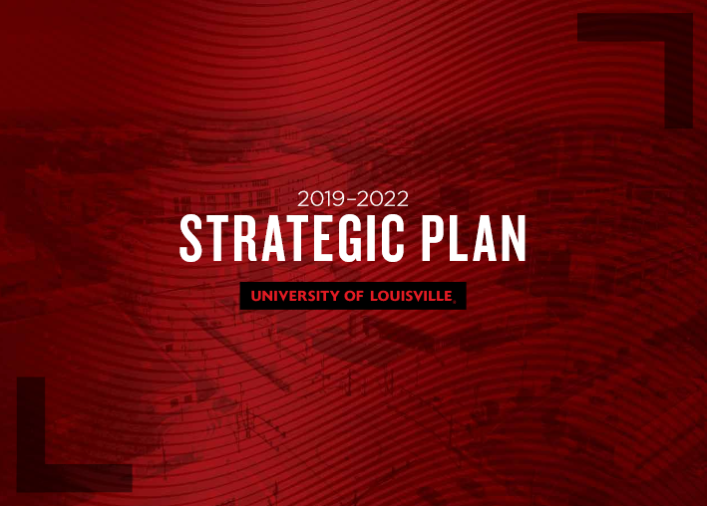
Strategic Plan
In fall 2018, University of Louisville President Neeli Bendapudi announced that the university would begin the process of developing a strategic plan to guide its actions in becoming a great place to learn, to work and in which to invest.
Beginning with recommendations from faculty, staff and students, and building on the university’s mission, vision and values, this nine-month process will be inclusive, open and transparent, incorporating input from campus constituencies and from the community UofL serves.
On August 27, 2019, the Board of Trustees adopted, in principle, the 2019-2022 Strategic Plan.
On September 23, 2019 the final 2019-2022 Strategic Plan was unveiled to the campus community.

Slide 58

Strategic Plan Year One Report
On November 16, 2020 the Strategic Plan Implementation Report Year One: 2019-2020 outlining our progress was shared with campus.

Slide 59


The University is dedicated to creating and applying knowledge that improves lives. By harnessing our research and scholarship efforts behind three Grand Challenges of our time, we will find solutions that make a difference and lead to thriving futures here and beyond.
View our Grand Challenges

Slide 60
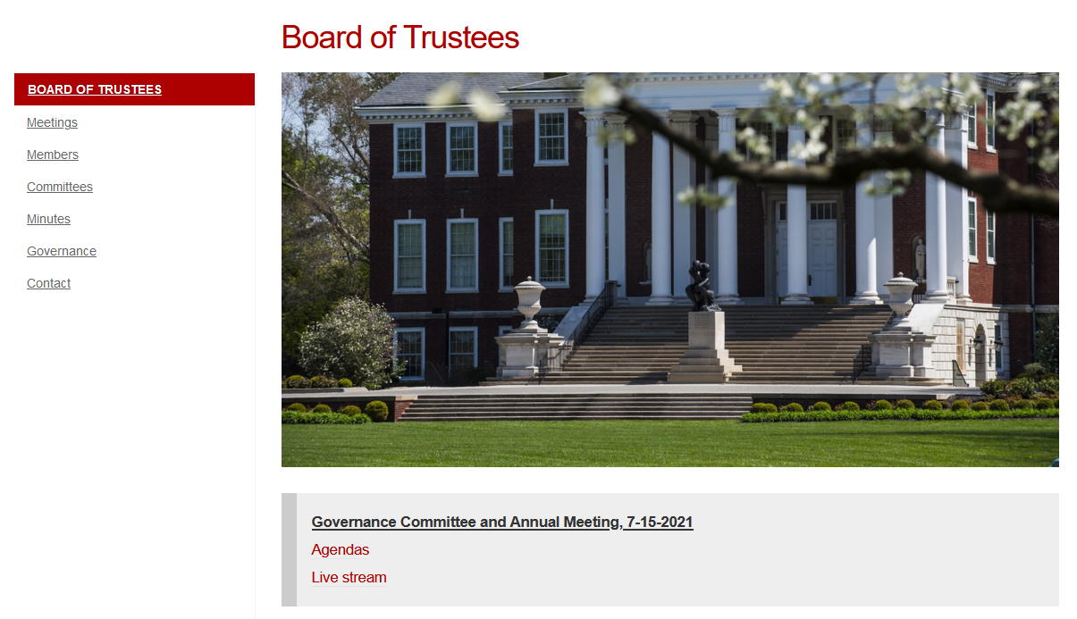
Board of Trustees Website
http://louisville.edu/president/boards/board-of-trustees

Slide 61
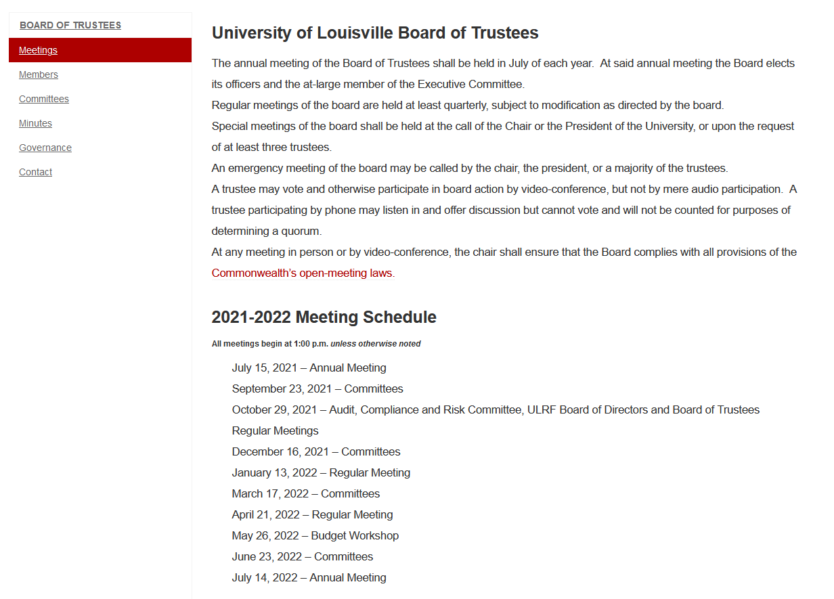
Board of Trustees Website
http://louisville.edu/president/boards/board-of-trustees

Slide 62
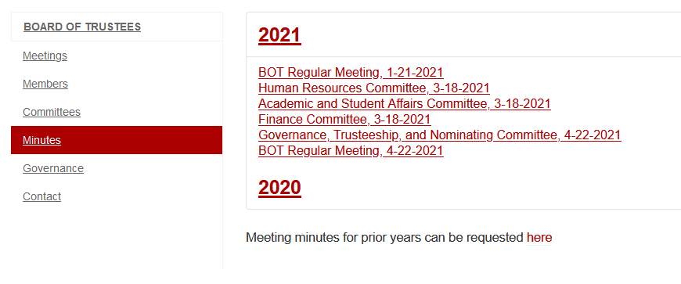
Board of Trustees Website
http://louisville.edu/president/boards/board-of-trustees

Slide 63
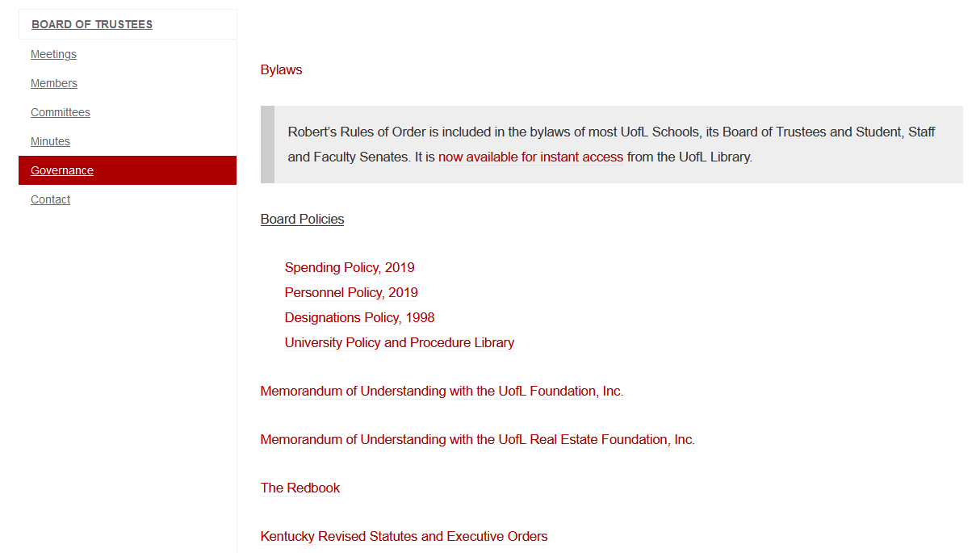
Board of Trustees Website
http://louisville.edu/president/boards/board-of-trustees

Slide 64
Welcome new and current trustees!
Brief Overview of the University
Membership and Powers of the Board
Fiduciary Responsibilities
Shared Governance
Administration and Operations
Policies and Procedures
Affiliated Organizations
Questions and Answers

Slide 65
Welcome new and current trustees!
Brief Overview of the University
Membership and Powers of the Board
Fiduciary Responsibilities
Shared Governance
Administration and Operations
Policies and Procedures
Affiliated Organizations
Questions and Answers

Slide 66
Requirements of a Public Institution
UofL is a public institution in the Commonwealth of Kentucky.
Thus, the University must have Accountability and Transparency.
  Conflicts of Interest
    KRS 45A.340
      (7) No member of a board of trustees or regents shall have an interest in any contract with a state university unless such contract shall have been subjected to competitive bidding in compliance with KRS Chapter 45A, unless such trustee or regent shall have been the lowest bidder and unless such trustee or regent shall have first notified in writing the remaining members of the board, and to the newspaper having the largest circulation in the county in which the state university is located, of his intention to bid on such contract.

Slide 67
Institutional Conflict of Interest Policy
This policy governs conflicts of interest and applies to situations involving the institution, as a whole, as well as Institutional Officials. It is the policy of the University of Louisville to ensure its transactions are conducted with integrity. This policy, and its associated policies, outlines the guiding principles and procedures utilized by the University of Louisville to identify and manage conflicts of interest that present a significant risk to the actual or perceived objectivity of transactions conducted in the name of the University of Louisville.
The following principles shall guide the Institution in addressing institutional conflict of interest:
Because it is critical to the mission and reputation of the Institution to maintain the public’s trust, Institution research, teaching, outreach, and other activities must not be compromised or perceived as biased by financial and business considerations.
Because of its numerous and complex relationships with public and private entities, the Institution must be aware of any relationships involving financial gain that may compromise or appear to compromise its integrity.
The Institution shall establish and maintain an oversight process to manage, reduce, or eliminate institutional conflict of interest.

Slide 68
Institutional Conflict of Interest Policy (cont.)
The Board reserves authority to review and approve plans for managing, reducing, or eliminating institutional conflict of interest involving:
external relationships with an unusually significant financial impact that present a potential conflict;
potential conflicts involving the president;
potential conflicts that raise serious policy issues or have a significant public impact on the mission and reputation of the Institution; or
potential conflicts arising in matters that otherwise require Board review and action under KRS 164.830
In these instances of conflict of interest, the president shall consult with the Board.

Slide 69
Institutional Conflict of Interest Policy (cont.)
The president or delegate shall:
implement an oversight process and administrative policies and procedures to address institutional conflict of interest and to identify situations in which institutional conflict of interest may arise;
recommend and implement plans to manage, reduce, or eliminate institutional conflict of interest;
develop and present conflict of interest plans to the Board for review and action as requested by the Board of Trustees;
ensure that individuals covered by this policy who act on behalf of the institution adhere to these policies and procedures, follow applicable conflict management plans, and do not engage in activities in which there is an actual conflict of interest; and
report to the Board annually all institutional conflict of interest matters that do not meet the thresholds identified above.

Slide 70
Requirements of a Public Institution
Annual Disclosure Form
Business transactions with UofL and ULRF
Business and family relationships with interested persons
Anticipated changes in information
2021-2022 Form to be emailed to you following today’s orientation.
Complete, sign, and return to Jake.Beamer@louisville.edu

Slide 71
What are Public Records?
Public Records include:
  "All documentation regardless of physical form... prepared, owned, used, in the possession of or retained by a public agency" – that includes UofL.
Open Records Requests (ORRs)
  HB 312, effective June 29, 2021, restricts inspection rights to Kentucky residents, requires public agencies to accept emailed open records requests, and extends public agencies’ time for handling requests from 3 to 5 days.
    Examples:
      All records related to UofL's accreditation since 2007
      All trustee Conflict of interest statements
      Philanthropic histories of trustees

Slide 72
Confidential Records Exempt from Disclosure
Student Education Reports—FERPA
  Federal law that protects the privacy of student education records; applies to all schools that receive funds from Dept. of Education.
Confidential healthcare information
Test questions and scoring keys
Records of law enforcement agencies
Antiterrorism Plans
Preliminary drafts
Records containing personal information which, if disclosed, would constitute an unwarranted invasion of privacy.

Slide 73
Open Meetings
Applies to meetings of a quorum of the board at which public business is discussed or action is taken.
Applies to committees
Permits Public Attendance
Requires Prior Notice to Public
Requires Minutes be Kept

Slide 74
Required Reading
The Kentucky Open Records & Open Meetings Acts: A guide for the public and public agencies (June 2021).
Managing Government Records: A Cooperative Undertaking. An Introduction to Kentucky’s Public Records Management Law (June 2021)

Slide 75
Policy & Procedure Library
POLICY
All policies can be found at
louisville.edu/policies
Board-relevant policies and procedures that affect the students, staff, and board members

Slide 76
Board of Trustees Policies
University Designations and Awards Policy
Adopted: June 24, 2021
Upon the recommendation of the President, the Board of Trustees shall approve the designation of all nameable spaces:
  with a philanthropic commitment of $1 million or greater;
  with a philanthropic commitment of $100,000 to $999,999 if the nameable space is considered a prominent public space – defined as those spaces with high visibility, heavy usage, or those linked to significant University traditions; and
  whenever the President otherwise deems it to be in the best interest of the University to request approval by the Board of Trustees.
All designations follow the procedure for designations and awards as described in the University Advisory Committee on Designations and Awards (UACDA) Procedures and Guidelines Document.
The policy for designations is described in the University of Louisville Naming Guidelines.

Slide 77
Board of Trustees Policies
Approvals for Personnel Actions Policy
Adopted: April 18, 2019
Personnel Items Requiring Board Action and Formally Reported to the Board: shall include initial faculty appointments with tenure or faculty appointments to Endowed Chairs, promotions of faculty above the rank of Assistant Professor or award of tenure, early termination of faculty, and the President and Executive Vice Presidents. Non-renewal of probationary appointments will be formally reported to the Board.
Personnel Items Requiring Administrative Approval Only and Reported to the Board As Information Items: shall include initial and renewal appointments of faculty not resulting in tenure; promotions up to the rank of Assistant Professor; resignations; retirements; expiration of appointments; permanent, acting, and interim appointments of administrators; medical leave, associate appointments; leaves without pay; sabbatical leaves; adjunct appointments; clinical appointments (both part-time and gratis); transfers from non-probationary to probationary status; changes in emeritus status; scheduling changes for sabbatical or other paid leaves; changes from full-time to part-time or gratis status; and changes in titles of assignments due to reorganizations or reassignments.
The Board of Trustees delegates to the President or her designee the authority to appoint and dismiss all other administrators with actions being formally reported to the Board.

Slide 78
Board of Trustees Policies
Financial Transactions Policy
Adopted: April 18, 2019
The Chair of the Ad Hoc Committee on Board Governance recommends adoption of the following Board policies defining University financial matters that must be brought before the Board of Trustees:
Approval of Annual Budget: The President is responsible under Section 2.1.2 of the Redbook for preparing and recommending to the appropriate Board of Trustees committees and, as appropriate, to the full Board of Trustees an annual University budget for review and approval.
Approval of Financial Transactions: Consistent with the President’s responsibility under Section 2.1.2 of the Redbook for recommending major actions to the Board of Trustees for final action, the President is responsible for recommending to the appropriate Board of Trustees committees and, as appropriate, to the full Board of Trustees for review and approval the following financial transactions:
  Any long-term debt financing transaction.
  Capital projects that involve University-owned land or which are for the University’s use when the estimated cost of acquisition, construction, reconstruction, improvement, or structural maintenance is estimated at $500,000 or more, regardless of fund source, except in the case of an expenditure determined by the President to be necessary because of an emergency (e.g., natural disaster or unforeseen mechanical, electrical, or structural breakdown that makes a facility or structure unusable.) Expenditures over the $500,000 threshold that are made in response to an emergency shall be initiated in consultation with the Board Chair, when circumstances make that possible, and shall be reported to the Board at its next meeting.

Slide 79
  Financial Transactions Policy Continued:
  Changes in scope of an approved University capital project that exceed five percent (5%)
  The acquisition or disposition of property by lease when the transaction involves an annual rental of over $250,000 per year or a term longer than five (5) years.
  Disposition of an interest in University real property, other than via lease, for a total amount in excess of $500,000.
  The award of any compensation, including base salary; bonuses; housing, car, club or similar allowances or stipends; or deferred compensation to the University President and Executive Vice Presidents.
  Financial transactions not provided for in the annual operating budget with a value in excess of $250,000, including loans, guarantees, or fund transfers of any kind from the University to another person or organization, including an affiliated or related entity.
  The President or the President’s designees shall have the authority to approve all financial transactions not requiring prior approval by the Board of Trustees. Any question about whether a particular transaction requires Board approval should be directed to the Board Chair and the University’s General Counsel.

Slide 80
  Financial Transactions Policy Continued:
Periodic Reporting Regarding Financial Matters: The President or his designee(s) shall report to the appropriate Board of Trustees committees and, as appropriate, to the full Board no less than quarterly on the University’s financial status, including a budget-to-actual analysis.
The full Board of Trustees and appropriate Board of Trustees committees shall receive a report annually on: (a) the University’s audited annual financial reports; (b) a budget-to-actual analysis; (c) the financial support provided by the University of Louisville Foundation, Inc. and its affiliates; (d) the status of the University’s long-term debt obligations; (e) any change in the rating or outlook assigned to the University’s debt by any rating agency; (f) the receipt of gifts and pledges; (g) the total compensation (including all fund sources) of the top fifty highest paid employees of the University, excluding faculty members in the School of Medicine; (h) the total compensation (including all fund sources) of: (i) the President, (ii) any Vice President reporting directly to the President, or (iii) any Dean reporting directly to the Executive Vice President and Provost, to the extent such individuals are not already included in the report required by subparagraph (g); (i) the University’s strategies for managing cash and short-term investment funds; and (j) the status of those matters approved by the Board pursuant to Section II above during the prior twelve months.
The Board shall request from the Chair of the Foundation Board a report no less than quarterly on: (I) the Foundation’s primary activities in support of the University; (II) the Foundation’s financial status, (III) a budget-to-actual analysis; and (IV) the Foundation’s investment performance.

Slide 81
Welcome new and current trustees!
Brief Overview of the University
Membership and Powers of the Board
Fiduciary Responsibilities
Shared Governance
Administration and Operations
Policies and Procedures
Affiliated Organizations
Questions and Answers

Slide 82
Welcome new and current trustees!
Brief Overview of the University
Membership and Powers of the Board
Fiduciary Responsibilities
Shared Governance
Administration and Operations
Policies and Procedures
Affiliated Organizations
Questions and Answers

Slide 83






Affiliated and Related Organizations
Affiliated
Related
Research Foundation
Board of Directors
President’s Council
Board of Directors

Slide 84
Affiliated and Related Organizations
http://louisville.edu/president/boards/research
Research Foundation
The University of Louisville Research Foundation (ULRF), Inc. is a non-profit corporation affiliated with the University of Louisville and incorporated under the laws of the Commonwealth of Kentucky for the performance of charitable, educational, and scientific purposes including carrying out and supporting projects relating to the educational, scientific, literary, artistic, health care, and public service missions of UofL.

Slide 85
Affiliated and Related Organizations
http://louisville.edu/president/boards/research
Research Foundation
The ULRF is governed by a Board of Directors composed of the members of the Board of Trustees of the University of Louisville, the term of each director being coterminous with service as a trustee. The officers of the ULRF are a Chair, Vice Chair, Treasurer, and Secretary.
Additionally, the president of the university serves as Chief Executive Officer of the ULRF; and the chief financial officer, chief academic officer, and chief research officer of UofL serve as Vice Presidents of the foundation.

Slide 86
Affiliated and Related Organizations
http://louisville.edu/president/boards/research
Research Foundation
The ULRF was created to:
  Promote, encourage, facilitate, foster and develop such projects and activities for the benefit of students, faculty, staff and trustees of the University of Louisville and the state as a whole;
  Foster the transfer and development of technology, patents, and research information useful to the public by means of publication, commercialization, licensing, cooperative agreements and other arrangements designed to bring new and useful ideas to the marketplace; and to
  Obtain and administer grants, contracts and gifts in support of research, educational and public service activities, directly or as intermediary or fiscal agent for the University of Louisville or related organizations.

Slide 87
Affiliated and Related Organizations
http://www.louisvillefoundation.org/about/
http://www.louisvillefoundation.org/about/reports/
The Foundation’s work is exclusively for the charitable and educational purposes of the University of Louisville. The Foundation’s vision is to make the University of Louisville a premier metropolitan research university recognized for advancing the intellectual, social and economic development of our community and its citizens while placing the University among the top tier of similar universities in the nation.
Founded in 1970, the Foundation is directed and supervised by a board of directors whose members each serve three-year terms. The Foundation is an independent 501(c)(3) not for profit corporation that holds, invests and designates funds of the University.

Slide 88
Board of Directors
Earl Reed, Chair
Ken Payne, Vice Chair
James Boone, Secretary
David Anderson
Paul Carrico
Jill Force
David Krebs
Larry Mcdonald
Mark Nickel
John Thompson
John Chilton, Board of Trustee Director
Mary Nixon, Board of Trustee Director
Jim Rogers, Board of Trustee Director
Neeli Bendapudi, ex officio
Ugonna Okorie, ex officio, UofL Student Rep*
David Schultz, ex officio, UofL Faculty Rep*
John Smith, ex officio, UofL Staff Rep*
* non-voting
http://www.louisvillefoundation.org/about/
http://www.louisvillefoundation.org/about/reports/

Slide 89

Memorandum of Understanding Between the University and the Foundation
University and Foundation agree to:
  Shared Mission; Separate Governance
    Share Mission
    University Governance
    Foundation Governance
  University Responsibilities
  Foundation Responsibilities
  License to use University Marks
  Miscellaneous Terms
MOU is intended to set forth policies and procedures that will contribute to the coordination and understanding of their mutual activities and responsibilities. It shall, subject to the provisions above, remain in effect until September 30, 2022 and shall automatically renew for successive additional two-year terms unless amended or terminated (subject to specific provisions in the MOU).
https://louisville.edu/president/boards/board-of-trustees/governance

Slide 90
Affiliated and Related Organizations
The Real Estate Foundation’s mission is to acquire, maintain, improve, manage, lease and convey real and personal property and assets for the benefit of the University of Louisville. Approximately $300 million of real estate that directly supports UofL.
The ULREF has a separate board of directors from the UofL Foundation and members have real estate related expertise.
http://www.louisvillefoundation.org/about/
http://www.louisvillefoundation.org/about/reports/

Slide 91
Ken Payne, Chair
Neeli Bendapudi
Jill Force
Steve Gault
Mariah Gratz
Craig Holley
Derrick Littlejohn
Earl Reed
Keith Sherman
Sandy Metts Snowden
Powell Spears
Board of Directors
http://www.louisvillefoundation.org/about/
http://www.louisvillefoundation.org/about/reports/

Slide 92
Memorandum of Understanding Between the University and the Real Estate Foundation
Memorandum of Understanding Between the University and the Real Estate Foundation
University and Real Estate Foundation agree to:
  Foundation Name, Seal, and Logotype
    Share Mission
    University Governance
    Foundation Governance
  University Governance
  The Foundation’s Relationship to the University
  The University’s Relationship to the Foundation
  Foundation Responsibilities
  Terms of the MOU
MOU is intended to set forth policies and procedures that will contribute to the coordination and understanding of their mutual activities and responsibilities. It shall, subject to the provisions above, remain in effect until June 30, 2019 and shall automatically renew for additional two-year terms unless modified by the parties.
https://louisville.edu/president/boards/board-of-trustees/governance

Slide 93
Affiliated and Related Organizations
http://louisville.edu/president/boards/athletic-association
The UofL Athletic Association (ULAA) was established in 1984 to
  Develop intercollegiate athletic teams composed of students of the University of Louisville and to schedule and manage intercollegiate athletic contests, all in harmony with and in subjection to the general educational policy of the University of Louisville
  Collect and own the receipts from subcontracts and such other moneys and goods as may be given or granted to the Corporation
  Expend and disburse such receipts, gifts, and grants in the interest of the intercollegiate athletic program at the University of Louisville
  Have authority to make contracts of employment, fix salaries, and establish personnel policies with respect to the Intercollegiate Athletics Program at the University of Louisville.

Slide 94
Affiliated and Related Organizations
http://louisville.edu/president/boards/athletic-association
ULAA Corporation Members are Board of Trustee members with the power to amend or alter the bylaws.
Management of ULAA is delegated to a Board of Directors, in accordance with the bylaws.

Slide 95
NCAA Constitution, Article 6
6.01.1 Institutional Control
  The control and responsibility for the conduct of intercollegiate athletics shall be exercised by the institution itself and by the conference(s), if any, of which it is a member. Administrative control or faculty control, or a combination of the two, shall constitute institutional control.
6.1.1 President or Chancellor
  A member institution’s president or chancellor has ultimate responsibility and final authority for the conduct of the intercollegiate athletics program and the actions of any board in control of that program.
6.1.2 Athletics Board
  A board in control of athletics…is not required, however, if such a board exists, it must conform to the following provisions:
    Composition – Administration and/or faculty staff members shall constitute at least a majority of the board in control of athletics
http://louisville.edu/president/boards/athletic-association

Slide 96
Board of Directors – 29 members
  President of the University
  Neeli Bendapudi, President & Chair
  9 Faculty Members
  Prof. Claudia Angeli
  Prof. Eric Berson
  Prof. Jeremy Clark
  Prof. Meg Hancock
  Prof. Carolyn Kling
  Prof. Eugene Mueller
  Prof. Whitney Nash
  Prof. Karen Turner
  Prof. Krista Wallace-Boaz (FAR to NCAA)
  8 At-large Members
  Larry Benz
  Ryan Bridgeman
  Dennis Heishman
  Steve Jones, Sr.
  Tom Meeker
  Sam Rechter
  Gayle Saunders
  Ron Wright
  2 Trustees
  Jim Rogers
  Sherrill Zimmerman
  4 Administrators
  Gerry Bradley
  Dan Durbin
  Mark Watkins
  Shannon Rickett
  2 Vice Presidents
  Jasmine Farrier
  Lori Gonzalez
  2 Students
  Sydney Finley
  Ugonna Okorie
  1 Staff Member
  Andrew Grubb
Faculty/Administrators constituting institutional control (16 of 29)
http://louisville.edu/president/boards/athletic-association

Slide 97
Board of Directors has the authority to:
Adopt and enforce the necessary rules and regulations governing all questions pertaining to the eligibility of players, intercollegiate relations, and membership in associations of universities and colleges organized for the regulation of athletics;
Be responsible for the business management of all activities, i.e., purchase, lease, receive, own, sell, and convey real and personal property of all kinds, particularly equipment necessary or convenient for participation in athletic training, games and contests provided, however, that any business transactions involving capital expenditures shall be handled through the Vice President for Finance and Administration of the University of Louisville;
Recommend the employment by the University of Louisville of the Vice President for Athletics, and the Associate Athletic Director(s), and delegate authority to the Athletic Director for the Corporation to hire other persons necessary for carrying out the purposes of the Corporation;
http://louisville.edu/president/boards/athletic-association

Slide 98
Board of Directors has the authority to:
Schedule, hold and conduct amateur athletic exhibitions, games and contests, make same open and accessible to the general community, and to establish ticket prices and receive admission fees for these events;
Conduct, receive, and accept donations by gift or trust, and to acquire in any other legal manner monies and properties for investment purposes;
Borrow money, guarantee debts, and give its notes or other obligations therefore and to secure payment thereof by pledging, assigning or mortgaging any property it may own;
Market and promote University of Louisville intercollegiate athletic activities;
Establish programs and enforce rulings in compliance with all pertinent federal and state laws and regulations including Title IX, National Collegiate Athletic Association (NCAA) governance, and Atlantic Coast Conference policies [and] consistent with the goals approved by the Board of Trustees of the University for intercollegiate athletics; and
Engage in any other lawful acts necessary to carry out the objectives and purpose of the Corporation.

Slide 99
Affiliated and Related Organizations
http://louisville.edu/president/boards/presidents-council
President’s Council
The University of Louisville President’s Council is an advisory body that provides the office of the president with ongoing assistance in achieving the strategic mission of the University. It is composed of persons interested in and loyal to the University of Louisville who have a record of leadership in other organizations or communities and who seek to contribute their leadership skills and resources to the development and advancement of the University.
The President’s Council of the University of Louisville shall consists of 60 Regular, voting members, at least two-thirds of whom shall reside in the Commonwealth of Kentucky. In addition, there may be Emeritus, non-voting members.

Slide 100
http://louisville.edu/president/boards/presidents-council
President’s Council
In advising the President, the primary objectives of the President’s Council shall be:
  to support and enhance the quality and effectiveness of the University’s programs
  to serve as a resource to the President for strategic planning, and to act as a sounding board for the President on any matters she may wish to communicate to the communities served by the University
  to serve as ambassadors for the University to enhance its reputation and strengthen external relations
  to assist the University in identifying and obtaining resourcesto assist the University in recruiting and retaining outstanding students, faculty, and staff
  to offer advice and candid feedback to the President on all matters affecting the mission of the University
  to help the University pursue its vision as it embodies the CARDINAL Principles, and
  to continually explore and question University policies, practices, and decisions to enhance outcomes in every manner possible and to assist the University in making wise choices on matters affecting its reputation.

Slide 101
http://louisville.edu/president/boards/presidents-council
President’s Council
Karen Abrams
Marie Abrams
Ron Abrams
Claire Alagia
Pat Alagia
Dana Allen
James Allen
Robert Allison
Joseph L. Ardery
Daniel Ash
LouAnn Atlas
Robert C. Ayotte
J. McFerran Barr
Martin L. Bell
Robert P. Benson
Larry Benz
Don Berg
Bonita Black
J. Neville Blakemore, III
Dale J. Boden
Hal Bomar
Phillip D. Bond
Olga P. Booher
Lewis Borders
Carl Brazley
Ernest A. Brooks, III
J. McCauley Brown
J. Michael Brown
Mike Brown
Sherman Brown
Kelly Burke
Wilson Chan
Malcolm Chancey
Naveed M. Chowhan
Toni Clem
Ann Ford Cobb
Martha Neal Cooke
Everett Cowan
Charles J. Dahlem
William E. Darragh
Scott Davis
Tonya York Dees
Charles Denny
Frank P. Doheny
Laurel Doheny
Joe Dougherty
Tom Drexler
Bruce K. Dudley
Welby E. Edwards
Larry Ethridge
Scott C. Ferguson
Carl T. Fischer
Gregory Fischer
J. Clint Follette
Marcus Folmar
Jean Frazier
Kevin Fuqua
Steve Gault
David George
Salem M. George, Jr.
Eugene Gilchrist
Edward Glasscock
Kimberly Gorski
Juliet Cooper Gray
Nathaniel Green
Ollie Green
Mary Moss Greenebaum
Julie Guenthner
Ali Haider
Daniel Hall
Luke Hancock
Maggie Payette Harlow
Blake Haselton
Dennis Heishman
Audwin Helton
Bruce M. Henderson
Michael A. Hendricks
Allen Hertzman
Henry V. Heuser, Jr.
Katheryn D. Higgins
Kelly Hodges
John L. Huber
Gregory K. Inman
W. Scott Jones
Steve Jones
Steve M. Jones, Jr.
Jan S. Karzen
Blanche Kitchen
Bob Koetter
Don Kohler, Jr.
Robert A. Kohn
Shelley Kusman
Brian F. Lavin
Jon Mapp
Romano L. Mazzoli
John R. McCall
Marty McClelland
Thomas H. Meeker
Tim Mulloy
Debra Murphy
George Nichols, III
Tommy Nolan
Kent Oyler
Thomas J. Payette
Winston Pittman
Marty Pollio
Marie E. Porter
Joe Rooks Rapport
Sam Rechter
Dana Reinhardt
William Renda
Benjamin K. Richmond
Eddy C. Roberts, Jr.
Elaine Johns Robinson
Ben Ruiz
Michael T. Rust
Ruth S. Ryan
Rob Samuels
T. William Samuels
Lalit Sarin
Todd Schmiedeler
Denise Sears
Michael L. Seebert
Butch Shaw
Kevin Shurn
George Siemens, Jr.
Ben Small
Sandy Metts Snowden
Joe Steier
William A. Stone
Raymond G. Strothman
James Strull
James L. Sublett
Richard Swope
Dan Tafel
Sandy Talbott
Susan Stout Tamme
Kiel Thomson
Steven E. Trager
Daniel C. Ulmer
J. Colin Underhill
Todd Underhill
Jerry Ward
Curtis Warfield
Louis I. Waterman
Barbara A. Weakley-Jones
Susan Weiss
Beverly Wheatley
Mark Wheeler
Mary Gwen Wheeler
Richard H. Wilson
Andrea Rice Woolfolk
Ron Wright
Sherrill Zimmerman

Slide 102

Neeli Bendapudi
Toni Ganzel
Kelly McMasters
Diane Medley
Fred Williams
Pat Mulloy
Ben Breier
Heidi Margulis
Junior Bridgeman
William Ballard
Richard Riney
UofL Health is a nonprofit corporation organized to be operated exclusively for the charitable, scientific or education purposes within the meaning of Section 501(c)(3) of the Internal Revenue Service. UofL Health has established a full service, seamless academic regional health care system of owned, affiliated and contracted services, programs and facilities covering the full continuum of health care delivery, advocacy, health promotion, education, research and disease prevention.
https://uoflhealth.org/about-us/board-of-directors/

Slide 103
University Medical Center
Board of Directors
(UofL Hospital)
UofL Health – Louisville
Board of Directors
UofL Health – Shelbyville Hospital Board of Directors
Dr. Jeffrey Bumpous
Dr. Rodrigo Cavallazzi
Dr. Jason Chesney
Dr. Sean Francis
Dr. Toni Ganzel
Jerry Johnson
Dr. Kris Krueger
Dr. Mary Nan Mallory
Dr. Kelly McMasters
Tom Miller
Dr. Ron Wright
Praveen Arla, MD
Lou Ann Atlas, Chair
Arthur Malkani, MD
Richard A. Schultz
Jeffrey Stidam, MD
Gerald D. Temes, MD
Huey-Yuan Tien, MD
Bill Wagner
Louis Waterman, Vice Chair
Russell Williams, MD
Valerie Briones-Pryor, MD, Chair
Ron Caughron
Janet Cuthrell
Andrew Duffee, MD, Vice Chair
Kenneth Gardner, MD
Pat Hargadon
Ray Leathers
Tom Miller, Secretary
Christopher Theuer
Ron Waldridge, II, MD
Gary Walls
https://uoflhealth.org/about-us/board-of-directors/

Slide 104
Alumni Association Board of Directors
Executive Committee:
Amy Farnsworth, Chair
Tommy Nolan, Immediate Past Chair
Will Baumgardner, Chair Elect
Dwayne Compton, Secretary
Rosalyn Carothers
Josh Hawkins, Asst. Vice President, Alumni Relations & Annual Giving
Jasmine Farrier, Vice President of Advancement
At-Large Board Members
Ben Donlon
Ahmed Awadallah
Justin Fowles
Erica Gray
Ashleigh Hazley
Alan Kleier
Larry Horn
Brandon McReynolds
Wilson Chan
DeShara Doub
Jan Myers
Goetz Kloecker
Sheri Riley
John Weber
Ginny Noe
http://www.uoflalumni.org

Slide 105
Questions?

Slide 106
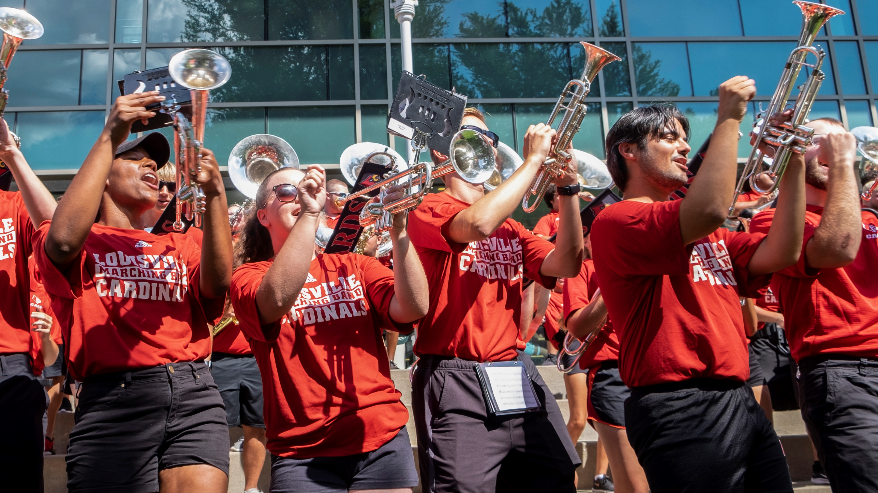
Complete online training within 45 days
Welcome to the University of Louisville!
Welcome to the Cardinal Family!

