Slide 1
Monday
Direct instruction
Vocabulary journal entries (word description, translation, & drawing)
“Check” the level of word understanding in vocab journal

Slide 2
Key vocabulary of the week
Food source
Extinct
Symbiotic relationship
Trophic level
Biosphere
Other important words:
Amount/number
Increase/decrease
Carry out
Prediction

Slide 3
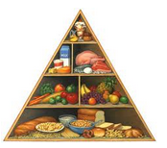
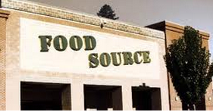
Key vocabulary of the week
Term: food source
Draw:
Definition: someone or something that provides food for an organism

Slide 4
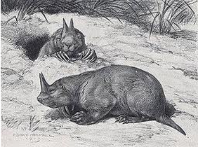
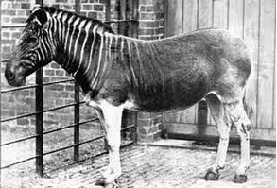
Key vocabulary of the week
Term: extinct
Draw:
Definition: no longer existing

Slide 5
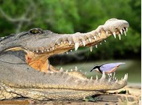
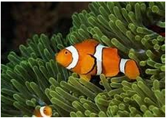
Key vocabulary of the week
Term: symbiotic relationship
Draw:
Definition: the relationship between two different kinds of living things that live together and depend on each other

Slide 6
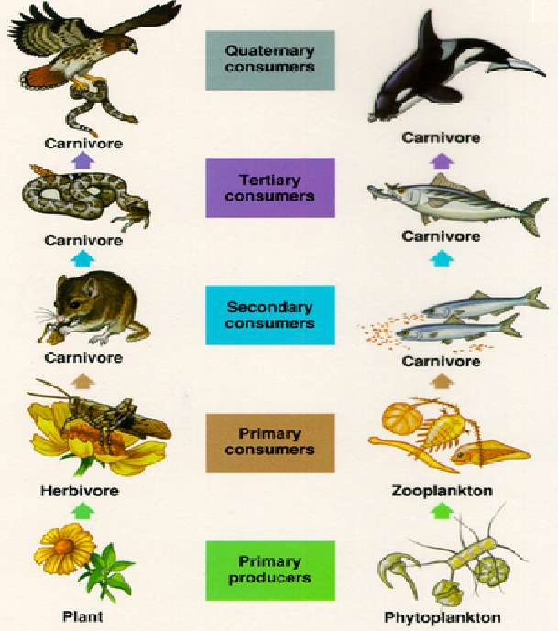
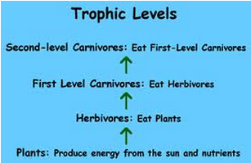
Key vocabulary of the week
Term: trophic level
Draw:
Definition: a role an organism has in energy transfer (a feeding relationship)

Slide 7
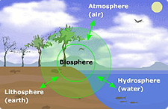
Key vocabulary of the week
Term: biosphere
Draw:
Definition: the part of the Earth in which life can exist

Slide 8
Meet someone who speaks your language and…
Explain your definitions & drawings using your native language for the key words of the words:
Food source
Extinct
Symbiotic relationship
Trophic level
Biosphere
When back in your sit, mark your level of the word’s understanding with a

Slide 9
Key vocabulary of the week
Term: number (n)
Definition: a quantity of something that can be counted (such as people, things)
Draw:
Term: amount (n)
Definition: a quantity of something that cannot be counted (such as information, effort, force)
Draw:

Slide 10
Key vocabulary of the week
Term: increase (v)
Definition: to become larger in size, amount, number
Draw:
Term: decrease (v)
Definition: to become smaller in size, amount, number
Draw:

Slide 11
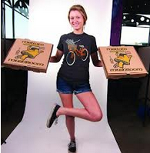
Key vocabulary of the week
Term: carry out
Definition: to do and complete (something)
Draw:

Slide 12
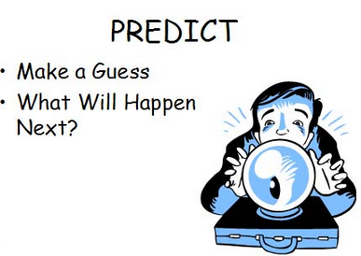
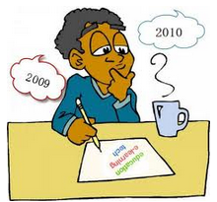
Key vocabulary of the week
Term: prediction
Definition: saying what will happen in the future; predicting something
Draw:

Slide 13
Meet someone who speaks your language and…
Explain your definitions & drawings using your native language for the key words of the words:
Prediction
Increase
Decrease
Carry out
Amount
Number
When back in your sit, mark your level of the word’s understanding with a

Slide 14
Picture Match
Step 1: Take the words out from the envelop
Step 2: Read the words out loud & think about images that describe the words
Step 3: Match the words & the pictures
Step 4: Explain your match using the sentence starter below
I chose this picture because the word shows ___________
is ___________
an example of…
something that …
an object that…
Notes:
Materials:
Picture board (1 per 2 students)
Cut-off vocabulary words (1 set per 2 students)
Facilitation: Modeling (a) directions, (b) how to use the sentence starter, and (c) corrective feedback (re-phrasing student sentences during the whole class review of the picture match

Slide 15
At home
Study the words while thinking about the Movement/Gestures that best describe/represent the word
Food source
Extinct
Symbiotic relationship
Trophic level
Biosphere
Other important words
Prediction
Increase
Decrease
Carry out
Amount
Number

Slide 16
Tuesday
Charades
Spelling pyramid
Working with a partner, write 1-2 sentences using the words

Slide 17
Charades
Use your arms, legs, and bodies to show that you know the meaning of the key word.
Option 1: Teacher calls the words, kids standing next to their desks show what the word means with their hands, motions, body language.
Option 2: Teacher give a word to each table, the table creates the charade, the class guesses.
Notes:
Materials for Option 2: 1 cut-out word per table

Slide 18
Spelling Pyramid
Using the example on your hand-out, build the Spelling pyramid for each key word:
Working with a partner, write 1-2 sentences using the words from the spelling pyramid
Abiotic
a
ab
abi
abio
abiot
abioti
abiotic

Slide 19
At home
Study the word definitions
Food source
Extinct
Symbiotic relationship
Trophic level
Biosphere
Other important words
Prediction
Increase
Decrease
Carry out
Amount
Number

Slide 20
Wednesday
Whole class review (tennis ball)
Card game

Slide 21
Card Game
Setp1: One person takes a Card and reads the word
Step 2: The first person who provides the best definition, description, or an example keeps the Card
The Player with the most Cards wins.

Slide 22
At home
Teach the words to someone else
Food source
Extinct
Symbiotic relationship
Trophic level
Biosphere
Other important words
Prediction
Increase
Decrease
Carry out
Amount
Number

Slide 23
Thursday
“Jeopardy”

Slide 24
Jeopardy: Round 1
Step 1: Form 2 teams & select a Host
Step 2: 1 person from each team approaches the host table
Step 3: The Host reads 1 word, the player who “hits” the Host’s table first, gets to provide a definition. The correct definition gets the team 1 point.
Step 4: Repeat Steps 2 & 3 with new players fro each team.

Slide 25
Jeopardy: Round 2
Step 1: Each team gets a set of 4 key words
Step 2: The teams develop and write sentences with the 4 words on blank sentence strips
Step 3: Each sentence that is accurate gets the team 2 points (1 pt. science + 1pt. English)
The team with the most points from Rounds 1 & 2 wins.

Slide 26
At home
Get ready for the quiz
Food source
Extinct
Symbiotic relationship
Trophic level
Biosphere
Other important words
Prediction
Increase
Decrease
Carry out
Amount
Number

Slide 27
Friday
Quiz
“Square” the level of word understanding (1- 4) in vocab journal

Slide 28
# | Sentence | Letter | Correct
1 | Based on the number of females per 100, I can make a prediction about how the milkweed bug population will change over time. | E
2 | In class, we carried out several experiments to see how biotic and abiotic factors will influence population growth of milkweed bugs. | D
3 | Little amount of rain over a long period of time will lead to drought. | A
4 | Species, communities, populations, and ecosystems are all part of the Earth’ biosphere. | B
5 | The population of milkweed bugs will increase if they have more space (volume). | C
6 | Sunlight, water, and carbohydrate are the food sources for plants. | E
7 | The bird lives in symbiotic relationship with the hippopotamus. The bird eats organisms harmful for the hippopotamus; hippopotamus protects the bird from predators. | C
8 | The population of milkweed bugs decreased when there were fewer eggs (per clutch). | A
9 | We say that a group of organisms at the same position (= place) in a food chain are at the same trophic level. | D
10 | With no food, water, and limited space (volume) over a long period of time, organisms may become extinct. | B

Slide 29
© Materials copyrighted by the University of Louisville. Educators are free to use these materials with the proper acknowledgement of source.

