Slide 1
Monday
Direct instruction
Vocabulary journal entries (word description, translation, & drawing)
“Circle” the level of word understanding in vocab journal

Slide 2
Key vocabulary of the week
Solar (Lunar) Eclipse
Wane
Wax
Crescent
Phase
Tide
Centrifugal
Review:
Mass
Inertia
Law of Universal Gravitation

Slide 3
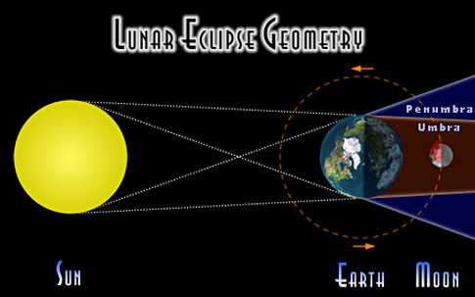
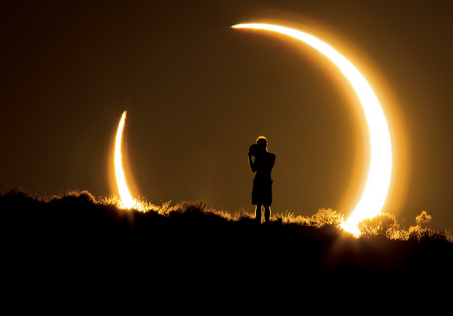
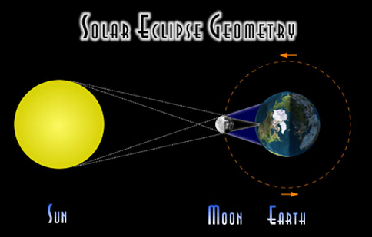

Key vocabulary of the week
Term: solar eclipse
Definition: when the Sun is completely or partially covered with a dark circle because the moon is between the Sun and the Earth
Also, lunar…
Draw:

Slide 4
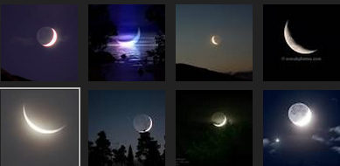
Key vocabulary of the week
Term: crescent
Definition: a shape that is curved, wide at its center, and pointed at its two ends
Related word:
Gibbous: seen with more than half
Draw:

Slide 5


Key vocabulary of the week
Term: wane
Definition: to become smaller or less
of the moon : to appear to become thinner or less full
Term: wax
Definition: to become larger or more
of the moon: to appear to become larger or more full

Slide 6
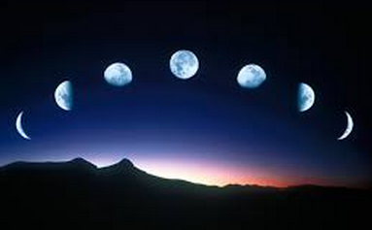
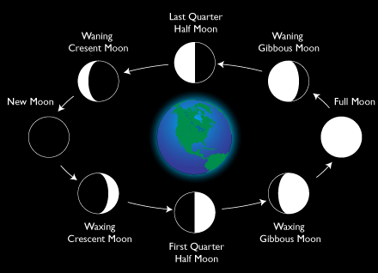
Key vocabulary of the week
Term: phase
Definition: a part or step in a process (one part in a series of related events or actions)
Draw:

Slide 7
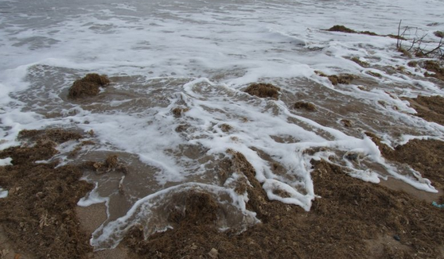
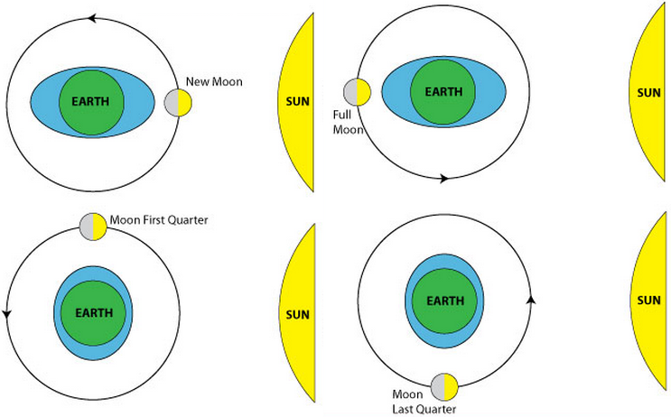
Key vocabulary of the week
Term: tide
Definition: the regular up and down movement of the ocean level caused by the pull of the Sun and the Moon on the Earth
Draw:
Notes:
http://www.google.com/imgres?hl=en&biw=1241&bih=584&tbm=isch&tbnid=mHQhyyP7y4hQzM:&imgrefurl=http://home.hiwaay.net/~krcool/Astro/moon/moontides/&docid=w8uf6XZxOlMRAM&imgurl=http://home.hiwaay.net/~krcool/Astro/moon/moontides/TideAni.gif&w=468&h=349&ei=EPV2UdrkG4fP2QWfmoCoDA&zoom=1&ved=1t:3588,r:8,s:0,i:173&iact=rc&dur=517&page=1&tbnh=182&tbnw=244&start=0&ndsp=12&tx=112&ty=121

Slide 8
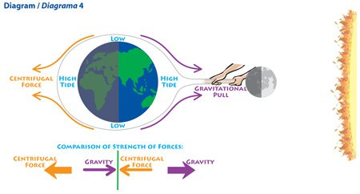
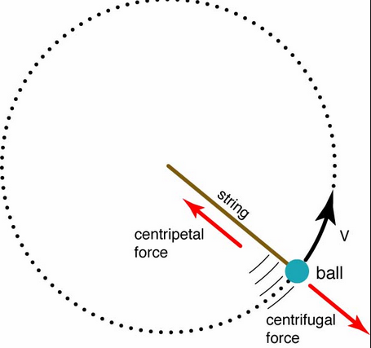
Key vocabulary of the week
Term: centrifugal
Definition: moving away from a center (acting in a direction away from a center)
Draw:
Notes:
https://www.google.com/search?q=Centrifugal&hl=en&source=lnms&tbm=isch&sa=X&ei=OU93UZHpOYOm2gX5yYDABA&ved=0CAcQ_AUoAQ&biw=1241&bih=584#imgrc=wTo8HHse6s9t9M%3A%3BKw0CkyV99Wr4iM%3Bhttp%253A%252F%252Fwww.simerics.com%252Fanimation%252Fcentrifugal_pre_ani.gif%3Bhttp%253A%252F%252Fwww.simerics.com%252Fgallery_centrifugal_pump%3B280%3B270

Slide 9
Meet someone who speaks your language and…
Explain your definitions & drawings using your native language for these words:
Eclipse (solar, lunar)
Wane
Wax
Crescent
Phase
Tide
Centrifugal
Also, make sure that you understand/remember:
Mass
Inertia
Law of Universal Gravitation

Slide 10
At home
Study the words while thinking about the images that best describe/represent the word

Slide 11
Tuesday
Whole class review (calling on volunteers)
Picture match
Homework:
  Spelling pyramid
  Write 1-2 sentences using the words from the spelling pyramid + sentence frames

Slide 12
Picture Match
Step 1: Take the words out from the envelope
Step 2: Read the words out loud & think about images that describe the words
Step 3: Match the words & the pictures
Step 4: Explain your match using the sentence starter below
I chose this word because the picture shows__________
an example of…
                something that …
                an object that…
                the formula for…
Notes:
Materials:
Picture board (1 per 2 students)
Cut-off vocabulary words (1 set per 2 students)
Facilitation: Modeling (a) directions, (b) how to use the sentence starter, and (c) corrective feedback (re-phrasing student sentences during the whole class review of the picture match

Slide 13
At home
Study the word definitions
Complete:
  Spelling pyramid
  Write 1-2 sentences using the words from the spelling pyramid + sentence frames

Slide 14
Wednesday
Whole class review (tennis ball)
Sentence review

Slide 15
Spelling pyramid + sentence check
With a partner…
Check each other’s pyramids + sentences
Find 1 positive thing about your partner’s sentences
Give 1 suggestion for improvement

Slide 16
At home
Teach the words to someone else

Slide 17
Thursday
“Card Game” OR “Jeopardy” OR Charades
Homework:
  Get ready for the quiz

Slide 18
Card Game
Setp1: The Reader takes the card and reads the word
Step 2: Player #1 provides a definition, description, or an example of the target word
Step 3: The team decides if the answer is correct
Step 4: If the answer is correct, Player #1 keeps the card & becomes the Reader for the next Player.
Step 5: Continue until there is no more cards in the set.
The Player with the most card wins.

Slide 19
Jeopardy: Round 1
Step 1: Form 2 teams & select a Host
Step 2: 1 person from each team approaches the host table
Step 3: The Host reads 1 word, the player who “hits” the Host’s table first, gets to provide a definition. The correct definition gets the team 1 point.
Step 4: Repeat Steps 2 & 3 with new players fro each team.

Slide 20
Jeopardy: Round 2
Step 1: Each team gets a set of 4 key words
Step 2: The teams develop and write sentences with the 4 words on blank sentence strips
Step 3: Each sentence that is accurate gets the team 2 points (1 pt. science + 1pt. English)
The team with the most points from Rounds 1 & 2 wins.

Slide 21
Homework:
Get ready for the quiz

Slide 22
© Materials copyrighted by the University of Louisville.
Educators are free to use these materials with the proper acknowledgement of source.

Slide 23
Friday
Quiz
“Square” the level of word understanding (1- 4)

