Slide 1
Monday
Direct instruction
Vocabulary journal entries (word description, translation, & drawing)
“Circle” the level of word understanding in vocab journal

Slide 2
Key vocabulary of the week
Season
Hemisphere
Atmosphere
Angle
Curvature
Absorb
Reflect
Review:
Axis
Tilt
Rotate

Slide 3
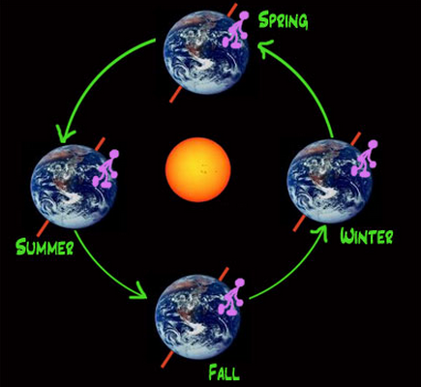

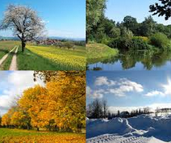
Key vocabulary
Term: season
Definition: one of the four periods (spring, summer, autumn, and winter) during the year
Draw:

Slide 4
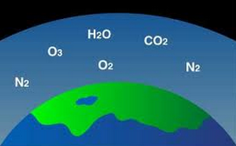
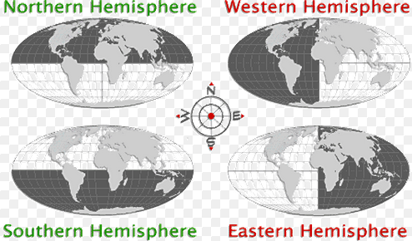
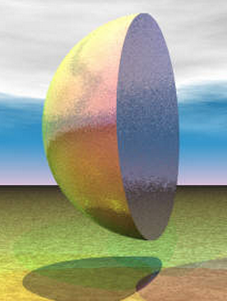
Key vocabulary of the week
Term: hemisphere
Definition: one half of the Earth
Term: atmosphere
Definition: a mass of gases surrounding a planet or star

Slide 5
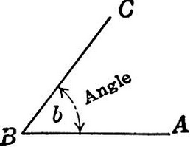
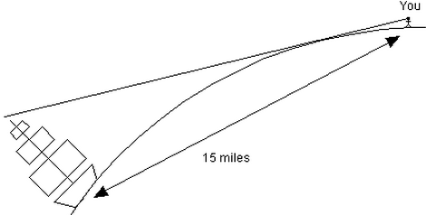
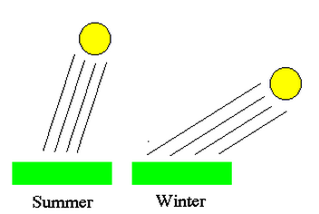
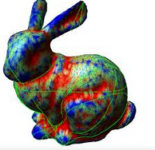
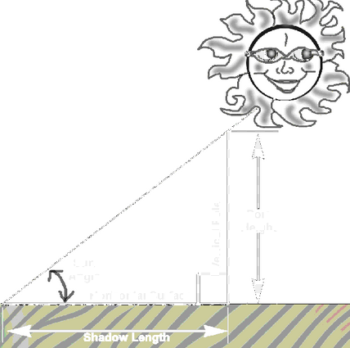
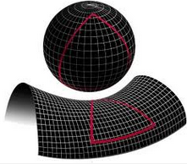
Key vocabulary of the week
Term: angle
Definition: the space/shape formed by two lines/ surfaces meeting each other
Term: curvature
Definition: the amount to which something has a rounded shape

Slide 6
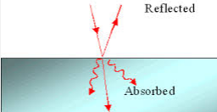
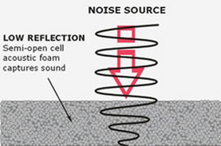
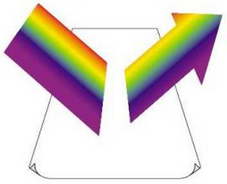
Key vocabulary of the week
Term: absorb
Definition: to take in (heat, light, energy, etc.)
Term: reflect
Definition: to cause something moving (heat, light, energy, etc.) to move in a different direction (to bounce away)

Slide 7
Meet someone who speaks your language and…
Explain your definitions & drawings using your native language for these words:
Season
Hemisphere
Atmosphere
Angle
Curvature
Absorb
Reflect
Also, make sure that you understand/remember:
Axis
Tilt
Rotate

Slide 8
At home
Study the words while thinking about the images that best describe/represent the word

Slide 9
Tuesday
Whole class review (calling on volunteers)
Picture match
Homework:
  Spelling pyramid
  Write 1-2 sentences using the words from the spelling pyramid + sentence frames

Slide 10
Picture Match
Step 1: Take the words out from the envelope
Step 2: Read the words out loud & think about images that describe the words
Step 3: Match the words & the pictures
Step 4: Explain your match using the sentence starter below
I chose this word because the picture shows__________
an example of…
                something that …
                an object that…
                the formula for…
Notes:
Materials:
Picture board (1 per 2 students)
Cut-off vocabulary words (1 set per 2 students)
Facilitation: Modeling (a) directions, (b) how to use the sentence starter, and (c) corrective feedback (re-phrasing student sentences during the whole class review of the picture match

Slide 11
At home
Study the word definitions
Complete:
  Spelling pyramid
  Write 1-2 sentences using the words from the spelling pyramid + sentence frames

Slide 12
Wednesday
Whole class review (tennis ball)
Sentence review

Slide 13
Spelling pyramid + sentence check
With a partner…
Check each other’s pyramids + sentences
Find 1 positive thing about your partner’s sentences
Give 1 suggestion for improvement

Slide 14
At home
Teach the words to someone else

Slide 15
Thursday
“Card Game” OR “Jeopardy” OR Charades
Homework:
  Get ready for the quiz

Slide 16
Card Game
Setp1: The Reader takes the card and reads the word
Step 2: Player #1 provides a definition, description, or an example of the target word
Step 3: The team decides if the answer is correct
Step 4: If the answer is correct, Player #1 keeps the card & becomes the Reader for the next Player.
Step 5: Continue until there is no more cards in the set.
The Player with the most card wins.

Slide 17
Jeopardy: Round 1
Step 1: Form 2 teams & select a Host
Step 2: 1 person from each team approaches the host table
Step 3: The Host reads 1 word, the player who “hits” the Host’s table first, gets to provide a definition. The correct definition gets the team 1 point.
Step 4: Repeat Steps 2 & 3 with new players fro each team.

Slide 18
Jeopardy: Round 2
Step 1: Each team gets a set of 4 key words
Step 2: The teams develop and write sentences with the 4 words on blank sentence strips
Step 3: Each sentence that is accurate gets the team 2 points (1 pt. science + 1pt. English)
The team with the most points from Rounds 1 & 2 wins.

Slide 19
Homework:
Get ready for the quiz

Slide 20
Friday
Quiz
“Square” the level of word understanding (1- 4)

Slide 21
© Materials copyrighted by the University of Louisville.
Educators are free to use these materials with the proper acknowledgement of source.

