Slide 1
Monday
Direct instruction
Vocabulary journal entries (word description, translation, & drawing)
Pictionary

Slide 2
Key vocabulary of the week
Acceleration/Deceleration
Constant speed
Exert a force/Experience a force
Number/Amount
Increase/Decrease
Other important vocabulary:
Upward/Downward
Opposite

Slide 3
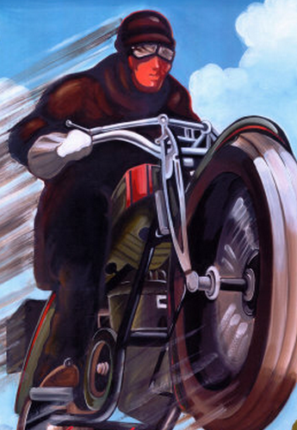
Key vocabulary of the week
Term: acceleration (n)
Definition: the act or process of moving faster
Draw:

Slide 4
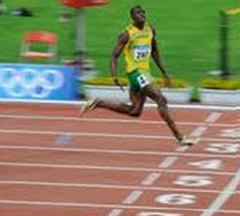
Key vocabulary of the week
Term: deceleration (n)
Definition: the act or process of moving slower
Draw:

Slide 5
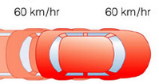
Key vocabulary of the week
Term: constant speed
Definition: the speed that is staying the same; not changing
Draw:

Slide 6
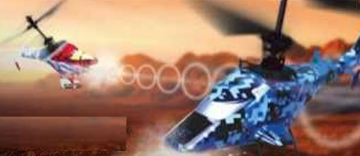
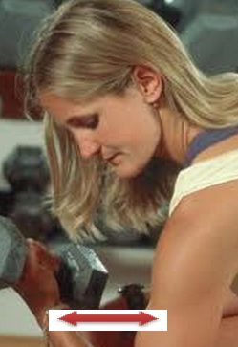
Key vocabulary of the week
Term: exert a force
Definition: to use a force
Also: exert strength, ability, etc.
Term: experience a force
Definition: to receive, feel a force
Also: experience stress, emotions, etc.

Slide 7
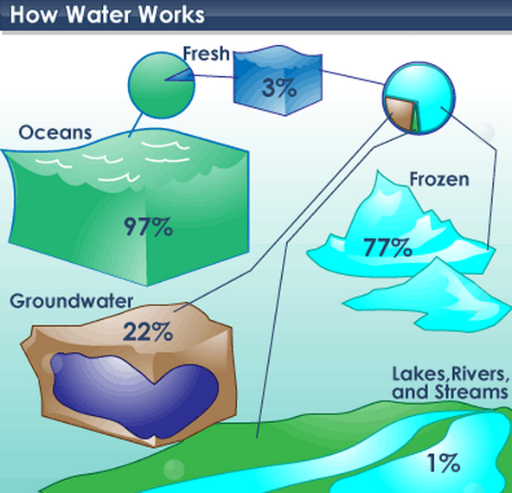
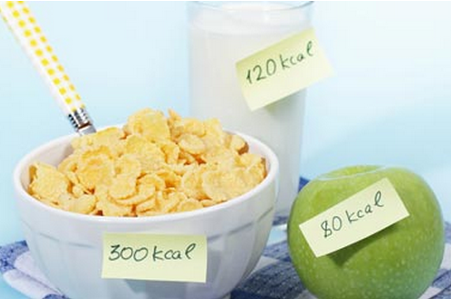
Key vocabulary of the week
Term: number (n)
Definition: a quantity of something that can be counted (such as people, things)
Draw:
Term: amount (n)
Definition: a quantity of something that cannot be counted (such as information, effort, force)
Draw:

Slide 8
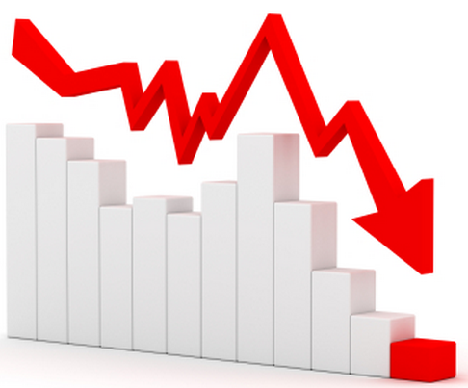
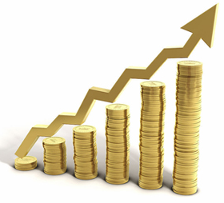
Key vocabulary of the week
Term: increase (v)
Definition: to become larger or greater in size, amount, number
Draw:
Term: decrease (v)
Definition: to become smaller in size, amount, number
Draw:

Slide 9
Pictionary
Working with a partner, find the word that best fits the picture.
Notes:
Materials for Pictionary:
Picture board (1 per 2 students)
Cut-off vocabulary words (1 set per 2 students)

Slide 10
Tuesday
Charade
Spelling pyramid
Working with a partner, write 1-2 sentences using the words

Slide 11
Charade
Use your arms, legs, and bodies to show that you know the meaning of the key word.
Option 1: Teacher calls the words, kids standing next to their desks show what the word means with their hands, motions, body language.
Option 2: Teacher give a word to each table, the table creates the charade, the class guesses.
Notes:
Materials for Option 2: 1 cut-out word per table

Slide 12
Spelling Pyramid
Using the example on your hand-out, build the Spelling pyramid for each key word:
Working with a partner, write 1-2 sentences using the words from the spelling pyramid
Amount
a
am
amo
amou
amoun
amount

Slide 13
Wednesday
Card game

Slide 14
Card Game
Setp1: The Reader takes the card and reads the word
Step 2: Player #1 provides a definition, description, or an example of the target word
Step 3: If answer is correct, Player #1 keeps the card & becomes the Reader for the next Player.
Step 4: Continue until there is no more cards in the set.
The Player with the most card wins.

Slide 15
Thursday
“Jeopardy”

Slide 16
Jeopardy: Round 1
Step 1: Form 2 teams & select a Host
Step 2: 1 person from each team approaches the host table
Step 3: The Host reads 1 word, the player who “hits” the Host’s table first, gets to provide a definition. The correct definition gets the team 1 point.
Step 4: Repeat Steps 2 & 3 with new players fro each team.

Slide 17
Jeopardy: Round 2
Step 1: Each team gets a set of 4 key words
Step 2: The teams develop and write sentences with the 4 words on blank sentence strips
Step 3: Each sentence that is accurate gets the team 1 point.
The team with the most points from Rounds 1 & 2 wins.

Slide 18
Friday
Quiz
Assess level of word understanding in the vocabulary journal

Slide 19
# | Sentence | Letter | Correct
 | The pilot increased the speed of the plane to take off . | G.
2. | We say that a car is accelerating when its velocity is increasing. | A.
3. | Stopping a high-seed baseball requires a great amount of force. | B.
4. | Movement up is called upward movement; movement down is called downward movement. | H.
5. | When an athlete kicks a ball, the ball exerts an equal and opposing force in return. | E.
6. | The driver decreased her speed as she approached the stop sign. | D.
7. | The amount of force experienced by the ball is equal to the amount of force applied by the player kicking the ball. | F.
8. | When a car is moving with no change in velocity, we say that the car is moving at constant speed. | C.

Slide 20
© Materials copyrighted by the University of Louisville.
Educators are free to use these materials with the proper acknowledgement of source.

