Slide 1
Reaffirmation of Accreditation @ UofL
October 14, 2014

Slide 2
Brief History
1895 - Southern Association of Colleges and Schools (SACS) began
1915 – UofL first accredited by SACS
2007 – UofL last reaffirmed as Level V institution (Bachelor’s, Master’s, Specialist, Doctoral and First-Professional degrees)
2017 – Next Reaffirmation

Slide 3
Reaffirmation Process
The Principles of Accreditation provide for: | Responsible Party:
Compliance Certification—16 Core Requirements; 72 Comprehensive Standards; 9 Federal Requirements | Institution
Off-Site Peer Review of Compliance Certification | Commission
Quality Enhancement Plan (QEP) | Institution
On-Site Peer Review of QEP | Commission
Commission Review of Results and Judgment | Commission

Slide 4
2017 Reaffirmation of Accreditation
Compliance
Certification
Audit of university compliance
Submitted September 2016
Reviewed by Off-Site Committee
Quality Enhancement Plan (QEP)
Proposed 5-year Student Learning Plan
Submitted 6 weeks prior to On-Site Visit
Reviewed by On-Site Committee – Spring 2017

Slide 5
SACS Committee Organization
Leadership Team
QEP
Development
Committee
Compliance
Certification
Committee

Slide 6
Committee Roles
The Leadership Team will provide general oversight to the process and will approve/sign-off on any final submissions to SACS. This team is headed by the President and the Provost.
The Quality Enhancement Plan Development Committee will develop a document focused on a topic central to the institutional mission and that impacts student learning. The QEP will be reviewed extensively by a variety of constituents.
The Compliance Certification Team will complete an analysis of compliance for each Core Requirement, Comprehensive Standard and Federal Requirement based on the work of the eight subcommittees.

Slide 7
Review Process - Compliance
Core Requirements – institutional mission and effectiveness; educational programs; faculty. In order for an institution to maintain accreditation in good standing without sanction an institution must maintain compliance with all core requirements.
Comprehensive Standards – governance; degree programs; faculty credentials; library and learning resources; student affairs; physical and financial resources. Areas of non-compliance are reported by the on-site visit team to SACSCOC for review and action (directive to the institution with timeframe for remediation).
Federal Requirements – HE Amendments, recruitment; academic policies; publications. SACSCOC under contract to USDOE monitors compliance with the federal standards.

Slide 8
Commonly Cited Principles
Requirement or Standard | Compliance Area
2.8 | Adequacy of full-time faculty
2.5 | Institutional effectiveness
2.12 | Acceptable QEP based on key issues emerging from student learning assessment results
3.2.10 | Administrator evaluations
3.3.1.1 | Student learning improvement based on assessment results
3.3.2 | Acceptable QEP; broad-based involvement, goals, and assessment plan
3.4.3 | Admissions policies published
3.4.7 | Consortial relationships/contractual agreements
3.5.4 | Terminal degrees of faculty (25% rule at baccalaureate level)
3.7.1 | Faculty competence/credentials/transcripts
3.12 | Substantive change

Slide 9
Faculty Credentials (3.7.1)
For all Faculty hires (full-time and part-time) the:
Institution must verify degrees;
Institution must have international credentials evaluated for comparability;
Institution must document qualifications and maintain a personnel file for all faculty (full-time hires - Faculty Personnel Office, Part-time hires – in the academic unit);
Institution must connect qualifications and course outcomes/descriptions; and
Instructional faculty teaching outside of their degree discipline or at a degree level not aligned with their credentials require a justification be written.

Slide 10
Faculty Credentials Roster
1 | 2 | 3 | 4 | 5
Name | Courses Taught | Course Description | Academic Degrees Earned | Other Qualifications/ Experiences
Faculty roster must be completed for a full academic year (2014-15/2015-16)
Data will be derived from PeopleSoft and reviewed for accuracy when preparing the roster.
Primary components of the roster – faculty transcripts, course syllabi and instructor justifications.
Personnel files maintained by the university must support information listed in faculty credentials roster.

Slide 11
Consortial Agreements
3.4.7 | Consortial relationships/contractual agreements - An institution is responsible for ensuring the quality of all course work offered through consortial relationships or contractual agreements and included on its students’ transcripts as credit earned from the institution (i.e joint degrees – UL/UK Executive MBA, articulation agreements – Ultra, consortial agreements – Metroversity, Metropolitian College).
3.13.2 | Collaborative Academic Arrangements: Policy and Procedures (new standard since 2007) - The institution should provide evidence that it has reported to the Commission all collaborative academic arrangements and signed final copies of the agreements (i.e. MPH Program in Pakistan).

Slide 12
Substantive Changes
3.12 | Substantive change - Member institutions are required to notify SACSCOC of institutional changes and, when required, seek approval prior to the initiation of changes (i.e. new branch campus, 50% or more of a program offered at an off-campus location [domestic & international], 50% or more of a program offered via distance education).
 | If an institution fails to follow the substantive change policy and procedures of the SACSCOC, it may lose its Title IV funding or be required by the U.S. Department of Education to reimburse it for money received by the institution for programs related to unreported substantive change. In addition, the institution's case may be referred to the Commission for the imposition of a sanction of for removal from membership. For more information - http://louisville.edu/oapa/substantive-change

Slide 13
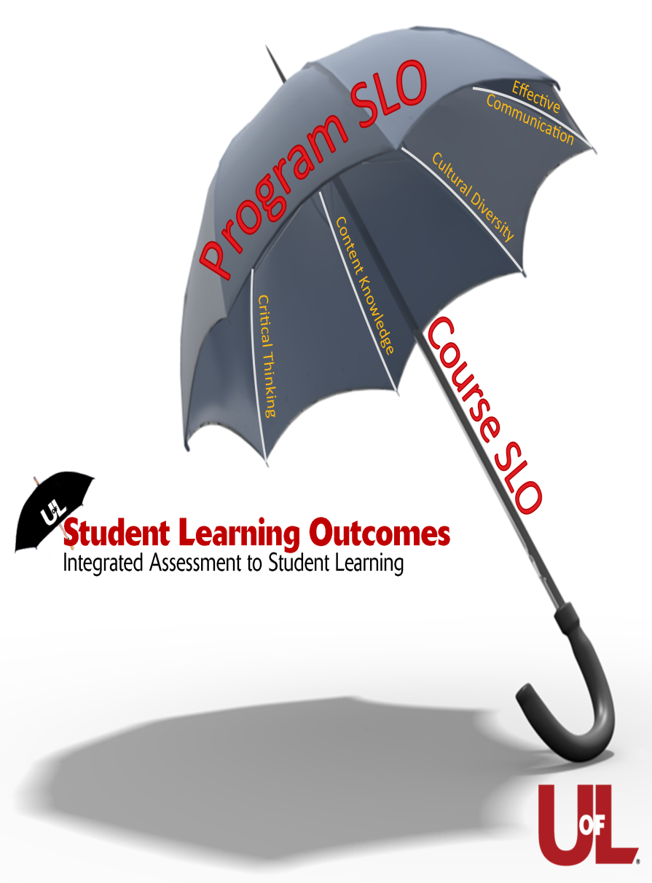
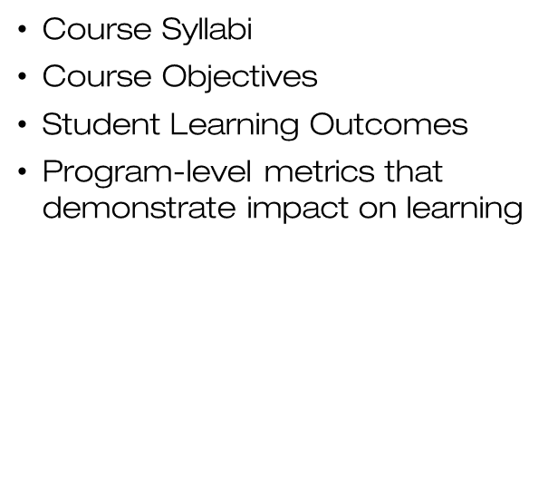
Student Learning Outcomes
(3.3.1.1)
Institutional Effectiveness

Slide 14
Acceptable Quality Enhancement Plan (2.12 & 3.3.2)
QEP
University Mission
Strategic Planning
Assessment

Slide 15
Quality Enhancement Plan
Complement strategic planning and institutional mission
Enhance student learning
Focused and futuristic
Reflect current best practices
Capitalize on university strengths and weaknesses
Engage the university community
75 (+25) Pages
Will be the focus of the SACS on-site visit team

Slide 16
Compliance Assist (CA)
The reaffirmation committee process will use CA to:
Organize information collected to address the compliance standards
Write compliance report drafts and share information to edit and finalize
Compile final QEP report
Organize all evidence and supporting compliance documentation
Publish a complete self-contained report for the external reviewers.

Slide 17
For more information about the 2017 SACS reaffirmation:
http://louisville.edu/oapa/2017-sacs-reaffirmation-project
Office of Academic Planning and Accountability
Robert S. Goldstein
Vice Provost of Institutional Research, Effectiveness and Analytics
Connie C. Shumake
Assistant Provost and Accreditation Liaison

