Slide 1
The HIPAA Privacy Rule and Research with Mobile Devices
NIH No. 1R01CA207538
Working Group Meeting #2
April 24, 2018
Stacey A. Tovino, JD, PhD
Lehman Professor of Law
Founding Director, Health Law Program
UNLV William S. Boyd School of Law

Slide 2
Roadmap
Are there any special issues raised by the application of the HIPAA Privacy Rule to mobile devices, including research with mobile devices?
Are there any elements of the HIPAA Privacy Rule that are important to incorporate in research conducted by researchers who are not regulated by the HIPAA Privacy Rule?
Is voluntary adoption of some HIPAA best practices by unregulated researchers possible and, if so, how?

Slide 3
Application of the HIPAA Privacy Rule
45 C.F.R. § 164.500(a), (c)
Covered entities
Business associates

Slide 4


HIPAA Covered Entities
45 C.F.R. §§ 160.102(a), 160.103
Health plans;
Health care clearinghouses; and
Health care providers who transmit health information in electronic form in connection with certain standard transactions.

Slide 5
HIPAA-Regulated Business Associates
45 C.F.R. § 160.103
Business associate means, with respect to a covered entity, a person who:
  (i) On behalf of such covered entity or of an OHCA in which the covered entity participates, but other than in the capacity of a member of the workforce of such covered entity or OHCA, creates, receives, maintains, or transmits PHI for a function or activity regulated by this subchapter, including claims processing or administration, data analysis, processing or administration, utilization review, quality assurance, patient safety activities, billing, benefit management, practice management, and re-pricing; or
  (ii) Provides, other than in the capacity of a member of the workforce of such covered entity, legal, actuarial, accounting, consulting, data aggregation, management, administrative, accreditation, or financial services to or for such covered entity, or to or for an OHCA in which the covered entity participates, where the provision of the service involves the disclosure of PHI from such covered entity or OHCA, or from another business associate of such covered entity or OHCA, to the person.

Slide 6


HIPAA-Regulated Business Associates

Slide 7
Summary so far
HIPAA-Regulated Researchers. Covered entities and business associates who use and disclose PHI for research are regulated by the HIPAA Privacy Rule.
Non-HIPAA Regulated Researchers: Independent researchers, patients who initiate their own research, and citizen scientists who do not meet the definition of a covered entity or a business associate are not regulated by the HIPAA Privacy Rule. However, HIPAA-like state laws may regulate these researchers. Always check state law.
  See, e.g., Tex. Health & Safety Code § 181.001(b)(2)(A) (defining a covered entity as “any person who: (A) for [almost any reason] engages … in the practice of assembling, collecting, analyzing, using, evaluating, storing, or transmitting protected health information. The term includes a . . . health researcher . . . [and] person who maintains an Internet site; (B) comes into possession of protected health information; [or] (C) obtains or stores protected health information . . . ”).

Slide 8

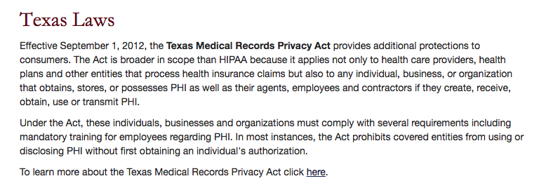

Slide 9
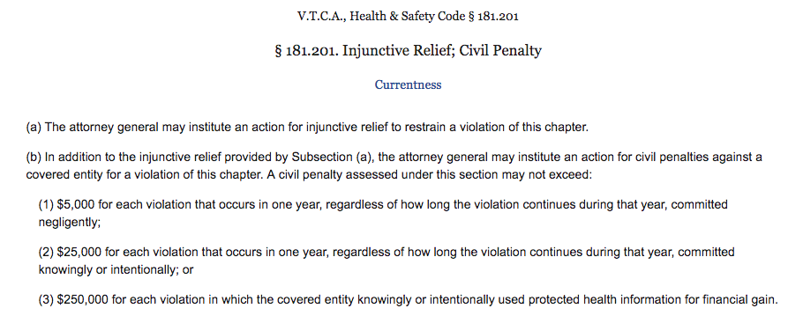
Texas AG Enforcement of Texas Law
Tex. Health & Safety Code § 181.201

Slide 10
Regulation of the use and disclosure of PHI by the HIPAA Privacy Rule (45 C.F.R. Part 164)
1. No prior authorization
    Treatment § 164.506(c)(1), (2)
    Payment § 164.506(c)(1), (3)
    Health care operations § 164.506(c)(1), (4)
    Public policy activities § 164.512(a)-(l)
2. Prior (oral) agreement § 164.510
3. Prior written authorization § 164.508

Slide 11
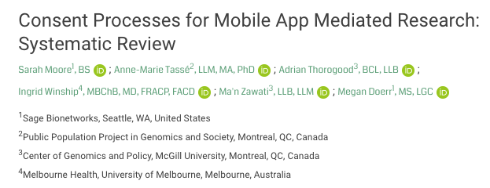
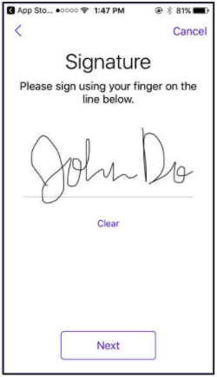

Slide 12
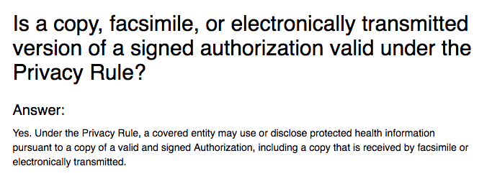
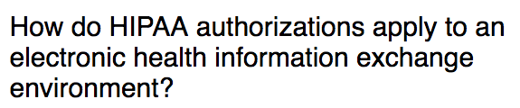

“Electronically transmitted” and “electronically obtained” authorizations are valid under the HIPAA Privacy Rule

Slide 13
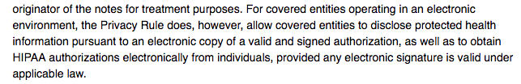
“Electronically transmitted” and “electronically obtained” authorizations are valid under the HIPAA Privacy Rule

Slide 14
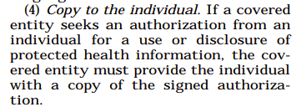
Copy of the signed authorization
45 C.F.R. § 164.508(c)(4)

Slide 15


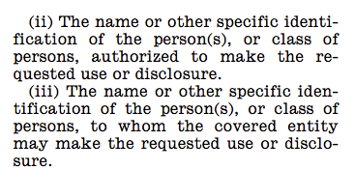
Core Authorization Elements
45 C.F.R. § 164.508(c)(1)(ii), (iii)
Primary investigators, backend collectors,
cloud storage providers,
“qualified researchers,”
etc.

Slide 16
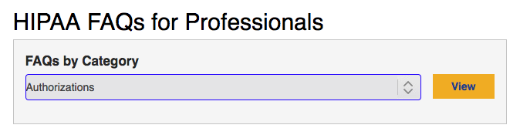
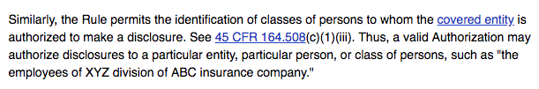
HHS guidance on recipient specificity
(“Particular entity, particular person, or particular class of persons”)

Slide 17
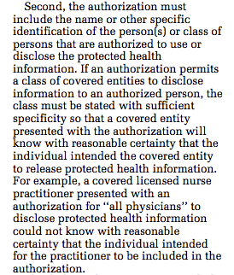
“[T]he class must be stated with sufficient specificity…”
65 Fed. Reg. 82462, 82517 (Dec. 28, 2000)
“All physicians” insufficiently specific; therefore, “all researchers” or even “qualified researchers” without more would also be insufficiently specific.

Slide 18

Core Authorization Elements
45 C.F.R. § 164.508(c)(1)(i)
Parkinson’s research: Voices? Posture? Reaction time?
ALS research: Response to lithium? What else?
Other research: Real-time GPS data? Which identifiers?

Slide 19
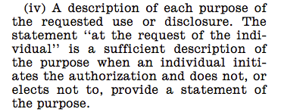

Core Authorization Elements
45 C.F.R. § 164.508(c)(1)(iv)

Slide 20
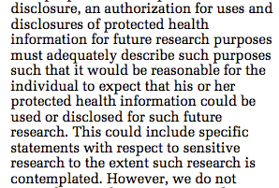
Authorizations for Future Research
78 Fed. Reg. 5566, 5612 (Jan. 25, 2013)

Slide 21
Other Core Elements and Required Statements
45 C.F.R. § 164.508(c)
Expiration date/event
Revocation
Conditioning
Re-disclosure
Signature
Date
Plain language

Slide 22
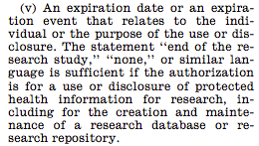
Core Authorization Elements
45 C.F.R. § 164.508(c)(1)(v)

Slide 23
Regulation of the use and disclosure of PHI by the HIPAA Privacy Rule (45 C.F.R. Part 164)
1. No prior authorization
    Treatment § 164.506(c)(1), (2)
    Payment § 164.506(c)(1), (3)
    Health care operations § 164.506(c)(1), (4)
    Public policy activities § 164.512(a)-(l)
2. Prior (oral) agreement § 164.510
3. Prior written authorization § 164.508
Research

Slide 24
Four research-related exceptions to the authorization requirement
45 C.F.R. §§ 164.512(i)(1), 164.514(e)(3)
1. Is the research on decedents’ information?
2. Do the researchers wish to review PHI to prepare a research protocol?
Can an IRB or privacy board approve a waiver of or alteration to the otherwise required HIPAA authorization?
Do the researchers need only a “limited data set” (LDS) of information and will they sign a “data use agreement” (DUA)?

Slide 25
HIPAA Regulated Research and the Individual Rights
45 C.F.R. §§ 164.520-.528
§ 164.520: The notice of privacy practices (NOPP)*
§ 164.522: The right to request restrictions
§ 164.524: The right of access to PHI*
§ 164.526: The right to request amendment of PHI
§ 164.528: The right to an accounting of disclosures*

Slide 26
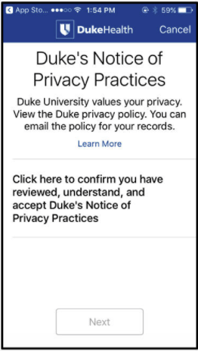

Slide 27
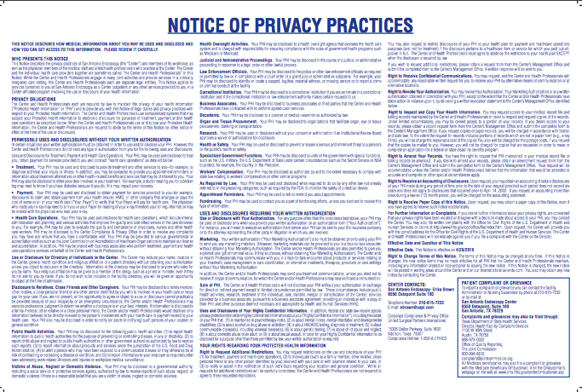
Notice of Privacy Practices
45 C.F.R. § 164.520

Slide 28
HIPAA-Regulated Research and the
Administrative Requirements
(a) Personnel designations
(b) Training
(c) Safeguards
(d) Complaints
(e) Sanctions
(f) Mitigation
(g) Refraining from intimidating or retaliatory acts
(h) Waiver of rights
(i) Policies and procedures
(j) Documentation

Slide 29
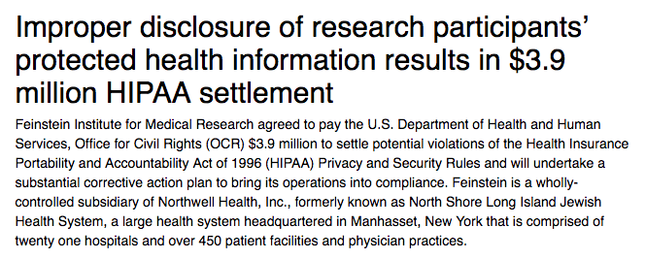
Research institute settles with HHS for $3.9M
(March 2016)

Slide 30
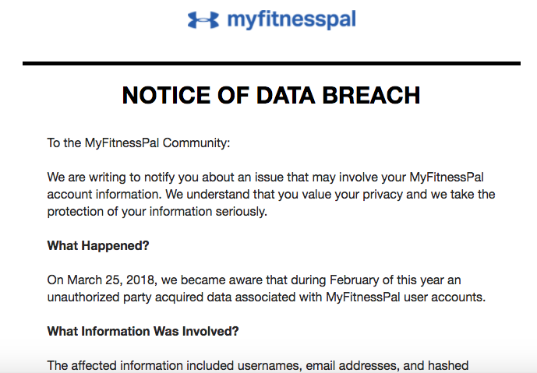

Mobile App Breach Notification
(Mar. 30, 2018)

Slide 31



Slide 32
Federal, state, and international best practices
Carefully written notice of privacy practices
Specific authorization for the use and disclosure of data
Available privacy officer or contact person
Completed risk analysis
Implemented data safeguards
In place breach notification policies and procedures

Slide 33
Summary:
Privacy Challenges for Mobile App-Based Research
Depending on the study, mobile app-based research may involve the gathering of more data and different types of data (e.g., real-time GPS data) compared to traditional research.
Mobile app-based research requires remotely located participants to self-guide through e-disclosure and e-forms, including notices of privacy practices and authorizations for the use and disclosure of their data.
It is unclear whether independent researchers, patients who initiate their own research, and citizen scientists are as familiar (compared to regulated researchers) with industry standards for data privacy and security.

Slide 34
The HIPAA Privacy Rule and Research with Mobile Devices
NIH No. 1R01CA207538
Working Group Meeting #2
April 24, 2018
Stacey A. Tovino, JD, PhD
Lehman Professor of Law
Founding Director, Health Law Program
UNLV William S. Boyd School of Law

Slide 35
Resources

Slide 36
Resources
HHS’s mobile health apps developer portal: https://www.hhs.gov/hipaa/for-professionals/special-topics/developer-portal/index.html
HHS’s website for mobile health apps developers: https://hipaaqsportal.hhs.gov/
FTC’s mobile health apps interactive tool: https://www.ftc.gov/tips-advice/business-center/guidance/mobile-health-apps-interactive-tool

Slide 37
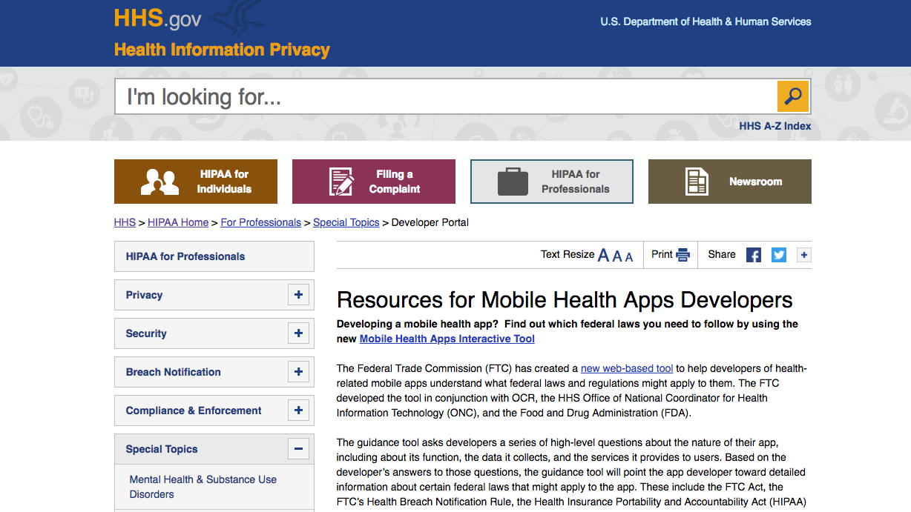
Resources

Slide 38
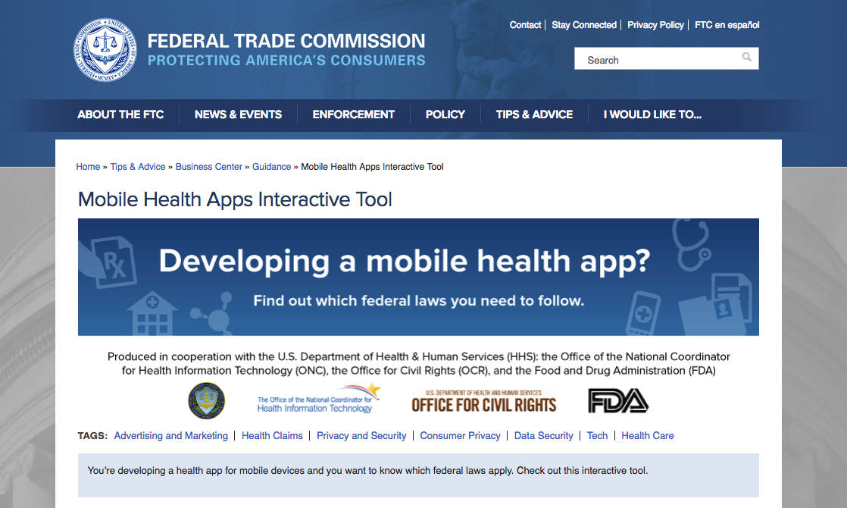
Resources

Slide 39
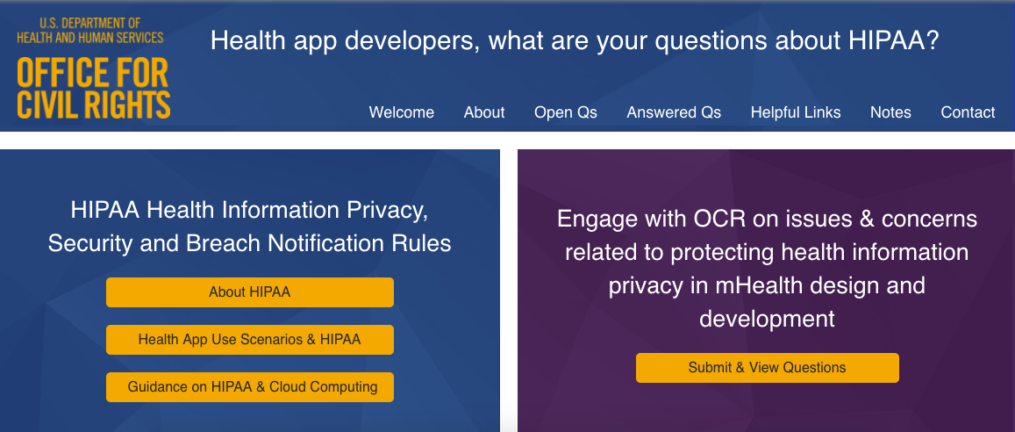
Resources

Slide 40
Resources
The HIPAA Privacy Rule’s regulation of research: https://www.hhs.gov/sites/default/files/ocr/privacy/hipaa/understanding/special/research/research.pdf
HHS’s answers to frequently-asked questions about the HIPAA Privacy Rule’s regulation of research: https://www.hhs.gov/hipaa/for-professionals/faq/research-uses-and-disclosures/index.html
The HIPAA Privacy Rule’s de-identification standard: https://www.hhs.gov/hipaa/for-professionals/privacy/special-topics/de-identification/index.html#standard

Slide 41
HHS’s answers to FAQs regarding electronically transmitted and obtained authorizations
https://www.hhs.gov/hipaa/for-professionals/faq/475/is-a-copy-of-a-signed-authorization-valid/index.html
https://www.hhs.gov/hipaa/for-professionals/faq/554/how-do-hipaa-authorizations-apply-to-electronic-health-information/index.html
https://www.hhs.gov/hipaa/for-professionals/faq/546/does-hipaa-permit-a-covered-entity-to-disclose-psychotherapy-notes/index.html

Slide 42
HHS’s answers to general FAQs regarding authorizations
https://www.hhs.gov/hipaa/for-professionals/faq/473/may-a-valid-authorization-list-categories-of-persons-who-may-use-protected-information/index.html
https://www.hhs.gov/hipaa/for-professionals/faq/472/does-hipaa-permit-a-covered-entity-to-use-or-disclose-protected-health-information/index.html
https://www.hhs.gov/hipaa/for-professionals/faq/477/may-a-covered-entity-disclose-protected-health-information-specified-in-an-authorization/index.html

Slide 43
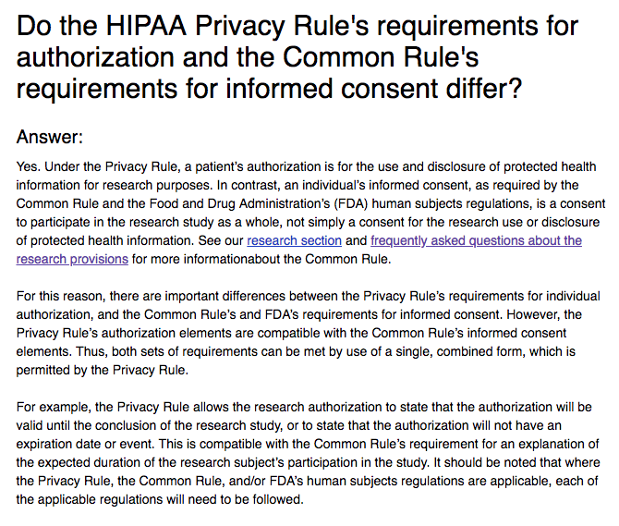
Resources
(HHS Frequently-Asked Question No. 313)

Slide 44
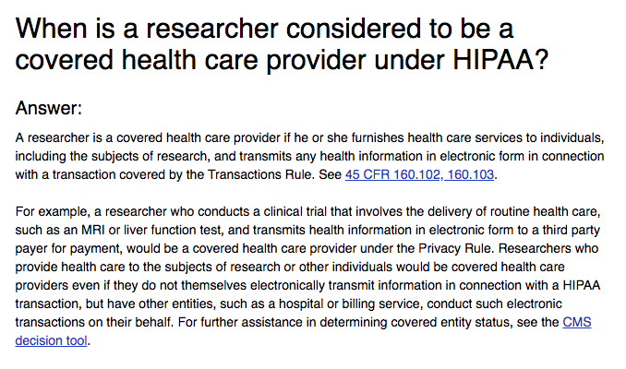
Resources
(HHS Frequently-Asked Question No. 314)

Slide 45
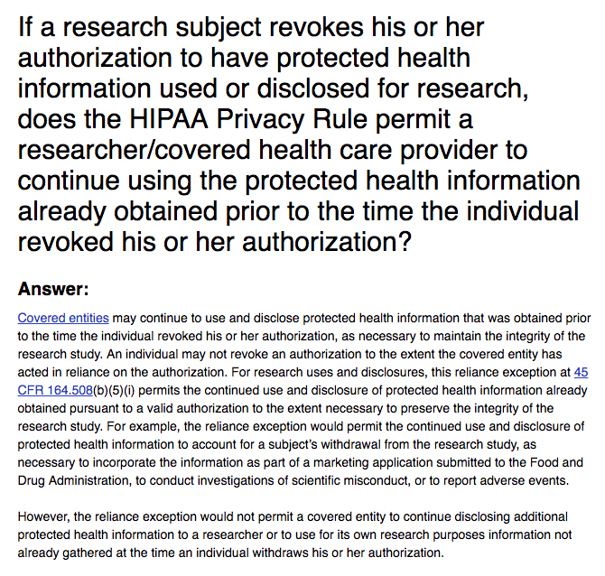
Resources
(HHS Frequently-Asked Question No. 316)

Slide 46
Additional information regarding authorizations

Slide 47
Expiration Dates and
Research-Related Authorizations
“We have determined that an expiration date or event would not always be feasible or desirable for some research uses and disclosures of [PHI]. By allowing for no expiration date, the final Rule permits without separate patient authorization important disclosures even after the termination of the research project that might otherwise be prohibited. However, the final Rule contains the requirement that the patient authorization specify if the authorization would not have an expiration date or event. Therefore, patients will have this information to make an informed decision about whether to sign the authorization.”
67 Fed. Reg. 53182, 53225 (Aug. 14, 2002).

Slide 48
HIPAA authorization: required statements
45 C.F.R. § 164.508(c)(2)
The individual’s right to revoke the authorization in writing, the exceptions to the right to revoke, and a description of how the individual can revoke;
The ability or inability to condition treatment, payment, enrollment or eligibility for benefits on the authorization; and
The potential for information disclosed pursuant to the authorization to be subject to re-disclosure by the recipient and no longer be protected by the HIPAA Privacy Rule.

Slide 49
Revocation of authorization – application to research
67 Fed. Reg. 53182, 53225 (Aug. 14, 2002)
“[HHS] agrees that it may sometimes be necessary to continue using and disclosing [PHI] even after an individual has revoked his or her authorization in order to preserve the integrity of a research study.”
“Therefore, [HHS] . . . would permit the continued use and disclosure of [PHI] already obtained pursuant to a valid authorization to the extent necessary to preserve the integrity of the research study.”

Slide 50
Research exception to general prohibition against compound authorizations
An authorization for use or disclosure of PHI may not be combined with any other document to create a compound authorization, except as follows:
  (i) An authorization for the use or disclosure of PHI for a research study may be combined with any other type of written permission for the same or another research study [including a] consent to participate in research. . . .
  45 C.F.R. § 164.508(b)(3)(i).

Slide 51
Research exception to general prohibition against conditioning
A covered entity may not condition the provision to an individual of treatment, payment, enrollment in the health plan, or eligibility for benefits on the provision of an authorization, except:
  (i) A covered health care provider may condition the provision of research-related treatment on provision of an authorization for the use or disclosure of PHI for such research . . .
  45 C.F.R. § 164.508(b)(4)(i)

Slide 52
Exceptions to the authorization requirement

Slide 53
1. Research on decedents’ information
45 C.F.R. § 164.512(i)(1)(iii)
The covered entity obtains from the researchers:
  (A) a representation that the use or disclosure sought is solely for research on the PHI of decedents;
  (B) documentation, at the request of the covered entity, of the death of such individuals; and
  (C) a representation that the PHI for which use or disclosure is sought is necessary for the research purposes.

Slide 54
2. Reviews preparatory to research
45 C.F.R. § 164.512(i)(1)(ii)
The covered entity obtains from the researchers representations that:
  (A) The use or disclosure is sought solely to review PHI as necessary to prepare a research protocol or for similar purposes preparatory to research;
  (B) No PHI will be removed from the covered entity by the researchers in the course of their review; and
  (C) The PHI for which use or access is sought is necessary for the research purposes.

Slide 55
3. Privacy Board or IRB waiver of authorization
45 C.F.R. §§ 164.512(i)(1)(i), 164.512(i)(2)
(A) The use or disclosure of PHI involves no more than a minimal risk to the privacy of individuals, based on, at least, the presence of the following elements (on next slide);
(B) The research could not practicably be conducted without the waiver or alteration; and
(C) The research could not practicably be conducted without access to and use of the protected health information.

Slide 56
Minimal Risk to Privacy Elements
(See last slide)
(1) Is there an adequate plan to protect identifiers from improper use and disclosure?
(2) Is there an adequate plan to destroy the identifiers at the earliest opportunity consistent with the conduct of the research; or, is there a health or research justification for retaining the identifiers or is such retention otherwise required by law?
(3) Are there adequate written assurances that the PHI will not be reused or disclosed to any other person or entity (except as required or permitted by the HIPAA Privacy Rule or other law)?

Slide 57
Waiver Criterion: “The research could not practicably be conducted without the alteration or waiver.”
Interventional research, such as most clinical trials, could not meet this waiver criterion because “a researcher who would have direct contact with research subjects should, in virtually all cases, be able to seek and obtain patients’ authorization for the use and disclosure of PHI about themselves in a research study.”
“If research could practicably be conducted with authorization, then authorization must be sought. Authorization may not be waived simply for convenience.”
65 Fed. Reg. 82462, 82693 (Dec. 28, 2000)

Slide 58
Waiver Criterion: “The research could not practicably be conducted without access to and use of the protected health information.”
“If a researcher could practicably use de-identified health information for the research study, protected health information should not be used or disclosed for the study without authorization.”
65 Fed. Reg. 82462, 82698 (Dec. 28, 2000)

Slide 59
4. Limited Data Set + Data Use Agreement
45 C.F.R. § 164.514(e)(1), (2), (3)(i), (4)
A covered entity may disclose PHI in a limited data set to a researcher who has entered into an appropriate data use agreement without obtaining prior written authorization of the individuals who are the subject of the PHI.

Slide 60
Direct identifiers that must be removed
45 C.F.R. § 164.514(e)(2)
The following direct identifiers of the individual or of relatives, employers, or household members of the individual must be removed:
  (i) Names;
  (ii) Postal address information other than town/city, State, and zip code;
  (iii) Telephone numbers;
  (iv) Fax numbers;
  (v) E-mail address;
  (vi) Social security numbers;
  (vii) Medical record numbers;
  (viii) Health plan beneficiary numbers;
  (ix) Account numbers;
  (x) Certificate/license numbers;
  (xi) Vehicle identifiers and serial numbers, including license plate numbers;
  (xii) Device identifiers and serial numbers;
  (xiii) Web URLs;
  (xiv) IP addresses;
  (xv) Biometric identifiers, including finger and voice prints; and
  (xvi) Full face photographic images and comparable images.

Slide 61
Identifiers that can remain
Any dates relating to the individual (e.g., admission, discharge, or service dates; birth and death dates); and
Any geographic subdivision other than a street address (e.g., State, county, city, precinct, and five-digit zip code).
67 Fed. Reg. 53182, 53235 (Aug. 14, 2002)

Slide 62
Permissible Forms of a
Data Use Agreement (DUA)
A formal contract;
An informal memorandum of understanding; or
If relevant to an internal use of PHI for research, an agreement between the covered entity and its workforce members (similar to a workplace confidentiality agreement).
67 Fed. Reg. 53182, 53236 (Aug. 14, 2002)

Slide 63
Approaches to Study Recruitment
Direct recruitment: “Under the Rule, a covered entity is permitted to disclose PHI to the individual who is the subject of the information, regardless of the purpose of the disclosure. Therefore, covered health care providers and patients may continue to discuss the option of enrolling in a clinical trial without patient authorization and without an IRB or Privacy Board waiver of patient authorization.”
Indirect recruitment: “However, where a covered entity wants to disclose an individual’s information to a third party for purposes of recruitment in a research study, the covered entity first must obtain either authorization … or a waiver of authorization.”

Slide 64
Research and the Individual Rights

Slide 65
Research and the
Notice of Privacy Practices (NOPP)
If a covered entity plans to disclose PHI without individual authorization pursuant to one of the exceptions to the patient authorization requirement, individuals must be informed of this possibility through the covered entity’s NOPP. See 65 Fed. Reg. 82462, 82695 (Dec. 28, 2000).
  Thus, a covered entity that has a mobile health app, uses that mobile health app to conduct research, and relies on an exception to the authorization requirement to conduct such research must notify individuals through its NOPP that it is so doing.

Slide 66
Research and Access to PHI
65 Fed. Reg. 82462, 82538 (Dec. 28, 2000)
An exception to an individual’s general right to access PHI applies when:
  PHI is obtained by a covered entity in the course of a clinical trial;
  The individual agreed to the denial of access when consenting to participate in the trial (if the individual’s consent was obtained);
  The trial is still in progress; and
  The participants have been informed that their right of access to PHI about them will be reinstated once the research is complete.

Slide 67
Research and the Accounting of Disclosures
45 C.F.R. § 164.528
Covered entities are required to account for disclosures of PHI except for disclosures:
  Uses and disclosures for TPO;
  to an individual about him or herself;
  of directory information or for notification purposes;
  for certain national security and intelligence purposes;
  to certain correctional institutions or law enforcement officials;
  that occurred before April 14, 2003;
  that occurred more than 6 years before the date of the request for the accounting;
  incidental to a permitted use or disclosure;
  made pursuant to an authorization form;
  of a limited data set of information pursuant to a data use agreement.

Slide 68
Application of the HIPAA Privacy Rule

Slide 69
Health Care Providers
45 C.F.R. § 160.103
A provider of services under 42 U.S.C. § 1395x(u);
A provider of medical or health services under 42 § U.S.C. 1395x(s); and
Any other person or organization who furnishes, bills, or is paid for health care in the normal course of business.

Slide 70
1. Providers of Services
42 U.S.C. § 1395x(u)
Hospital
Critical access hospital (CAH)
Skilled nursing facility (SNF)
Comprehensive outpatient rehabilitation facility (CORF)
Home health agency (HHA)
Hospice program

Slide 71
2. Providers of Medical or Health Services
42 U.S.C. § 1395x(s)
Physician’s services
Certified nurse-midwife services
Psychologist services
Clinical social worker services
Durable medical equipment
Ambulance services
Prosthetic devices
Certified registered nurse anesthetist services
Etc.

Slide 72
3. Any other person or organization . . .
45 C.F.R. § 160.103
Health care means care, services, or supplies related to the health of an individual. Health care includes, but is not limited to … :
  Preventive, diagnostic, therapeutic, rehabilitative, maintenance, or palliative care, and counseling, service, assessment or procedure with respect to the physical or mental condition, or functional status, of an individual or that affects the structure or function of the body;
  Sale or dispensing of a drug, device, equipment, or other item pursuant to a prescription.

Slide 73
Standard Transactions
45 C.F.R. § 160.103
Health claims or equivalent encounter information
Health care payment and remittance advice
Health care claim status
Enrollment and disenrollment in a health plan
Eligibility for a health plan
Health plan premium payments
Referral certification and authorization
First report of injury
Health claims attachments
Other transactions that the Secretary of HHS may prescribe by regulations

Slide 74
HIPAA Covered Entities
45 C.F.R. §§ 160.102(a), 160.103
Health plans;
Health care clearinghouses; and
Health care providers who transmit health information in electronic form in connection with certain standard transactions.

Slide 75
Health Plans
45 C.F.R. § 160.103
An individual or group health plan that provides, or pays the cost of, medical care. Examples include, but are not limited to:
  Private health insurance issuers;
  Medicare Parts A-D;
  Medicaid; and
  A group health plan, defined as an employee welfare benefit plan, including insured and self-insured plans, to the extent that the plan provides medical care, including items and services paid for as medical care, to employees or their dependents directly or through insurance, reimbursement, or otherwise, that: (1) has 50 or more participants; or (2) is administered by a third party administrator (TPA).

Slide 76
Note: Researchers are not business associates
“Because the researcher is not conducting a function or activity regulated by the Administrative Simplification Rules, such as payment or health care operations, or providing one of the services listed in the definition of “business associate,” the researcher is not a business associate of the covered entity, and no business associate agreement is required.”
HHS Guidance on Business Associates, at 5 (Apr. 3, 2003)

Slide 77
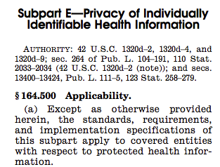

Protected health information (PHI)
45 C.F.R. § 164.500(a), (c)

Slide 78
Individually Identifiable Health Information
45 C.F.R. § 160.103
Information that is a subset of health information, including demographic information collected from an individual, and:
  (1) Is created or received by a health care provider, health plan, employer, or health care clearinghouse; and
  (2) Relates to the past, present, or future physical or mental health or condition of an individual; the provision of health care to an individual; or the past, present, or future payment for the provision of health care to an individual; and
    (i) That identifies the individual; or
    (ii) With respect to which there is a reasonable basis to believe the information can be used to identify the individual.

Slide 79
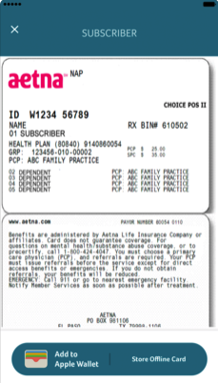
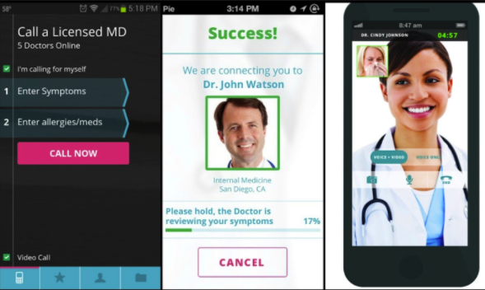
Examples of PHI in mHealth

