Slide 1
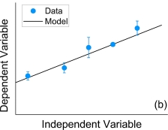
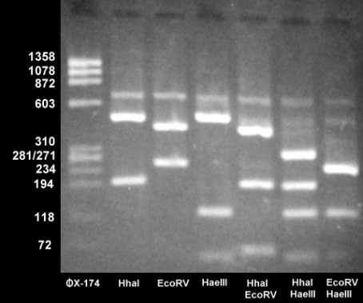
Poster Title: May be in All Capitals
and May Be on Two Lines
John B. Doe, M.D., Julie M. Partner, M.S., Jane P. Sample, M.D., Ph.D., Paul F. Comrade, M.D. Distinction in [Your Track] University of Louisville, School of Medicine
Introduction
Results
CONCLUSIONS
Template Instructions
This template contains poster elements you can populate with your own content.
We have provided a standardized combination of background color and shading, title and author lines, section headings, text boxes with 36 point Arial black font on white background, and bullets
You can highlight and replace the current text in any text box with your own content.
We recommend keeping the text at least 36 point Arial and in bulleted format for ease of reading
To rearrange the center panel, you can copy and paste any given text box from the sides to a new location, then add text to the new text box.
Keep “Gridlines” turned (on the View tab, click “Gridlines”) on while building the poster to help you align boxes and titles
Remember. for posters, color, readability and alignment are important!
Figure 1
Table
Tips from UofL IT Imaging Services
HELPFUL POSTOR INSTRUCTIONS
For best results, use Arial font.
For special characters, use the menu to “Insert” “Symbol”, scroll down, select the character needed
This template is set for a 36 inch by 56 inch poster
3ft is the maximum height if your poster is to be laminated
Lamination is recommended for posters which will travel or be presented more than once.
Lamination costs extra
Posters on glossy paper that will not be laminated may be up to 44 inches high
Posters may be wider than 56 inches if necessary.
When your poster is ready to be printed, send it via email to Stephan Alfred in I.T. Imaging Services, Dental School basement, as an attachment
stephan.alfred@louisville.edu
You will need to pay in advance for poster printing
ADDITIONAL RESOURCES ON POSTER DESIGN
http://omerad.msu.edu/meded/poster_intro.html
 | Experimental Group n = 16 | Control Group n = 15 | p
Protein Assay ABC | 15.1 ± 0.7 | 11.9 ± 0.6 | 0.033 *
Enzyme Assay XYZ | 42.6 ± 1.3 | 32.0 ± 1.7 | 0.078
Likert Scale 1 to 5 | 3.0 ± 0.7 | 3.3 ± 0.9 | 0.988
Table: Be sure to highlight your results by adding captions to any figure, table, diagram, or photo whenever possible. * p < 0.05
Figure 2
Figure 3
Hypothesis
We hypothesize that:
Put your first hypothesis here
Put your second hypothesis here
Or put your purpose(s) for doing the study here
Future Study
Put Fig 2 caption here, highlight any findings
Never stretch an image or a logo without ensuring the dimensions are locked
Hold the SHIFT key as you drag a corner to keep dimensions intact
Consider cropping the image if it does not fit the desired spatial needs on the poster
Never crop or distort the UofL logo or the DT logo.
Fig 3 caption goes here. Highlight the results.
Methods
Tables, graphs, and photos: x and y axes clearly marked, font large and easily readable, use error bars, or ± SEM (SD) as much as possible, align decimals, use COLOR!!! .Highlight significant p values whenever possible, e.g. * p < 0.05
Summarize your Methods succinctly in bulleted format
Be concise and precise
Succinct Phrases are better than complete sentences
Be sure to mention whether your study was approved by the UofL IRB, IACUC, or other body
As you edit your poster, zoom in repeatedly to edit text, and zoom out to see the entire poster.
Results Subheading 1 (optional subheading, use your own words)
From the Reader’s standpoint, your RESULTS are the MOST important part of your poster
Display your results in the top middle section of your poster, never the bottom
Use color to your advantage!
As shown in this template, try to employ photographs, large font, and easy to read colorful graphs and tables
Be sure to highlight your results with captions beneath any figure, table, diagram, or photo
Remember to report results as mean ± SD or mean ± SEM, and include error bars on all graphs
HINT: it’s often easier to build and edit tables in EXCEL and then copy paste the final product into PowerPoint
Be consistent with your decimal places when reporting numerical values. Align decimals in tables
Use a desktop computer rather than a laptop computer to refine your poster before printing. Better visuals!
Bibliography
Use the lower portions of the poster for the less important information to the Reader such as methods bibliography, and acknowledgments.
Bibliography font may be smaller than 36 point, and only 3 or 4 articles are needed

