Slide 1
Financial Aid – Pre-Orientation
Angela M. Hall, MSM
SOM Financial Aid Coordinator

Slide 2
Financial Aid Office
Part of SOM Student Affairs
Staff:
Leslie R. Kaelin M.Ed.-Director, SOM Financial Aid
A Building-Room A-204
Angela M. Hall MSM – SOM Financial Aid Coordinator
A Building-Room A-205
(Our offices are across from the SOM Student Affairs Office)
Office hours:
M-F 8:30 a.m.-4:30 p.m.
Phone: 502-852-5187

Slide 3
SOM Financial Aid Office Services Provided:
Financial Aid Awarding, Loan Counseling & Problem Solving
SOM Financial Aid Website: www.Louisville.edu/medicine/financialaid
Financial Literacy Programing and Information
“The Price is Right” - Setting Goals & Budgeting - M1
“So, you want to be a Millionaire?” - Credit Basics - M2
“Financing a House” Webinars - M3 & M4
“AAMC FIRST” Webinars (wide range of topics) for all classes
Loan Entrance & Exit Counseling - Individual/Group Sessions
Fiscal & Posting Responsibility for SOM Scholarship Accounts
Credit Counseling Assistance and Referral, as needed
Budgeting and Loan Borrowing Planning, as needed
LCME & Federal Financial Aid Reporting
Catch All - If you are not sure who to, ask us and we will get you to the correct office or find the answer for you!

Slide 4
WHAT TO EXPECT
If a FAFSA is on file, at the end of May/beginning of June (this process differs yearly), you will be packaged with loans. You will be notified once you have been packaged so that you know when to go onto ULink to accept/reduce/deny loans.
Use the COA to budget!
Please plan to have FAFSA on file by March 1st
During the first week of July, the Bursar’s office will post student bills for fall semester, once they do, you will be able to view to your balance. An email will be sent notifying you.
If eligible, you will need to waive the major medical insurance (each semester) by the deadline provided by Academic Health Plans (they will send emails each semester with this information).
Once your aid has disbursed on your student account, the Bursar’s office will send any residual funds to your Nelnet account, based off your selection on how to receive it. You will be notified by Nelnet when they receive these funds. This is typically within 2 to 5 business days of your disbursement.
*You can expect fall aid disbursement during Orientation week*

Slide 5
Bursar's Office – Student Billing
All Tuition & Fees listed on COA: billed half in the fall and half in the spring
When does the Bursar's office post student bills?
Fall Semester – First week of July
Spring Semester – Late November
Major medical health insurance will automatically be placed on your account during billing; it is required to have.
If eligible, you can waive the automatic charge if you have qualifying insurance coverage already.
Books and Supplies – Estimated (not billed)
This Photo by Unknown Author is licensed under CC BY-NC

Slide 6
Total Cost of Attendance (COA) explained
What’s in it?
Tuition and required fees (Billed as a fixed/direct cost by Bursar)
Required Books, Course Materials, Supplies & Equipment (Includes Board Exams, not a direct cost)
Food and Housing
Transportation
Misc. Personal Expenses (Includes Major Medical Insurance & loan fees)
May include (by special request and documentation):
Dependent childcare expenses, if eligible-(Professional Judgement)
Expenses associated with a disability, if eligible-(Professional Judgement)
Excessive Medical expenses of the student-(Professional Judgement)
This Photo by Unknown Author is licensed under CC BY-ND

Slide 7
Fixed Charges the Bursar’s Office place on your Student bill Per semester:
SOM Tuition & Fees (examples from 24-25 academic year):
KY Resident - $23,353
Non-Resident - $35,471
HSC Health fee - $52.50
SOM Technology fee - $625
Major Health Insurance - $1551.50
Can waive, if you have major medical insurance!
University Recreation fee - $98
SOM Disability Insurance fee - $55 (Fall only)
MD Drug Test Fee – $49 (M3 year, Fall only)
NOTE: All listed figures are estimated until Board of Trustees approve T&F for following year

Slide 8
Books and Supplies
What we include:
Current Books and Supplies for
24-25 Estimated Non-Direct Charges:
1st year $1,332
2nd year $1,584
3rd year $1,490
4th year $2,420
Books/Supplies/Equipment
Exam Fees (Step 1 & 2)
Costs for Residency Applications

Slide 9
Living Expenses in the COA
What we include:
Current Living Expenses for
24-25 Estimated/Non-Direct amounts:
1st year $28,058 (10 months)
2nd year $30,822 (11 months)
3rd year $33,583 (12 months)
4th year $28,058 (10 months)
Food and Housing
Transportation
Personal Expenses
Loan Fees
Major Medical Insurance

Slide 10
UofL Ulink Student Account
Visit:
http://www.ulink.louisville.edu/
Here you can:
- Visit “Financial Aid” to accept/deny/reduce awards
-Visit “Financial Tile” to view balances, pay bills, and set up Student Choice refund account (Nelnet).
- Can also click on “Tasks”
Print any documents requesting to be completed

Slide 11
Now that you are accepted,
How will you pay for medical school?
Scholarships?
Other outside sources?
Loans?
Payments?
This Photo by Unknown Author is licensed under CC BY-ND

Slide 12
Scholarships Offered by UofL Admissions
All incoming student scholarship awards are offered by the SOM Admissions Office. No application is needed. Please contact the SOM Admissions Office for additional information, 502-852-5193.
Financial aid is notified of the awards and will automatically have them added to student accounts.
“We have a scholarship committee which looks at applicants, our various scholarship sources and our mission statement and makes recommendations on how to use the too-limited funds. Funding changes from year to year based on the amount in and return on the University foundation investments, as well as the amount of additional support the administration is able to give to scholarships. Given our interest in attracting an excellent and diverse group of students, the amount per student does end up being less than we wish it were.”
SOM Admissions Office

Slide 13
Outside Scholarships to research:
Types: (Some have commitments)
Military HPSP (Health Professions Scholarship Program)
Veterans HPSP
Vocational Rehab
Veteran's Benefits (All Chapters)
Religions Affiliation
Ethnicity
Employer offered
Practice interests
NHSC (National Health Service Corp)
National Medical Fellowships Scholarships
We have additional outside scholarships listed on our SOM Financial Aid webpage.
Scholarship Websites:
Fastweb.com, College Board, scholarships.com, finaid.org

Slide 14
Outside Scholarships must be reported
All outside scholarships or aid must be reported to SOM Financial Aid as soon as you know of the award, failure to do so can create an unnecessary over award you will be responsible to pay back. It can/will impact the amount of Unsub loan you can receive.
Some EXAMPLES:
Received Military Scholarship that covers all tuition
NHSC Scholarships (National Health Service Corp)
Daviess County Medical Society
Community or Outside Scholarships
National Medical Fellowships Scholarships
Important Notes:
If tuition was initially paid by loans, we may have to reduce the loan(s) to “fit in” your scholarship with the COA.
If you receive a UofL scholarship, and later an outside scholarship that covers full tuition/fees, your UofL scholarship will be cancelled out.

Slide 15
Applying for Federal aid (loans)
Create an FSA ID then complete the current year FAFSA online at www.studentaid.gov
-FAFSA’s are usually available each October 1st, (apply each academic year!)
-Use UofL School code: 001999
Complete online at www.studentaid.gov (Loans and Grants dropdown menu):
Master Promissory Note(s) (MPN’s)
Unsub loans and the Grad PLUS loan each have their own (complete both if you plan to use the PLUS loan).
Entrance Counseling
Complete any forms requested by Financial Aid Office on “To do” task list at www.ulink.louisville.edu
This Photo by Unknown Author is licensed under CC BY-ND

Slide 16
Federal Direct unsubsidized Loan
The combined aggregate for Sub and Unsub loan limits is $224,000 max (including undergrad loans).
Current Fixed interest rate: 8.08% *Disbursed on or After July 1, 2024, and Before July 1, 2025
Federal Loan Fee for Unsub: 1.057% *On or after 10/1/20 and before 10/1/25
Unsub interest accrues during all loan statuses: in-school, grace, forbearance and deferment.
*Source from https://studentaid.gov/understand-aid/types/loans/interest-rates

Slide 17
Unsubsidized Yearly loan limits
Up to total COA – After all scholarships are applied AND
Maximum yearly Direct Unsubsidized Loan up to:
$42,722 per 10-month academic year (M1 & M4)
Unsubsidized $20,500
Additional Unsubsidized $22,222
$44,944 per 11-month academic year (M2)
Unsubsidized $20,500
Additional Unsub $24,444
$47,167 per 12-month academic year (M3)
Unsubsidized $20,500
Additional Unsub $26,667

Slide 18
Direct unsubsidized Loan…Continued
“Non-Need Based”
Requires Master Promissory Note (MPN) (good for 10-years once loan disburses)
Repayment options: 10 yr. Standard, Extended, Graduated, Income-Driven Repayment: IBR, ICR, PAYE & SAVE (currently paused)
Federal Forgiveness Programs:
Department of Education-”Public Service Loan Forgiveness” (PSLF) - for Eligible Loans
DHHS - “NHSC Loan Forgiveness Program” & “NHSC Students 2 Service Loan Forgiveness Program” - for Eligible Loans
Military Loan Forgiveness Programs - for Eligible Loans

Slide 19
Federal Direct Graduate/Professional Plus Loan
Limit - Up to COA: (After all Scholarships and Max. Direct Unsubsidized Loan awarded)
Fixed interest rate: 9.08% *Disbursed on or After July 1, 2024, and Before July 1, 2025
Federal Loan Fee: 4.228% *On or after 10/1/20 and before 10/1/25
Like the Unsub loan, interest will accrue during all periods: In-School, Grace, Forbearance, Deferment
*Source from https://studentaid.gov/understand-aid/types/loans/interest-rates

Slide 20
Direct Graduate/Professional Plus Loan…Continued
“Non-Need Based”
Requires a separate Master Promissory Note - MPN (also good for 10 years once loan disburses)
Graduate/Professional Student as Borrower (not a parent!)
Credit process by Dept. of Education (borrower can be denied loan w/adverse credit history)
Repayment options: 10 yr. standard, Extended, Graduated, Income-Driven Repayment: IBR, ICR, PAYE & SAVE (currently paused)
Federal Forgiveness Programs:
Department of Education - ”Public Service Loan Forgiveness” (PSLF) - for Eligible Loan
DHHS - “NHSC Loan Forgiveness Program” & “NHSC Students 2 Service Loan Forgiveness Program” – for Eligible Loans
Military Loan Forgiveness Programs - for Eligible Loans

Slide 21
Department of Health and Human Services - Title VII Loan Programs
Primary Care Loan (PCL)
Loan for Disadvantaged Students (LDS)
Only students that are interested in being considered for the two HRSA/DHHS Loan Programs must provide parental data!
(household size and number in college)

Slide 22
Primary Care Loan (PCL)
Must be in Primary Care Residency & Practice: Pediatrics, Internal Medicine, Medicine/Pediatrics, Family Practice and Preventive Medicine – NO SPECIALITIES
Fixed Interest Rate - 5%
Penalties for Non-Primary Care Residency and Practice-becomes a 7% interest rate & immediate repayment required
Subsidized during in-school and approved Primary Care Residency period (up to 4 years)
10-year Level Repayment (120 equal payments) - no income determined repayment plans

Slide 23
Primary Care Loan (PCL) Continued
MUST PROVIDE PARENTAL DATA (unless student is 24 years of age and has not been claimed on parent’s tax returns for the last 3 years - if so, student signs a “Verification Exemption Statement”)
PCL is not eligible for federal forgiveness programs.
Department of Education-”Public Service Loan Forgiveness Program” (PSLF)
“NHSC Loan Forgiveness Program” & “NHSC Students 2 Service Loan Forgiveness Program”
Contact SOM Financial Aid, Leslie or myself, if you would like to be considered for PCL during any year of Medical School

Slide 24
Loan for Disadvantage Students (LDS)
Subsidized during in - school and residency
Fixed Interest Rate 5%
Students from PEPP counties are given priority.
MUST PROVIDE PARENTAL DATA - NO EXCEPTIONS - Determination of award based on parental & student income data, this is considered a “need based” loan.
10-year Level Repayment (120 equal payments)
Parental data is required to be reviewed. Individual student eligibility determined, and LDS offered as very limited funds are available
May be eligible for federal forgiveness programs*
”Public Service Loan Forgiveness” (PSLF) - Eligible Loan-Only if consolidated into Direct Consolidation Loan
“NHSC Loan Forgiveness Program” & ”NHSC Students 2 Service Loan Forgiveness Program”- Eligible Loan - Only if consolidated into Direct Consolidation Loan

Slide 25
Making Payments – Bursar Office
The Bursar’s office will place student bills during:
First week of July for fall semester
Thanksgiving week for spring semester
You can find due dates for student bills listed on their website.
The Bursar’s office collects payments on student accounts.
You can make payments on your student account, ULink.
From Checking account – no charge
Credit/Debit Card Payments – 2.75% non-refundable transaction fee.

Slide 26
Receiving Residuals/Refunds
Nelnet Student Choice is UofL’s contracted refunding partner
All students need to sign up/create an account, not just those using Financial Aid
Sign up via ULINK
Set up your preferred method to receive residuals, with Nelnet; we highly recommend direct deposit.
Once there is a credit established on your student account, the Bursar’s office will send that to our third-party, Nelnet, and they send to you; whichever way you set it up.

Slide 27
FIRST Financial Information, Resources, Services & Tools www.aamc.org/FIRST
What can FIRST do for you?
Help you navigate the complexities of student debt
Provide resources to expand your financial literacy skills
Assist you with wisely managing your student debt
-Guide to Money Management and Student Loans- (Essential Reading!)
-AAMC MedLoans Organizer and Calculator
-FIRST Financial Aid FACT Sheets
-FIRST Videos & Webinars
-Budgeting Worksheets for Students & Residents

Slide 28
AAMC Financial Wellness aamc.org/financialwellness
Online education platform
Interactive tools & calculators
Content & activity recommendations tailored to a user’s actions and interests
A Financial Wellness assessment for each user
Mobile/PC/table compatible-amc.org/financialwellness

Slide 29
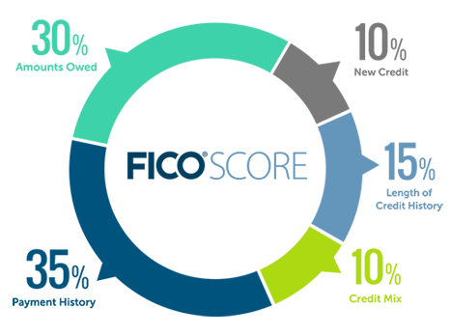
Credit 101
www.annualcreditreport.com
(TransUnion, Experian & Equifax)
Credit Report-provides a snapshot of a borrower’s creditworthiness and helps lenders calculate the amount of risk they will assume when providing a borrower access to borrowed funds.
Credit Score-is a numerical calculation that is based on your financial behavior as reported on your credit report (Payment History, Amounts Owed, Length of Credit History, New Credit & Types of Credit Used)
This Photo by Unknown Author is licensed under CC BY-SA

Slide 30
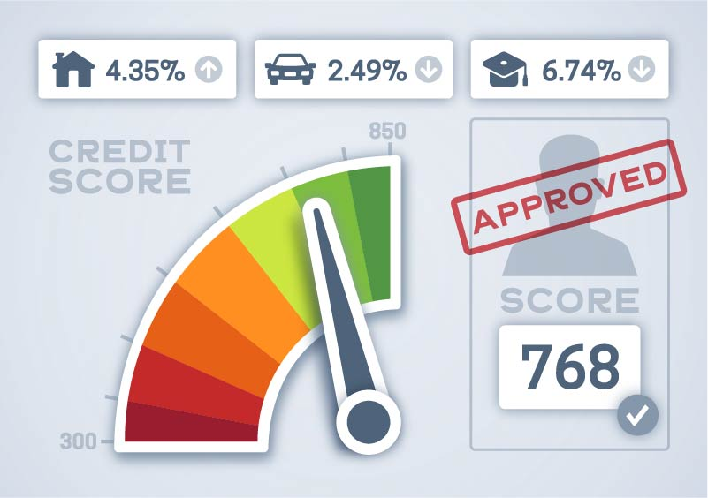
Benefits of Good credit...
Better Loan Offers
Lower Interest Rates
Faster Credit Approvals
Increased Leasing & Rental Options
Reduced Security Deposits
Reduced Premiums for Auto/Home/Renter’s Insurance
…and more.
This Photo by Unknown Author is licensed under CC BY-SA-NC

Slide 31
Contacts
SOM Financial Aid – 502-852-5187 (me directly)
Bursar’s Office – 502-852-6503
Billing & Student Account
Residuals
Third - Party Payments
Invoicing
Academic Health Plans – 855-850-4191
Waiving Major Medical Insurance
Questions regarding eligibility or billing
Your Federal Loan Servicer
Questions regarding accrued interest or interest payments while in school
In-school deferments (where you would get form and turn it in once complete)

Slide 32
Recap
The SOM FA office will be your primary contact for your financial aid needs.
FAFSA’s are available usually Oct 1st every year, they are required to be completed yearly if using loans.
Ulink is a great tool to use to keep up with your account, and where you accept/decline/reduce your aid when offered.
Contact the Bursar’s office with billing questions and/or refunds, make sure to set up your Nelnet account for refunds!
Understand the different types of aid and what you are receiving. We can help!
Please make sure to keep up with your email!

Slide 33
Thank you!
Congratulations to the
Class of 2029 !
See you in July!
-Angela and Leslie
SOM Financial Aid

