Slide 1
Student Loans and Repayment Strategies
Prepared for the Graduating Class of 2020
Leslie R. Kaelin M.Ed.
UofL SOM Financial Aid Director
lrkael01@Louisville.edu
Spring 2020
Disclaimer: All information and estimates are based on AAMC interpretation of federal regulations as of January 2020 and are subject to change. These are estimates only. Students should contact their servicer(s) to discuss exact loan balances and repayment options.
Notes:
The reality is that many people spend more time planning a vacation than planning for their financial future. We do not want you to be one of those people, so if you don’t already have a strategy for managing your student loan debt, we are going to help jump start that process.
Note to SPEAKER: The information provided in this presentation will support the audience’s understanding of how the “exit” topics relate to a medical graduate. It is encouraged that the audience first complete their formal (online) Exit Interview before offering this presentation since this PowerPoint/speaker notes are not intended to satisfy the federal requirements for an Exit Interview.
All information is accurate and compliant with Federal regulations, to the best of our knowledge, as of 1/15/20.

Slide 2
To help you during & after the EXIT…
1. Know your Federal Loan Servicer: FedLoan Servicing (PHEAA), Great Lakes Educational Loan Services, Inc., Navient, Nelnet, CornerStone,
Granite State-GSMR, HESC/Edfinancial, OSLA Servicing or MOHELA
2. MedLoans Organizer and Calculator (MLOC):
aamc.org/medloans
3. Education Debt Manager Booklet: aamc.org/first/edm

Slide 3
Exit Agenda
Average Indebtedness
Basic Federal Loan Facts
Interest Rates & Interest Capitalization
Loan Repayment timeline
Repayment Plans-Select your Repayment Plan
Income Driven Repayment Plans (IDR)-Most likely choice!
Forbearance or Repayment during Residency-Make your plan!
Various Repayment Examples-starting in Residency
MedLoans Organizer and Calculator (MLOC)
Public Service Loan Forgiveness (PSLF)
Federal Loan Consolidation
Should I Refinance?
Helpful Hints
Where to find additional information and assistance

Slide 4
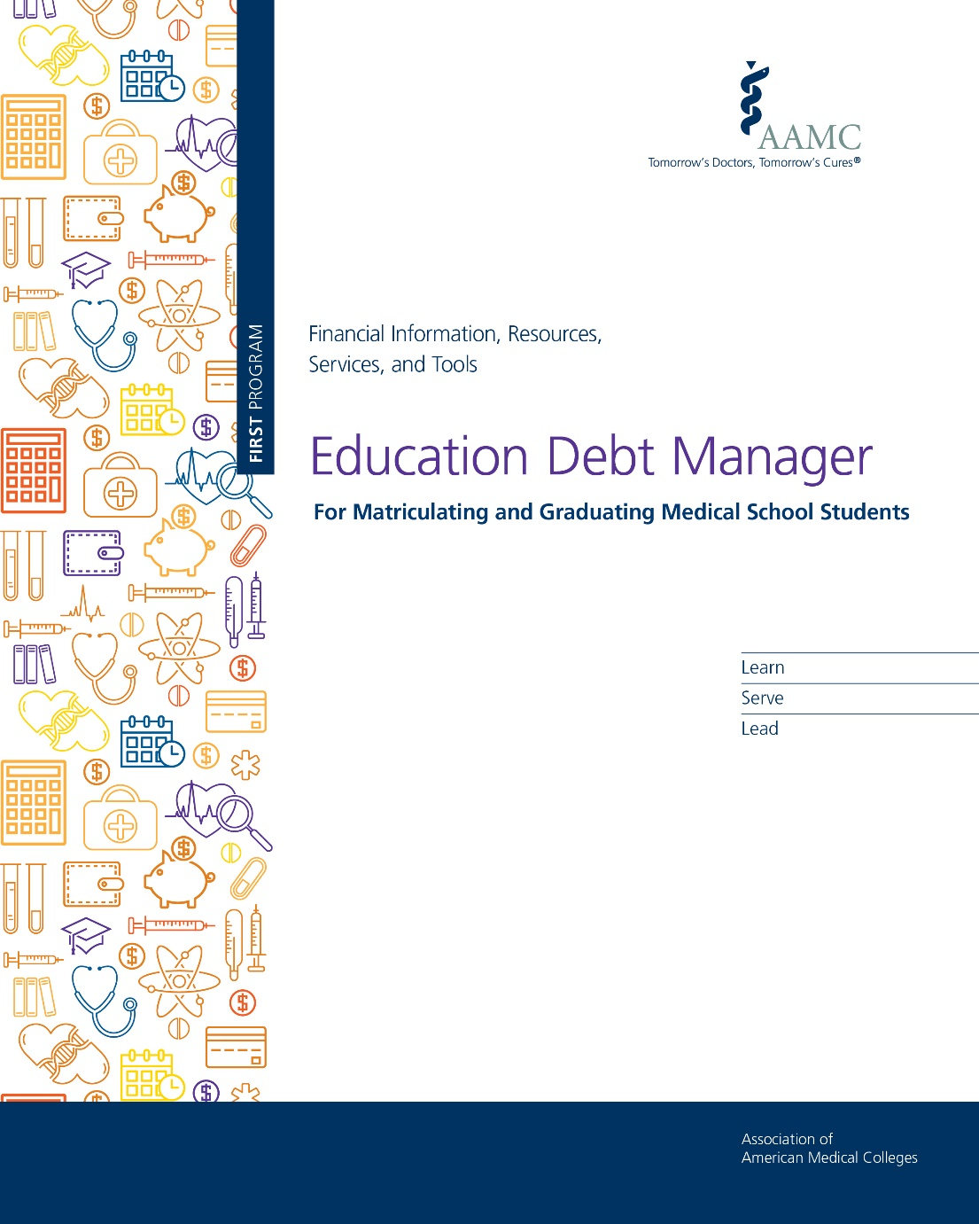
Free Online Resource (PDF Download)
Education Debt Manager (EDM)
aamc.org/first/edm
Notes:
A copy of the Education Debt Manager is available online, aamc.org/first/edm, and it will serve as the best resource/takeaway from this session.

Slide 5
Class of 2019 Indebtedness
Median MD School Debt: $200,000
PUBLIC
private
$200,000
$215,000
Source: AAMC 2019 Graduate Questionnaire (GQ)
73% of class report having education debt
54% report debt of $200,000 or higher
Notes:
Let’s first familiarize ourselves with the landscape of student loan debt: The median level of debt for the class of 2019 was $200,000 (based on public and private MD degree granting schools, and including undergraduate debt), and 73% of last year’s graduates completed their MD education with student loans. Although it may provide little comfort, know that graduating with debt is “the norm” for today’s medical students; you are not alone.
Although the data displayed is from last year’s class, it gives you a point of reference. The AAMC collects this information from students before they graduate, and you too will be asked to share your data regarding your education experience, including debt levels, through a survey called the Graduation Questionnaire (GQ).
The average level of debt here at (SCHOOL NAME) for the class of 2019 was ($AVG DEBT), and the expected average for the class of 2020, will be an estimated (EXPECTED $AVG DEBT).
Today’s presentation focuses primarily on federal loans; however, we will briefly discuss private loans at the end. Additionally, there are several strategies for managing private loans addressed on page 64 of the Education Debt Manager.
Keep in mind, federal loans and private loans are very different, and private loans cannot be included in any of the federal programs that we will discuss today– with the exception of NHSC. If you have private loans in your portfolio, you will need to contact the private lender to learn about your repayment options.
.

Slide 6
University of Louisville SOM Indebtedness (MD Debt only)
Class of 2019 Average Debt: $200,930
Estimated Class of 2020 Average Debt: $203,185
Class of 2020 graduates with zero debt: 29
Estimated as of 3-20-20 by SOM Financial Aid

Slide 7
Master Promissory Note
Is a contract with the lender
Documents your agreement to repay
Details terms and conditions
Includes rights & responsibilities
Notes:
The Master Promissory Note (or MPN) is a good place to find the details for your federal loans.
An MPN is a legally binding agreement between you and your lender.
The MPN is important because it generally details the terms and conditions of the loans and describes your rights and responsibilities as a borrower.
If you can’t locate your MPN, contact your lender or servicer to get a copy.

Slide 8
Rights and Responsibilities
RIGHTS
Prepay any federal loan without penalty
Change repayment plans
Request a deferment or forbearance
Request a shorter repayment schedule
Review the promissory note for all rights
Notes:
When you review your MPN and the Borrower’s Rights and Responsibility Statement, you will see that as a borrower you have a number of specific rights. These include the right to prepay any of your federal loans because there are no prepayment penalties on federal student loans.
Another right, that will serve you well during repayment, is the right to request that your repayment plan be changed (more details about the available repayment plans will be discussed shortly), but just keep in mind that as your financial situation changes, you are able to change your repayment plan. Also, at any time, you can contact your servicer to request a shorter repayment term.
Finally, if you are experiencing financial difficulties or unforeseen circumstances, you have the right to request to reduce or postpone payments through deferment or forbearance. Keep in mind that, though these are your rights, YOU have to be proactive to exercise them, as your servicer will not likely reach out to remind you.
For more details on these and other rights, review the MPN and the Borrower’s Rights and Responsibility Statement.

Slide 9
Rights and Responsibilities
RESPONSIBILITIES
Make on time loan payments
Make payments despite non-receipt of bill
Notify servicer if contact information changes
Complete exit counseling
Review promissory note for all responsibilities
Notes:
The saying goes something like this, “With great rights, comes great responsibility.” Well, that concept holds true with federal student loans. To sum it up: your primary responsibility is to pay your loans back and pay them back on time.
This next part is very important. Your payments are required whether you receive a bill or not. Be sure to notify your servicer(s) of any address changes. If you forget to change your address, the servicer will still expect an on-time payment – no excuses.

Slide 10
A Serious Obligation
Manage your debt -don’t let it manage you
Manage your debt -don’t let it manage you
Student loans must be repaid
Notes:
Although we do not expect this to be an issue for anyone here, we must stress the seriousness of the obligation to repay your loans. You know it is your responsibility to make on-time payments, but this is the case whether or not you:
complete your program,
complete it in the expected amount of time,
feel satisfied with your education experience,
are able to obtain employment.
You simply must pay back all of your student loans and pay them back on-time!

Slide 11
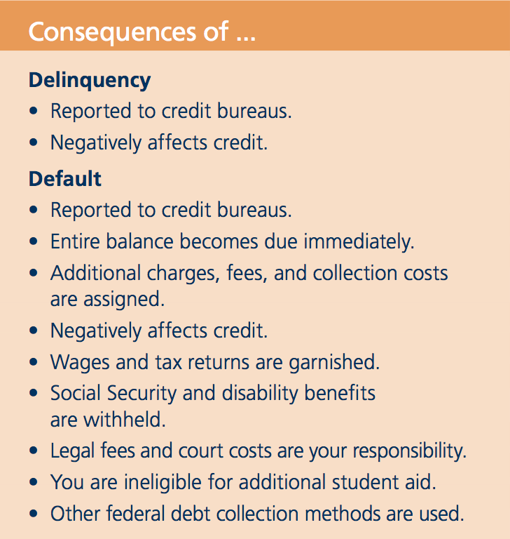
Delinquency
Default
Notes:
On a lighter note, medical school borrowers have a very low default rate. This means that borrowers like you repay their loans, repay them on-time, and many even pay their loans off earlier than required. The key to this, especially during residency, is to stay organized and know when your payments are due.
To make sure you don’t miss a payment, consider setting your account up for an automatic payment so that your payments are automatically withdrawn from your checking or savings account on a specific date each month. Automation of payment removes the element of a resident’s fatigue and/or forgetfulness, and assures that your loan(s) are paid on time.
If a loan payment does “slip through the cracks” you should know that the loan will be considered delinquent as soon as the payment is late. The consequences of this are negative for your credit.
[CLICK] After being 270 days late, the servicer places your loan(s) in default.
In a default situation, the negative impact to your credit increases as do the costs to you. If you default, not only will your lack of payments be reported to the credit bureaus, but you may also experience:
a garnishment of wages and tax refunds
lawsuits in which you are responsible for the cost and/or
other methods of federal debt collection
Nobody wants you to get to that point, so if you are experiencing financial difficulties at any point, do not wait until it’s too late -- call your servicer(s) immediately and see what arrangements can be made.

Slide 12
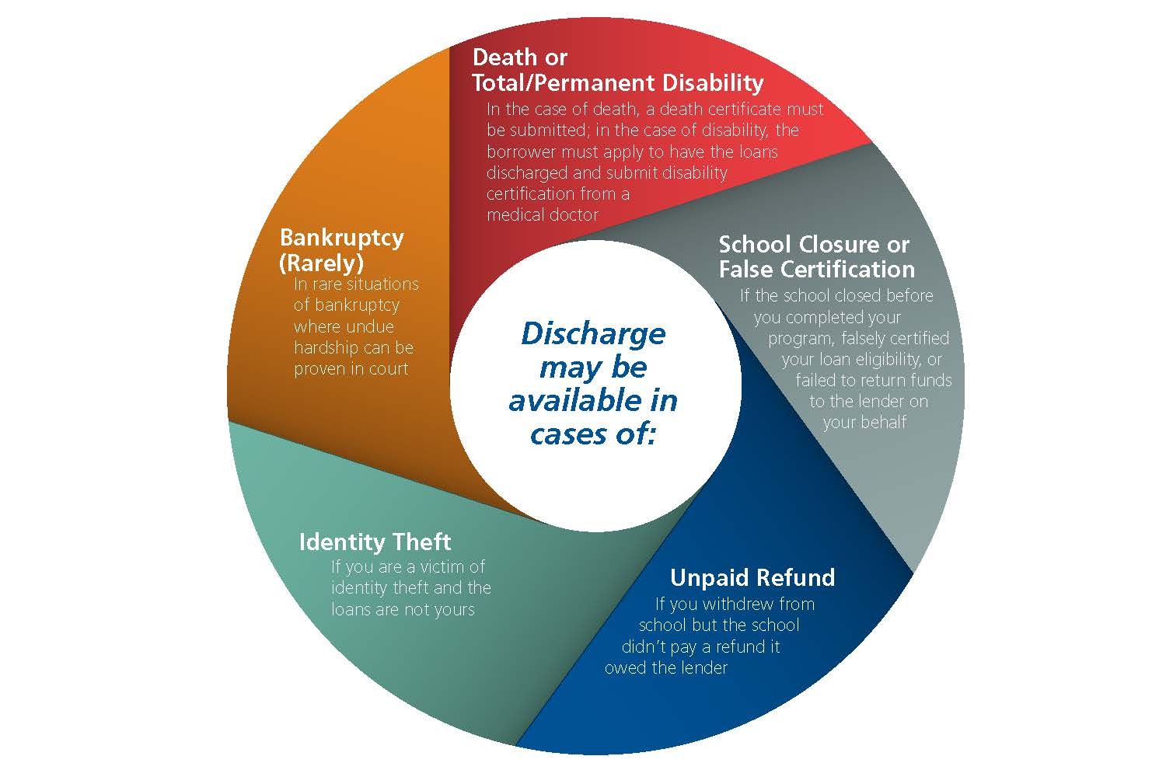
Loan Discharge
Notes:
In rare cases, your federally guaranteed student loans may be discharged and your repayment obligation cancelled or forgiven. The possible reasons for this include:
Death or Disability – In the case of death, a death certificate must be submitted; in the case of disability, the borrower must apply to have the loans discharged and submit disability certification from a medical doctor
School Closure or False Certification – If the school closed before you completed your program, falsely certified your loan eligibility, or failed to return funds to the lender on your behalf
Unpaid Refund– If you withdrew but a refund was not paid by the school to your lender
Identity Theft – If you are a victim of identity theft and the loans are not yours
Bankruptcy – In very rare situations of bankruptcy where undue hardship can be proven in court
While you would never want any of these things to happen, if they do, the servicer(s) must be notified so that the appropriate discharge process can begin.
This now completes our review of some of the “fine print” of your loans. So, let’s move on and look at what is actually in your student loan portfolio.

Slide 13
Finding Your Federal Loans
To access, provide your FSA ID and Password
www.StudentAid.gov
www.StudentAid.gov
Notes:
To find all of your federal student loans, from undergrad and medical school, you can access the National Student Loan Data System (or NSLDS), a central database for federal loans at nslds.ed.gov.
After entering your NSLDS account, you will see a variety of important details about each loan you’ve borrowed, but pay attention most to:
the name of the loan
the date of disbursement
and the name of the servicer.
Pay special attention to who your current servicers are and how to contact them. This is information that you will need in order to change your contact information (when you move to your residency location) and to ask questions about your loans.
As a final tip on finding your federal loans, the Financial Aid Office is always a resource available to you - even after you graduate.
What you will not find in NSLDS is information on private student loans. For details on your private loans, you must contact the lender(s) of those loans. If you are not sure who you borrowed from, you can find this information on your credit report at annualcreditreport.com.

Slide 14
Subsidized Loans vs. Unsubsidized Loans
Subsidized
Unsubsidized
Direct Subsidized
Perkins Loans*
Primary Care Loans
Loans for Disadvantaged Students (LDS)*
Institutional Loans (some)
Consolidation Loans (underlying subsidized loans)
Direct Unsubsidized
Direct PLUS
Private Loans
Institutional Loans (some)
Consolidation Loans (underlying unsubsidized loans)
* Subsidy and deferment rights are lost in a consolidation loan
Notes:
After identifying the loans listed in your portfolio, it may be evident by the names alone, that some of your loans are subsidized and others are unsubsidized.
As a medical student, the majority of your education debt will be unsubsidized - meaning that this debt has been accruing interest since the day it was disbursed to you.
Alternatively, if you have subsidized loans in your portfolio, like Perkins or LDS Loans, these loans have been interest free while you’ve been in school. Once you go into repayment though, interest will accrue on those loans just like with any other loan.
Keep in mind, the interest that accrues on student loans can be paid at any time, whether you are in school, residency, a deferment, forbearance or otherwise. It’s your right to prepay this debt as fast as you are able.

Slide 15
Fixed Interest Rates for the Class of 2020
M1
2016-17
M2
2017-18
M3
2018-19
M4
2019-20
PERKINS*
PERKINS*
PERKINS*
PERKINS*
5.0%
5.0%
5.0%
5.0%
DIRECT UNSUBSIDIZED
DIRECT UNSUBSIDIZED
DIRECT UNSUBSIDIZED
DIRECT UNSUBSIDIZED
5.31%
6.0%
6.6%
6.08%
DIRECT PLUS
DIRECT PLUS
DIRECT PLUS
DIRECT PLUS
6.31%
7.0%
7.6%
7.08%
* Perkins, PCL and LDS Loans are disbursed at a fixed rate of 5%. All loans shown have a fixed interest rate.
Notes:
The rate of interest accrual is important, and the interest rates for the loans you borrowed while in medical school is likely detailed above. These rates are fixed, so no matter what happens in the economy– these are the interest rates you will pay on these loans.

Slide 16
Capitalization
Addition of unpaid interest to the principal
$231,700
$200,000
9,2,000
$31,700
Larger
Principal
Principal
+
Interest
=
Notes:
(NOTE: The numbers on this slide can be manipulated to reflect your school’s average indebtedness and interest accrual – use the MedLoans® Organizer and Calculator to determine the interest accrued during medical school and grace).
After medical school, the unpaid accrued interest for the last 4+ years will capitalize. Capitalization is a cost of student loans that many are not aware of, but the impact is significant. Capitalization increases the cost of the loans because it takes the accrued interest (from loans such as your Direct Unsubsidized and Direct PLUS Loans) and adds it to the original principal balance. After capitalization occurs, your larger principal balance then begins accruing interest, so in effect, your interest is accruing interest – and if unpaid, this interest may capitalize as well.
Servicers have policies on when loans capitalize and at what times. You should direct any capitalization questions to the servicer of your loan(s). However, most likely, capitalization will be postponed until after you separate from school and possibly even for a short time thereafter.
For those of you who are visual learners, here is an example of the capitalization a medical school student will experience immediately or shortly after graduation. Obviously, the less often capitalization happens, the better.
As we saw earlier, the median balance of student loan debt for the Class of 2019 was $200,000. For a 2020 medical graduate that borrowed $200,000, they would likely accrue over $31k of interest (based on medical school Direct Loans only). When this interest capitalizes, the loans have a new, higher principal balance of $231,700 and the interest that accrues going forward will be based on this higher balance.

Slide 17
When does Capitalization occur?
End of your graduating year, at Repayment
AND
Each time your loans change status
AND
When the servicer’s policy dictates it
Contact the loan servicer for more details.
Notes:
So, when can you expect your first capitalization… likely near the end of your graduating year (if not earlier).
When will the NEXT capitalization occurs? After this first one, but it depends on how you choose to manage your loans during residency.
Contact your loan servicers for more details.

Slide 18
Repayment Tip
When Sending a Voluntary Payment
1) Send as a Separate Payment
- Instruct servicer to APPLY NOW
- Specify WHERE to apply it
(high interest rate loans are the priority)
2) Verify Payment was Applied Accurately
Pay the interest on your loans
before they capitalize – when possible.
Notes:
A tip to use during repayment is to pay all or some of the interest prior to capitalization. More specifically, while you have been in school, your Direct Unsubsidized and your Direct PLUS Loans have been accruing interest. If your residency salary, the help of a family member, or some other financial means provides you with extra money, consider applying it towards the interest prior to capitalization. By doing this, you can reduce your total loan cost, and possibly pay your loans off more quickly.
If you choose to send in voluntary payments, be sure to do it the right way – following the simple instructions shown here.
Although this may not be a viable option for you now, consider this strategy in the future since interest will be accruing throughout residency. Paying interest as you are able will limit the effects of future capitalization and possibly save you money during repayment.

Slide 19
Loan Repayment Timeline
The path for many federal student loans
REPAYMENT
IN-SCHOOL
GRACE
Notes:
After you graduate from school, your loans will either enter active repayment or a grace period. A grace period is automatic - no application is required – and will begin as soon as you separate from school (i.e. – graduate).
During grace, the subsidies on federal loans remain active. Alternatively, unsubsidized loans will continue to accrue interest - as they always have done.

Slide 20
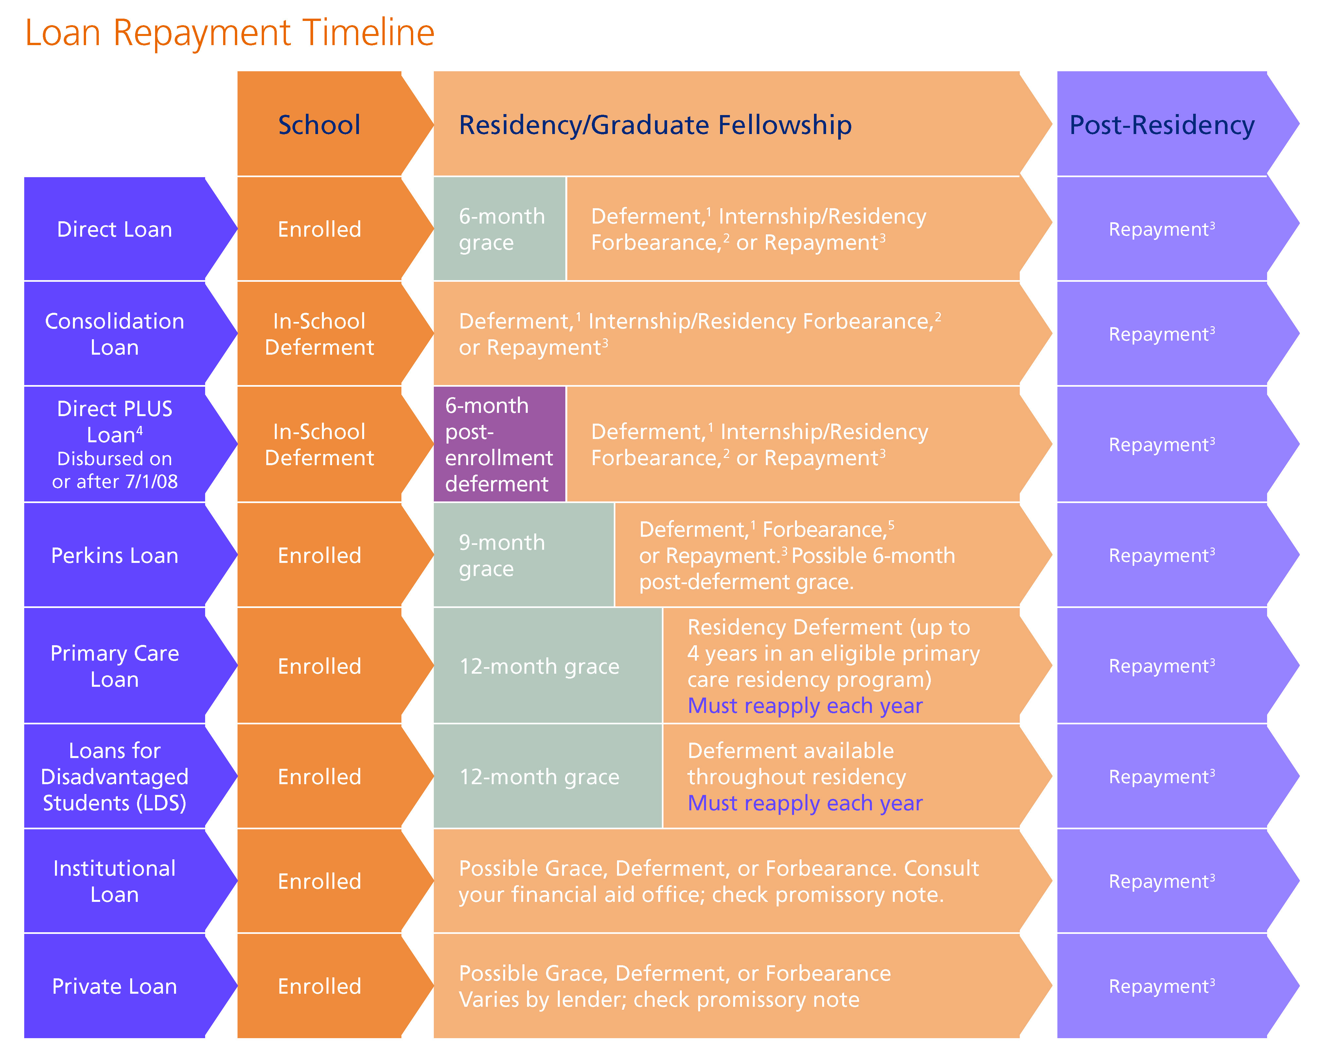
When are the First Payments Due?
aamc.org/first/timeline
Notes:
The availability and length of a grace period is based on the loan type – and is best addressed in this chart. To verify the existence or length of a grace period, contact the servicer of the loan.
Grace is intended to allow you to transition smoothly from school into repayment, but notice:
The chart above shows that Direct Loans and Perkins Loans have an automatic grace period of 6-9 months.
However, Consolidation Loans have no grace period and require immediate payment (as do loans that don’t have or have already used their grace periods).
PLUS Loans have a 6-month post-enrollment deferment (similar to a grace period, but interest is accruing – like a forbearance). This “deferment” is applied automatically, but it can be waived (to avoid the additional accrual of interest) by contacting the servicer.
If you have loans with varying repayment start dates, an ‘Alignment Forbearance’ can be used to line up the repayment start dates of all federal loans – discuss this with your servicers.

Slide 21
Postponement Options
Contact the loan servicer to apply
- Request 30-days before needed -
Forbearance
Forbearance
Deferment
Deferment
Notes:
Whether there is a grace period or not, if you prefer not to make payments on your student loans, you have two options to postpone payments:
Forbearance or Deferment
In either case, you need to request these from each of your servicers 30-days before you want them to be effective (this allows time to process your request).

Slide 22
Postponement Options
Subsidized loans are interest free
Interest accrues on unsubsidized loans
Contact each loan servicer to apply
Strict requirements to qualify
Deferment
NOTE: For more details, or to request a deferment or forbearance, contact each loan servicer
Notes:
Deferment is an option to postpone payment. During this time, interest is not accumulating on the subsidized portion of the loans - though it will be accumulating on unsubsidized loans. Borrowers have to apply AND qualify, in order to obtain a deferment.
Contact your servicers to discuss if your financial and family situation allow for a deferment. In the case of most single residents, they don’t qualify for a deferment, and therefore will need to obtain a forbearance if they desire to postpone payments.

Slide 23
Postponement Options
Interest accrues on all loans
Interest will capitalize
Contact each loan servicer to apply
Request 30-days before needed
Forbearance
NOTE: For more details, or to request a deferment or forbearance, contact each loan servicer
Notes:
A forbearance postpones payments, like a deferment; however, the primary difference between these two options is that you are responsible for all interest that accrues during a forbearance, even on subsidized loans. Keep in mind, this interest will ultimately capitalize.

Slide 24
Postponement Options
Medical Residency Forbearance
Postpones payments in annual increments
Capitalization may occur at end of residency (if increments occur back-to-back throughout residency)
An option for medical residents/interns
NOTE: Request increments in a timely manner to avoid unnecessary and additional capitalization.
Notes:
The specific type of forbearance available for medical residents is called a Mandatory Medical Residency Forbearance. As a medical resident or intern, servicers are required (upon your request) to provide you with this forbearance for your federal student loans (but this does not apply to Perkins Loans in their original form).
Remember, both your subsidized AND unsubsidized loans are accruing interest. If a medical student graduates in 2020 with $200,000, the amount of interest accruing during residency is approximately $1,200 per month.
You must reapply for a forbearance, with each servicer, each year (in a timely manner – which is 30 days before you need it) because having a continuous forbearance (without a gap between years) will allow you to postpone capitalization until the end of your residency. If reapplication for the next increment of forbearance is not received on time, you may experience an unnecessary capitalization.

Slide 25
Medical Residency/Internship Forbearance
An Entitlement for
Medical Residents and Interns
BEST for You, IF…
NOT for You, IF…
Seeking to REDUCE stress and financial obligations
Seeking Public Service Loan Forgiveness (PSLF)
If life changes, you can change
Desiring to INCREASE disposable income
Seeking an Income-Driven Repayment (IDR) plan forgiveness
Have PRIVATE loans with higher interest rates
Concerned with the Total Repayment cost
Notes:
Postponing payments can be a good… or bad…. Option for you- - - - depending on what your financial goals are. (CLICK) if your goal is to minimize stress and financial worries during residency, or if your goal is to repay higher rate private loans or credit cards, then postponing payments could help accomplish these prioritized goals.
On the other hand, (CLICK) ‘Postponing’ may not be the best for you if you desire to obtain a forgiveness, either a Public Service Loan Forgiveness or an Income-Driven Repayment plan term forgiveness. It also may not be best for you if minimizing the total cost is your main priority – because often, the longer it takes you to pay, the more it could cost to repay the loans in full.
So know your options and know your goals and use a postponement when you need to. (CLICK) And, of course, as already stated before, you are free to switch in and out of a postponement during residency as you need to – just stay in touch with your servicers.

Slide 26
Forbearance During Residency
The numbers after a 4-year residency*
 | Balance after Grace | Residency Interest | Post- Residency Balance Owed
TOTAL | $231K | $56K | $287K
+
=
*Based on a 2019 graduate’s median indebted level of $200,000.
Notes:
An example of the cost to use forbearance consecutively during a 4-year residency is shown above. If each forbearance increment is requested on-time, the unpaid interest will not capitalize until the last increment expires.

Slide 27
Repayment Plans
Notes:
One of the benefits of federal student loans (compared to other types of debt) is that it offers flexibility during repayment. Not only can you use a deferment or forbearance to postpone payments, but you can also use different repayment plans to adjust the required amount of the monthly payment (which in turn affects the total interest cost of the loans). Based on that, you are in control of how much this debt ultimately costs you.
Additionally, as your financial situation changes, switching repayment plans may help you to better accomplish your financial goals.
To request or change a repayment plan, contact your servicer(s).

Slide 28
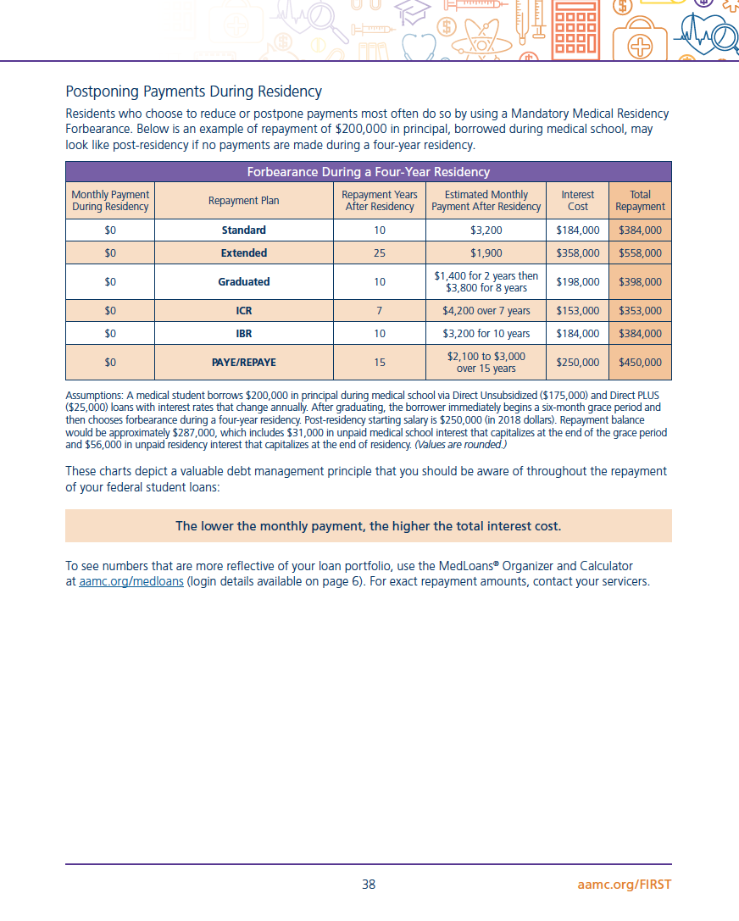
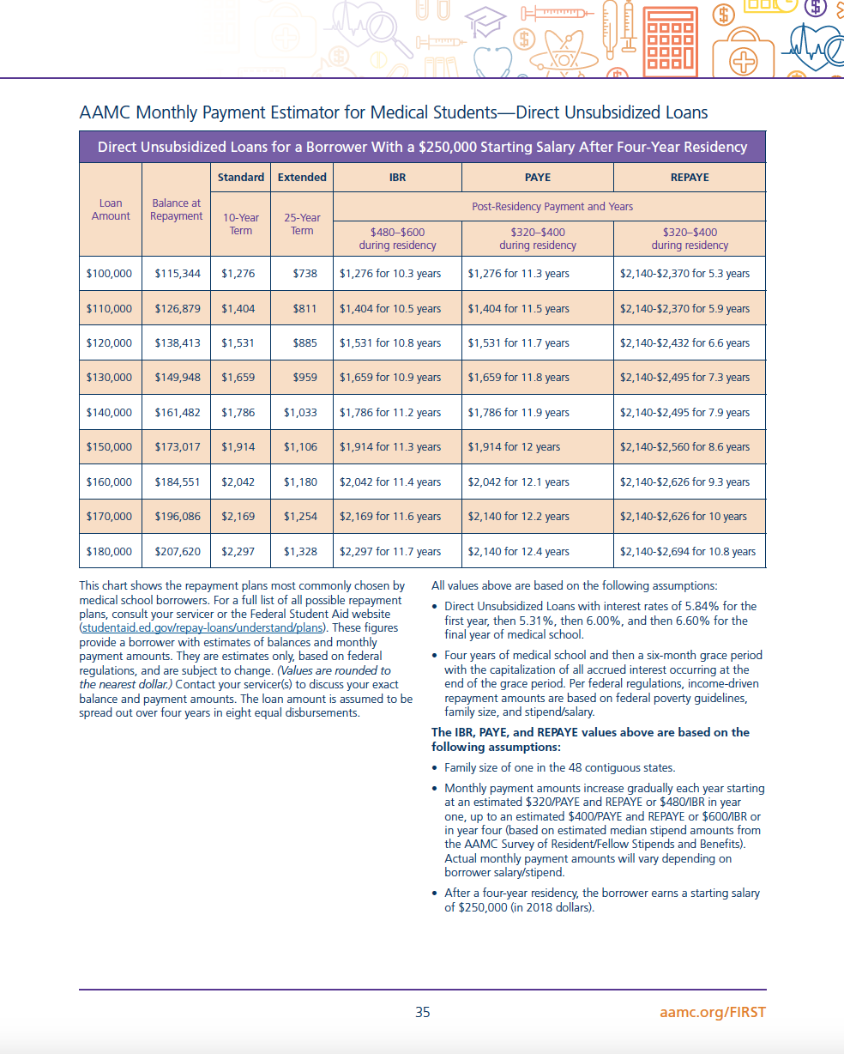
Monthly Payment Estimator
aamc.org/first/estimator
Notes:
For your reference, on pages 35-36 of the Education Debt Manager (aamc.org/first/edm), the Monthly Payment Estimators reflect some of the more common repayment plans used during residency and their correlating monthly payment amounts.
A chart for Direct Unsubsidized Loans is on page 35 and a chart for Direct PLUS Loans is on page 36, or the charts can be found using the link aamc.org/first/estimator
For more precise payment amounts consult an online loan calculator, like the MedLoans® Organizer and Calculator, or call your servicer(s).

Slide 29
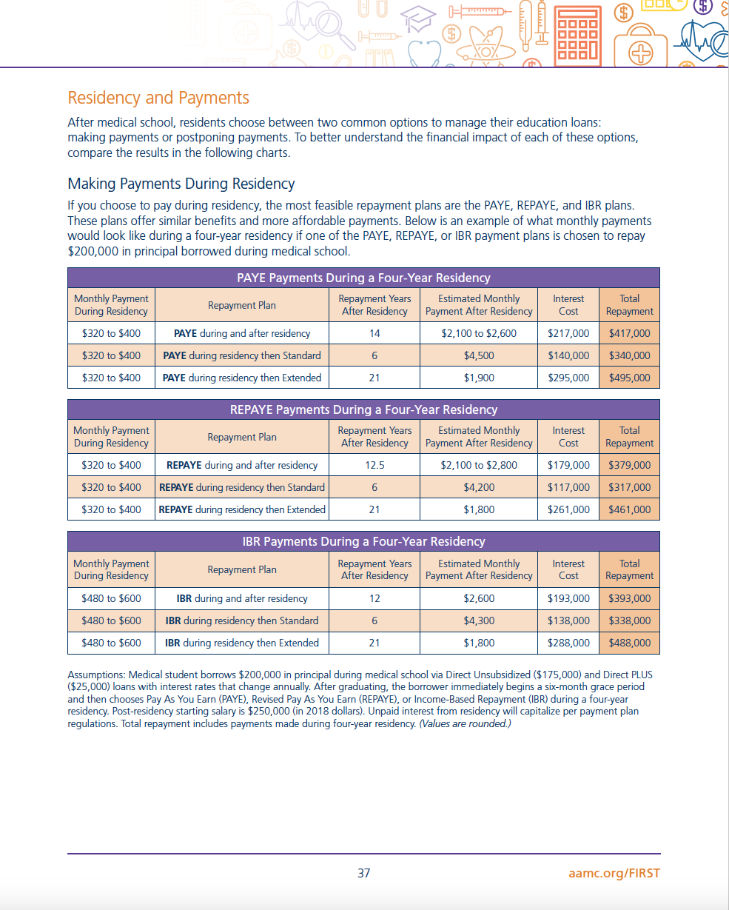
Managing Loans During Residency
The Impact of Popular Management Strategies
aamc.org/first/edm
Notes:
The charts on pages 37-38 of the Education Debt Manager (aamc.org/first/edm) highlight the impact of several popular repayment plans during residency - as well as the impact of postponing payments during residency. For each option, you can see possible monthly payments, interest costs, and total amount repaid.

Slide 30
Debt Fact
The lower the monthly payment, the higher the overall cost
Notes:
Very often, the lower the monthly payment amount, the higher the overall costs you will experience.
As you select your repayment plan, keep this debt fact in mind.
Periodically, you will need to review your financial goals to determine if it would be beneficial to change your selected repayment plan – or simply send in additional monies to the loan servicers via a voluntary payment. Often, a borrower is deciding between a low monthly payment (a common goal during residency) or minimizing interest costs (a more popular goal after residency). As life changes, be sure to change how you are managing your student loan debt.
*A noteworthy exception to the statement above is sometimes seen in student loans when a forgiveness is obtained. Case studies in the following slides will show this.

Slide 31
Repayment Plans
Traditional
Standard
10 Years
$ 2,600/mo
Monthly payments for the entire repayment term are calculated up-front and disclosed to you.
Extended
25 Years
$ 1,500/mo
Graduated
10 Years
$ 1,200/mo
Based on total education debt (median) as self-reported by 2019 grads on the GQ survey.
Notes:
Assuming repayment begins immediately following graduation… here are the available options. The first plans are known as traditional plans where the monthly payments are calculated UP-FRONT, based on how much you borrowed, and the total cost for the loan term is known. The amounts shown here are based on a principal balance of $200,000.
[CLICK]
The Standard, or level payment plan, is a plan where you pay the same amount every month for the term of the loan (10 years). This plan offers one of the lower total repayment costs (meaning it accrues less interest), but this is accomplished because the required monthly payment is high from the beginning. The Standard repayment plan is the default plan so if you fail to notify your servicer of a different plan selection, you will automatically be put in the Standard plan. As a resident, this is likely not a manageable plan due to the amount of the monthly payment in relation to your monthly income.
[CLICK]
Alternatively, the Extended repayment plan allows you a longer repayment term -- up to 25 years. When this occurs (a longer term), the monthly payment drops, but the total cost of the loan is higher because of the longer repayment term. A lower monthly payment can make it easier to manage a monthly budget but Extended repayment is possibly the more expensive option.
[CLICK]
Graduated repayment, which offers tiered payments, (over 10 years) starts with a reduced payment and then increases over time – usually after two years - until you pay off the debt. This plan is known for higher costs because no principal is paid in the early years of repayment.

Slide 32
Repayment Plans
Income-Driven*
Income-Contingent Repayment (ICR)
$760/mo
Income-Based Repayment (IBR)*
$490/mo
Payments are based on household income (AGI) and family size - recalculated annually.
$320/mo
Pay As You Earn (PAYE)
$320/mo
Revised Pay As You Earn (REPAYE)
Based on total education debt (median) as self-reported by 2019 grads on the GQ survey, a PGY1 stipend of $58,000 and a family size of 1. * New Borrowers on or after July 1, 2014 that select IBR will receive payment amounts equal to that of PAYE.
Notes:
The next plans are referred to as income-driven plans because the payment amount is based on your income (as reflected in your Adjusted Gross Income (AGI) from the previous year’s tax records). The payment amounts shown here are based on a resident’s starting salary of $58,000 and a family size of 1. (If married filing jointly, a spouse income will be included. If married filing separate, the spouses income will not be factored in – with the exception of REPAYE.
[CLICK]
Income-Contingent repayment, ICR, could be based on 20% of your discretionary income, or if the payment is less, it will be based on your income over a 12 year term. On a resident’s salary, the initial payment for ICR can be interest only, but negative amortization will occur (meaning the required monthly payment may not cover the amount of interest accrued in the same month). Alternatively, there is no maximum payment, so loans may be paid aggressively if the household income increases.
[CLICK]
The Income-Based Repayment plan, offers payments based on your household’s AGI and family size. This amount is 15% of the household’s discretionary income. We will discuss this plan in more depth in the upcoming slides because it’s a payment plan that many residents may choose.
[CLICK]
The PAYE and REPAYE plans are the most affordable plans. These plans are based on the household’s AGI and family size, but the payment amount is only 10% of the household’s discretionary income, making them possibly the lowest monthly payment options. In a moment, we’ll discuss the qualifications for these plans, but ultimately, it is best to contact your servicer to verify your eligibility for any one of these plans.

Slide 33
Income-Driven Repayment (IDR) Plans
20%
ICR
Different Payment Amounts
15%
IBR*
10%
PAYE
LOWEST
10%
REPAYE
LOWEST
* New Borrowers - If you had no outstanding student loans when you received your first Direct Loan on or after 07/01/2014, then you are considered a "new borrower" and will have access to the new IBR plan which has payments equal to a PAYE repayment plan.
Notes:
First thing to consider is the payment amount…. The payment is based on anywhere from 20% down to 10% of the discretionary income for the household. With several plans offering identical payment amounts, but as they say, the devil is in the details.
Use the MedLoans Organizer and Calculator to see how these “details” impact your total cost and time of repayment to determine which plan best supports your goals.

Slide 34
IDR Plans: Payments
No Max
ICR
Different Payment Limits
Max
IBR
CAPPED
Max
PAYE
CAPPED
No Max
REPAYE
Notes:
Secondly, though the payments are based on income, for some plans once the income and payment reach a certain amount, the payments cease to rise (even if the income does) because there is a maximum payment in effect. This is the case for IBR and PAYE. For ICR and REPAYE, the payment will rise as the income rises.

Slide 35
Plans
IDR Plans: Terms
25 years
ICR
Different Term Lengths
25 years
IBR*
20 years
PAYE
LEAST
25 years
REPAYE
* New Borrowers - If you had no outstanding student loans when you received your first Direct Loan on or after 07/01/2014, then you are considered a "new borrower" and will have access to the new IBR plan which has a term equal to a PAYE repayment plan.
Notes:
Then, there is the repayment term…. The maximum length of time to pay in these plans ranges from 20-25 years. Additionally, for all of these plans, if you pay for the entire term and still have a balance remaining, it will be forgiven (though it is currently a taxable forgiveness).
Use the MedLoans Organizer and Calculator to see what the length of time you may pay and if forgiveness is a possibility based on your loan debt. Remember, if you do qualify for forgiveness, it is currently taxable.

Slide 36
IDR Plans Eligibility: Eligible Loans
Eligible Loans
ICR
Perkins and LDS loans are not eligible… unless included in a Direct Consolidation Loan
Eligible Loans
IBR
Eligible Loans
PAYE
Direct Only
Eligible Loans
REPAYE
Direct Only
Notes:
Furthermore, getting into a plan is NOT as simple as requesting it. Some plans are more difficult to qualify for than other plans: All four IDR plans require that the loans be Direct Loans, and that is the only eligibility requirement for ICR and REPAYE – making these the easiest plans to enter.
Though, don’t despair over ineligible loans (like Perkins Loans or LDS Loans), that debt can be made eligible by including it in a Direct Consolidation Loan.

Slide 37
IDR Plans Eligibility: Financial Need
Must have a Partial Financial Hardship (PFH)
ICR
Eligible Loans
PFH
Required
IBR
Eligible Loans
Show Need
LIKELY
DURING
RESIDENCY
PFH
Required
Eligible Loans
Show Need
PAYE
REPAYE
Eligible Loans
Notes:
Other plans, like the IBR and PAYE are more difficult to qualify for as they require that you also show a financial need.

Slide 38
The Test for a PFH
Partial Financial Hardship (PFH)
$2,600 / mo
Standard Payment
PAYE or
IBR Payment
$490 (IBR) or
$320 (PAYE)
>
Must have PFH to enter into IBR or PAYE
Can remain in IBR or PAYE in subsequent years, even without a PFH
Must submit annual documentation
Max payment in IBR or PAYE is the Standard amount (determined when entering the plan)
Based on indebtedness of 200K with a PGY1 stipend of $58,000 and a family size of one.
Notes:
Financial need is shown if your monthly payment in the 10-year standard plan is greater than your IBR or PAYE payments.
[CLICK]
If the answer to this formula is positive, then you have a partial financial hardship.
[CLICK]
Typically, medical residents demonstrate a partial financial hardship (PFH) going into residency, but contact your servicers to verify your eligibility.
[CLICK]
Once you’re in IBR or PAYE, you can stay in the plan, even when you no longer have a PFH -- as long as you submit annual paperwork on-time. During your time in these plans, the payment amount is capped at the 10 year Standard payment as it was determined when you entered into the plan - no matter what your salary is.

Slide 39
IDR Plan Eligibility: New Borrowers Only
ICR
Eligible Loans
Easiest
IBR*
Eligible Loans
Show Need
Eligible Loans
Show Need
PAYE
Hardest
NEW Borrower
Easiest
REPAYE
Eligible Loans
Must be a “new” borrower
* New Borrower in IBR - If you had no outstanding student loans when you received your first Direct Loan on or after 07/01/2014, then you are considered a "new borrower" and will have access to the new IBR plan which has payments equal to a PAYE repayment plan.
Notes:
Finally, the last criteria to know about is that of being a “new borrower” and this is an eligibility requirement only for Pay As You Earn.
This plan is one of the most affordable, but only for those who meet these qualifications.

Slide 40
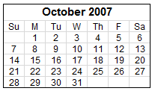
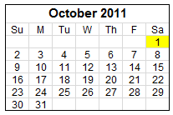
“New Borrower” in PAYE
Two Requirements
No outstanding loans on October 1, 2007 or paid-off all outstanding loans before receiving a new loan on or after 10/1/07
AND
Received a Direct Loan disbursement
on/after October 1, 2011
Notes:
Specifically, Pay As You Earn is only available for borrowers that had no outstanding balance on their federal loans, on October 1, 2007. Or, IF THEY DID have a loan balance on that date, they must have completely paid off those loans before they later took out loans (like for medical school). If this is you, you meet the requirement of being a new borrower.
[CLICK]
Secondly, you must ALSO have received at least one Direct Loan disbursement on or after October 1, 2011. Since most of your borrowing was done here in the last four years, this is likely a requirement that this class meets.

Slide 42
How to Know Your “Best” Strategy
It’s not about the best one
It’s about what fits with your life and financial goals
Notes:
As we conclude this section, let’s clarify something: There’s NO single BEST way to repay. Everyone’s life is different.
So YOUR “BEST” PLAN (CLICK) will be what best FITS your life and your financial goals.
Figure out what your financial goals are during residency… and then run the numbers and see which repayment plan will support those financial goals. That is YOUR best strategy!

Slide 43
Step #1: Set a Student Loan Repayment Goal
Minimize Total
Repayment Costs
Minimize Monthly Repayment Costs
Financial
Goal
A means to:
reducing cost,
reducing time,
saving money…
A means to:
affordability,
flexibility,
forgiveness…
Repayment Plans
Can Change When
Life Changes
Notes:
STEP 1 (CLICK) towards choosing your BEST repayment plan is to: SET A GOAL FOR YOUR STUDENT LOANS
Let’s look at your options (CLICK). You will either attempt to: (CLICK)
Minimize the TOTAL repayment cost of your loans (CLICK) (so you’re thinking long term, reducing cost, reducing time, and saving money overall) (CLICK)
OR you may be focused on
Minimize the Monthly cost of the loans (CLICK) (with a focus more on immediate affordability, flexibility and even loan forgiveness) (CLICK)
Either way, after you’ve set a goal… you will then move onto STEP #2.

Slide 44
Notes:
If you want to go into repayment during Residency to reduce loan debt as quickly as possible or you are considering PSLF
The vast majority of Residents will use the “Income Determined Repayment Plans”: PAYE or REPAYE

Slide 45
Notes:
Once in a PAYE or REPAYE Repayment plan, you stay in that PLAN.
How would you get “Kicked out” of a PLAN?
Fail to recertify income each year and ON TIME! This has Interest Capitalization impact (more debt) and changes the payment amount due

Slide 46
Options During Residency
CASE STUDIES
Notes:
This leads us to discussing the dynamics of residency and student loans.

Slide 47
Decision Time: 6 Months Post-Graduation
Make Payments
Postpone Payments
PAYE REPAYE IBR
Medical Residency Forbearance
Notes:
When it comes to managing student loan payments during residency, you basically have two options. You can pay, or you can not pay!
In reality, you do have a few more choices to make.
On one hand, if you don’t want to make payments, your most likely option is to use a Mandatory Medical Residency Forbearance.
But if you want to pay, your choices will likely be from the three most affordable IDR plans (IBR, PAYE and REPAYE).

Slide 48
Which Option to Choose?
Notes:
When it comes to deciding which of these options to choose, just remember,
The only route that leads you to “failure” is ignoring your loans.
There are no right or wrong decisions among the options we’ve discussed. Making a decision is a matter of personal goals and priorities and the decision is fluid because it is made based on your situation at a particular point in your life.
To illustrate this, let’s look at a few sample residents – these cases will show that there is no “right” answer and the best plan depends on the borrower!

Slide 49
Dr. Internal Medicine (General)
Career: Internal Medicine
Residency Length: 3 years
Debt: $200,000
Starting Res Stipend: $58,000
Post-Res. Y-1 Salary: $190,000
Notes:
This is Dr. Internal Medicine
An internal medicine specialty with a 3 year residency in front of her and the median amount of debt $200,000 (at graduation).
Her post-residency salary is expected to be approximately $190,000, and if she were to just put these facts into the MedLoans Organizer and Calculator, she would see that her options include the following:

Slide 50
Dr. Internal Medicine (General)
Student Loan Debt: $200,000
Repayment Plan | Total Yrs | Post- Residency Payment (range) | Total Repayment Amount | Forgiven* | Lowest Cost | Highest Cost
Pay As You Earn (PAYE) | 20 | $1,500 – 2,300 | $394k | $79k*
Revised Pay As You Earn (REPAYE) | 22 | $1,500 – 2,400 | $443k | $0 |  | X
Income-Based (IBR) | 15 | $2,300 – 2,600 | $380k | $0 | X
aamc.org/medloans
* Currently a taxable forgiveness amount – the cost of a future tax bill has not been accounted for in the above numbers.
Notes:
When $200k is borrowed, the plan that costs the least – of the 3 modeled above - is IBR because there is a higher monthly payment from the beginning of repayment resulting in the debt being repaid more quickly. If Dr. IM can afford IBR, it could lead to a lower total cost compared to the other two plans since less interest is allowed to accrue.
On the other hand, REPAYE is the most expensive because 1) the required monthly payments are lower and so it takes longer to pay the debt off. The additional time in REPAYE (7 years longer than IBR) allows more interest to accrue and thus increases the cost of repayment. REPAYE is more expensive than PAYE because REPAYE does not reach forgiveness until after 25 years of payments – rather than the 20 years that PAYE offers.
Noteworthy is that since PAYE does reach a forgiveness at the end of the term (20-years), there will also be a tax bill to pay as a result. We cannot know what the exact amount will be, but if we estimated 33% of the PAYE forgiven amount to be the tax ‘cost’, PAYE still remains less costly than REPAYE.

Slide 51
Dr. Internal Medicine (General)
Student Loan Debt: $250,000
Repayment Plan | Total Yrs | Post- Residency Payment (range) | Total Repayment Amount | Forgiven | Lowest Cost | Highest Cost
Pay As You Earn (PAYE) | 20 | $1,500 – 2,300 | $394k | $259k* | X (w/o including tax bill from forgiveness)
Revised Pay As You Earn (REPAYE) | 25 | $1,500 – 2,600 | $541k | $143k*
Income-Based (IBR) | 19 | $2,300 – 3,300 | $547k | $0 |  | X
aamc.org/medloans
* Currently a taxable forgiveness amount – the cost of a future tax bill has not been accounted for in the above numbers.
Notes:
When $250k is borrowed, the plan that costs the least to repay is PAYE primarily because of the 20-year term forgiveness that is reached. This option is the lowest cost even considering the estimated tax bill that will result after the forgiven amount is taxed. (based on an estimate of 33%)
On the other hand, REPAYE is the most expensive because REPAYE has a term of 25 years, whereas PAYE has a 20 year term, meaning the borrower spends an additional 5 years in repayment in the REPAYE plan versus the PAYE plan.

Slide 52
Dr. Internal Medicine (General)
Student Loan Debt: $325,000
Repayment Plan | Total Yrs | Post- Residency Payment (range) | Total Repayment Amount | Forgiven | Lowest Cost | Highest Cost
Pay As You Earn (PAYE) | 20 | $1,500 – 2,300 | $394k | $475k* | X (w/o including tax bill from forgiveness)
Revised Pay As You Earn (REPAYE) | 25 | $1,500 – 2,600 | $541k | $399k*
Income-Based (IBR) | 25 | $2,300 – 3,900 | $811k | $ 88k* |  | X
aamc.org/medloans
* Currently a taxable forgiveness amount – the cost of a future tax bill has not been accounted for in the above numbers.
Notes:
When 325k is borrowed, the plan that costs the least is PAYE (for all of the reasons that were previously mentioned in the 250k scenario).
However, in this situation with a higher balance of debt, the IBR plan becomes the more costly plan because simply stated the other 2 plans (PAYE and REPAYE) allow more debt to be forgiven since they require lower monthly payments than IBR along the way.
Which path is most appealing to you?
Maybe none of these paths… but as far as your time during residency, these may be the options that will be most feasible.
After residency, you can continue in your chosen plan, or switch to a different plan. Regardless of the plan you’re in, you can send in extra money whenever you choose, and ultimately determine the total amount you will pay overall.

Slide 53
Dr. ObGyn
Career: Obstetrics & Gynecology
Residency Length: 4 years
Debt: $200,000
Starting Res Stipend: $58,000
Post-Res. Y-1 Salary:$240,000
Notes:
Now let’s look at how a longer residency and higher post-residency salary affects the outcomes of these plans.

Slide 54
Dr. ObGyn
Student Loan Debt: $200,000
Repayment Plan | Total Yrs | Post- Residency Payment (range) | Total Repayment Amount | Forgiven | Lowest Cost | Highest Cost
Pay As You Earn (PAYE) | 19 | $2,000 – 2,600 | $430k | $0 |  | X
Revised Pay As You Earn (REPAYE) | 17 | $2,000 – 2,800 | $391k | $0 | X
Income-Based (IBR) | 16 | $2,600 | $396k | $0
aamc.org/medloans
Notes:
Dr. ObGyn borrowed $200k in loans, and her lowest cost plan is REPAYE, because her Post-Residency payments would eventually increase to an amount ($2,800) which is greater than the other maximum payments in the other two plan.
In REPAYE, higher earnings lead to higher payments because there is NO maximum monthly payment, requiring for the debt to be paid more when income increases.
The highest cost option is PAYE because payments are smaller throughout repayment, so it takes longer to pay the debt off completely.
Longer time in repayment can lead to higher interest rate costs.

Slide 55
Dr. ObGyn
Student Loan Debt: $250,000
Repayment Plan | Total Yrs | Post- Residency Payment (range) | Total Repayment Amount | Forgiven | Lowest Cost | Highest Cost
Pay As You Earn (PAYE) | 20 | $2,000 – 2,900 | $485k | $135k* | X (w/o including tax bill from forgiveness)
Revised Pay As You Earn (REPAYE) | 22 | $2,000 – 3,100 | $574k | $0 |  | X
Income-Based (IBR) | 17 | $3,100 – 3,300 | $511k | $0
aamc.org/medloans
* Currently a taxable forgiveness amount – the cost of a future tax bill has not been accounted for in the above numbers.
Notes:
If Dr. ObGyn borrowed more, at $250k, the lowest costing plan becomes PAYE – but only if you ignore the tax bill that would come with the forgiven balance after 20 years of payment. If factoring the tax cost into the total cost, IBR becomes the lowest costing plan.
In comparison, REPAYE is the highest costing plan because, compared to PAYE, payments are needed for an additional 2 years before the debt is repaid in full. The shorter term of PAYE (20 years) is what allowed forgiveness to be reached, and even with the possible tax bill, this plan is expected to be less costly than REPAYE. The term is reached and a significant amount is forgiven. The PAYE option allows her to have debt forgiven earlier than REPAYE, and therefore she pays less towards her loans. Keep in mind that the amount forgiven is currently taxable.
REPAYE would then be the highest costing plan because, compared to PAYE, it has a longer repayment term, and since there is a longer term, Dr. ObGyn would end up paying more. In this case, in REPAYE the balance would be paid in full prior to reaching the end of the 25 year term.

Slide 56
Dr. ObGyn
Student Loan Debt: $325,000
Repayment Plan | Total Yrs | Post- Residency Payment (range) | Total Repayment Amount | Forgiven | Lowest Cost | Highest Cost
Pay As You Earn (PAYE) | 20 | $2,000 – 2,900 | $485k | $384k* | X (w/o including tax bill from forgiveness)
Revised Pay As You Earn (REPAYE) | 25 | $2,000 – 3,300 | $674k | $246k*
Income-Based (IBR) | 21 | $3,100 – 4,300 | $777k* | $0 |  | X
aamc.org/medloans
* Currently a taxable forgiveness amount – the cost of a future tax bill has not been accounted for in the above numbers.
Notes:
And finally, if this ObGyn graduated with $325k in loans, the least expensive plan remains PAYE, while IBR now presents the highest cost (because of the high monthly payments but never reaching the term forgiveness – whereas the other plans paid less and had debt forgiven).
Which path is most appealing to you?
Maybe none of these paths… but as far as your time during residency, these may be the options that will be most feasible.
After residency, you can continue in your chosen plan, or switch to a different plan. Regardless of the plan you’re in, you can send in extra money whenever you choose, and ultimately determine the total amount you will pay overall.

Slide 57
Dr. Cardiologist
Career: Cardiology
Residency Length: 6 years
Debt: $200,000
Starting Res Stipend: $58,000
Post-Res. Y-1 Salary:$300,000
Notes:
We’ll conclude the case studies with this cardiologist that had the longest residency and the highest post-residency salary.

Slide 58
Dr. Cardiologist
Student Loan Debt: $200,000
Repayment Plan | Total Yrs | Post- Residency Payment (range) | Total Repayment Amount | Forgiven | Lowest Cost | Highest Cost
Pay As You Earn (PAYE) | 20 | $2,600 | $451k | $0 |  | X
Revised Pay As You Earn (REPAYE) | 16 | $2,700 – 3,300 | $376k | $0 | X
Income-Based (IBR) | 19 | $2,600 | $436k | $0
aamc.org/medloans
Notes:
At $200k of debt upon graduation, REPAYE offers Dr. Cardio the lowest repayment costs, while PAYE is the highest costing plan – nearly $80k more than REPAYE.
The reason for this difference is based on the post-residency salary of Dr. Cardio. Higher earnings result in paying higher monthly payments under REPAYE (which has no maximum monthly payment), meaning Dr. Cardio pays the loans off the fastest using REPAYE and accrues less interest compared to PAYE and IBR – which both have maximum (capped) payment amounts.

Slide 59
Dr. Cardiologist
Student Loan Debt: $250,000
Repayment Plan | Total Yrs | Post- Residency Payment (range) | Total Repayment Amount | Forgiven | Lowest Cost | Highest Cost
Pay As You Earn (PAYE) | 20 | $2,700 – 3,300 | $544k | $55k*
Revised Pay As You Earn (REPAYE) | 19 | $2,700 – 3,700 | $522k | $0 | X
Income-Based (IBR) | 20 | $3,300 | $571k | $0 |  | X
aamc.org/medloans
* Currently a taxable forgiveness amount – the cost of a future tax bill has not been accounted for in the above numbers.
Notes:
If Dr. Cardio’s debt were higher, $250k, REPAYE stays the lowest cost option - for salary related reasons as stated in the previous analysis – and the IBR plans is the highest costing plan primarily because forgiveness is not reached.

Slide 60
Dr. Cardiologist
Student Loan Debt: $325,000
Repayment Plan | Total Yrs | Post- Residency Payment (range) | Total Repayment Amount | Forgiven | Lowest Cost | Highest Cost
Pay As You Earn (PAYE) | 20 | $2,700 – 3,700 | $559k | $302k* | X (w/o including tax bill from forgiveness)
Revised Pay As You Earn (REPAYE) | 25 | $2,700 – 4,200 | $798k | $ 17k* |  | X
Income-Based (IBR) | 20 | $4,000 – 4,300 | $765k | $0
aamc.org/medloans
* Currently a taxable forgiveness amount – the cost of a future tax bill has not been accounted for in the above numbers.
Notes:
Finally, with a longer residency and a higher amount of debt, $325k, as well as a higher post-residency salary, $300k, the lowest costing plan would become PAYE. The reason for this is attributed to the significant amount forgiven at the end of the 20 year term. PAYE offering the lowest cost remains the case even when a possible tax bill of 33% is factored into the equation.
(remember, currently forgiveness amounts received at the end of the term of an income-driven repayment plan are taxable) This taxable nature could change in the future, but it must be accounted for (as best as possible).

Slide 61
The FIRST Stop
A tool for graduates!!
MedLoans® Organizer and Calculator (MLOC)
aamc.org/medloans
Notes:
Ultimately, to a great degree, you are in control of how much repayment costs you because you choose the plan in which to pay. Don’t make a blind decision. Run your numbers and see which plan will best support your financial goals (as they exist today).
Keep in mind, if your life changes, (and it likely will) then you can change your repayment plan. Just stay in touch with your servicer and be aware of what the loans are costing you.
To understand your repayment options and to stay organized throughout residency, the MedLoans® Organizer and Calculator (MLOC) is available. It’s an online resource where you can safely and securely organize your loan portfolio and calculate different repayment options.
This tool not only helps medical school students and residents with organization, but it also shows the impact (total interest cost) of each of the different repayment plans.
Using the MLOC during repayment will enable you to make educated decisions about your repayment options.

Slide 62
Other Considerations
Notes:
As a medical professional there may be other forgiveness or assistance programs that could reduce your repayment responsibility by forgiving or repaying either some or all of your education loans.

Slide 63
Public Service Loan Forgiveness (PSLF)
Direct Loans
Eligible Loans
+
Qualifying Payments
Any IDR
Plan
+
Qualifying Work
501©3 Tax- Exempt Non-Profit employer,
Any level of gov’t
Public Service Loan Forgiveness
Myfedloan.org
Notes:
In order to qualify for this program, you must meet the following criteria for 10 years (not consecutively) and the remaining balance of debt will be forgiven (currently tax-free)
(CLICK) First, you must have Eligible Loans: If the word ‘Direct’ is not in the name of the loan, it is not eligible. It must be a Direct Loan to be eligible for PSLF.
(CLICK) Secondly, Qualifying Payments are needed: 120-qualifying payments to be specific. Payments considered “qualifying” include any done under any of the IDR plans or the Standard repayment plan – voluntary payments that are sent in outside of a qualifying plan do not count.
(CLICK) Finally, the qualifying payments must be made while doing Qualifying work: Qualifying work is about who you are working for. Are they a tax exempt, 501c3, non-profit. Most medical schools and teaching hospitals fall into this category, so it is possible that your time in residency may count as Public Service. Other eligible Public Service positions include employees of the government (any branch), military personnel, or employment with a private organization providing a public service.
Confirm who is paying your paycheck – AND how they are organized with the IRS for a better idea on whether they count as eligible employment. Also, complete the ECF form with Fedloan Servicing at MyFedloan.org – discussed again in a moment to verify your employers state in the PSLF program.
For more information, review the PSLF booklet on the AAMC website.

Slide 64
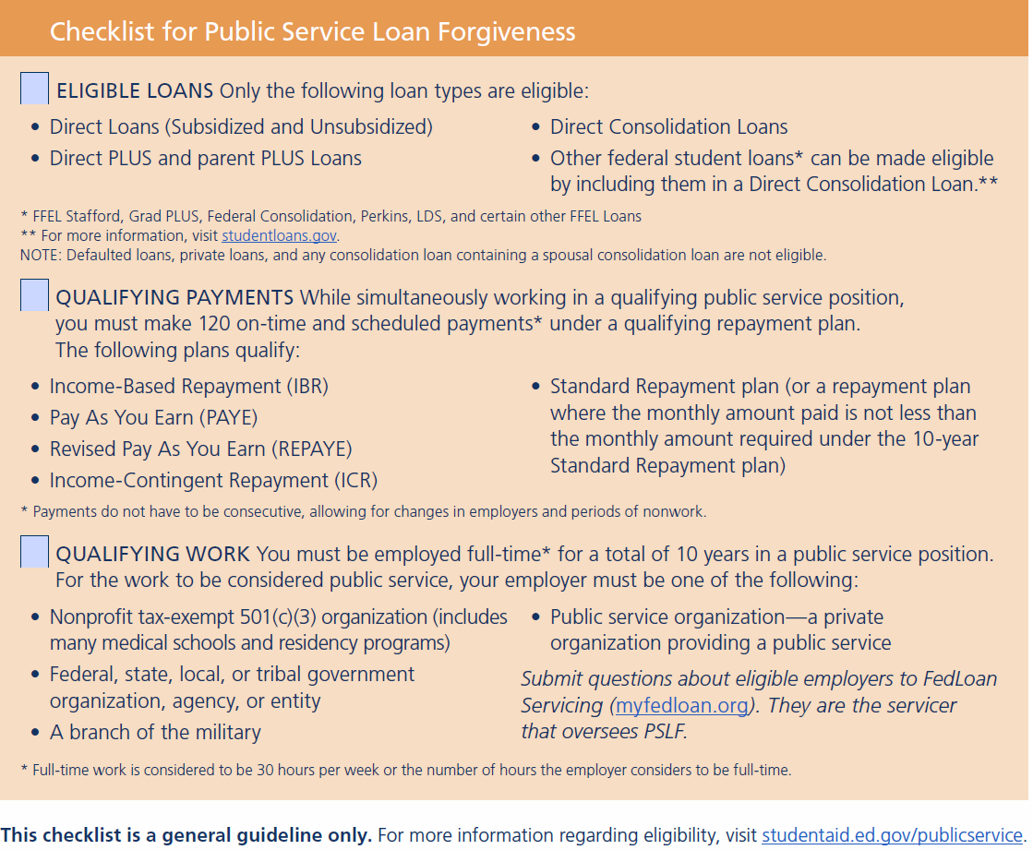
aamc.org/first/pslfeligibility
Notes:
More information is available in the Education Debt Manager (aamc.org/first/edm) on pages 55 as well as online (see the link above for a checklist). Videos, fact sheets, and even a PSLF booklet are also posted online at www.aamc.org/first.

Slide 65
Public Service Loan Forgiveness
aamc.org/first/pslfbooklet
Notes:
Here is the link for the PSLF booklet – which contains links in it to easily connect you to other necessary PSLF resources.

Slide 67
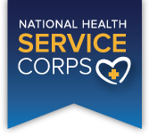
Loan Forgiveness & Repay Assistance
aamc.org/stloan
aamc.org/repayasst
Notes:
Beyond PSLF, there are other repayment and forgiveness programs available. There are several resources to look into including the: AAMC Loan Forgiveness & Repayment Database, NIH, NHSC, and others.
You may also want to review the repayment Fact Sheets on the FIRST website, and the one that includes many of these resources is: Repayment Assistance Through Forgiveness, Scholarships, and Service.
If you desire other options, then ask questions along the way, especially in your residency program, at future hospitals, counties, or states where you may work.

Slide 68
Reasons to Consolidate
Reduce
# of
Servicers
Eligibility
for
PAYE
or
REPAYE
Eligibility
for
PSLF
Eligibility
for
IBR
Notes:
Consolidating allows you to combine one or more federal student loans together into a new single loan, with a single servicer, which may simplify repayment.
Most often, medical graduates use consolidation to accomplish 1 of 2 things:
[CLICK]
Either to simplify their loan management (1 loan with 1 servicer)
[CLICK]
or to make ineligible loans eligible for a federal program (like an IDR plan, PSLF, or Mandatory Medical Residency Forbearance)

Slide 69
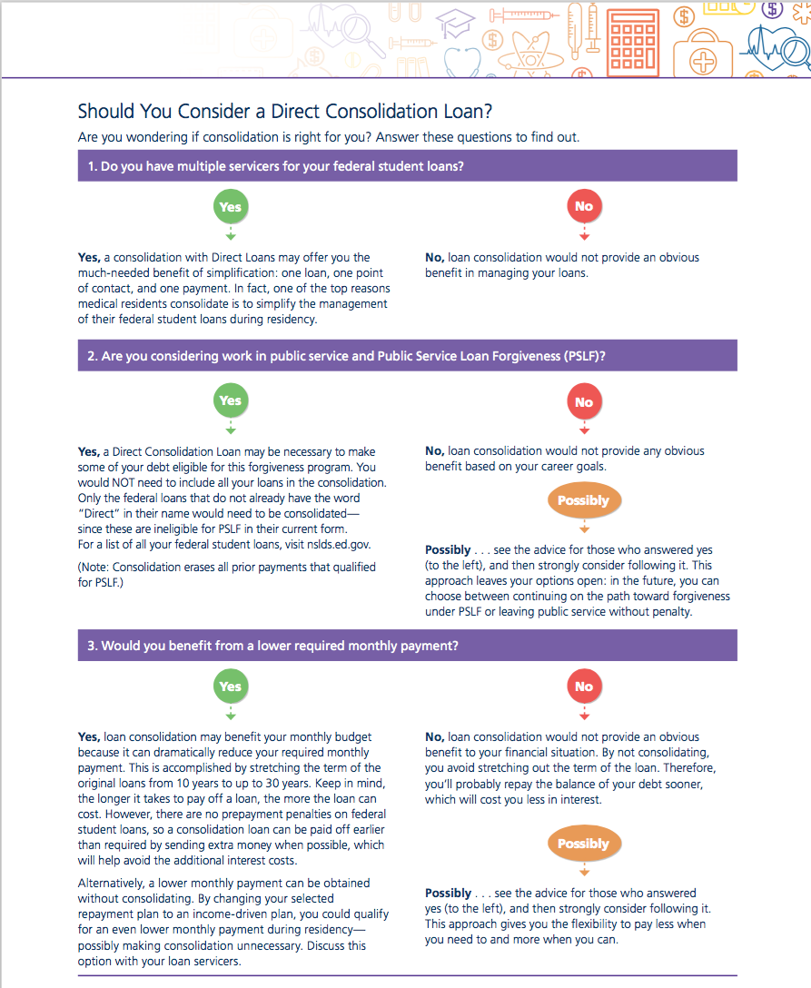
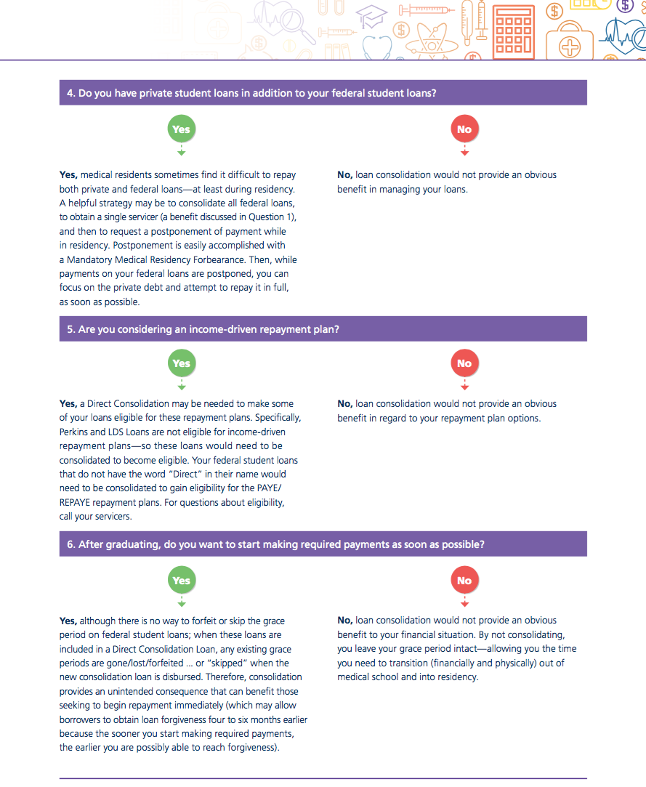
Should You Consolidate?
aamc.org/first/consolidatequiz
Notes:
To determine if consolidation is something that will benefit you, take the short quiz found on pages 60-61 of the EDM (aamc.org/first/edm). It can also be found as a stand alone resource using the address above.

Slide 70
Federal Loan Consolidation
When to consider consolidating federal loans:
Multiple servicers to repay
You have Non-Direct loans (like Perkins and LDS Loans)
To make Non-Direct loans eligible for federal options
Medical Residency/Internship Forbearance
Public Service Loan Forgiveness (PSLF)
an Income-Driven Repayment (IDR) plan
A Lower Interest Rate is NOT a Reason to Consolidate
aamc.org/first/consolidatequiz
Notes:
Federal loan consolidation offers a variety of benefits, but medical graduates tend to use consolidation to either:
simplify their repayment into 1 loan with 1 servicer OR
to make federal loans eligible for other federal programs (like residency forbearance, PSLF, or an IDR plan)
loans that do not have the word “Direct” in their name (like Perkins or LDS loans) are examples of loans that MUST be consolidated to participate in some of these other options.
NOTE - A lower interest rate is NOT a reason to consolidate federal loans into a Direct Loan Consolidation.

Slide 71
Be Advised
If you consolidate your loans after making eligible PSLF payments… these payments won’t count and your count will reset back to zero! Consolidate FIRST!
Notes:
Be careful about the timing of your consolidation. You do not want to erase progress already made towards PSLF.

Slide 72
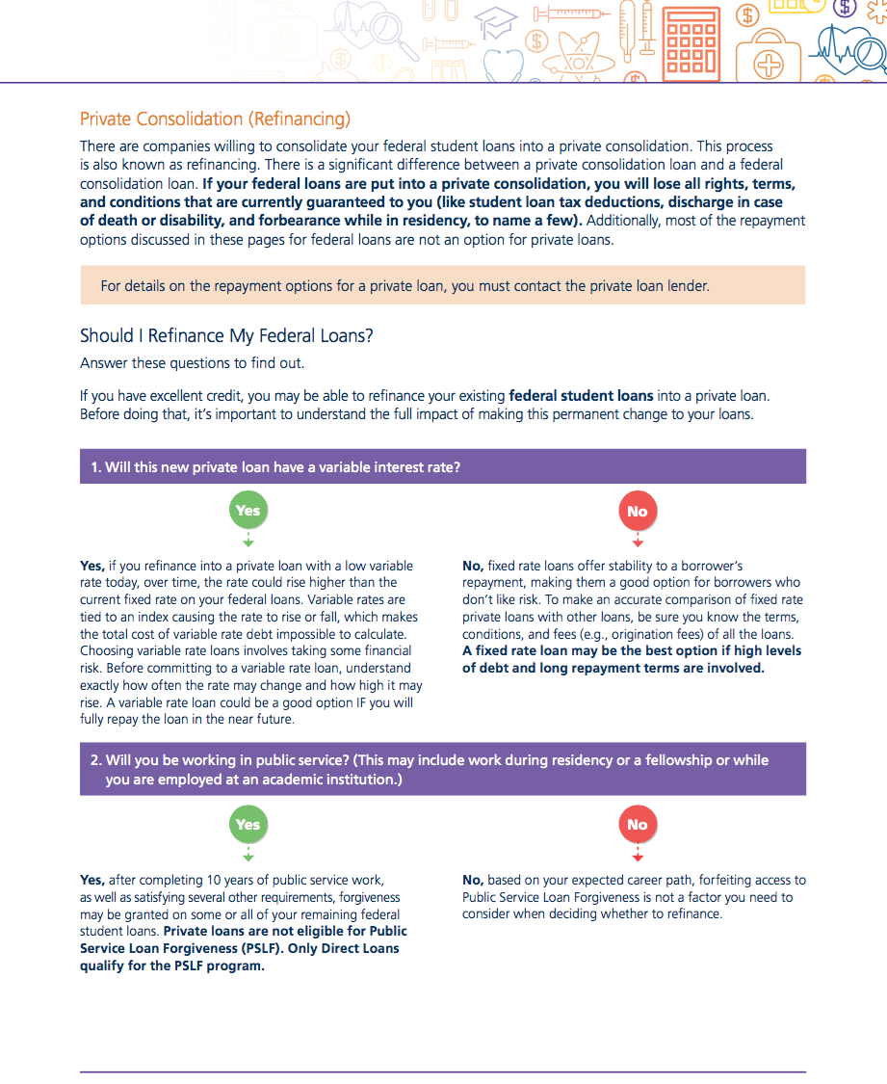
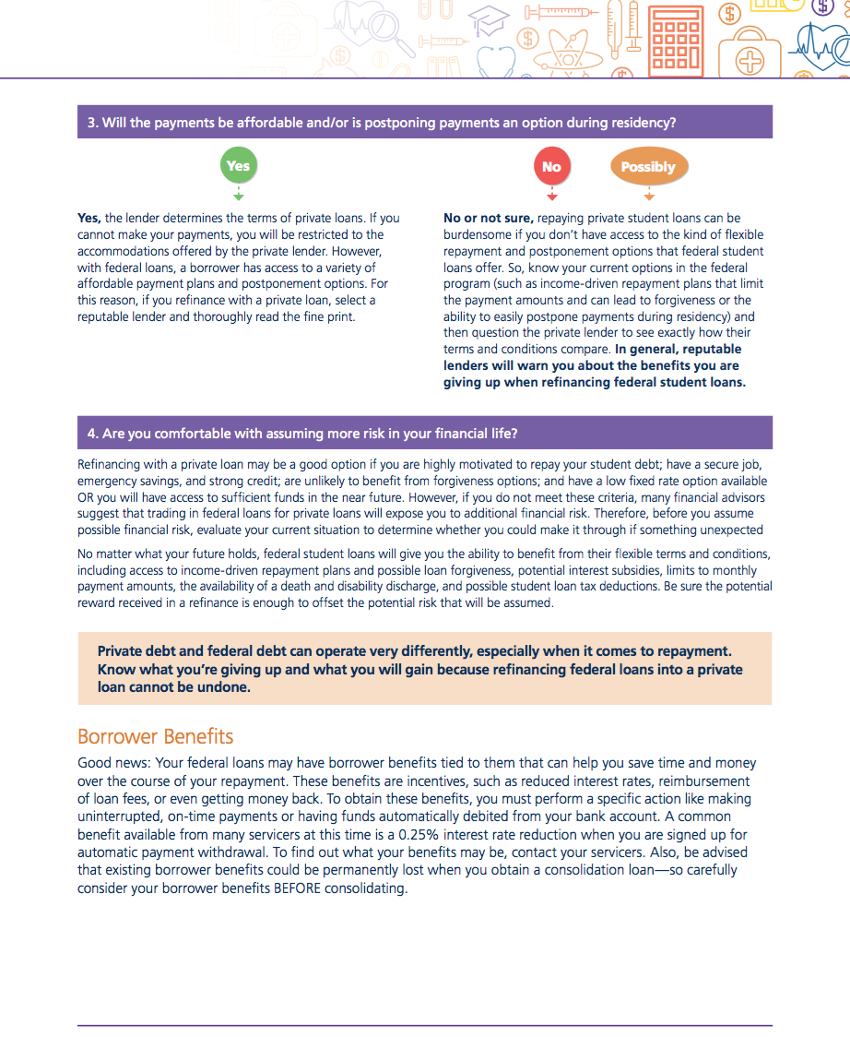
Should I Refinance?
aamc.org/first/shouldirefinance
Notes:
If your questions involve refinancing your federal loans with a private loan – this is a very different process from consolidating since you are moving loans out of the federal program and into private debt. To see if refinancing is for you, take this short quiz. The results will give you a better perspective on whether or not it would be a wise financial move for you.
If you have questions afterwards, contact FIRST, first@aamc.org, or your loan servicers for more information.

Slide 73
Private Loan Refinancing
When to consider it:
Unlikely to benefit from forgiveness options!
Postponement/flexible repayment plans not needed
You have a secure job and strong credit
A low fixed rate loan is available (and/or)
You’re able to repay in full in the near future
Read the fine print carefully
aamc.org/first/shouldirefinance
Notes:
On a separate note, forfeiting your federal loans in exchange for a private loan could be a good option IF you can save yourself money during repayment, but only if you won’t need the entitlements of the federal program (like forgiveness or flexible repayment and postponement options).
Read the fine print before completing any action because a refinance cannot be undone.

Slide 74
Taxpayer Relief Act of 1997*
 | Full Deduction | Partial Deduction | NO Deduction
Single | $70,000 or less | $70,001 to $84,999 | $85,000 or more
Married filing Jointly | $140,000 or less | $140,001 to $169,999 | $170,000 or more
Max student loan interest deduction: $2,500/year
May be eligible: Voluntary payments & capitalization
* Source: IRS Publication 970, 2019
irs.gov/publications/p970
Notes:
Lastly, as a final financial tip, you may qualify to take advantage of the student loan interest tax deduction (up to $2,500 per return). Due to income restrictions, physicians are most likely to qualify for this deduction only during residency. See the chart on page 65 of the EDM for the income thresholds for this tax benefit.

Slide 75
aamc.org/nextsteps
Notes:
In conclusion, it is understandable that this may seem like a lot of information to process. So to help you get started, we have identified in a clear and concise manner the Next Steps to take from now to graduation and beyond.
This NEXT STEPS timeline can be found on page 67 of the Education Debt Manager (aamc.org/first/edm) or online as a stand alone piece (aamc.org/next steps)– and if you take away nothing else from today… it should be this! I encourage you to print it and use it as a map that keeps you on the path towards successful loan management.

Slide 76
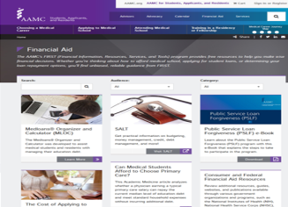
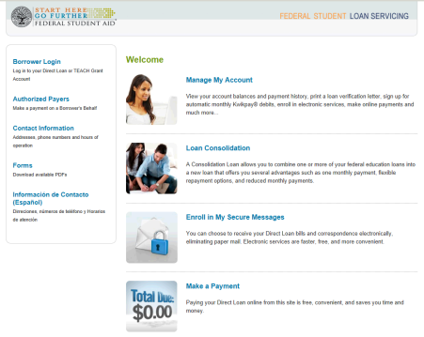
Support Along The Way
feedback.studentaid.ed.gov
aamc.org/advocacy/meded
Financial Aid Office & Residency Programs
aamc.org/FIRST
MedLoans Organizer & Calculator
aamc.org/medloans
aamc.org/financialwellness
StudentAid.gov
Notes:
One last note, if you experience a disagreement with your servicer, and you feel that it has not been handled satisfactorily, you may want to contact the Federal Student Aid (FSA) to provide your feedback and gain additional assistance. If appropriate, they will pass your concern onto the Ombudsman Office, but for this to happen, be sure you’ve exhausted all other possibilities and that you’ve used the available resources at StudentAid.gov.
Beyond this, there are a plethora of other areas of support, including:
[CLICK] Your medical school financial aid office and residency program,
[CLICK] Definitely, your servicer(s) and their websites (bookmark them)
[CLICK] The AAMC offers information on all financial literacy matters, these resources include how to create a budget, manage credit, and more. Go to aamc.org/financialwellness to access all these resources.
[CLICK] Tools and resources made available by the FIRST team – including the MLOC, and
[CLICK] The option to stay up-to-date on changes in student loans by becoming familiar with the Advocacy portion of the AAMC website at aamc.org/advocacy/meded.

Slide 77
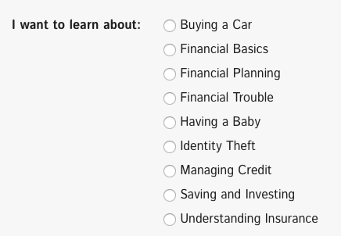
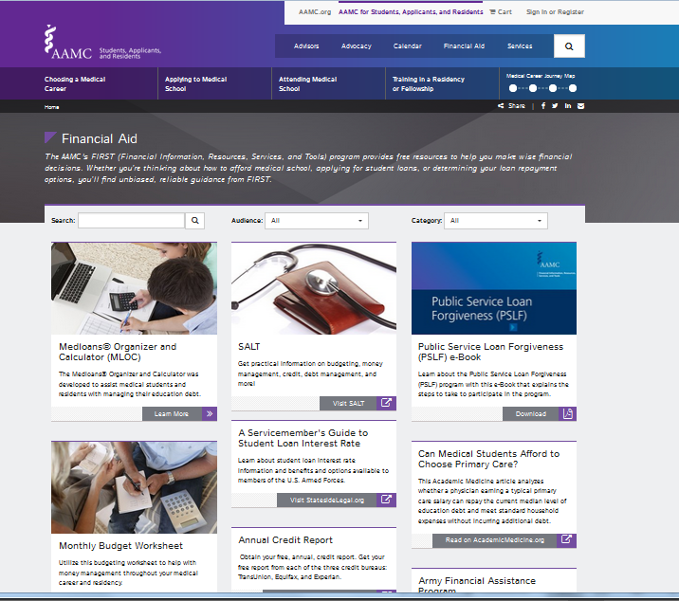
FIRST Resources
AAMC Financial Wellness (courses)
aamc.org/FIRST
MedLoans® Organizer and Calculator
Fact Sheets: Student Loan & Repayment
Upcoming Webinar and Posted Videos
aamc.org/financialwellness
aamc.org/first/financialplanning
aamc.org/first/financialplanning2
aamc.org/first/homefinancing
aamc.org/videowebinars
videowebinars
Notes:
Additional information and resources can be found online at aamc.org/FIRST – including our Financial Wellness Program which is free to participate and includes an evaluation of your current financial knowledge along with numerous courses to take at your convenience.
We also encourage you to join FIRST in upcoming webinars where we’ll discuss relevant and timely topics for medical students and residents.
You can review and register for these at aamc.org/videowebinars

Slide 78
“An investment in knowledge always pays the best interest”
Notes:
In conclusion, the following quote seems appropriate: Benjamin Franklin has been attributed with saying, “An investment in knowledge always pays the best interest”. Therefore, despite the debt that you may be taking with you from this experience, remind yourself that the money you borrowed was an INVESTMENT in your future and the returns you reap from that investment will be priceless.
With that, congratulations and best wishes as you embark on your career as a physician.

