Slide 1

Financial Aid & Money Management
for Entering UofL Medical School Students
Prepared for the SOM Class of 2026
Angela Hall, MSM
Financial Aid Coordinator-School of Medicine
University of Louisville - SOM Orientation
Disclaimer: All information and estimates are based on AAMC interpretation of federal regulations as of July 2021 and are subject to change. These are estimates only. Students should contact their servicer(s) to discuss exact loan balances and repayment options.

Slide 2


Financial Aid
Welcomes the
SOM Class of 2026 !

Slide 3

UofL SOM FA Specifics…

Slide 4

SOM Financial Aid Staff
Leslie R. Kaelin, M.Ed.
Financial Aid Director, SOM
Angela Hall, MSM
Financial Aid Coordinator, SOM
SOM A Building (Instructional Bldg.)
Suites 204 & 205 (across from SOM Student Affairs)
502-852-5187

Slide 5

What we do…
Make Financial Literacy Fun!
M1 - The Price is Right! - Topic: Goals and Budgeting (Fall)
M1 - Fashion $ense Show (Spring) College competition - “Doing More with Less”- Celebrity SOM Judges
M2 - So You Want To Be a Millionaire? - Credit Reports and Scores
Various emails about AAMC Financial Literacy Webinars
Financial Aid Open house - Scholarship raffle, Snacks!
Individual Counseling
Financial Wellness programing and M4 elective course

Slide 6
Functions of Different offices:
SOM - Financial Aid:
Assist with account questions
Additional loan offers/loan reductions
Post internal awards
Billing for NHSC
Counseling
Financial Literacy Events
Bursar’s office:
Student Billing
Refunds (Student Choice - Nelnet)
Third Party Billing
  VA and Military HPSP
Takes payments
Campus Health Services:
Waving Major Medical Insurance
Questions regarding medical coverage
Main Campus Financial Aid:
Clear Conflicting info on FAFSA
Process Verification
Clears Citizenship
Posts outside scholarships

Slide 7
1 year
22-23 Cost of Attendance (COA) Details – M1 year
Bursar’s Office Bill Fall 22
$21,805 KY-R Tuition
$625 Technology Fee
$52.50 HSC Health Fee
$98 UofL Recreation Fee
$55 Disability Insurance Fee
$1,580.50 Major Medical Health Ins. (waive?)
$24,216.00 Total Billed Fall 22
Bursar’s Office Bill Spring 23
$21,805 KY-R Tuition
$625 Technology Fee
$52.50 HSC Health Fee
$98 UofL Recreation Fee
0 Disability Insurance Fee (not billed in spring)
$1,580.50 Major Medical Health Ins. (waive?)
$24,161.00 Total Billed Spring 23
Not billed, but in your (M1) 22-23 COA
$1,202 M1 Books & Supplies-per UME (includes 24 month-USMLE RX 360 First Aid & all UME required books + supplies)
$25,902 Living Expenses (Includes the $3,161 billed Major Medical Health Ins.)
Living Expenses includes: Room & Board, Transportation, Major Medical Insurance, Personal Expenses & Loan fees
Total M1 COA: $72,320
Total M1 COA Non-Resident tuition: $94,950
Books & Supplies items included in COA for M2-M4
M2 includes: 6-month Uworld Question Bank (UME pays half), First Aid for Step 1, Pretest Question Books for 7 subjects, 2 extra NBME practice exams for Step 1, Cost of Step 1, all UME required books + supplies.
M3 includes: Step 2 CK, all UME required books + supplies.
M4 includes: Residency Application/Interview Expense, all UME required books + supplies.
Notes:
During this session, we will share information and cover strategies and tips that will help you to make the right decisions at the right times. We will accomplish this by reviewing these five agenda items:
The first of these items is to “Know the Details of Your Loans”. Why do you need to know about your loans? Because this debt will have an impact on your future -- your life style, your credit, and your peace of mind!
You will also need to understand “The Repayment Timeline” for these loans, so that you know what to expect and are better prepared when it comes time to repay.
Then, we will look at “Strategic Borrowing” during your years in medical school – which may mean not borrowing at all, or only borrowing what you need.
Finally, we will wrap up with information that everyone needs to know to make smart financial decisions: this includes the importance of “The Value of a Spending Plan” and “Understand and Protect your Credit”.
If you grasp these 5 concepts and apply the tips that are shared, then you will be well on your way towards a healthy financial future.

Slide 8
Financial Aid Helpful Hints
#1 Develop a Budget !!! Just do it!
Ask SOM Financial Aid, don’t assume or take the advice from a fellow classmate to answer your questions. There are no stupid or wrong questions!
If you originally received or borrowed less than your full allowed 22-23 Cost of Attendance (COA), you can request previously declined loan funds, contact our office by April 14, 2023
If you are having any financial issues or concerns throughout medical school, contact our office. SOM FA will do everything we can to assist you. Unfortunately, an answer may be “no” based on federal aid regulations, but it never hurts to inquire. You don’t know unless you ask!
If possible, plan for a backup financial assistance option, plan in advance, before it happens
Remember to save for lump sum expenses from your first disbursement
Attend Financial Wellness & Literacy programs! Fun, informative, prizes and lunch!
Make a plan for summer 2023
Notes:
As a tip – if a financial crisis occurs during any semester, and you accepted loans frugally, seek out the assistance of the financial aid office. We may be able to access those previously declined monies for your use.

Slide 9
Most frequently asked questions…
I forgot to submit my FAFSA, now what do I do? File the 22-23 FAFSA as soon as possible!
When should I expect my refund? M1 & M2 Financial Aid First Disbursement today! Bursar’s Office Refund/Residual 3-5 days after aid disbursement (estimate Thursday?)
How do I request my loans to be re-offered? Contact SOM FA at 502-852-5187
Why haven’t my loans disbursed? Many possible reasons…
UofL did not receive your 22-23 FAFSA or you have not filed it yet
Not packaged yet - late FAFSA or other issue
Did not accept loans on Ulink
Just accepted loans on ULink in the last few workdays
Did not complete Loan Entrance or Loan MPN at www.studentaid.gov
Did not sign up for Bursar’s Office refund process
Expired MPN
Prior balance due to UofL,
Credit issue with Grad/Plus loan
Various possible Registrar, Admissions, Student ID issues
How do I waive the health insurance, or the health insurance charge is still on my account! You will receive emails each semester providing the instructions from Academic Health Plans, for additional questions regarding the health insurance, contact Campus Health Services at 502-852-6519

Slide 10
What do I have to do to make sure any refund/residual amount is deposited into my bank account?
I have to accept my loans on my ULink account
I have to complete Master Promissory Note(s) and Loan Entrance Counseling at studentaid.gov
I have to set up my refund “Direct Deposit” with the Bursar’s Office via “Student Choice” (Nelnet)
I have to do all of the above!

Slide 11
Federal Loan Aid
Notes:
Now that we have discussed the details of student loans, let’s look at the repayment timeline that comes with these loans.

Slide 12
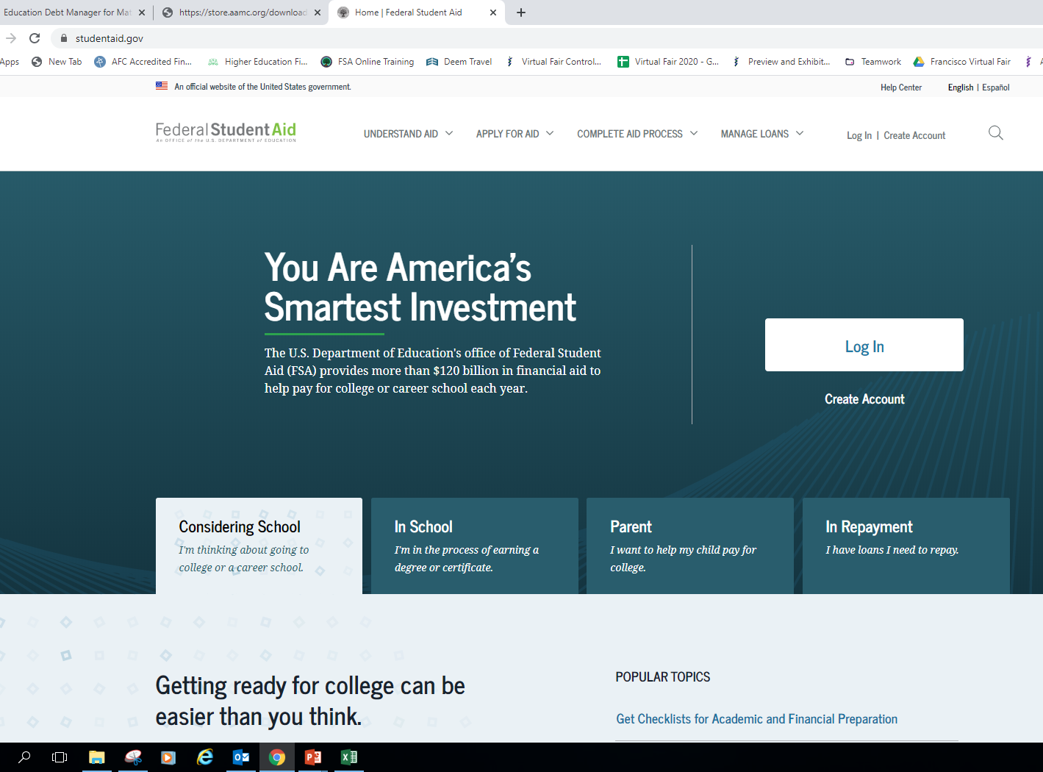
studentaid.gov
studentaid.gov
Notes:
To find details of the federal student loans, log into your Federal Student Aid (FSA) account at studentaid.gov.
You will need to provide your FSA ID (which consists of your username - or email address - and your password).
What you will find in your FSA account are your federal student loans from undergrad and medical school, and you will also have the option to select ‘Download My Aid Data’ once you get to the dashboard in your account.
That action will help you use the MedLoans Organizer and Calculator much more effectively, as you will have a simple file to upload into the MLOC to quickly see your potential repayment options.
Your FSA account will detail the current lender, servicer, and the outstanding principal balance (OPB) of your federal loans. The information is not real-time data, and due to processing times and periodic updates, your current loan situation may be different than what is reflected.
Contact your servicer(s) to determine the exact balance and status of your loans.

Slide 13
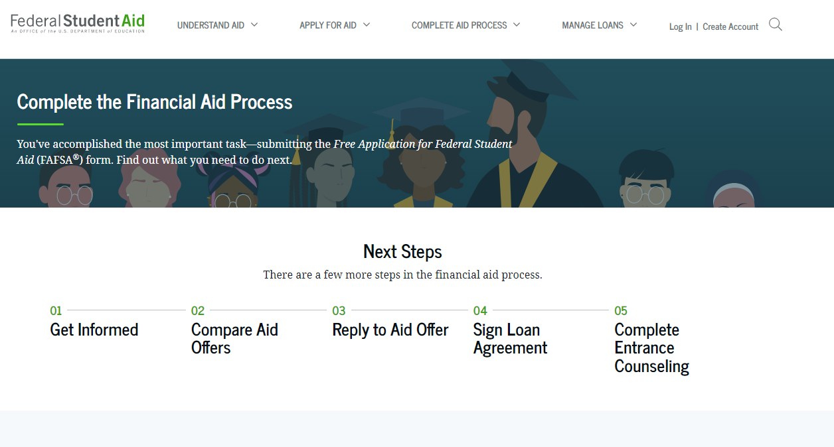
studentaid.gov
Notes:
To find details of the federal student loans, log into your Federal Student Aid (FSA) account at studentaid.gov.
You will need to provide your FSA ID (which consists of your username - or email address - and your password).
What you will find in your FSA account are your federal student loans from undergrad and medical school, and you will also have the option to select ‘Download My Aid Data’ once you get to the dashboard in your account.
That action will help you use the MedLoans Organizer and Calculator much more effectively, as you will have a simple file to upload into the MLOC to quickly see your potential repayment options.
Your FSA account will detail the current lender, servicer, and the outstanding principal balance (OPB) of your federal loans. The information is not real-time data, and due to processing times and periodic updates, your current loan situation may be different than what is reflected.
Contact your servicer(s) to determine the exact balance and status of your loans.

Slide 14

Master Promissory Note (MPN)
    Is a contract with the lender
    Can be used for multiple years
    Read before signing
    Lists your rights & responsibilities
Notes:
The Master Promissory Note (MPN) is a legally binding agreement between you and the lender. By signing the MPN, you are promising to repay the loans under the terms described in the Note.
You may receive multiple loans under a single MPN if it has a multi-loan feature. However, you will sign one MPN for Direct Unsubsidized Loans, and a separate MPN if you also receive Direct PLUS Loans. Once you have signed these MPN’s, you usually will not need to sign another promissory note for those loan types (unless you are here for longer than 10 years). You may opt-out of the multi-loan feature by communicating with the lender and financial aid office.
Like all contracts, it is wise to carefully read and understand the important details about your Rights and Responsibilities as a borrower, prior to signing the MPN.
If you have questions about your loans, the MPN is a good place to start looking for answers.
If you can’t locate your MPN, contact your lender or servicer to get a copy.

Slide 15
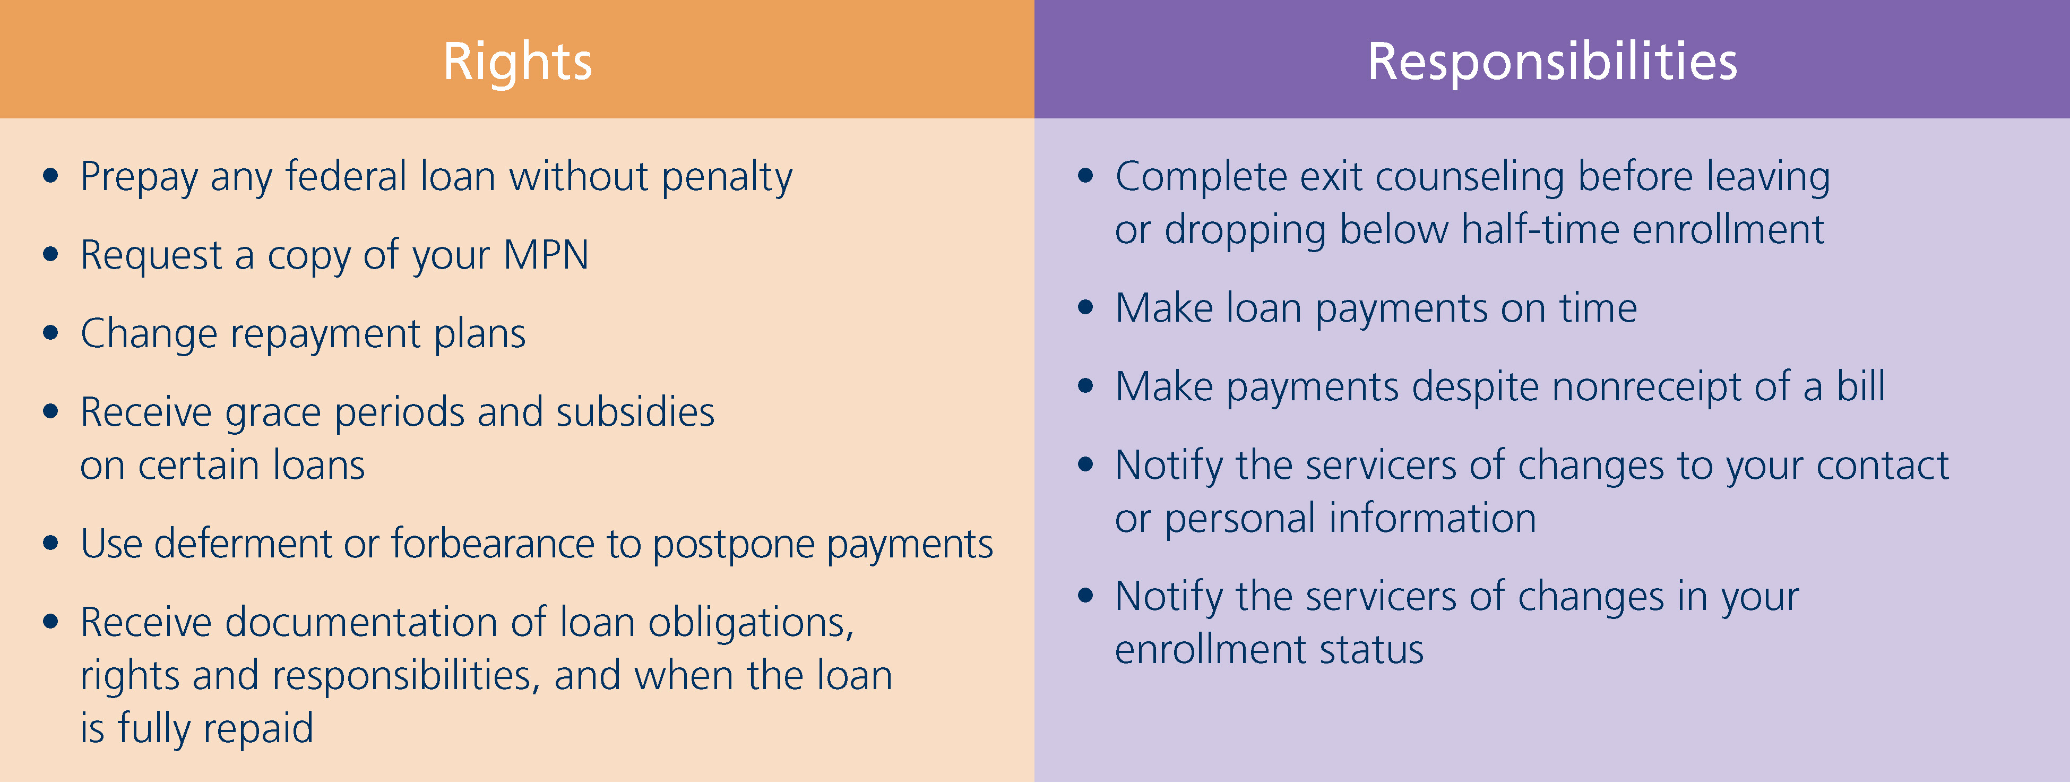
Rights and Responsibilities
  See the MPN for all rights
Notes:
If you review your MPN, and the Borrower’s Rights and Responsibility Statement, you will see that as a borrower you have a number of specific rights. These include the right to prepay any federal loan. What this means is that at any time, including while you are in school, you may either make payments towards the loans or pay more than what is required during repayment.
Also, at any time – but likely during or after residency - you can contact your servicer and request that your term be shortened or that your repayment plan be changed.
Finally, when it comes time to repay your loans, if you experience financial difficulties or unforeseen circumstances arise, you have the right to request that the servicer reduce or postpone your required payments using a deferment or a forbearance. Keep in mind that, although these are your rights, YOU have to be proactive to exercise them, as your servicer may not reach out and remind you of them.
If you do not have a copy of your promissory note, you can request one from your servicer at any time. For more details on these and other rights, review your MPN and the Borrower’s Rights and Responsibility Statement, or contact your servicer.

Slide 16
Rights and Responsibilities
  See the MPN for all responsibilities
Notes:
The saying goes, “With great rights, comes great responsibility.” This concept holds true with federal student loans. The MPN and Borrower’s Rights and Responsibility Statement details your rights as well as your responsibilities, and to sum it up: your primary responsibility is to pay back your loans, and pay them back on time.
This next part is very important! Your payments are required whether you receive a statement or not – so be sure to notify your servicer(s) any time your address changes. If you fail to stay in touch with your servicers, they will still expect an on-time payment.
The good news, though, is that as long as you are enrolled more than half-time, many of these responsibilities are not relevant until you separate or graduate from medical school.

Slide 17

A Serious Obligation
Student Loans Must Be Repaid
Manage
Your
Debt
Don’t Let It Manage You
Notes:
Though we do not expect this to be an issue for anyone here, it is a federal requirement that we stress the seriousness of the obligation to repay your loans.
So, again, it is your responsibility to make on-time payments. This means that payment is expected from you whether or not you:
complete your program
complete it in the expected amount of time
feel satisfied with your education experience
receive the purchased program or services and
whether or not you are able to obtain employment
You simply must pay back your student loans. No excuses.

Slide 18

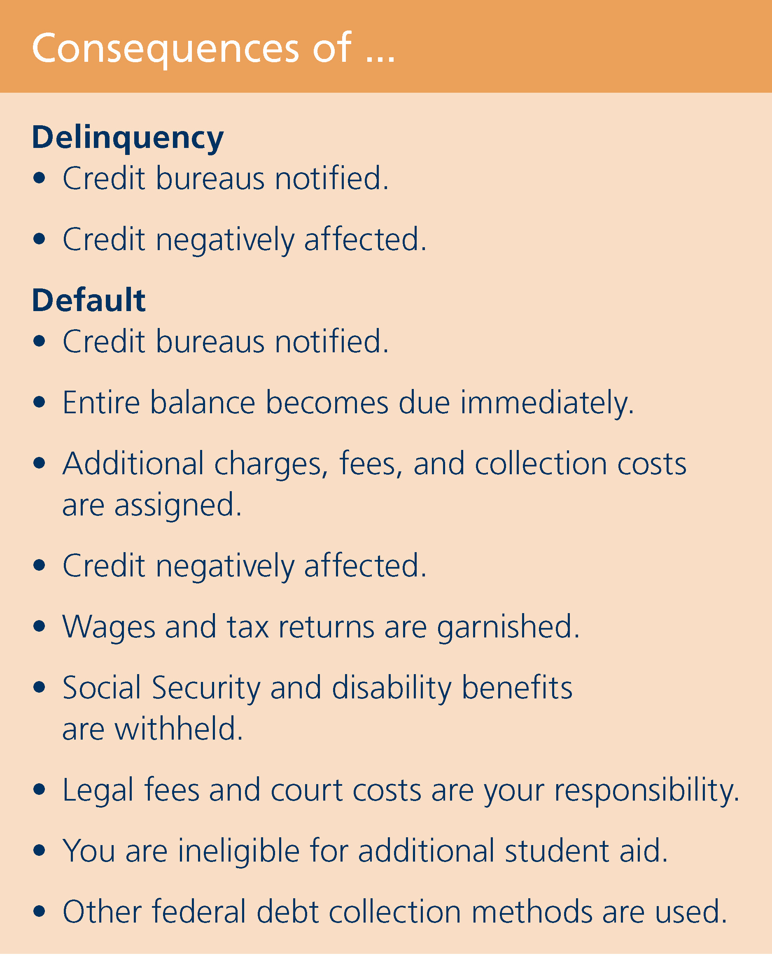
Consequence of Late Payments
Financial Problems?
Contact Your
Servicers
Immediately!
Notes:
On a positive note, medical school borrowers have a very low default rate. This means that borrowers like you repay their loans, repay them on-time, and many even pay their loans off earlier than required. The key to this, especially during residency, is to stay organized and know when your payments are due.
On that note, a resource to become familiar with is automatic withdrawal or scheduling online payments to be automatically sent from your checking or savings account to your creditors (i.e. – utilities, credit cards, loans, etc.). Automation removes the element of a student’s fatigue and/or forgetfulness.
(CLICK) In case a payment does “slip thru the cracks” with your student loans, you should know that the loan will be considered delinquent as soon as a payment is late, and after being 270 days late, the servicer assumes you will not pay, and places your loans in default. There are negative consequences for both of these situations. In the case of delinquency, your credit score will be negatively impacted. In the case of default, not only will your lack of payments be reported to the credit bureaus, but you may also experience:
a garnishment of wages and tax refunds
lawsuits - in which you are responsible for the cost
and other federal debt collection methods
Nobody wants you to get there. If you are experiencing financial difficulties, do not wait until it’s too late -- call your servicer immediately and see what arrangements can be made.

Slide 19
Subsidized Loans vs. Unsubsidized Loans
Subsidized
Unsubsidized
  Direct Subsidized
  Perkins Loans*
  Primary Care Loans
  Loans for Disadvantaged Students (LDS)*
Institutional Loans (some)
Consolidation Loans
(underlying subsidized loans)
  Direct Unsubsidized
  Direct PLUS
  Private Loans
Consolidation Loans
(underlying unsubsidized loans)
* Subsidy and deferment rights are lost in a consolidation loan
Notes:
Despite the majority of debt being unsubsidized, it is important to know that interest payments are allowed, and encouraged, to cover some or all of the accruing interest, even while you are still in school. Making payments against the accruing interest will not cause payments to be required, but it will help to reduce the total cost of the debt.
Subsidized Loans include Perkins Loans, Primary Care Loans, Loans for Disadvantaged Students (LDS), some Institutional Loans, and possibly a portion of a Consolidation Loan (depending on the underlying loan type). However, if you put your Perkins or LDS Loans into a consolidation, they will not only lose their favorable deferment rights, they will also become unsubsidized balances.
The larger portion of your debt, unsubsidized loans, accrues interest from the date of disbursement and includes Direct Unsubsidized Loans, Direct PLUS Loans, Private Loans, some Institutional Loans, and possibly a portion of the Consolidation Loan (depending on the underlying loan type).

Slide 20
Direct Unsubsidized & Grad/Plus
2022-2023 Direct Unsubsidized Loan
6.54% Fixed Interest Rate
1.057% Federal Loan Fee
Interest starts accruing continuously, at the point of disbursement*
Automatic in-school deferment
Maximum yearly (if eligible): M1-$42,722 (10), M2-$44,944 (11), M3-$47,167 (12), M4-$42,722 (10)
Maximum Undergrad/Grad: $138,500 Maximum professional student lifetime limit: $224,000
2022-2023 Direct Grad/PLUS Loan
7.54% Fixed Interest Rate
4.228% Federal Loan Fee
Interest starts accruing continuously, at the point of disbursement*
Automatic in-school deferment will postpone repayment
Grad/PLUS has a maximum interest rate cap of 10.5%
Maximum up to COA (if eligible)
Dept. of Education approval includes a “Credit Check”
*(Interest free until Aug. 31, 2022 - per Covid Relief federal legislation)

Slide 21
Interest Rates – Class of 2026
Fixed Interest Rates (’22 - ’23 Student Loans)
DIRECT UNSUBSIDIZED
LOAN
DIRECT
PLUS
LOAN
6.54%
7.54%
FIXED
FIXED
  * PCL Loans and LDS Loans are a fixed 5%
Notes:
You will be borrowing at the rates shown here. These rates are for your loans disbursed between July 1st and June 30th, and these rates are fixed for the life of the loan.
In future academic years, Direct Loans (Unsubsidized and PLUS), will be based on different rates (depending on the 10-Year Treasury Note prior to the beginning of those academic years).

Slide 22
Fixed Interest Rates for the Class of 2022
M1
2018-19
M2
2019-20
M3
2020-21
M4
2021-22
N/5.0%
5.0%
PERKINS*
PERKNS*
PERKINS*
PERKINS*
5.0%
5.0%
5.0%
DIRECT UNSUBSIDIZED
DIRECT UNSUBSIDIZED
DIRECT UNSUBSIDIZED
DIRECT UNSUBSIDIZED
6.6%
6.08%
4.30%
5.28%
DIRECT PLUS
DIRECT PLUS
DIRECT PLUS
DIRECT PLUS
7.6%
7.08%
5.30%
6.28%
  * Perkins, PCL and LDS Loans are disbursed at a fixed rate of 5%. All loans shown have a fixed interest rate.
Notes:
The rate of interest accrual is important, and the interest rates for the loans you borrowed while in medical school is likely detailed above. These rates are fixed, so no matter what happens in the economy– these are the interest rates you will pay on these loans.

Slide 23
Federal Loan Origination Fees
The federal loan fee is deducted proportionately from each loan disbursement by the Dept. of Education prior to disbursement
The disbursed amount you receive will be slightly less than the amount you actually accept/borrow (your gross amount).
You’re responsible for repaying the entire amount (gross amount) you borrowed and not just the (net amount) that was disbursed
Unsubsidized Loan: 1.057% Loan Fee
$20,500 + $22,222=$42,722 Total Accepted
$216 + $234=$450 Total Loan Fees
$42,272 “Net” Disbursed ($21,136 per semester)
Grad/PLUS Loan: 4.228% Loan Fee
$27,244 Total Accepted
$1,150 Total loan Fees
$26,094 “Net” Disbursed ($13,047 per semester)

Slide 24

Capitalization
Addition of unpaid interest to the principal
$231,700*
$200,000
$31,700
Principal
+
Interest
=
Larger Principal
  *Based on the median education debt level for the Class of 2019 and interest rates from the Class of 2020
Notes:
(NOTE TO SPEAKER: #’s on this slide can be manipulated using your school’s average indebtedness along with the MedLoans® Organizer and Calculator. The numbers provided above are based on a 2020 graduate that borrowed $200,000 in federal loans.
At certain points in time, the unpaid accrued interest will capitalize. Capitalization is a process that may seem invisible, but the impact is significant. Capitalization can increase the cost of your loans because it takes all accumulated interest that is unpaid (from loans such as your Direct Unsubsidized and Direct PLUS Loans) and makes it a part of the original principal balance. Once capitalization occurs, your new (and larger) principal balance begins accruing interest. In effect, your interest is now accruing interest.
Your servicers have policies on how loans capitalize and at what times. You should direct capitalization questions to the servicer of the loan. However, what is most often the case is that while you are enrolled more than half-time, capitalization will be postponed until your loans enter repayment--after you separate from school.
For those of you who are visual learners, here is an example of the capitalization a medical school student will experience after graduation. Obviously, it is not a positive process, and the less often it happens, the better.
For a 2020 graduate that borrowed $200,000, they likely accrued over $31,000 of interest (based on 4 years in medical school and six months of grace). When this interest capitalizes, the loans have a new, higher principal balance of over $231,000, and the interest that accrues thereafter (approximately $1,200/month) based on this higher balance.

Slide 25
Capitalization of Interest
Addition of unpaid interest to the principal
$215,500
$200,000
$15,500*
Principal
+
Interest
=
Larger Principal
  * Based on CARES Act in effect through Sep. 30, 2021. “Savings” of an estimated. $17,000 is realized because interest was avoided due to the CARES Act.
Notes:
(NOTE: The numbers on this slide can be manipulated to reflect your school’s average indebtedness and interest accrual – use the MedLoans® Organizer and Calculator (MLOC) to determine the interest accrued during medical school and grace. Realize, though, that the MLOC does NOT factor in the full effect of the CARES Act through Sept, 30 2021. If you need an accurate number for your session, email nknight@aamc.org).
After medical school, the unpaid interest that accrued over the last 4+ years will capitalize. Capitalization is a cost of student loans that many are not aware of, but the impact can be significant. Capitalization increases the cost of the loans because it takes the accrued interest (from loans such as your Direct Unsubsidized and Direct PLUS Loans) and adds it to the original principal balance. After capitalization occurs, your larger principal balance then begins accruing interest, so in effect, your interest is accruing interest – and if unpaid, this interest may capitalize as well.
Servicers have policies on when loans capitalize and at what times. You should direct any capitalization questions to the servicer of your loan(s). However, most likely, capitalization will be postponed until after you separate from school and possibly even for a short time thereafter.
For those of you who are visual learners, here is an example of the capitalization a medical school student will experience at the end of the grace period (which is often in November of the graduating year). Obviously, the less often capitalization happens, the better.
As we saw earlier, the median balance of student loan debt for the Class of 2020 was $200,000. For a 2021 medical graduate that borrowed $200,000, they would likely accrue over $15k of interest (based on medical school Direct Loans only and factoring the CARES Act). When this interest capitalizes, the loans have a new, higher principal balance of $215,500 and the interest that accrues going forward will be based on this larger balance.
*NOTE – if the CARES Act is extended, the amount of interest that capitalizes will be further reduced.

Slide 26


If possible, pay the interest before it capitalizes!
1. Separate from required payments
2. With instructions to apply the monies
immediately
towards the highest % rate loan
3. Follow-up to see it was done
Notes:
One debt management strategy is to pay all or some of the interest that has accrued prior to capitalization.
More specifically, while you are in school, your unsubsidized loans will be accruing interest. If you, or a helpful family member, have extra money, consider applying it towards the interest of your loans--prior to capitalization. This will help reduce your total loan cost, and it can enable you to pay your loans off faster.
If this is not a viable option at this time, consider this strategy for future purposes – if interest is accumulating during residency, attempt to pay some or all of it as you are able. This will limit the effects of future capitalization and save you money in repayment.
For many loans, the initial capitalization of accrued interest will occur when the loan enters repayment (either immediately when you separate from school OR when your grace period expires – whichever happens later). The exact repayment start date for loans differs depending on the type of loan it is, when you received it, and possibly even who the lender was.
The Repayment Timeline, in the next section, will help explain when the initial capitalization might occur (but again, always check with the servicer to confirm their policy).

Slide 27
Primary Care loan &
Loan for Disadvantaged Students
Need based loans with limited funding:
  Primary Care Loan (PCL): Interest rate is 5%
    Subsidized (interest free) during school and approved primary care residency
    Pediatrics, Internal, Med/Peds, Family Medicine, Preventative Medicine – NO specialties
  Loan for Disadvantaged Students (LDS): Interest rate is 5%
    Subsidized (interest free) during school and residency
    If interested: update your 22-23 FAFSA to include your parents’ financial information and notify SOM Financial Aid if you are interested in PCL

Slide 28
The Loan Repayment Timeline
Notes:
Now that we have discussed the details of student loans, let’s look at the repayment timeline that comes with these loans.

Slide 29

Loan Repayment Timeline
The path for many federal student loans
REPAYMENT
IN-SCHOOL
GRACE
Notes:
After you separate from school, your loans will either enter active repayment or a grace period. In most cases, a grace period is automatic - no application is required – and will begin as soon as you separate from school (i.e. – graduate), withdraw, take a LOA or drop below half-time status. Typically, a grace period on a loan bridges the time between being in-school and beginning active repayment.
During grace, the subsidies on federal loans remain active. Alternatively, unsubsidized loans will continue to accrue interest - as they always have done.
The availability and length of a grace period is based on the loan type – and is better addressed with the chart on the next slide. To verify the existence or length of a grace period, contact the servicer(s) of your loans.

Slide 30

NOTICE: Repayment Begins
If taking a LOA, dropping below half-time or withdrawing:
    Contact the Financial Aid Office
    Exit counseling is required
    Payments may start (or 6-month grace period begin)
Notes:
30
If your course load or enrollment status drops below half-time (which for our school means less than ___ classes or ____ hours) or if you withdraw altogether, it is critical that you remember to CONTACT THE FINANCIAL AID OFFICE immediately!
The financial aid office will:
guide you through the required exit counseling for your loans and
inform you which loans are going into repayment right away and which loans might have a grace period (‘grace period’ will be defined in a moment).
If you drop below half-time, repayment begins on all student loans. So, stay in touch with the financial aid office to best understand your options.
For any questions about the rights and responsibilities, or terms and conditions of your student loans, you may contact the following staff person at this school: (NAME) and (NUMBER or EMAIL) located in (office/bldg/room#).

Slide 31
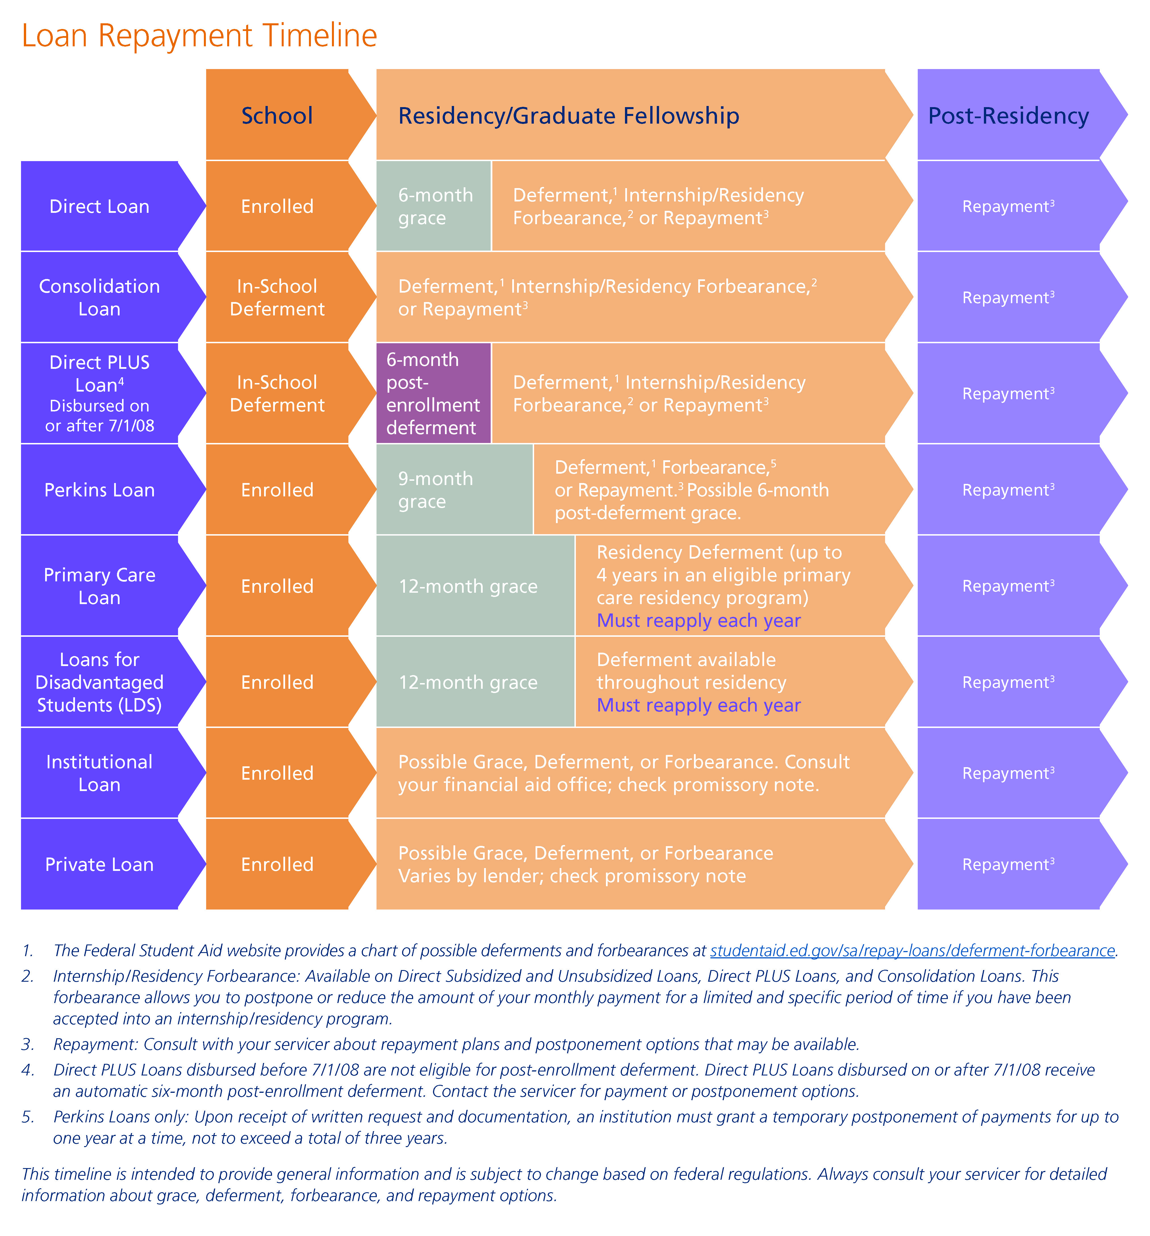
When is Your First Payment Due?
aamc.org/first/timeline
Notes:
The availability and length of a grace period is based on the loan type – and is best addressed in this chart. To verify the existence or length of a grace period, contact the servicer of the loan.
Grace is intended to allow you to transition smoothly from school into repayment, but notice:
The chart above shows that Direct Loans and Perkins Loans have an automatic grace period of 6-9 months.
However, Consolidation Loans have no grace period and require immediate payment (as do loans that don’t have or have already used their grace periods).
PLUS Loans have a 6-month post-enrollment deferment (similar to a grace period, but interest is accruing – like a forbearance). This “deferment” is applied
automatically, but it can be waived (to avoid the additional accrual of interest) by contacting the servicer.
If you have loans with varying repayment start dates, an ‘Alignment Forbearance’ can be used to line up the repayment start dates of all federal loans – discuss this with your servicers.

Slide 32

Options During Residency
There are two choices during residency
Make Payments
Postpone Payments
Deferment
Forbearance
Notes:
Alternatively, upon separation from school, if the loan does not have a grace period, or if the grace period has expired, you will be required to make payments. During this active repayment status, you have two primary options: To Pay or Not to Pay.
More specifically, you can decide:
To postpone payments (using deferment or forbearance) or
Make payments (under a repayment plan)

Slide 33
Postpone Payments
Deferment
Must apply and qualify
Interest continues to accrue on Direct Unsub and Direct PLUS loans (only waived on subsidized loans-from undergrad)
Forbearance
Must request from servicer
Interest accrues on all loans
Medical Residency Forbearance available
NOTE: For more details, or to request a deferment or forbearance, contact the servicer of the loan.
Notes:
One option you have to postpone your payments is through deferment. During deferment, if you have any subsidized loans in your portfolio, the subsidized portion of the loan would remain subsidized, while the unsubsidized portion would continue to accrue interest. Deferment does not occur automatically; you have to apply, AND qualify in order to receive a deferment. For a list of possible deferments, see the Education Debt Manager booklet.
(CLICK) An alternative to deferment, and a more likely option to postpone payments for a resident, is forbearance. During a forbearance, interest accrues on ALL of the loans (subsidized and unsubsidized), and if this interest goes unpaid, it will eventually capitalize. Thankfully, though, forbearance offers the flexibility of allowing voluntary payments to be made - at your discretion.
Like a deferment, though, forbearance does not occur automatically – you need to request a forbearance. As a medical resident, you are entitled to a Mandatory Medical Internship/Residency Forbearance for federal student loans. Upon request, this type of forbearance is issued in annual increments and can be re-requested each year, allowing you to postpone payments throughout residency.

Slide 34
Options During Residency
There are two choices during residency
Make Payments
Postpone Payments
Select a
Repayment Plan
Notes:
On the other hand, you may instead choose to begin repayment under a plan that best suits your financial situation.

Slide 35
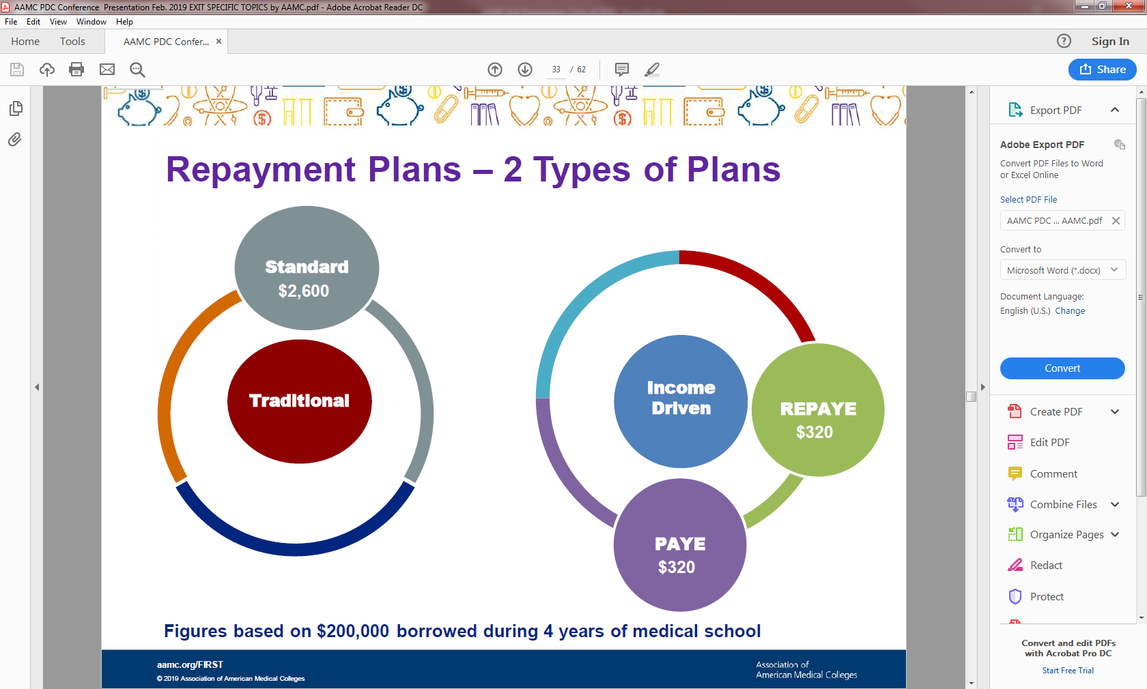
Notes:
If you want to go into repayment during Residency to reduce loan debt as quickly as possible or you are considering PSLF
The vast majority of Residents will use the “Income Determined Repayment Plans”: PAYE or REPAYE

Slide 36
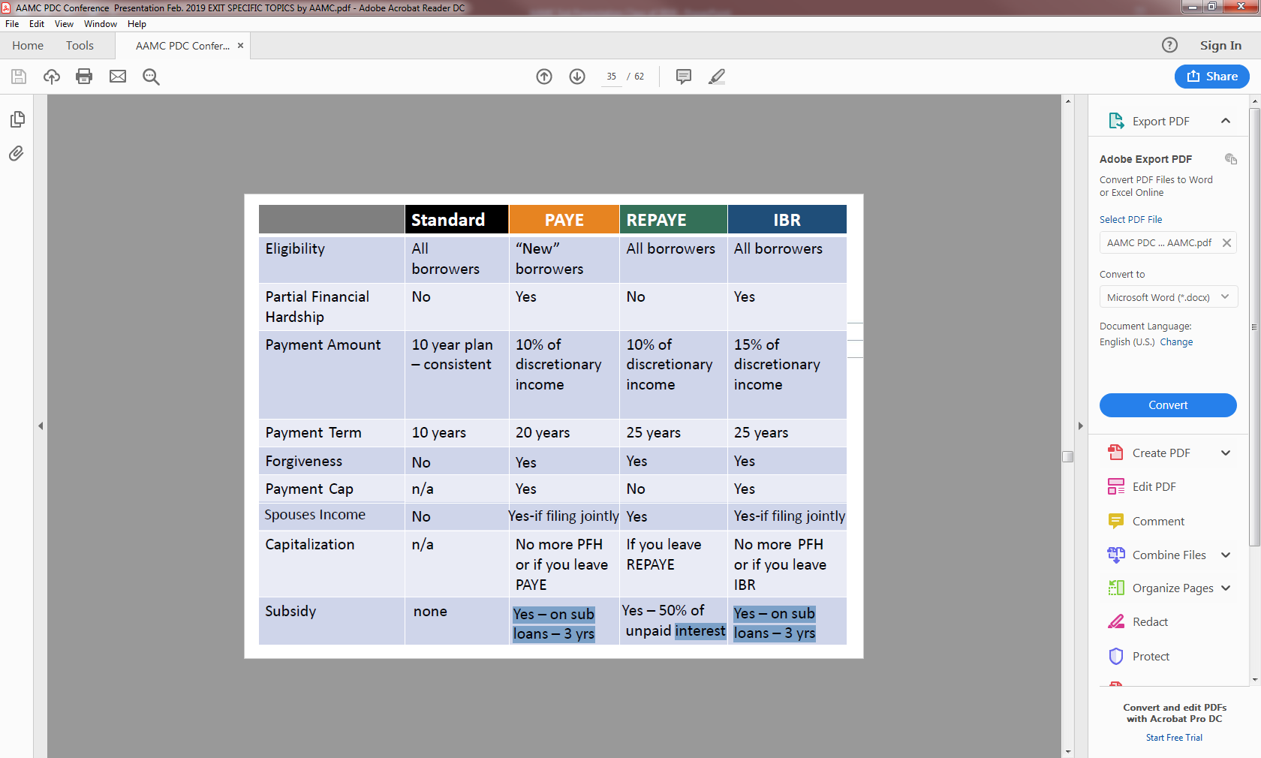

Slide 37
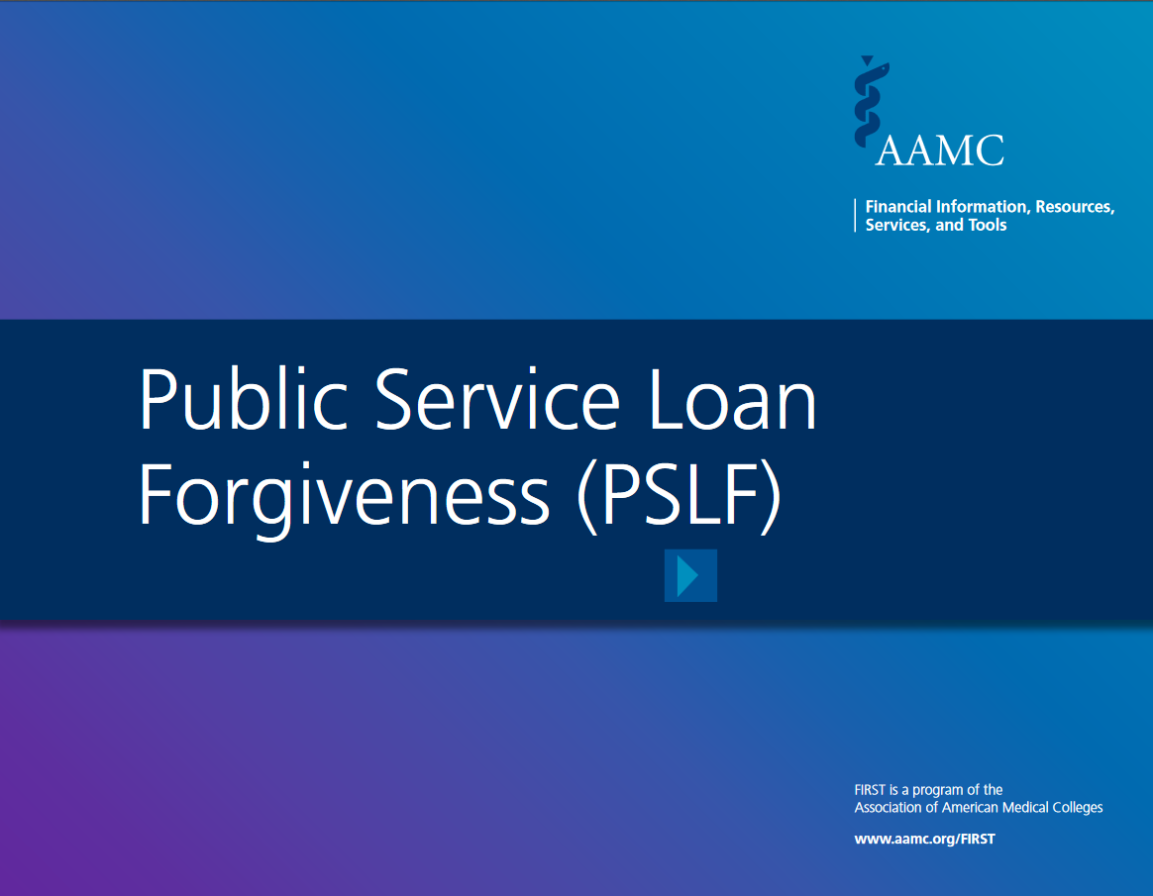
Public Service Loan Forgiveness
aamc.org/first/pslfbooklet
Notes:
Here is the link for the PSLF booklet – which contains links in it to easily connect you to other necessary PSLF resources.

Slide 38








Loan Forgiveness & Repay Assistance
aamc.org/stloan
aamc.org/repayasst
Notes:
Beyond PSLF, there are other repayment and forgiveness programs available. There are several resources to look into including the: AAMC Loan Forgiveness & Repayment Database, NIH, NHSC, and others.
You may also want to review the repayment Fact Sheets on the FIRST website, and the one that includes many of these resources is: Repayment Assistance Through Forgiveness, Scholarships, and Service.
If you desire other options, then ask questions along the way, especially in your residency program, at future hospitals, counties, or states where you may work.

Slide 39
Strategic Borrowing
Notes:
Now that you know the details of your loans and your many repayment and postponement options, let’s discuss how to borrow wisely for the next four years of medical school… and how to pay wisely as soon as you are able.

Slide 40
Class of 2021 Indebtedness
Mean MD School Debt: $182,662
PUBLIC
private
$178,837
$188,895
  Source: AAMC 2020 Graduate Questionnaire (GQ)
74.3% of class report having medical debt
22.2% report debt of $250,000 or higher
Notes:
Financing a medical education can be challenging. In fact, the majority of medical school graduates complete their education with student loans. As of last year, 73% of medical graduates reported leaving school with student loans. So, if you are financing your education, you are following a path that is well worn by others seeking to become a physician.
Across the country, the median level of debt* for the class of 2019 was $200,000 (based on public and private M.D.-degree granting schools, and including undergraduate debt). This information was collected by the AAMC from the class of 2019 as they graduated, and it offers you a point of reference regarding the current indebtedness of medical students. (Class of 2020's responses are currently being assimilated and will be available in November of this year.)
As a point of reference, the average level of debt here at (INSERT MEDICAL SCHOOL NAME) for the class of 2020 was approximately (INSERT $AVG DEBT).

Slide 41
SOM Indebtedness
Class of 2021 Average Debt (MD degree borrowing only): $212,075
161 Graduates
134 Graduates with medical debt
34.6 report debt of $250,000 or higher

Slide 42
Alternatives to Borrowing
FORGIVENESS
Faith & civic organizations
Military
NHSC S2S
aamc.org/stloan
BUDGETING
SUPPORT
Financial aid office
Family support
SCHOLARSHIPS
Alternatives to Debt
Cornerstone to avoid unnecessary debt
aamc.org/studentbudget
aamc.org/financialwellness
Hospital, county & state
Income-Driven Repayment
Public Service Loan Forgiveness
aamc.org/first/pslfbooklet
Notes:
First, borrowing wisely may mean not borrowing at all! There are alternatives to medical school debt, for example:
(CLICK)
Scholarships from outside sources – such as your faith affiliation, civic organizations, etc. There are also service based scholarships such as military and public health service programs (i.e. National Health Service Corps), or even scholarships from the school. Stop by the financial aid office to discuss possible scholarships this year or in the coming years.
(CLICK)
2. Don’t forget the support you have available to you. Support systems include the financial aid office – which is your primary point of contact for all financial aid matters – so visit them to discuss possible alternatives to borrowing. Also, do not forget the support you have from your family. Your family may be able to provide assistance through these years in the form of financial and emotional support. If a family member can help you pay down the accruing interest while you are in school, this will reduce not only the total cost of your student loan debt but also can reduce the amount of time that it takes to repay your debt.
(CLICK)
3. If you do not find alternatives to borrowing during medical school, be sure to make yourself familiar with the loan forgiveness and repayment options available after graduation and residency. The AAMC website, aamc.org/stloan, lists nearly 70 possibilities of assistance available during and post-medical school. Check it out!
(CLICK)
Lastly, and the cornerstone of avoiding debt, is to have a budget. Well done to those of you already doing this! We will look deeper into the value of living on a budget in just a moment, but first let’s look at the next step to strategic borrowing: borrowing in the right order.

Slide 43
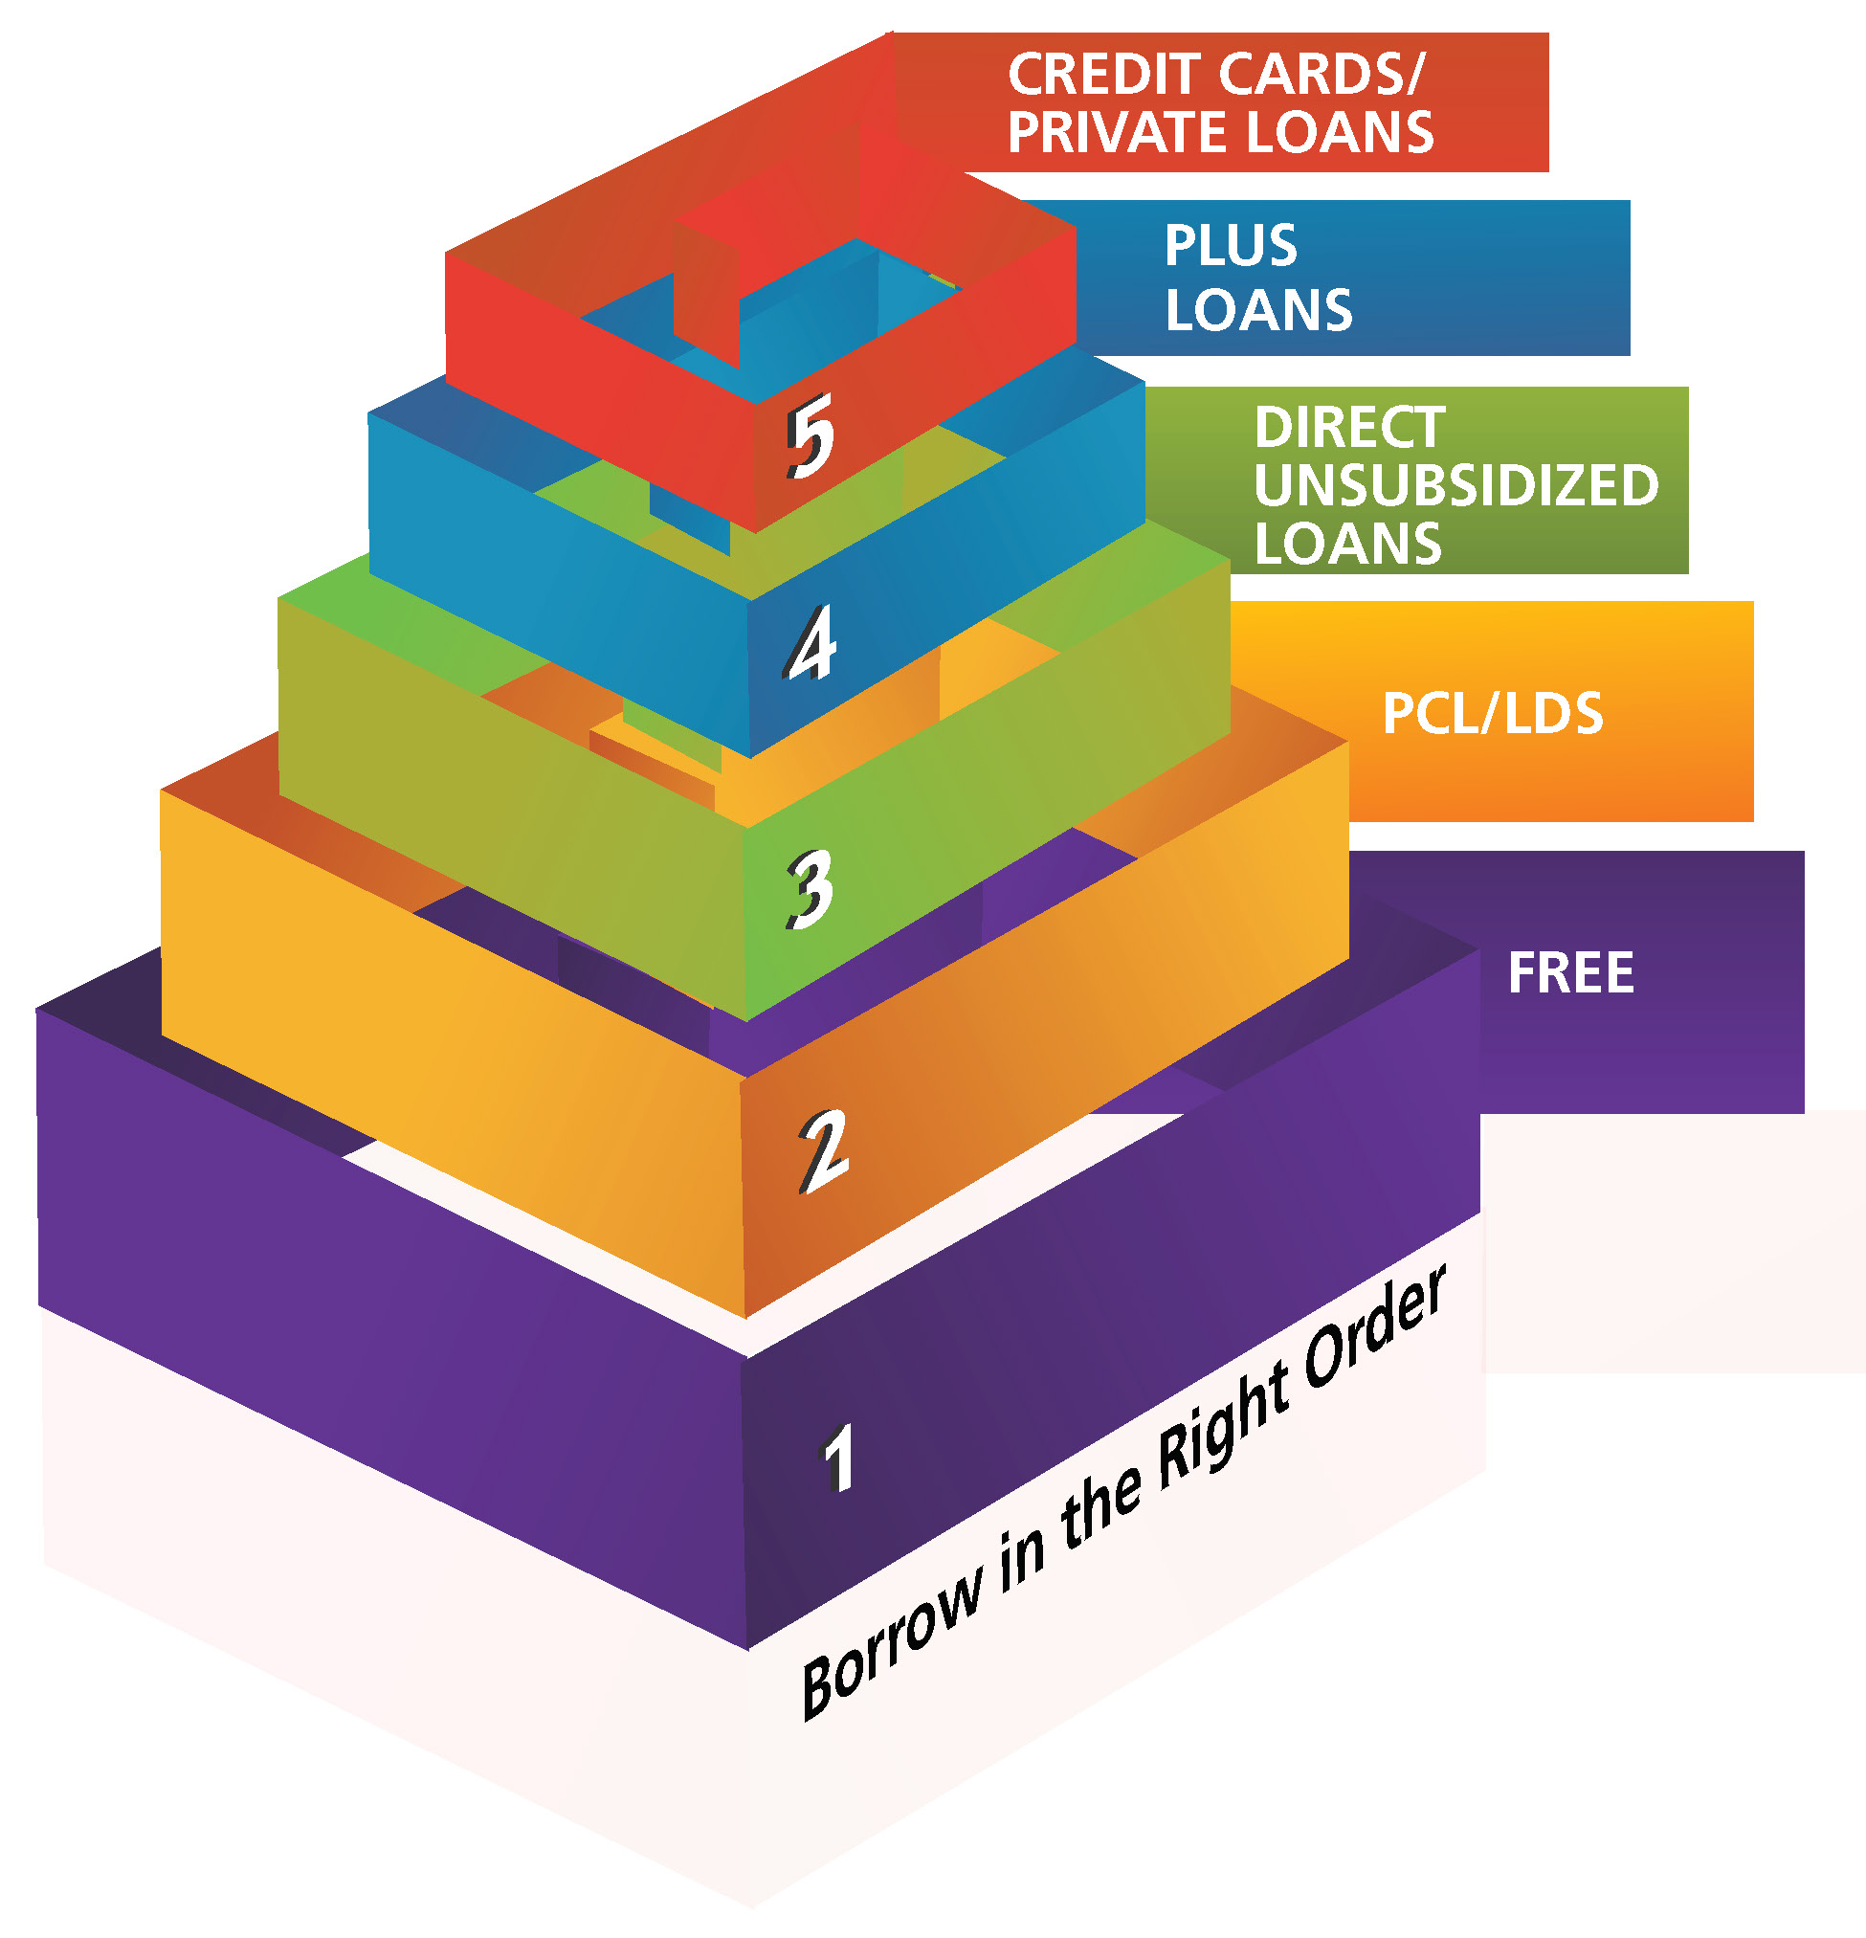
Borrow Wisely – In The Right Order
Notes:
Borrowing wisely means borrowing ONLY what you need, but it also means borrowing the least expensive debt FIRST.
This translates into seeking out all free money (grants/scholarships) and then turning to… in this order: PCL, LDS (if eligible), then Direct Unsubsidized Loans, then PLUS Loans, and finally private loans or credit cards.
If you find yourself resorting to credit cards and private loans, discuss your situation with us (the financial aid office), immediately, because financial aid award packages are made with the intention of avoiding these types of financing options. Our office may be able to offer additional assistance and guidance.

Slide 44
How Will You Borrow?
Do NOT borrow just because you are eligible…
    Create a BUDGET, only way to know what you need to borrow
    Cannot borrow above the published SOM COA
    Know the difference between a NEED and WANT
    Borrow what you need, not what you want
    Know how you will cover the expenses for summer, after M1
    Decline loans that exceed your need
Notes:
A common misunderstanding that many new medical school students have is that they have to accept all of the loans that they are awarded; however that is not the case. We encourage you to know how much money you need each semester and borrow only what you need and decline any loans that exceed your need.
As you are accepting loans, please understand that when you accept certain loans it may affect your eligibility for other aid. You are limited in the total amount of financial aid, including all loans and scholarships, that you can receive each year. You cannot receive more aid than your cost of attendance. This fact could mean forfeiting free or lower rate loans because you have already accepted a higher rate loan – so accept carefully.

Slide 45

Borrow Wisely
BORROWING CHALLENGE
$5,000 less each year
will REDUCE the amount borrowed
and REDUCE your:
    Monthly Payments by $310
    Total Interest Cost by $17,500
TIP -
Have a budget and save money
Note: Example is based on a projected 2025 M.D. graduate borrowing Direct Unsubsidized and PLUS Loans at CBO-projected interest rates with forbearance during a three-year residency prior to beginning a Standard 10-year repayment plan.
Notes:
An example of the effects of borrowing less.
What if a medical student has a budget, knows what they need and determines that although it is available to them, they will decline $5,000 of the Direct Unsubsidized Loans offered to them – and they do this every year?
The result is that they would reduce their debt levels by $5,000 each year of medical school (totaling $20,000 less borrowed), and reducing their future monthly payment by approximately $310 per month - ultimately saving themselves thousands ($17,000+) in interest costs!
So, have a plan – a budget – and stick to it. Borrow only what you need to borrow… it will save you money in the long run.

Slide 46
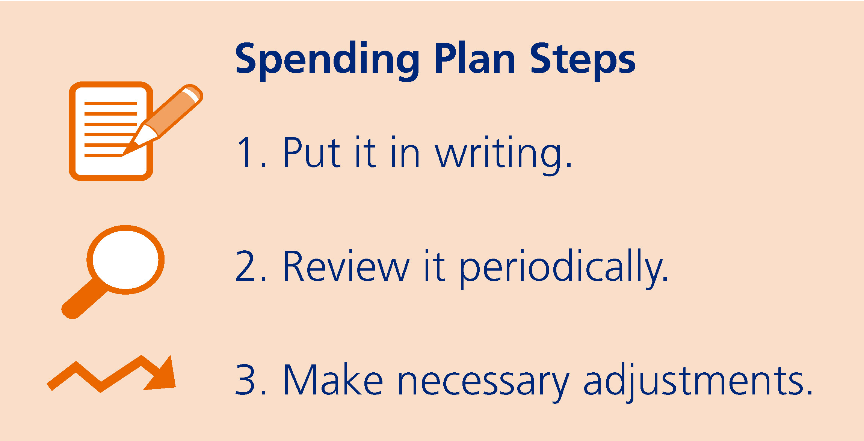
How to Create a Spending Plan
  “Live like a student while you are a student…”
Notes:
The simple steps to a spending plan include putting it in writing, reviewing it periodically, and making adjustments as necessary. These steps are not time consuming, but similar to eating healthy and working out, a spending plan takes self-discipline. If you create a spending plan, and attempt to follow it, you will reap the benefits.

Slide 47

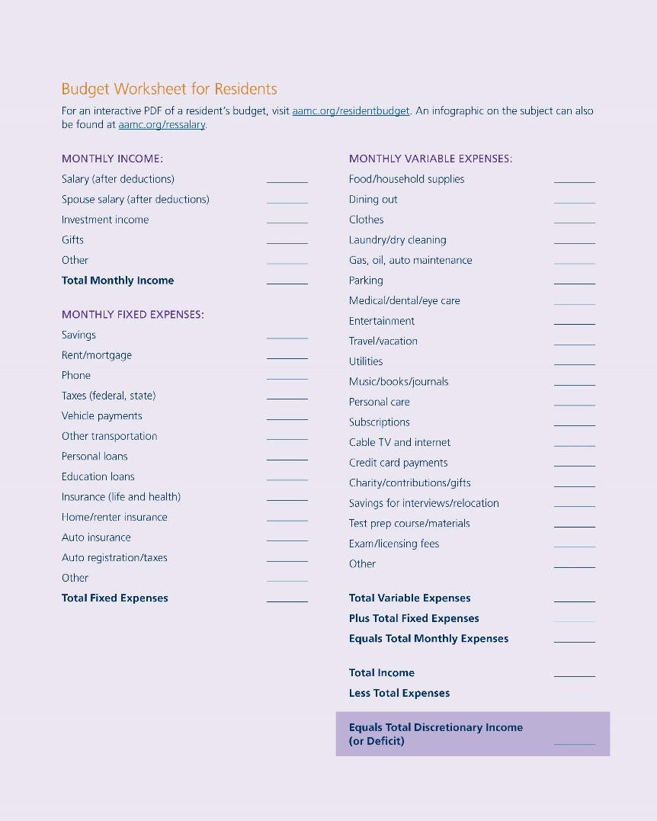
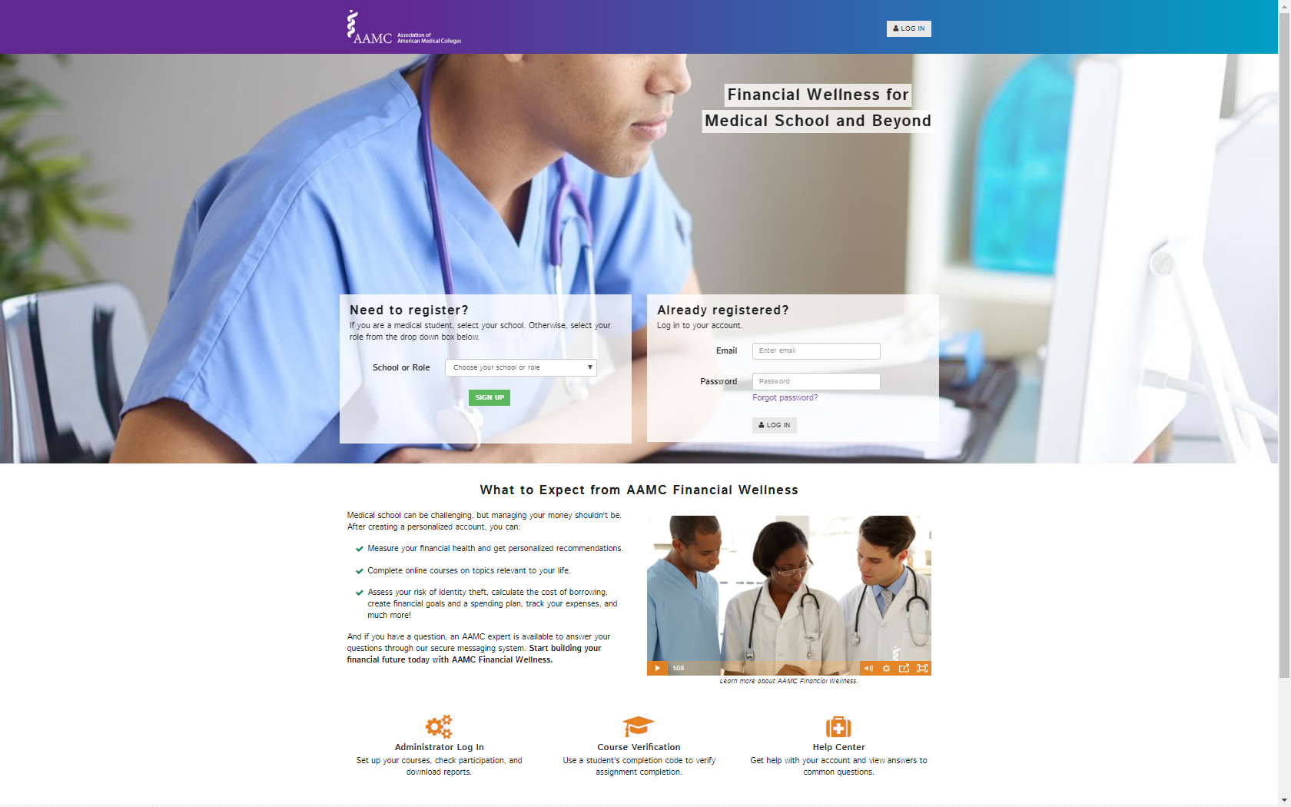
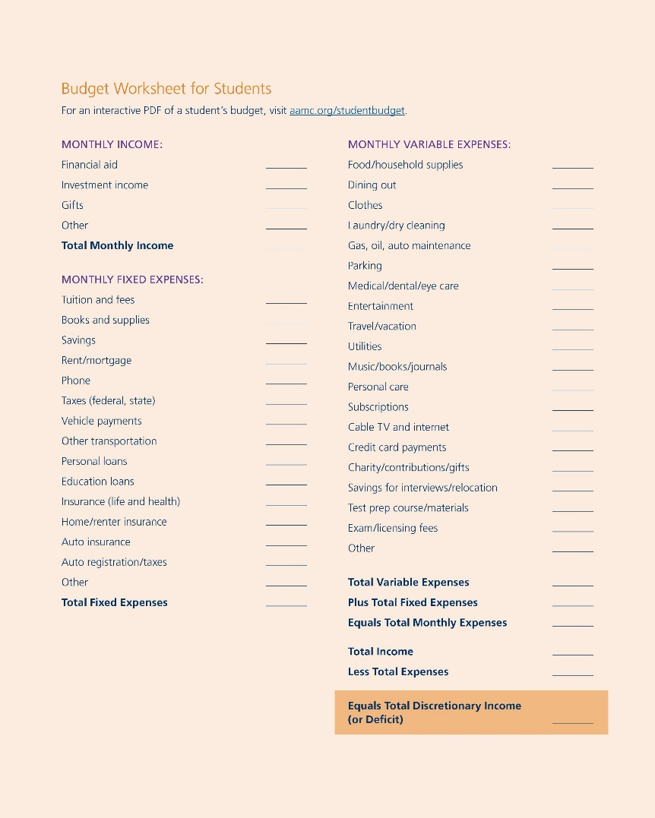
Resources to Create a Spending Plan
aamc.org/financialwellness
aamc.org/studentbudget
Notes:
To get you started, the AAMC offers several ways to help you create a detailed budget, including:
A budgeting course and Budget Calculator that can help you create a monthly budget that tracks and saves your spending plan is available in our Financial Wellness program (aamc.org/financialwellness).
And if you prefer another format, there is an interactive budgeting worksheet for students at aamc.org/studentbudget as well as Financial Aid Fact Sheets on budgeting (aamc.org/first/factsheets).
All of these resources can be found online and offer a quick and convenient way to create a budget for life in medical school, residency, and beyond.

Slide 48


The Basics of Budgeting
Your Total Income
Your Total Expenses
= Your Discretionary Income
Notes:
Basic elements of budgeting include three simple things:
Your income (income includes all sources of monies received by you – this includes financial aid)
Your expenses (fixed and variable) and
Your discretionary income (this is your spending money).
To determine your discretionary income, subtract your expenses from your income. This balance is your extra spending money.

Slide 49

Spending Wants: Leaks
Small amounts add up over time
It may not seem like much in the short term
$5/day, 5 days/week
$100/month, 10 months
$1,000/year x 4 years =
GOURMET
$4,000
Notes:
Despite the amount of time and effort that you put into a budget, spending “leaks” can occur. A leak may be something small, like a small “want” that you have each day or each week… a small indulgence (Starbucks coffee, happy hour, maybe even date nights). However small a leak may be, the little things will add up over time.
For example, a stop at the gourmet coffee shop (replace whatever your indulgence is here… the moral is the same) can easily mean $100/month or $1000/year. That is $4,000 during medical school -- FOR COFFEE. Is anyone budgeting $4,000 for gourmet coffee during medical school? Probably not. But if you don’t acknowledge your “wants” AND make room for them in your budget, you will slowly spend money without even realizing it.

Slide 50

Spending Wants: Leaks
Consider the alternatives
Savings can also add up quickly
$10/month
10 months/year
$100/year x 4 =
$400
AT HOME
Notes:
Acknowledge your ‘wants’ in a budget and determine if they are affordable. If they are not affordable, identify an alternative. In our example, the stop at the gourmet coffee shop could be substituted for coffee made at home.
If you make coffee at home, you would spend about $10/month, or $100/year, which saves you $900 in one year. That means, during medical school, you could spend about $400 making coffee at home vs $4000 buying coffee at the gourmet coffee shop.
Time at medical school may be filled with other alternatives. What can you substitute? Be honest with yourself; budget for your special “wants.” Do not deny yourself, but do not over indulge. Most importantly, do not bury your head in the sand and wait until the end of medical school to manage your finances.

Slide 51

Are Credit Cards Bad?
Notes:
Credit cards are NOT bad. There are many good things that a credit card can help you do. They allow you to tap a line of credit without using your own money on the spot. They also help you establish good credit and are great for emergencies. However, you must be wise about your use of credit cards. You should look for a card with a low rate, no annual fees, AND you should always pay the balance off each month, but if you can't, then at least pay more than the minimum balance.
What you don’t want to do with credit cards is:
- use them for cash advances, or
charge more than you can pay each month, or
pay an annual fee or high interest rate
(The national average interest rate for credit cards as of July 11, 2018 was 16.15% variable – source: bankrate.com)
If you find yourself using your credit cards to survive, then you need to put the brakes on your lifestyle and spending and consider making some drastic changes.
Most importantly, do not be late with your payments. Late payments are a fast way to ruin your credit score… but on time payments can improve your score.

Slide 52
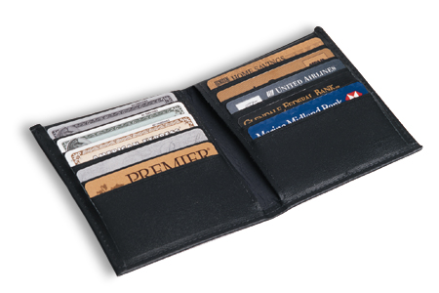
The Minimum Payment Trap
$5,000 balance with an 18% interest rate
(Making minimum monthly payments)
Source: BankRate.com
Notes:
Finally, in regards to credit cards and budgeting… be sure that you do not fall into the Minimum Payment Trap.
Let’s say you have a bit of a problem budgeting your first year of medical school, so you put $5,000 on your credit card (at 18%) to make up for a shortfall in your finances. Then, after Y1, you choose to make the minimum monthly payments…

Slide 53
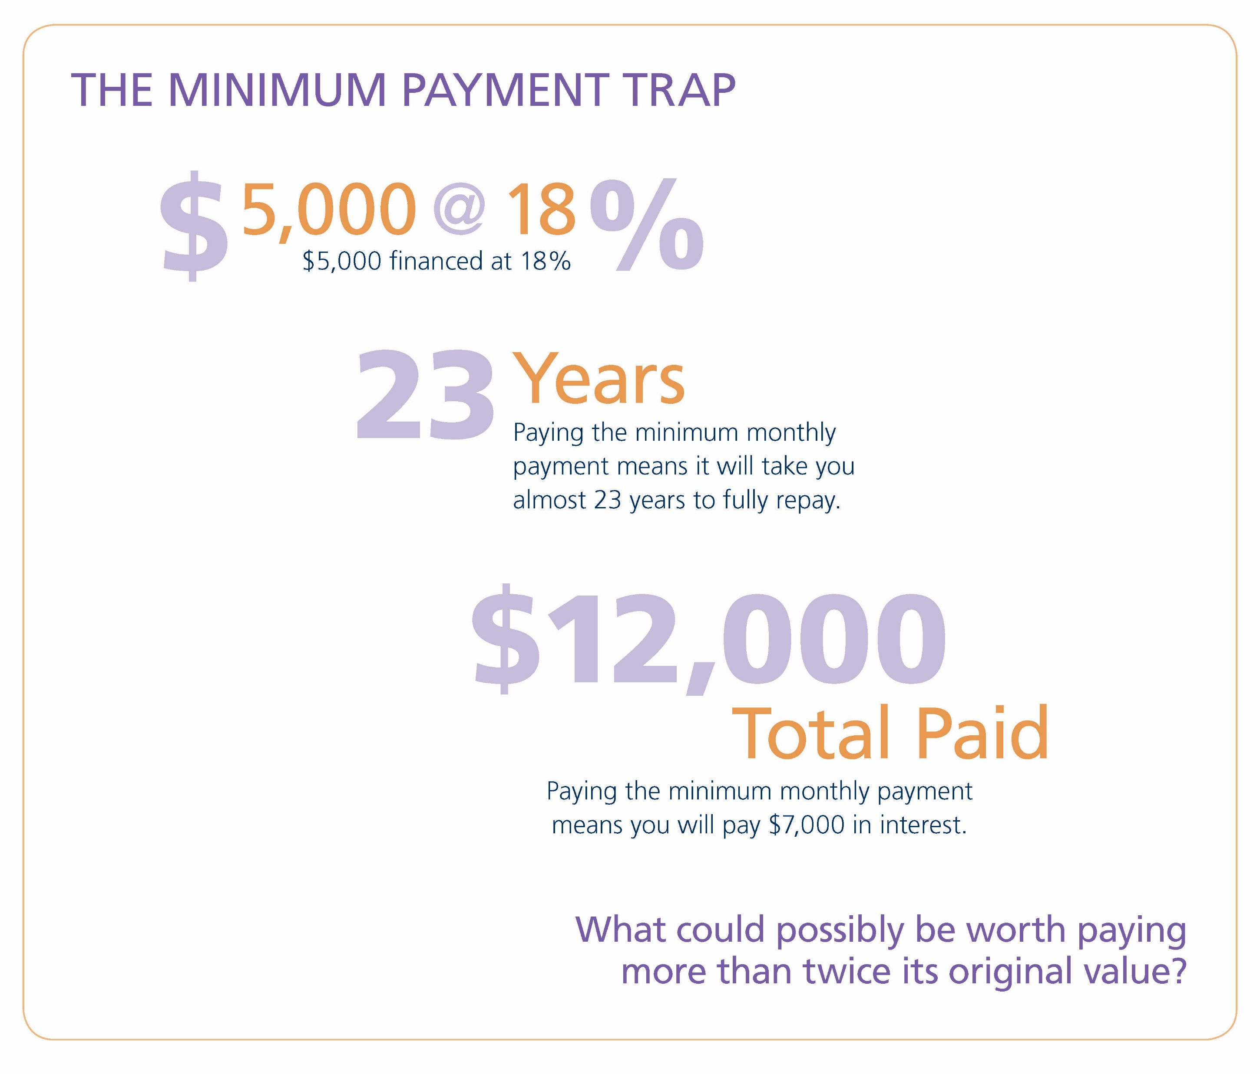
The Minimum Payment Trap
Source: BankRate.com
Notes:
The result of this $5,000 on a credit card, then paid down with minimum monthly payments, is that it will take you over 20 years to pay the balance off AND it will cost you nearly $7,000 in interest alone – totaling $12K when repaid! What can possibly be worth paying more than twice its original value?
Be willing to forfeit a purchase today, until you can really afford it. Budget wisely and avoid the need for credit cards. They are not bad, if used and paid off, but some of you already know this trap from undergrad… so do not fall victim to it during medical school.

Slide 54
Credit: Understand & Protect
Notes:
There are some common misunderstandings about credit – and one of the most prevalent ones held by medical school students is: “Since I will have no job, little-to-no savings, and will take out an abundance of student loan debt each year for the next four or more years, my credit will be bad.” This is false. Just because you are accumulating student loans without a full-time job anywhere in the near future, it does not mean that you will have a bad credit score. In fact, if you know what goes into a credit score, you will find that you can have a better credit score at the end of medical school than what you have today.

Slide 55

Check your
Credit Report
annualcreditreport.com
Notes:
I have one last piece of guidance for you. Your credit, and thus your identity, is so important that the federal government has created a website for you to freely review your credit reports (all three of them from the three credit bureaus). I encourage you to do this at least once a year and notify the appropriate bureau if you see any inaccuracies on your report.
The website is annualcreditreport.com.
(TIP - it does not hurt your credit score to check your own credit. In fact, in light of the increased risk of identify theft, checking your credit report is crucial to your financial health.)

Slide 56

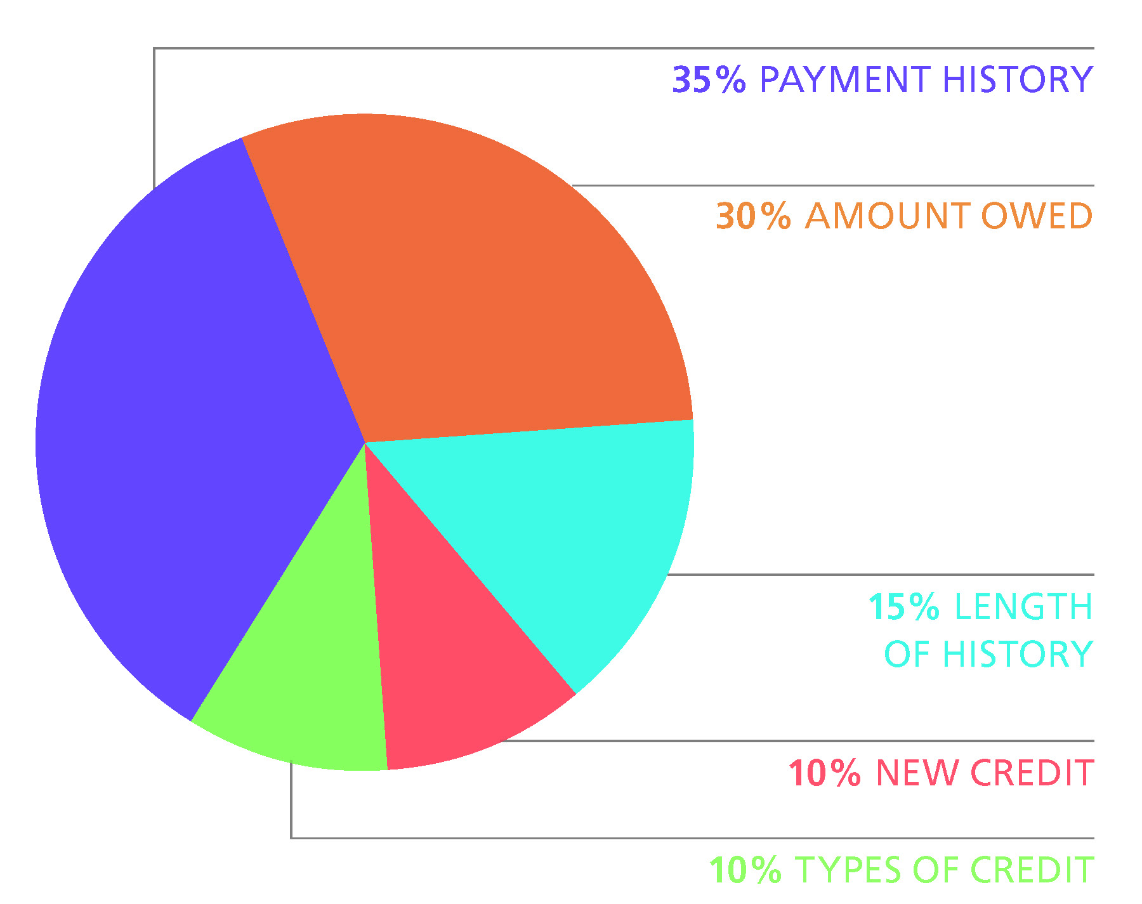




A FICO Score is Based On
30%
35%
15%
10%
10%
Notes:
A good credit score, or FICO score, is based on a number of factors and is determined by Fair Isaac and Co. What they have shared with the public is that no one category is used as the sole determination of a credit score. Rather, there are five factors used, including:
Payment history – 35%: This is the largest portion of your score. Delinquent payments can have a major impact on scoring, but consistent, on-time payments will raise a credit score.
Amount owed (also referred to as utilization rate) – 30%: The total amount of your credit line that you are currently utilizing will impact your credit score. The goal is to use less than 30% of your line of credit (add up the maximum credit line on all of your credit cards to determine how much you are using).
Length of history – 15%: The longer the credit history, the higher the score.
New credit – 10%: A high number of inquiries (over three) inside of 12 months can be negative, so limit the amount of times you allow a company to “pull your credit”.
Type of credit – 10%: Possessing a variety of credit is optimal (student loans, car loans, house loans, credit cards, etc.). Additionally, there is a difference between secured versus unsecured debt and how it weighs into your credit score.
This information, and much more, is available at myfico.com. Make yourself an expert on your credit. It can mean lower interest rate loans in the future. This will become a more critical topic in your life as you approach graduation and possibly consider using residency and relocation loans, or when you are ready to buy a car or a house. Use your time in medical school to build your credit score – you will be glad you did.

Slide 57

How to Improve Your Score
During medical school, these simple steps will help.
    Pay bills on time
    Pay down debt on lines of credit
    Apply for credit sparingly
Notes:
There are three items to focus on, during medical school, to improve your credit score:
Pay your bills on time – set up automatic payments to go out to each of your reoccurring lines of credit
Pay down your debt – live on a budget
Apply for credit sparingly – during your time in school, new lines of credit are unnecessary in most cases.
After four years of watching and protecting your credit, it is very likely that you will leave school with a better credit score than when you started.

Slide 58
AAMC Resources

Slide 59
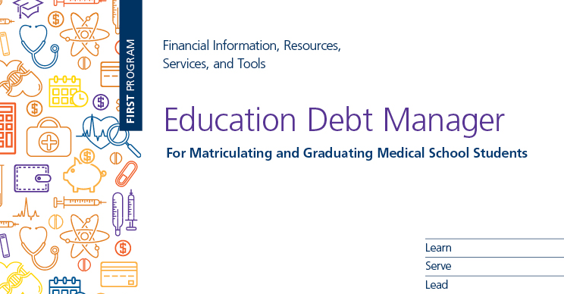
aamc.org/first/edm
Notes:
All of the material covered in this presentation is also found – in greater detail - within the Education Debt Manager (EDM).
A free PDF copy of the Education Debt Manager can be downloaded from the FIRST website, and it will serve as the best resource and takeaway for this session.

Slide 60
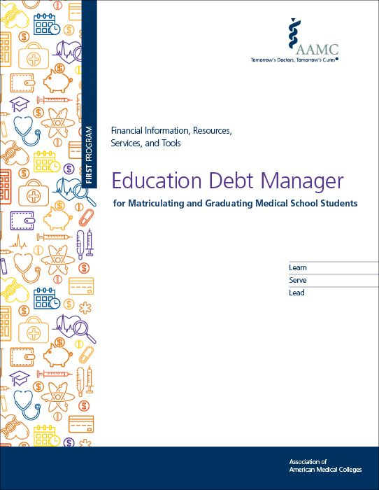
Resources: from the AAMC
AAMC FIRST
Offers Financial Aid Fact Sheets on Topics Like:
Budgeting worksheets
Roommates and money
Transitioning to medical school
The cost of interviewing for residency
Repayment
Credit
Offers Videos and Webinars on Topics Like:
How long will it take to pay your student loans
7 steps to increasing your credit score
Home financing for graduating Medical students
Student loans and repayment for married physicians
AAMC’s – Education Debt Manager – Free PDF Download – aamc.org/first/edm

Slide 61
AAMC Financial Wellness Program
Some of the available courses include:
Budget Basics
Buying a Car
Financial Basics
Financial Planning
Financial Trouble
Having a Baby
Identity Theft
Managing Credit
Saving and Investing
Understanding Insurance
Financial Health Check - Measure your financial wellness.
Auto Loan Calculator - Estimate your monthly car payment.
Chronic Debtor Assessment – Obtain feedback on your spending behavior.
Financial Goals – Set your short and long term financial goals and store them within your account.
Mortgage Calculator – See estimated payments and learn about potential tax breaks.

Slide 62
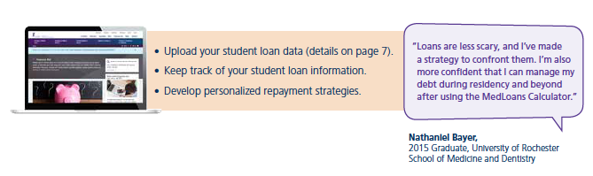
Know Your Numbers
MedLoans® Organizer and Calculator
A free tool for MD students
and graduates!!
aamc.org/medloans
Notes:
First, let’s talk about going into this experience with your eyes-wide open. The easiest way to see potential monthly payments and estimated total repayment costs is to download your loan details from your FSA account, www.studentaid.gov, and then upload that file into the MedLoans® Organizer and Calculator (MLOC).
As a medical student, your loan portfolio could get complex, so it is important to remain organized with your loan information – in fact, organization during your borrowing years will be key to your debt management abilities after school. Develop a system now; get a filing cabinet; scan and store your information, or do whatever you need to do to start saving all important documents in one place.
To assist you in staying organized AND making educated borrowing decisions, the AAMC has created an online tool to safely and securely enter and organize your loan information. This tool, called the MedLoans® Organizer and Calculator (MLOC), not only helps medical school students with organization, it also shows the impact (total repayment cost) of borrowing a loan – BEFORE YOU ACCEPT IT – so that you can decline the loan or reduce the amount before you borrow. The MLOC provides valuable insight throughout medical school, and it is offered by the AAMC as a FREE resource for medical students.
Using the MLOC will enable you to make educated decisions as you borrow loans and also show you the many repayment options available post-graduation. To log in to your already created MLOC account, refer to page 6 of the EDM and visit aamc.org/medloans.

Slide 63





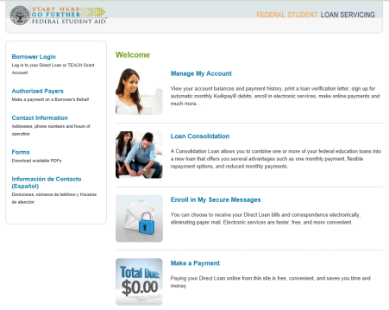
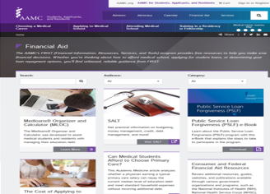
Support Along The Way
StudentAid.gov/feedback
aamc.org/advocacy/meded
Financial Aid Office
aamc.org/FIRST
MedLoans Organizer & Calculator
aamc.org/medloans
StudentAid.gov
Notes:
If you experience a disagreement with your servicer, and you feel that it has not been handled satisfactorily, you may want to provide feedback through the FSA Feedback system.
Beyond this, there are a plethora of other areas of support, including:
[CLICK] Your medical school financial aid office and eventually your residency program.
[CLICK] the department of education, via Federal Student Aid (FSA)
[CLICK] As well as the AAMC and the MedLoans Organizer and Calculator,
[CLICK] and the FIRST team at the AAMC that puts out many resources including the calculator, Financial Aid Fact Sheets (briefly discussing some of the topics presented today), videos, and other financial resources.
[CLICK] And many others along the way. You are not alone on this journey.
And with that, we will conclude this session! Class of 2025, congratulations on your entry into medical school!
Remember… borrow wisely and live like a student… You won’t go wrong if you live by these financial mottos during your time in medical school.

Slide 64

QUESTIONS

