Slide 1
Financial Aid & Money Management
for Entering Medical School Students
Prepared for the Class of 2027
Angela Hall
Financial Aid Coordinator for SOM
University of Louisville – SOM Orientation
Disclaimer: All information and estimates are based on AAMC interpretation of federal regulations as of July 2022 and are subject to change. These are estimates only. Students should contact their servicer(s) to discuss exact loan balances and repayment options.

Slide 2


Welcome
Class of 2027!
Notes:
First and foremost, congratulations to each of you for making the decision to become a doctor. You have worked hard to get here. Welcome to _____________________________(insert name of medical school), and again, congratulations!

Slide 3


UofL SOM FA Specifics…

Slide 4

SOM Financial Aid Staff
Leslie R. Kaelin, M.Ed.
Financial Aid Director, SOM
Angela Hall, MSM
Financial Aid Coordinator, SOM
Located in:
SOM A Building (Instructional Bldg.)
Suites 204 & 205 (across from SOM Student Affairs)
502-852-5187

Slide 5
Functions of Different offices:
SOM - Financial Aid:
Assist with account questions
Additional loan offers/loan reductions
Post internal awards
Billing for NHSC
Counseling
Financial Literacy Events
Bursar’s office:
Student Billing
Refunds (Student Choice - Nelnet)
Third Party Billing
  VA and Military HPSP
Takes payments
Main Campus Financial Aid:
Clear Conflicting info on FAFSA
Process Verification
Clears Citizenship
Posts outside scholarships
Packaging processing
Campus Health Services:
Waving Major Medical Insurance
Questions regarding medical coverage

Slide 6

Financial Literacy Provided by our Office:
We Make Financial Literacy Fun!
M1 - The Price is Right! - Topic: Goals and Budgeting (Fall)
M1 - Fashion $ense Show (Spring) College competition - “Doing More with Less”- Celebrity SOM Judges
M2 - So You Want To Be a Millionaire? - Credit Reports and Scores
Various emails about AAMC Financial Literacy Webinars
Financial Wellness programing
New M4 elective course

Slide 7
1 year
23-24 Cost of Attendance (COA) Details – M1 year
Bursar’s Office Bill Fall 23
$22,241 KY-R Tuition
$625 Technology Fee
$52.50 HSC Health Fee
$98 UofL Recreation Fee
$55 Disability Insurance Fee
$1617 Major Medical Health Ins. (waive?)
$24,688.50 Total Billed Fall 23
Bursar’s Office Bill Spring 24
$22,241 KY-R Tuition
$625 Technology Fee
$52.50 HSC Health Fee
$98 UofL Recreation Fee
0 Disability Insurance Fee (not billed in spring)
$1617 Major Medical Health Ins. (waive?)
$24,633.50 Total Billed Spring 24
Not billed, but in your (M1) 23-24 COA
$1,308 M1 Books & Supplies & Equipment
$26,710 Living Expenses (Includes Major Medical Health Ins., $3234 total)
Living Expenses includes: Room & Board, Transportation, Major Medical Insurance, Personal Expenses & Loan fees
Total M1 COA: $74,106
Total M1 COA Non-Resident tuition: $97,188

Slide 8
Financial Aid Helpful Hints
#1 Develop a Budget !!! Just do it!
Ask SOM Financial Aid, don’t assume or take the advice from a fellow classmate to answer your questions. There are no stupid or wrong questions!
If you originally received or borrowed less than your full allowed Cost of Attendance (COA), you can request previously declined loans, contact our office!
If you are having any financial issues or concerns throughout medical school, contact our office. SOM FA will do everything we can to assist you. Unfortunately, an answer may be “no” based on federal aid regulations, but it never hurts to inquire. You don’t know unless you ask!
If possible, plan for a backup financial assistance option, before the unexpected happens.
Remember to save for lump sum expenses from your first disbursement
Attend Financial Wellness & Literacy programs! Fun, informative, prizes and lunch!
Make a financial plan for summer!
Notes:
As a tip – if a financial crisis occurs during any semester, and you accepted loans frugally, seek out the assistance of the financial aid office. We may be able to access those previously declined monies for your use.

Slide 9
Most frequently asked questions…
I forgot to submit my FAFSA, now what do I do?
File the appropriate FAFSA as soon as possible!
When should I expect my refund?
M1 & M2 Financial Aid First Disbursement today! Bursar’s Office Refund/Residual 3-5 days after aid disbursement
How do I request my loans to be re-offered?
Contact SOM FA at 502-852-5187
Why haven’t my loans disbursed? Many possible reasons…some examples are:
UofL did not receive your FAFSA, or you have not filed it yet
Not packaged yet - late FAFSA or other issue
Did not accept loans on ULink, or recently did it
Did not complete Loan Entrance or Loan MPN at www.studentaid.gov
Did not sign up for Bursar’s Office refund process via Student Choice - Nelnet
Expired MPN
Various other issues, contact us for help!
How do I waive the health insurance, or the health insurance charge is still on my account!
You will receive emails each semester providing the instructions from Academic Health Plans, for additional questions regarding the health insurance, contact Campus Health Services at 502-852-6519

Slide 10
Federal Loan Aid

Slide 11
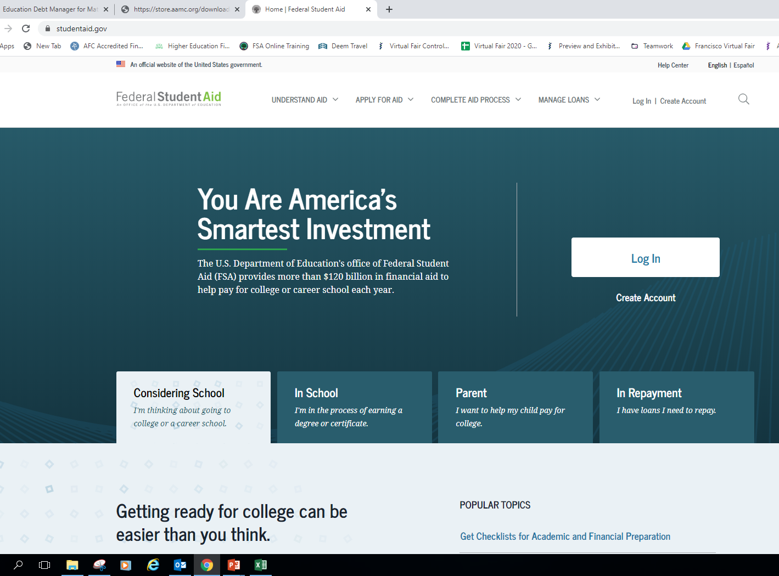
studentaid.gov
studentaid.gov
Notes:
To find details of the federal student loans, log into your Federal Student Aid (FSA) account at studentaid.gov.
You will need to provide your FSA ID (which consists of your username - or email address - and your password).
What you will find in your FSA account are your federal student loans from undergrad and medical school, and you will also have the option to select ‘Download My Aid Data’ once you get to the dashboard in your account.
That action will help you use the MedLoans Organizer and Calculator much more effectively, as you will have a simple file to upload into the MLOC to quickly see your potential repayment options.
Your FSA account will detail the current lender, servicer, and the outstanding principal balance (OPB) of your federal loans. The information is not real-time data, and due to processing times and periodic updates, your current loan situation may be different than what is reflected.
Contact your servicer(s) to determine the exact balance and status of your loans.

Slide 12
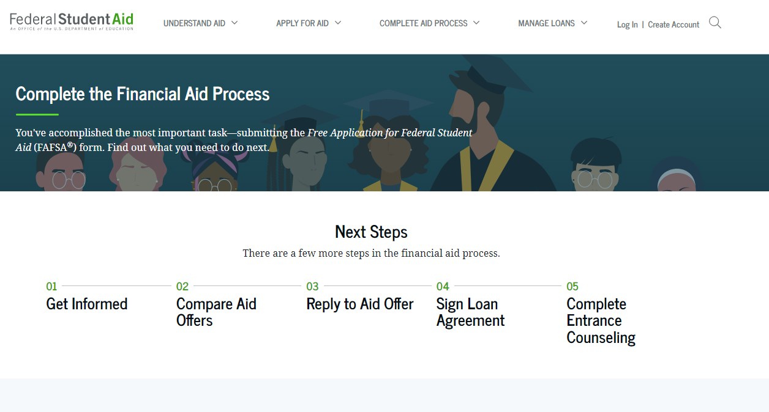
studentaid.gov

Slide 13

Complete Entrance Counseling:
Entrance counseling explains your rights and the obligations you agree to meet as a condition of accepting a Direct Loan.
Topics include: Estimate the Cost of Your Education
Paying for Your Education
Federal Student Loans
How Much You Can Expect to Borrow
Prepare for Repayment After School
Consequences of Not Repaying Student Loans
This Photo by Unknown Author is licensed under CC BY-SA

Slide 14

Master Promissory Note (MPN)
    Is a contract with the lender
    Can be used for multiple years
    Read before signing
    Lists your rights & responsibilities
    Unsub and PLUS will have their own MPN
Notes:
The Master Promissory Note (MPN) is a legally binding agreement between you and the lender. By signing the MPN, you are promising to repay the loans under the terms described in the Note.
You may receive multiple loans under a single MPN if it has a multi-loan feature. However, you will sign one MPN for Direct Unsubsidized Loans, and a separate MPN if you also receive Direct PLUS Loans. Once you have signed these MPN’s, you usually will not need to sign another promissory note for those loan types (unless you are here for longer than 10 years). You may opt-out of the multi-loan feature by communicating with the lender and financial aid office.
Like all contracts, it is wise to carefully read and understand the important details about your Rights and Responsibilities as a borrower, prior to signing the MPN.
If you have questions about your loans, the MPN is a good place to start looking for answers.
If you can’t locate your MPN, contact your lender or servicer to get a copy.

Slide 15
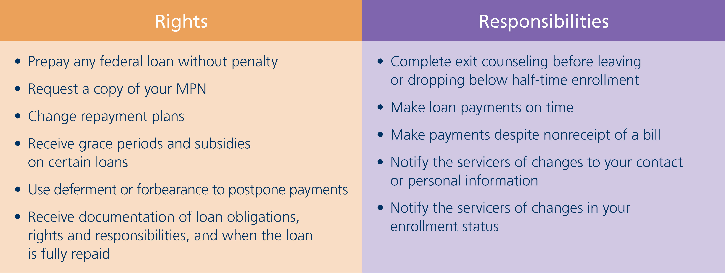
Rights and Responsibilities
  See the MPN for full list
Notes:
The saying goes, “With great rights, comes great responsibility.” This concept holds true with federal student loans. The MPN and Borrower’s Rights and Responsibility Statement details your rights as well as your responsibilities, and to sum it up: your primary responsibility is to pay back your loans, and pay them back on time.
This next part is very important! Your payments are required whether you receive a statement or not – so be sure to notify your servicer(s) any time your address changes. If you fail to stay in touch with your servicers, they will still expect an on-time payment.
The good news, though, is that as long as you are enrolled more than half-time, many of these responsibilities are not relevant until you separate or graduate from medical school.

Slide 16
Direct Unsubsidized & Grad/Plus
2023-2024 Direct Unsubsidized Loan
7.05% Fixed Interest Rate
1.057% Federal Loan Fee
Interest starts accruing continuously, at the point of disbursement*
Automatic in-school deferment
Maximum yearly (if eligible): M1-$42,722 (10), M2-$44,944 (11), M3-$47,167 (12), M4-$42,722 (10)
Maximum Undergrad/Grad: $138,500 Maximum professional student lifetime limit: $224,000
2023-2024 Direct Grad/PLUS Loan
8.05% Fixed Interest Rate
4.228% Federal Loan Fee
Interest starts accruing continuously, at the point of disbursement*
Automatic in-school deferment will postpone repayment
Grad/PLUS has a maximum interest rate cap of 10.5%
Maximum up to COA (if eligible)
Dept. of Education approval includes a “Credit Check”
*Congress recently passed a law preventing further extensions of the payment pause. Student loan interest will resume starting on Sept. 1, 2023.

Slide 17
Federal Loan Origination Fees
The federal loan fee is deducted proportionately from each loan disbursement by the Dept. of Education prior to disbursement
The disbursed amount you receive will be slightly less than the amount you actually accept/borrow (your gross amount).
You’re responsible for repaying the entire amount (gross amount) you borrowed and not just the (net amount) that was disbursed
Unsubsidized Loan: 1.057% Loan Fee
$20,500 + $22,222=$42,722 Total Accepted
$216 + $234=$450 Total Loan Fees
$42,272 “Net” Disbursed ($21,136 per semester)
Grad/PLUS Loan: 4.228% Loan Fee
$27,244 Total Accepted
$1,150 Total loan Fees
$26,094 “Net” Disbursed ($13,047 per semester)

Slide 18
Class of 2022 Indebtedness
Median MD School Debt: $200,000
PUBLIC
private
$193,000
$224,000
  Source: AAMC 2022 Graduate Questionnaire (GQ)
71% of class report having education debt
53% report debt of $200,000 or higher

Slide 19
Indebtedness
Class of 2022 Average Debt (MD degree borrowing only): $229,543
153 Graduates
116 Graduates with medical debt / 37 without debt
51 report debt of $250,000 or higher

Slide 20
The Details of Your Loans
Notes:
The first step to making wise decisions is to clearly understand what you are dealing with. Your student loan portfolio may consist of a number of different types of loans, with different balances, different interest rates, and different repayment terms.
It is important that you understand exactly what is in your loan portfolio and be familiar with the details of your debt, because only then can you make the best debt management decisions.

Slide 21
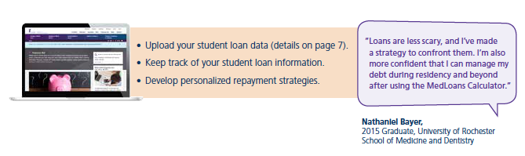
Know Your Numbers
MedLoans® Organizer and Calculator
A free tool for MD students
and graduates!!
aamc.org
Notes:
First, let’s talk about going into this experience with your eyes-wide open. The easiest way to see potential monthly payments and estimated total repayment costs is to download your loan details from your FSA account, www.studentaid.gov, and then upload that file into the MedLoans® Organizer and Calculator (MLOC).
As a medical student, your loan portfolio could get complex, so it is important to remain organized with your loan information – in fact, organization during your borrowing years will be key to your debt management abilities after school. Develop a system now; get a filing cabinet; scan and store your information or do whatever you need to do to start saving all important documents in one place.
To assist you in staying organized AND making educated borrowing decisions, the AAMC has created an online tool to safely and securely enter and organize your loan information. This tool, called the MedLoans® Organizer and Calculator (MLOC), not only helps medical school students with organization, it also shows the impact (total repayment cost) of borrowing a loan – BEFORE YOU ACCEPT IT – so that you can decline the loan or reduce the amount before you borrow. The MLOC provides valuable insight throughout medical school, and it is offered by the AAMC as a FREE resource for medical students.
Using the MLOC will enable you to make educated decisions as you borrow loans and also show you the many repayment options available post-graduation. To log in to your already created MLOC account, refer to page 6 of the EDM and visit aamc.org/medloans.

Slide 22

A Serious Obligation
Student Loans Must Be Repaid
Manage
Your
Debt
Don’t Let It Manage You
Notes:
Though we do not expect this to be an issue for anyone here, it is a federal requirement that we stress the seriousness of the obligation to repay your loans.
So, again, it is your responsibility to make on-time payments. This means that payment is expected from you whether or not you:
complete your program
complete it in the expected amount of time
feel satisfied with your education experience
receive the purchased program or services and
whether or not you are able to obtain employment
You simply must pay back your student loans. No excuses.

Slide 23

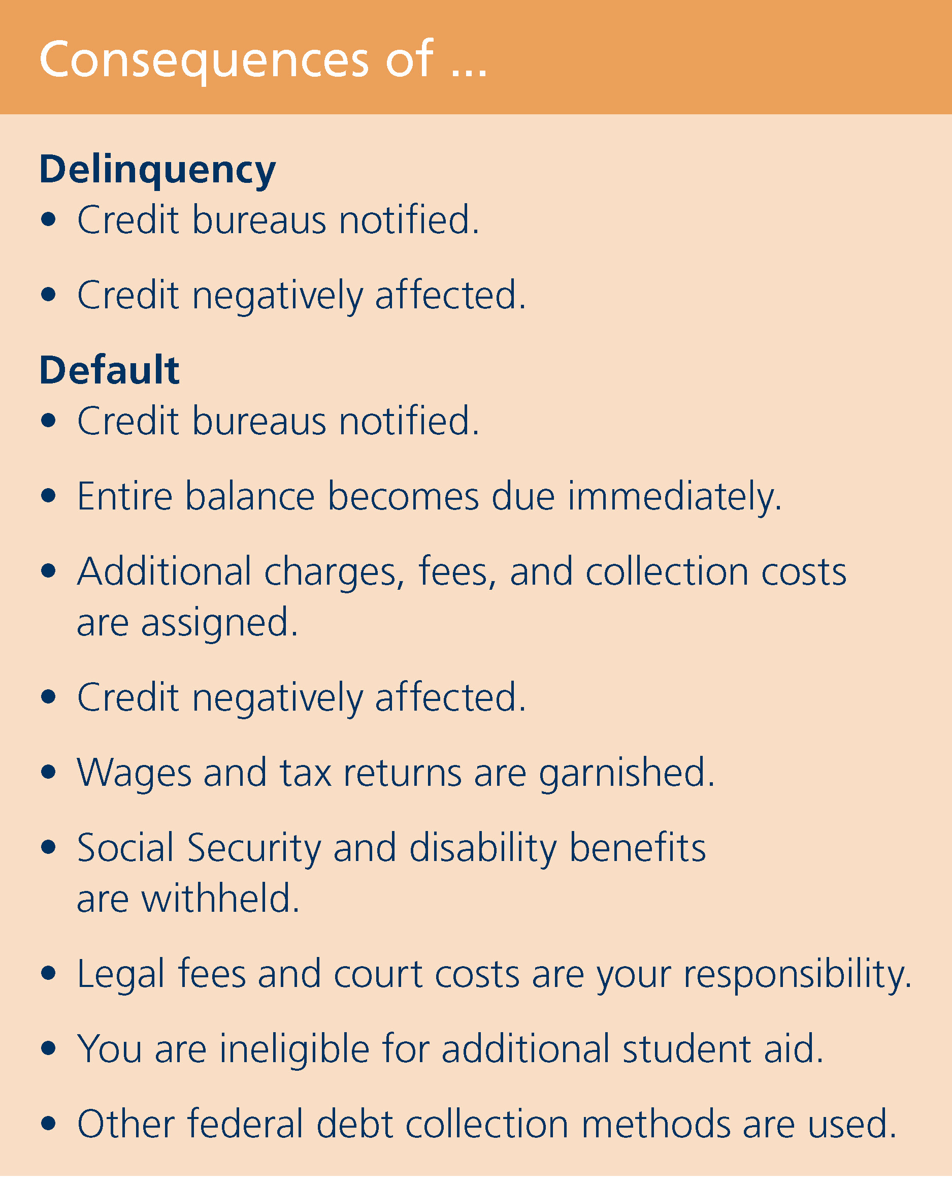
Consequence of Late Payments
Financial Problems?
Contact Your
Servicers
Immediately!
Notes:
On a positive note, medical school borrowers have a very low default rate. This means that borrowers like you repay their loans, repay them on-time, and many even pay their loans off earlier than required. The key to this, especially during residency, is to stay organized and know when your payments are due.
On that note, a resource to become familiar with is automatic withdrawal or scheduling online payments to be automatically sent from your checking or savings account to your creditors (i.e. – utilities, credit cards, loans, etc.). Automation removes the element of a student’s fatigue and/or forgetfulness.
(CLICK) In case a payment does “slip thru the cracks” with your student loans, you should know that the loan will be considered delinquent as soon as a payment is late, and after being 270 days late, the servicer assumes you will not pay, and places your loans in default. There are negative consequences for both of these situations. In the case of delinquency, your credit score will be negatively impacted. In the case of default, not only will your lack of payments be reported to the credit bureaus, but you may also experience:
a garnishment of wages and tax refunds
lawsuits - in which you are responsible for the cost
and other federal debt collection methods
Nobody wants you to get there. If you are experiencing financial difficulties, do not wait until it’s too late -- call your servicer immediately and see what arrangements can be made.

Slide 24
Fixed Interest Rates for the Class of 2023
M1
2019-20
M2
2020-21
M3
2021-22
M4
2022-23
PERKINS*
PERKINS*
PERKINS*
PERKINS*
5.0%
5.0%
5.0%
5.0%
DIRECT UNSUBSIDIZED
DIRECT UNSUBSIDIZED
DIRECT UNSUBSIDIZED
DIRECT UNSUBSIDIZED
6.08%
4.30%
5.28%
6.54%
DIRECT PLUS
DIRECT PLUS
DIRECT PLUS
DIRECT PLUS
7.08%
5.30%
6.28%
7.54%
  * Perkins, PCL and LDS Loans are disbursed at a fixed rate of 5%. All loans shown have a fixed interest rate.
Notes:
The interest rates for the loans you borrow during medical school will be based on 2 things: the loan type and when it is borrowed. Detailed above are the rates for the last 4 academic years – and thus, what the Class of 2022 will be carrying with them out of medical school.

Slide 25
Subsidized Loans vs. Unsubsidized Loans for medical students
Subsidized
Unsubsidized
  Primary Care Loans
  Loans for Disadvantaged Students (LDS)*
Institutional Loans (some)
Consolidation Loans
(underlying subsidized loans)
  Direct Unsubsidized
  Direct PLUS
  Private Loans
Institutional Loans (some)
Consolidation Loans
(underlying unsubsidized loans)
* Subsidy and deferment rights are lost in a consolidation loan
Notes:
Despite the majority of debt being unsubsidized, it is important to know that interest payments are allowed, and encouraged, even while you are in school. Making payments against the accruing interest will not cause payments to be required, but it will help to reduce the total cost of the debt. Having said that, we do not suggest to use borrowed money to make payments – rather, it is a better idea to not over-borrow and only borrow what you need.
Subsidized Loans include Perkins Loans, Primary Care Loans, Loans for Disadvantaged Students (LDS), some Institutional Loans, and possibly a portion of a Consolidation Loan (depending on the underlying loan type). However, if you put your Perkins or LDS Loans into a consolidation, they will not only lose their favorable deferment rights, they will also become unsubsidized balances.
The larger portion of your debt, unsubsidized loans, accrues interest from the date of disbursement and includes Direct Unsubsidized Loans, Direct PLUS Loans, Private Loans, some Institutional Loans, and possibly a portion of the Consolidation Loan (depending on the underlying loan type).

Slide 26
Subsidized vs. Unsubsidized
Sub • si • dy [suhb-si-dee] noun -
  Financial assistance granted by the government to cover accruing interest while in-school, in grace, or in a qualifying deferment.
Source: dictionary.com
Notes:
What does a subsidized loan mean to you? A subsidy is financial assistance that is granted by the government to cover accruing interest. When a subsidy exists on a loan, no interest accumulates during specific times, including: while in-school, in grace, or in a qualifying deferment.
If a loan is unsubsidized, you are responsible for the interest that accrues on that loan and interest accrual begins on the day the loan is disbursed to you and it will continue until the entire loan balance is paid in full.
Though subsidized loans are more beneficial and less costly, Direct Subsidized Loans are no longer offered to graduate-level students, which means the majority of your medical school debt will be unsubsidized.

Slide 27

Capitalization
Addition of unpaid interest to the principal
$208,900*
$200,000
$8,900
Principal
+
Interest
=
Larger Principal
  *Based on the median education debt level for the Class of 2021 and interest rates from the Class of 2022. Values reflect student loan relief measures in place from 3/13/20 – 8/31/22. Capitalized amount is based on capitalization policy prior to start of student loan relief measures.
Notes:
(NOTE TO SPEAKER: #’s on this slide can be manipulated using your school’s average indebtedness along with the MedLoans® Organizer and Calculator. The numbers provided above are based on the median debt of the class of 2021 with the interest rates from the class of 2022.)
As it currently stands, at certain points in time, the unpaid accrued interest will capitalize. Capitalization is a process that may seem invisible, but the impact is significant. Capitalization can increase the cost of your loans because it takes all accumulated interest that is unpaid (from loans such as your Direct Unsubsidized and Direct PLUS Loans) and makes it a part of the original principal balance. Once capitalization occurs, your new (and larger) principal balance begins accruing interest. In effect, your interest is now accruing interest.
Your servicers have policies on how loans capitalize and at what times. You should direct capitalization questions to the servicer of the loan. However, what is most often the case is that while you are enrolled more than half-time, capitalization will be postponed until your loans enter repayment--after you separate from school.
For those of you who are visual learners, here is an example of the capitalization a medical school student will experience after graduation. Obviously, it is not a positive process, and the less often it happens, the better.
If someone borrowed $200,000, over the course of medical school (based on 4 years of school and six months of grace) a significant amount of interest will accrue. When this accrued interest capitalizes, the borrower will owe a larger principal balance and this larger balance, will then accrue interest during residency.

Slide 28

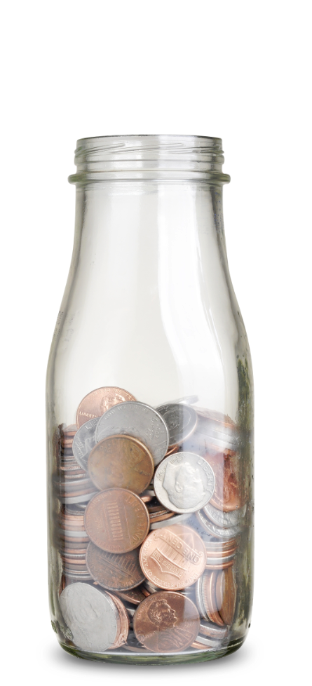
If possible, pay the interest before it capitalizes!
1. Separate from required payments
2. With instructions to apply the monies
immediately
towards the highest % rate loan
3. Follow-up to see it was done
Notes:
One debt management strategy is, prior to capitalization, to pay all or some of the interest that has accrued. Keep in mind, the first capitalization that most medical grads experience is NOT during medical school but in November of their graduating year - but talk to your loan servicer for details related to your loans.
More specifically, while you are in school, your unsubsidized loans will be accruing interest. If you, or a helpful family member, are able to send monies towards your outstanding debt, consider doing so following the directions above. If done prior to capitalization, this will help reduce your total loan cost, and that can enable you to pay your loans off faster.
If this is not a viable option during medical school (which is often the case), consider utilizing this strategy once you have the finances to do so. Remember, as a borrower of federal loans, you can always make payments – without penalty. So, resign yourself to pay interest when you can and attempt to minimize future capitalizations.
The Repayment Timeline, in the next section, will visually show when the initial capitalization may occur (but again, check with the servicer to confirm their policy).

Slide 29

NOTICE: Repayment Begins
If dropping below half-time or withdrawing
    Contact the Financial Aid Office
    Exit counseling is required
    Payments are required (or grace periods begin)
Notes:
29
If your course load or enrollment status drops below half-time (which for our school means less than ___ classes or ____ hours) or if you withdraw altogether, it is critical that you remember to CONTACT THE FINANCIAL AID OFFICE immediately!
The financial aid office will:
guide you through the required exit counseling for your loans and
inform you which loans are going into repayment right away and which loans might have a grace period (‘grace period’ will be defined in a moment).
If you drop below half-time, repayment begins on all student loans. So, stay in touch with the financial aid office to best understand your options.
For any questions about the rights and responsibilities, or terms and conditions of your student loans, you may contact the following staff person at this school: (NAME) and (NUMBER or EMAIL) located in (office/bldg/room#).

Slide 30
Strategic Borrowing
Notes:
Now that you know the details of your loans and your many repayment and postponement options, let’s discuss how to borrow wisely for the next four years of medical school… and how to pay wisely as soon as you are able.

Slide 31
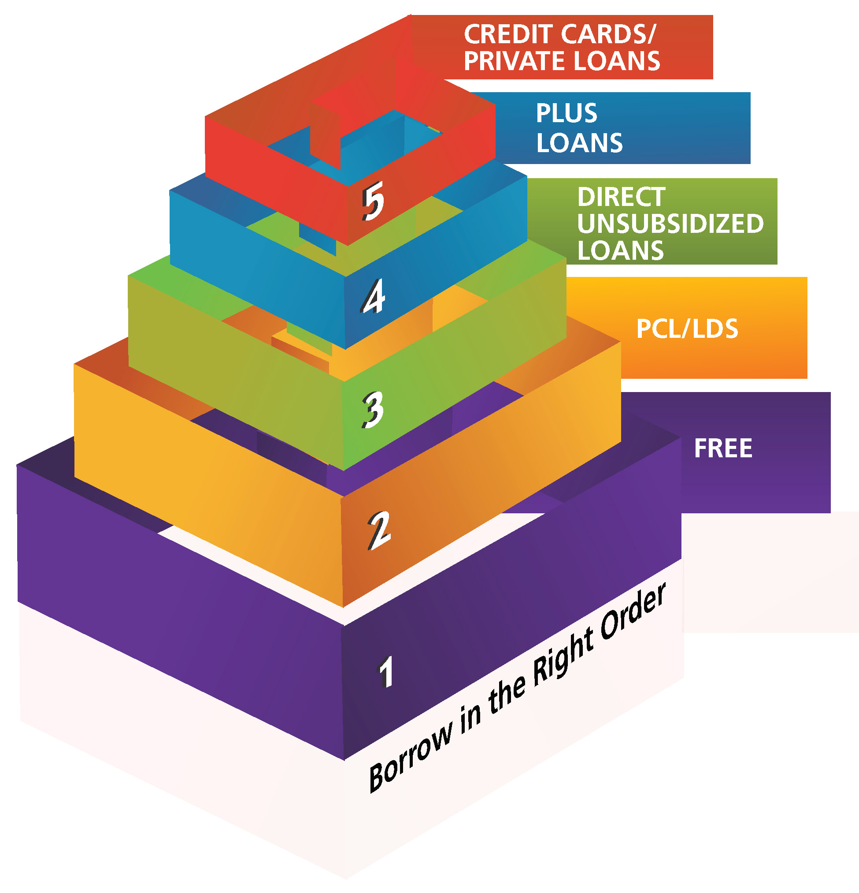
Borrow Wisely – In The Right Order
Notes:
Borrowing wisely means borrowing ONLY what you need, but it also means borrowing the least expensive debt FIRST.
This translates into seeking out all free money (grants/scholarships) and then turning to… in this order: PCL, LDS (if eligible), then Direct Unsubsidized Loans, then PLUS Loans, and finally private loans or credit cards.
If you find yourself resorting to credit cards and private loans, discuss your situation with us (the financial aid office), immediately, because financial aid award packages are made with the intention of avoiding these types of financing options. Our office may be able to offer additional assistance and guidance.

Slide 32
Borrow Wisely – In The Right Order
Direct Unsub. | Monthly Payment | Total Interest | Total Cost
10 Years | $455 | $14,600 | $54,600
Additional
Cost
+$2,500
Direct PLUS | Monthly Payment | Total Interest | Total Cost
10 Years | $476 | $17,100 | $57,100
Additional
Cost
+$15,900
Private | Monthly Payment | Total Interest | Total Cost
10 Years | $588 | $30,500 | $70,500
Notes:
To quantify the impact of borrowing wisely, see the comparison of borrowing the same balance from three different types of loans.
This example is based on borrowing $10K per year or $40,000 total over 4 years of medical school.
The interest rates on these three loans are different (6.54%, 7.54% and 12.6%) and therefore the total cost of each loan is different.
By opting to borrow as much as possible from the least expensive loan (Direct Unsubsidized), you can save yourself thousands of dollars during repayment.
Why would you want to spend an additional $2,500 to borrow a Direct PLUS Loan rather than a Direct Unsubsidized Loan OR unnecessarily spend over $15,000 to borrow a private loan rather than a Direct Unsubsidized Loan?
Borrow smart, maximize your least expensive debt first, and realize that private loans are not federal loans, and they should be carefully considered.
(This example includes a 6-month grace period after medical school and then immediate repayment via a 10-yr Standard payment - but the point of this information is to depict the impact of the interest rates, not to have a hyper-accurate example)

Slide 33
How Will You Borrow?
Do NOT borrow just because you are eligible
    Borrow what you need, not what you want
    Decline loans that exceed your need
    Accepting loans may affect eligibility for other aid
Notes:
A common misunderstanding that many new medical school students have is that they have to accept all of the loans that they are awarded; however that is not the case. We encourage you to know how much money you need each semester and borrow only what you need and decline any loans that exceed your need.
As you are accepting loans, please understand that when you accept certain loans it may affect your eligibility for other aid. You are limited in the total amount of financial aid, including all loans and scholarships, that you can receive each year. You cannot receive more aid than your cost of attendance. This fact could mean forfeiting free or lower rate loans because you have already accepted a higher rate loan – so accept carefully.

Slide 34
Alternatives to Borrowing
FORGIVENESS
Faith & civic organizations
Military
NHSC S2S
aamc.org/stloan
BUDGETING
SUPPORT
Financial aid office
Family support
SCHOLARSHIPS
Alternatives to Debt
Cornerstone to avoid unnecessary debt
aamc.org/studentbudget
aamc.org/financialwellness
Hospital, county & state
Income-Driven Repayment
Public Service Loan Forgiveness
aamc.org/first/facts/pslf
Notes:
First, borrowing wisely may mean not borrowing at all! There are alternatives to medical school debt, for example:
(CLICK)
Scholarships from outside sources – such as your faith affiliation, civic organizations, etc. There are also service based scholarships such as military and public health service programs (i.e. National Health Service Corps), or even scholarships from the school. Stop by the financial aid office to discuss possible scholarships this year or in the coming years.
(CLICK)
2. Don’t forget the support you have available to you. Support systems include the financial aid office – which is your primary point of contact for all financial aid matters – so visit them to discuss possible alternatives to borrowing. Also, do not forget the support you have from your family. Your family may be able to provide assistance through these years in the form of financial and emotional support. If a family member can help you pay down the accruing interest while you are in school, this will reduce not only the total cost of your student loan debt but also can reduce the amount of time that it takes to repay your debt.
(CLICK)
3. If you do not find alternatives to borrowing during medical school, be sure to make yourself familiar with the loan forgiveness and repayment options available after graduation and residency. The AAMC website, aamc.org/stloan, lists nearly 70 possibilities of assistance available during and post-medical school. Check it out!
(CLICK)
Lastly, and the cornerstone of avoiding debt, is to have a budget. Well done to those of you already doing this! We will look deeper into the value of living on a budget in just a moment, but first let’s look at the next step to strategic borrowing: borrowing in the right order.

Slide 35








Loan Forgiveness & Repay Assistance
aamc.org/stloan
aamc.org/repayasst
Notes:
Beyond PSLF, there are other repayment and forgiveness programs available. There are several resources to look into including the: AAMC Loan Forgiveness & Repayment Database, NIH, NHSC, and others.
You may also want to review the repayment Fact Sheets on the FIRST website, and the one that includes many of these resources is: Repayment Assistance Through Forgiveness, Scholarships, and Service.
If you desire other options, then ask questions along the way, especially in your residency program, at future hospitals, counties, or states where you may work.

Slide 36
Tips and Tricks
Notes:
A major component of borrowing wisely is having a spending plan (also known as a budget).
Having a spending plan will help you manage your financial situation during medical school. Some of you may choose to ignore this step, and stick your head in the sand about reality, but those of you who take notice and make an effort will inevitably borrow less and thus “live like a doctor” sooner.

Slide 37
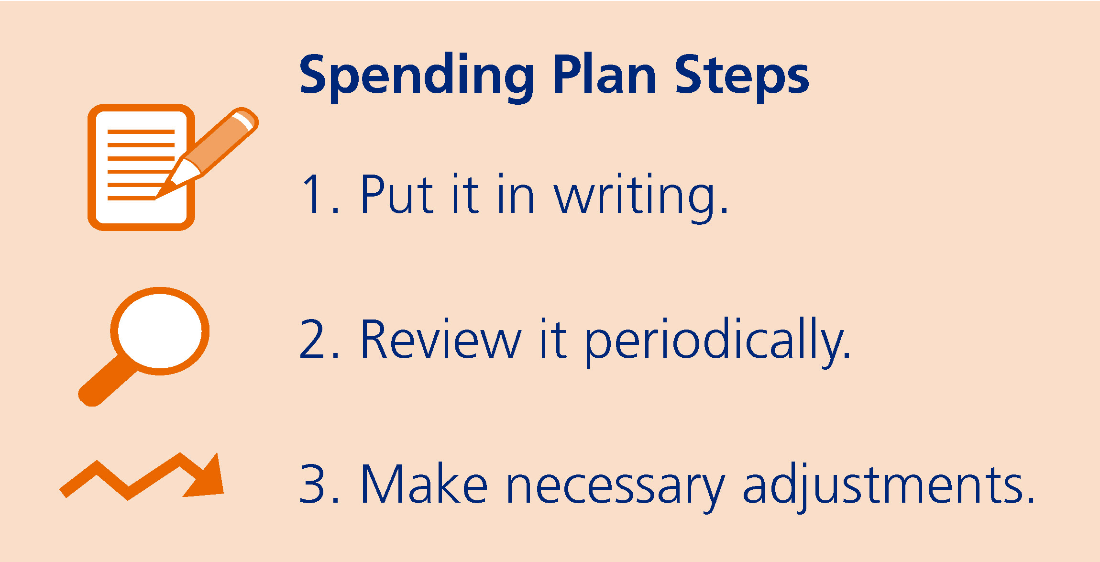
How to Create a Spending Plan
  “Live like a student while you are a student…”
Notes:
The simple steps to a spending plan include putting it in writing, reviewing it periodically, and making adjustments as necessary. These steps are not time consuming, but similar to eating healthy and working out, a spending plan takes self-discipline. If you create a spending plan, and attempt to follow it, you will reap the benefits.

Slide 38

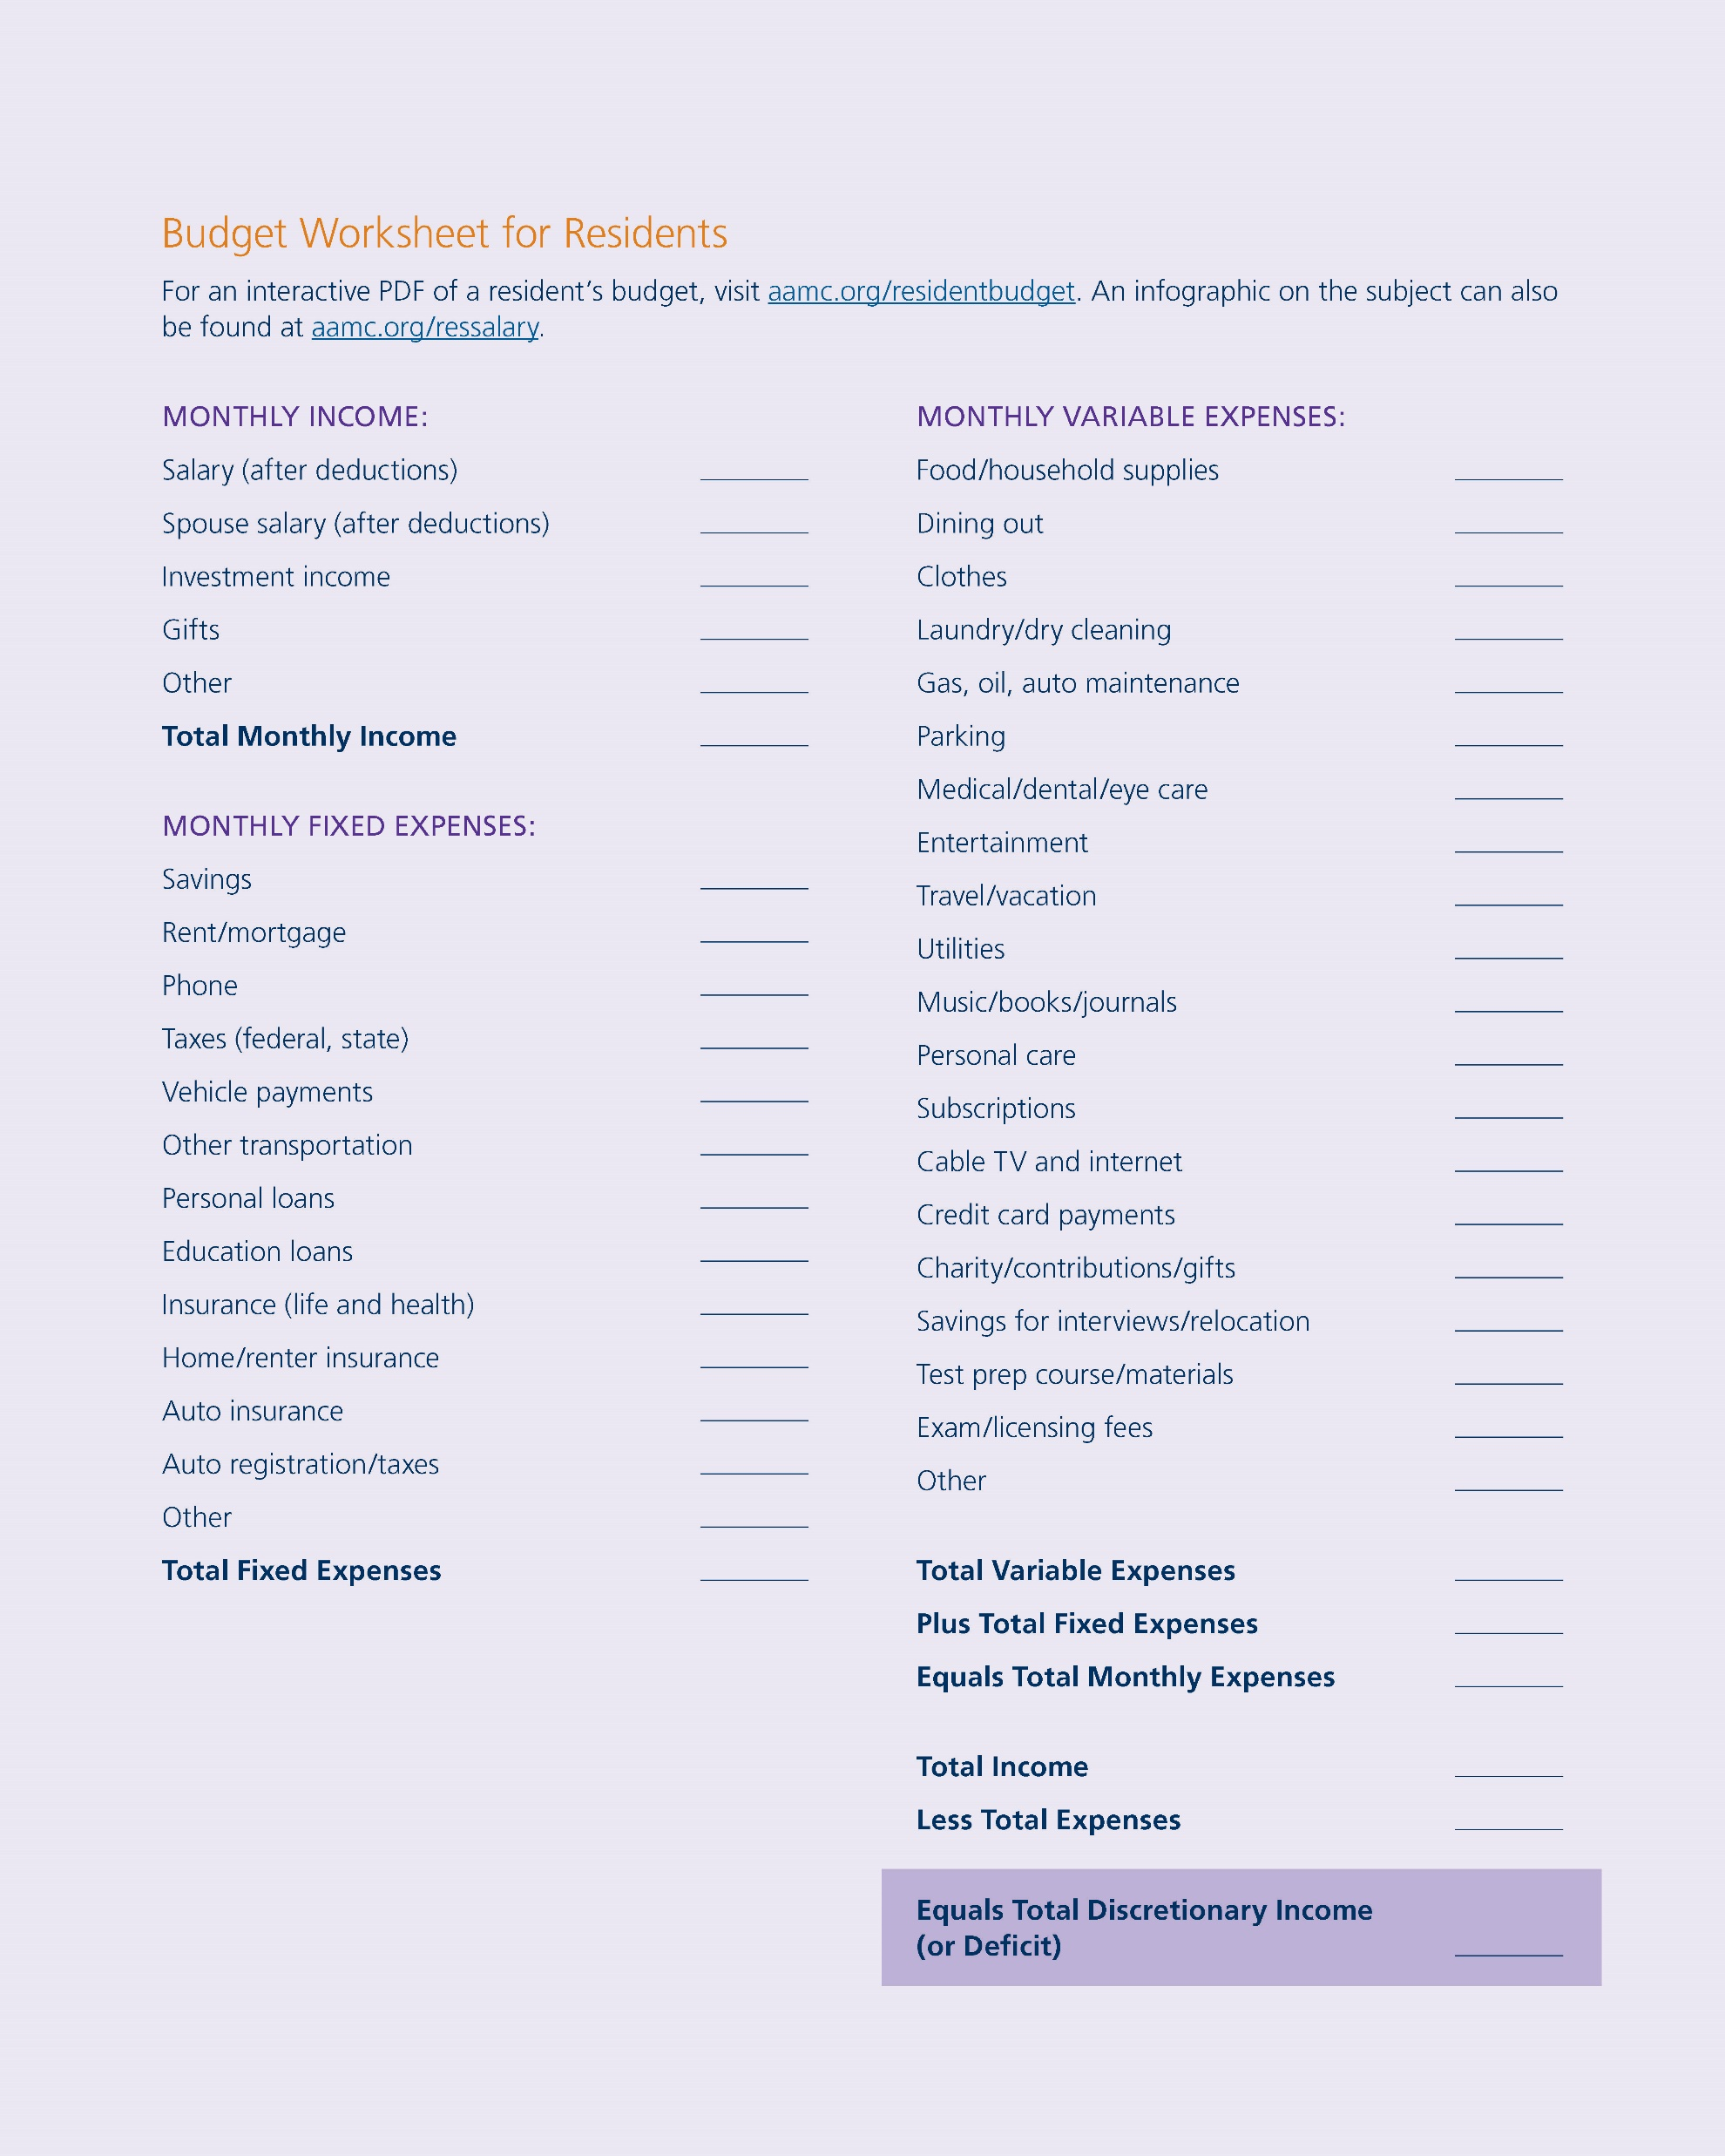
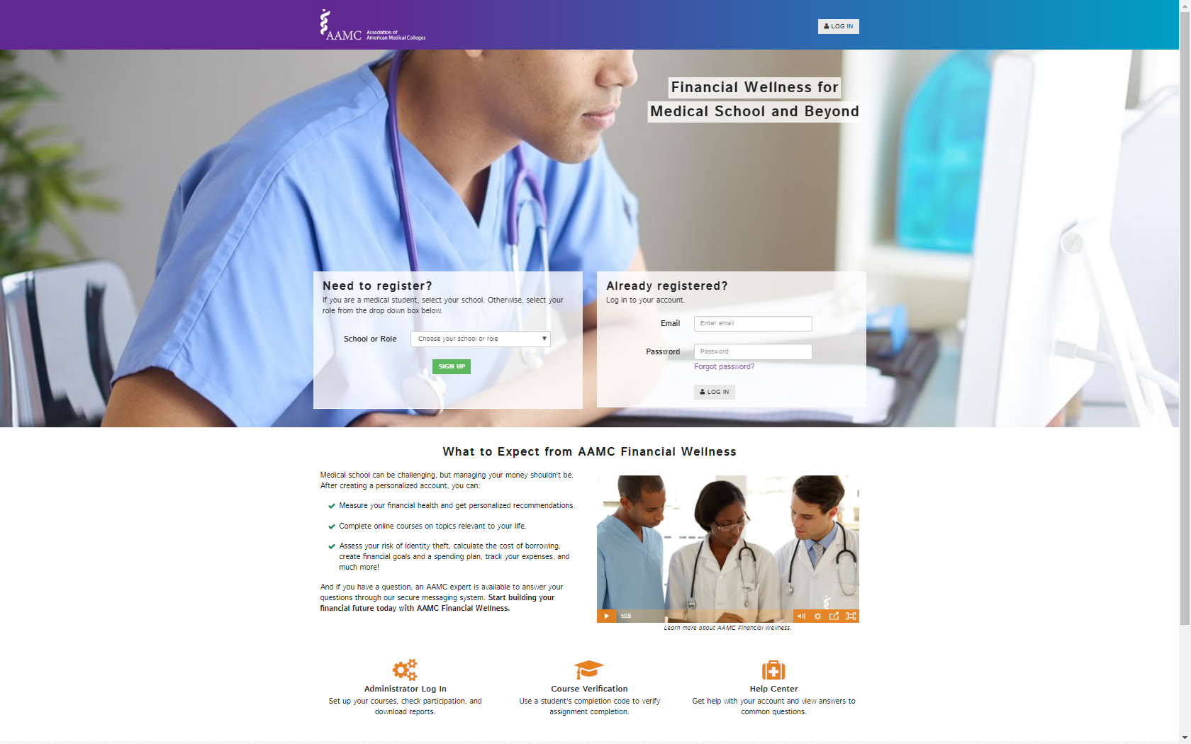
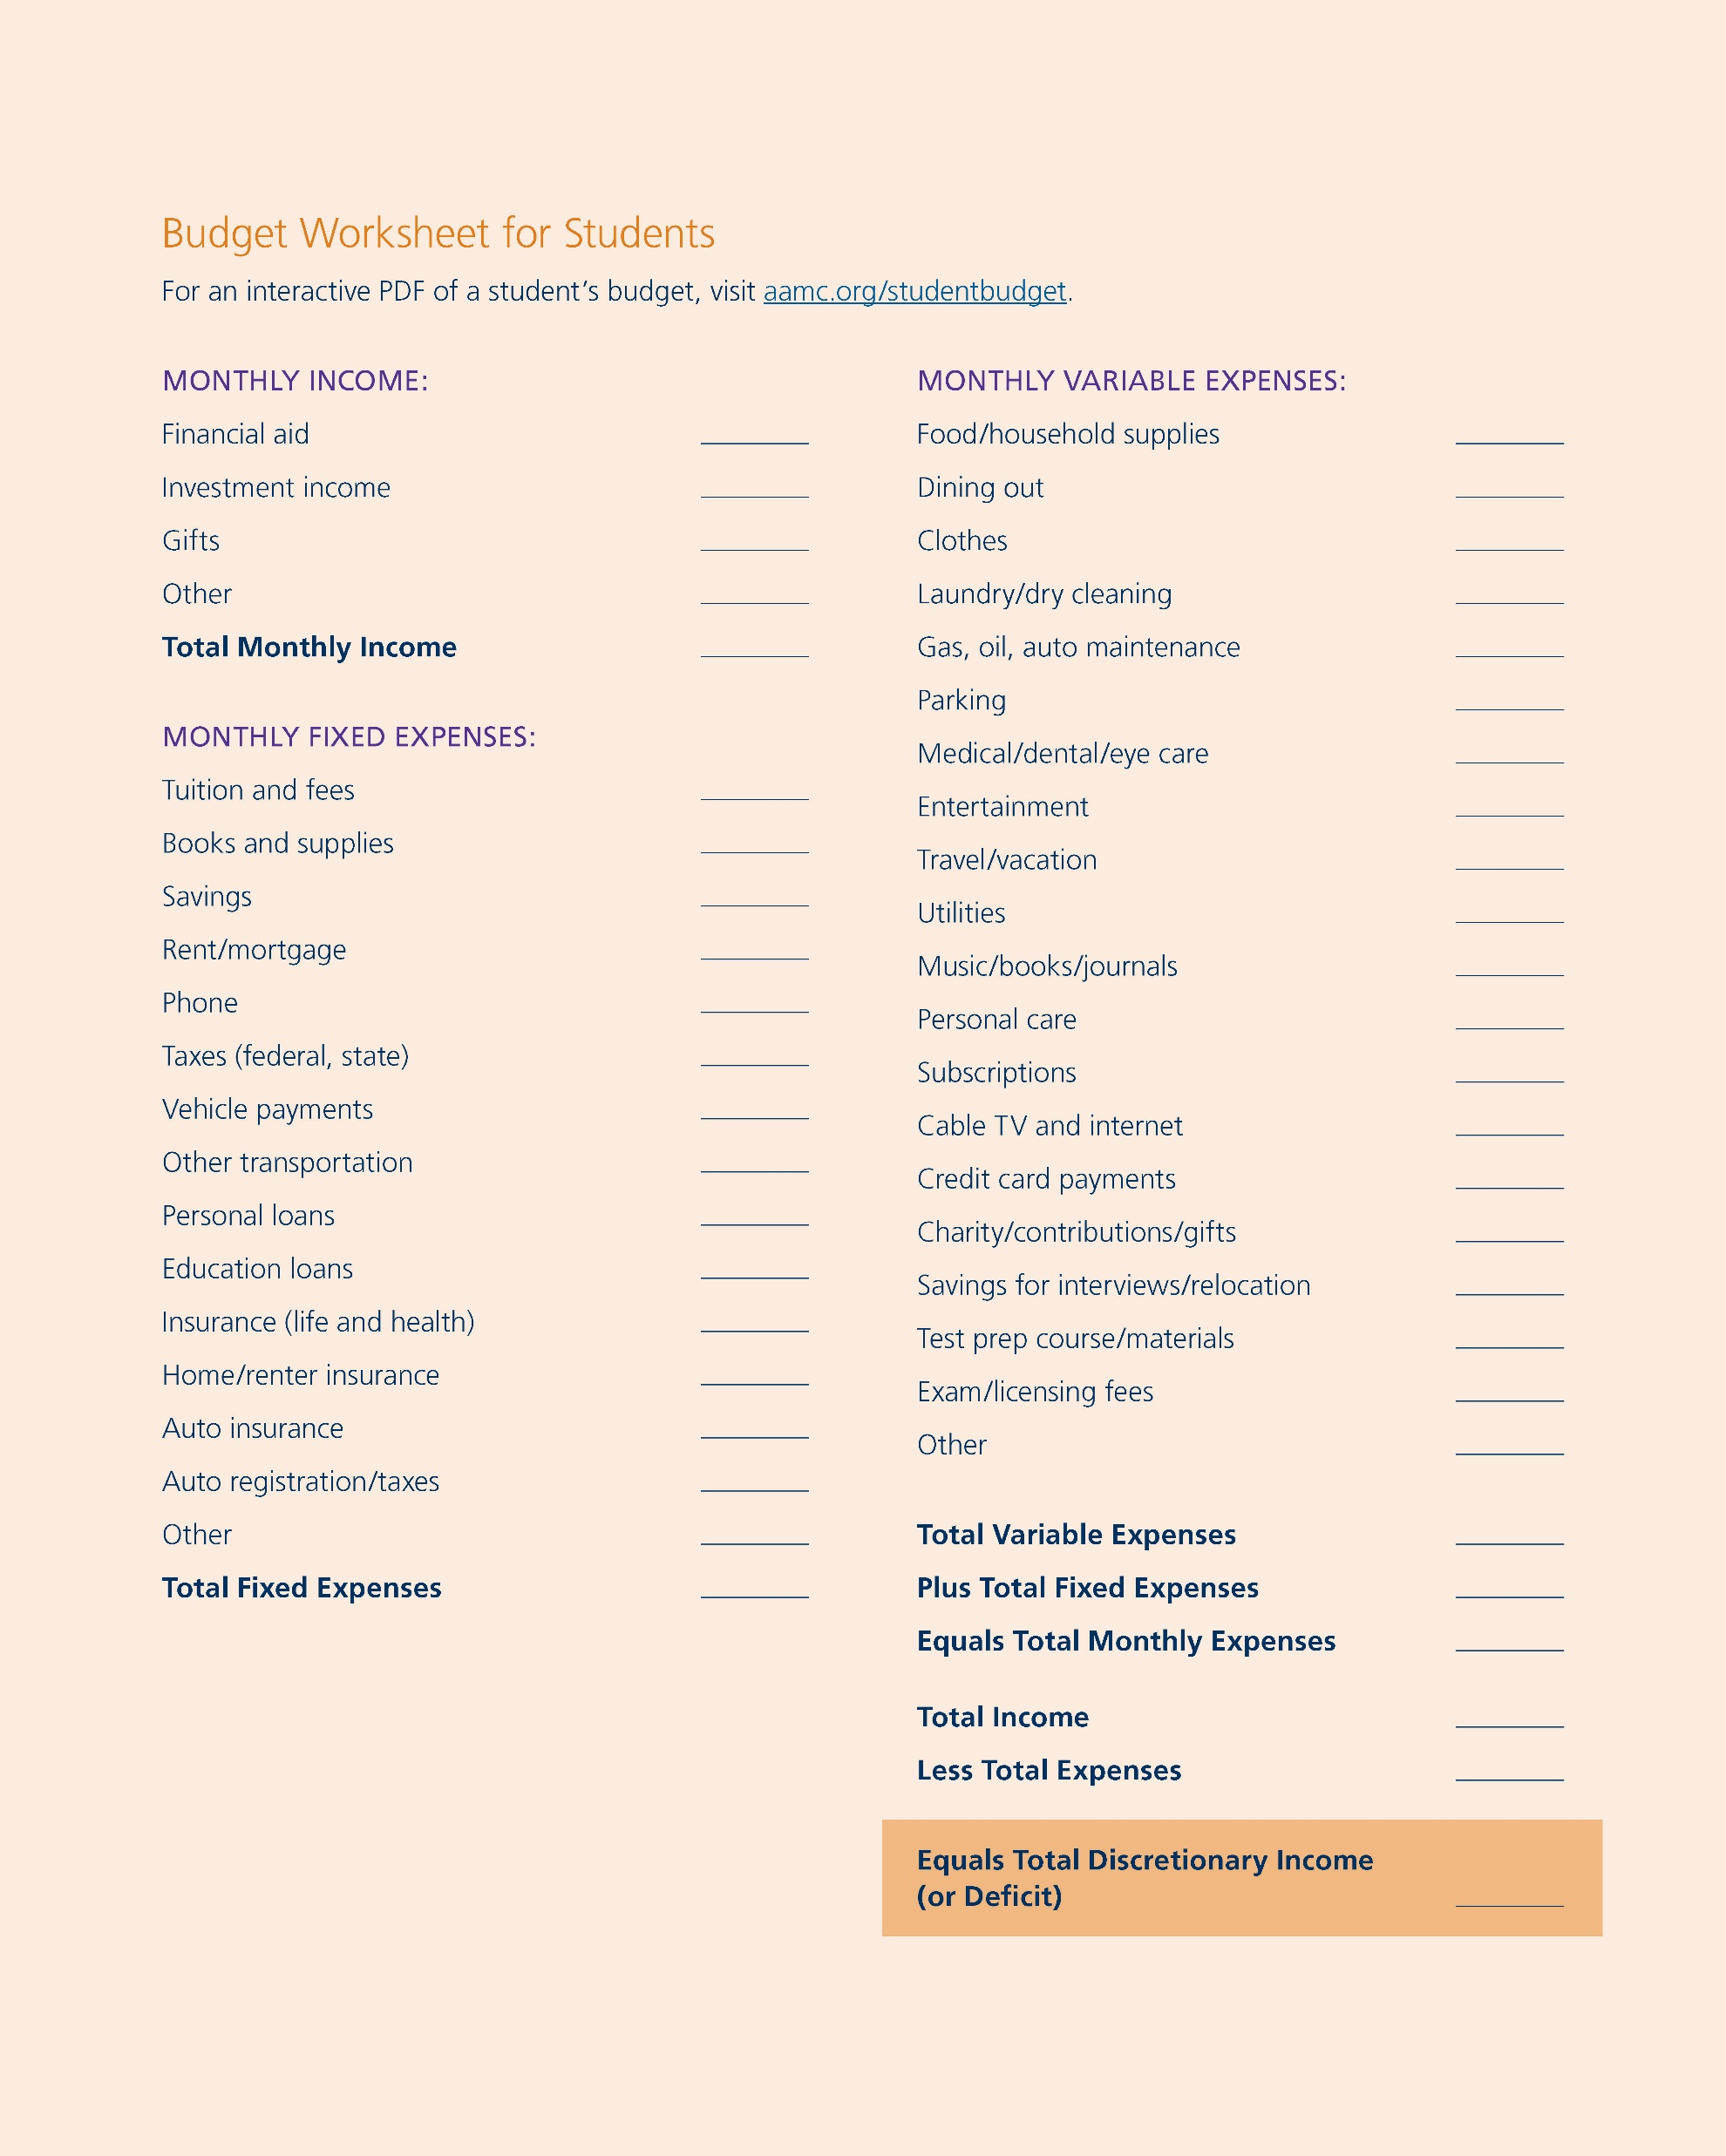
Resources to Create a Spending Plan
aamc.org/financialwellness
aamc.org/studentbudget
Notes:
To get you started, the AAMC offers several ways to help you create a detailed budget, including:
A budgeting course and Budget Calculator that can help you create a monthly budget that tracks and saves your spending plan is available in our Financial Wellness program (aamc.org/financialwellness).
And if you prefer another format, there is an interactive budgeting worksheet for students at aamc.org/studentbudget as well as FIRST Fact Sheets on budgeting (aamc.org/first/factsheets).
All of these resources can be found online and offer a quick and convenient way to create a budget for life in medical school, residency, and beyond.

Slide 39

The Basics of Budgeting
Your Total Income
Your Total Expenses
= Your Discretionary Income
Notes:
Basic elements of budgeting include three simple things:
Your income (income includes all sources of monies received by you – this includes financial aid)
Your expenses (fixed and variable) and
Your discretionary income (this is your spending money).
To determine your discretionary income, subtract your expenses from your income. This balance is your extra spending money.

Slide 40

Spending Wants: Leaks
Small amounts add up over time
It may not seem like much in the short term
$5/day, 5 days/week
$100/month, 10 months
$1,000/year x 4 years =
GOURMET
$4,000
Notes:
Despite the amount of time and effort that you put into a budget, spending “leaks” can occur. A leak may be something small, like a small “want” that you have each day or each week… a small indulgence (Starbucks coffee, happy hour, maybe even date nights). However small a leak may be, the little things will add up over time.
For example, a stop at the gourmet coffee shop (replace whatever your indulgence is here… the moral is the same) can easily mean $100/month or $1000/year. That is $4,000 during medical school -- FOR COFFEE. Is anyone budgeting $4,000 for gourmet coffee during medical school? Probably not. But if you don’t acknowledge your “wants” AND make room for them in your budget, you will slowly spend money without even realizing it.

Slide 41

Are Credit Cards Bad?
Notes:
Credit cards are NOT bad. There are many good things that a credit card can help you do. They allow you to tap a line of credit without using your own money on the spot. They also help you establish good credit and are great for emergencies. However, you must be wise about your use of credit cards. You should look for a card with a low rate, no annual fees, AND you should always pay the balance off each month, but if you can't, then at least pay more than the minimum balance.
What you don’t want to do with credit cards is:
- use them for cash advances, or
charge more than you can pay each month, or
pay an annual fee or high interest rate
(The national average interest rate for credit cards as of July 6, 2022 was 17.30% variable – source: creditcards.com)
If you find yourself using your credit cards to survive, then you need to put the brakes on your lifestyle and spending and consider making some drastic changes.
Most importantly, do not be late with your payments. Late payments are a fast way to ruin your credit score… but on time payments can improve your score.

Slide 42
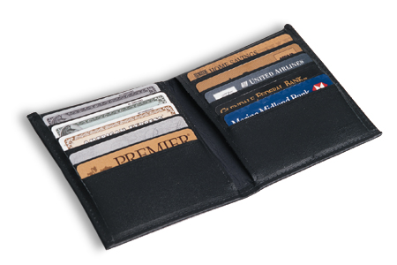
The Minimum Payment Trap
$5,000 balance with an 18% interest rate
(Making minimum monthly payments)
Source: BankRate.com
Notes:
Finally, in regards to credit cards and budgeting… be sure that you do not fall into the Minimum Payment Trap.
Let’s say you have a bit of a problem budgeting your first year of medical school, so you put $5,000 on your credit card (at 18%) to make up for a shortfall in your finances. Then, after Y1, you choose to make the minimum monthly payments…

Slide 43
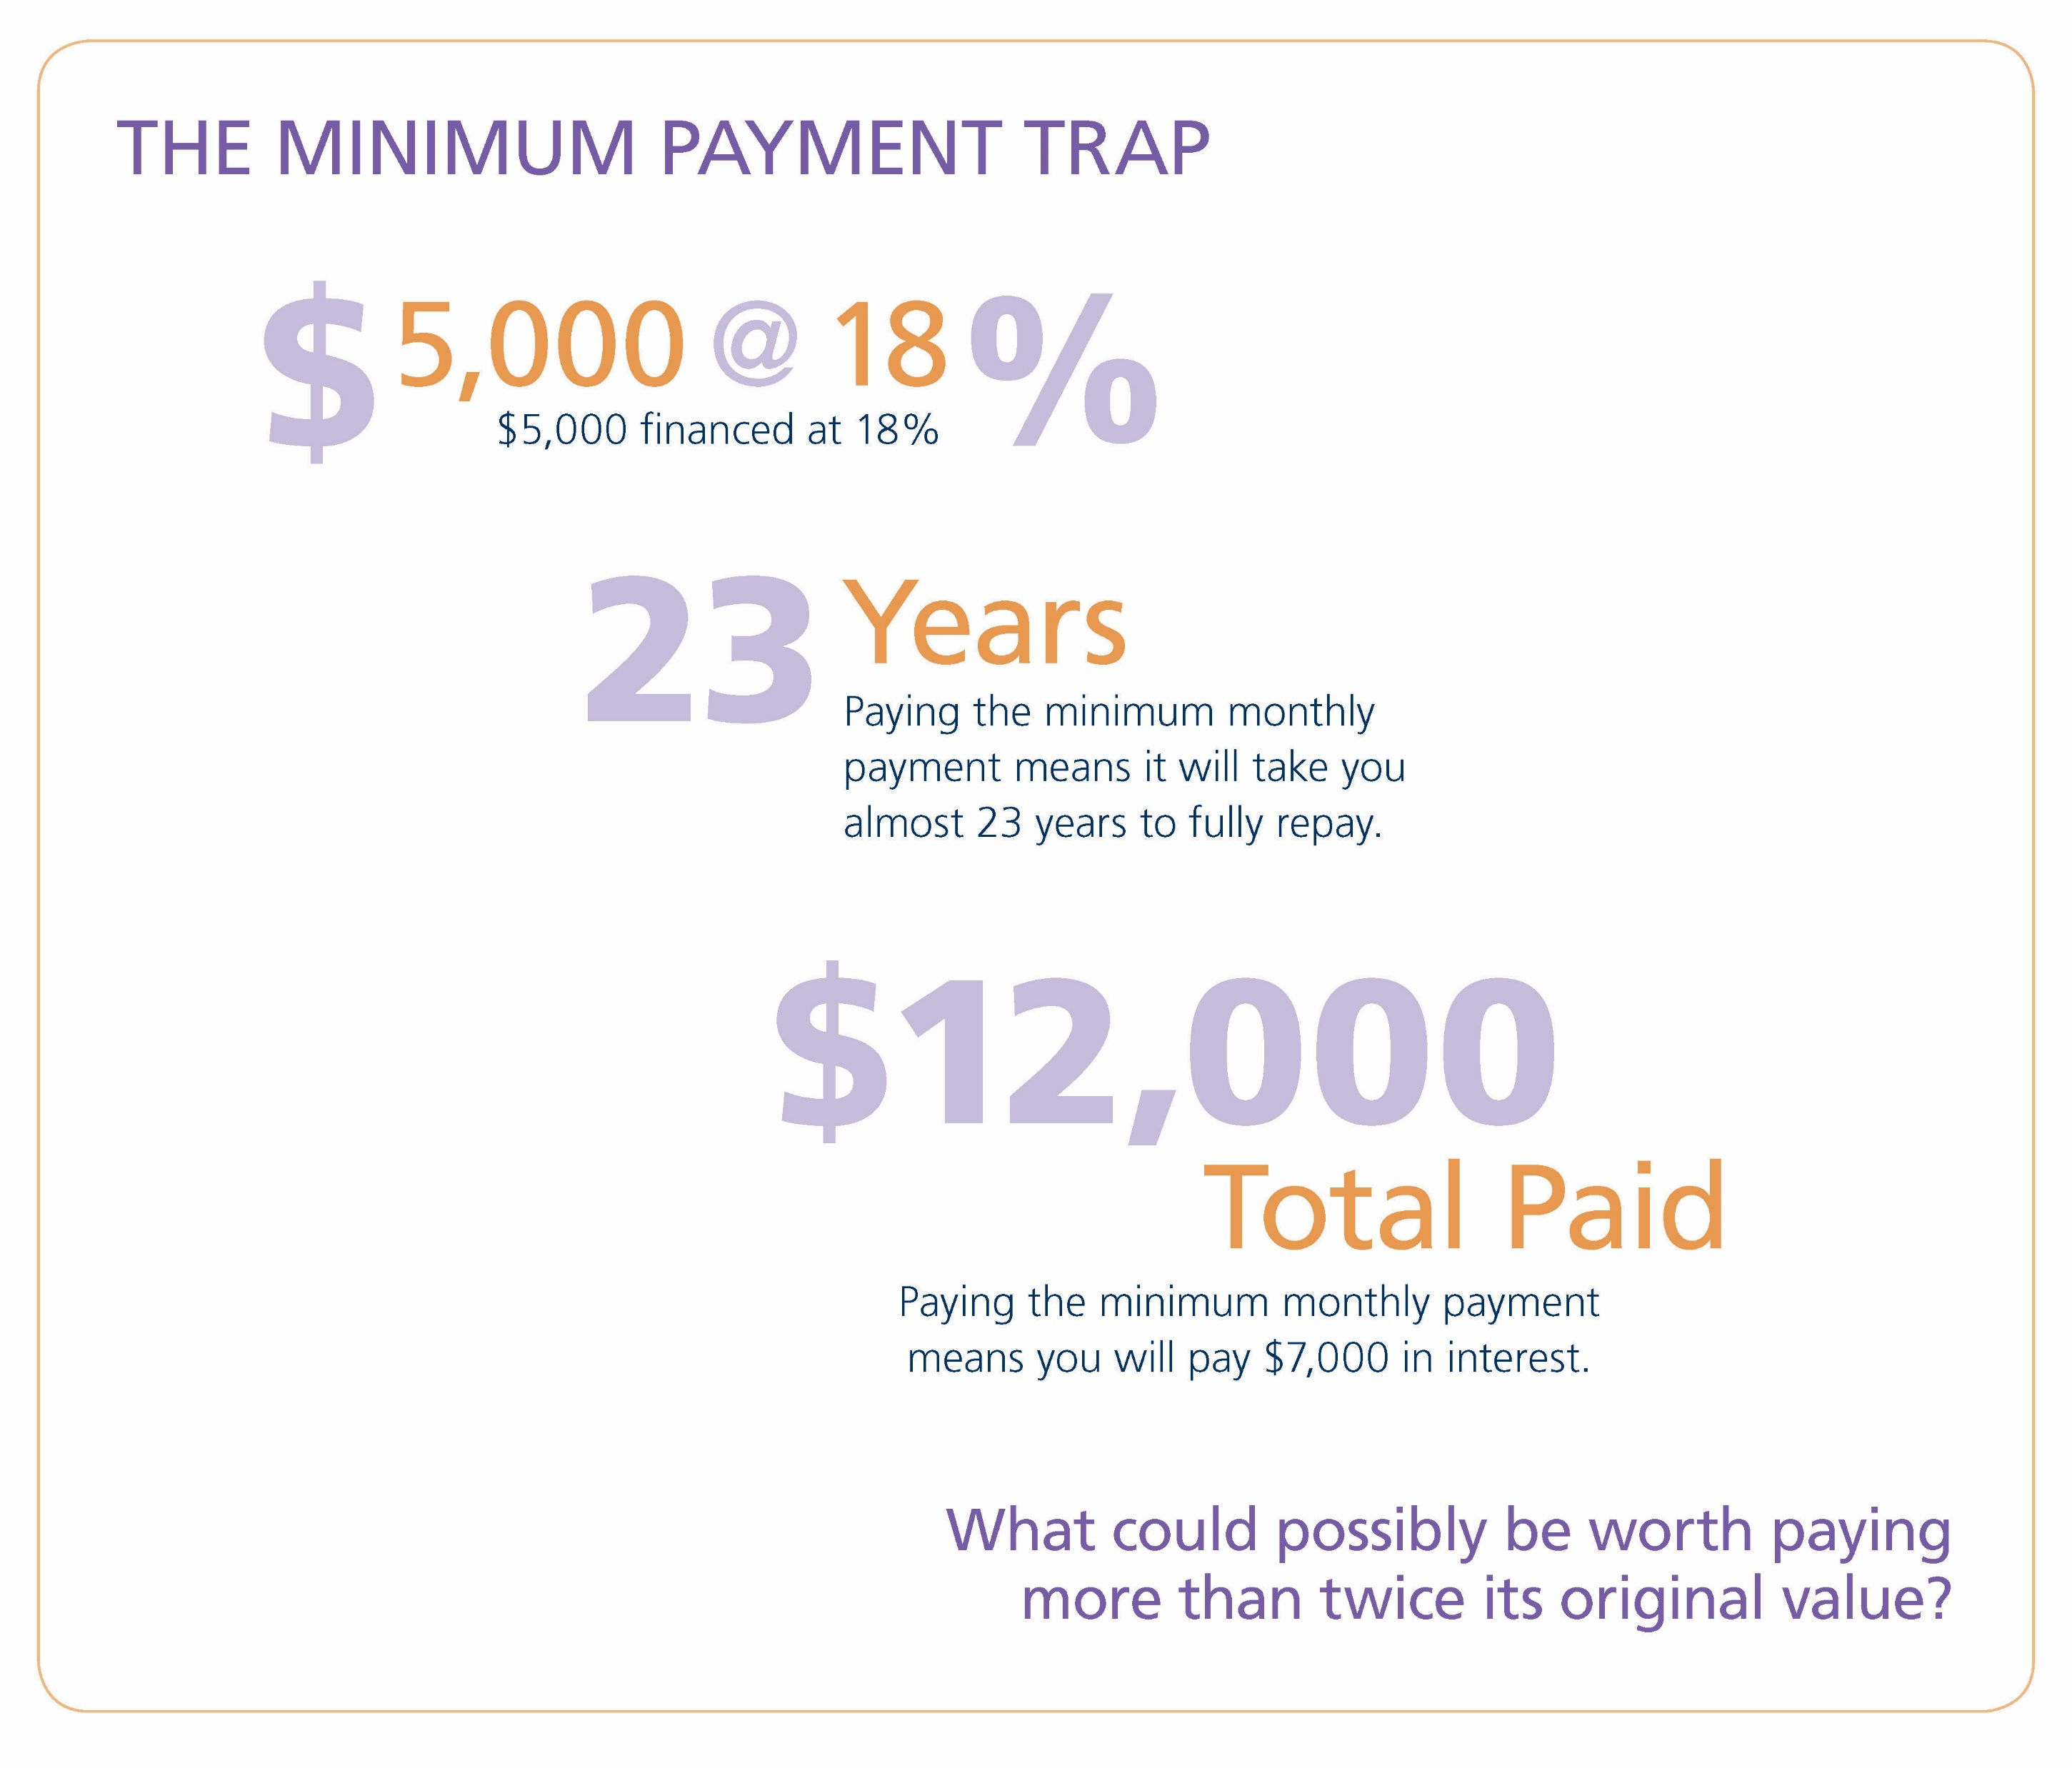
The Minimum Payment Trap
Source: BankRate.com
Notes:
The result of this $5,000 on a credit card, then paid down with minimum monthly payments, is that it will take you over 20 years to pay the balance off AND it will cost you nearly $7,000 in interest alone – totaling $12K when repaid! What can possibly be worth paying more than twice its original value?
Be willing to forfeit a purchase today, until you can really afford it. Budget wisely and avoid the need for credit cards. They are not bad, if used and paid off, but some of you already know this trap from undergrad… so do not fall victim to it during medical school.

Slide 44
Credit: Understand & Protect

Slide 45

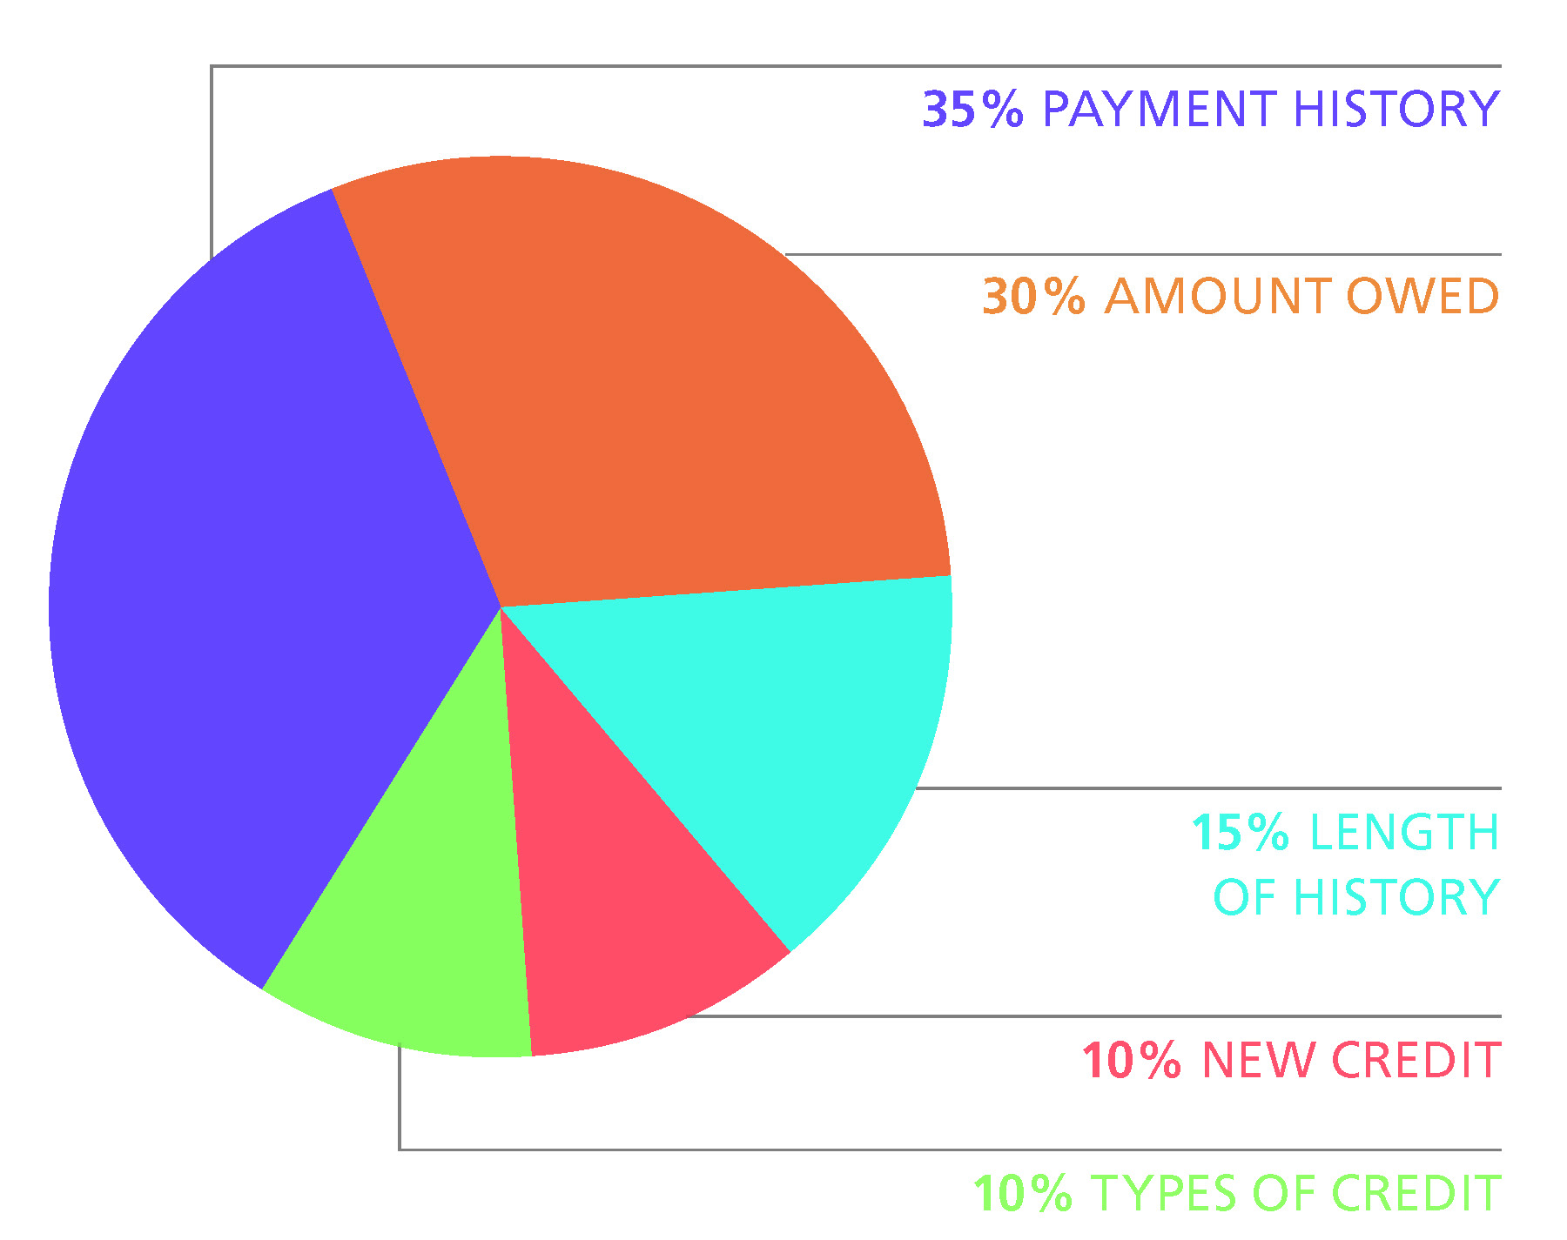




A FICO Score is Based On
30%
35%
15%
10%
10%
Notes:
A good credit score, or FICO score, is based on a number of factors and is determined by Fair Isaac and Co. What they have shared with the public is that no one category is used as the sole determination of a credit score. Rather, there are five factors used, including:
Payment history – 35%: This is the largest portion of your score. Delinquent payments can have a major impact on scoring, but consistent, on-time payments will raise a credit score.
Amount owed (also referred to as utilization rate) – 30%: The total amount of your credit line that you are currently utilizing will impact your credit score. The goal is to use less than 30% of your line of credit (add up the maximum credit line on all of your credit cards to determine how much you are using).
Length of history – 15%: The longer the credit history, the higher the score.
New credit – 10%: A high number of inquiries (over three) inside of 12 months can be negative, so limit the amount of times you allow a company to “pull your credit”.
Type of credit – 10%: Possessing a variety of credit is optimal (student loans, car loans, house loans, credit cards, etc.). Additionally, there is a difference between secured versus unsecured debt and how it weighs into your credit score.
This information, and much more, is available at myfico.com. Make yourself an expert on your credit. It can mean lower interest rate loans in the future. This will become a more critical topic in your life as you approach graduation and possibly consider using residency and relocation loans, or when you are ready to buy a car or a house. Use your time in medical school to build your credit score – you will be glad you did.

Slide 46

How to Improve Your Score
During medical school, these simple steps will help.
    Pay bills on time
    Pay down debt on lines of credit
    Apply for credit sparingly

Slide 47
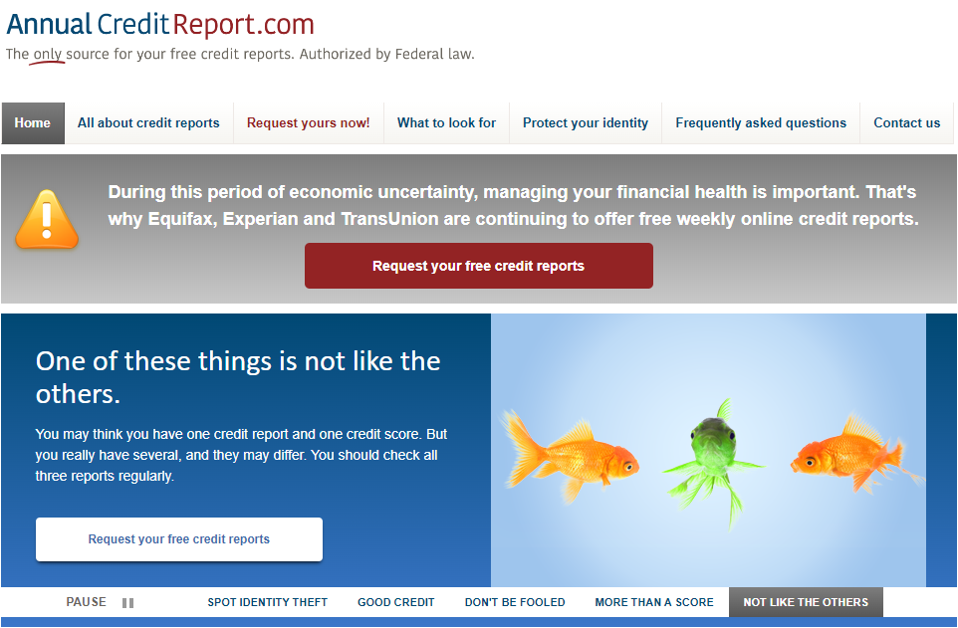
Check your
Credit Report
annualcreditreport.com

Slide 48





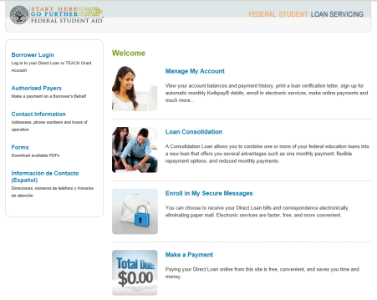
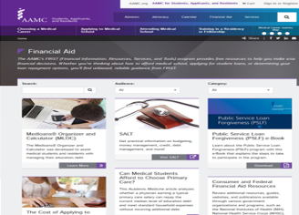
Support Along The Way
StudentAid.gov/feedback
aamc.org/advocacy/meded
Financial Aid Office
aamc.org/FIRST
MedLoans Organizer & Calculator
aamc.org/medloans
StudentAid.gov

Slide 49

QUESTIONS

