Slide 1
Faculty Forum
Departmental Spotlight
Pediatric Pulmonology
Scott Bickel, MD

Slide 2
Description and Demographics
Division of Pediatric Pulmonology
Serves children with a variety of complex respiratory conditions from western and central KY to southern IN
Four board certified pediatric pulmonology faculty
One nurse practitioner
Two respiratory therapists, two RNs in our outpatient clinic
Dietician and pharmacist support for our CF clinic
Two main outpatient locations (Novak Center and Brownsboro Crossing)
Inpatient services at Norton Children’s Hospital
Weekly rounds at Home of the Innocents and Frazier Rehabilitation Center

Slide 3
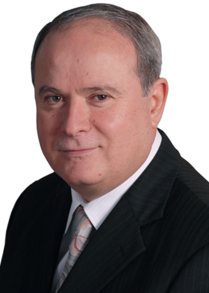
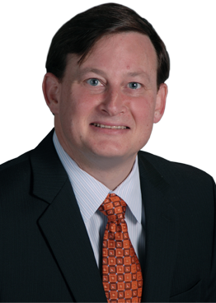
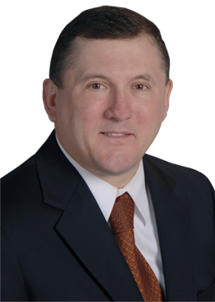
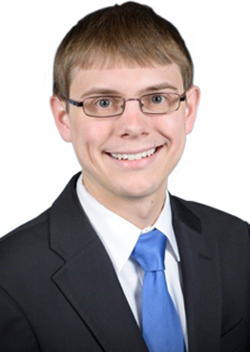
Description and Demographics
Division of Pediatric Pulmonology
Nemr Eid, M.D.
Professor of Pediatrics
Division Chief
Director of Research, Pediatric Pulmonology Fellowship Program
Adrian O’Hagan, M.D.
Associate Professor of Pediatrics
Director of Adult CF Center
Fellowship Director
Ronald L Morton, M.D.
Professor of Pediatrics
CF Center Director
Director of Pediatric Home Ventilator Program
Scott Bickel, M.D.
Assistant Professor of Pediatrics
Associate Fellowship Director

Slide 4
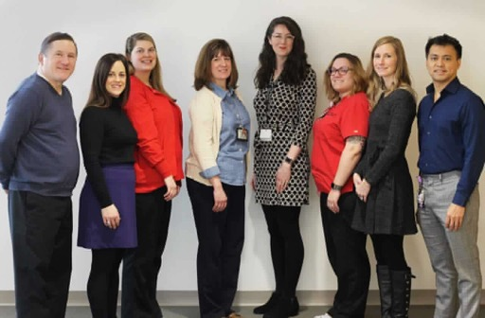
Description and Demographics
Division of Pediatric Pulmonology

Slide 5
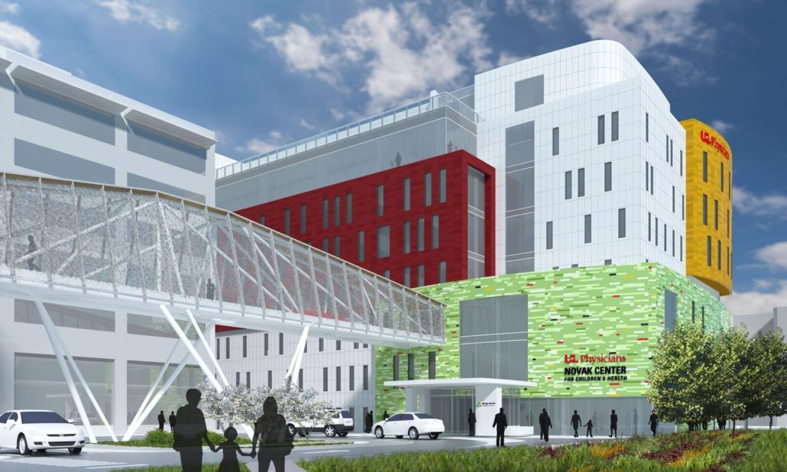
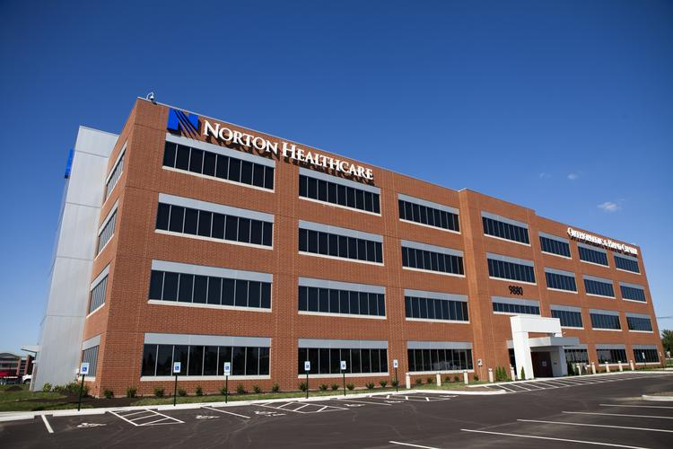
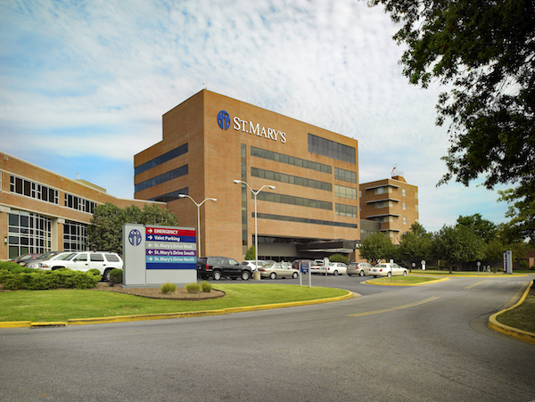
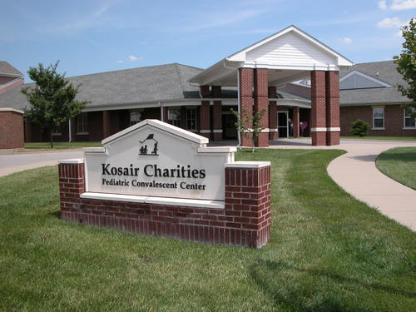
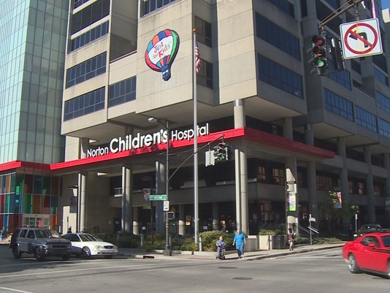
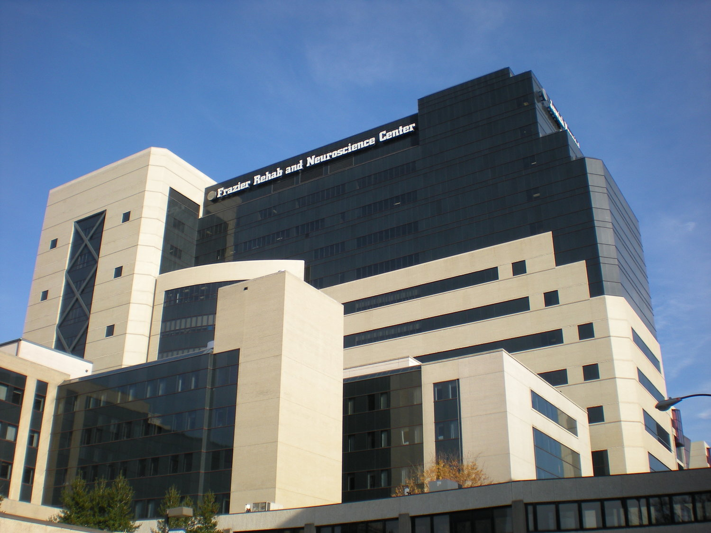
Clinical Sites
Division of Pediatric Pulmonology

Slide 6
Division Contribution to the SOM four planning pillars
Division of Pediatric Pulmonology
Education
Fellowship Program
ACGME Accreditation for 1 fellow/year (funding for 1 fellow every three years ☹ )
Three year program divided equally between research and clinical duties
First graduated fellow in 2016
New fellow starting July 2019
Pediatric Residency Program
Pediatric residents rotate in 2-4 week blocks and are exposed to all aspects of pediatric pulmonology
Faculty provides multiple core lectures/year
Fellows lead weekly “pulmonology rounds” with residents to review interesting cases
Medical Students
Multiple fourth year students rotate with us each year
Faculty provides case based lecture to each group of 3rd year students
Faculty provides PFT lectures to 2nd students
Have presented multiple years to Pediatrics Club, Pulmonology Interest Group

Slide 7
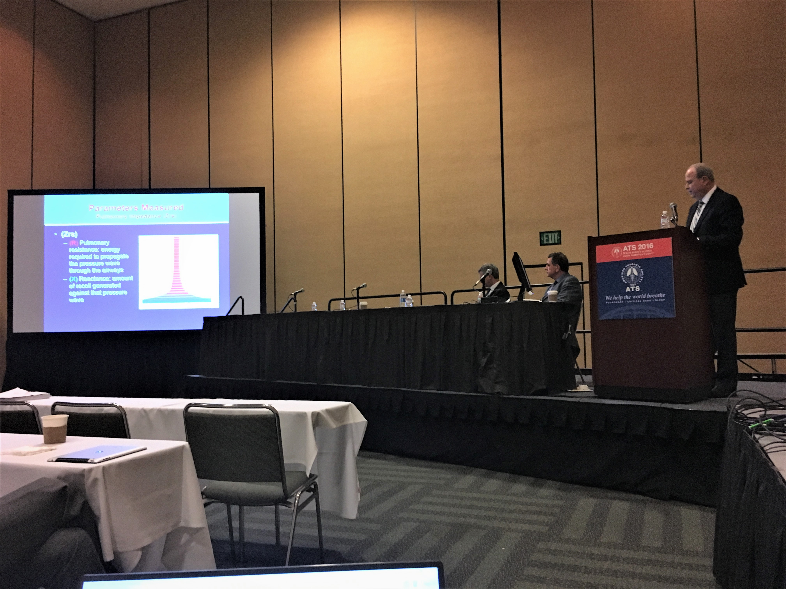
Department Contribution to the SOM four planning pillars
Division of Pediatric Pulmonology
Research
CF Foundation Therapeutics Development Network member
Over 20 abstracts at international meetings and 10 peer reviewed publications over past 5 years
Multiple ongoing independent clinical studies within division
2018
Four abstracts presented at international conferences (3 at American Thoracic Society conference, 1 at European Respiratory Society conference)
Three peer reviewed publications
Multiple trials with Kosair Charities Pediatric Clinical Research Unit

Slide 8
Department Contribution to the SOM four planning pillars
Division of Pediatric Pulmonology
Clinical Care
4,828 outpatient encounters in 2018
125 flexible bronchoscopies
Specialty/Outreach Clinics:
Cystic Fibrosis Foundation Accredited CF Center
Technology Dependent Clinic (chronic tracheostomy/ventilator support)
High Risk Severe Asthma Clinic
Muscular Dystrophy Clinic
Cerebral Palsy Clinic through KY Commission for Children
Home of the Innocents
Aerodigestive clinic (starting 2019)
St. Mary’s (Evansville, IN) outreach clinic

Slide 9
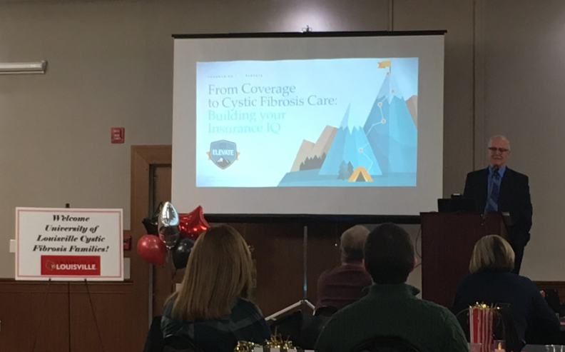
Community Outreach
Division of Pediatric Pulmonology

Slide 10
Interesting Facts about the Division
Division of Pediatric Pulmonology
Pioneered use of infant PFTs and now impulse oscillometry in preschool age children
Only 9 pediatric pulmonologists in Kentucky
Currently recruiting to expand access to care, multidisciplinary clinics

