Slide 1
Faculty Forum
Departmental Spotlight
Department of Ophthalmology and Visual Sciences
School of Medicine
Jeremy Clark, MD

Slide 2
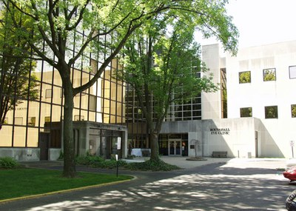
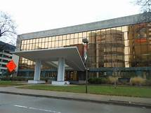

Slide 3
Description and Demographics
Department of Ophthalmology
Description of Department:
Divisions
Adult
Ophthalmology
Comprehensive, Cornea/Refractive, Retina, Uveitis, Oculoplastics, Neuro-ophthalmology, Oncology
Optometry:
Primary Care, Low Vision, Contact Lenses
Pediatrics

Slide 4
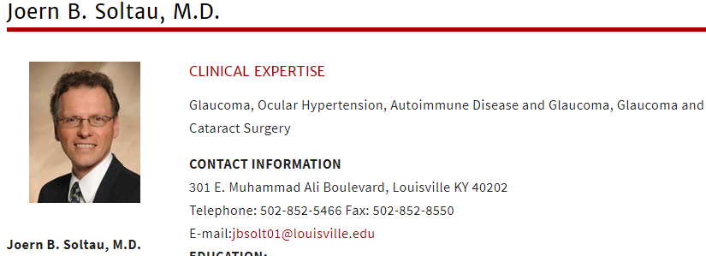
Description and Demographics
Department of Ophthalmology
Description of Department
Chairman

Slide 5
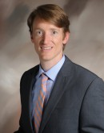
Description and Demographics
Department of Ophthalmology
Description of Department
Program Director
Residency Program Director
Assistant Professor of Ophthalmology – Oculofacial Plastic and Reconstructive Surgery
CONTACT INFORMATION: Kentucky Lions Eye Center 301 E. Muhammad Ali Boulevard, Louisville, KY 40202 Telephone: 502-588-0550 Fax: 502-588-0553

Slide 6
Description and Demographics
Department of Ophthalmology
Description of Department
Faculty
CLINICAL (16)
Comprehensive/Contact Lens – Patrick Scott (OD,PhD)
Cornea – Hossein Asghari MD, Richard Eiferman MD
Glaucoma – Judith Mohay MD, Joern Soltau MD
Oculoplastics & Orbit – Jeremy Clark MD, Chris Compton MD, William Nunery MD
Retina/Uveitis – Charles Barr MD, Douglas Sigford MD, Harpal Sandhu MD, Wei Wang MD
Oncology – Aparna Ramasubramanian MD
Neuro-ophthalmology – Thong Pham MD
Pediatrics – Aparna Ramasubramanian MD, Nic Silvestros OD
Low Vision – Andrea Smith OD
VA – Mark Cassol MD, Jonathan Gambrell MD, Shorye Payne MD, Leila Vaghei MD

Slide 7
Description and Demographics
Department of Ophthalmology
Description of Department
Faculty
Research (10)
Maureen McCall (Director of Research) PhD
Douglas Dean PhD
Douglas Borchman PhD
Qiutang Li PhD
Yongqing Liu PhD
Qingxian Lu PhD
Hui Shao MD,PhD
Shigeo Tamiya PhD
Wei Wang MD,PhD
Patrick Scott OD,PhD

Slide 8
Description and Demographics
Department of Ophthalmology
Description of Department
Residents/Fellows
Residents (12)
3rd year (PGY4): M Adhi, S Puri, N Piri
2nd year (PGY3): J Noble, K Lowder, P Burchell, J Elpers, J Gross
1st year (PGY2): F Blodi, A Clarke, C O’shea, M Ali Sadiq
Fellows (2)
Oculoplastics: Kevin Tomasko MD
Retina: Efrat Fleissig MD

Slide 9
Description and Demographics
Department of Ophthalmology
Description of Department
Administration
Harry H. Schulman
Executive Director
Phone: (502) 852-5455
Mark Spanyer
Business Manager
Phone: (502) 852-7297
Erin Moody
Residency Coordinator
Phone: (502) 852-0710
Cynthia Brock
Communications, Marketing and Media Relations Specialist
Phone: (502) 852-3716

Slide 10
Department Contribution to the SOM four planning pillars
Department of Ophthalmology
Education:
Stephenson Lecture Series (4 renowned keynote lectures/year on various topics)
Faculty Grand Rounds 1st Friday 730am
Resident Grand Rounds 2nd and 3rd Friday 730am
Didactic Series Friday 830am-noon (lecture based)
Surgical Skills Lab Training (peer/peer and attending/peer mentorship of OR techniques)
SURGICAL OLYMPICS
Residents as Teachers:
BCSC Peer Model for Teaching for In-training exam
Ophthalmology 101 (MS2 flipped-classroom model for teaching Ophthalmology)
Ophthalmology Interest Group and Suture Workshops
Journal Club 2x/month
ARVO/AAO/WIO Sponsorship for presenters

Slide 11
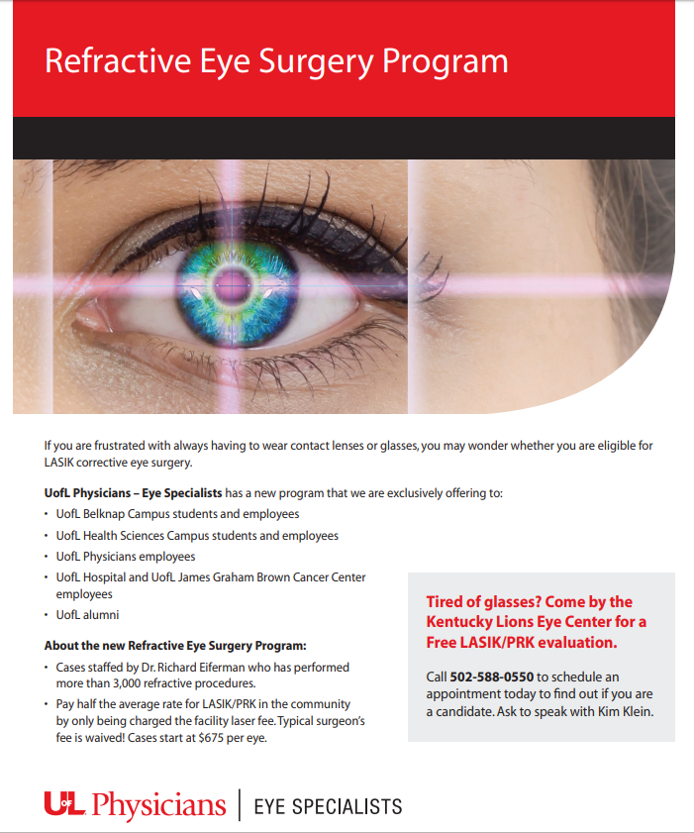
Department Contribution to the SOM four planning pillars
Department of Ophthalmology
Education:
Ophtho 101
Case Presentations
Surgical Volume: Top 5 nationally with graduating cataract experience
LASIK certification program (Bausch & Lomb)
- One of three programs in country to achieve certification prior to graduation (Mayo/Cleveland Clinic/UofL)

Slide 12
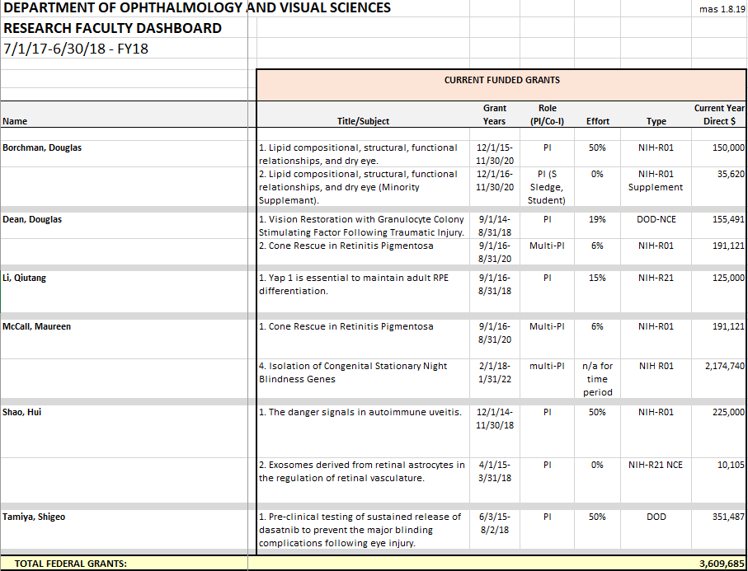
Department Contribution to the SOM four planning pillars
Department of Ophthalmology
Research

Slide 13
Department Contribution to the SOM four planning pillars
Department of Ophthalmology
Research
45 Peer Reviewed Publications in 2018
Pediatric Eye Cancer Program
- Dr. Rama
Center for SIGHT Trial
- Surgical Idiopathic Intracranial Hypertension Treatment Trial
- Dr. Clark & Dr. Compton & Dr. Pham
Center for Trials of Retinopathy of Prematurity (E-ROP, Cryo-ROP, ET-ROP)
- Dr. Barr, Dr. Rama, Dr. Sigford, Dr. Sandhu

Slide 14
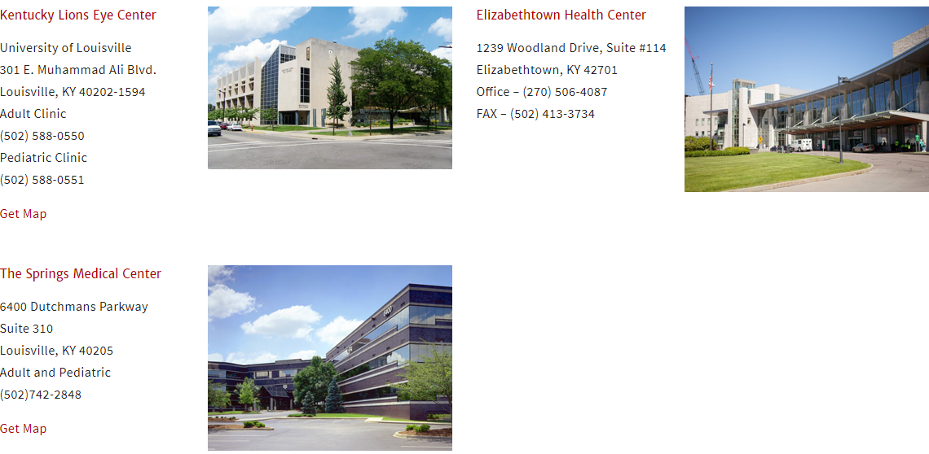
Department Contribution to the SOM four planning pillars
Department of Ophthalmology
Clinical Care
Outreach Clinics:
Madison, Indiana
Owensboro, Kentucky
Campbellsville, Kentucky
Bowling Green, Kentucky

Slide 15
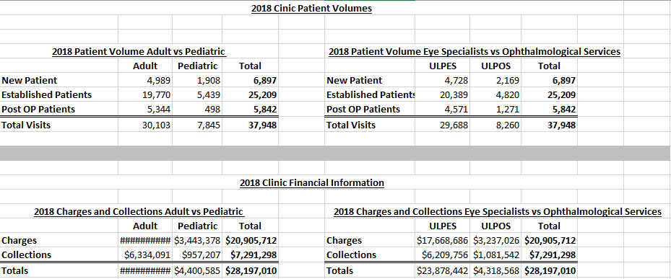
Department Contribution to the SOM four planning pillars
Department of Ophthalmology
Clinical Care
Notes:
2016 totals
Visits: 36,500
2016 Collections: 6.5 million

Slide 16
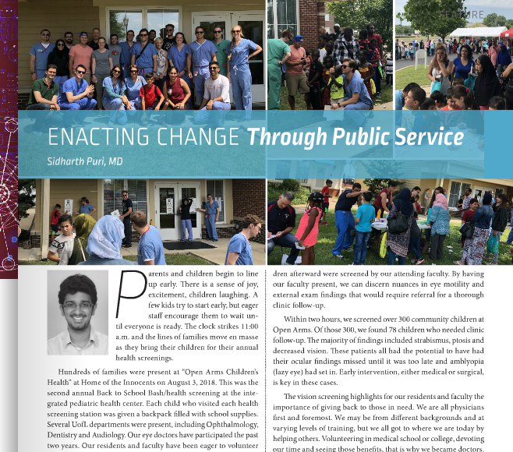
Department Contribution to the SOM four planning pillars
Department of Ophthalmology
Community Engagement
Back to School Screenings
Notes:
Home of the Innocents/Ky refugee ministries

Slide 17
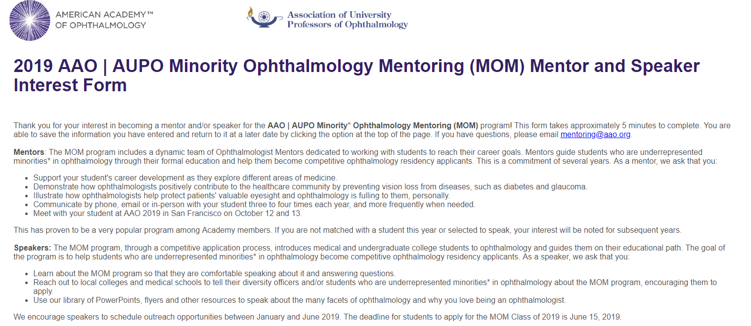
Department Contribution to the SOM four planning pillars
Department of Ophthalmology
Community Engagement
MOM Program – targeting local high school students/college students to pursue ophthalmology as career path
Notes:
Home of the Innocents/Ky refugee ministries

Slide 18
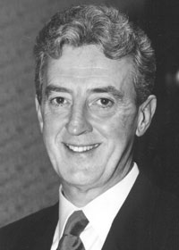
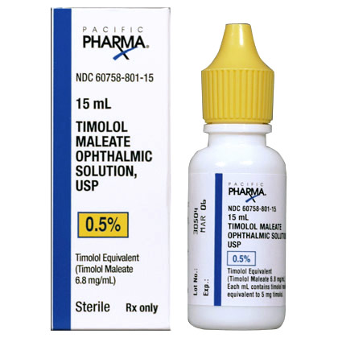
Interesting Fact about the Department
Department of Ophthalmology
Dr. Thom Zimmerman (former chairman)
Credited with developing timolol maleate for the treatment of glaucoma
Merck 1978
Still most widely used drop in the world to treat glaucoma
The University of Louisville Lions Eye Bank
Fully accredited and a charter member of the Eye Bank Association of America. Eye bank technicians recover and distribute eye tissue from more than 300 donors a year for transplant, research and surgical practice

