Slide 1
Faculty Forum
Departmental Spotlight
Department of Obstetrics, Gynecology and Women’s Health
Sara Petruska

Slide 2
Obstetrics, Gynecology and Women’s Health
16 full time faculty, 4 part time, 3 midwives
6 residents in each of four years
2 fellows in MIGS, 2 in REI, 2 in FPMRS
Chair Sean Francis
Vice Chair of Education Marvin Yussman
Vice Chair of Clinical Affairs Dan Metzinger

Slide 3
Obstetrics, Gynecology and Women’s Health
Generalist Obstetrics and Gynecology: Stauble, Petruska, Brees, Franklin, Hamm, Bergin, Marques, Conklin, Kline
Gynecologic Oncology: Metzinger, Sarah Todd
Maternal-Fetal Medicine: Cook, Pallano
Reproductive Endocrinology and Infertility: Yussman
Female Pelvic Medicine and Reproductive Surgery: Francis
Minimally Invasive Gynecology: Pasic, Biscette
Midwifery: Jenkins, Franco, Chandler
Part Time Clinical Faculty: Katz, Boerner, Cook, Gall

Slide 4
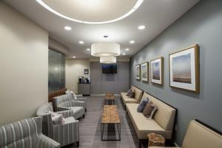
Obstetrics, Gynecology and Women’s Health
401 East Chestnut Street (Generalist OB/Gyn, MIGS, FPMRS)
Brown Cancer Center (Onc)
Jewish Med Center East (Onc)
Springs Medical Center (FPMRS)

Slide 5
Education
Undergraduates: learning site for GEMS students, postbacch/premed
SOM: core clerkship, 15 different 4th year electives, Milestone 1 boot camp
Residents:
6 per year
95%ile for gynecologic volume including robotic training
cadaveric dissection curriculum in Acland Fresh Tissue Lab
88% fellowship placement rate
Fellowships: FPMRS, MIGS, REI
Postgraduate: MIGS hosts AAGL courses in advanced laparoscopy in Acland Fresh Tissue Lab with international attendance

Slide 6
Research- Basic Science Division
Zenmen Lei, Vice Chair for Research
Gonadotropin control of gametogenesis and impact on male factor infertility
Role of LH suppression in recovery after hematopoetic radiation injury
LH and cognitive functions in postmenopausal women and relevance to Alzheimer's disease
Amanda LaBlanc
Autologous cell therapy to reduce aging-induced deficits in cardiovascular function, exploring why women predominantly develop coronary microvascular disease following ischemia
$3.7 million in current funding through NIH, NIGMS, National Institute on Aging and Jewish Heritage Foundation for Excellence
Authored 8 peer reviewed publications 2018-19

Slide 7
Community Engagement
Community Engagement
AHEC Community Outreach Project– mentoring 8th grade Distinguished Math Scholars interested in a medical career
TAPP (Teen Age Parent Program)- Dr. Brees provides services for pregnant and delivered teenagers. There is an on-site daycare so they can continue studies after delivery.
Kentucky Science Center

Slide 8
Clinical Care: Obstetrics
Stauble, Petruska, Franklin, Brees, Hamm, Bergin, Marques, Conklin, Kline
Full scope of Obstetrics care at the Center for Women and Infants at ULH
Only in-patient midwifery service in Louisville
ULH certified WHO Baby Friendly status
High acuity: stroke, morbid obesity, cardiomyopathy, trauma, abnormal placentation
Low intervention: tubs for labor, waterproof, wireless monitors, evidence-based birth practices
24-7-365 in house attending coverage
Practice at 401 East Chestnut St, Suite 470 588-4400

Slide 9
Clinical Care: Obstetrics
2015: 1600 deliveries
2016: 1800 deliveries
2018: 1932 deliveries
24 sets of twins, 2 sets of triplets
186 BTOs
178 CNM deliveries
5449 total patient visits to ULH
85% breastfeeding initiation
Kangaroo Care: 94% at SVD, 40% in OR, 80% in PACU
12% before 37 weeks
20.7% overall CS rate
(Quality Goal 23.9; Norton 29.6, Floyd 24.8, Clark 23.9; Baptist and UK
declined to answer)

Slide 10
Clinical Care: Family Planning
Contraceptive planning and devices- adolescents, medically complex patients, uninsured
Ryan Foundation for LARC devices for uninsured patients
Termination of pregnancy for maternal medical indication can be performed at ULH with approval of MFM
Elective terminations at EMW clinic on Market Street

Slide 11
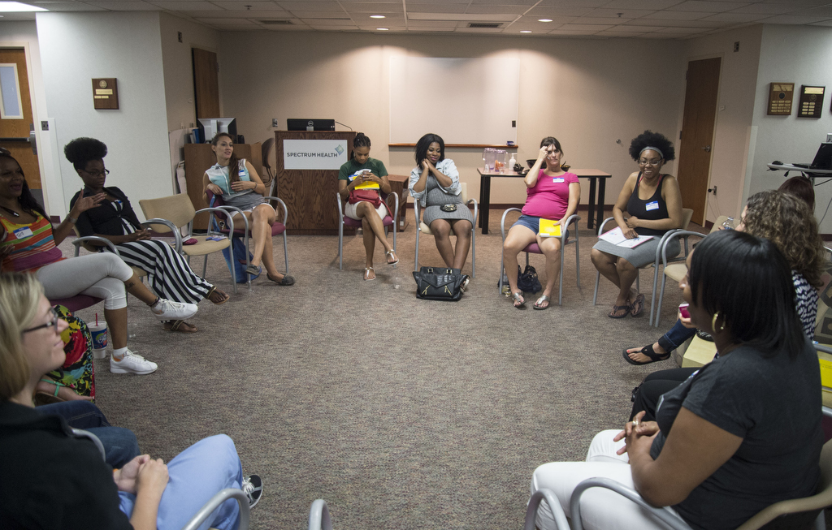
Clinical Care: Centering Pregnancy

Slide 12
Menopause Clinic

Slide 13
Clinical Care: Maternal Fetal Medicine
Vernon Cook, Stanley Gall, locums team, actively recruiting
ULH and Baptist East
Large volume of high risk patients
Referral center for much of KY
WHAS Crusade for Children grant supports ultrasound unit
401 East Chestnut, Suite 410 588-4400

Slide 14
Clinical Care: Minimally Invasive Gynecology
Paya Pasic
Past president of AAGL
President Elect of ISGE International Society of Gyn Laparoscopy
Published 5th textbook of laparoscopy
Shan Biscette elected to the board of ISGE
New contract for emergency gyn coverage at VA

Slide 15
Clinical Care: Gynecologic Oncology
Dan Metzinger, Sarah Todd and Judy Gladish, APRN
Surgical treatment of gynecologic cancer
Minimally invasive surgery including robotic surgery
Fertility sparing surgery
Chemotherapy for gynecologic cancers
Consultations or second opinions
Cancer surveillance and survivorship
BCC at Jewish Medical Center Northeast: (502) 561-7220
BCC Downtown: (502) 561-7220
Next day appointments available

Slide 16
Clinical Care: Reproductive Endocrinology and Infertility
Dr. Marvin Yussman
Two fellows in training
Affected by service line reductions
Hope to reconstitute the division in the future

Slide 17
Clinical Care: FPMRS
Sean Francis, Kate Meriweather, Alyce Goodman
Prolapse, stress and urge incontinence, pelvic/vulvovaginal pain
Office management: urodynamics, cystoscopy, trigger point and botox injection, pessary fitting
Surgery: abdominal, robotic, laparoscopic, vaginal
Outpatient visits at HCOC and Springs
Surgery at Baptist East and ULH

Slide 18
Clinical Care: all divisions
wRVUs/cFTE adjusted for actual FTE:
15 of 16 full time faculty above 50th percentile
6 of 16 fulltime faculty above 75th percentile

Slide 19
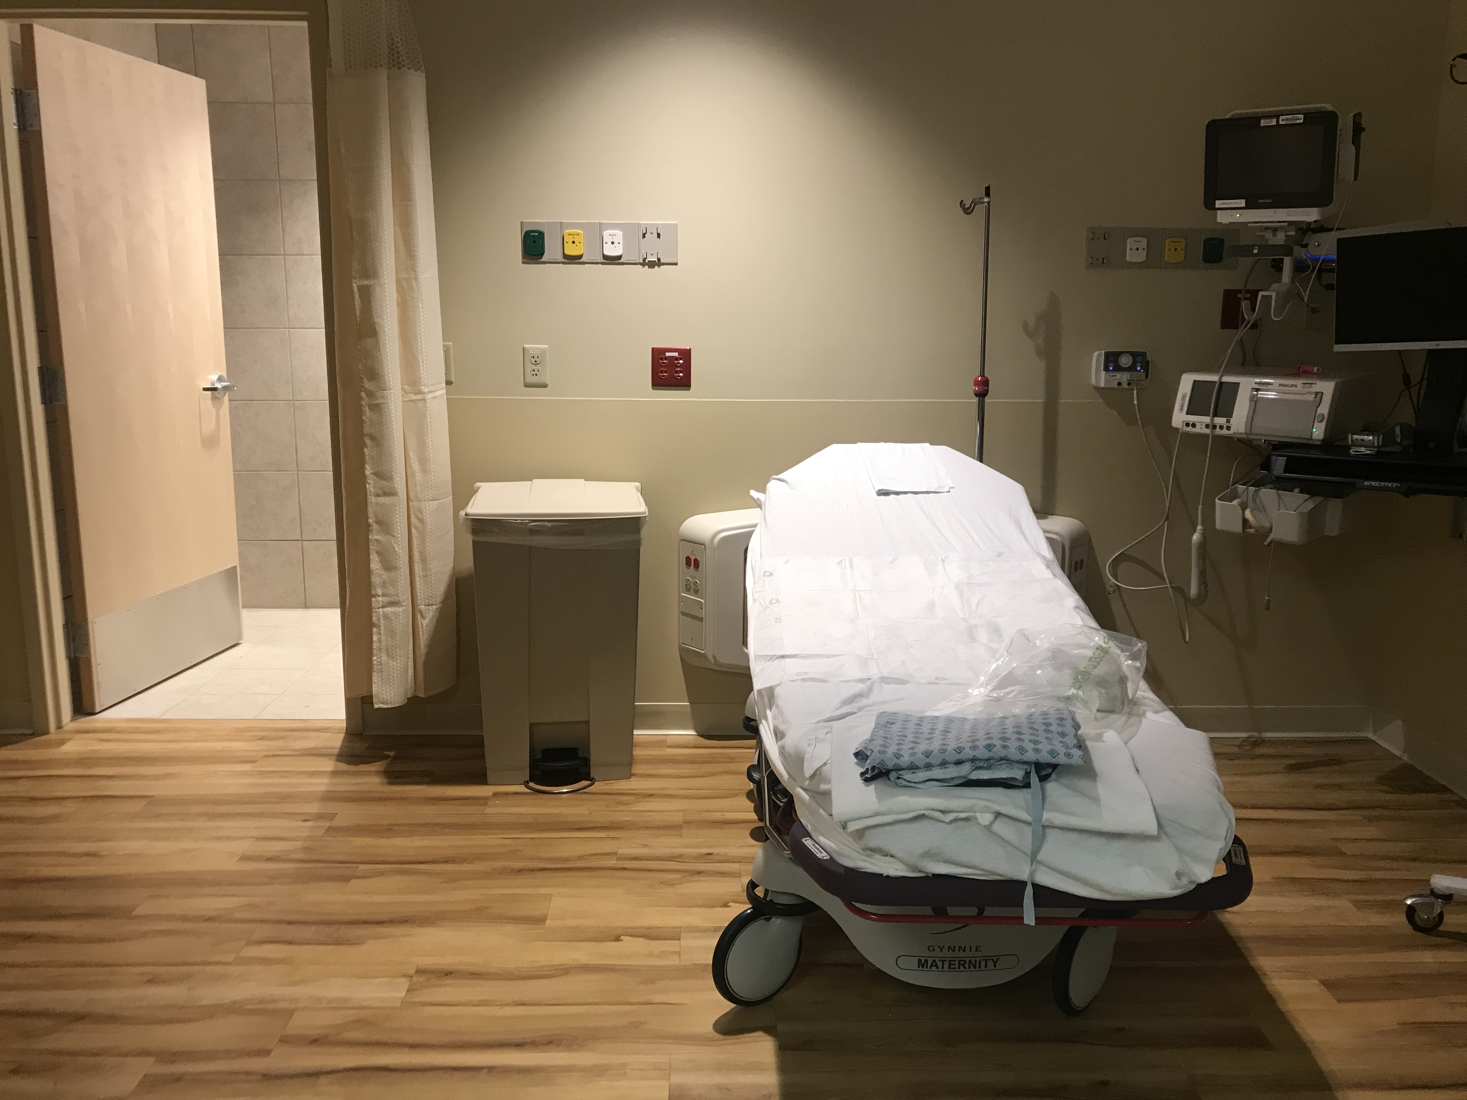

Slide 20
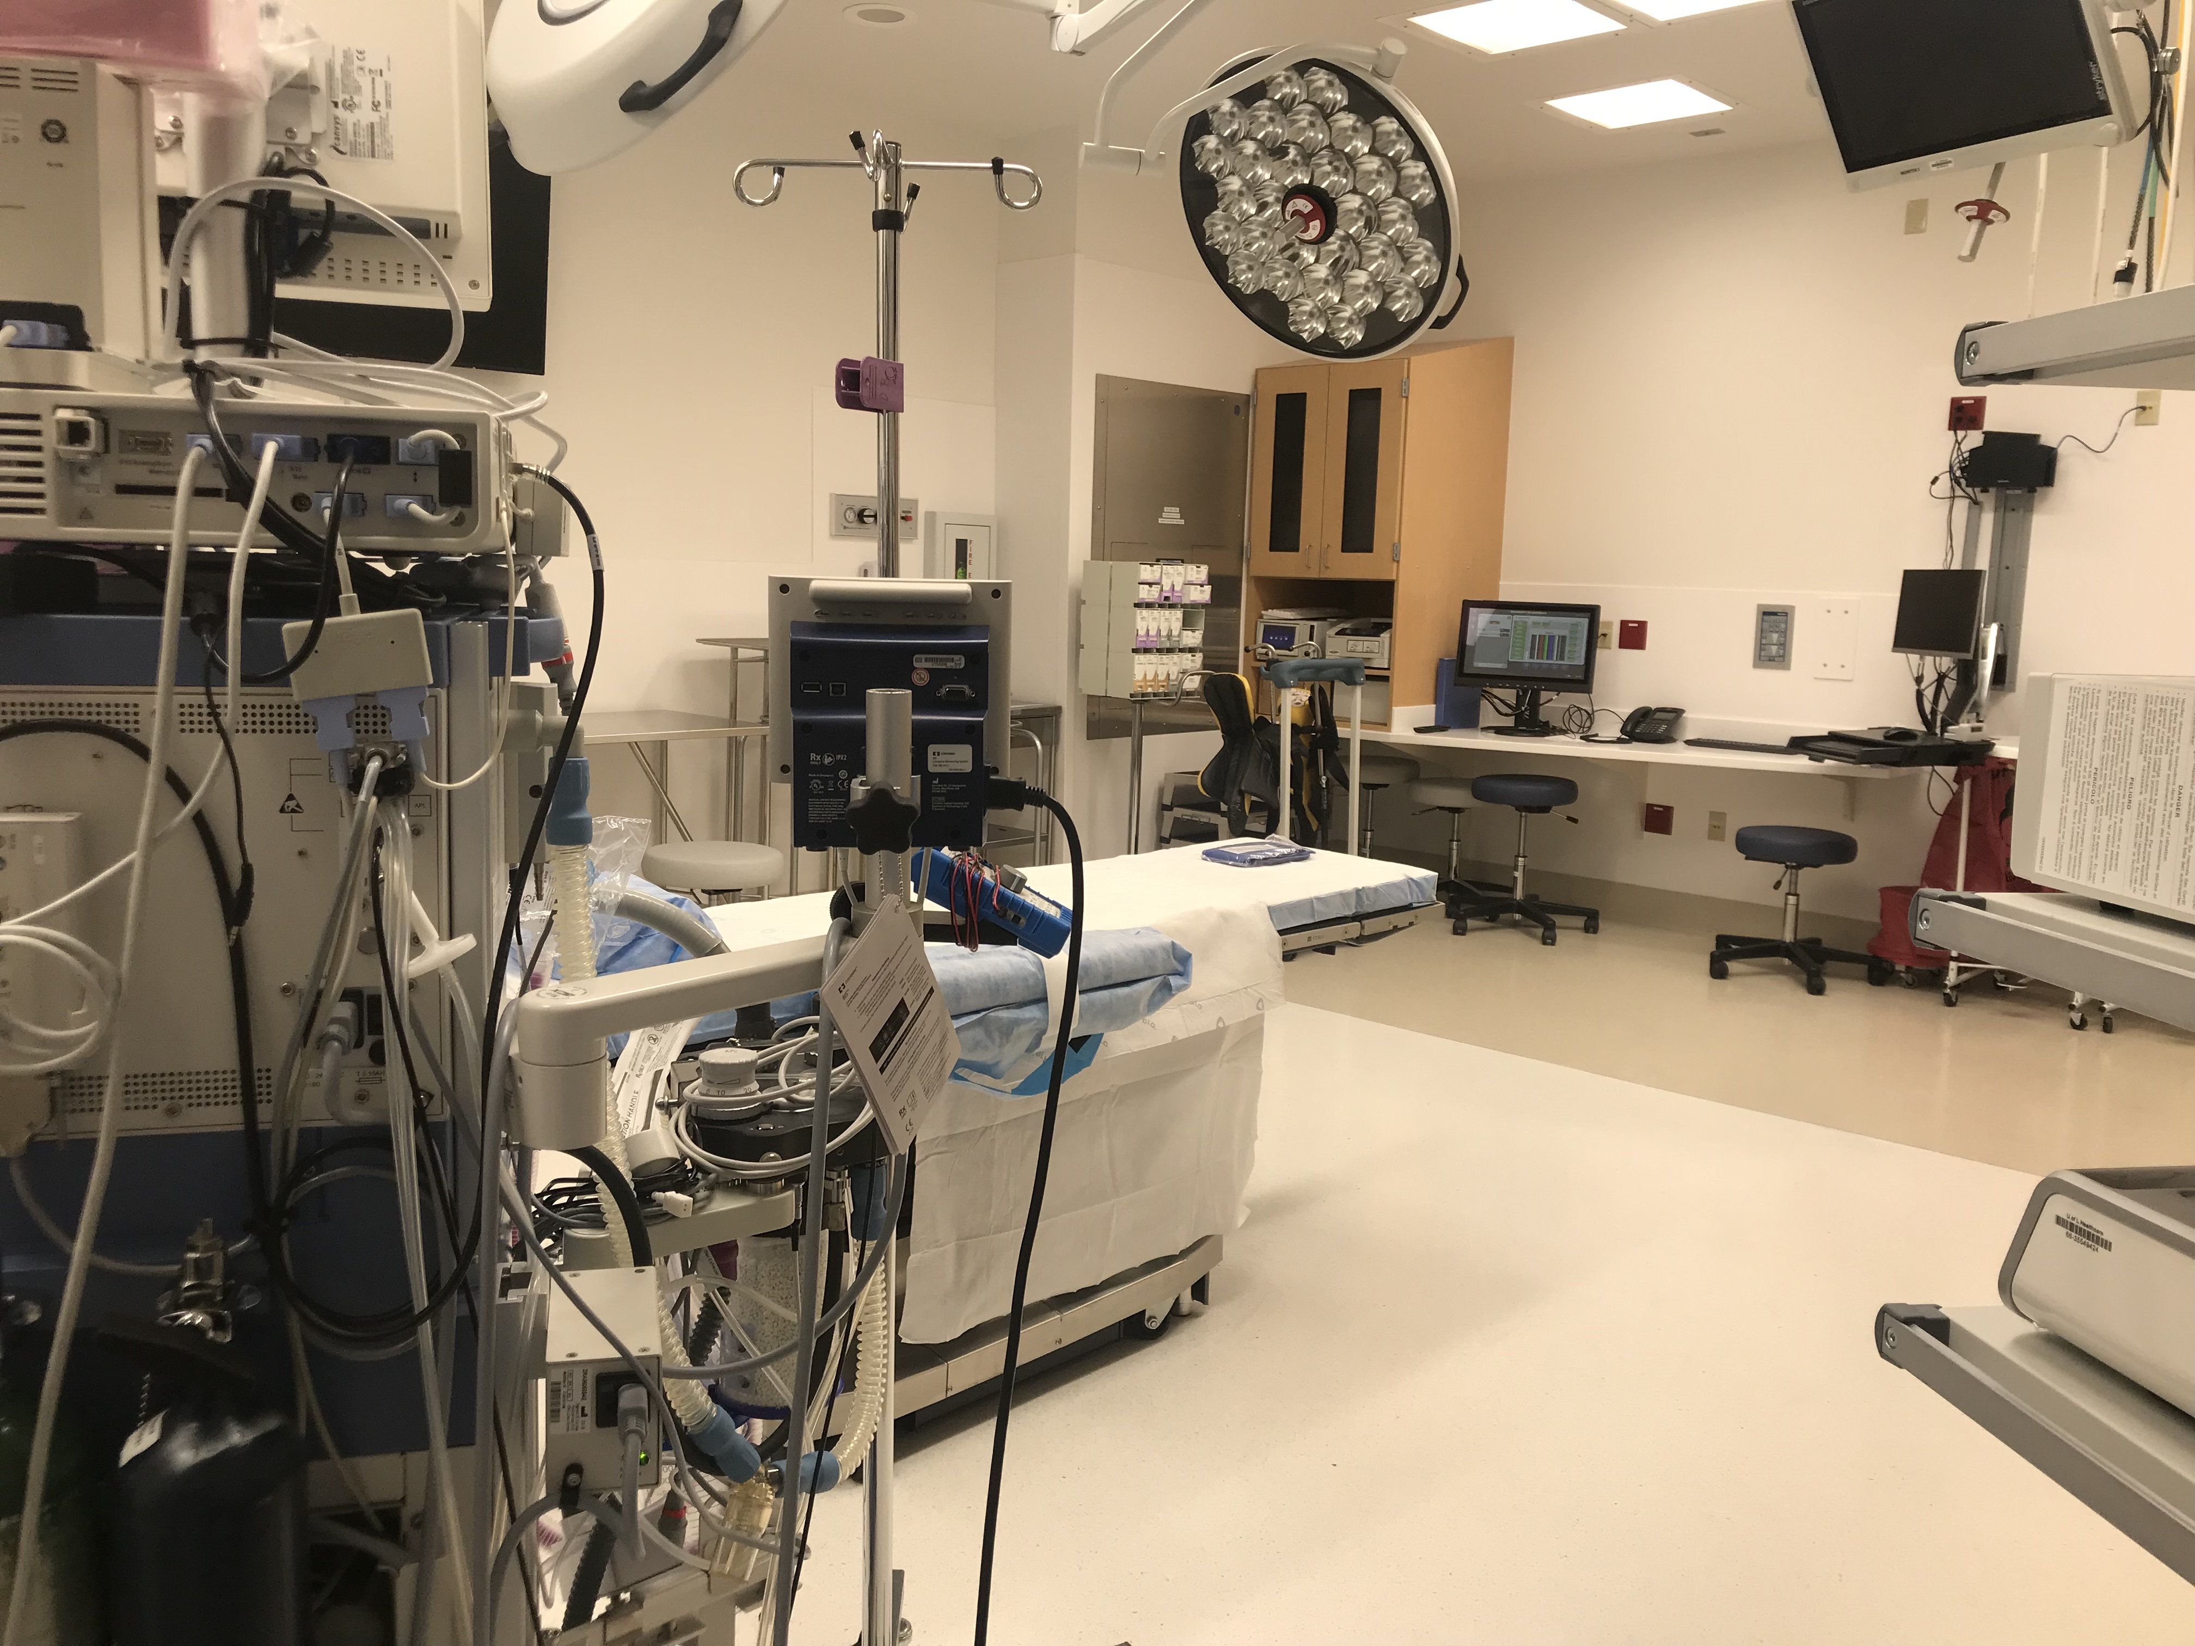

Slide 21
Surprising Fact
Spanish
Somali
Nepali
Arabic
Swahili
Kinyarwanda
Burmese
French
Kiche
Vietnamese
Amharic
Dahri
Haitian Creole
Karen
Mandarin
Tigrinya
Hindi
Korean
Lingala
Mam
Sudanese Arabic
Zomi
Chin Falam
Farsi
Gujarati
Hakha Chin
Kirundi
Kurdish
Laos
Maay Maay
Mum
Pashto
Russian
Wolof

Slide 22
Congratulations in Somali is HAMBALYO
Spanish: Felicidades
French: Felicitaciones
Arabic: Mabrouk
Somali: Hambalyo
Swahili: Eh-ko
Karen: Thai KU doe MA
Portugese: Parabianz
Tegrinya: ink WAH dess BELL ek
Nepali: BOH dei ncha
Kinyaranda: neeWAN whay
Amharic: en quan de salish
Burmese: wantabaDAY
Farci: Tabric boscia

Slide 23
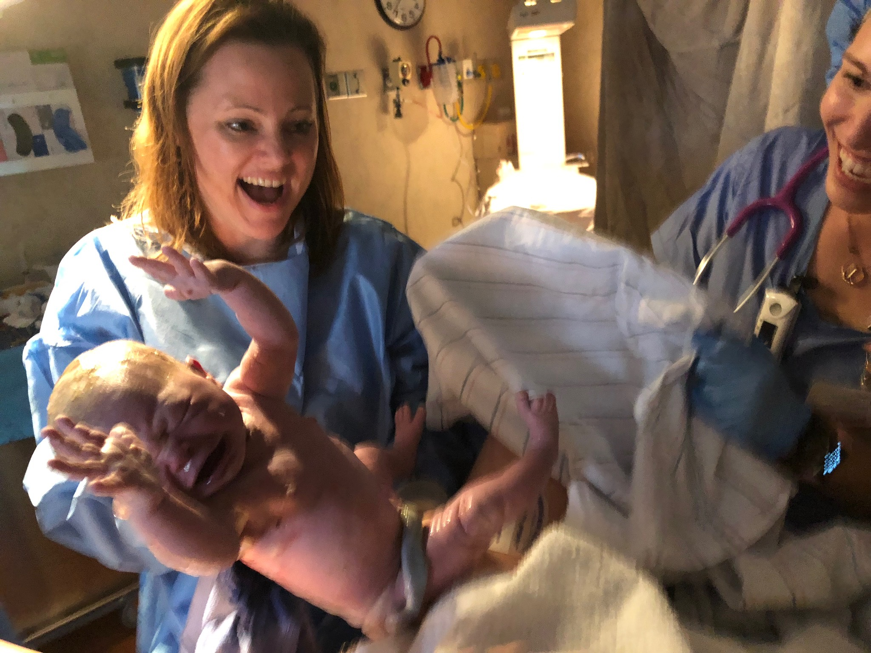
Obstetrics, Gynecology and Women’s Health
588-4400

