Slide 1
Faculty Forum
Departmental Spotlight
Department of Medicine
Clayton M. Smith, MD, FACP
Associate Professor of Medicine
Division of General Internal Medicine, Palliative Medicine, and Medical Education

Slide 2
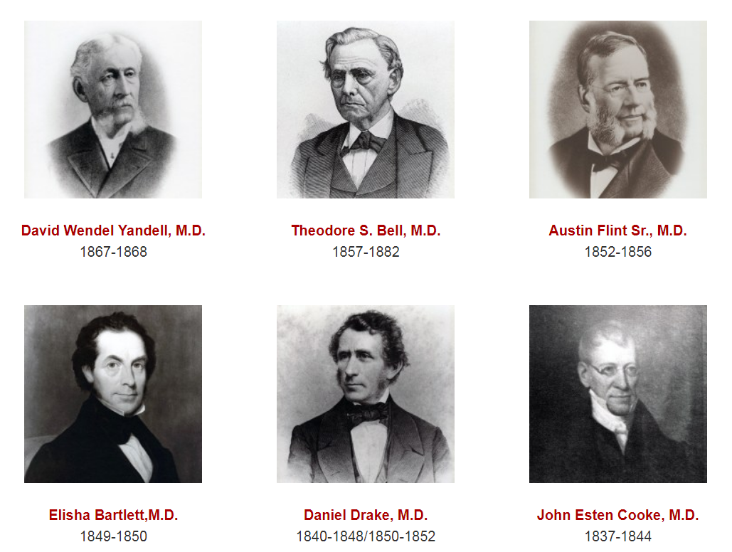
Description and Demographics
Department of Medicine

Slide 3
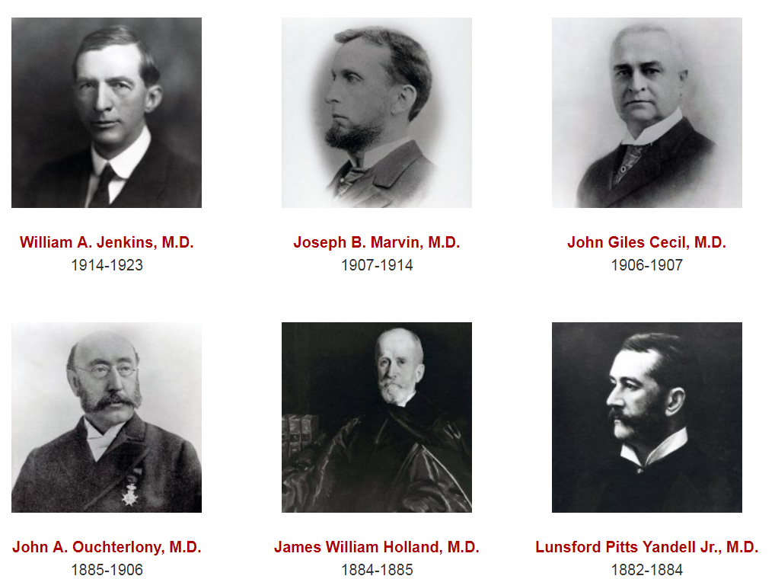
Description and Demographics
Department of Medicine

Slide 4
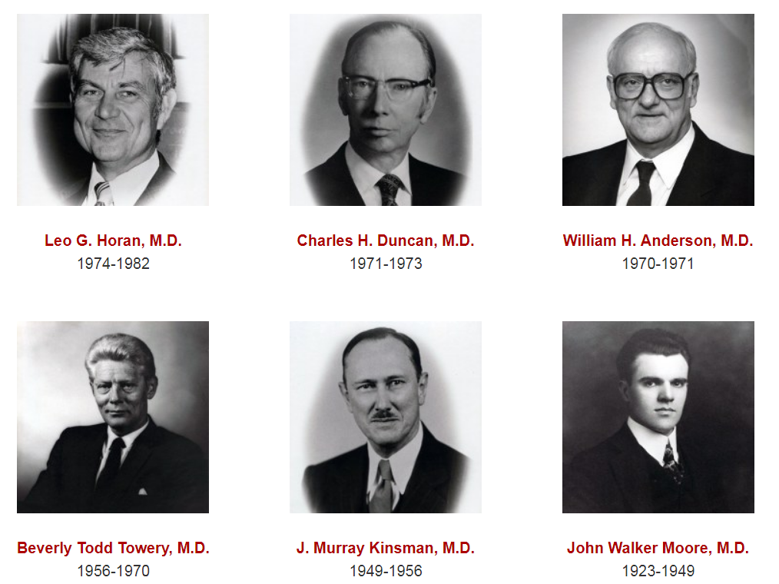
Description and Demographics
Department of Medicine

Slide 5
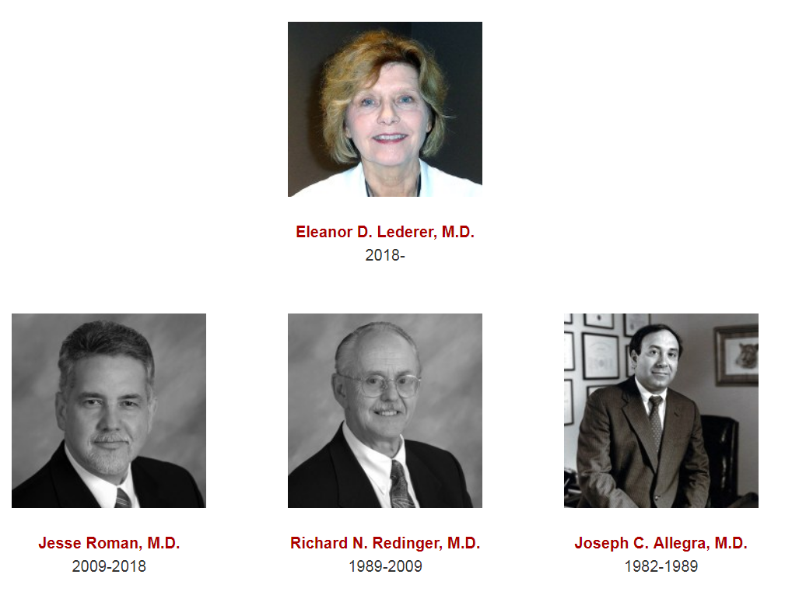
Description and Demographics
Department of Medicine

Slide 6
Description and Demographics
Department of Medicine
11 Divisions
Blood and Bone Marrow Transplantation
Cardiovascular Medicine
Dermatology
Endocrinology and Metabolism
Gastroenterology, Hepatology, and Nutrition
General Internal Medicine, Palliative Medicine, and Medical Education
Infectious Diseases
Medical Oncology and Hematology
Nephrology
Pulmonary, Critical Care, and Sleep Disorders Medicine
Rheumatology
208 Faculty (MD, MD/PhD, PhD, PharmD, JD, APRN, PA-C)
~300 staff (~500 including ULP)
3rd highest revenue in ULP, FY17 budget $117 million

Slide 7
Department Contribution to the SOM four planning pillars
Department of Medicine
Education
Residency Program Director: Jennifer Koch, MD, FACP
Four Associate Program Directors: Kubiak, Smith, Sharpe, Olges
83 categorical residents, 12 preliminary residents, many rotators
94% board pass rate
The mission of the University of Louisville Internal Medicine Residency Program is to provide comprehensive education in general internal medicine which fully prepares its graduates to practice compassionate and evidence-based medicine in a variety of settings. We strive to create a supportive and challenging learning environment that offers strong mentorship, values diversity and inclusiveness, encourages intellectual curiosity and lifelong learning, and teaches physicians to work in inter-professional teams and to realize their roles as advocates for their patients and in their communities.

Slide 8
Department of Medicine
Department Contribution to the SOM four planning pillars
16 Fellowships (15 accredited, 1 non-accredited)
72 fellows
Cardiovascular Medicine, Electrophysiology, Interventional Cardiology, Advanced Heart Failure, Endocrinology, Gastroenterology and Nutrition, Infectious Diseases, Medical Oncology and Hematology, Nephrology, Pulmonary-Critical Care, Sleep Medicine, Palliative Medicine
Palliative Medicine Clerkship (Furman) and Fellowship (Hubert))
~150 4th year students, 2-3 fellows
Medicine Clerkship: Kristan Milam, MD and Julianna Brown, MD
3rd year clerkship: ~150 students (UofL and VA wards)
4th year acting internship: ~100 students (UofL and VA wards/MICU)

Slide 9
Department Contribution to the SOM four planning pillars
Department of Medicine
Research
Executive Vice Chair: Roberto Bolli, MD, FAHA
Currently #47 in NIH rankings
$24.9M ($5.3M increase last 8 years)
15 endowed chairs, 4 Distinguished University Scholars and
2 University Scholars
Baxter Buildings I and II, Medical-Dental Research Building, Clinical Translation Research Center, Clinical Trials Unit
Notable Programs
Stem Cells (Cardiology)
Pulmonary Fibrosis (Pulmonary/Critical Care)
Alcoholic Liver Disease, Motility (Gastroenterology)
Melanoma (Medical Oncology)
Proteomics, Glomerulonephritis (Nephrology)
Pneumonia, Clinical Epidemiology (Infectious Disease)
Educational Innovations (General Internal Medicine)
Envirome Institute (Cardiology)

Slide 10
Department Contribution to the SOM four planning pillars
Department of Medicine
Clinical Care
Downtown Hospitals (ULH, Jewish, Norton), VAMC, Baptist East
Ambulatory Care at ULP Outpatient Care Center, Springs Medical Center, and rural Kentucky
Many physicians in Louisville Magazine’s “Top Docs”
Areas of Expertise
Structural Heart Disease
Heart Failure / Transplant
Cardio-Oncology
Inflammatory Bowel Disease
GI Motility
Diabetes
HIV care
Travel Medicine
Refugee Health
Primary Care
LGBT Health
Nephrolithiasis
Glomerulonephritis
Interventional Nephrology
Melanoma
Pulmonary Hypertension
Interstitial Lung Disease
Lupus

Slide 11
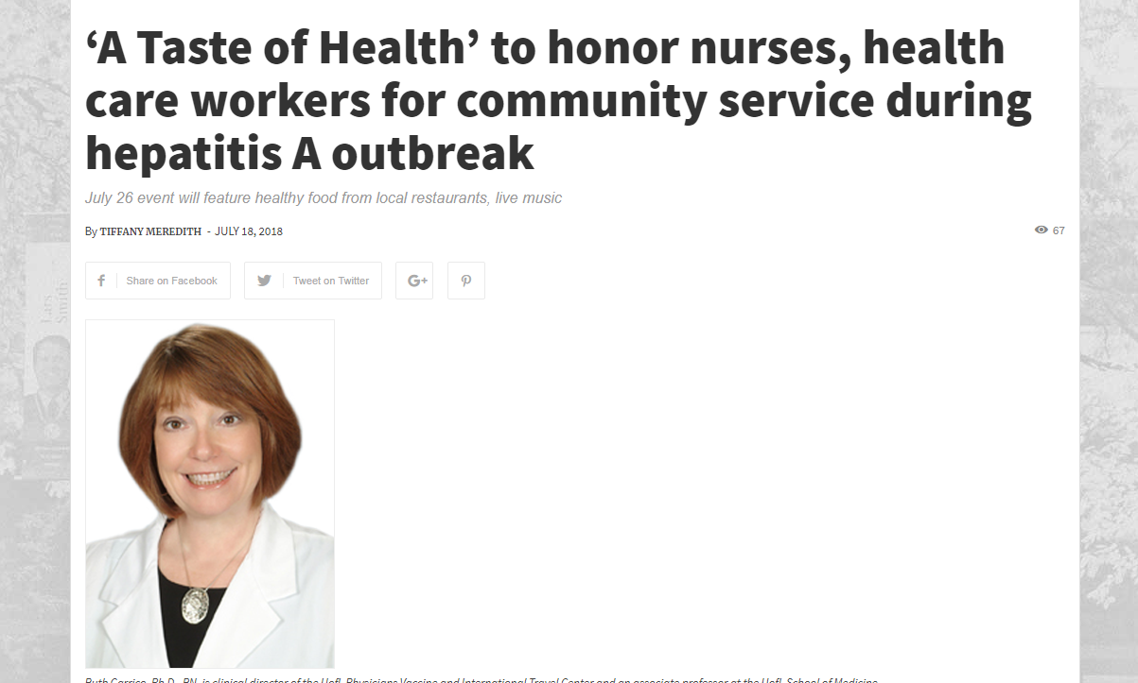
Department Contribution to the SOM four planning pillars
Department of Medicine
Community Engagement
Patient support groups
Educational activities for community physicians
CPR training for the community
Next-day appointments for newly diagnosed cancers
Global Health Initiative

Slide 12
Department of Medicine

Slide 13
Department of Medicine

Slide 14
Department of Medicine

