Slide 1
Faculty Forum
Departmental Spotlight
Department of Anesthesiology and Perioperative Medicine
Brittany Maggard, MD

Slide 2
Description and Demographics
Department of Anesthesiology
23 Faculty members
36 Residents
Will be increasing to 38 in 2019
2 Pain Management Fellows
1 ICU Fellow starting 2019
26 CRNA’s
Department Chair: Dr. Sean Clifford

Slide 3
Department Contribution to the SOM four planning pillars
Department of Anesthesiology
Education
Medical Students
Residents
Beyond
4 year program
CBY:
6 months with IM
1 mo Trauma
1 mo Anes NICU
1 mo ER
1 mo Anes
1 mo Radiology and OB Anes
CA 1 – CA 3:
Obstetric Anesthesia
Cardiothoracic Anesthesia
Neurocritical care
Acute Pain Management
Pediatric Anesthesia
Chronic Pain Management
Neuroanesthesia
Anesthesia Clinical Ties
One event held each semester
Paris Simulation Center
Approx. 40 students per session
Rotate through 6 stations
“A Day in the Life of an Anesthesiologist”
“How To Get Into An Anesthesia Residency”
Mask Ventilation
Intubations
A.line and IV placement
Spinal Anesthetics
Year | Number of Students
2014 - 2015 | 31
2015 - 2016 | 33
2016 - 2017 | 41
2017 - 2018 | 54
2018 - 2019 | 48
Extensive Advanced Exam Curriculum:
- OSCE training with our standardized patients
- Oral board practice exams
Perioperative Critical Events in Obstetrics
Mastering The Difficult Airway June 2019
Point of Care Ultrasound Course 2020
Notes:
ASA 2018 – 17 Residents and 12 Faculty had presentations at ASA 2018

Slide 4
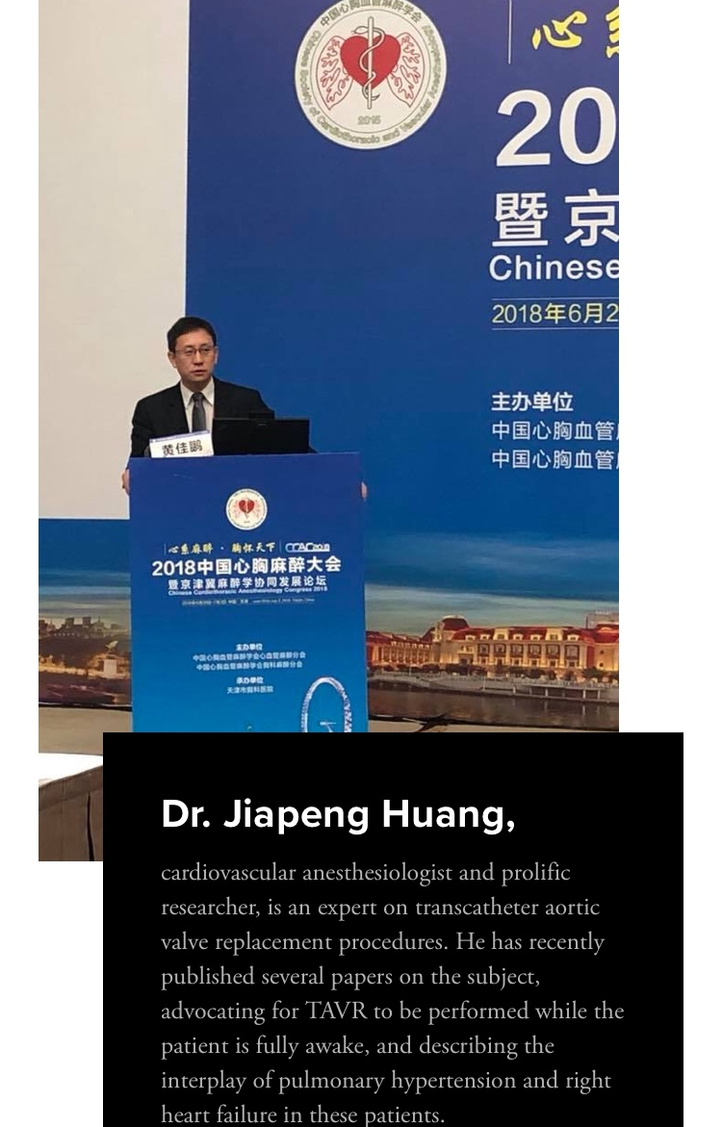
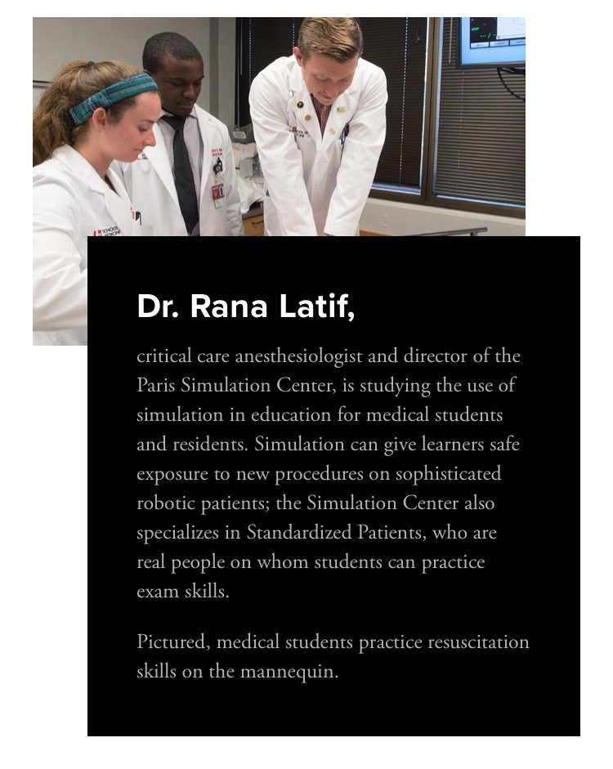
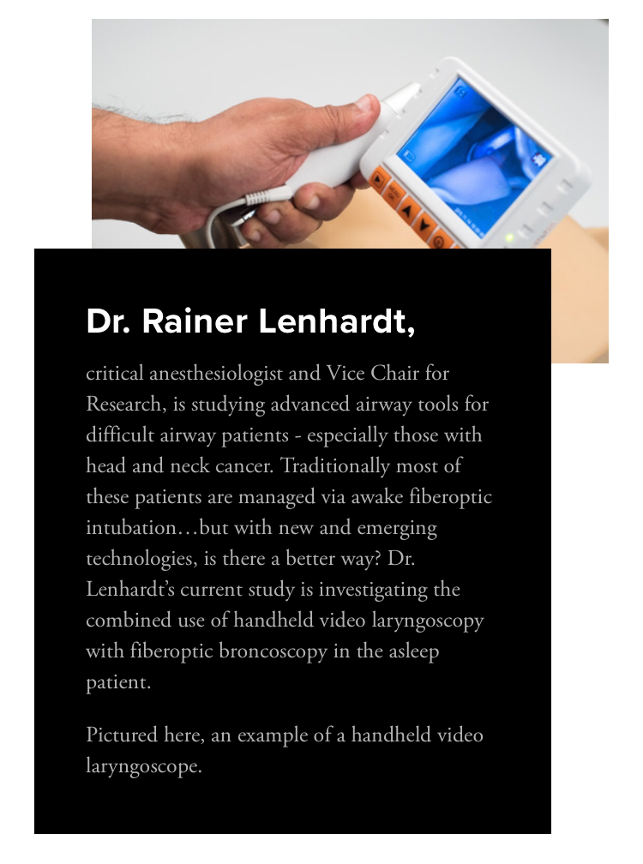
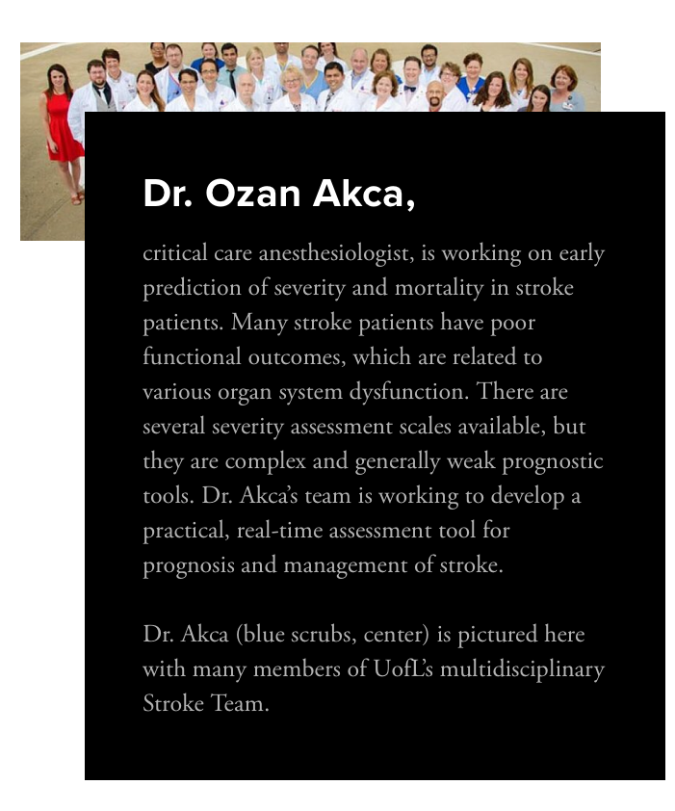
Department Contribution to the SOM four planning pillars
Department of Anesthesiology
Research
Number of Publications
2010 | 7
2011 | 11
2012 | 16
2013 | 15
2014 | 15
2015 | 18
2016 | 17
2017 | 13

Slide 5
Department Contribution to the SOM four planning pillars
Department of Anesthesiology
Clinical Care
Veteran’s Hospital
Approx 300 cases/mo
or 3,600 cases per year
University of Louisville Hospital
Main OR
815 cases/mo
OSC
375 cases/mo
Inpatient Endoscopy
220 cases/mo
Total:
Approx 1300 cases per month
15,600 cases per year
1.98 million OR minutes/year

Slide 6
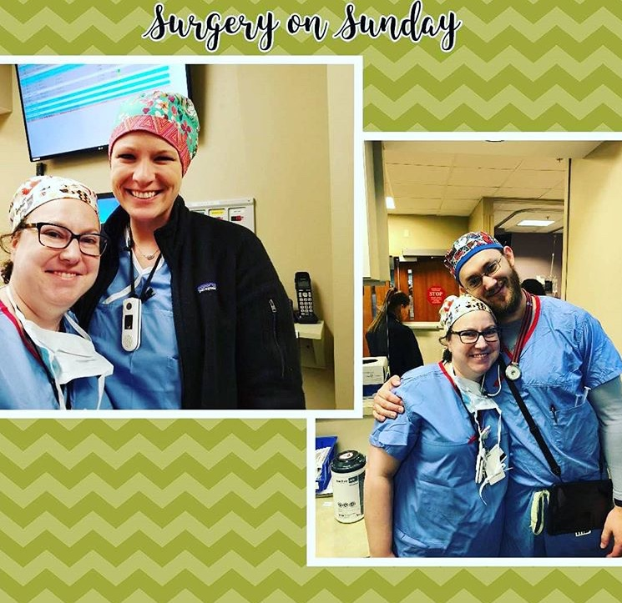
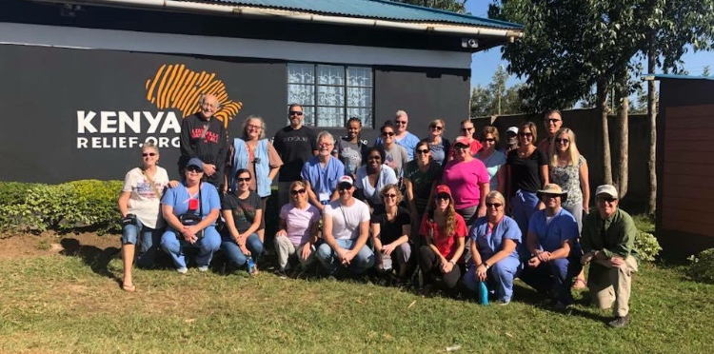
Department Contribution to the SOM four planning pillars
Department of Anesthesiology
Community Engagement

Slide 7
Interesting Fact about the Department
Department of Anesthesiology
Dr. Daniel Sessler founded the Outcomes Research Consortium in 1990 at The University of California in San Francisco.
In 2000, Dr. Sessler and some of his brightest researchers moved the Outcomes Research Institute to The University of Louisville
The worlds largest Clinical Anesthesia Research Organization
Members of this organization have published more than 900 full journal articles since its inception and publish a new full paper every 5 days
The ORC published a full paper or editorial every 3 days. The consortium is thus responsible for nearly 10% of the clinical research in high-profile general anesthesia journals
Dr. Sessler moved to Cleveland Clinic, however, we have retained several of his best researchers here at UL.
Dr. Rana Latif
Dr. Ozan Akca
Dr. Detlef Obal

