Slide 1
Clinical Features and Follow-up of Children Evaluated for Persistent Unwellness Following Acute COVID-19
Kathryn E. Weakley, M.D.; Allegra Schikler; Julianne V. Green, M.D. Ph.D.; Daniel B. Blatt, M.D.; Shanna M. Barton, M.D., M.Sc.; Victoria A. Statler, M.D., M.Sc.; Yana Feygin, M.S; Gary S. Marshall, M.D.

Slide 2
Background
Adults and children may have persistent or new symptoms following acute COVID-19
Known as:
Long-COVID
Long-hauler syndrome
Post-COVID conditions
Post-acute sequelae of SARS-CoV-2 infection (PASC)
https://www.cdc.gov/coronavirus/2019-ncov/long-term-effects/index.html
Notes:
Adults and children may experience a wide range of persistent or new symptoms following SARS-COV2 infection
This has become known by many names, including long COVID, but I will refer to it as post-acute sequelae of SARS-CoV-2 infection, or PASC

Slide 3
PASC in Adults
Symptoms:
Fatigue
Headache
Shortness of breath
Loss of taste and/or smell
Cognitive disturbance
Anxiety and/or depression
Duration: ≥ 3 months to ≥ 1 year
Risk Factors:
Severe COVID-19
Older age
Female
Pre-existing medical conditions
Davis. EClinicalMedicine, 2021; Sudre. Nat Med, 2021; Sneller. Ann Intern Med, 2022; Hope. Infect Dis Clin North Am, 2022; https://www.kff.org/policy-watch/long-covid-what-do-latest-data-show/; Robineau. JAMA Netw Open, 2022
Notes:
The symptoms of PASC in adults are listed here and studies estimate that symptoms can last anywhere from >3 months to >1 year, with risk factors including severity of acute COVID-19, older age, being female, and pre-existing medical conditions.

Slide 4
PASC in Children and Adolescents
Symptoms may be similar to those in adults
May follow mild or asymptomatic COVID-19
Prevalence estimates vary from <5% to >60%
>75% of U.S. children are seropositive for SARS-CoV-2
Burden of PASC may be large
Zimmermann. PIDJ, 2021; Lopez-Leon. Sci Rep, 2022; Stephenson. Lancet Child Adolesc Health, 2022; Funk. JAMA Netw Open, 2022; Molteni. Lancet Child Adolesc Health, 2021; Buonsenso. Acta Paediatr, 2021; Rao. JAMA Pediatr, 2022; Messiah. PIDJ, 2022; Blankenburg. Sci Rep, 2022; Ashkenzai-Hoffnung. PIDJ, 2021; Blomberg. Nat Med, 2021; Sneller. Ann Intern Med, 2022 Say. Lancet Child Adolesc Health, 2021; Clarke. MMWR, 2022
Notes:
Less is known about PASC in children and adolescents.
Early data suggests that the symptoms of PASC in children may be similar to those in adults
But in contrast, PASC in children has been reported to follow even mild or asymptomatic COVID-19
There is marked heterogeneity in study methodologies, so prevalence estimates vary between <5% to >60%
But given that >75% of U.S. children and adolescents have serological evidence of prior SARS-CoV-2 infection, the public health burden of PASC could be large

Slide 5
Post-Acute COVID Clinic (PACC)
Pediatric Post-Acute COVID clinic (PACC) opened October 2020
Opportunity to gather detailed, patient-level data
Understand the clinical features and long-term effects of PASC in referred children and adolescents
Notes:
So in October 2020, our institution established one of the first dedicated pediatric Post-Acute COVID Clinics (PACC) in the country.
This afforded us with the opportunity to gather detailed, patient-level data that could improve our understanding of the clinical features and long-term effects of PASC in a unique population of children and adolescents whose symptoms rose to the level of referral.
***
To our knowledge, there were only 3 clinics that opened prior to ours and they were not spearheaded by peds ID specialists.
Kennedy Krieger Institute (MD) July 2020
Children’s Hospital New Orleans (LA) Sept 2020
UT Houston (TX) Sept 2020
To my knowledge, the only other peds ID PACC is run by Boston Children’s, which was established in May 2021

Slide 6
Post-Acute COVID Clinic (PACC)
Regional providers notified via:
E-mails
Televised news interviews
Print newsletters
Norton Children’s Medical Group website
Notes:
Regional providers learned about the clinic through e-mails, televised news interviews, print newsletters, and the Norton Children’s Medical Group website.

Slide 7
Post-Acute COVID Clinic (PACC)
Patient requirements:
Proven or strongly suspected COVID-19 ≥ 10 days prior
Afebrile
New symptoms or “persistent unwellness”
Referred (self-referrals and walk-ins not allowed)
Scheduled within 2 weeks of referral
Notes:
Patients were scheduled if they had proven or strongly suspected COVID-19 beginning ≥10 days earlier; were afebrile; and had new or lingering symptoms or a general sense of not being well, which we refer to as “persistent unwellness.”
Patient symptoms had to be significant enough to warrant referral by another medical provider, and, in general, appointments were scheduled within 2 weeks of referral

Slide 8
Post-Acute COVID Clinic (PACC)
Evaluation by pediatric infectious diseases provider
Standardized intake template:
Previous state of health
Antecedent COVID symptoms and duration
Ongoing post-COVID symptoms
Modified Disability Inventory (MFDI)
Kashikar-Zuck. Pain, 2011
Notes:
Pediatric infectious diseases providers performed the intake evaluation using a standardized template which included questions about each patient’s previous state of health, their acute COVID symptoms and duration, and any ongoing symptoms they were experiencing. Patients also completed a Modified Functional Disability Inventory (MFDI), which is a validated tool that was originally used to assess disability in adolescents with chronic pain.
***
One of 4 pediatric infectious diseases physicians or a nurse practitioner

Slide 9
Post-Acute COVID Clinic (PACC)
Targeted lab evaluation and subspecialty referrals made at the discretion of each PACC provider
Other subspecialists agreed to see patients within 1 week of referral
Standardized educational material
Most patients were scheduled for at least 1 PACC follow-up
Notes:
Targeted lab evaluation and subspecialty referral was at the discretion of each post-acute COVID clinic provider.
Subspecialty services agreed to schedule patients within 1 week of referral.
At the end of each visit, patients received standardized educational materials including information about PASC, graded increase in exercise, how to receive school accommodations if necessary, and the COVID vaccine.
Most patients were scheduled for at least 1 post-acute covid clinic follow-up after the initial visit.

Slide 10
Study Cohort and Medical Record Review
Charts reviewed for all patients evaluated Oct 12, 2020 – Dec 6, 2021
Excluded:
Acute COVID-19
Multisystem inflammatory syndrome in children (MIS-C)
Patients with negative testing not excluded
Possible false negative test results
Strong suspicion of prior COVID-19 required
Kuwelker. Lancet Reg Health Eur, 2021; Toh. JAMA Netw Open, 2022; Langeland. Lancet Reg Health Eur, 2021; Van Elslande. J Clin Virol, 2021; Liu. Emerg Infect Dis, 2021; Dattner. PLoS Comput Biol, 2021
Notes:
The charts of all patients evaluated between October 12, 2020, and December 6, 2021, were reviewed.
Patients who were found to have acute COVID-19 or MIS-C were excluded from the analysis
But patients with negative SARS-CoV-2 tests or negative SARS-CoV-2 serology were not excluded because of multiple studies citing the possibility of false-negative test results in children with low viral load or waning immunity, but again, a strong suspicion of COVID-19 was required for entry into the PACC. So for example, the patient may have tested negative, but was symptomatic and their whole family tested positive at the same time.
***
This portion of the study was approved by the University of Louisville and Norton Children’s Institutional Review Boards (IRBs) under a waiver of informed consent.

Slide 11
Study Cohort and Medical Record Review
Diagnostic test results interpreted in real time by ordering provider
Interpretation used in the analysis
Notes:
The results of diagnostic tests performed before referral, in the PACC, or during subspecialty evaluations were interpreted as explanatory or not explanatory with respect to the patient’s symptoms in real time by the ordering providers, and those interpretations were used in the analysis.
***
IRB approved with waiver of consent

Slide 12
Follow-up Telephone Interview
Structured interview with similar questions + improvement ranking
January 2022 – March 2022
Parent/guardian and patient included when possible
Notes:
A structured telephone interview was then conducted with available and willing patients between January 2022 and March 2022. Questions were similar to those used during the intake evaluation, but we additionally asked during this interview if each patients’ symptoms were worse, about the same, improved, or back to normal.
When possible, the parent or guardian and the patient were both included in the conversation
***
IRB approved with verbal consent by parent and assent from child if present
Interview by one of 4 investigators

Slide 13
Statistics
Median, IQR, range calculated and compared using Kruskal-Wallis test
Proportions compared using Chi squared or Fisher’s exact tests with Freeman-Halton extension
Exploratory cluster analyses using divisive analysis (DIANA)
Kaufman, An Introduction to Cluster Analysis, 1990;
https://www.rdocumentation.org/packages/cluster/versions/2.1.4/topics/diana
Notes:
Medians, with interquartile range (IQR) and range, were used as of measures central tendency and were compared using the Kruskal-Wallis test (non-parametric b/c data was not normally distributed in clusters).
Proportions were compared using the Chi squared (for demographics b/c expected values>5) or Fisher’s exact tests (for the clusters and race/gender/payer proportions, b/c cluster size was low and expected value <5 and >2x2 table).
Exploratory cluster analyses were performed for presenting symptoms using the divisive analysis (DIANA) clustering algorithm and clusters were described by the proportion of patients with each symptom.
***
Jaccard distance was used to create a dissimilarity matrix (basically looking at how far apart the observations are), since the DIANA (and AGNES) can't work on strictly binary data.
DIANA was used because it was best able to tease out the clusters. DIANA takes the entire dataset and divides it into 2 groups and then down into more and more groups.
Freeman-Halton (2x3 table)

Slide 14
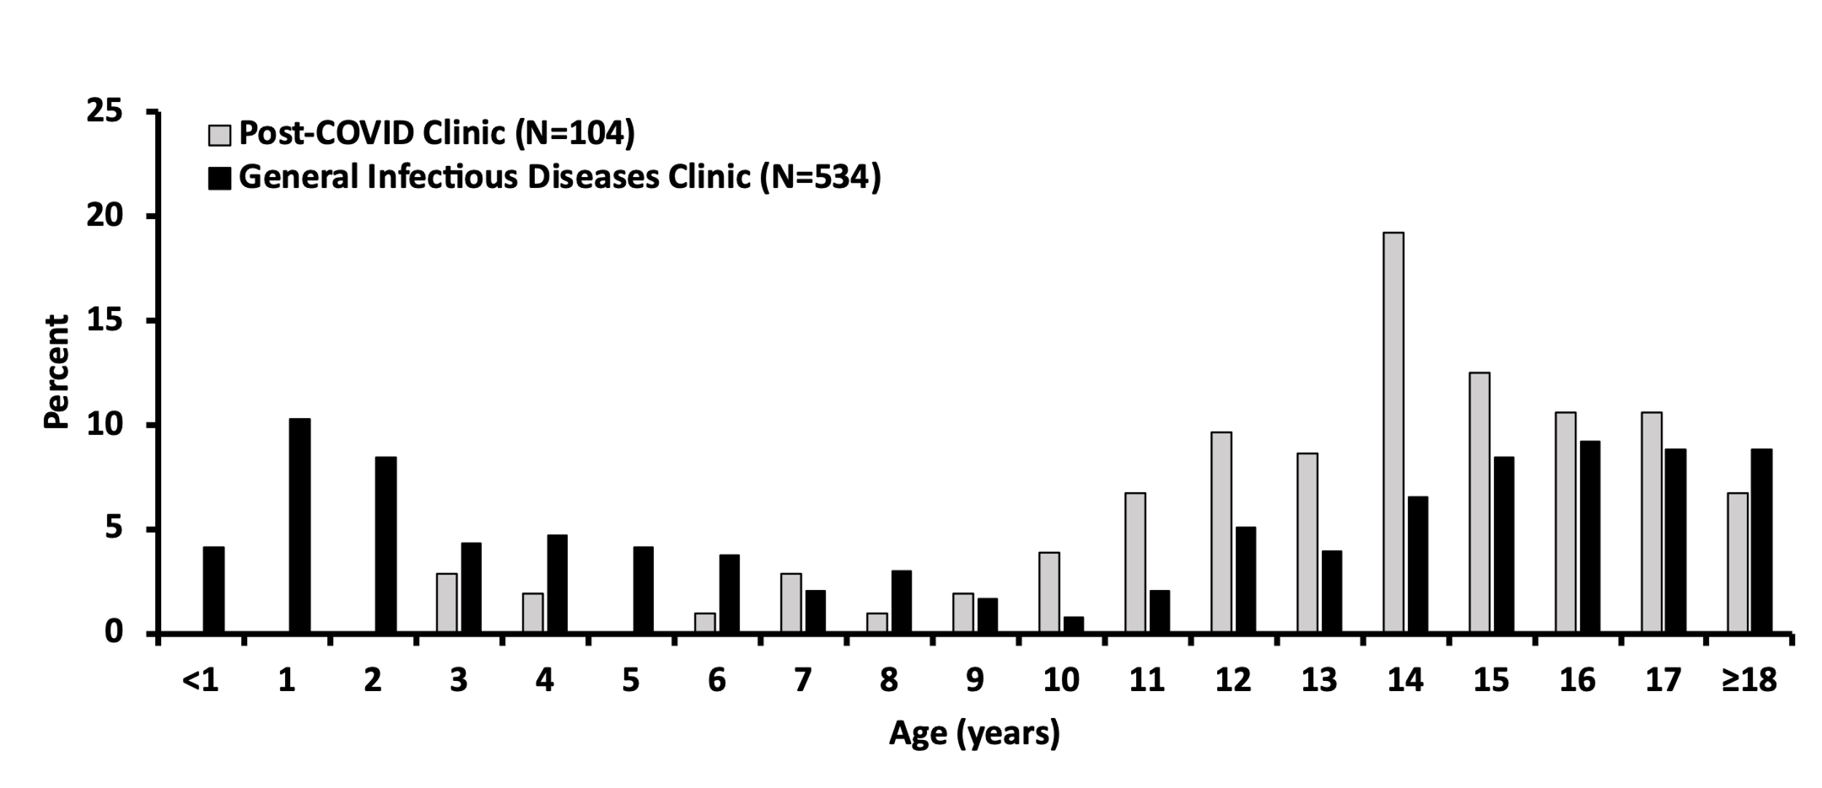
Results
Age of New Patients Seen in Post-COVID Clinic (PACC) in Relation to New Patients Seen in the General Pediatric Infectious Diseases Clinic
Notes:
The cohort consisted of 104 patients, and most were greater than 10 years of age, which differed from our general pediatric infectious diseases clinic
***
young kids DO get referred to PIDC but DO NOT get referred to PASC

Slide 15
Results
Slight female predominance (55%)
No significant difference between PACC and GPIDC:
Gender (p=0.51)
Race (p=0.69)
Insurance (p=0.12)
Notes:
Among patients ≥10 years of age, there was a slight female predominance, but there was no significant difference in the gender, race (white versus non-white/unknown), or payer (commercial versus non-commercial) proportions between PACC and GPIDC patients.
***
If asked: Younger patients were excluded from the rest of the demographic eval b/c of confounding variables: perinatal syph, HIV, HCV risk factors may lean towards different population than other infectious complaints in older individuals
No referral bias

Slide 16
Results
Median 2.6 months from COVID to PACC (IQR 1.5-4.4; range 0.7-18.1)
Institution | Duration of symptoms | Percent of Cohort
Department of Health and Human Services | ≥4 weeks | 98%
World Health Organization | ≥2 months | 90%
Delphi Consensus for Children | ≥12 weeks | 84%
https://www.covid.gov/assets/files/National-Research-Action-Plan-on-Long-COVID-08012022.pdf; Soriano. Lancet Infect Dis, 2022; Stephenson. Arch Dis Child, 2022
Notes:
The median interval from onset of COVID-19 symptoms to the first PACC visit was 2.6 months.
98% of patients met the Department of Health and Human Services definition of long COVID, which requires that symptoms be present for greater than 4 weeks after the initial infection.
Additionally, 90% had symptoms for >2 months, and 84% had symptoms for more than 12 weeks.
***
Ninety-eight patients had symptoms for greater than 4 weeks at presentation, and 4 of the remaining 6 patients that presented with <4 weeks of symptoms eventually had symptoms for >4 weeks.
World Health Organization criteria for adults
Delphi = proposed pediatric-specific research case definition

Slide 17
Results
4 asymptomatic with acute COVID-19
2 hospitalized with acute COVID-19
93 of remaining 98 had mild acute symptoms lasting ≤2 weeks (5 unknown)
Notes:
Four patients had been asymptomatic with acute COVID-19 and 2 had been hospitalized.
93 of the other 98 had experienced mild acute COVID symptoms lasting ≤2 weeks. (data unavailable for 5 patients)
***
Hospitalized patients: 1 week and unknown

Slide 18
Results
96% of patients reported good health prior to COVID-19
54% with moderate to severe disability at first PACC visit
Kashikar-Zuck. Pain, 2011
Notes:
Ninety-six percent of patients reported good health before contracting COVID-19 (N=100, prior health status was unknown for 4 patients).
But more than more than half of patients were experiencing moderate-to-severe disability according to the modified disability inventory score obtained at the initial PACC visit (N=94, 10 unknown)
***
Hospitalized patients: 1 week and unknown

Slide 19
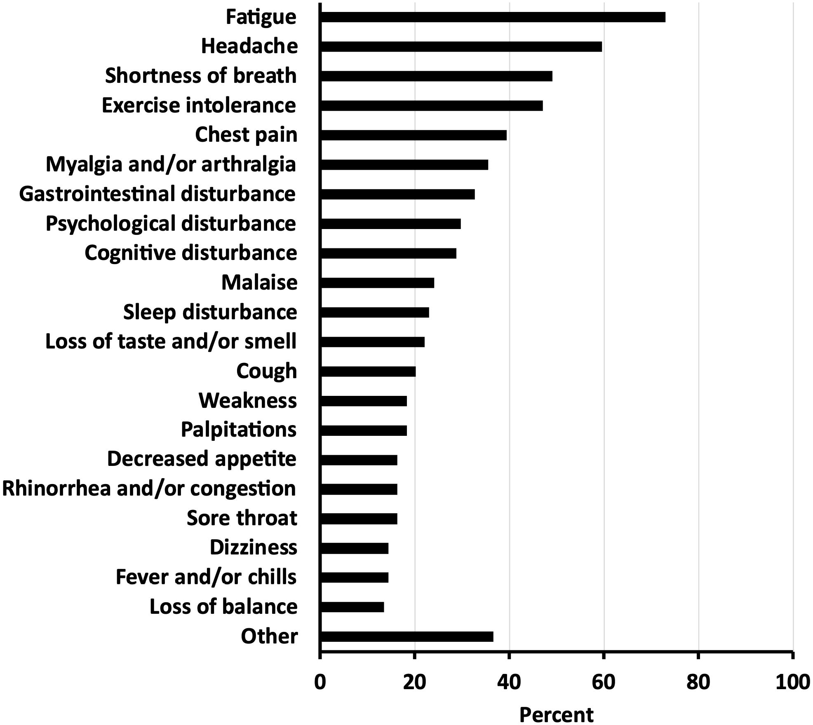
Symptoms at Time of Presentation to PACC
Notes:
The most common symptoms reported by patients during their first PACC visit were fatigue (73%), headache (60%), shortness of breath (49%), exercise intolerance (47%), and chest pain (39%).
***
Anecdotal impression: “SOB” is really “Can’t catch a deep breath, which is a classic anxiety symptom.

Slide 20
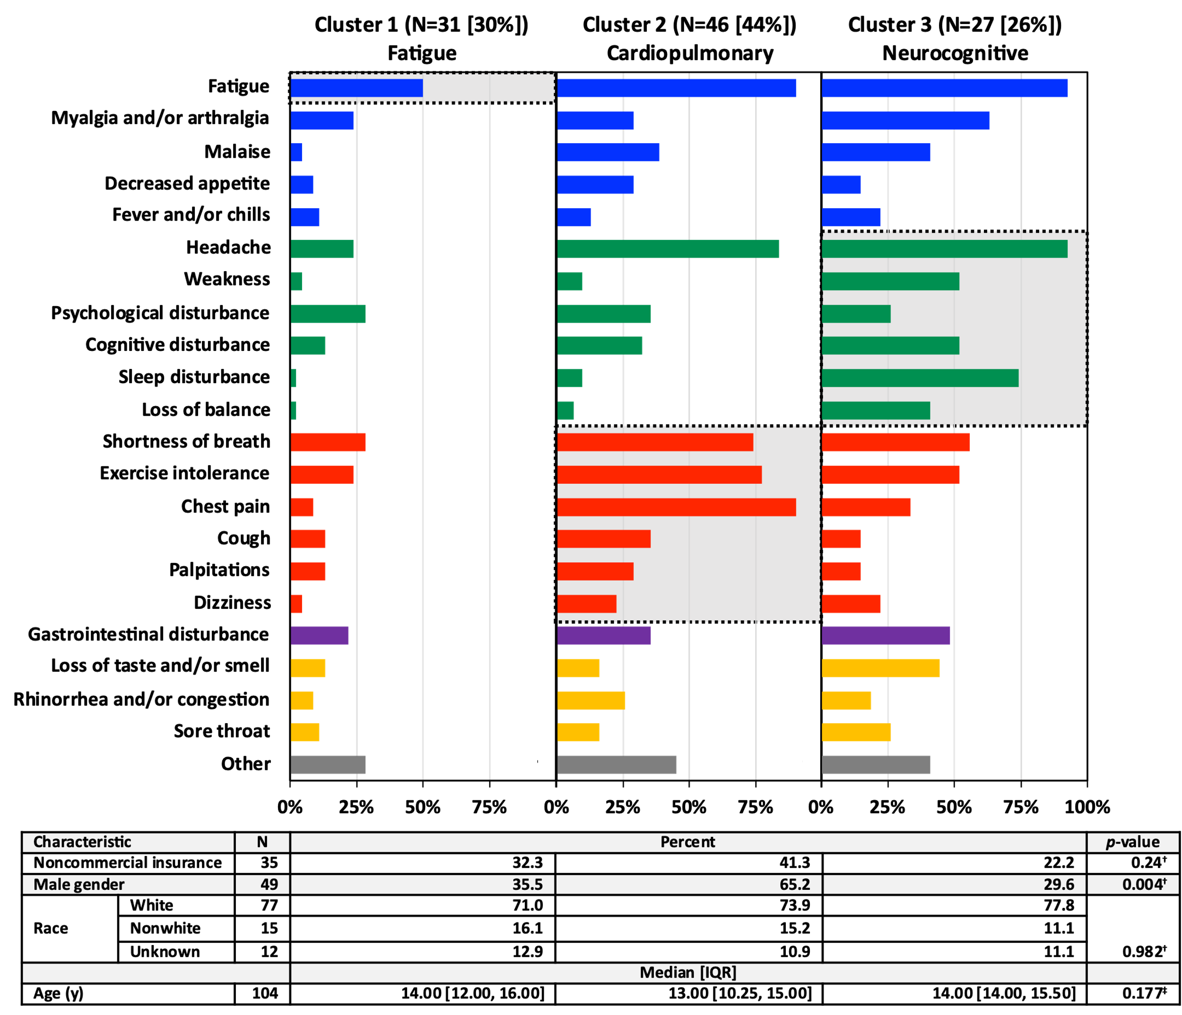
3 distinguishable but overlapping symptom phenotypes
Notes:
And exploratory cluster analysis suggested 3 distinguishable but overlapping symptom phenotypes.

Slide 21

Constitutional
Neurocognitive
Cardiopulmonary
3 distinguishable but overlapping symptom phenotypes
Notes:
Each color represents related symptoms. The blue bars represent constitutional symptoms, the green bars represent neurocognitive symptoms, and the red bars show cardiopulmonary symptoms

Slide 22
3 distinguishable but overlapping symptom phenotypes
Notes:
Cluster 1 was characterized by fatigue as the dominant symptom.

Slide 23
3 distinguishable but overlapping symptom phenotypes
Notes:
Fatigue and headache were also major features of Clusters 2 and 3
Those clusters were distinguished by a predominance of cardiopulmonary symptoms (in Cluster 2) or neurocognitive symptoms (in Cluster 3).

Slide 24
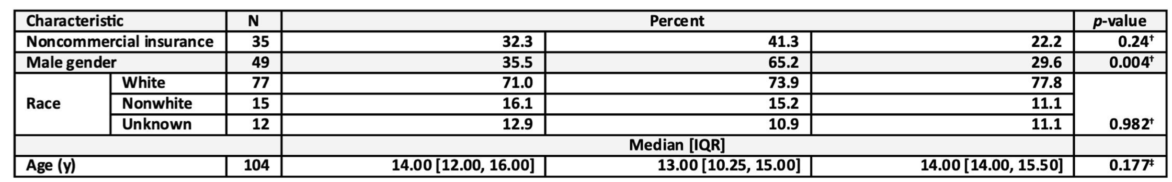
Cluster 1 (N=31)
Fatigue
Cluster 2 (N=46)
Cardiopulmonary
Cluster 3 (N=27)
Neurocognitive
No significant differences in age, race, or payer distribution
Males were disproportionately represented in cardiopulmonary cluster
Notes:
The demographics of the clusters were also compared. There was no significant difference in age, race, or payer distribution, but, interestingly, males were disproportionately represented in Cluster 2, which was dominated by cardiopulmonary symptoms.

Slide 25
Diagnostic Studies
Notes:
This heat map shows the diagnostic studies that were ordered by a medical provider either prior to, during, or within 6 months of their first visit to Post-Acute COVID Clinic.
***
Routine
Chem = Basic metabolic panel, comprehensive metabolic panel, and/or renal function panel
APR = acute phase reactant = C-reactive protein, erythrocyte sedimentation rate, ferritin, IL-6, procalcitonin
Micro/Serol
SARS-CoV-2 antigen and/or polymerase chain reaction
Epstein-Barr virus antibody panel, Epstein-Barr virus blood polymerase chain reaction, and/or serum heterophile antibody
Resp = Influenza antigen, influenza polymerase chain reaction, multiplex respiratory pathogen panel, rapid group A streptococcus screen, respiratory syncytial virus antigen, respiratory syncytial virus polymerase chain reaction, and/or throat culture
Other = Acute viral hepatitis panel, antistreptolysin-O titer, Bartonella henselae antibody, blood culture, blood cytomegalovirus polymerase chain reaction, cytomegalovirus antibody, histoplasma antibody, human immunodeficiency virus antibody, Mycoplasma pneumoniae antibody, stool Clostridioides difficile assay, stool culture, stool ova and parasites exam, tuberculosis test, tick-borne disease antibody or panel, and/or urine culture
Cardio
Img/Proc = Echocardiogram, electrocardiogram, event monitor, and/or stress test
Chem = B-type natriuretic peptide, creatine kinase myocardial band, and/or troponin
Pulm = Breathing capacity, chest X-ray, impulse oscillometry, lung computed tomography (high-resolution), lung computed tomography (pulmonary embolus protocol), and/or pulmonary function test
Endo
Thy = Free T4, T3, T4, antithyroglobulin antibody, thyroid peroxidase antibody, thyroid-stimulating hormone, and/or thyroid ultrasound
Other = 17-hydroxyprogesterone, adrenocorticotropic hormone, cortisol, estradiol, free testosterone, follicle-stimulating hormone, glucose, glucose tolerance test, hemoglobin A1c, luteinizing hormone, parathyroid hormone, prolactin, sex hormone binding globulin, somatomedin, and/or testosterone
Heme
Iron and/or total iron binding capacity
Coag = ADAMTS13 antibody, antithrombin-III, D-dimer, Factor II, Factor V Leiden, Factor VII, Factor VIII, Factor IX, Factor X, fibrinogen, homocysteine, international normalized ratio, methylmalonic acid, methylenetetrahydrofolate reductase gene mutation, platelet pathology, protein-C, protein-S, prothrombin time, partial thromboplastin time, and/or von Willebrand factor
Gastro
Chem/serol = Amylase, celiac panel, cholesterol, coenzyme-Q10, disaccharidase, fractionated bilirubin, gamma-glutamyl transferase, gastrin, hepatic function panel, intrinsic factor, lipase, lipid panel, lipoprotein[a], prealbumin, and/or stool calprotectin
Img/Proc = Abdomen computed tomography, abdomen ultrasound, abdomen X-ray, endoscopy, gastric emptying, liver ultrasound, and/or pelvis computed tomography
Neuro = Autoimmune dysautonomia antibody panel, brain magnetic resonance imaging, electroencephalogram, head computed tomography, head magnetic resonance imaging, levetiracetam level, neck magnetic resonance arteriogram, neck magnetic resonance imaging, and/or spine magnetic resonance imaging
Nutr = Folate, vitamin B1, vitamin B2, vitamin B6, vitamin B12, vitamin C, and/or vitamin D
Rhm = Aldolase, angiotensin converting enzyme, anticardiolipin antibody, anti-DNA antibody, antinuclear antibody, antinuclear cytoplasmic antibody, antiphospholipid antibody, C3, C4, creatine kinase, cyclic citrullinated peptide, extractable nuclear antigen panel, human leukocyte antigen B27, lupus anticoagulant, and/or rheumatoid factor
Onc = Lactate dehydrogenase, lysozyme, peripheral smear, uric acid, urine catecholamines
All/Imm = Alternative pathway hemolytic complement (50%), allergen antibody panel, antigen-specific antibody, IgE, immunophenotype, quantitative immunoglobulins, serum histamine, total hemolytic complement (50%), tryptase, urine histamine, urine prostaglandins
Misc = Aldosterone, fundus photography, lithium level, pregnancy test, renin, sinus computed tomography, toxicology screen, urine calcium, urine creatinine, urine protein, pelvis ultrasound, kidney ultrasound, musculoskeletal imaging

Slide 26
Diagnostic Studies
Row = Individual Patient
Notes:
Each row represents an individual patient and black shading indicates the tests that were performed for that patient.
***
Routine
Chem = Basic metabolic panel, comprehensive metabolic panel, and/or renal function panel
APR = acute phase reactant = C-reactive protein, erythrocyte sedimentation rate, ferritin, IL-6, procalcitonin
Micro/Serol
SARS-CoV-2 antigen and/or polymerase chain reaction
Epstein-Barr virus antibody panel, Epstein-Barr virus blood polymerase chain reaction, and/or serum heterophile antibody
Resp = Influenza antigen, influenza polymerase chain reaction, multiplex respiratory pathogen panel, rapid group A streptococcus screen, respiratory syncytial virus antigen, respiratory syncytial virus polymerase chain reaction, and/or throat culture
Other = Acute viral hepatitis panel, antistreptolysin-O titer, Bartonella henselae antibody, blood culture, blood cytomegalovirus polymerase chain reaction, cytomegalovirus antibody, histoplasma antibody, human immunodeficiency virus antibody, Mycoplasma pneumoniae antibody, stool Clostridioides difficile assay, stool culture, stool ova and parasites exam, tuberculosis test, tick-borne disease antibody or panel, and/or urine culture
Cardio
Img/Proc = Echocardiogram, electrocardiogram, event monitor, and/or stress test
Chem = B-type natriuretic peptide, creatine kinase myocardial band, and/or troponin
Pulm = Breathing capacity, chest X-ray, impulse oscillometry, lung computed tomography (high-resolution), lung computed tomography (pulmonary embolus protocol), and/or pulmonary function test
Endo
Thy = Free T4, T3, T4, antithyroglobulin antibody, thyroid peroxidase antibody, thyroid-stimulating hormone, and/or thyroid ultrasound
Other = 17-hydroxyprogesterone, adrenocorticotropic hormone, cortisol, estradiol, free testosterone, follicle-stimulating hormone, glucose, glucose tolerance test, hemoglobin A1c, luteinizing hormone, parathyroid hormone, prolactin, sex hormone binding globulin, somatomedin, and/or testosterone
Heme
Iron and/or total iron binding capacity
Coag = ADAMTS13 antibody, antithrombin-III, D-dimer, Factor II, Factor V Leiden, Factor VII, Factor VIII, Factor IX, Factor X, fibrinogen, homocysteine, international normalized ratio, methylmalonic acid, methylenetetrahydrofolate reductase gene mutation, platelet pathology, protein-C, protein-S, prothrombin time, partial thromboplastin time, and/or von Willebrand factor
Gastro
Chem/serol = Amylase, celiac panel, cholesterol, coenzyme-Q10, disaccharidase, fractionated bilirubin, gamma-glutamyl transferase, gastrin, hepatic function panel, intrinsic factor, lipase, lipid panel, lipoprotein[a], prealbumin, and/or stool calprotectin
Img/Proc = Abdomen computed tomography, abdomen ultrasound, abdomen X-ray, endoscopy, gastric emptying, liver ultrasound, and/or pelvis computed tomography
Neuro = Autoimmune dysautonomia antibody panel, brain magnetic resonance imaging, electroencephalogram, head computed tomography, head magnetic resonance imaging, levetiracetam level, neck magnetic resonance arteriogram, neck magnetic resonance imaging, and/or spine magnetic resonance imaging
Nutr = Folate, vitamin B1, vitamin B2, vitamin B6, vitamin B12, vitamin C, and/or vitamin D
Rhm = Aldolase, angiotensin converting enzyme, anticardiolipin antibody, anti-DNA antibody, antinuclear antibody, antinuclear cytoplasmic antibody, antiphospholipid antibody, C3, C4, creatine kinase, cyclic citrullinated peptide, extractable nuclear antigen panel, human leukocyte antigen B27, lupus anticoagulant, and/or rheumatoid factor
Onc = Lactate dehydrogenase, lysozyme, peripheral smear, uric acid, urine catecholamines
All/Imm = Alternative pathway hemolytic complement (50%), allergen antibody panel, antigen-specific antibody, IgE, immunophenotype, quantitative immunoglobulins, serum histamine, total hemolytic complement (50%), tryptase, urine histamine, urine prostaglandins
Misc = Aldosterone, fundus photography, lithium level, pregnancy test, renin, sinus computed tomography, toxicology screen, urine calcium, urine creatinine, urine protein, pelvis ultrasound, kidney ultrasound, musculoskeletal imaging

Slide 27
Diagnostic Studies
Notes:
Every patient had a different diagnostic workup. So for example, the patient in the top row had numerous tests performed while the patient highlighted near the bottom had just a couple.
***
Routine
Chem = Basic metabolic panel, comprehensive metabolic panel, and/or renal function panel
APR = acute phase reactant = C-reactive protein, erythrocyte sedimentation rate, ferritin, IL-6, procalcitonin
Micro/Serol
SARS-CoV-2 antigen and/or polymerase chain reaction
Epstein-Barr virus antibody panel, Epstein-Barr virus blood polymerase chain reaction, and/or serum heterophile antibody
Resp = Influenza antigen, influenza polymerase chain reaction, multiplex respiratory pathogen panel, rapid group A streptococcus screen, respiratory syncytial virus antigen, respiratory syncytial virus polymerase chain reaction, and/or throat culture
Other = Acute viral hepatitis panel, antistreptolysin-O titer, Bartonella henselae antibody, blood culture, blood cytomegalovirus polymerase chain reaction, cytomegalovirus antibody, histoplasma antibody, human immunodeficiency virus antibody, Mycoplasma pneumoniae antibody, stool Clostridioides difficile assay, stool culture, stool ova and parasites exam, tuberculosis test, tick-borne disease antibody or panel, and/or urine culture
Cardio
Img/Proc = Echocardiogram, electrocardiogram, event monitor, and/or stress test
Chem = B-type natriuretic peptide, creatine kinase myocardial band, and/or troponin
Pulm = Breathing capacity, chest X-ray, impulse oscillometry, lung computed tomography (high-resolution), lung computed tomography (pulmonary embolus protocol), and/or pulmonary function test
Endo
Thy = Free T4, T3, T4, antithyroglobulin antibody, thyroid peroxidase antibody, thyroid-stimulating hormone, and/or thyroid ultrasound
Other = 17-hydroxyprogesterone, adrenocorticotropic hormone, cortisol, estradiol, free testosterone, follicle-stimulating hormone, glucose, glucose tolerance test, hemoglobin A1c, luteinizing hormone, parathyroid hormone, prolactin, sex hormone binding globulin, somatomedin, and/or testosterone
Heme
Iron and/or total iron binding capacity
Coag = ADAMTS13 antibody, antithrombin-III, D-dimer, Factor II, Factor V Leiden, Factor VII, Factor VIII, Factor IX, Factor X, fibrinogen, homocysteine, international normalized ratio, methylmalonic acid, methylenetetrahydrofolate reductase gene mutation, platelet pathology, protein-C, protein-S, prothrombin time, partial thromboplastin time, and/or von Willebrand factor
Gastro
Chem/serol = Amylase, celiac panel, cholesterol, coenzyme-Q10, disaccharidase, fractionated bilirubin, gamma-glutamyl transferase, gastrin, hepatic function panel, intrinsic factor, lipase, lipid panel, lipoprotein[a], prealbumin, and/or stool calprotectin
Img/Proc = Abdomen computed tomography, abdomen ultrasound, abdomen X-ray, endoscopy, gastric emptying, liver ultrasound, and/or pelvis computed tomography
Neuro = Autoimmune dysautonomia antibody panel, brain magnetic resonance imaging, electroencephalogram, head computed tomography, head magnetic resonance imaging, levetiracetam level, neck magnetic resonance arteriogram, neck magnetic resonance imaging, and/or spine magnetic resonance imaging
Nutr = Folate, vitamin B1, vitamin B2, vitamin B6, vitamin B12, vitamin C, and/or vitamin D
Rhm = Aldolase, angiotensin converting enzyme, anticardiolipin antibody, anti-DNA antibody, antinuclear antibody, antinuclear cytoplasmic antibody, antiphospholipid antibody, C3, C4, creatine kinase, cyclic citrullinated peptide, extractable nuclear antigen panel, human leukocyte antigen B27, lupus anticoagulant, and/or rheumatoid factor
Onc = Lactate dehydrogenase, lysozyme, peripheral smear, uric acid, urine catecholamines
All/Imm = Alternative pathway hemolytic complement (50%), allergen antibody panel, antigen-specific antibody, IgE, immunophenotype, quantitative immunoglobulins, serum histamine, total hemolytic complement (50%), tryptase, urine histamine, urine prostaglandins
Misc = Aldosterone, fundus photography, lithium level, pregnancy test, renin, sinus computed tomography, toxicology screen, urine calcium, urine creatinine, urine protein, pelvis ultrasound, kidney ultrasound, musculoskeletal imaging

Slide 28
Diagnostic Studies
Notes:
But if you step back and look at the big picture overall, testing was very thorough.
***
Routine
Chem = Basic metabolic panel, comprehensive metabolic panel, and/or renal function panel
APR = acute phase reactant = C-reactive protein, erythrocyte sedimentation rate, ferritin, IL-6, procalcitonin
Micro/Serol
SARS-CoV-2 antigen and/or polymerase chain reaction
Epstein-Barr virus antibody panel, Epstein-Barr virus blood polymerase chain reaction, and/or serum heterophile antibody
Resp = Influenza antigen, influenza polymerase chain reaction, multiplex respiratory pathogen panel, rapid group A streptococcus screen, respiratory syncytial virus antigen, respiratory syncytial virus polymerase chain reaction, and/or throat culture
Other = Acute viral hepatitis panel, antistreptolysin-O titer, Bartonella henselae antibody, blood culture, blood cytomegalovirus polymerase chain reaction, cytomegalovirus antibody, histoplasma antibody, human immunodeficiency virus antibody, Mycoplasma pneumoniae antibody, stool Clostridioides difficile assay, stool culture, stool ova and parasites exam, tuberculosis test, tick-borne disease antibody or panel, and/or urine culture
Cardio
Img/Proc = Echocardiogram, electrocardiogram, event monitor, and/or stress test
Chem = B-type natriuretic peptide, creatine kinase myocardial band, and/or troponin
Pulm = Breathing capacity, chest X-ray, impulse oscillometry, lung computed tomography (high-resolution), lung computed tomography (pulmonary embolus protocol), and/or pulmonary function test
Endo
Thy = Free T4, T3, T4, antithyroglobulin antibody, thyroid peroxidase antibody, thyroid-stimulating hormone, and/or thyroid ultrasound
Other = 17-hydroxyprogesterone, adrenocorticotropic hormone, cortisol, estradiol, free testosterone, follicle-stimulating hormone, glucose, glucose tolerance test, hemoglobin A1c, luteinizing hormone, parathyroid hormone, prolactin, sex hormone binding globulin, somatomedin, and/or testosterone
Heme
Iron and/or total iron binding capacity
Coag = ADAMTS13 antibody, antithrombin-III, D-dimer, Factor II, Factor V Leiden, Factor VII, Factor VIII, Factor IX, Factor X, fibrinogen, homocysteine, international normalized ratio, methylmalonic acid, methylenetetrahydrofolate reductase gene mutation, platelet pathology, protein-C, protein-S, prothrombin time, partial thromboplastin time, and/or von Willebrand factor
Gastro
Chem/serol = Amylase, celiac panel, cholesterol, coenzyme-Q10, disaccharidase, fractionated bilirubin, gamma-glutamyl transferase, gastrin, hepatic function panel, intrinsic factor, lipase, lipid panel, lipoprotein[a], prealbumin, and/or stool calprotectin
Img/Proc = Abdomen computed tomography, abdomen ultrasound, abdomen X-ray, endoscopy, gastric emptying, liver ultrasound, and/or pelvis computed tomography
Neuro = Autoimmune dysautonomia antibody panel, brain magnetic resonance imaging, electroencephalogram, head computed tomography, head magnetic resonance imaging, levetiracetam level, neck magnetic resonance arteriogram, neck magnetic resonance imaging, and/or spine magnetic resonance imaging
Nutr = Folate, vitamin B1, vitamin B2, vitamin B6, vitamin B12, vitamin C, and/or vitamin D
Rhm = Aldolase, angiotensin converting enzyme, anticardiolipin antibody, anti-DNA antibody, antinuclear antibody, antinuclear cytoplasmic antibody, antiphospholipid antibody, C3, C4, creatine kinase, cyclic citrullinated peptide, extractable nuclear antigen panel, human leukocyte antigen B27, lupus anticoagulant, and/or rheumatoid factor
Onc = Lactate dehydrogenase, lysozyme, peripheral smear, uric acid, urine catecholamines
All/Imm = Alternative pathway hemolytic complement (50%), allergen antibody panel, antigen-specific antibody, IgE, immunophenotype, quantitative immunoglobulins, serum histamine, total hemolytic complement (50%), tryptase, urine histamine, urine prostaglandins
Misc = Aldosterone, fundus photography, lithium level, pregnancy test, renin, sinus computed tomography, toxicology screen, urine calcium, urine creatinine, urine protein, pelvis ultrasound, kidney ultrasound, musculoskeletal imaging

Slide 29
Patient Referrals
Notes:
Similarly, this heat map shows the clinical services to which patients were referred prior to or within 6 months after their first visit to Post-COVID Clinic.
***
Other: Hand surgery (N=1); Nephrology (1); Neuropsychiatry (1); Neurosurgery (1); Nutrition (1); Occupational Therapy (2); Optometry (1); other infectious diseases group (2); Pain Medicine (1); Speech Therapy (2).
Total exceeds number of patients because some people were referred to more than one subspecialty

Slide 30
Patient Referrals
Column = Individual Patient
Notes:
Each column represents an individual patient and black shading indicates that a referral was made to the service in the left-hand column.
***
Other: Hand surgery (N=1); Nephrology (1); Neuropsychiatry (1); Neurosurgery (1); Nutrition (1); Occupational Therapy (2); Optometry (1); other infectious diseases group (2); Pain Medicine (1); Speech Therapy (2).
Total exceeds number of patients because some people were referred to more than one subspecialty

Slide 31
Patient Referrals
Notes:
The most common subspecialty referrals were to Neurology, Cardiology, Pulmonology, Physical Therapy/Physical Medicine and Rehabilitation, and Psychiatry/Psychology.
***
Other: Hand surgery (N=1); Nephrology (1); Neuropsychiatry (1); Neurosurgery (1); Nutrition (1); Occupational Therapy (2); Optometry (1); other infectious diseases group (2); Pain Medicine (1); Speech Therapy (2).
Total exceeds number of patients because some people were referred to more than one subspecialty

Slide 32
Patient Referrals
Notes:
And, like the diagnostics, referral patterns varied widely between patients
***
Other: Hand surgery (N=1); Nephrology (1); Neuropsychiatry (1); Neurosurgery (1); Nutrition (1); Occupational Therapy (2); Optometry (1); other infectious diseases group (2); Pain Medicine (1); Speech Therapy (2).
Total exceeds number of patients because some people were referred to more than one subspecialty

Slide 33
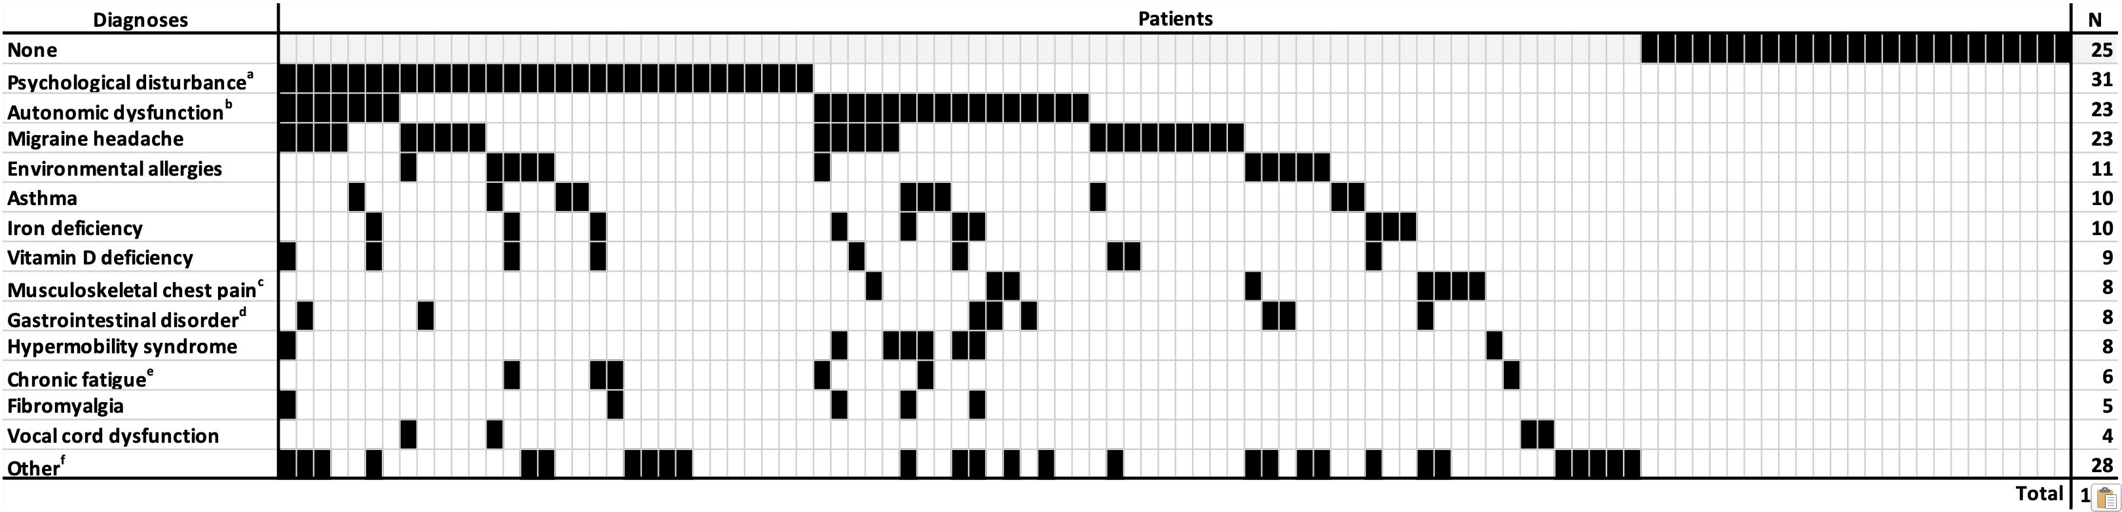
New Diagnoses
Notes:
For the most part, the results of routine tests did not affirm specific alternative diagnoses that would explain the presenting symptoms.
The most common new diagnoses were anxiety, depression, and/or panic disorder, autonomic instability, and migraine headaches; and these diagnoses were largely made on clinical grounds.
Despite 46 cardiology referrals, no patients were diagnosed with myocarditis, heart failure, or any sort of electrographic cardiac abnormality.
And only one child was diagnosed with an autoimmune disease; this patient had antibodies suggesting Hashimoto’s thyroiditis, but, interestingly, thyroid function was normal, so this diagnosis likely did not explain her presenting symptoms.
***
The total number of diagnoses (N=184) exceeds the number of patients (N=104) because some patients had more than one diagnosis made.
***
Mental Health = Anxiety, depression and/or panic disorder
Autonomic dysfunction = Vasomotor instability, postural orthostatic tachycardia syndrome, dysautonomia, and/or orthostatic dizziness
GI d/o = Gastritis, esophagitis, gastroesophageal reflux disease, and/or duodenitis
Chronic fatigue = Patients did not necessarily meet case definition
Other = Anisometropia (N=1); anorexia (1); bilateral patellofemoral syndrome (1); cervical radiculopathy with possible disk herniation (1); cholecystitis (1); chronic brain infarct (1); contact dermatitis (1); delayed gastric emptying (1); dermatographia (1); elevated Factor VIII (1); eosinophilic esophagitis (1); Factor X deficiency (1); fatty liver disease (2); food allergy (1); functional gastrointestinal disorder (2); ganglion cyst (1); Gilbert syndrome (1); Hashimoto’s disease (1); hereditary alpha tryptasemia (1); hypersomnolence disorder (1); irritable bowel syndrome (2); iliotibial band syndrome (1); keratosis pilaris (1); lactose intolerance (1); lumbar spondylosis with radiculopathy (1); lupus anticoagulant (1); menorrhagia (2); mononucleosis and/or Epstein-Barr virus infection (2); methylenetetrahydrofolate reductase gene mutation (2); Osgood-Schlatter disease (1); post-infectious disaccharidase deficiency (1); post-viral myofascial pain (2); pre-diabetes (1); Raynaud’s phenomenon (1); reactive airways disease (2); tension headaches (2); tetrahydrocannabinol dependence (1); toxic headache (1); urticaria (1); viral illness (1); visceral hyperalgesia (2); vitamin C deficiency (1). Note that some patients had more than one diagnosis in this category.

Slide 34
Results
Longitudinal clinical information available for 77 patients
Last encounter:
63 telephone interviews
14 in-person follow-ups
Median time from first to last encounter:
5.3 months (IQR 3-9.95; range 0.23-15.3)
Notes:
Longitudinal clinical information was available for 77 patients at a median of 5.3 months after the initial intake visit. For 63 patients, the last encounter was a telephone interview and for 14 patients, the last encounter was an in-person clinic follow-up

Slide 35
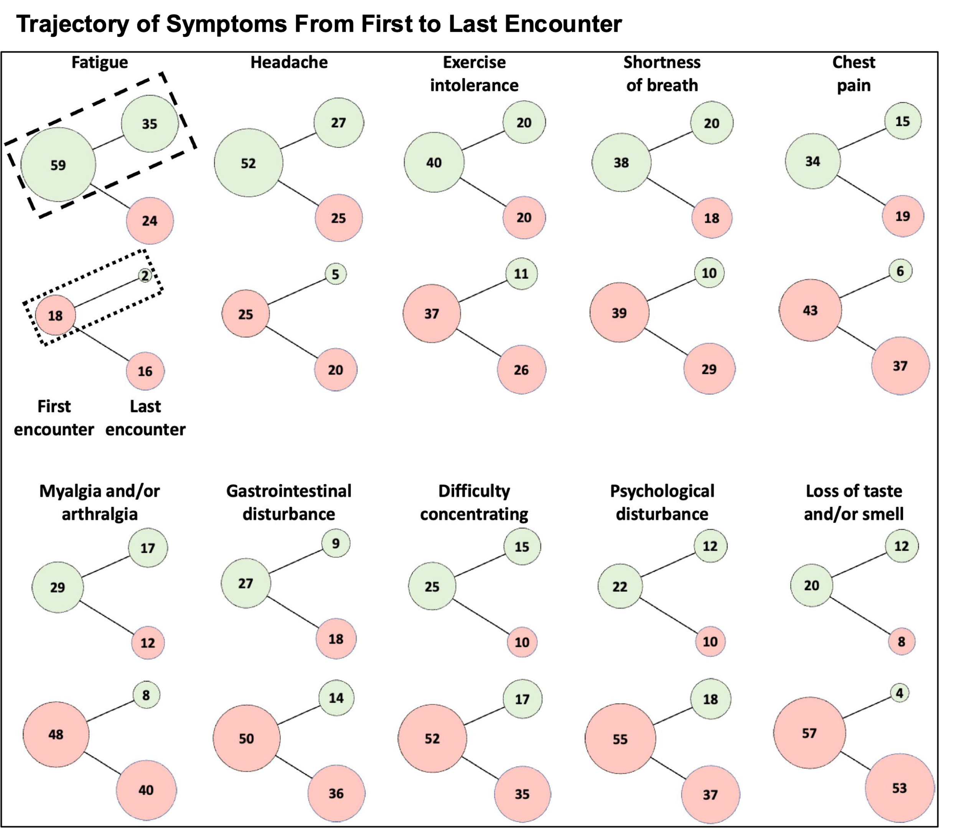
Notes:
This figure shows the evolution of symptoms experienced by individual patients (N=77) from their first PACC visit to their last encounter.
Let me orient you
***
Shortness of breath includes chest tightness and/or difficulty breathing.
Gastrointestinal disturbance includes abdominal pain, nausea, vomiting, constipation and/or diarrhea
Difficulty concentrating includes “brain fog”
Psychological disturbance includes anxiety, depressed mood, psychiatric distress, and/or behavior problem.

Slide 36
Notes:
Symptoms are listed from left to right according to their prevalence at the first PACC visit.
***
Shortness of breath includes chest tightness and/or difficulty breathing.
Gastrointestinal disturbance includes abdominal pain, nausea, vomiting, constipation and/or diarrhea
Difficulty concentrating includes “brain fog”
Psychological disturbance includes anxiety, depressed mood, psychiatric distress, and/or behavior problem.

Slide 37
Notes:
The first column of circles under each symptom indicates that the symptom was present, in green, or absent/unknown, in red, at the first PACC visit
***
Shortness of breath includes chest tightness and/or difficulty breathing.
Gastrointestinal disturbance includes abdominal pain, nausea, vomiting, constipation and/or diarrhea
Difficulty concentrating includes “brain fog”
Psychological disturbance includes anxiety, depressed mood, psychiatric distress, and/or behavior problem.

Slide 38
Notes:
the second column of circles indicates that the symptom was present (green) or absent/unknown (red) at the last encounter
***
it is assumed that in most cases, unknown means the symptom was absent because it was not affirmatively expressed.
***
Shortness of breath includes chest tightness and/or difficulty breathing.
Gastrointestinal disturbance includes abdominal pain, nausea, vomiting, constipation and/or diarrhea
Difficulty concentrating includes “brain fog”
Psychological disturbance includes anxiety, depressed mood, psychiatric distress, and/or behavior problem.

Slide 39
Notes:
The area of each circle is proportionate to number of patients, which is shown inside the circle.
The dashed rectangle illustrates the persistence of a symptom. For example, there were 59 patients with fatigue present at intake and 35 of those same patients had fatigue at follow-up.
The dotted rectangle illustrates the new development of a symptom. For example, 2 of the 18 patients who did not have fatigue at intake developed it during the follow-up period.
***
Shortness of breath includes chest tightness and/or difficulty breathing.
Gastrointestinal disturbance includes abdominal pain, nausea, vomiting, constipation and/or diarrhea
Difficulty concentrating includes “brain fog”
Psychological disturbance includes anxiety, depressed mood, psychiatric distress, and/or behavior problem.

Slide 40
Notes:
Symptoms that were present in individuals at intake persisted at least 50% of the time, with the exception of chest pain (persistent in 44%) and gastrointestinal disturbance (33%).
***
Shortness of breath includes chest tightness and/or difficulty breathing.
Gastrointestinal disturbance includes abdominal pain, nausea, vomiting, constipation and/or diarrhea
Difficulty concentrating includes “brain fog”
Psychological disturbance includes anxiety, depressed mood, psychiatric distress, and/or behavior problem.

Slide 41
Notes:
And the most common symptoms to emerge included psychological disturbance (33% of patients), difficulty concentrating (33%),exercise intolerance (30%), gastrointestinal disturbance (28%), and shortness of breath (26%).
***
Shortness of breath includes chest tightness and/or difficulty breathing.
Gastrointestinal disturbance includes abdominal pain, nausea, vomiting, constipation and/or diarrhea
Difficulty concentrating includes “brain fog”
Psychological disturbance includes anxiety, depressed mood, psychiatric distress, and/or behavior problem.

Slide 42
Results
79% were improved or back to normal; similar between clusters (p=0.36)
Cluster 1 (Fatigue): 77%
Cluster 2 (Cardiopulmonary): 88%
Cluster 3 (Neurocognitive): 71%
92% were satisfied with the care they received in PACC
Median 6.2 months from first visit to telephone follow-up
N=63, IQR 3.83-10.3, range 1.7-15.3
Notes:
But overall, 79% of patients who completed the telephone interview were improved or back to normal at a median follow-up time of 6.2 months.
The proportion of surveyed patients who were improved or back to normal was similar among those who initially presented with fatigue, cardiopulmonary symptoms, or neurocognitive symptoms. (Fisher exact test, Freeman-Halton extension).
And ninety-two percent of respondents (N=59) reported that they were satisfied with the care they received in the PACC.
***
Back to normal: 30%
Improved: 49%
Same: 13%
Worse: 8%

Slide 43
Conclusions
Previously healthy adolescents with mild acute COVID-19
Fatigue, cardiopulmonary, and neurocognitive symptom clusters
Extensive evaluation did not affirm specific alternative diagnoses
Notes:
In conclusion, children referred for evaluation of PASC tended to be previously health adolescents who had mild acute COVID -19.
Presenting symptoms clustered into fatigue, cardiopulmonary, and neurocognitive categories.
But extensive laboratory evaluation did not affirm specific alternative diagnoses that would explain their presenting symptoms.

Slide 44
Conclusions
Most common new diagnoses:
Anxiety, depression, and/or panic disorder
Autonomic dysfunction
Migraines
Most patients improved within 6 months
Triage PACC model was effective and may have led to good outcomes
Notes:
Rather, most new diagnoses were made clinically, with the most common being anxiety, depression, and/or panic disorder; autonomic dysfunction; and migraines.
Most patients improved within 6 months.
And the triage PACC model was effective and may have contributed to good outcomes.

Slide 45
Conclusions
Provides reassurance to patients and parents that most cases of PASC in children and adolescents are self-limited
May help guide providers regarding the extent of diagnostic testing and referrals in children and adolescents with PASC
May help providers identify and manage symptoms and new diagnoses
Notes:
Within the limits of a single-center, referral-based, observational cohort, this study provides some measure of reassurance to patients and parents that most cases of PASC in children and adolescents are self-limited.
These data may also help guide providers regarding the extent of diagnostic testing and referral that should take place, as well as the symptoms and new diagnoses that might need to be managed.

Slide 46
References
Centers for Disease Control and Prevention. Long COVID or post-COVID conditions. https://www.cdc.gov/coronavirus/2019-ncov/long-term-effects/index.html.
Long COVID: What do the latest data show? Kaiser Family Foundation Web site. https://www.kff.org/policy-watch/long-covid-what-do-latest-data-show/. Accessed March 8, 202323.
Robineau O, Zins M, Touvier M, et al. Long-lasting symptoms after an acute COVID-19 infection and factors associated with their resolution. JAMA Netw Open. 2022;5(11):e2240985. Published 2022 Nov 1. doi:10.1001/jamanetworkopen.2022.40985
Davis HE, Assaf GS, McCorkell L, et al. Characterizing long COVID in an international cohort: 7 months of symptoms and their impact. EClinicalMedicine. 2021;38:101019. doi:10.1016/j.eclinm.2021.101019.
Sudre CH, Murray B, Varsavsky T, et al. Attributes and predictors of long COVID [published correction appears in Nat Med. 2021 Jun;27(6):1116]. Nat Med. 2021;27(4):626-631. doi:10.1038/s41591-021-01292-y
Sneller MC, Liang CJ, Marques AR, et al. A longitudinal study of COVID-19 sequelae and immunity: Baseline findings. Ann Intern Med. 2022;175(7):969-979. doi:10.7326/M21-4905
Hope AA, Evering TH. Postacute sequelae of severe acute respiratory syndrome coronavirus 2 infection. Infect Dis Clin North Am. 2022;36(2):379-395. doi:10.1016/j.idc.2022.02.004
Zimmermann P, Pittet LF, Curtis N. How common is long COVID in children and adolescents? Pediatr Infect Dis J. 2021;40(12):e482-e487. doi:10.1097/INF.0000000000003328
Lopez-Leon S, Wegman-Ostrosky T, Ayuzo Del Valle NC, et al. Long-COVID in children and adolescents: a systematic review and meta-analyses. Sci Rep. 2022;12(1):9950. Published 2022 Jun 23. doi:10.1038/s41598-022-13495-5
Stephenson T, Pinto Pereira SM, Shafran R, et al. Physical and mental health 3 months after SARS-CoV-2 infection (long COVID) among adolescents in England (CLoCk): a national matched cohort study [published correction appears in Lancet Child Adolesc Health. 2022 Jul;6(7):e21]. Lancet Child Adolesc Health. 2022;6(4):230-239. doi:10.1016/S2352-4642(22)00022-0
Funk AL, Kuppermann N, Florin TA, et al. Post-COVID-19 Conditions Among Children 90 Days After SARS-CoV-2 Infection [published correction appears in JAMA Netw Open. 2022 Aug 1;5(8):e2231131]. JAMA Netw Open. 2022;5(7):e2223253. Published 2022 Jul 1. doi:10.1001/jamanetworkopen.2022.23253

Slide 47
References
Molteni E, Sudre CH, Canas LS, et al. Illness duration and symptom profile in symptomatic UK school-aged children tested for SARS-CoV-2 [published correction appears in Lancet Child Adolesc Health. 2021 Aug 31]. Lancet Child Adolesc Health. 2021;5(10):708-718. doi:10.1016/S2352-4642(21)00198-X
Buonsenso D, Munblit D, De Rose C, et al. Preliminary evidence on long COVID in children. Acta Paediatr. 2021;110(7):2208-2211. doi:10.1111/apa.15870
Rao S, Lee GM, Razzaghi H, et al. Clinical features and burden of postacute Sequelae of SARS-CoV-2 infection in children and adolescents. JAMA Pediatr. 2022;176(10):1000-1009. doi:10.1001/jamapediatrics.2022.2800
Messiah SE, Hao T, DeSantis SM, et al. Comparison of persistent Symptoms following SARS-CoV-2 infection by antibody status in nonhospitalized children and adolescents. Pediatr Infect Dis J. 2022;41(10):e409-e417. doi:10.1097/INF.0000000000003653
Blankenburg J, Wekenborg MK, Reichert J, et al. Comparison of mental health outcomes in seropositive and seronegative adolescents during the COVID19 pandemic. Sci Rep. 2022;12(1):2246. Published 2022 Feb 10. doi:10.1038/s41598-022-06166-y
Ashkenazi-Hoffnung L, Shmueli E, Ehrlich S, et al. Long 384 COVID in children: observations from a designated pediatric clinic. Pediatr Infect Dis J. 2021;40(12):e509-e511. 386 doi:10.1097/INF.0000000000003285
Blomberg B, Mohn KG, Brokstad KA, et al. Long COVID in a prospective cohort of home-isolated patients. Nat Med. 2021;27(9):1607-1613. doi:10.1038/s41591-021-01433-3
Say D, Crawford N, McNab S, Wurzel D, Steer A, Tosif S. Post-acute COVID-19 outcomes in children with mild and asymptomatic disease. Lancet Child Adolesc Health. 2021 Jun;5(6):e22-e23. doi: 10.1016/S2352-4642(21)00124-3
Clarke KEN, Jones JM, Deng Y, et al. Seroprevalence of infection-induced SARS-CoV-2 antibodies - United States, September 2021-February 2022. MMWR Morb Mortal Wkly Rep. 2022;71(17):606-608. Published 2022 Apr 29. doi:10.15585/mmwr.mm7117e3
Kuwelker K, Zhou F, Blomberg B, et al. Attack rates amongst household members of outpatients with confirmed COVID-19 in Bergen, Norway: A case-ascertained study. Lancet Reg Health Eur. 2021;3:100014. doi:10.1016/j.lanepe.2020.100014
Toh ZQ, Anderson J, Mazarakis N, et al. Comparison of seroconversion in children and adults with mild COVID-19. JAMA Netw Open. 2022;5(3):e221313. Published 2022 Mar 1. doi:10.1001/jamanetworkopen.2022.1313

Slide 48
References
Langeland N, Cox RJ. Are low SARS-CoV-2 viral loads in infected children missed by RT432 PCR testing? Lancet Reg Health Eur. 2021;5:100138. doi:10.1016/j.lanepe.2021.100138
Van Elslande J, Oyaert M, Ailliet S, et al. Longitudinal follow-up of IgG anti-nucleocapsid antibodies in SARS-CoV-2 infected patients up to eight months after infection. J Clin Virol. 2021;136:104765. doi:10.1016/j.jcv.2021.104765
Liu W, Russell RM, Bibollet-Ruche F, et al. Predictors of nonseroconversion after SARS437 CoV-2 infection. Emerg Infect Dis. 2021;27(9):2454-2458. doi:10.3201/eid2709.211042
Dattner I, Goldberg Y, Katriel G, et al. The role of children in the spread of COVID-19: Using household data from Bnei Brak, Israel, to estimate the relative susceptibility and infectivity of children. PLoS Comput Biol. 2021;17(2):e1008559. Published 2021 Feb 11. doi:10.1371/journal.pcbi.1008559
Covid-19 weekly case count by age groups in Jefferson County, KY. Louisville (LOJIC) Open GeoSpatial Data. https://data.lojic.org/datasets/LOJIC::covid-19-weekly-case-count-by-age-groups-in-jefferson-county-ky/explore
Kaufman, L., Rousseeuw, P. J. (1990). Finding Groups in Data: An Introduction to Cluster Analysis. John Wiley. ISBN: 978-0-47031680-1
RDocumentation. diana: DIvisive ANAlysis Clustering. https://www.rdocumentation.org/packages/cluster/versions/2.1.4/topics/diana.
Kashikar-Zuck S, Flowers SR, Claar RL, et al. Clinical utility and validity of the Functional Disability Inventory among a multicenter sample of youth with chronic pain. Pain. 2011;152(7):1600-1607. doi:10.1016/j.pain.2011.02.050
Department of Health and Human Services, Office of the Assistant Secretary for Health. 2022. National Research Action Plan on Long COVID, 200 Independence Ave SW, Washington, DC 20201. https://www.covid.gov/assets/files/National-Research-Action-Plan-on-Long-COVID-08012022.pdf.
Soriano JB, Murthy S, Marshall JC, Relan P, Diaz JV; WHO Clinical Case Definition Working Group on Post-COVID-19 Condition. A clinical case definition of post-COVID-19 condition by a Delphi consensus. Lancet Infect Dis. 2022;22(4):e102-e107. doi:10.1016/S1473-3099(21)00703-9
Stephenson T, Allin B, Nugawela MD, et al. Long COVID (post-COVID-19 condition) in children: a modified Delphi process. Arch Dis Child. 2022;107(7):674-680. doi:10.1136/archdischild-2021-323624
Kostev K, Smith L, Koyanagi A, Konrad M, Jacob L. Post-COVID-19 conditions in children and adolescents diagnosed with COVID-19 [published online ahead of print, 2022 May 14]. Pediatr Res. 2022;1-6. doi:10.1038/s41390-022-02111-x

Slide 49
References
Borch L, Holm M, Knudsen M, Ellermann-Eriksen S, Hagstroem S. Long COVID symptoms and duration in SARS-CoV-2 positive children - a nationwide cohort study. Eur J Pediatr. 2022;181(4):1597-1607. doi:10.1007/s00431-021-04345-z
Garai R, Krivácsy P, Herczeg V, et al. Clinical assessment of children with long COVID syndrome [published online ahead of print, 2022 Dec 7]. Pediatr Res. 2022;10.1038/s41390-94 022-02378-0. doi:10.1038/s41390-022-02378-0
Reese JT, Blau H, Casiraghi E, et al. Generalisable long COVID subtypes: Findings from the NIH N3C and RECOVER programmes [published online ahead of print, 2022 Dec 21]. EBioMedicine. 2022;87:104413. doi:10.1016/j.ebiom.2022.104413
COVID-19 rapid guideline: managing the long-term effects of COVID-19. https://www.nice.org.uk/guidance/ng188.
Wong TL, Weitzer DJ. Long COVID and myalgic encephalomyelitis/chronic fatigue syndrome (ME/CFS)-A systemic review and comparison of clinical presentation and symptomatology. Medicina (Kaunas). 2021;57(5):418. Published 2021 Apr 26. doi:10.3390/medicina57050418
Bussières EL, Malboeuf-Hurtubise C, Meilleur A, et al. Consequences of the COVID-19 pandemic on children's mental health: A meta-analysis. Front Psychiatry. 2021;12:691659. Published 2021 Dec 1. doi:10.3389/fpsyt.2021.691659
Siberry VGR, Rowe PC. Pediatric long COVID and myalgic encephalomyelitis/chronic fatigue syndrome: Overlaps and opportunities. Pediatr Infect Dis J. 2022;41(4):e139-e141. doi:10.1097/INF.0000000000003477Nalbandian A, Sehgal K, Gupta A, et al. Post-acute COVID-19 syndrome. Nat Med. 2021;27(4):601-615. doi:10.1038/s41591-021-01283-z
Luijten MAJ, van Muilekom MM, Teela L, et al. The impact of lockdown during the COVID-19 pandemic on mental and social health of children and adolescents. Qual Life Res. 2021;30(10):2795-2804. doi:10.1007/s11136-021-02861-x
Jones SE, Ethier KA, Hertz M, et al. Mental health, suicidality, and connectedness among high school students during the COVID-19 pandemic - Adolescent behaviors and experiences survey, United States, January-June 2021. MMWR Suppl. 2022;71(3):16-21. Published 2022 Apr 1. doi:10.15585/mmwr.su7103a3
Nalbandian A, Sehgal K, Gupta A, et al. Post-acute COVID-19 syndrome. Nat Med. 2021;27(4):601-615. doi:10.1038/s41591-021-01283-z
Living with COVID19—Second Review. National Institute for Health and Care Research. https://evidence.nihr.ac.uk/themedreview/living-with-covid19-second-review/
Magnusson, K., Kristoffersen, D.T., Dell’Isola, A. et al. Post-covid medical complaints following infection with SARS-CoV-2 Omicron vs Delta variants. Nat Commun 13, 7363 (2022). https://doi.org/10.1038/s41467-022-35240-2

Slide 50
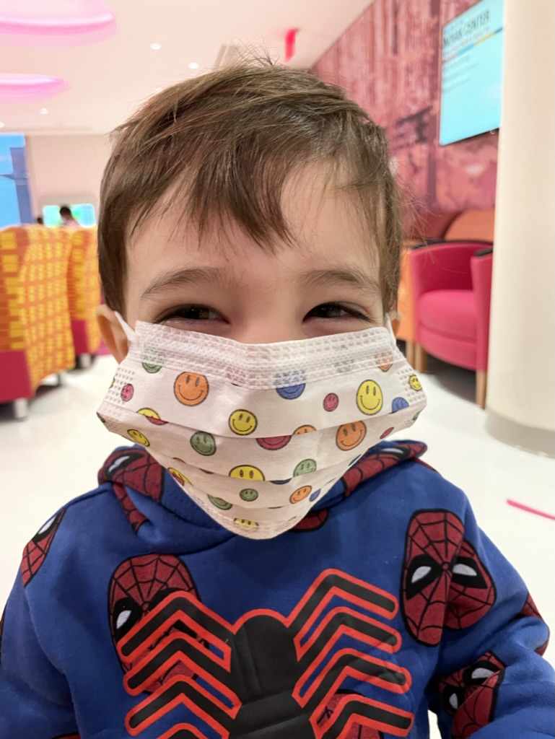
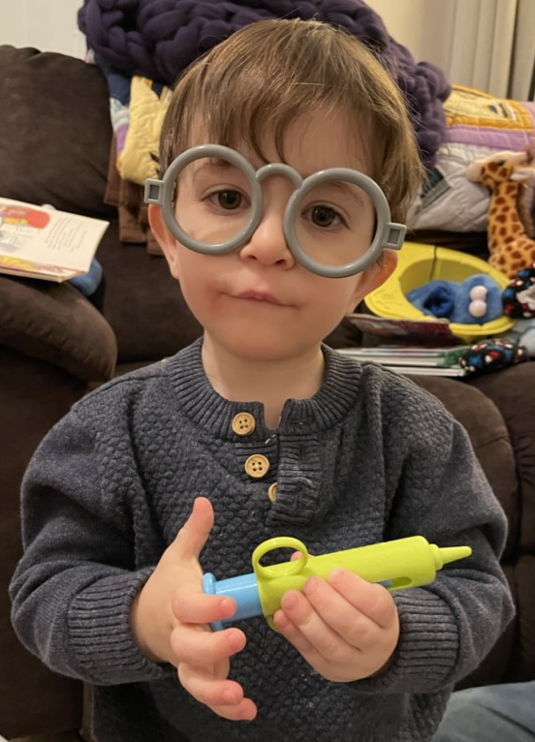
Thank you!

Slide 51

Questions?

