Slide 1
Outcomes of Heart Transplantation in Children with Previously Palliated Hypoplastic Left Heart Syndrome; A retrospective review
Johnna Sizemore, DO Pediatric Critical Care Fellow PGY-6
B. Alsoufi, S. Wilkens, J. Furlong-Dillard, D. Kozik, A. Lambert, J. Trivedi
Pediatric Fellow Research Day April 14th 2023

Slide 2
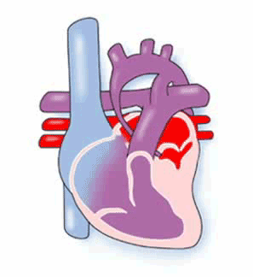
Background
The prognosis of children born with single ventricle malformations such as hypoplastic left heart syndrome (HLHS) and related anomalies, have improved with the introduction of multistage palliation starting with the Norwood operation.
The presence of unfavorable anatomic or hemodynamic factors might disqualify those patients from progressing through palliative stages or might cause late deterioration following completion of all palliative stages; necessitating listing to receive heart transplantation.
Pediatric Heart Transplant (PHT) in this population is associated with challenges related to immune, clinical, or anatomic risk factors that might decrease survival.
https://chfed.org.uk/how-we-help/information-service/heart-conditions/hypoplastic-left-heart-syndrome-hlhs/
Márquez-González H, Hernández-Vásquez JG, Del Valle-Lom M, Yáñez-Gutiérrez L, Klünder-Klünder M, Almeida-Gutiérrez E, Koretzky SG. Failures of the Fontan system in univentricular hearts and mortality risk in heart transplantation: A systematic review and meta-analysis. Life (Basel). 2021;11:1363
Notes:
transplant free survival for the HLHS patient is only 64% at 3 years of age (annals of cardiothoracic surgery 2018) with transplant free survival to 18 years of age being 14% (AHA 2018)

Slide 3
Staged Palliation for HLHS
https://www.ssmhealth.com/cardinal-glennon/fetal-care-institute/fetal-heart-program/heart-conditions/hypoplastic-left-heart-syndrome
Notes:
For some background context, these are the three stages of single ventricle palliation. The first being the Norwood procedure performed within the first week of life, then the Glenn procedure at 4-6 months of life, and finally the Fontan between 18 to 36 months .
Norwood: unobstructed systemic blood flow, restricted pulmonary blood flow
Glenn: try to create normal physiology, SVC to pulmonary arteries
Fontan: Conduit from IVC to SVC. The final result is that the right ventricle pumps oxygenated blood through a reconstructed aorta and venous blood returns directly to the lungs

Slide 4
Introduction
Pediatric heart transplantation (PHT) is necessary in children who fail multi-stage palliation of hypoplastic left heart syndrome (HLHS)
PHT may become necessary at any stage of palliation
Palliated HLHS patients have anatomic, immune, and clinical risk factors that may affect:
Donor allocation
PHT complications and survival
Notes:
Although transplant-free survival following Fontan surgery exceeds 80% at 20 years (Annals of CT surgery 2018) PHT is still necessary in who fail multi stage palliation.
Risk factors for transplantation include : worse right ventricular function, complex intensive care unit stay, higher number of discharge medications

Slide 5
Introduction
Analysis of outcomes and risk factors of heart transplantation in this patient population from single-institution studies have been limited by the small number of patients
There are previously reported inferior outcomes for PHT in this population.
https://chfed.org.uk/how-we-help/information-service/heart-conditions/hypoplastic-left-heart-syndrome-hlhs/
Notes:
Outcomes have been reported as especially unfavorable in the single ventricle patient < then one year of age who fails palliation.

Slide 6
Objectives
Examine outcomes in PHT in children with previously palliated HLHS
Assess risk factors affecting the outcomes of
Survival
Retransplantation
Rejection
Notes:
survival being the primary outcome

Slide 7
Methods
Patient Population:
Patients 0-17 years of age
Prior palliation for HLHS
Heart transplant between January 2009-December 2019
Patients separated into three groups based on age at time of PHT

Slide 8
Patients
Notes:
Our initial cohort was taken from the pediatric health information system database, where we looked at any patient between 2004 to 2021 who had a procedure code for pediatric heart transplant. Then any patient over the age of 18, prior to 2009, and who did not have a diagnosis of HLHS was excluded.
This cohort was then matched through the UNOS (united network for organ sharing) database and any patients that did not match between PHIS and the UNOS registry was omitted. Which left us with 849 patients. This enabled us to procur outcome data which can’t be obtained from PHIS.

Slide 9
Methods
The (UNOS) transplantation database was merged with the Pediatric Health Information System (PHIS) administrative database to identify children who received PHT following prior palliation for HLHS.
Enables analysis of outcomes of PHT in larger series of HLHS children
Multiple variables were examined including demographic data, blood group, mean pulmonary artery pressures, creatinine, dialysis, bilirubin, ventilator requirement, ECMO, VAD, inotrope support, ischemia time, and waitlist days.
Multivariable regression analysis of outcomes and factors affecting survival was performed.

Slide 12
Results
Previously palliated HLHS, underwent PHT
N=849
< 1 year of age
n=298
1-5 years of age
N=242
> 5 years of age
N= 309
81%
p <0.1
96%
p <0.1
91%
p <0.1
1 year survival
70%
p =0.34
67%
p =0.34
72%
p =0.34
10 year survival
Notes:
Patient age and palliation stage might affect early mortality but not late survival.

Slide 13
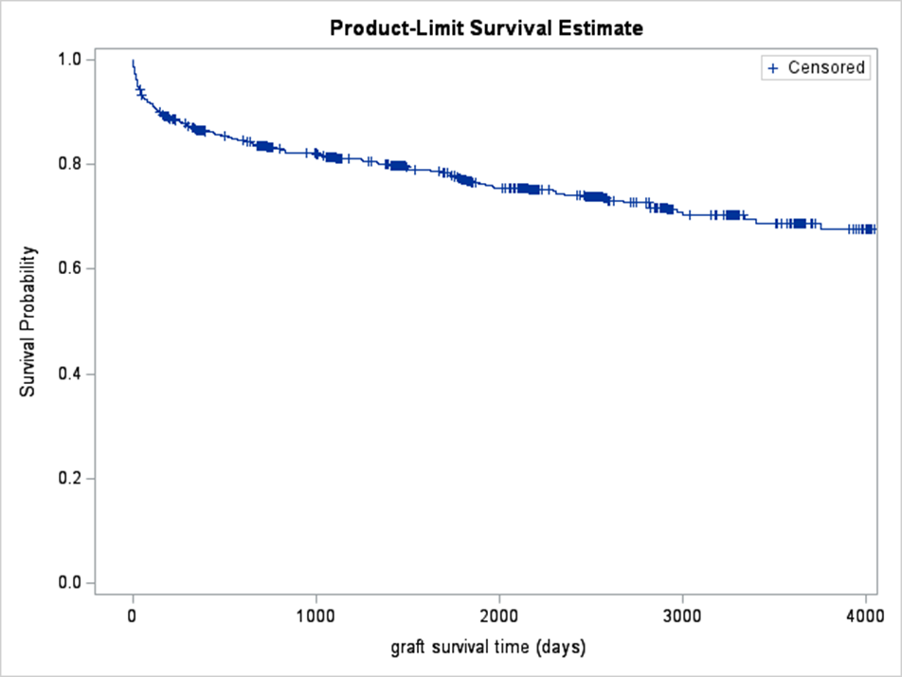
Results
Notes:
These graphs show the combined survival of all age groups.
The first graph on the left showed proportion of patients on the y axis, and time since transplantation on the x axis.
It shows competing risks depiction of events (death without retransplantation, heart retransplantation, with the remaining being alive without retransplantation) following heart transplantation in our cohort. Competing risks analysis showed that the hazard for death following heart transplantation was highest the further out from transplantation you were overall. This differs from a prior study from 2015 that was a similar study (n=188) that showed a more biphasic curve with evidence of early and late phases of risk.
The figure to the right is a Kaplan meier curve which showed the survival probability over time for 10 years with survival decreasing over the first year the most drastically and then slowly declining over time.

Slide 14
Results
The majority of deaths in the 1 year survival group were perioperative
Infants (<1 year) were more likely to be on a ventilator, to require inotropes and to have received ECMO support at time of listing.
Age at time of listing was not associated with survival (HR=0.84,p=0.54).
On multivariable analysis, the only factor associated with survival following PHT was race other than white (HR=1.72,p=0.017).

Slide 15
Results: Risk Factors For Survival
Risk Factor | Hazard Ratio | P-value
Black race | 1.729 | 0.017
Blood Type (not B) | 2.016 | 0.043
ECMO | 2.138 | 0.055
Male Gender | 1.340 | 0.082

Slide 16
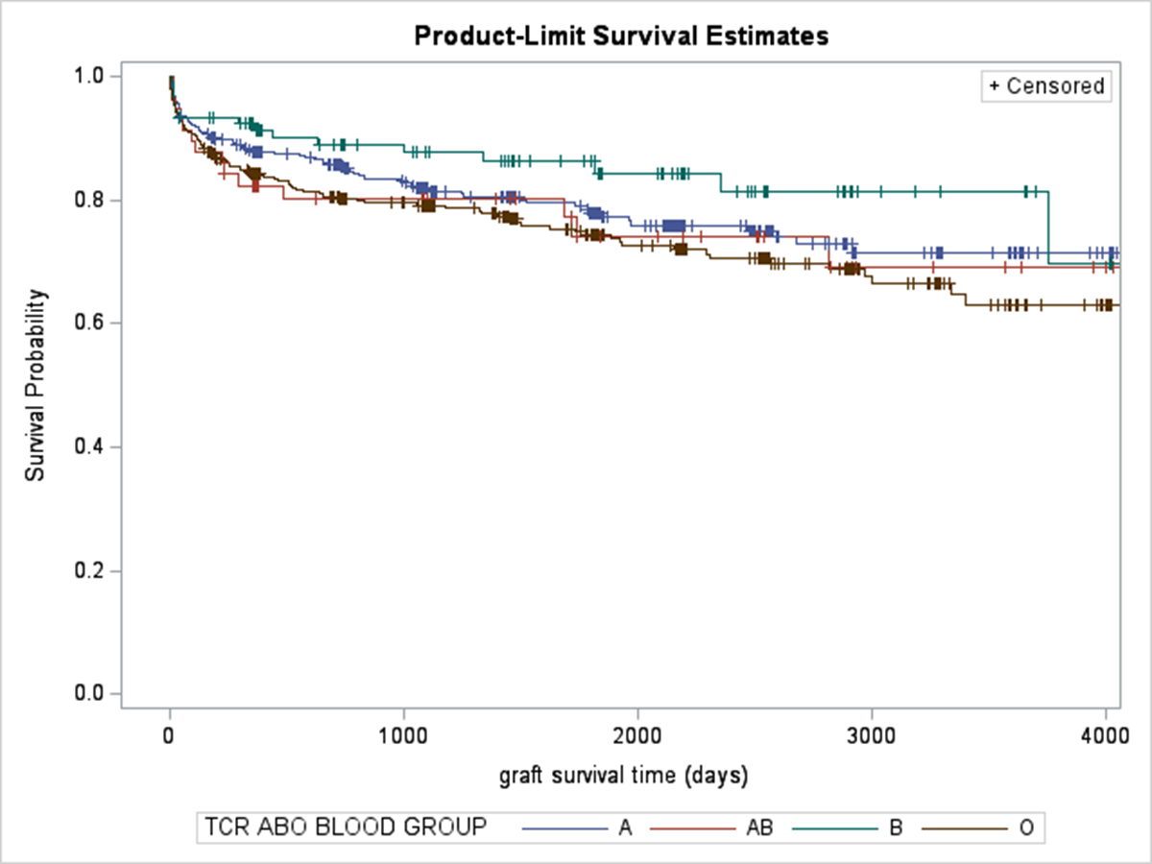
Results
Notes:
Here we have more Kaplan meier curves
On the left you can see over time that race other then white different significantly with survival over 10 years.
On the right this is the Kaplan meier curve for blood type and survival with type B being the lowest risk earlier on after transplant.

Slide 17
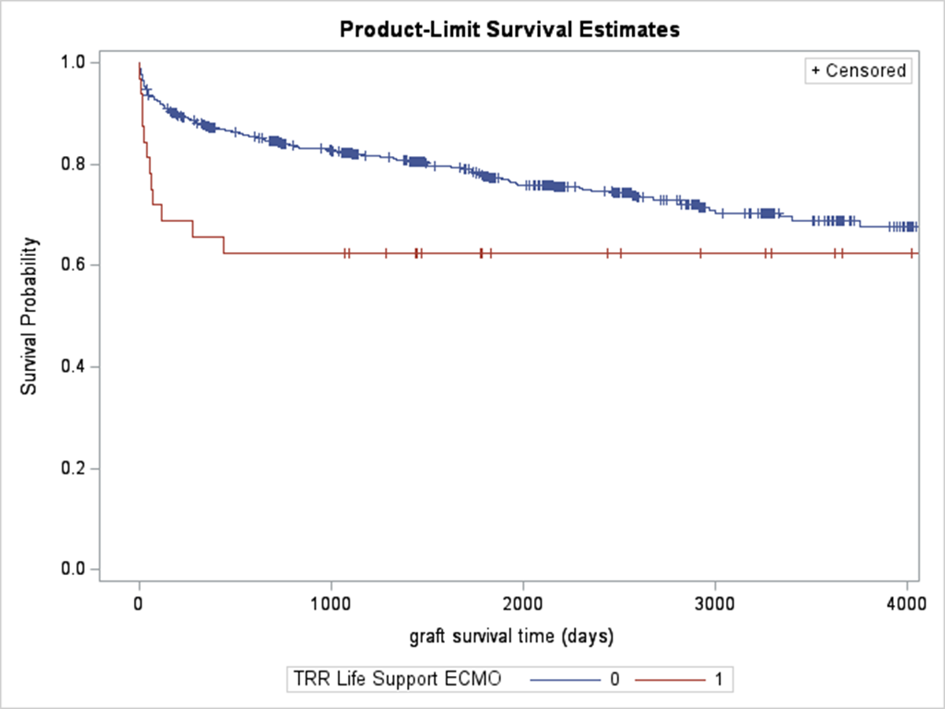
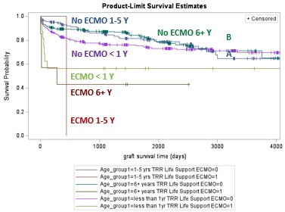
Results
Notes:
The left graph reflects survival for patients who required ECMO PRIOR to transplant. This is not surprising as you would expect these to be more unstable and sicker going into transplant.
The right graph is broken down by age and pre transplant ECMO, as well as survival broken down by age. This shows that none of the patients over one year of age who required ECMO pre operatively and were transplanted survived to 10 years.

Slide 18
Results: Not Significant
Risk Factor | Hazard Ratio | P-value
Age group | 0.948 | 0.278
VAD (Ventricular Assist Device) | 1.407 | 0.289

Slide 19
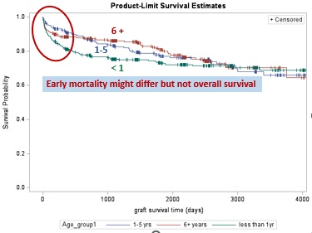
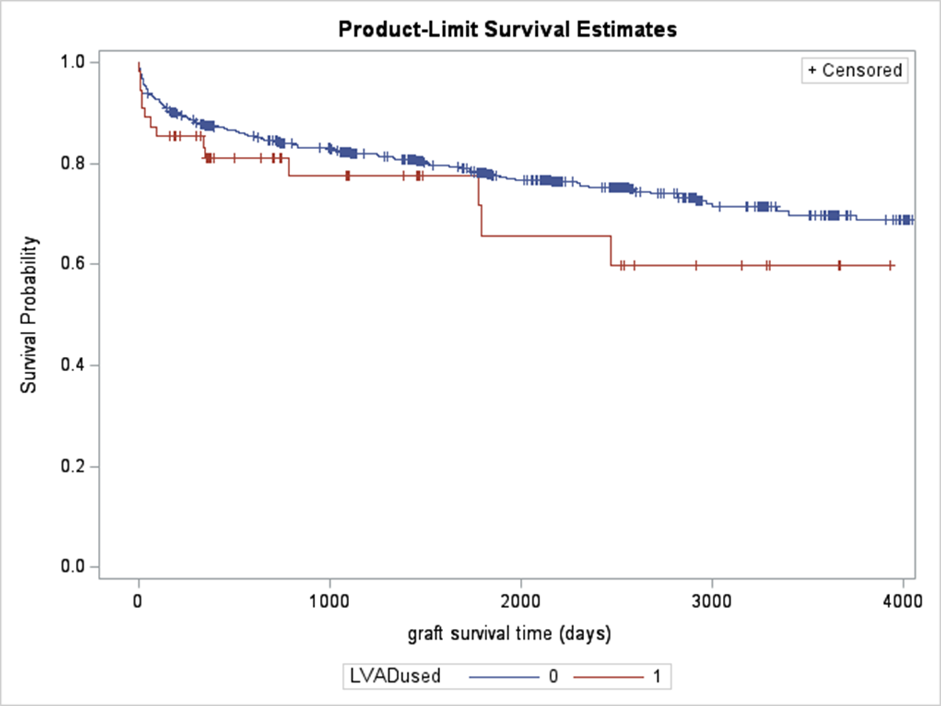
Results
Notes:
None of the patients who required a VAD survived to 10 years. The 1-5 age group had the highest incidence of ventricular assist device requirement.

Slide 20
Freedom From Retransplantation
Notes:
This graph shows that not many patients end up needing retransplantation, in our cohort it was a total of 24. Because of such a small n we did not perform a risk analysis.

Slide 21
Rejection
Notes:
Infants have the lowest rate of rejection (despite the highest incidence of early mortality) consistent with previous studies

Slide 22
Discussion
Our study demonstrated 1 year survival outcomes lowest in the < 1 year population similar to existing literature.
Age and palliation stage might affect early mortality, but not overall survival
ECMO is a risk factor, most pronounced in > 1 year of age
The number of children with prior HLHS palliation who received PHT has noticeably increased in the current era (n=846).
In a study from 2016 examined the period from 1993 to 2012
253 patients who had undergone Norwood
188 of these patients underwent heart transplant (compared to our study that identified 767 transplants)
Everitt MD, Boyle GJ, Schechtman KB, Zheng J, Bullock EA, Kaza AK, Dipchand AI, Naftel DC, Kirklin JK, Canter CE, for the Pediatric Heart Transplant Study Investigators. Early survival after heart transplant in young infants is lowest after failed single-ventricle palliation: A multi-institutional study. J Heart Lung Transplant. 2012;31:509-516.
Dipchand AI, Honjo O, Alonso-Gonzalez R, McDonald M, Roche SL. Heart transplant indications, considerations, and outcomes in Fontan patients: Age-related nuances, transplant listing, and disease-specific indications. Can J Cardiol. 2022;38:1072-1085.
Alsoufi B, Mahle WT, Manlhiot C, Deshpande S, Kogon B, McCrindle BW, Kanter K. Outcomes of heart transplantation in children with hypoplastic left heart syndrome previously palliated with the Norwood procedure. J Thorac Cardiovasc Surg. 2016;151(1):167-175.e2.
Notes:
Although our study showed survival outcomes lowerst in the one year population similar to previous studies, the one year survival rate was better compared to prior estimates. An article published in the journal of heart and lung transplant in 2012 reported ~ 70% one year survival in HLHS with previous palliation who underwent heart transplant. This was data was obtained through the pediatric heart transplant study database. While our data reported 81% survival in the first year for infants.
The study references above was also through the PHTS database, and similarly reported a one year survival of 81% in patients who had undergone Norwood.

Slide 23
Limitations
Inconsistency of detailed surgical stage/unable to identify stage of palliation patients were transplanted at
Lack of listing information (i.e. PRA which may affect survival)
PHIS database: can only gather data by encounter diagnosis and procedure using ICD-9/ICD-10 codes
UNOS database: Lack of granular data (PRA, surgical technique, stage of palliation, etc)

Slide 24
Conclusions
Patient age and palliation stage might affect early mortality but not late survival.
Survival following PHT in this patient population is acceptable.
https://www.google.com/search?q=pediatric+heart+transplant&rlz=1C1UEAD_enUS1001US1002&source=lnms&tbm=isch&sa=X&ved=2ahUKEwiShf6U0Jf-AhVZlGoFHcd0DjIQ0pQJegQIBRAC&biw=1536&bih=873&dpr=1#imgrc=56nyUzfi-Obb_M

Slide 25
Questions?
References
Special Thanks to Dr. Alsoufi and Dr. Furlong-Dillard

