Slide 1
Point-of-Care Ultrasound Confirmation of Endotracheal Tube Positioning: Accurate enough to have a role in neonates?
By: Diane Buckley, PGY-6

Slide 2
Background
Ultrasound is widely used in pediatrics as a primary imaging modality
Point of care ultrasound (POCUS) is used in multiple pediatric subspecialties at bedside by physicians
Becoming more widely available in NICU
Broad list of potential uses
Notes:
Has been described since the 1980’s in evaluating ETT position

Slide 3
ETT positioning
Gold standard = radiography
XR not available in the delivery room
Delay getting to bedside at times
POCUS can be utilized at the bedside to evaluate proper ETT position
Potential NICU specific uses
Delivery room
Prior to surfactant administration
Rapid evaluation in cases of clinical deterioration
Surveillance to limit radiation exposure

Slide 4
Anatomical considerations
Sternum in neonates is cartilaginous in nature
Helps with visualization
Various studies use surrogate marker for the carina
Aortic Arch
>1 cm above is considered “not deep”
Does require a measurement between the ETT and the aortic arch
Superior border of the RPA
Above is considered “not deep”

Slide 5
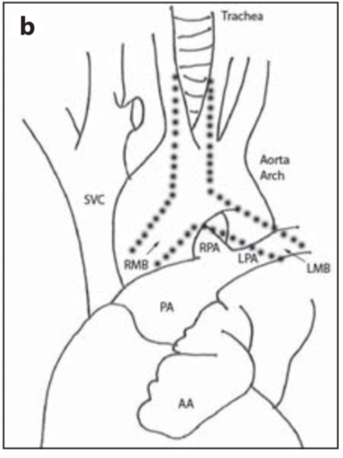
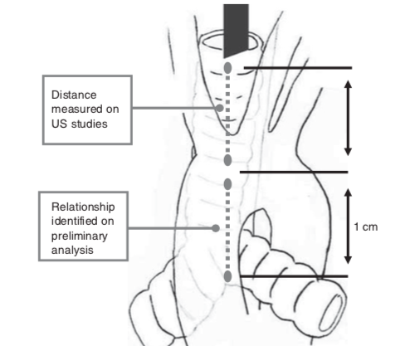
Anatomic overlay with Aortic Arch and Carina
Anatomic overlay with RPA and Carina

Slide 6
Literature today
Few studies in Neonates
Most are small
Minimal stratification across gestational ages
Most studies included limited VLBW infants
Most studies showed 90% concordance between x-ray and POCUS for “not deep”
Carina surrogate marker varies
Most studies utilize the Aortic Arch

Slide 7
My study objectives
Primary: To determine if POCUS will agree with X-ray (gold standard) for ETT positioning in neonates <1 month of age across gestational ages utilizing the superior aspect of the RPA as a surrogate marker for the carina
Secondary: Investigate interrater reliability by calculating a kappa coefficient for multiple non-expert ultrasonographers (Cindy Crabtree, DO and Diane Buckley, MD)

Slide 8
General Study Design
Observational, prospective cohort study
I was primary ultrasonographer
Dr. Crabtree was secondary ultrasonographer
US machine that was in the unit was utilized
US images were obtained on days with previously scheduled x-rays
Goal was to define tube on US as “deep” or “not deep”
Deep: past the superior border of the RPA
Not Deep: at or above the superior border of the RPA

Slide 9
Statistics
Required 35 POCUS scanning encounters
Allows us to conclude agreeability in >90% of encounters with a 10% margin of error
Alpha 0.05, 95% confidence intervals
Allows for calculation of inter-rater reliability
Cohen’s Kappa (unweighted)

Slide 10
Inclusion/Exclusion Criteria
Inclusion
NCH NICU
Infants <1 month of age
Intubated
Exclusion
Known cardiac malformation/congenital heart disease that affected vasculature
Known trachea/airway malformation
Significant anasarca or skin abnormalities precluding appropriate images
Significant clinical instability

Slide 11
Study protocol
Informed consent obtained
Bedside US obtained within 3 hours of standard, pre-planned and clinically appropriate chest x-ray
Used midsternal approach to visualize RPA and ETT tip
Used linear probe for consistency
Dr. Crabtree and I performed US independently, without discussion about imaging, and in succession
Excel data collection sheet with “locked” tabs, so data remained blinded and saved to encrypted flash drive

Slide 12
Study Protocol
Still images and movie clips obtained were saved to an encrypted USB drive
POCUS images underwent a quality assurance review with Pediatric Cardiologist (Ashley Neal, MD)
Anatomy verification
Radiographs were independently evaluated by Pediatric Radiologist (Brittany Albers, MD)
Used at or above the carina as “not-deep”
Below carina as “deep”
Notes:
34 optimal quality images were able to be reviewed (15 images for ultrasonographer 1, 19 images for ultrasonographer 2)
These images were verified to have appropriate anatomic landmarks identified per Dr. Neal

Slide 13
Data collection
Enrolled 15 patients between Sept 2022-Jan 2023
2 patients weren’t able to be scanned prior to extubation
13 patients were scanned between 1-5 times
Total 35 scans
ETT always able to be seen on US
All POCUS images performed within 2.5 hours of x-ray (only 3 were obtained >1 hour between)

Slide 14
Demographics
Demographics n=13
 |  | Mean (SD) | Range (min, max) | Median
Gestational Age at Birth (Weeks + days) |  | 27+5(38) | 22+2, 37+3 | 25+4
Birth Head Circumference (cm) |  | 23.7 (4.8) | 18, 33 | 22.5
Birth Length (cm) |  | 35.6 (8.1) | 26.7, 50.8 | 33
Birth Weight (g) |  | 1138 (910) | 365, 2860 | 710
 | ELBW (%) |  |  |  | 77%
 | VLBW (%) |  |  |  | 0%
Birth Weight classification | SGA (%) |  |  |  | 15%
 | AGA (%) |  |  |  | 85%
 | LGA (%) |  |  |  | 0%
Sex | M (%) |  |  |  | 54%
 | F (%) |  |  |  | 46%

Slide 15
Demographics

Slide 16
Demographics

Slide 17
Respiratory Characteristics
Respiratory Characteristics
Ventilator Type | CMV (%) | 91.4%
 | HFV (%) | 8.6%
Primary Reason for Ventilation | Respiratory (%) | 100.0%
 | Surgical (%) | 0.0%
 | Neurological (%) | 0.0%
ETT size | 2.0 (%) | 5.7%
 | 2.5 (%) | 85.7%
 | 3.0 (%) | 2.9%
 | 3.5 (%) | 5.7%

Slide 18
Results

Slide 19
Results

Slide 20
Results

Slide 21
Results
Agreeability and Interrater Reliability
Physician 1 | Physician 2 | Imaging Modality | Agreement (%) | Cohen's Kappa | 95% CI
Neo 1 | Rads Expert | XR | 100.0% | 1.00 | (1,1)
Neo 2 | Rads Expert | XR | 94.2% | 0.82 | (0.78,0.86)
Neo 1 | Neo 2 | XR | 94.2% | 0.82 | (0.78,0.86)
Neo 1 | Neo 1 | XR and own POCUS | 91.4% | 0.72 | (0.68,0.76)
Neo 2 | Neo 2 | XR and own POCUS | 100.0% | 1.00 | (1,1)
Neo 1 | Neo 2 | POCUS | 85.7% | 0.58 | (0.53,0.63)

Slide 22
Conclusions
POCUS is feasible for ETT depth determination in the NICU
Valid across gestational ages and birth weights
Generalizable for non-expert physician ultrasonographers
Implementation of POCUS is easy
POCUS safe – no infants with adverse reactions or worsening clinical status after imaging

Slide 23
Limitations
Small sample size
X-ray requires repositioning of the babies
Differing definitions of “deep” and “not deep” on radiograph interpretations
Applicable only to infants with normal cardiac and airway anatomy

Slide 24
References
Chowdhry, R, et al. “The Concordance of Ultrasound Technique versus X-Ray to Confirm Endotracheal Tube Position in Neonates.” Journal of Perinatology, vol. 35, no. 7, 2015, pp. 481–484., doi:10.1038/jp.2014.240.
Cowan, Eileen, et al. “Implementing Point of Care Ultrasound in the Neonatal Intensive Care Unit: a Safety Study.” Journal of Perinatology, vol. 41, no. 4, 2021, pp. 879–884., doi:10.1038/s41372-021-00955-5.
Dennington, Debra, et al. “Ultrasound Confirmation of Endotracheal Tube Position in Neonates.” Neonatology, vol. 102, no. 3, 2012, pp. 185–189., doi:10.1159/000338585.
Jaeel, Pooja, et al. “Ultrasonography for Endotracheal Tube Position in Infants and Children.” European Journal of Pediatrics, vol. 176, no. 3, 2017, pp. 293–300., doi:10.1007/s00431-017-2848-5.
Najib, Khadijehsadat, et al. “Ultrasonographic Confirmation of Endotracheal Tube Position in Neonates.” Indian Pediatrics, vol. 53, no. 10, 2016, pp. 886–888., doi:10.1007/s13312-016-0953-6.
Saul, David, et al. “Sonography for Complete Evaluation of Neonatal Intensive Care Unit Central Support Devices.” Journal of Ultrasound in Medicine, vol. 35, no. 7, 2016, pp. 1465–1473., doi:10.7863/ultra.15.06104.
Sethi, Ankur, et al. “Point of Care Ultrasonography for Position of Tip of Endotracheal Tube in Neonates.” Indian Pediatrics, vol. 51, no. 2, 2014, pp. 119–121., doi:10.1007/s13312-014-0353-8.
Sharma, Deepak, et al. “Role of Ultrasound in Confirmation of Endotracheal Tube in Neonates: a Review.” The Journal of Maternal-Fetal & Neonatal Medicine, vol. 32, no. 8, 2017, pp. 1359–1367., doi:10.1080/14767058.2017.1403581.
Sheth, Mansi, et al. “Ultrasonography for Verification of Endotracheal Tube Position in Neonates and Infants.” American Journal of Perinatology, vol. 34, no. 07, 2016, pp. 627–632., doi:10.1055/s-0036-1597846.
Singh, Poonam, et al. “Normative Data of Optimally Placed Endotracheal Tube by Point-of-Care Ultrasound in Neonates.” Indian Pediatrics, vol. 56, no. 5, 2019, pp. 374–380., doi:10.1007/s13312-019-1533-3.
Uya, Atim, et al. “Point-of-Care Ultrasound in Sternal Notch Confirms Depth of Endotracheal Tube in Children*.” Pediatric Critical Care Medicine, vol. 21, no. 7, 2020, doi:10.1097/pcc.0000000000002311.
Zaytseva, Alla, et al. “Determination of Optimal Endotracheal Tube Tip Depth from the Gum in Neonates by X-Ray and Ultrasound.” The Journal of Maternal-Fetal & Neonatal Medicine, vol. 33, no. 12, 2019, pp. 2075–2080., doi:10.1080/14767058.2018.1538350.

Slide 25
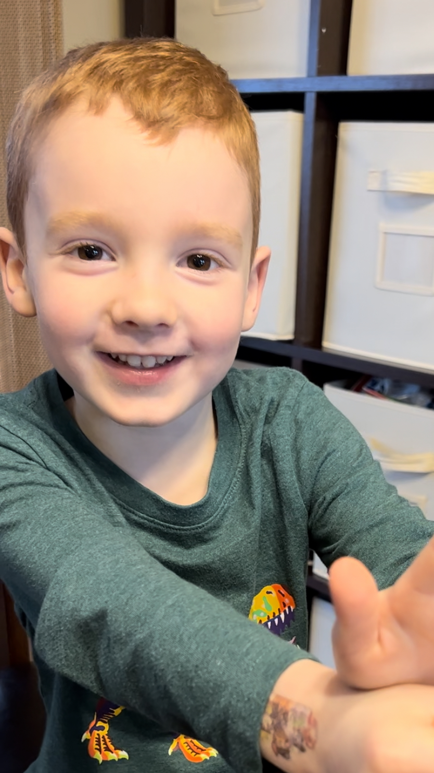
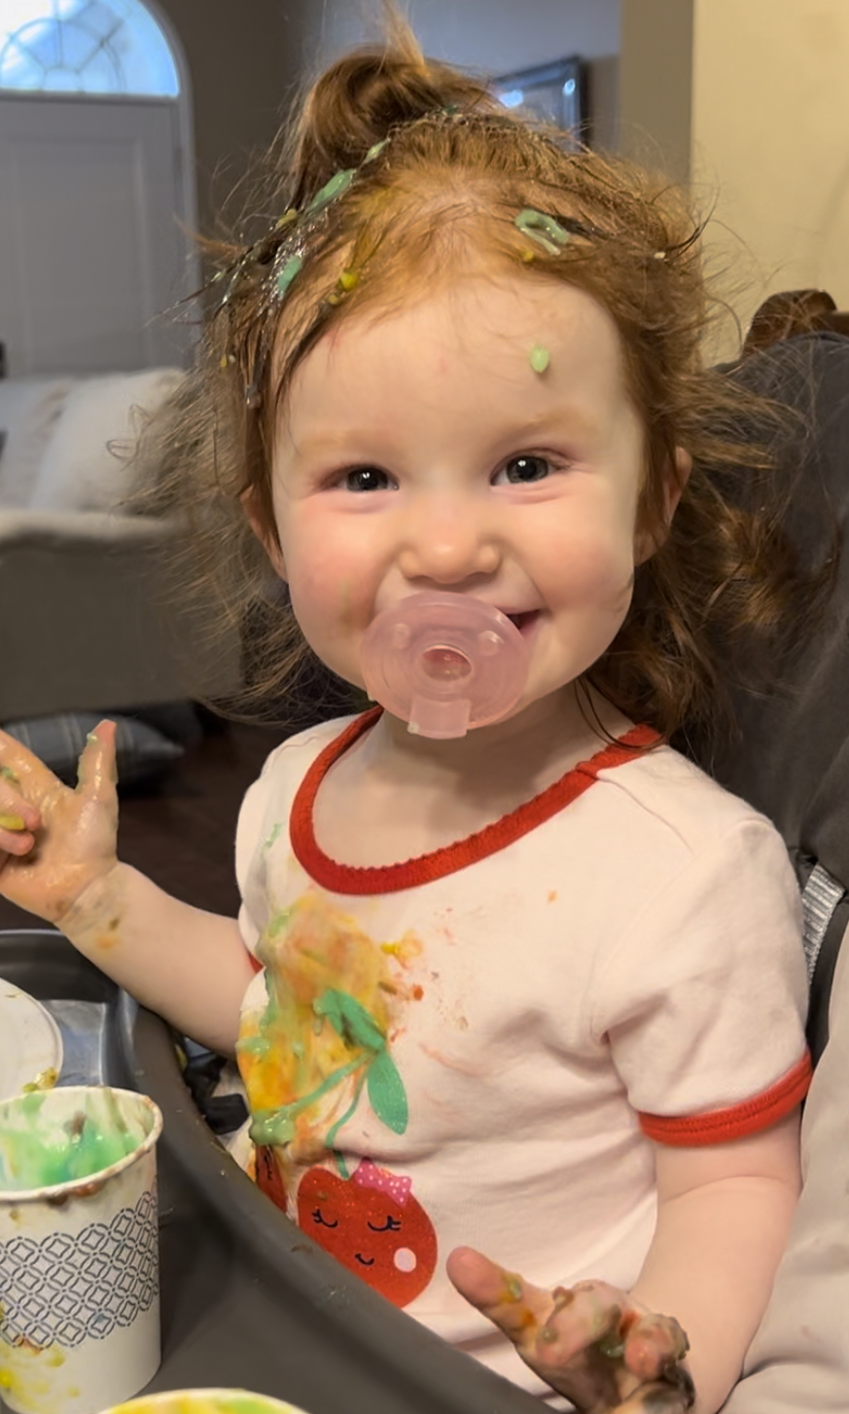
Thank you!
Dr. Crabtree
Dr. Neal
Dr. Albers
Yana Feygin, Sharmin Sumy
SOC members: Dr. Stewart, Dr. Fischer, Dr. Ruppe

