Slide 1
Kentucky Antibiotic Awareness Education
Presented By: YOUR NAME HERE
This project was supported by the following: Kentucky Cabinet for Health and Family Services: Department for Medicaid Services under the contract titled “Improving Care Quality for Children Receiving Kentucky Medicaid”, Norton Children’s Hospital, and the University of Louisville: School of Medicine, Department of Pediatrics; School of Public Health and Information Sciences

Slide 2
Introduction
Presenter introduction
Kentucky Antibiotic Awareness is a state-wide campaign to improve antibiotic use throughout Kentucky.
This project was supported by the following: Kentucky Cabinet for Health and Family Services: Department for Medicaid Services under the contract titled “Improving Care Quality for Children Receiving Kentucky Medicaid”, Norton Children’s Hospital, and the University of Louisville: School of Medicine, Department of Pediatrics; School of Public Health and Information Sciences

Slide 3
What is Antibiotic Awareness?
Antibiotics save lives, but any time they are used they can cause side effects and antibiotic resistance
CDC Video: Antibiotics Aren’t Always the Answer

Slide 4
Antibiotic Prescribing and Use
National
At least 80 million antibiotic prescriptions each year are unnecessary
Children receive the majority of antibiotic prescriptions
Kentucky has the second highest rate of antibiotic prescriptions in the US
Kentucky has the highest rate of antibiotic prescribing in children
Local

Slide 5
Good News
Antibiotics treat many common illnesses such as:
Strep throat
Pneumonia
Ear infections
Bladder infections
Sexually transmitted infections

Slide 6
Bad News
Antibiotics do not work against viruses such as the flu or a common cold
Antibiotics can cause side effects
Overuse of antibiotics can make them ineffective
Antibiotic resistance
Superbugs

Slide 7
Patient story
http://www.pewtrusts.org/en/research-and-analysis/video/2017/a-superbug-survivor-shares-his-struggle-with-antibiotic-resistance
Notes:
Entire video: 5:03
If you prefer to shorten, show: 0:48-3:15, 4:15-end

Slide 8
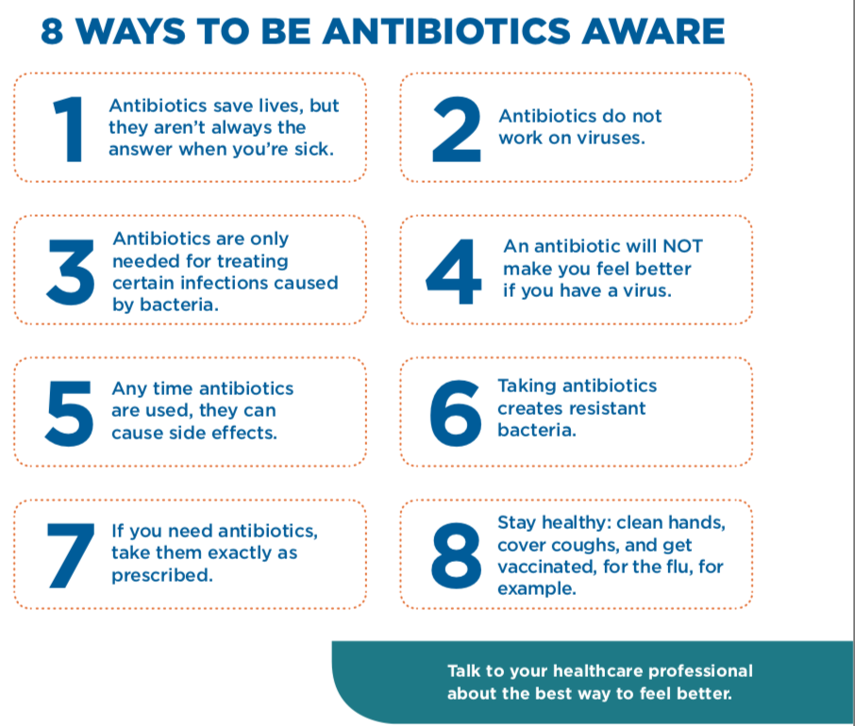
What you need to know

Slide 9
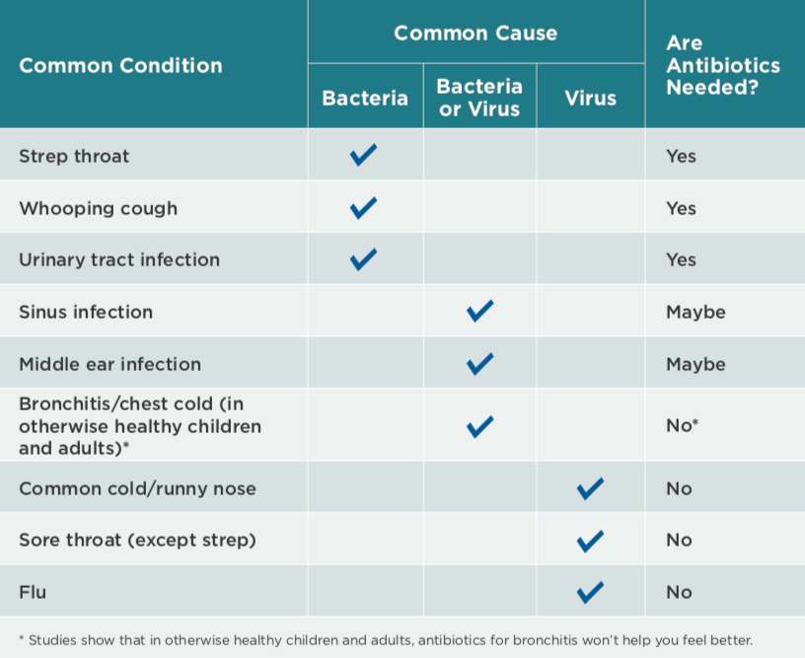
What you need to know

Slide 10
What you need to know
Yellow/green mucus doesn’t necessarily mean you need antibiotics
It usually takes 7-14 days to feel better after a viral infection
Over the counter medications can help you feel better – Ask your doctor or pharmacist for recommendations
Antibiotics can take several days to make you feel better

Slide 11
How can you help?
Only take antibiotics when needed
Always take them as directed
Do not share or save for later
Tell friends and family what you’ve learned!
Follow KAA on Facebook and Twitter: @KYAbxAwareness

Slide 12
Thank you for coming!
For more information:
Ky Antibiotic Awareness: uofl.edu/ky-antibiotic-awareness
CDC : https://www.cdc.gov/antibiotic-use/community/index.html

