Slide 1
Barrett’s Esophagus
Minesh Mehta, PGY-4
University of Louisville
Department of Gastroenterology

Slide 2
Outline
Importance of Barrett’s Esophagus
Diagnosis
Screening
Surveillance
Diagnosis and Management of Dysplasia
Endoscopic Therapy for Barrett’s Related Neoplasia

Slide 3
Significance of BE
Acquired condition in response to Gastro-esophageal reflux leading to columnar lined epithelium in the distal esophagus
Intestinal metaplasia, characterized by goblet cells, is biologically unstable with greatest risk of neoplastic progression
Making it a major risk factor in development of esophageal adenocarcinoma
Incidence of EAC rising rapidly in western countries
Wang KK, Sampliner RE, Practice Parameters Committee of the American College of G. Updated guidelines 2008 for the diagnosis, surveillance and therapy of Barrett's esophagus. Am J Gastroenterol 2008;103:788-797.

Slide 4
Definition of BE
Change in the distal esophageal epithelium of any length that can be recognized as columnar type mucosa at endoscopy and is confirmed to have intestinal metaplasia by biopsy of the esophagus
Clearly visible endoscopically above the GEJ(>1cm) and confirmed histo-pathologically with distal esophageal biopsies of columnar lined epithelium only

Slide 5
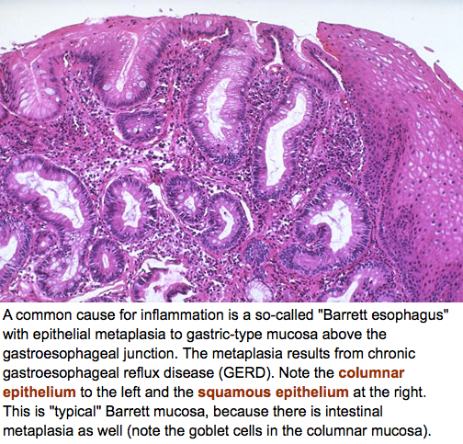
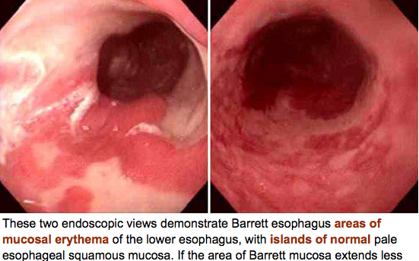
http://library.med.utah.edu/WebPath/GIHTML/GIIDX.html#1

Slide 6
Endoscopic Diagnosis of BE
Must distinguish BE from Irregular Z-line
Where the squamo-columnar junction appears with tongues of columnar epithelium less than 1cm with no confluent columnar lined segments
Biopsies are generally NOT RECCOMENDED for Irregular Z-line
If done, then label as GEJ not esophageal biopsies

Slide 7
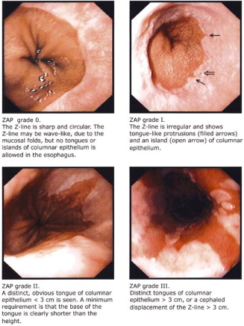
REGULAR Z - Line
Irregular Z - Line
Wallner B, Sylvan A, Janunger KG. Endoscopic assessment of the "Z-line" (squamocolumnar junction) appearance: reproducibility of the ZAP classification among endoscopists. Gastrointest Endosc 2002;55:65-69.

Slide 8
Must accurately delineate the GEJ by detecting the proximal end of the longitudinal Gastric Folds with minimal air insufflation
Columnar epithelium should be visible endoscopically (minimum of 1cm) above the GEJ to diagnose as BE

Slide 10
Endoscopic Reporting of BE
Should be done using the Prague Criteria
Which assesses the circumferential (C) and maximal (M) extent of endoscopically visualized Barrett’s Segment
Diaphragmatic Pinch and Proximal End of the Gastric Folds
The presence and location of visible lesions should be recorded according to Paris Classification

Slide 11
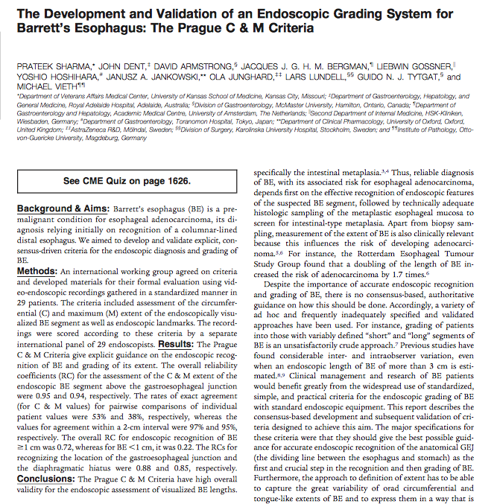

Slide 12
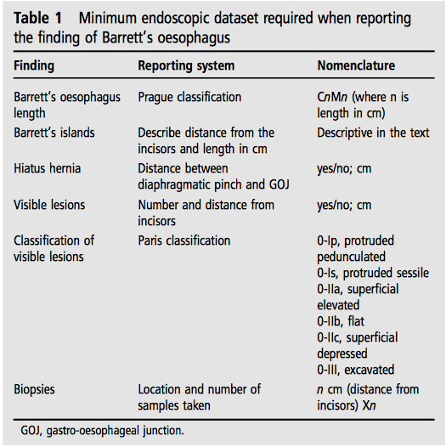
Fitzgerald RC, di Pietro M, Ragunath K, Ang Y, Kang JY, Watson P, Trudgill N, et al. British Society of Gastroenterology guidelines on the diagnosis and management of Barrett's oesophagus. Gut 2014;63:7-42.

Slide 13
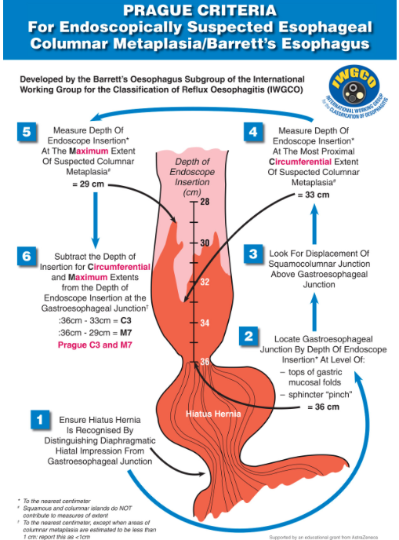
Developed by the Barrett’s Oesophagus Subgroup of the International Working Group for the Classification of Reflux Oesophagitis (IWGCO)

Slide 14
Recognize Hiatus Hernia

Slide 15
Circumferential Extent of Suspected Barrett’s
http://www.quality-in-endoscopy.org/assets/download/pdf/reports/qine30/04_1_LT_Bisschops.pdf

Slide 16
Maximal Extent of Suspected Barrett’s
http://www.quality-in-endoscopy.org/assets/download/pdf/reports/qine30/04_1_LT_Bisschops.pdf

Slide 17
Developed by the Barrett’s Oesophagus Subgroup of the International Working Group for the Classification of Reflux Oesophagitis (IWGCO)

Slide 18
Biopsy Protocol
Minimum of 8 biopsies provides adequate assessment of Intestinal Metaplasia
Starting distally 1-2cm above GEJ, 4 quadrant random biopsies should be done every 2cm while advancing proximally
Targeted biopsies of visible lesions (should be done before random biopsies)
Ideally, erosive esophagitis should be healed prior to biopsies for BE to avoid missing short segments of columnar epithelium
Harrison R, Perry I, Haddadin W, McDonald S, Bryan R, Abrams K, Sampliner R, et al. Detection of intestinal metaplasia in Barrett's esophagus: an observational comparator study suggests the need for a minimum of eight biopsies. Am J Gastroenterol 2007;102:1154-1161.
Hanna S, Rastogi A, Weston AP, Totta F, Schmitz R, Mathur S, McGregor D, et al. Detection of Barrett's esophagus after endoscopic healing of erosive esophagitis. Am J Gastroenterol 2006;101:1416-1420.
Notes:
Cant find article for quandrantic biospies

Slide 19
Minimum Dataset
To improve standard of care and ease of communication between experts, the use of a minimum dataset is recommended to record histo-pathologic findings

Slide 20
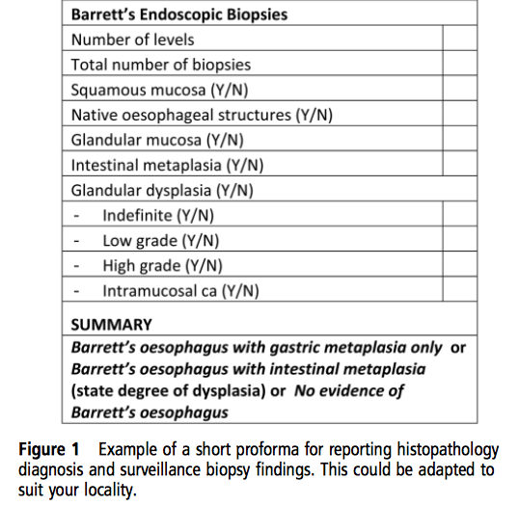
Notes:
bsg

Slide 21
Screening For BE
Screening for BE in unselected population of patients with gastro esophageal reflux symptoms is not recommended
Screening should be considered in patients with chronic GERD (> 13 years) and multiple risk factors including at least 3 of the following
Age 50 or older
White race
Male sex
Obesity
Threshold of multiple risk factors should be lowered in those with a first degree relative with Barrett’s or esophageal adenocarcinoma
Notes:
ACG and BSG guidelines

Slide 22
Surveillance
Aim of surveillance is to detect cancer or pre-cancer at a stage when intervention may be curative
Surveillance correlates with earlier staging and improved survival from cancer
Endoscopic monitoring with histo-pathologic assessment of dysplasia is the only current method of surveillance
Patients should have access to outpatient clinic to discuss diagnosis of BE and discussion of pros and cons of surveillance
High resolution Endoscopy should be used for surveillance

Slide 23
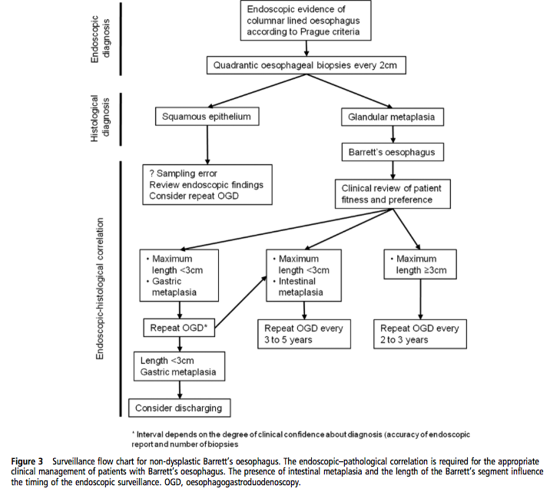
Surveillance of Non Dysplastic Barrett’s Esophagus
Gastric metaplasia or
Intestinal
- A number of studies have reported a positive correlation between length of Barrett’s and risk for adenocarcinoma
- Therefore, those with >3cm maximum segment of Barrett’s without dysplasia should be considered for repeat EGD every 2-3 years
Notes:
bsg

Slide 24
Pathologic features and Reporting of Dysplasia
Dysplasia should be reported as low or high grade (controversy over indefinite)
Any grade of dysplasia should be confirmed by an expert or two independent pathologist
Revised Vienna Classification for GI mucosal neoplasia standardizes diagnostic terminology into biologically similar groupings with scores of 1-5 depending on presence/absence of dysplasia or malignancy
1. Negative for Dysplasia
2. Indefinite for Dysplasia
3. Low Grade Dysplasia
4. High Grade Dysplasia
5. Submucosal Invasion of Adenocarcinoma
Notes:
bsg

Slide 25
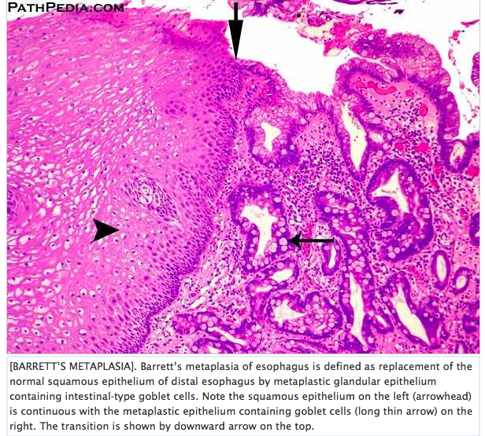
Intestinal Metaplasia

Slide 26
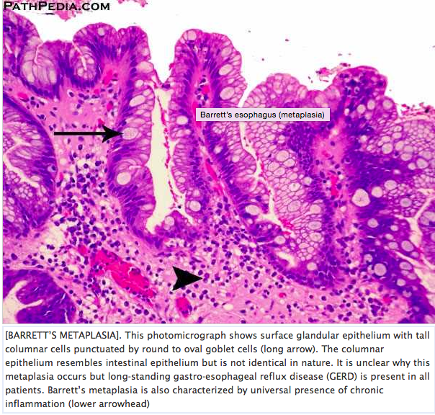
Higher Power

Slide 27
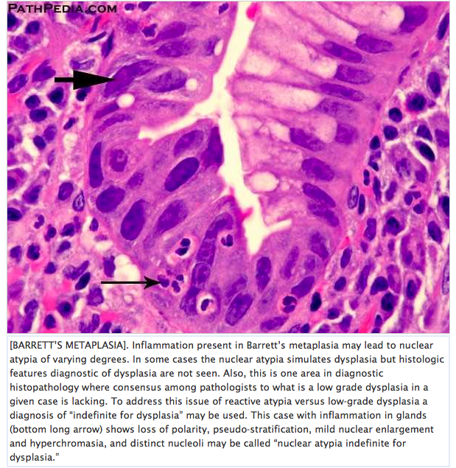
Indefinite for Dysplasia

Slide 28
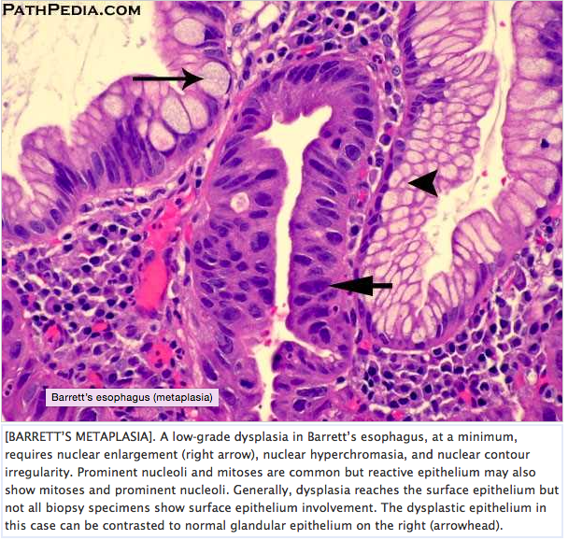
Low Grade Dysplasia

Slide 29
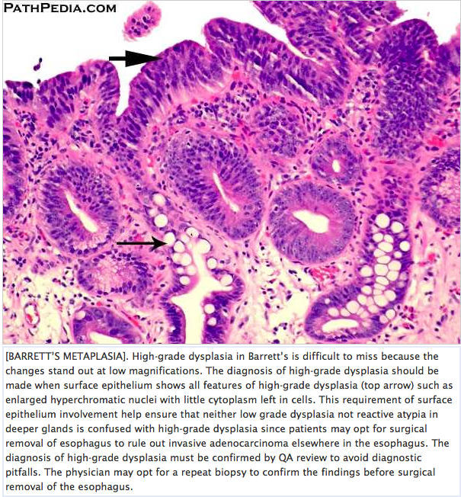
High Grade Dysplasia

Slide 30
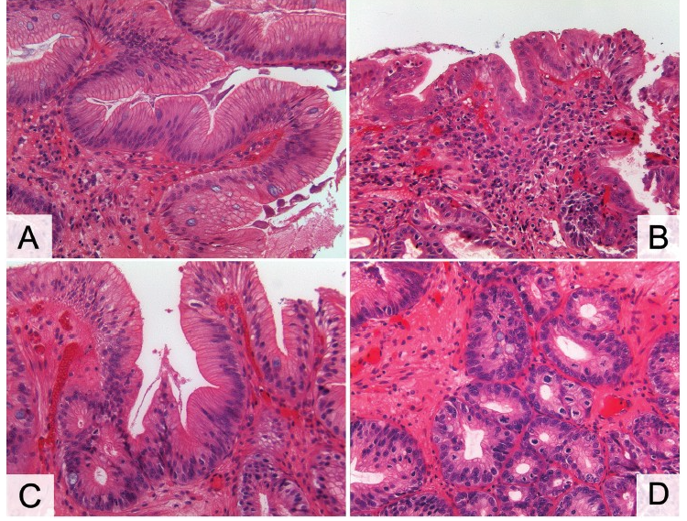

Slide 31
Booth CL, Thompson KS. Barrett's esophagus: A review of diagnostic criteria, clinical surveillance practices and new developments. J Gastrointest Oncol 2012;3:232-242.

Slide 32
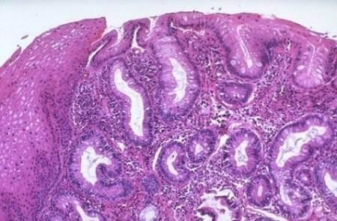
Esophageal adenocarcinoma

Slide 33
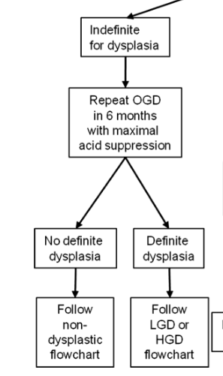
Controversy exists for management of indefinite for dysplasia
Rate of cancer progression in patients with indefinite for dysplasia was similar to non-dysplastic patients; however, if the indefinite for dysplasia was multifocal, the rate of progression was as high as in patients with LGD
Younes M, Lauwers GY, Ertan A, Ergun G, Verm R, Bridges M, Woods K, et al. The significance of "indefinite for dysplasia" grading in Barrett metaplasia. Arch Pathol Lab Med 2011;135:430-432.

Slide 34
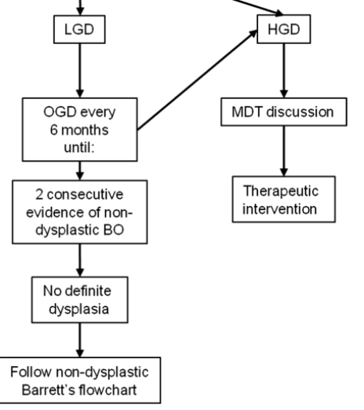
Management of Low Grade Dysplasia – Prior to SURF Trial Data
BSG
ACG

Slide 35
Biopsy Protocol for Known Dysplasia
Obtain every 1 cm in patients with known dysplasia

Slide 36
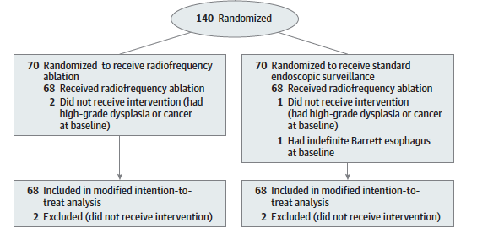

Slide 37
Primary outcome: occurrence of HGD or Adenocarcinoma anytime during 3 years following randomization
Secondary outcomes: histological eradication of dysplasia and intestinal metaplasia, and adverse events

Slide 38
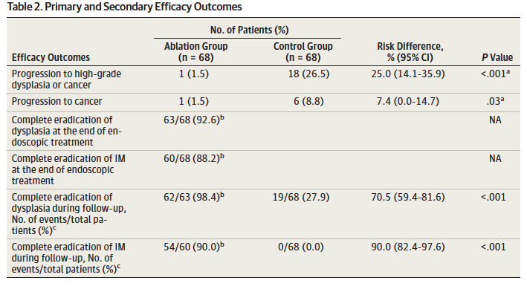
Patients in Ablation group were less likely than the control group to progress to high-grade dysplasia or adenocarcinoma
Ablation reduced the risk of progression to high-grade dysplasia or adenocarcinoma by 25.0% (95% CI, 14.1%-35.9%), with an NNT of 4.0 (95% CI, 2.8-7.1)
Ablation reduced the risk of progression to adenocarcinoma by 7.4% (95% CI, 0.0%-14.7%), with an NNT of 13.6 (95% CI, 6.8-)

Slide 39
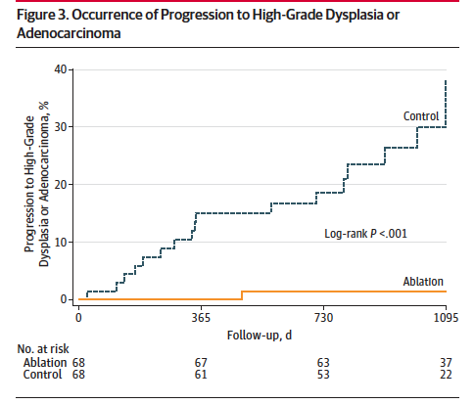

Slide 40
Conclusions from SURF
Endoscopic ablative therapy is a superior management strategy to endoscopic surveillance in patients with Barrett’s esophagus and confirmed low-grade dysplasia
Ablation treatment was generally safe with esophageal stricture being the most common complication (11.8%), requiring a median of 1 dilation
Phoa KN, van Vilsteren FG, Weusten BL, Bisschops R, Schoon EJ, Ragunath K, Fullarton G, et al. Radiofrequency ablation vs endoscopic surveillance for patients with Barrett esophagus and low-grade dysplasia: a randomized clinical trial. JAMA 2014;311:1209-1217.

Slide 41
2015 Updated BSG Guideline for LGD
patients with LGD should have a repeat endoscopy in 6 months time
If LGD is found in any of the follow up EGDs and is confirmed by an expert GI pathologist, the patient should be offered endoscopic ablation therapy
https://youtu.be/X-9u-99HFOc

Slide 42
Management of High Grade Dysplasia
If the possibility of high grade dysplasia has been raised, it is critical that a high-quality baseline endoscopy is done to map out any visible lesions and extent of dysplasia
Endoscopic assessment will usually identify the area with the most advanced neoplasia. EMR should aim to resect all visible abnormalities.
HGD and Barrett’s-related adenocarcinoma confined to the mucosa, endoscopic therapy is preferred over esophagectomy or endoscopic surveillance

Slide 43
Esophageal Wall

Slide 44
Esophageal cancer staging

Slide 45
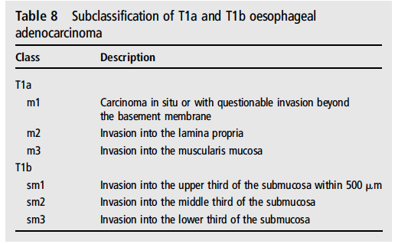

Slide 50
Endoscopic therapy for Barrett’s neoplasia has been developed on the evidence that HGD and T1a EAC is associated with a low rate of lymph node metastasis: endoscopic and surgical series indicate a 0–10% risk in T1a cancer, while submucosal invasion carries a higher risk (up to 46%)
ER should be considered the therapy of choice for dysplasia associated with visible lesions and T1a adenocarcinoma (Recommendation grade B)

Slide 51
For patients at high surgical risk, endoscopic therapy can be offered as an alternative to surgery for treatment of good prognosis T1b adenocarcinomas (T1b sm1, well differentiated and without lymph vascular invasion).
For T1b adenocarcinomas with involvement of the second sub-mucosal layer or beyond (T1b sm2–sm3), endoscopic therapy should not be considered curative

Slide 52
In the presence of HGD or intramucosal cancer without visible lesions (flat HGD/intramucosal cancer), these should be managed with an endoscopic ablative technique. RFA currently has a better safety and side-effect profile and comparable efficacy.
Eradication of residual Barrett’s esophagus after focal ER reduces the risk of metachronous neoplasia and is recommended.

Slide 53
In patients treated for HGD, endoscopic follow-up is recommended every 3 months for 1 year and yearly thereafter.
This should include biopsies at the GOJ and within the previous extent of the Barrett’s epithelium.

Slide 54
