Slide 1
Microsoft Teams | More than Video Kent Gardner & David Aylor

Slide 3
Reasons to use Microsoft Teams
More efficient communication platform
Designed for back-and-forth, chat communication
Easy file sharing done by the end user and not an IT admin
one platform for all of your resources
access to resources from anywhere
Overall team organization: reminders, tasks, notifications, calendar, automation, and flow creation
Website or portal for your office
Replaces your desk phone with video and audio conferencing
Allows for seamless transition in work-from-anywhere environment

Slide 4
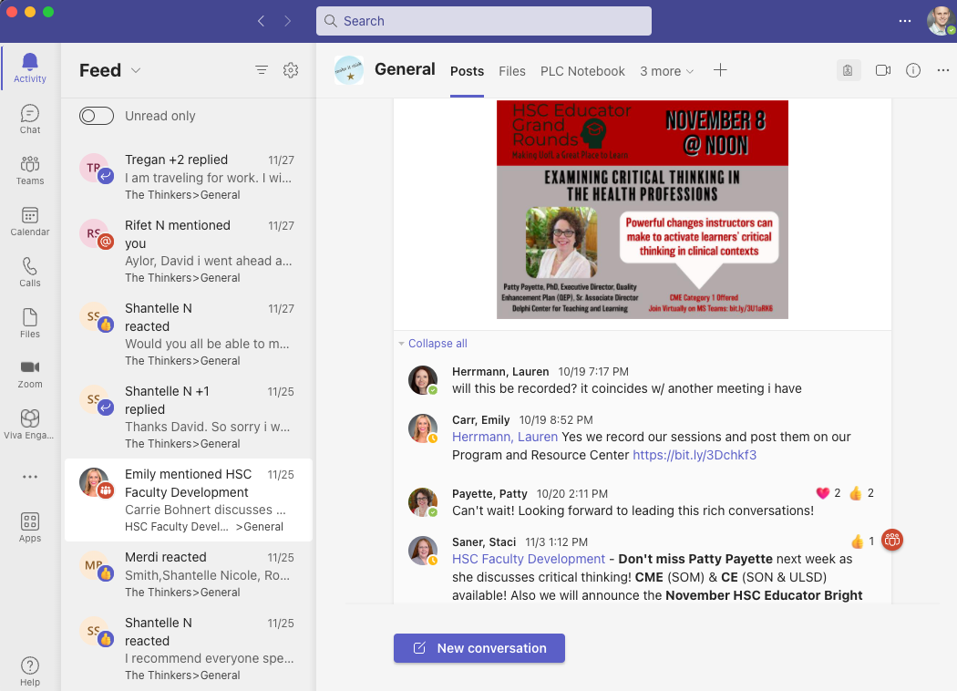
Chat conversations and posts

Slide 5
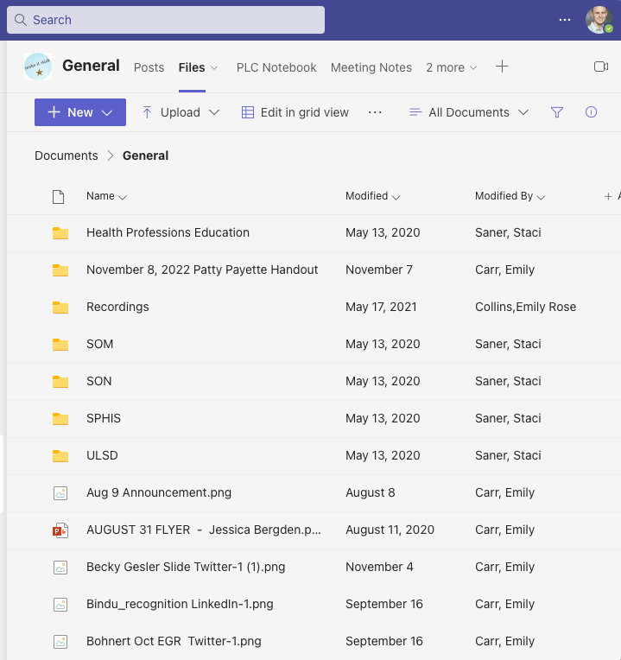
File sharing

Slide 6
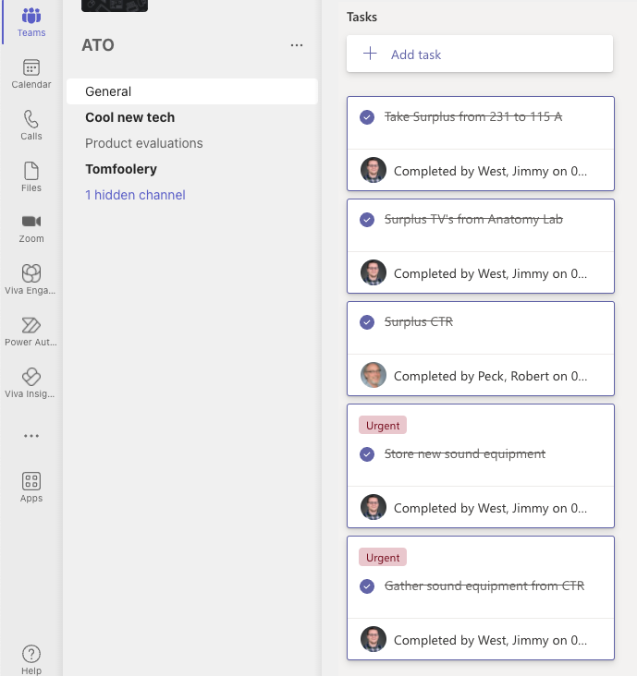
Tasks, reminders, workflow organization

Slide 7
Relationship Between Teams and SharePoint
Teams and SharePoint are connected: When you create a new team from scratch, a new SharePoint site is created and connected to the team.
Three things happen when you create an MS Team:
The Team is created
A Microsoft User Group is created
A SharePoint website associated with the Team is created.
What does this imply? You have created an Intranet for your office

Slide 8
Imperfect but helpful ways to think about Teams and SharePoint
Teams and SharePoint are the same thing, but they present themselves in different ways.
Teams is like a desktop client for SharePoint
SharePoint is like a website only visible to those in your group.
Teams replaces the majority of your casual email communication.
SharePoint replaces file servers (i.e.”I drive”).
Teams replaces your desk phone.

Slide 9
What is the same?
Online collaboration platforms, file sharing platforms.
Both are apart of the Microsoft 365 environment
Use the same user groups, permissions and file structure.
SharePoint and Teams can both be used for communication and file sharing.

Slide 10
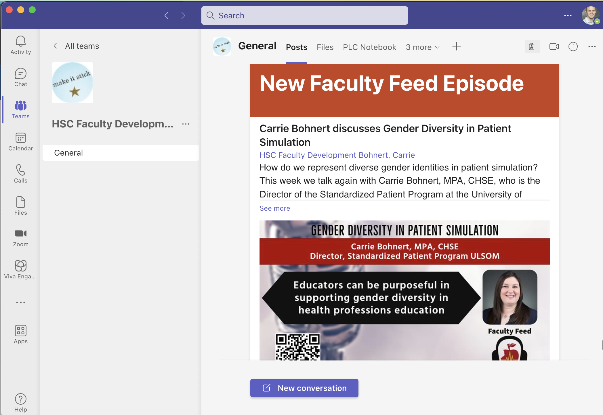

Slide 11
What is different?
Teams focuses on communication
Chat
Posts
Videos
Calendars
SharePoint focuses on files storage and sharing
Files
Libraries
Lists
Web Pages

Slide 12
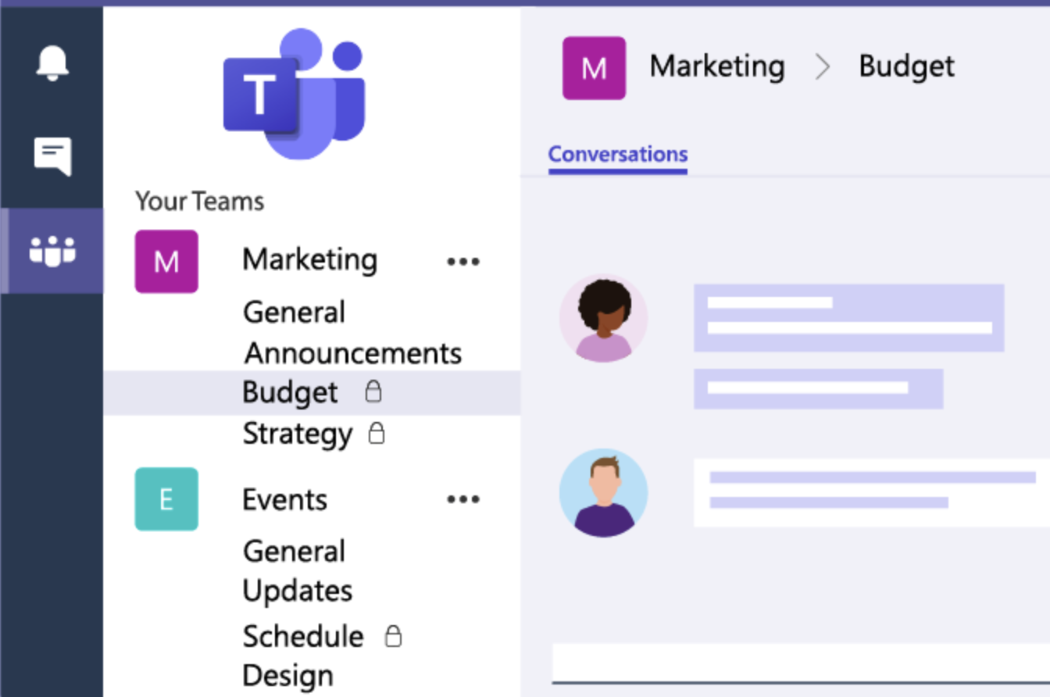
Channels are: dedicated sections within a team to keep conversations organized by specific topics, projects, disciplines places where conversations happen where the work actually gets done can be open to all team members (standard channels), or selected team members (private channels)

Slide 13
Overview of Teams and Channels

Slide 14
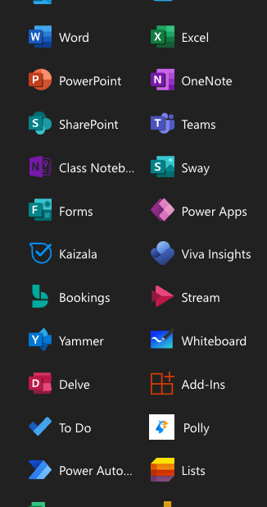
Teams capability in the 365 environment
More than Word, Excel, PowerPoint
Forms, polling, surveys and assessment
Lists and databases
Data analytics and visualizations
To-do lists, task, organizational management
Project Management
Automate tasks and create flows
Media creation
File storage and share
Video and chat collaboration
Video content streaming
Booking system
Whiteboarding
Website creation
App and form creation

Slide 15
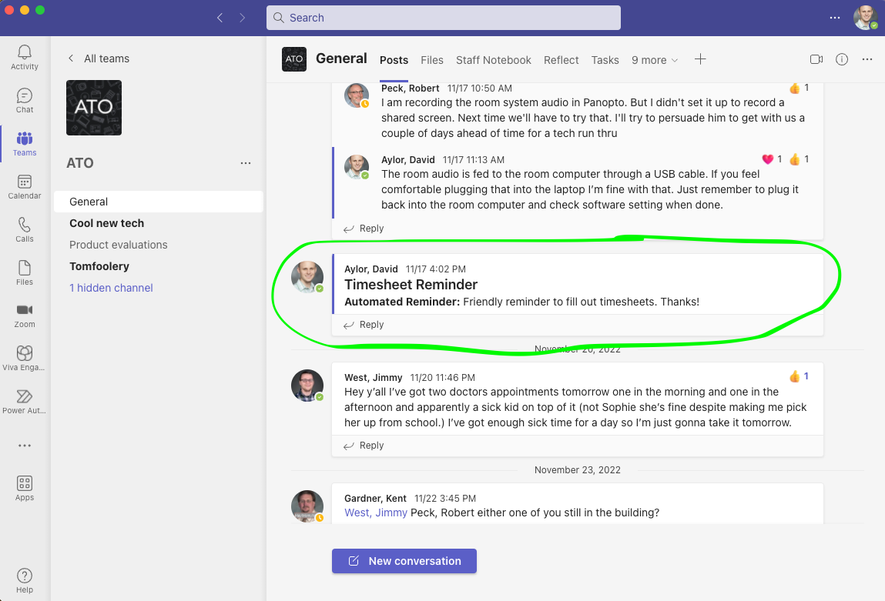
Automate tasks and create flows

Slide 16
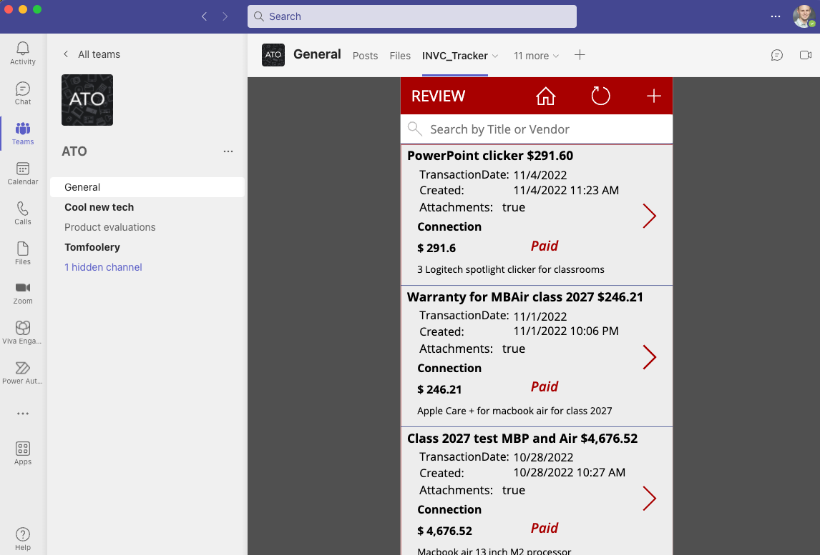
App and form creation

Slide 17
Website creation for the intranet

Slide 18
Resources
LinkedIn Learning – in depth videos from 30 minutes to hours long courses. You get micro-credentials for completing these modules.
ATO website: https://louisville.edu/medicine/tech/teams-tutorials
If you are one of the areas we support, request a meeting. We're happy to help develop a plan to migrate your office to Teams

