Slide 1
LCME Update
February 4, 2014

Slide 2
Update Overview
Renovation Projects
Major Curriculum Changes
Action Plan Highlights
Next Steps

Slide 3
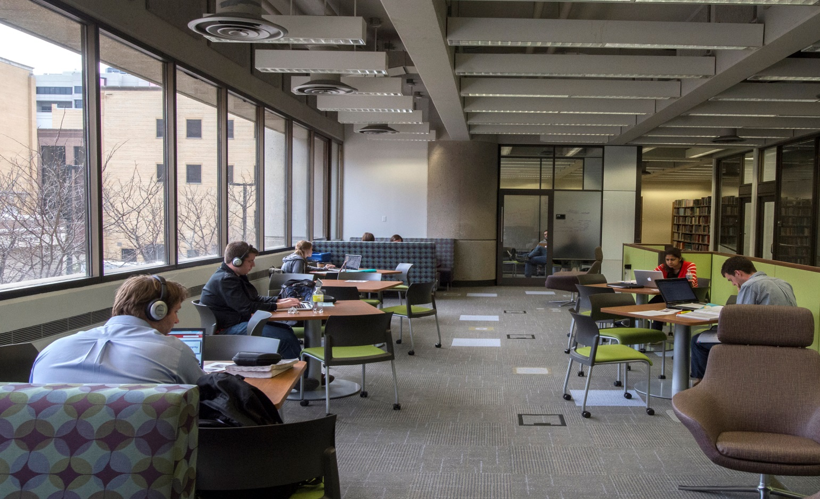
Kornhauser
Library Renovation

Slide 4
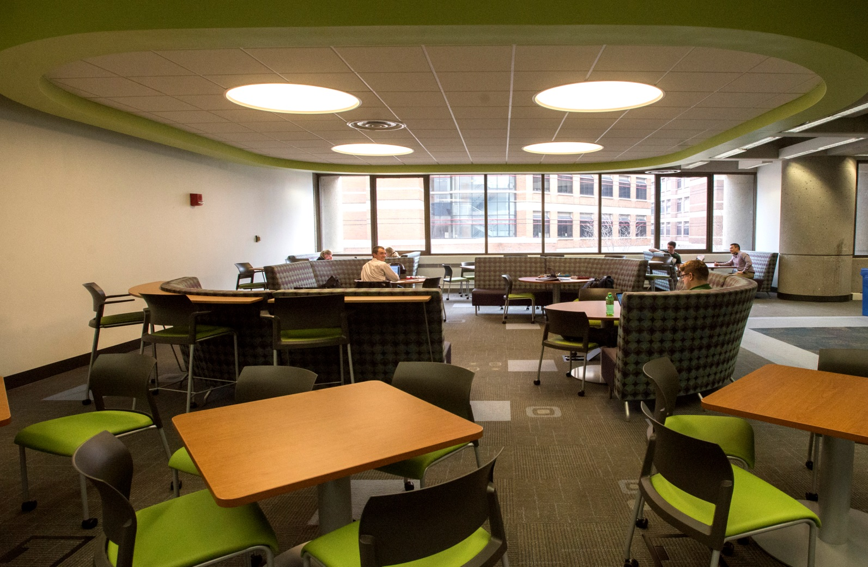
Kornhauser
Library Renovation

Slide 5
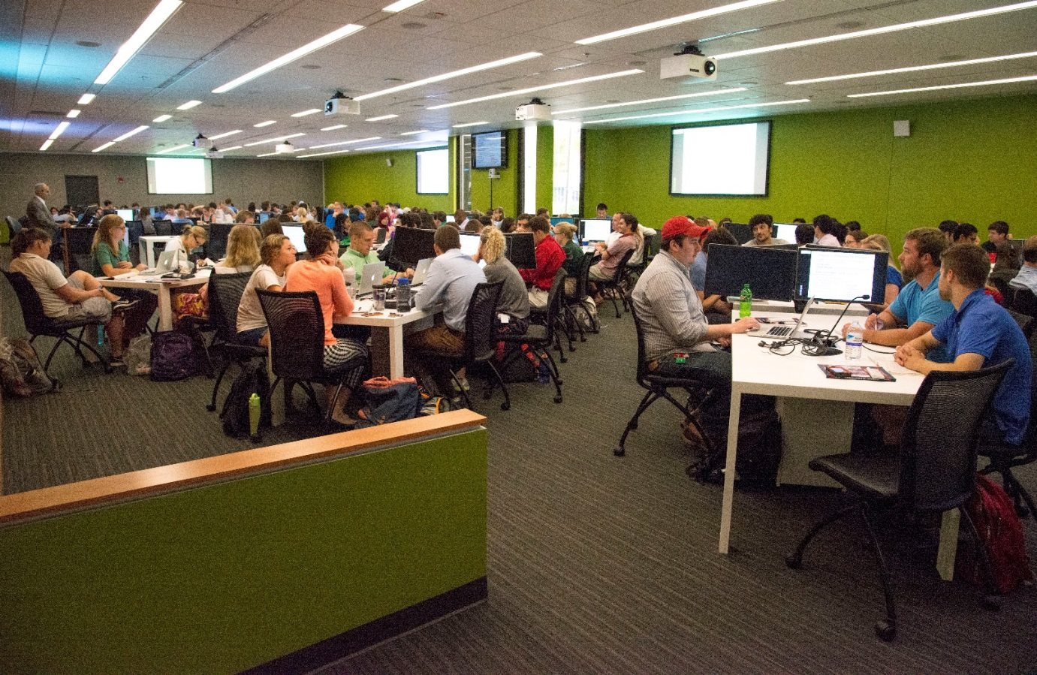
Instructional Building
Renovation

Slide 6
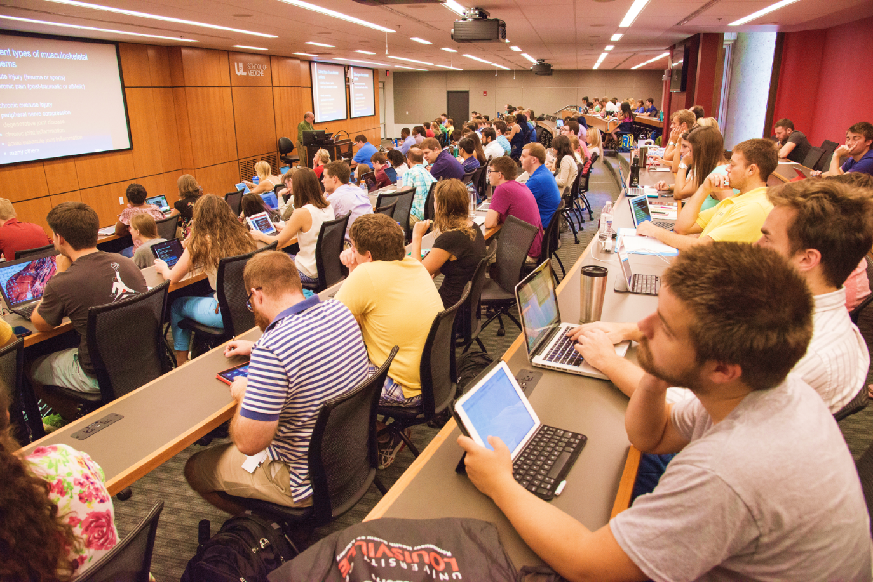
Instructional Building Renovation

Slide 7
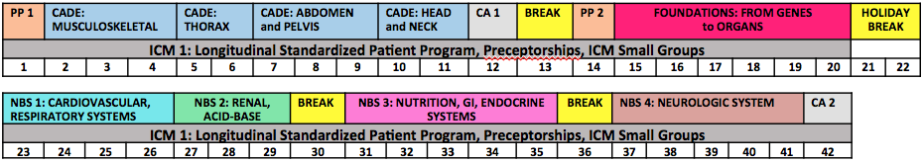
New First Year Curriculum
Integrated across disciplines
Collaboration among course directors and clinical educators
Clinical integration from Day 1

Slide 8
Proposed Second Year Curriculum

Slide 9
Action Plan Updates:
Educational Program: ED-33, ED-5-A, ED-32, ED-35,
Educational Resources: ER-4, ER-7, ER-9

Slide 10
Action Plan: ED-33 Integration
Revise SOM educational leadership model and EPC subcommittee structure to reflect importance of educational mission & position school to achieve its educational goals
Increase horizontal & vertical integration across all 4 years
Fully utilize RedMed to evaluate all aspects of the curriculum

Slide 11
ED-33 Integration (cont.)
Year 1: New integrated curriculum launched August 2014
Year 2: Increase collaboration among course directors to enhance horizontal integration (temporal integration, iTBL, PBL)
Year 3: Increase basic science integration in clinical years and introduce emerging topics of importance across clerkships
Year 4: Increase focus on preparation for residency

Slide 12
Action Plan: ED-5-A, ED-8
ED-5-A: Self-directed learning: Increase learning experiences that require students to develop & master their own learning objectives
ED-8: Comparability across clinical sites: Implement new system for collecting, analyzing, and monitoring site-specific data on student learning experience

Slide 13
Action Plan: ED-35, ED-32, ED-31
ED-35: Curriculum Review: Revise EPC system for curriculum review at the objective, course, and entire curriculum levels
ED-32: Narrative feedback: Revise EPC policy to require narrative feedback in specific preclinical courses when appropriate
ED-31: Formative Feedback: Provide opportunities for 1st and 2nd year students to identify their strengths & weaknesses

Slide 14
Next Steps
October 2014: LCME endorsed action plans
AY 2014-2015: Action Plans implemented
February 2015: Student Survey on LCME requested items
March 25, 2015: Submit Briefing Book
May 10 – 13, 2015: Limited Site Visit
October 2015: Reconsideration of probation
Continue to engage faculty, staff and students

