Slide 1


Updates in Movement Disorders
Advances in Neurology 2014
Kathrin LaFaver, MD
Assistant Professor of Neurology
Movement Disorder Center
University of Louisville
05/31/2014

Slide 2
Disclosures
I have received consulting fees and travel reimbursement for educational activities from the following companies: US World Meds, Medtronics

Slide 3
Learning Objectives
Learn about updates on treatment options for several common Movement Disorders
Identify indications for Deep Brain Stimulation in Parkinson’s disease to improve patient outcomes

Slide 4
Outline
1) Updates on Parkinson’s disease
2) Updates on Essential Tremor
3) Updates on Restless legs syndrome
4) Updates on Huntington’s chorea
5) Updates on Ataxia
6) Updates on Dystonia
7) Updates on Functional Movement Disorders

Slide 5
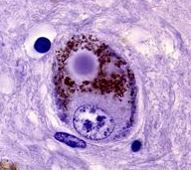
Updates on Parkinson’s disease (PD)
Second most common neurodegenerative disorder after Alzheimer’s disease
Affects 1% of people over the age of 65, about 1 million in the US and 7-10 million worldwide
Hallmarks of PD are loss of dopaminergic neurons in the substantia nigra and intracellular Lewy bodies which mainly consist of aggregated alpha-synuclein

Slide 6
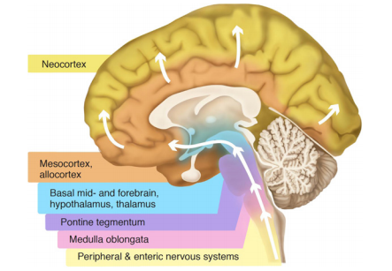
PD - Braak Staging
Prion-like spread of misfolded
alpha-synuclein?

Slide 7

α-synuclein normally has an α-helical conformation
Can adopt a β-sheet structure that polymerizes to form toxic oligomers and plaques
Patients receiving fetal nigral mesencephalic cell grafts were shown to have Lewy bodies in grafted neurons at autopsy
Misfolded α-synuclein can transfer from neuron to neuron in cell cultures and mouse models
Misfolded protein can act as template to promote misfolding of α-synuclein in the host cell and lead to neurodegeneration
→ Novel targets for therapeutic interventions?

Slide 8
PD Clinical features
Motor features of PD
Resting Tremor | 70% of patients “Pill-rolling” tremor in hands Can involve lips, chin, jaw, legs
Bradykinesia | 80-90% of patients Most disabling symptom of PD
Rigidity | >90% of patients “Cogwheeling” or “lead pipe”
Postural Instability | Indicative of advanced-stage PD Frequent cause of falls

Slide 9
Non-motor symptoms of PD
Psychiatric problems | Depression Anxiety
Cognitive disorders | Mild cognitive impairment Dementia
Sleep abnormalities | Insomnia REM sleep behavior disorder
Autonomic dysfunction | Constipation Urinary urgency Orthostatic hypotension
Sensory dysfunction | Loss of smell Pain in limbs
Other | Fatigue Weight loss

Slide 10
PD Diagnosis
History and clinical examination
No disease-specific biological marker available at present time
Single-photon Emission Computed Tomography (SPECT) with dopaminergic radioligands (DaT-Scan)
Exclusion of secondary Parkinsonism, e.g. structural lesion of basal ganglia, Manganese, drug-induced
Exclusion of atypical Parkinsonian syndromes, e.g. Progressive Supranuclear Palsy, Multisystem Atrophy, Corticobasal Degeneration Syndrome

Slide 11
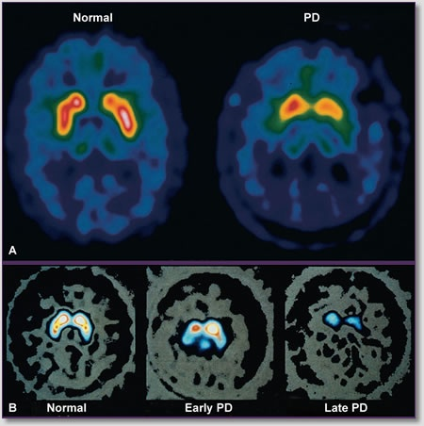
DaT-Scan: measures dopamine transporter activity
[¹⁸F]dopa uptake in the basal ganglia is reduced in PD.

Slide 12
Indications for DaT-Scan
Diagnostic uncertainty
  PD versus Essential Tremor*
  CAVEAT: Cannot distinguish between PD, MSA and PSP
  PD versus psychogenic or drug-induced PD-ism
  Dementia with Lewy bodies versus Alzheimer’s disease
Help in clinical decision making
  Uncertain response to medication
  Early disease
  Confirmation of diagnosis in research studies for PD
* Only FDA approved indication

Slide 13
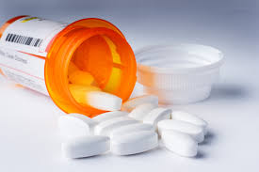
Current treatment options: Medications
  Carbidopa/Levodopa to replace dopamine: most effective drug therapy
  Dopamine receptor agonists, e.g. Ropinirole, Pramipexole: often used early in the disease or later in long-acting form as “add-on”
  MAO_{B} inhibitors e.g. Selegiline, Rasagiline

Slide 14
Levodopa versus Dopamine Agonists
Carbidopa/Levodopa
--most effective
--higher risk for dyskinesias
--side effects: nausea, orthostatic hypotension
→ Preferred for patients over 65
Dopamine Agonists
--less effective
--more difficult to titrate
--side effects: sedation, sleep attacks, peripheral edema, impulse control disorders
→ Preferred initial treatment for younger patients, eventually everyone will require Carbidopa/Levodopa

Slide 15

Current treatment options: Medications
  COMT (catechol-O-methyl-transferase) inhibitors, e.g Entacapone: prolong effect of carbidopa/levodopa
  Amantadine: helps with tremor and dyskinesias
  Anticholinergic drugs, e.g. benzatropine, trihexyphenidyl: help with tremor, can worsen memory

Slide 16
Updates on neuroprotection
Neuroprotection = Treatment to slow down or stop the progression of neuronal loss
No treatment has as of yet been established as neuroprotective in PD, tested substances were for example green tea, coenzyme Q10 and creatine
Problem is the lack of understanding of the exact cellular mechanisms of neurodegeneration in PD
Current studies planned or ongoing with isradipine, pioglitazone, transdermal nicotine and inosine*
* UofL Movement Center has applied as a study site

Slide 17

Updates on medication development
Slow-release preparations of levodopa to provide more stable levels throughout the day
  IPX066: needs to be taken less frequently and reduces OFF time, approved by FDA
  Inhaler formulation of levodopa in development

Slide 18
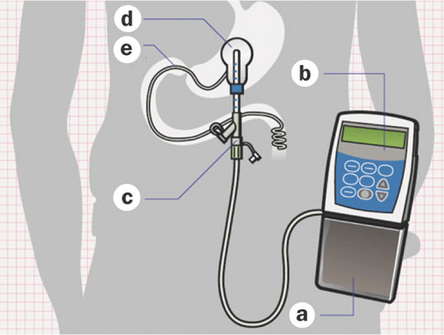
Updates on medication development
Levodopa Intestinal Gel (DuoDopa)
  Continuous infusion of levodopa through PEG tube
  Already available in Europe
  Side effects are GI complications and increase in peripheral neuropathy

Slide 19
Updates on medication development
Dopamine agonists: Apomorphine sublingual preparations and continuous subcutaneous infusions
MAO-B Inhibitors: Safinamide, expected FDA approval in 2014
Adenosine antagonists: enhance levodopa without worsening dyskinesias
  Istradefylline: approved in Japan
  Tozadenant: Phase III study planned for 2015

Slide 20
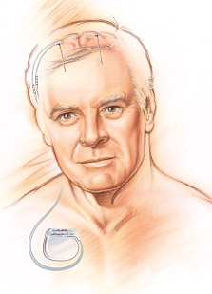
Deep Brain Stimulation Surgery (DBS)
- High frequency electrical stimulation of brain structures via electrodes implanted in basal ganglia.
- FDA approved for:
  Tremor in 1997
  Parkinson’s disease in 2002
  Dystonia in 2003
- Approximately 100,000 patients have been implanted worldwide, safety and efficacy established in large follow-up studies over 10 years.

Slide 21
Indications for DBS
- “Idiopathic” Parkinson’s disease
- Good L-dopa response
- Disabling off state symptoms
- Motor fluctuations, dyskinesias, dystonia
- Uncontrolled tremor
- No significant cognitive or psychiatric abnormalities

Slide 22
“Red flags” for DBS
Major L-dopa resistant symptoms
  Midline symptoms (speech, gait)
  Postural instability
  Cognitive impairment
Psychiatrically unstable
  Psychosis
  Manic features
  Impulsive or compulsive features
  History of severe depression/suicide attempts

Slide 23
What Does DBS improve ?
YES…
More “on” time
Less “off” time
Tremor
Bradykinesia
Rigidity
Dyskinesia
Gait (if L-dopa
responsive)
NO…
Gait freezing on
L-dopa
Postural instability
Falls
Voice and swallowing problems
Dementia

Slide 24
New DBS Indications under investigation
Tourette syndrome
  Thalamus and pallidum
Obsessive compulsive disorder
  Anterior internal capsule
Depression
  Subgenual cingulate cortex (area 25)
Alcoholism
  Nucleus accumbens
Cluster headache
  Hypothalamus

Slide 25
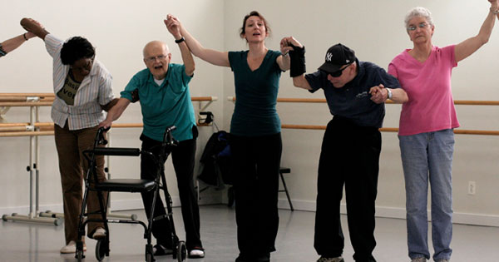
Updates on Exercise
Many studies have confirmed the benefit of exercise for Parkinson’s disease
Both aerobic and weight based exercises are beneficial
Tai Chi and dance therapy have been shown to improve balance and gait for Parkinson’s patients
Mark Morris Dance Group, New York City

Slide 26
Updates on gene and cell-based therapies
Fetal cell transplant studies have not shown clear benefit for PD patients to date
Gene therapy studies:
  AAV2-Neurturin and AAV2-GAD (completed)
  AAV2-GDNF (National Institutes of Health)
  AAV2-AADC (University of California San Francisco)
  In these studies, viral vectors (AAV2) are used to place growth factors or enzymes in the basal ganglia with the goal of improving dopamine function in neurons
  Not clear if better than currently available therapies

Slide 27
PD - Summary
Several agents are studied for neuroprotection
Carbidopa/Levodopa remains the most effective medication for treatment of motor symptoms
New formulations of levodopa and medications to enhance dopaminergic action in the brain are under development/waiting for FDA approval
DBS is a well established treatment option for advanced PD and earlier use may be beneficial
Gene therapy may be an alternative option to DBS in the future

Slide 28
Updates on Essential Tremor
AAN practice guideline on treatment 2014:
Effective: Propranolol, Primidone
Probably effective: Topiramate, Atenolol, Alprazolam
Insufficient evidence: Gabapentin, Pregabalin, Zonisamide
No new treatment options available
DBS can be very effective, target is VIM of the thalamus

Slide 29

Positive effects of alcohol on Essential Tremor have long been recognized
1-octanol is a long-chain alcohol that is well tolerated without the ethanol’s typical side effects of sedation and intoxication
Pilot study showed benefit of octanoic acid on tremor reduction in a single dose
Requires large volumes to be orally admininistered
holds promise for future treatment option, further
studies needed

Slide 30
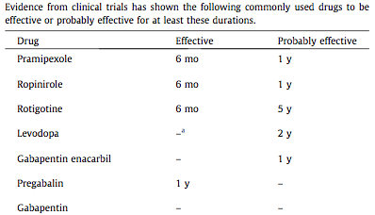
Updates on Restless legs syndrome
Treatment guidelines from the International RLS Study Group:
Sleep Medicine 14 (2013) 675–684

Slide 31

Comparison of pregabalin with pramipexole and placebo in a 52 week, double blinded randomized controlled trial
Pregabalin 300 mg versus pramipexole 0.25 or 0.5 mg or placebo
Clinical improvement comparable between pregabalin and pramipexole, aumentation rates significantly higher on pramipexole 0.5 mg dose (7.7% versus 2.1%)

Slide 32
Updates on Huntington’s chorea
Promising results in animal models for HD with RNA interference technology
Promising data on neuroprotection with high-dose creatine, PRECREST trial results published showing safety and possible evidence of disease modification

Slide 33
Updates on Ataxia
Recent positive study for benefit of varenicline for patients with spinocerebellar ataxia type 3 (Machado-Joseph disease) on gait and stance
Recent report at AAN meeting 2014 on possible neuroprotective benefit from Coenzyme Q10
Current studies with Riluzole and Acetyl-L-Carnitine in several forms of genetic ataxias

Slide 34
Updates on Dystonia
New genes for primary dystonia are constantly being reported (DYT1-DYT23)
New forms of neuronal brain iron accumulation and a potentially treatable form of generalized dystonia with brain manganese deposition were recently reported
Increased recognition of dystonia as network disease, involving brain areas beyond the basal ganglia, treatment options currently lagging behind

Slide 35
Treatment of Dystonia
Oral medications: Baclofen and other muscle relaxants, trihexyphenidyl, benzodiazepines, carbidopa/levodopa for early onset, dopamine-responsive dystonia (DYT-5)
Botulinum toxin for focal dystonias
Deep brain stimululation in select cases
Physical therapy

Slide 36
Updates on Functional Movement Disorders
Deficits not explained by organic lesions in the nervous system, thought to be related to psychological factors
Most commonly present as tremor, gait disorders and dystonia, can mimic any movement disorder
Acute onset, variability over time, spontaneous remissions can occur
Related to other functional neurological disorders, e.g. functional weakness and psychogenic non-epileptic seizures (PNES)
Constitute 3-5% of patients in Movement disorder clinics

Slide 37
FMD Typical exam findings
Movements often not easy to classify
Combination of different movements (e.g. tremor + dystonia + astasis/abasia)
Distractible movements
Movements can be entrained to different frequencies
Other non-neurological findings, such as giveway weakness or sensory loss with a non-anatomical pattern

Slide 38
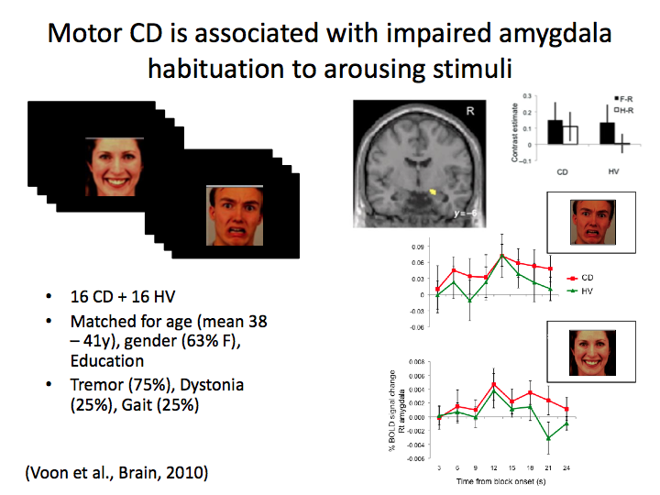

Slide 39
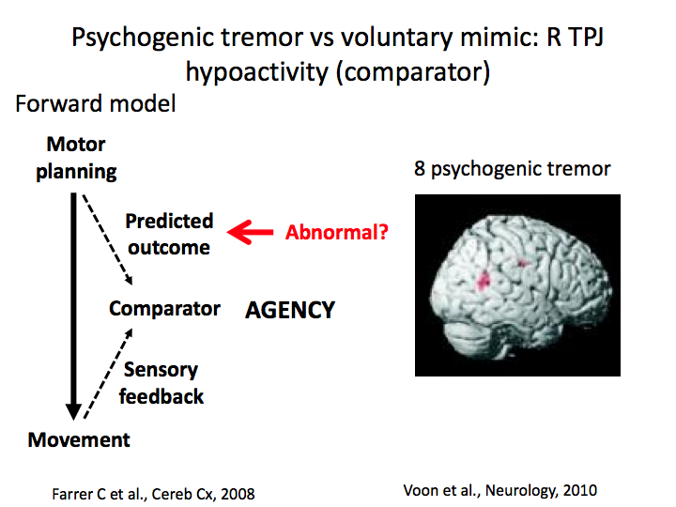

Slide 40
FMD Treatment options
Cognitive-behavioral therapy
Treatment of psychiatric comorbidities
Physical/occupational therapy
New inpatient rehabilitation program at Frazier: MoRe (Motor Reprogramming), referral made by UofL Movement disorder clinic
FMD Neuroimaging study at UofL, fMRI and structural imaging of patients before and after rehab program

Slide 41
Questions?

