Slide 1
New and emerging therapies for migraine
Jonathan H. Smith, M.D.
Assistant Professor of Neurology
University of Kentucky, Department of Neurology

Slide 2
Disclosures
No conflicts of interest

Slide 3
objectives
Discuss new routes of administration of existing medications
Introduce emerging treatments with novel mechanisms of action
Discuss neurostimulation in migraine

Slide 4
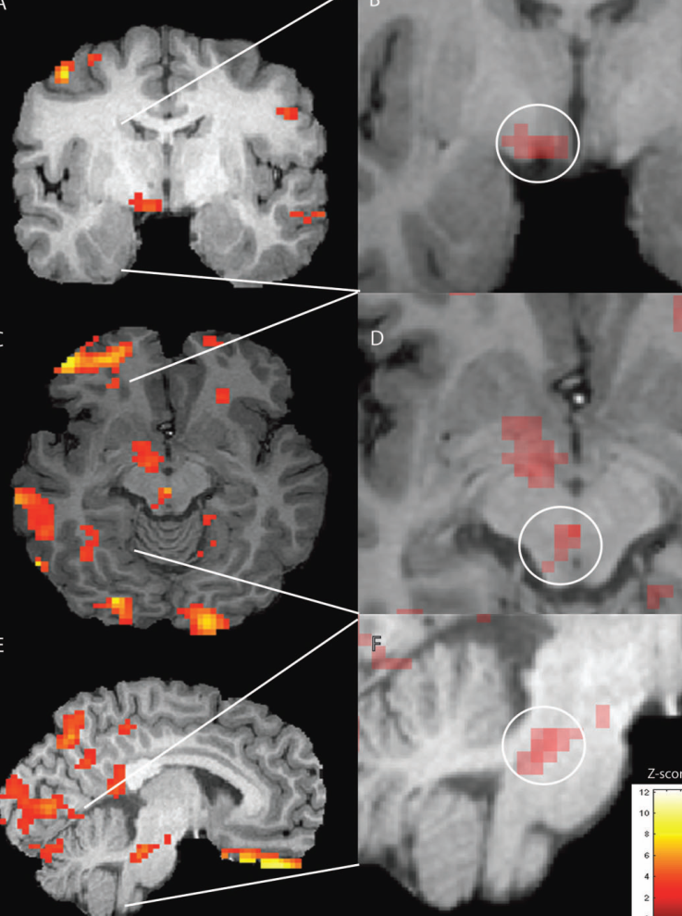
Migraine cycle
Migraine
Premonitory
Aura
Headache
Postdrome
10-90%
20%
INTERICTAL
98%
68%
Kelman L. Headache 2004-2007
Griffin NJ, et al. Neurology 2003
Maniyar F, et al. Brain 2014;137(1):232-41

Slide 5
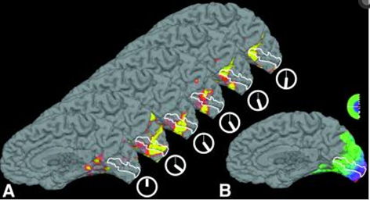
Migraine Pathophysiology
Polygenic, heterogeneous
Recent 3-tesla MRA studies argue against vascular hypothesis
Amin FA, et al. Lancet Neurology 2013;12(5):454-61
Weiler, et al. Nat Med 1995
Hadjikhani N, et al. PNAS 2001

Slide 6
Migraine genetics: a window to new therapies
MTDH and PGCP
TRPM8
LRP1
PRDM16
MEF2D
TFGBR2
Glutamate homeostasis
DRG expression, neuropathic pain
Co-localizes with NMDAR+ neurons
Transcription factor
↓ activity at excitatory synapses
Regulation of extracellular matrix
Anttila, et al. Nat Gen 2010
Chasman, et al, Nat Gen 2011
Freilinger T, et al. Nat Gen 2012

Slide 7
Current treatment options
NSAID
triptan
+ / -
antiemetic
Antiepileptic drugs
Antihypertensive drugs
Antidepressant drugs
OnabotulinumtoxinA
Biobehavioral interventions

Slide 8
the problems with migraine therapy
Efficacy
Side-effects
Contraindications
Unmet needs
2 hour pain freedom after triptan ~ 20-40%
Same day recurrence after triptan ~20-25%
Preventative efficacy ~ 40-50%
X

Slide 9
New and emerging treatments
New routes of administration
Novel mechanisms of action
Neurostimulation

Slide 10
New routes of administration
Goals:
Bypass gastroparesis/vomiting
Faster availability
Improved tolerability
Improved efficacy

Slide 11
New routes of delivery
CAMBIA (June 2009)
SPRIX (May 2010)
SUMAVEL DosePro (July 2009)
ALSUMA (June 2010)
ZECUITY (January 2013)
OPTINOSE
LEVADEX TEMPO Inhaler

Slide 12
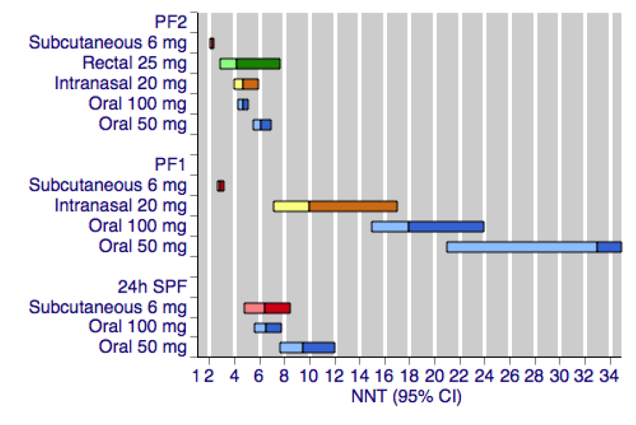
Sumatriptan 2014
Derry CJ, et al. Cochrane Database Sys Rev 2014;28(5) ePub
Notes:
Single dose by any route is effective
Subcutaneous best for 2 hour pain relief: 59% versus 11%
Subcutaneous best for rapid relief @ 1 hour

Slide 13
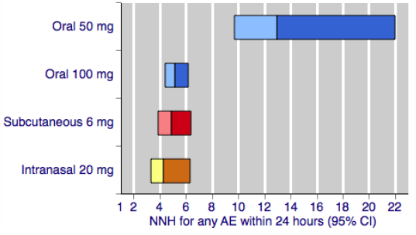
Sumatriptan 2014
Derry CJ, et al. Cochrane Database Sys Rev 2014;28(5) ePub

Slide 14
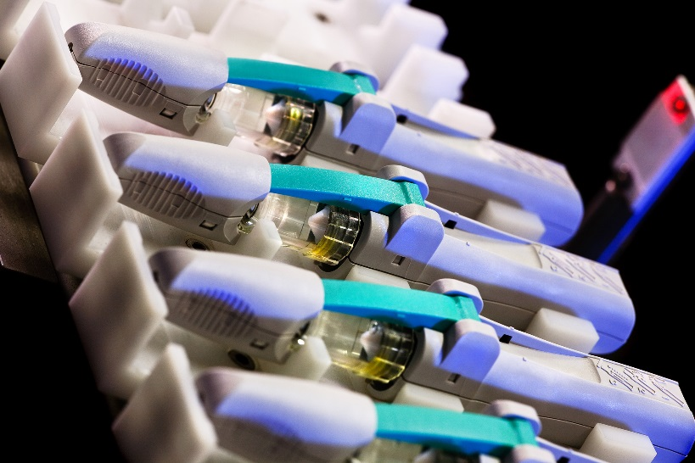
SUMAVEL DosePro
Needle-free subcutaneous sumatriptan, 6 mg
Bioequivalent to needle in thigh or abdomen, but not arm
Easier to use, greater patient satisfaction
12% injection site pain
www.sumaveldosepro.com
Cady RK, et al. Headache 2011;51:1202-11

Slide 15
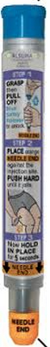
ALSUMA
Sumatriptan, 6 mg
Autoinjector (“epipen-like”) mechanism
Easy-to-use
15% injection site bruising, 6% pain
www.alsuma.com/
Landy SH, et al. Headache 2013;53(1):118-125

Slide 16
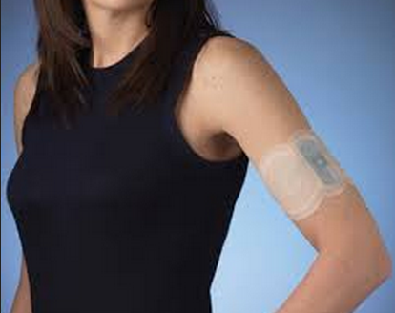
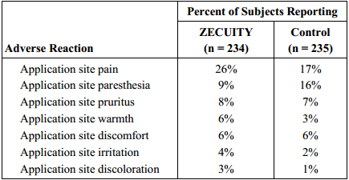
ZECUITY
Sumatriptan Iontophoretic Transdermal System, 6.5 mg (over 4 hours)
Single use, battery-powered patch
2 hour pain freedom: 18% vs. 9% (p < 0.01)
www.zecuity.com
Goldstein J, et al. Headache 2012;52:1402-10

Slide 17
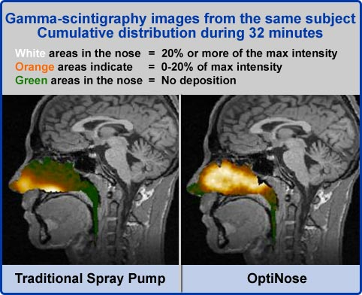
Optinose
Sumatriptan, 20 mg
Breath-powered nasal delivery
2 hour pain freedom (20 mg vs. placebo): 57% vs. 25% (p <0.05)
Larger, ongoing trial: nasal device versus sumatriptan 100 mg tabs (double-dummy)
www.optinose.com
Djupesland PG, et al. Cephalalgia 2010;30(8):933-42
Obaidi M, et al. Headache 2013;53(8):1323-33

Slide 18
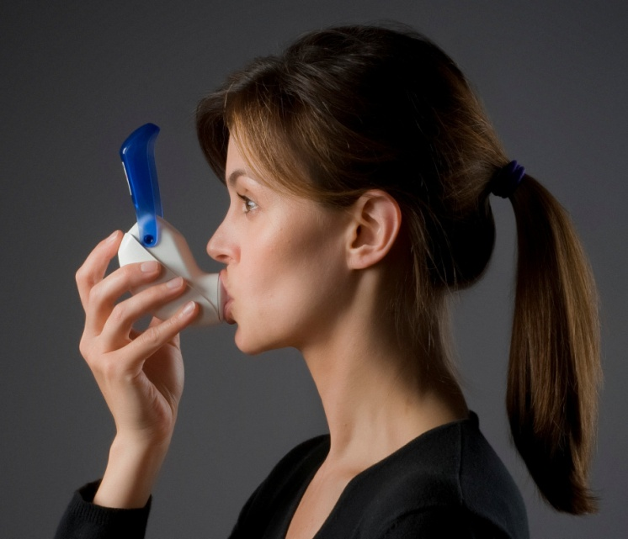
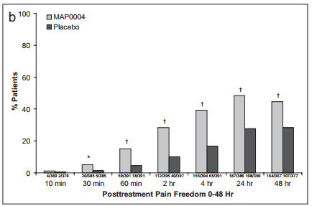
LEVADEX TEMPO inhaler
Breath-synchronized, plume-controlled inhaler
Rapid delivery, lower max serum concentration than IV DHE
Efficacy despite allodynia (early and late attacks)
6.4% bad taste, 4.5% nausea
Still pending FDA approval
Aurora SK, et al. Headache 2011;51(4):507-17
Tepper SJ. Headache 2013;53(Suppl 2):43-53

Slide 19
Novel mechanisms of action
Calcitonin gene-related peptide antagonists/antibody
5-HT1_{F} Receptor agonist
Nitric oxide synthetase inhibitor
Transient Receptor Potential Vanilloid (TRPV1)Receptor agonists
Orexin Receptor Antagonists

Slide 20
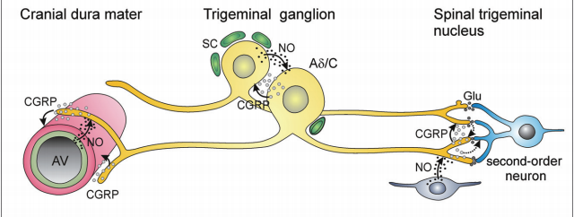
Calcitonin gene-related peptide antagonists
Four “–gepants” have demonstrated efficacy in phase 3 trials
Excellent tolerability
No vasoconstrictive properties
Liver toxicity is Achilles heel (possible class effect)
Messlinger K, et al. Headache 2012;52:1411-1427

Slide 21
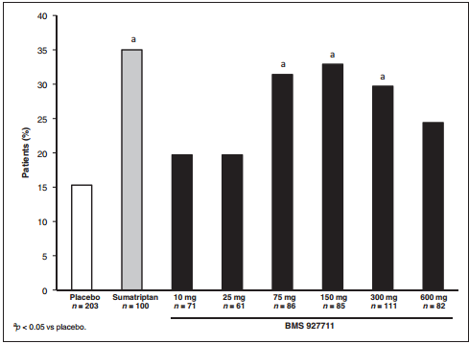
BMS-927711 for the acute treatment of migraine: A double-blind, randomized, placebo controlled, dose-ranging trial
Dose-dependent side-effects:
0-8% nausea
Marcus R, et al. Cephalalgia 2014;34(2):114-125

Slide 22
Calcitonin gene-related peptide humanized antibody
Twice weekly SC injection of LY2951742 (150mg) or placebo (n = 217)
-4.2 versus -3 migraine headache days per month after 3 months (p<0.003)
AE: injection site pain, upper respiratory infection, and abdominal pain
http://www.americanheadachesociety.org/initial_results_for_ly2951742_a_new_investigational_medicine_for_migraine_prevention/

Slide 23
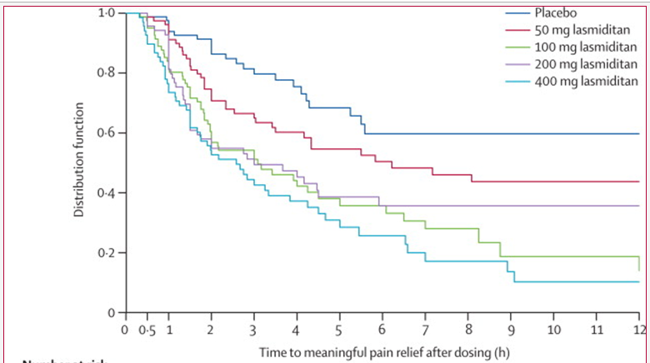
5-HT1_{F} Receptor Agonist
Blocks second order transmission without vasoconstriction (5-HT1_{B})
Placebo-controlled phase 2 trial of lasmiditan demonstrating efficacy (n = 512)
25% dizzy, 24% paresthesias, 10% heavy sensation
Farkkila M, et al. Lancet Neurology 2012;11(5):405-13

Slide 24
Nitric oxide synthetase (NOS) inhibitors
Nitric oxide is a migraine trigger, ↑ CGRP
Failed studies of inducible NOS inhibitor
Blinded, small study of a non-selective NOS inhibitor (n = 29) suggests efficacy:
2 hour pain relief of 67% vs. 14% (P<0.05), no adverse events
NXN-188: combined nNOS inhibitor and 5-HT1_{B/D} agonist
Holvik H, et al. Cephalalgia 2010;30:1458-1467
Hoye K, et al. Cephalalgia 2009;29:132
Bhatt DK, et al. Cephalalgia 2013;33(2):87-100

Slide 25
Transient Receptor Potential Vanilloid (TRPV1)Receptor Modulators
Capsaicin and vanilloid receptor
TRPV1 agonist: c-fiber suppression, depletion of CGRP, SP
Double-blind, randomized, dose-comparison study of 20 µg and 150 µg intransal civamide for acute migraine: pain freedom in 22% and 33%
91% burning, 44% lacrimation
Diamond S, et al. Cephalalgia 2000;20:597-602

Slide 26
Orexin Receptor Antagonists
Orexin synthesized in hypothalamus; roles in arousal and pain
Successful phase 3 DBRCT of suvorexant for insomnia; 13% somnolence as AE
Preliminary ongoing trials for migraine
Michelson D, et al. Lancet Neurology 2014;13(5):461-471

Slide 27
neurostimulation
Transcutaneous supraorbital nerve stimulation (Cefaly)
Transcranial magnetic stimulation (TMS)
Implantable peripheral nerve stimulation

Slide 28
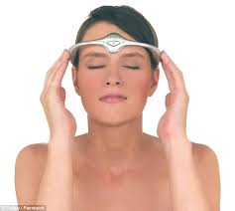
Cefaly
Transcutaneous supraorbital nerve stimulation
Migraine prevention in episodic migraine, sham-controlled (n = 67)
38% vs. 12.1% responder rate
Safe and well-tolerated
www.cefaly,com
Schoenen J, et al. Neurology 2013;80(8):697-707

Slide 29
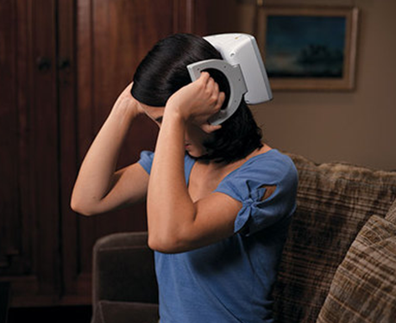
Transcranial magnetic stimulation
Sham-controlled, single pulse treatment of migraine with aura (n = 201)
2 hour pain free: 39% vs. 22%, sustained significance at 1 and 2 days
AE similar between groups
Lipton RB, et al. Lancet Neurology 2010;9(4):373-380

Slide 30
Transcranial magnetic stimulation
Mixed results from small preventative trials of repetitive TMS
Low-frequency rTMS at vertex ineffective
High-frequency rTMS at left dorsolateral prefrontal cortex effective
Ongoing studies
Teepker M, et al. Cephalalgia 2010;30(2):137-44
Bringhina F, et al. J Neurol Sci 2004;227(1):67-71
Misra UK, et al. Neurol Res 2012;34(6):547-51

Slide 31
implantable nerve stimulation
Need careful patient selection, psychological evaluation
Currently no consensus on optimal patient selection
Invasive, risk of lead migration (>25%) / fracture/ infection
-- At 1 year, 29% ONS explanted (Silberstein)
Silberstein SD, et al. Cephalalgia 2012;32(16):1165-1179

Slide 32
Occipital nerve stimulation
Feasibility study (ONSTIM) (n = 75)
Safety and efficacy (St. Jude) (n = 157)
Prospective, randomized crossover study (Non-industry) (n = 30)
Promising efficacy (39% adjustable vs. 6% preset)
Failure to meet 1º end-point (17.1% vs. 13.5%)
Significant ≥ 30% VAS difference and reduced migraine-related disability
Safe and effective at 1 year
Saper JR, et al. Cephalalgia 2011;31(3):271-85
Silberstein SD, et al. Cephalalgia 2012;32(16):1165-1179
Serra G, et al. Pain Physician 2012;15(3):245-53

Slide 33
ONS: methodological concerns
12 weeks too short to assessed end-points?
Trial phase confounds blinding
Varying definitions of refractory migraine/inclusion criteria
Varying surgical methods

Slide 34
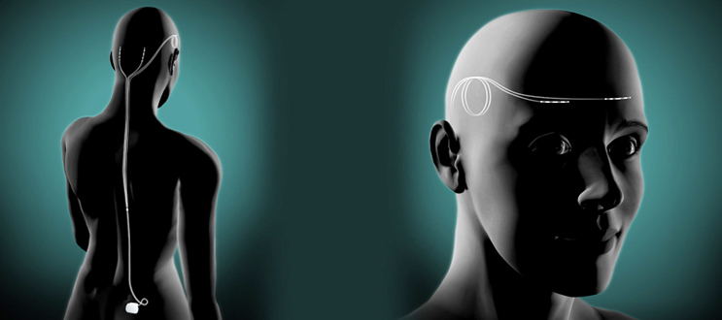
Dual supraorbital and occipital neurostimulation
7 patients, occipital versus dual neurostimulation
> 90% improvement with dual versus < 50% improvement with occipital alone
www.reedmigraine.com
Reed KL, et al. Cephalalgia 2010;30:260-271
Notes:
Better coverage of headache topography

Slide 35
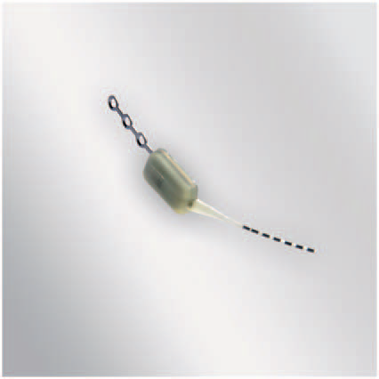
Sphenopalatine ganglion stimulation
Parasympathetic ganglion, experimental activation may trigger cluster attacks
Recent successful trial in chronic cluster headache with implantable microstimulator; tingling may unblind
CM trial underway
Schoenen J, et al. Cephalalgia 2013;33(10):816-830

Slide 36
Vagal nerve stimulation
Vagal stimulation can modulate analgesic responses @ level of medulla
Retrospective experience in patients with depression and epilepsy
Transcutaneous VNS (n = 13), 10 stopped due to lack of efficacy and/or side-effects
Magis D, et al. J Headache Pain; 2012;Suppl 1: 198i

Slide 37
Don’t forget “the basics”…

Slide 38
Why am I getting so many headaches!?
Overuse of analgesic medications
Excessive caffeine intake
Obesity
Sleep disorders
Psychiatric disease
Stress
~3%/year
Episodic migraine
Chronic migraine

Slide 39
What can I do to get less headaches!?
Adherence to migraine prophylactic drugs
Withdrawal of overused migraine abortive drugs
Withdrawal from overuse caffeine
Nicotine cessation
Weight loss
Regular physical exercise
Stress management

Slide 40
Conclusions
Multiple treatment-gaps exist in the care of patients with migraine
Previously used agents with new delivery systems, agents with novel mechanisms of action, and neurostimution are emerging options for our patients
Invasive treatments should only be pursued in highly selected cases, pending further data

Slide 41
Questions

