Slide 1

What is Equal Justice Works (EJW)?
EJW = A nonprofit organization dedicated to mobilizing “the next generation of lawyers committed to equal justice.”
• Provides leadership to ensure lawyers are involved in public service
• Offers the largest Fellowship Program for Attorneys
• Offers summer internships in public service
• Compiles and shares information needed by law students going into public service

Slide 2
EJW Conference & Career Fair
• Date: October 21-23, 2021
• Location: Virtual
• Cost: $25 –Students may be reimbursed by the law school after the conference. Please contact Jina Scinta at jina.scinta@louisville.edu for more information on reimbursement after the conference.
• Website: https://www.equaljusticeworks.org/conference-and-career-fair/about/
    EJW Conference & Career Fair is the largest public interest career fair and conference for law students in the U.S.
•1400 law students from 150 different schools participate each year
•200+ employers participate seeking 1L/2L students for summer jobs and 3Ls for post-graduation positions

Slide 3
EJW Career Fair Details
2 days of workshops, interviews & Table Talk
  Prescheduled Interviews: You are encouraged to apply with as many organizations as you are interested in during the prescheduled interview application period. Interviews will be 20 minutes & conducted virtually.
  Table Talk: Even if you do not get the interview you were hoping for, there are several opportunities to speak to employers outside of the formal interview times. Students will have the option to “wait in line” or “walk up” to a table during designated times during the fair.
  Value: One-stop shop for career growth, résumé reviews, workshops, panel discussions, and networking opportunities.

Slide 4
Timeline for Signing up & Attending Fair
Student Registration: Registration is open and closes on Monday, October 18. The base registration fee for all three days will be $25.00.
Employer Registration Deadline: Employers must post positions for prescheduled interviews by Tuesday, August 31 at 11:59 PM (ET).
Deadline for Applying to Prescheduled Interviews: Monday, September 13 at 11:59 PM (ET).
Employer Selection Deadline: By Thursday, September 23, 2021, employers will make their selections of which students they plan to interview at the Career Fair.
Prescheduled Interview Sign-Up: By Friday, September 24, 2021, students will have been notified of their status for prescheduled interviews (unless otherwise contacted) and may begin to sign-up for specific interview times (Do so asap on this date if you have interviews!).
Last Date for Students to Finalize Interview Times: Monday, October 4 at 11:59 PM (ET).

Slide 5
Which Employers are Attending?
List of Employers who are registered can be found at https://www.equaljusticeworks.org/conference-and-career-fair/registered-employers/
  Log in as guest to see hiring requirements
  Note if Employer is interviewing, attending Table Talk or both
  Note class years, type of position and whether paid
  Employers must post positions for prescheduled interviews by Tuesday, August 31 and submit their interview selections by Thursday, September 23.

Slide 6
Registered Employers

Slide 7
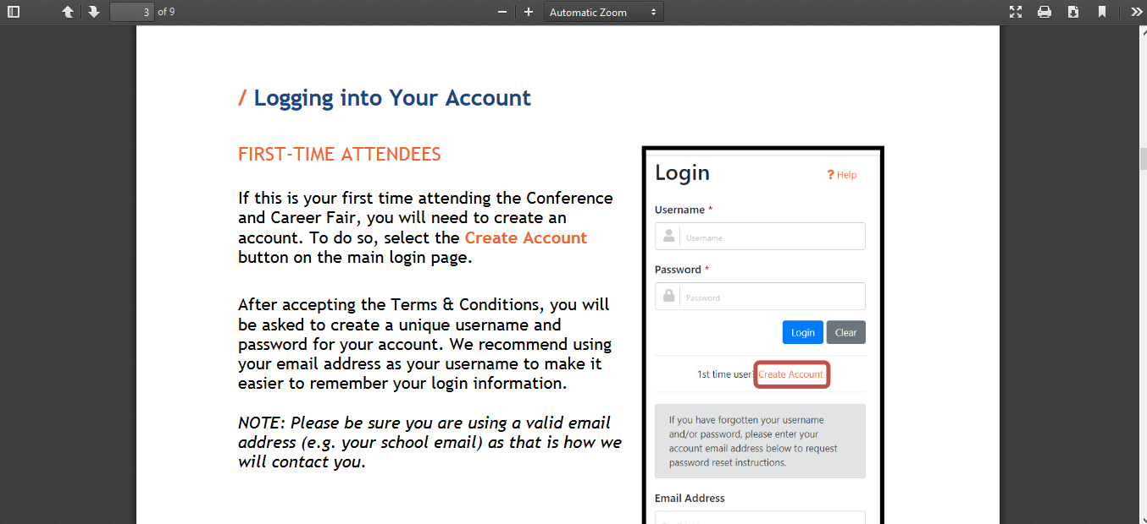
How to Register and use the Career Fair System to Apply for Interviews
Go to: https://www.equaljusticeworks.org/conference-and-career-fair/for-attendees/law-students-graduates

Slide 8
EJW Webinars to Help You Prepare for the Career Fair
Crash Course: Resumes & Cover Letters | August 19, 2021, 2–3 p.m. EDT
Join Equal Justice Works as we provide an overview of what makes a strong resume and cover letter when applying to public interest internships and postgraduate positions. We’ll go over common application mistakes and provide tips on how to avoid these and stand out.
Going Virtual: Navigating Conf. & Career Fair’s Digital Platform| Sept. 22, 2021, 1 – 2 p.m. EDT. Join Equal Justice Works as we teach you how to navigate our new digital platform.
Getting the Most Out of the Conference & Career Fair| October 19, 2021, 2 – 3 p.m. EDT. Topics include general logistics, a breakdown of our schedule, what to prepare ahead of the event, tips and tricks for interviews and Table Talk, and ways you can network virtually.

Slide 9
Webinars Focusing on the Public Interest Job Search in General
1L Crash Course: Roadmap to Success in Public Interest Law | Sept. 9, 2021, 2–3 p.m. EDT
Join Equal Justice Works as we outline a roadmap to help students navigate their first year of law school. We will break down the timeline of your first year to help ensure that you land your dream summer internship and set you up on the path to success in public interest law.
Crash Course: Public Interest Job Interviewing 101| October 5, 2021, 5–6 p.m. EDT
This webinar will prepare you to interview at the Conference and Career Fair. We’ll provide tips and tricks for standing out and making a lasting impression during your virtual interviews.

Slide 10
Other EJW Resources Available for the Conference and Career Fair
• Public Interest Law References Advice
• Writing Sample Advice
• Public Interest Law Résumé Advice
• Public Interest Law Cover Letter Advice
These resources are available in Document Library on Symplicity. They will also be available in the Daily Docket.

Slide 11
Wrap-up and Questions
Questions: Contact Jina Scinta at jina.scinta@louisville.edu to be added to our distribution list.
EJW Distribution List: Email careerfair@equaljusticeworks.org to be added to the EJW distribution list for the Conference & Career Fair.
  Strongly recommended so you don’t miss deadlines and get updated information immediately as it becomes available.
OPD Support: Contact Jina Scinta, jina.scinta@louisville.edu, or Dean Hajek, laurel.hajek@louisville.edu, for any questions, assistance or guidance regarding the EJW Conference & Career Fair.

