Slide 1
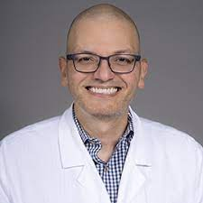
Camilo Castillo, MD, MBA- Director Spinal Cord Injury Medicine & Fellowship Program
camilo.castillo@uoflhealth.org

Slide 2
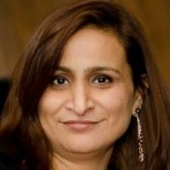
Manpreet Chopra, MS- Senior Research Scientist
manpreet.chopra@louisville.edu

Slide 3
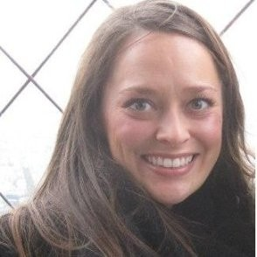
Lauren Ellis- Director of Clinical Operations
UofL Health – Restorative Neuroscience
UofL SOM – Neurosurgery & PM&R
lauren.ellis@uoflhealth.org

Slide 4
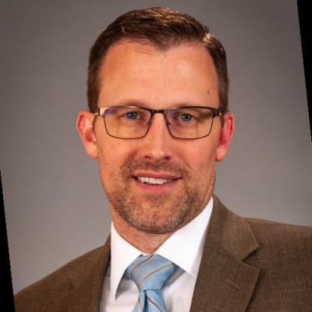
Abraham “Abe” Gage, MBA- Systems and Business Intelligence VP, UofL physicians
abraham.gage@louisville.edu

Slide 5
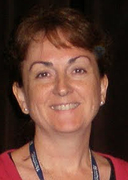
Dena Howland, PhD- Professor
dena.howland@louisville.edu

Slide 6
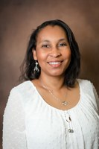
V. Faye Jones, MD, PhD, MSPH- Senior Associate Vice President for Diversity and Equity & Associate Vice President for Health Affairs/Diversity Initiatives
vfjone01@louisville.edu

Slide 7
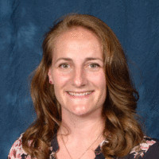
Ellyce Patton, MBA- Executive Director
ellyce.patton@uoflhealth.org

Slide 8
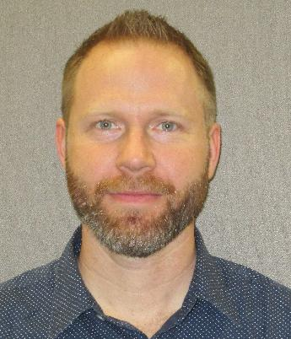
Ryan Simpson- Program Director HSC Office of Diversity and Inclusion ryan.simpson.1@louisville.edu; 502-852-0709

Slide 9
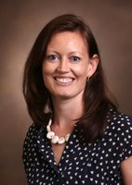
Nelleke van Wouwe, PhD – Associate Professor nelleke.vanwouwe@louisville.edu

