Slide 1
Culturally Effective Care for Refugee and Immigrant Populations
2016 Patricia Allen Culturally Effective Care Symposium

Slide 2
PATIENT/CLIENT PERSPECTIVE
Culturally Effective Care for Refugee and Immigrant Populations
VOICES
Notes:
The session opens with a 10-15 minute personal story of barriers in accessing health care from an individual who was an immigrant/refugee. This should be a community member who the instructor has met with and discussed talking points prior to the session, and is comfortable sharing their story with health professions students.

Slide 3
Who is a refugee?
“…any person who is outside their country of origin and unable or unwilling to return there or to avail themselves of its protection, on account of a well-founded fear of persecution for reasons of race, religion, nationality, membership of a particular group, or political opinion.”

Slide 4
Migrant Diversity
Refugee
Asylees
Immigrant
SIV
Fled due to fear of persecution; identified oversees
Third country resettlement
Same as refugee but identified at U.S. port of entry
Voluntarily come to U.S.
Family reunification
Work/study
Special Immigrant Visa
Translator interpreter working with Armed Forces
“Parolee”
Notes:
As we are discussing labels, whether we call them “patients” or “clients,” we are talking about people. Public health and social work may refer to these people as clients instead of patients, but whatever our profession deems them, these people need health care, and we have to work on an interprofessional team to accomplish that for them. So for today, however your profession deems them, we are treating human beings, and in this session, specifically refugees.

Slide 5
Resettlement Process
1. Refugee registration with UNHCR
2. UNHCR verifies refugee status, approves resettlement
3. Case file is prepared, individual or family
4. Interviews
5. Sponsorship
6. Medical screenings and pre-departure cultural orientations
7. State refugee office collaborates with local refugee agencies
8. In KY, refugee is placed with either KY Refugee Ministries or Catholic Charities

Slide 6
Kentucky Resettlement
23 Countries and 45 Languages
http://louisville.edu/medicine/departments/medicine/divisions/infectiousdiseases/refugee-health/services/KYRHAReport2016.pdf

Slide 7
State of Refugee Health in Kentucky Top Health Conditions: All Refugees

Slide 8
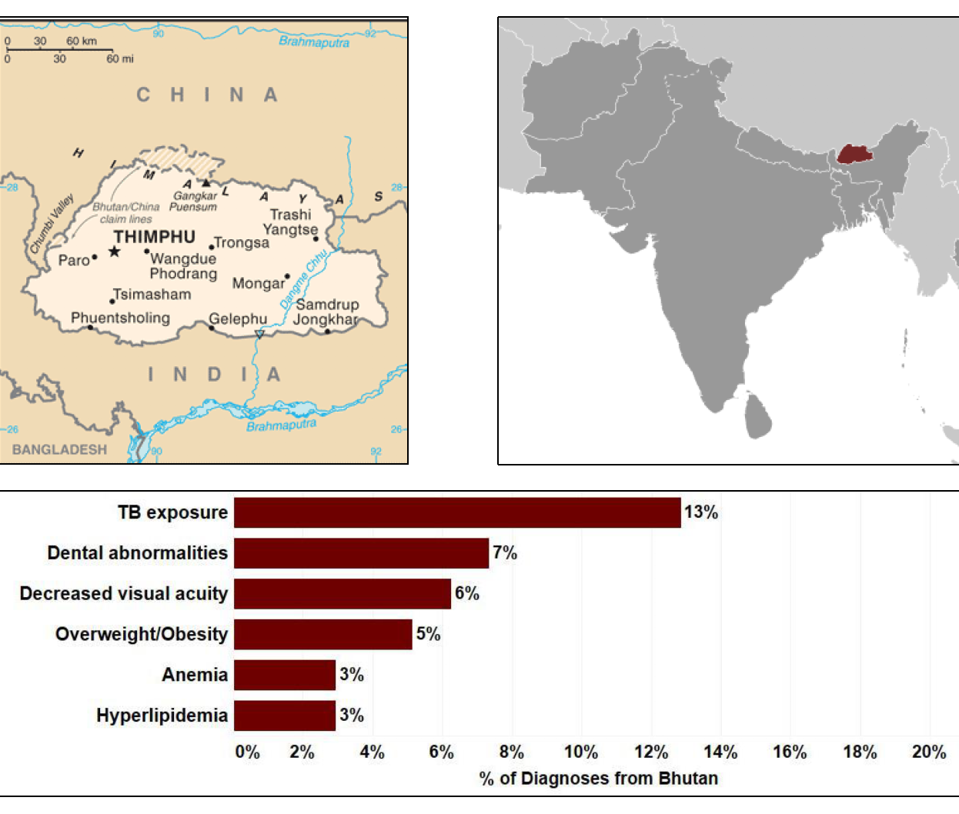
State of Refugee Health in Kentucky Top Health Conditions: Bhutanese

Slide 9
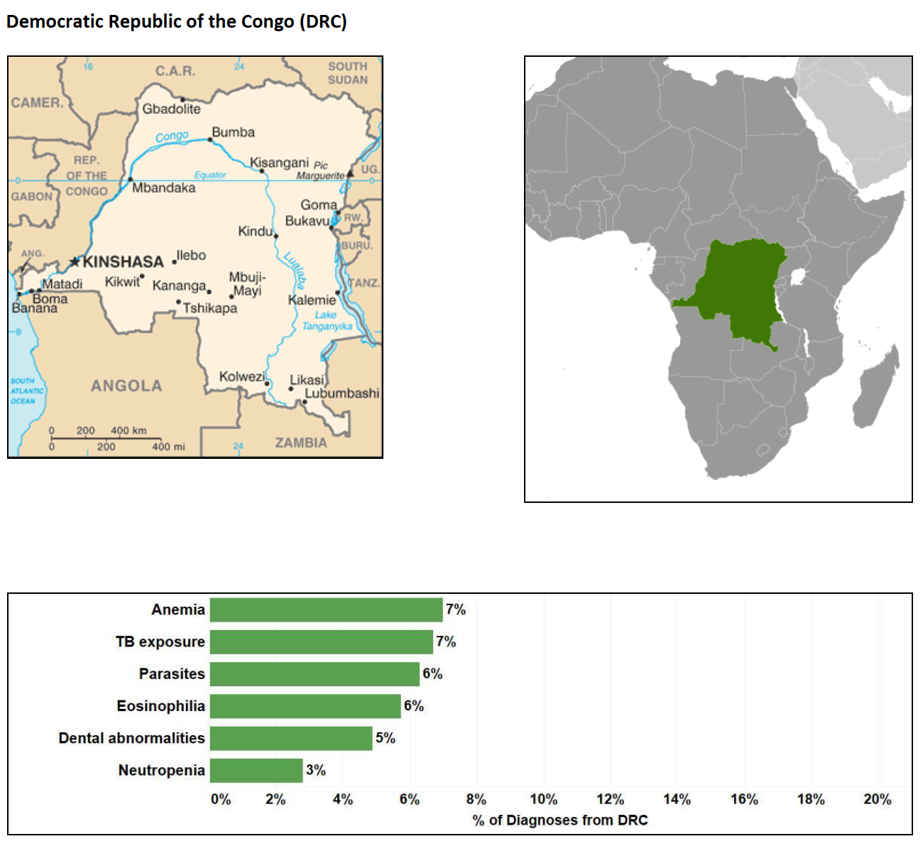
State of Refugee Health in Kentucky Top Health Conditions: Congolese

Slide 10
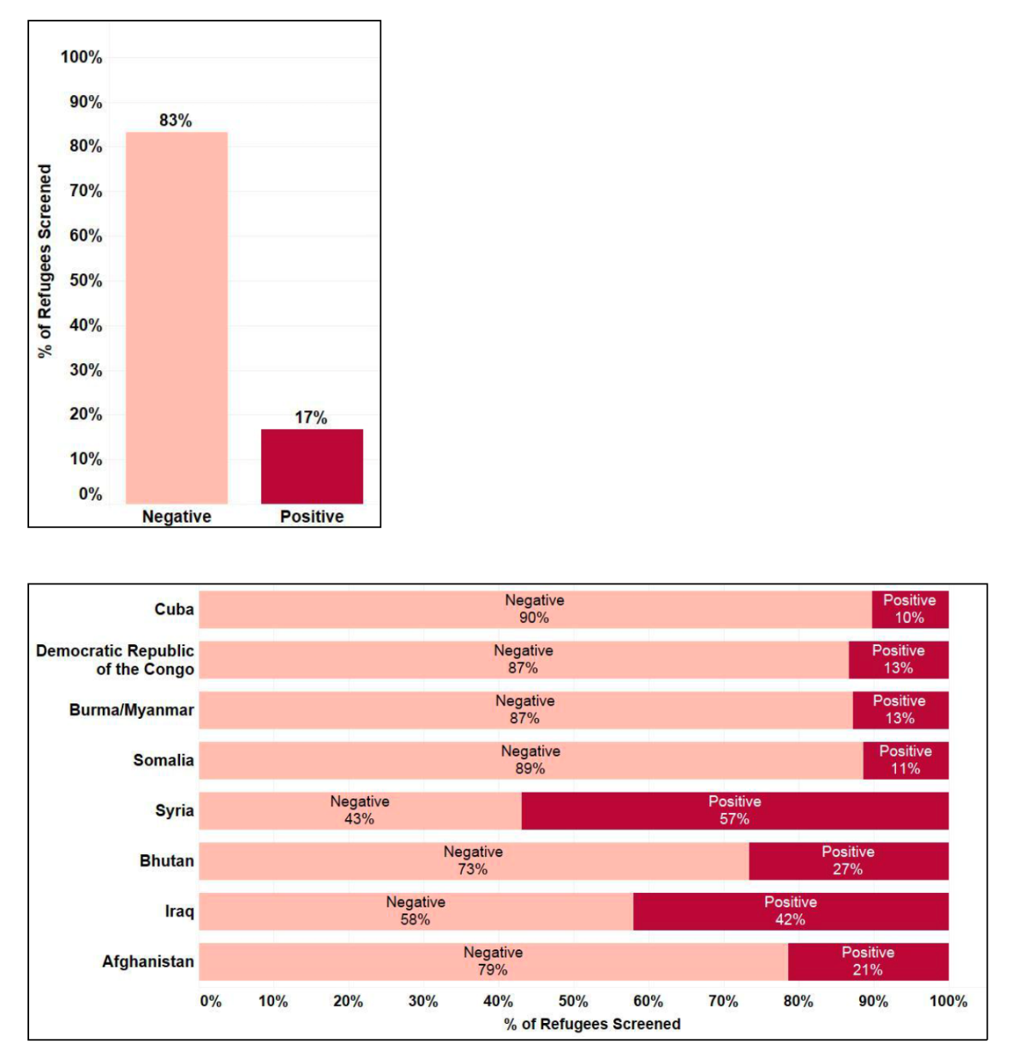
State of Refugee Health Kentucky Mental Health: RHS-15 Screen Positive
Mental health concerns are present across the entire refugee population
This is a complicating factor for all care and impacts all settings in which care is delivered

Slide 11
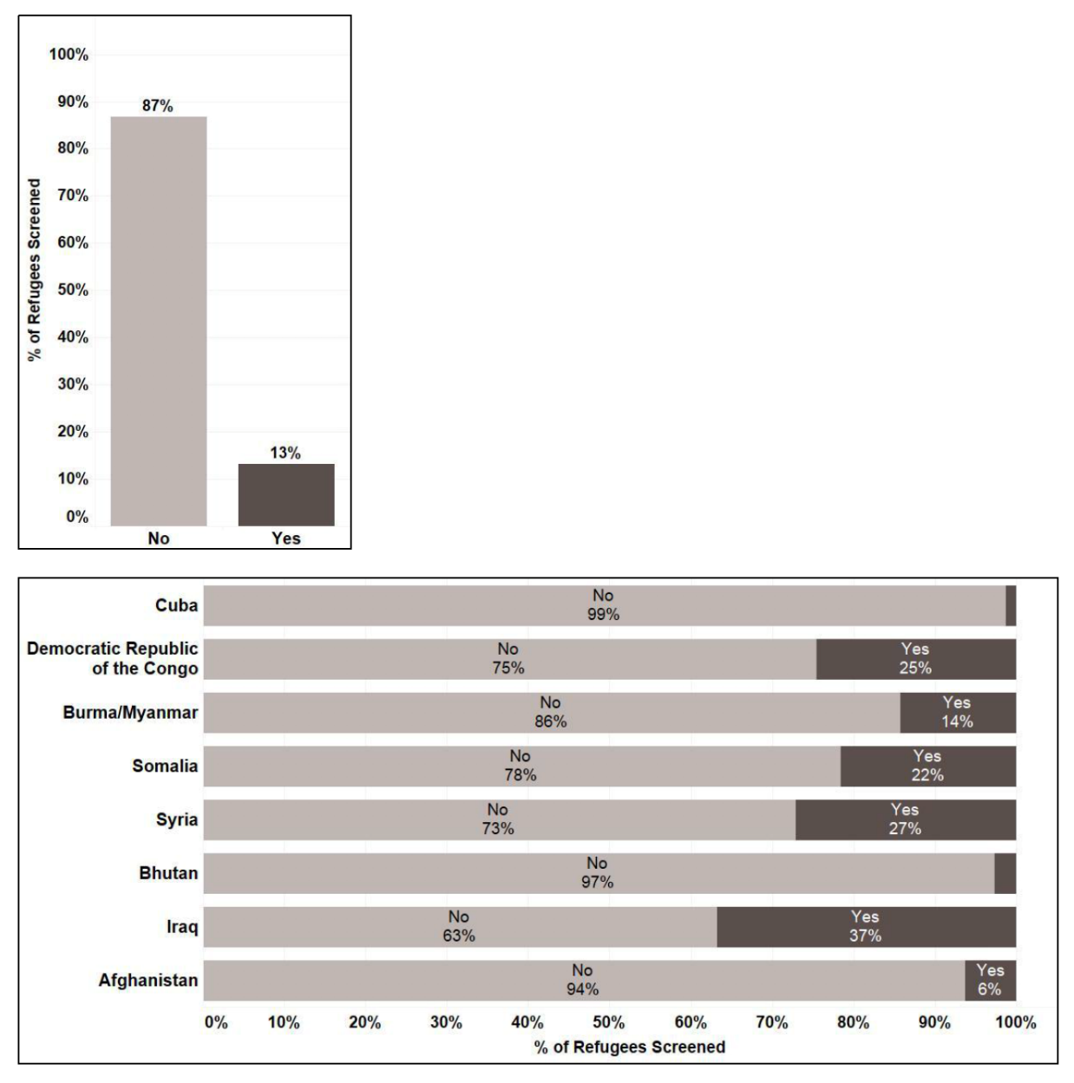
State of Refugee Health Kentucky
Mental Health: Torture
Consider the impact of witnessing or experiencing torture.
Influences abilities to ride public transportation, accept medical care, interact and communicate with providers, and general trust

Slide 12
Refugee Cash Assistance and Refugee Medical Assistance
Services Available to Refugees
8 Months to Self-Sufficiency
Housing
Medicaid
Health Screening
Food Stamps
ESL Classes
Cultural Orientation
Job Training

Slide 13
Perception of “sameness” of refugee populations
Homogeneity vs. Individualism
Are you meeting your patients where they need you to be?
All refugees, and all individuals have different:
Health needs
Values
Health priorities
Life priorities
Our job: to provide individualized care

Slide 14
Breakout Session Instructions
REFUGEE BREAKOUT SESSION

Slide 15
Student Responsibilities
EXPECTATIONS
Get to know your new patient
Listen to their story, and ask thoughtful questions
Critically think as a team to
Identify health disparities, social determinants of health, and barriers to accessing care
Navigate through health care options in the U.S.
Engage your peers to help resolve health concerns
By the end of this session, your patient should have a clear idea of what health care opportunities are available

Slide 16
Breakout Cases
CASE DEBRIEF
You have 30 minutes to
Explore health and social history
Share your role in the US health care system, and how you can serve this patient
Counsel the patient on their concerns with their health and barriers to accessing care
Cuban man, newly arrived to the US as CHEP parolee.
Recently diagnosed with HIV
Iraqi woman with two sons, newly arrived from Baghdad
Experiencing mental distress

Slide 17
Facilitators, please respond to the following:
LARGE GROUP DEBRIEF
What was the main challenge for this patient?
What assumptions were made about this patient?
What barriers were you able to resolve?

Slide 18
Exemplary Practice Models
REFUGEE BREAKOUT SESSION

Slide 19
Social Determinants of Health
Social Determinants
Economic Stability
Education
Health and Health Care
Neighborhood and Built Environment
Social and Community Context
Healthy People 2020. Social determinants of health. 2016; https://www.healthypeople.gov/2020/topics-objectives/topic/social-determinants-of-health. Accessed July 6, 2016.
Notes:
Pull this up as a review from morning (30 seconds).
Economic Stability
Poverty
Employment
Food Security
Housing Stability
Education
High School Graduation
Enrollment in Higher Education
Language and Literacy
Early Childhood Education and Development
Health and Health Care
Access to Health Care
Access to Primary Care
Health Literacy
Neighborhood and Built Environment
Access to Healthy Foods
Quality of Housing
Crime and Violence
Environmental Conditions
Social and Community Context
Social Cohesion
Civic Participation
Perceptions of Discrimination and Equity
Incarceration/Institutionalization

Slide 20
Challenges within the Health System
BARRIERS TO CULTURALLY-EFFECTIVE CARE
Treatment bias
Perceived discrimination
Mistrust of medicine and health systems
Patient Navigation
Health Literacy
Interpretation Communication Barriers
Notes:
Treatment bias
Perceived discrimination
Mistrust of medicine and health systems
Patient Navigation
Health Literacy
Interpretation Communication Barriers
Cultural or literal
Phone interpretation – dialect
Lack of understanding of terminology

Slide 21
Considerations
CULTURALLY-EFFECTIVE CARE
Do you speak the other person’s language?
Are you familiar with the culture?
Familiarity with trauma informed care/treatment?
Gender preferences
Concept of time
Eye contact
Notes:
Do you speak the other person’s language?
Language access services?
Cultural broker
Are you familiar with the culture?
Perceptions of symptoms and treatment
Western medicine vs. other
Familiarity with trauma informed care/treatment?
Gender preferences
Concept of time
Eye contact

Slide 22
Considerations
Culturally-Effective Care
Understanding instructions/how to take medication
Availability of payment options and plans
Trust/fear
Paperwork
Verbal
Homeland Security
Notes:
Understanding instructions/how to take medication
Long-term vs. short-term medication (immediate perception of cure)
Availability of payment options and plans
Trust/fear
Paperwork
Verbal
Homeland Security

Slide 23
Challenges in quantifying disparities
DISPARITIES
Lack of data
Before disparities can be addressed they have to be identified
Many populations of great diversity lumped together (i.e. “Asian” or “Hispanic”)
Immigrant and refugee populations that arrive in the US with better health status than average native-born US populations lose this health status advantage after a number of years¹
Edberg, M., Cleary, S., & Vyas, A. (2011), A trajectory model for understanding and assessing health disparities in immigrant/refugee communities. J Immigrant Minority Health, 13, 576-584)

Slide 24
Immigrant and Refugee Populations
STRATEGIES for Culturally Effective Care
Build Rapport/Trust:
Provide extended time visits
Make follow up appointments prior to leaving current visit
Understand transportation systems/provide bus passes
Follow up on referrals for patients
Consider home/community visits
Designate regular times for refugees
Notes:
Add tips for appropriately using interpreter, assisting with patient navigation

Slide 25
Immigrant and Refugee Populations
STRATEGIES for Culturally Effective Care
Build Structures:
Allow for flexibility in your rules/policies (e.g. arriving late, rescheduling, caring for multiple family members at once)
Commit to full language access (non-family interpreters, literature, complete description of care/prescriptions)
Create referral networks with competent providers and reduce # of referrals
Hire a Case Managers/Cultural Liaisons/Patient Navigators
Develop rolls for all staff in refugee care and partnerships

Slide 26
Immigrant and Refugee Populations
STRATEGIES for Culturally Effective Care
Train All Staff:
Refugee 101
Cultural humility
Cultural norms for prominent populations served
Language access commitment and procedures

Slide 27
Core Concepts for Refugee Healthcare
● Culture is not static; it consists of multiple variables
● Culture should be reframed with a perspective beyond race and ethnicity
● The patient’s perspective is illness, while the physician views the same issue as a disease
● Core cultural issues include misunderstanding in situations, interactions and behaviors
● Social factors of disease
● Negotiating across cultures with the goals of mutual agreement, relationship building, agenda-setting, assessment, problem clarification and closure

Slide 28
Core Concepts for Refugee Healthcare
● Kleinman questions- use as a framework for understanding the refugee perspective:
○ What do you call this problem?
○ What do you believe is the cause of this problem?
○ What course do you expect it to take?
○ How serious is it?
○ What do you think this problem does inside your body?
○ How does it affect your body and your mind?
○ What do you most fear about this condition?
○ What do you most fear about the treatment?
Kleinman A, Benson P. Anthropology in the clinic: the problem of cultural competency and how to fix it. PLoS medicine. 2006;3(10):1-4. Available at: http://eutils.ncbi.nlm.nih.gov/entrez/eutils/elink.fcgi?dbfrom=pubmed&id=17076546&retmode=ref&cmd=prlinks.

Slide 29
Exemplary Models
INTERPROFESSIONAL PRACTICE
Open Door Health Center, Mankato, MN - http://www.odhc.org/ Non-profit community health center providing quality and affordable medical, dental, and behavioral health care. Staff reflective of the population served, bilingual staff.
Refugee Health Program at the Anthony Jordan Health Center, Rochester, NY – http://www.jordanhealth.org/refugee-health/ Primary care setting for entire families with on site translation services in 8 languages.
Refugee Program at the Squirrel Hill Health Center, Pittsburg, PA https://squirrelhillhealthcenter.org/refugee-program/ – Provides integrated care regardless of insurance or ability to pay. Videos explaining first medical visit.
The Refugee Women’s Health Clinic of the Maricopa Integrated Health System, Pheonix, AZ http://www.refugeewomensclinic.org/ – Provides educational classes, counseling and community outreach, and employs Cultural Health Navigators.

Slide 30
Within Local Community
Resources
Catholic Charities
Kentucky Refugee Ministries
Americana Community Center
University of Louisville Global Health Center
Family Health Centers
Home of the Innocents (pediatrics)
Notes:
Describe what each does

