Slide 1
Racism in Health

Slide 2
Defining Racism
Racism is…
“beliefs, attitudes, institutional arrangements and acts that tend to denigrate individuals or groups because of phenotypic characteristics or ethnic group affiliation.” (Clark et al., 1999)
Manifested through stereotypes, prejudices, and/or discrimination
Racism is NOT binary
Racism as a fundamental cause of racial inequalities in health

Slide 3
Defining Racism
Racism is…
“beliefs, attitudes, institutional arrangements and acts that tend to denigrate individuals or groups because of phenotypic characteristics or ethnic group affiliation.” (Clark et al., 1999)
Manifested through stereotypes, prejudices, and/or discrimination
Racism is NOT binary
Racism as a fundamental cause of racial inequalities in health

Slide 4
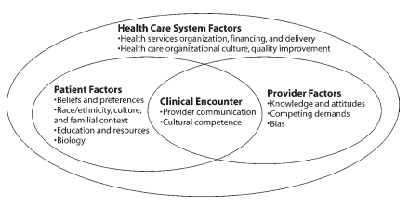
Potential Determinants of Health Disparities within the Health Care System
Kilbourne, A. M., Switzer, G., Hyman, K., Crowley-Matoka, M., & Fine, M. J. (2006). Advancing health disparities research within the health care system: a conceptual framework. American Journal of Public Health, 96(12), 2113-2121.

Slide 5
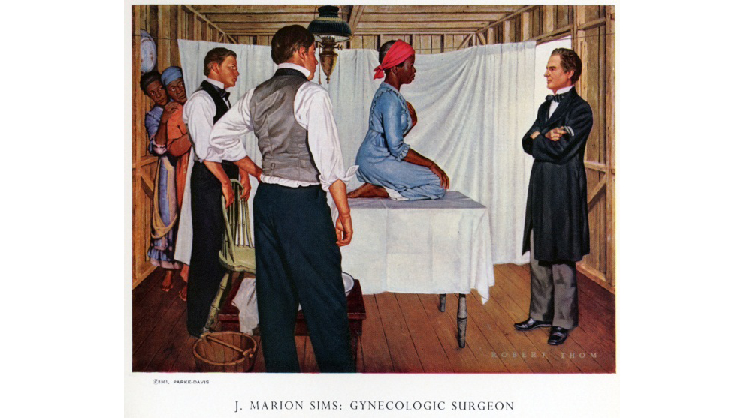
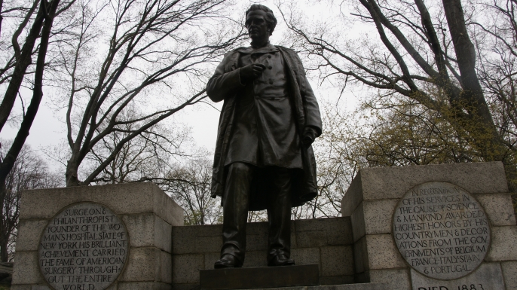
The Legacy of Slavery on Patients, Past & Current
Dr. J. Marion Sims, Father of American Gynecology
Vesico-vaginal fistulae (incontinence) on 12 enslaved women between 1844 to 1849
Without anesthesia
Owens, D. C. (2017). Medical Bondage: Race, Gender, and the Origins of American Gynecology. University of Georgia Press.

Slide 6
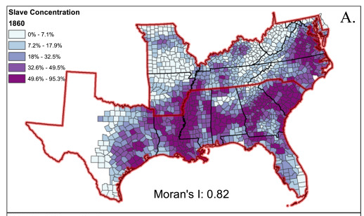
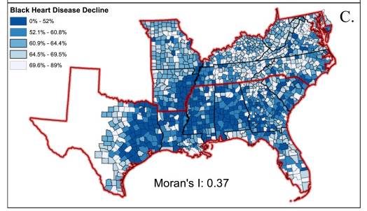
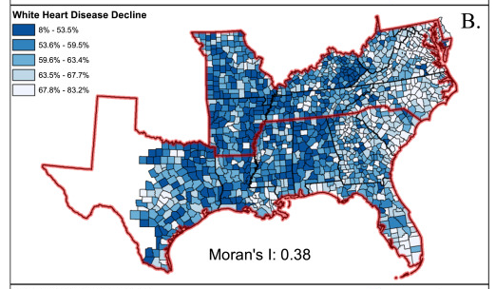
The Legacy of Slavery on Patients, Past & Current
The legacy of slavery and contemporary declines in heart disease in the U.S. South
Kramer, M. R., Black, N. C., Matthews, S. A., & James, S. A. (2017). The legacy of slavery and contemporary declines in heart disease mortality in the US South. SSM-Population Health, 3, 609-617.

Slide 7
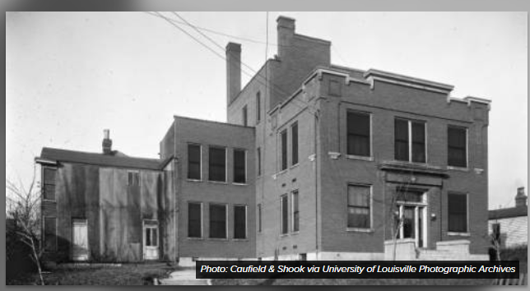
Responses to Racism & Exclusion in Clinical Care
Building an African-American healthcare community in Louisville, 1865-1990 (Calloway, 2013)
Louisville National Medical College & Red Cross Hospital
Park DuValle Community Health Center
“limited, but rich” community of care that some viewed was lost with integration
Distrust of interactions with white health professionals
Calloway, A. (2013). The evolution of healthcare for Louisville's African American community, 1865-1990 (Unpublished doctoral dissertation). University of Louisville, Louisville, KY.

Slide 8
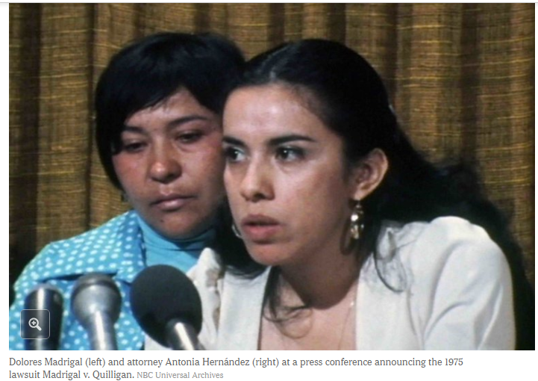
Early & Persistent Clinical Encounters & Provider Factors among Latinos
Historical examples of racism tied heavily to institutional/structural racism & stereotypes
Facility built in 1910 by U.S. Public Health Service & Bureau of Immigration to “sanitize” Mexican and other Latino/a/x immigrants.
Madrigal v. Quilligan (1975)
Sterilization of 10 women in Los Angeles
Bullied by nurses and doctors after having cesarean section
Form of “family planning” (“she already had five kids”)
Latinos are least likely to utilize health services (Census, 2014)
Stern, A. M. (1999). Buildings, boundaries, and blood: Medicalization and nation-building on the US-Mexico border, 1910-1930. The Hispanic American Historical Review, 79(1), 41-81.

Slide 9
Take-Home Points
Racism as a fundamental cause of racial inequalities in health
Racism is multidimensional and not binary
It is a “problem of racism”, not a problem of race

Slide 10
Racism in Health
Think
Pair
Share
Take a few seconds to think about and write on your notecards contemporary examples of racism in your fields of practice. These could be in your classrooms, research, clinical settings, etc.
Find a partner, preferably from a different degree program
Share your examples with your partner.

Slide 11
Panel Discussion
How do higher education/professional schools (or the broader health system) currently perpetuate racism in health?
How can students use their current and/or future immense power and privileges to change institutional and systemic racism?

Slide 12
Group Orientation Transition
Raise your hand if within your profession you do this:
Provide direct services to patients/clients
Complete a patient assessment
Do home visits
Develop a treatment plan
Preventative education
File computerized notes
Testify in court
Discharge/aftercare planning with patient/family

Slide 13
BREAKOUT ROOMS
10:30 – 11:00: Group Orientation
Group Black – Teams 1-34 (Great Hall)
Group Red – Teams 1-14 (Pavilion Lobby)
Group Red – Teams 15-34 (Education Center)
11:00 – 12:30: Breakout 1
Group Black – Teams 1-34 (Great Hall) Refugee/Immigrant
Group Red – Teams 1-14 (Pavilion Lobby) LGBT Health
Group Red – Teams 15-34 (Education Center) LGBT Health
1:15 – 2:45: Breakout 2
Group Red – Teams 1-34 (Great Hall) Refugee/Immigrant
Group Black – Teams 1-14 (Pavilion Lobby) LGBT Health
Group Black – Teams 15-34 (Education Center) LGBT Health

