Slide 1
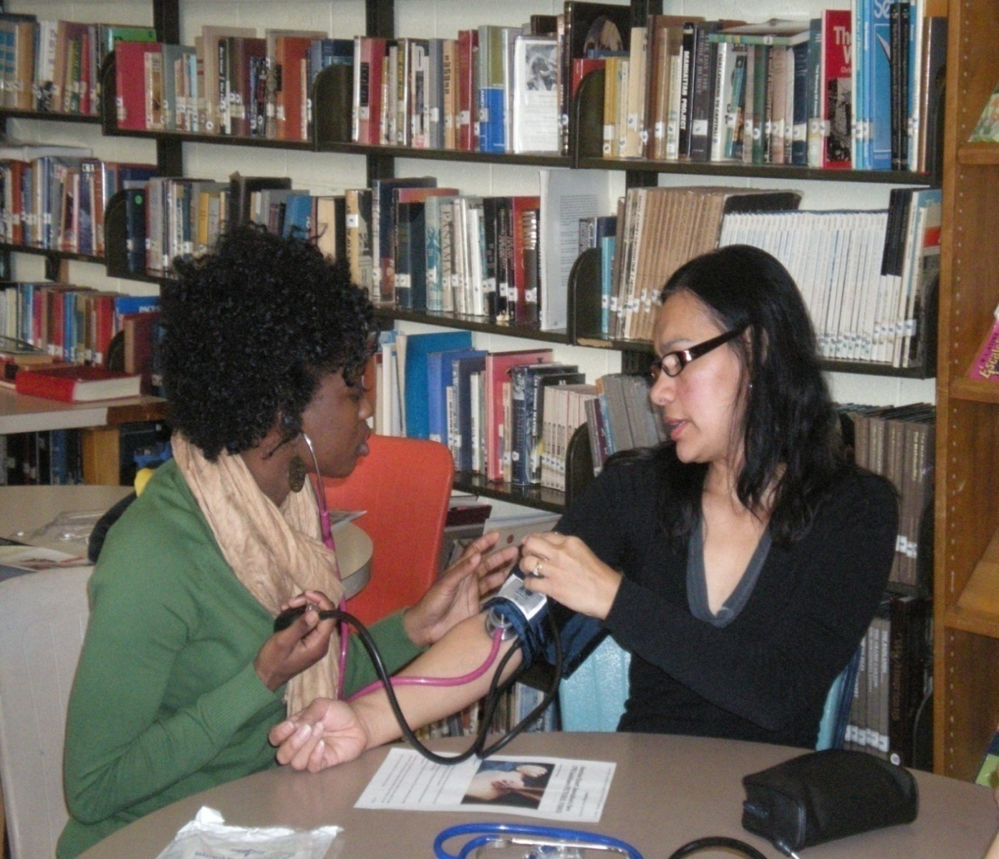
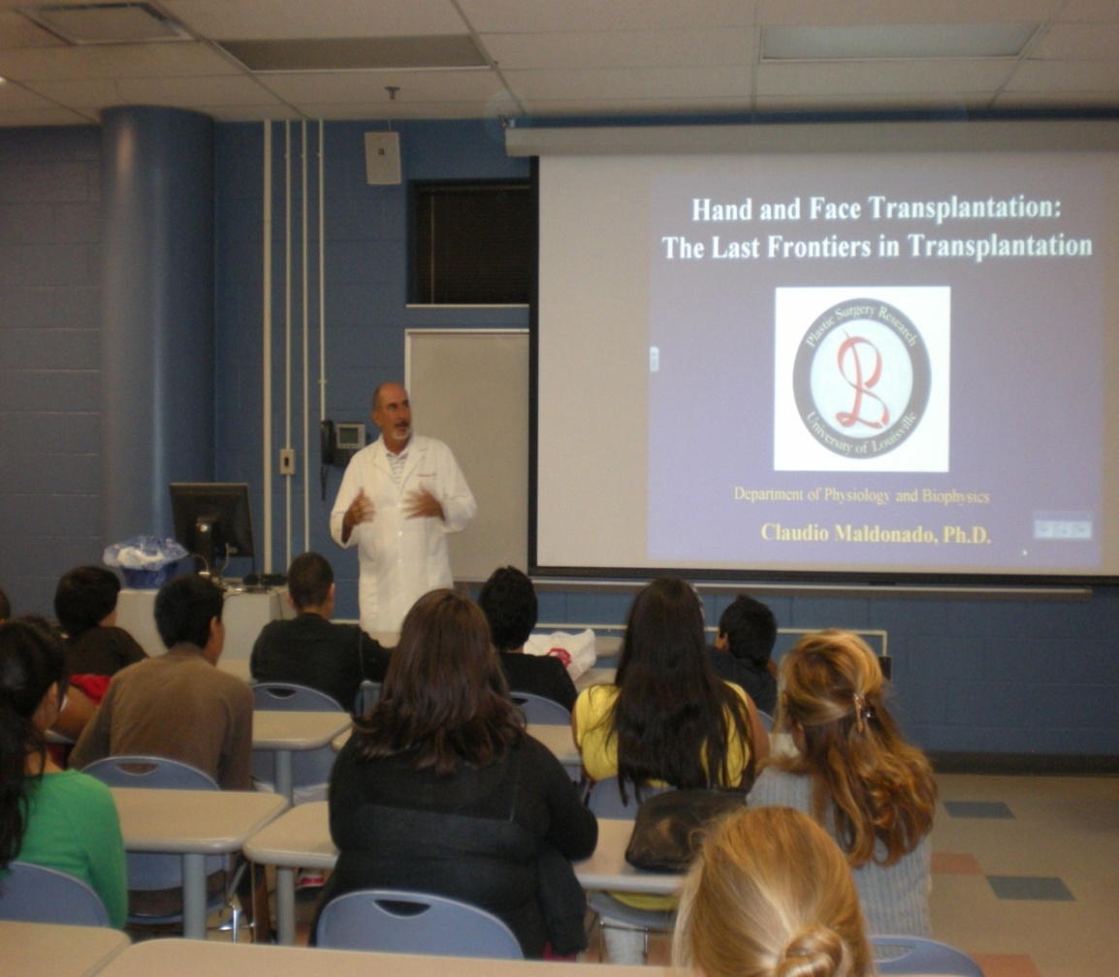
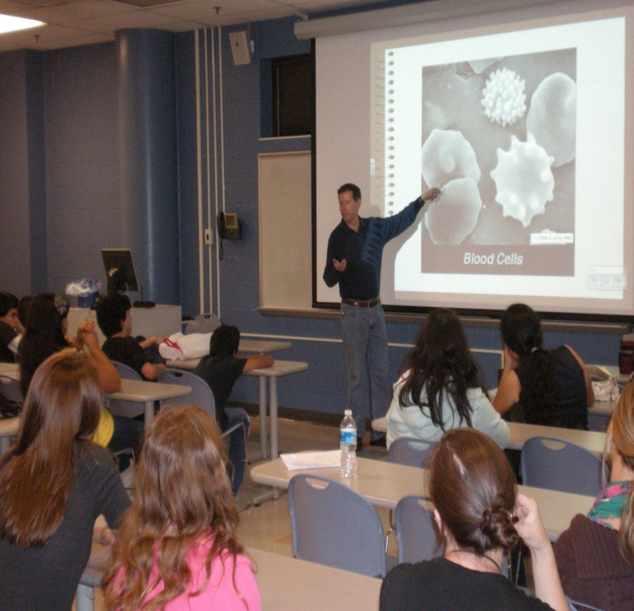
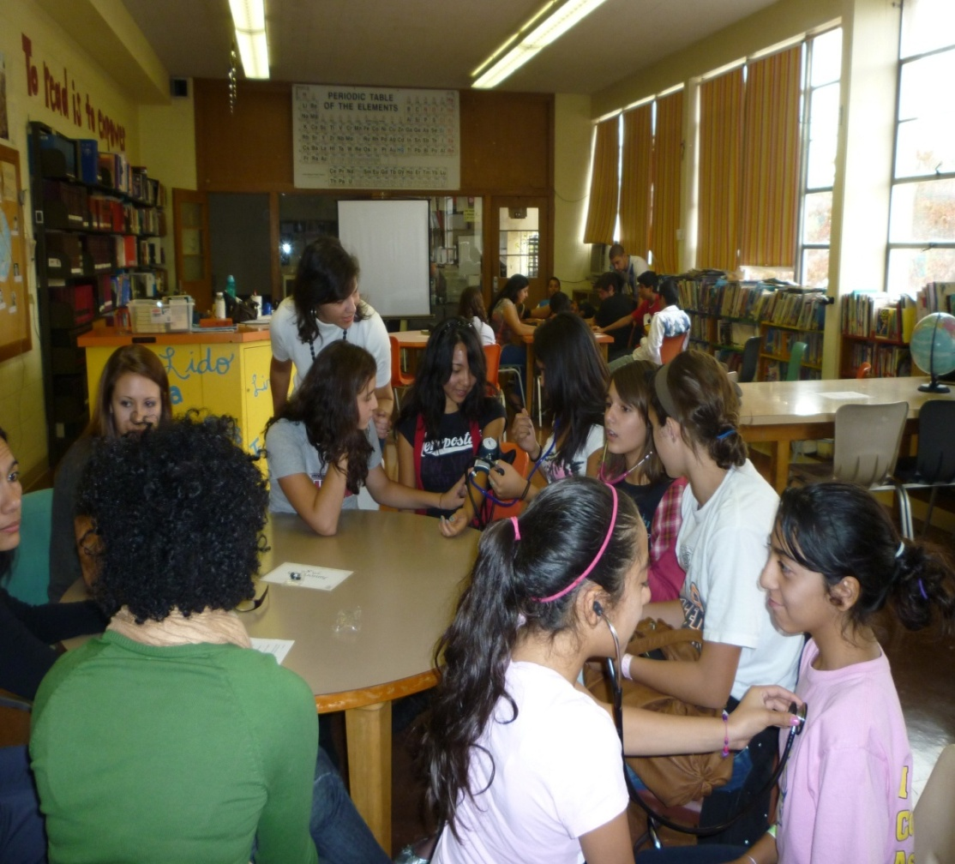
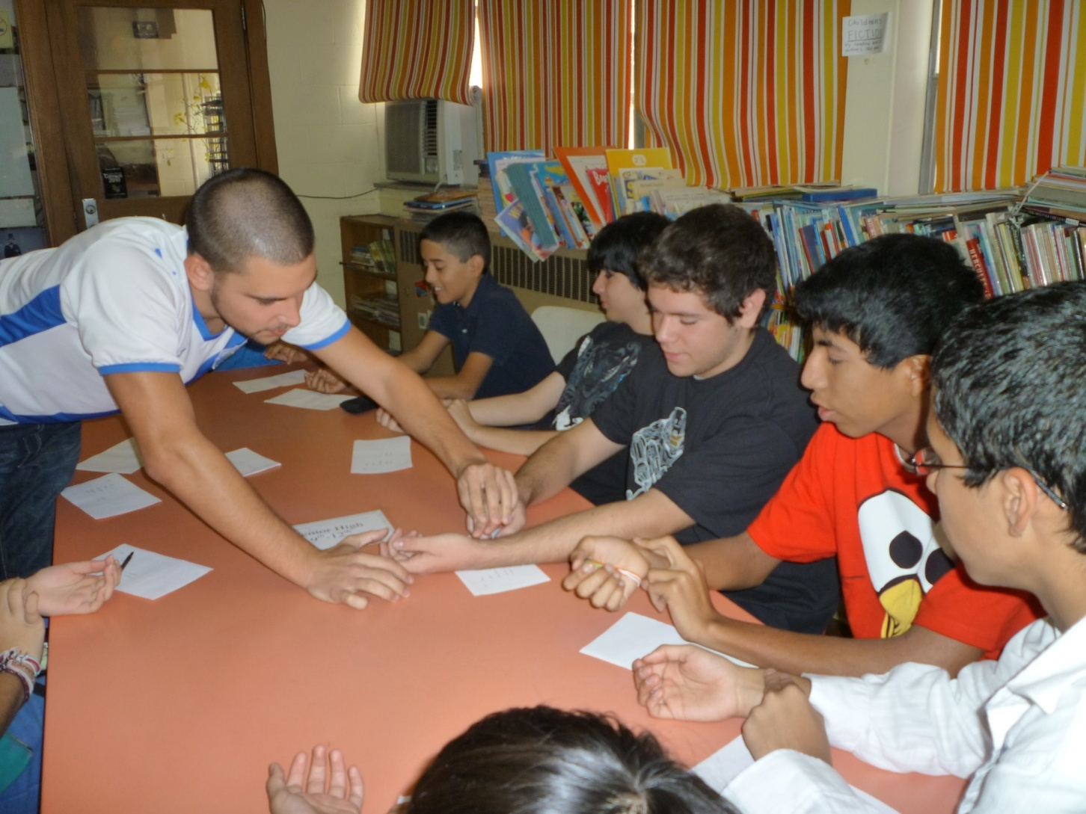
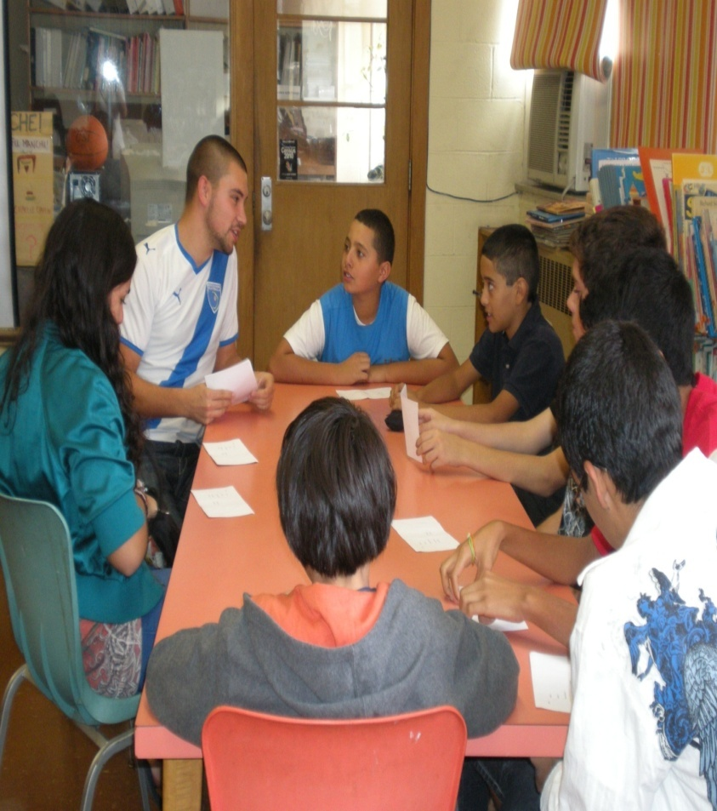
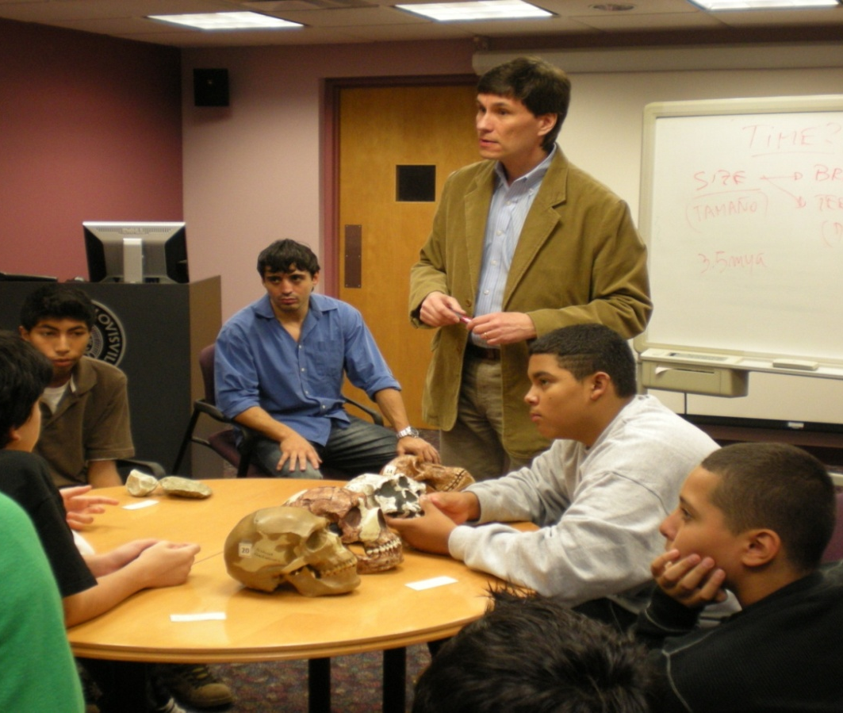
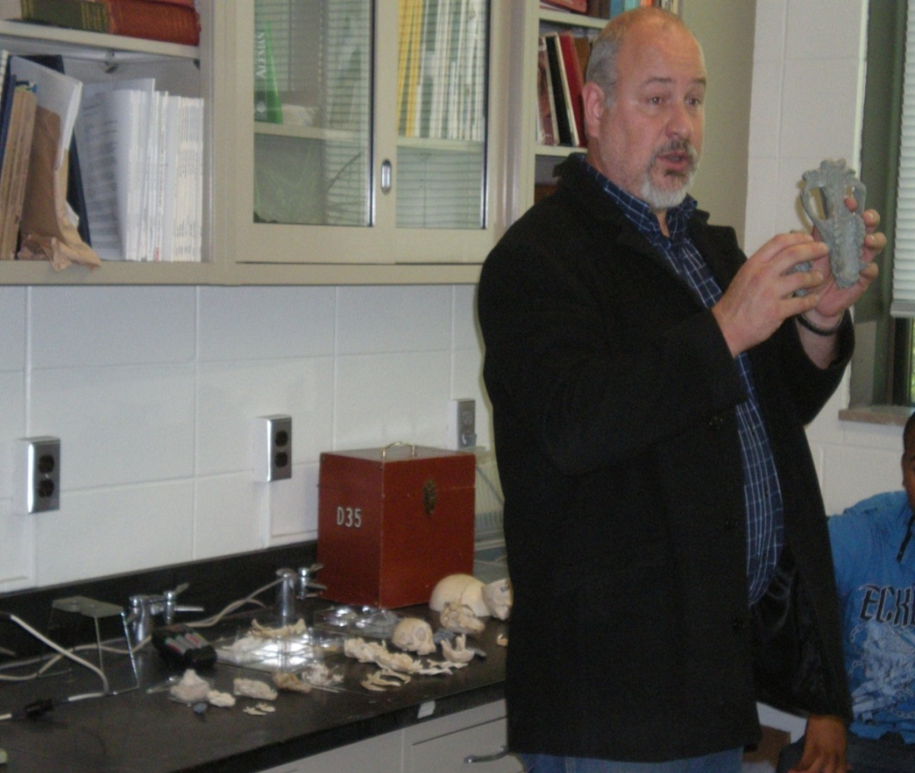
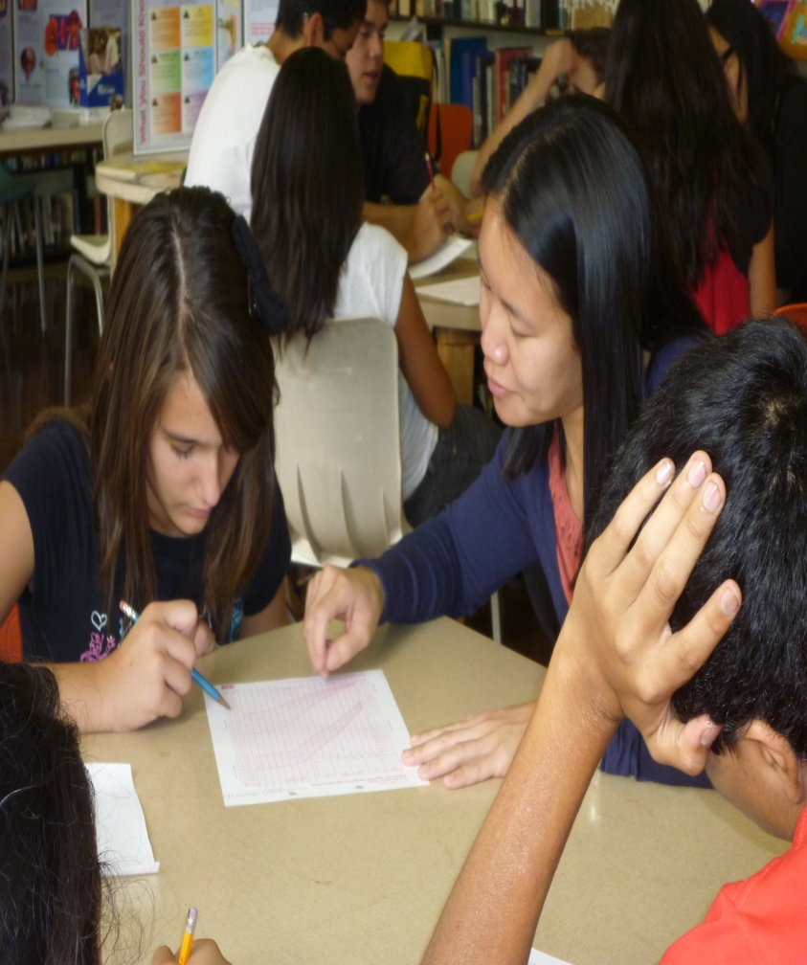
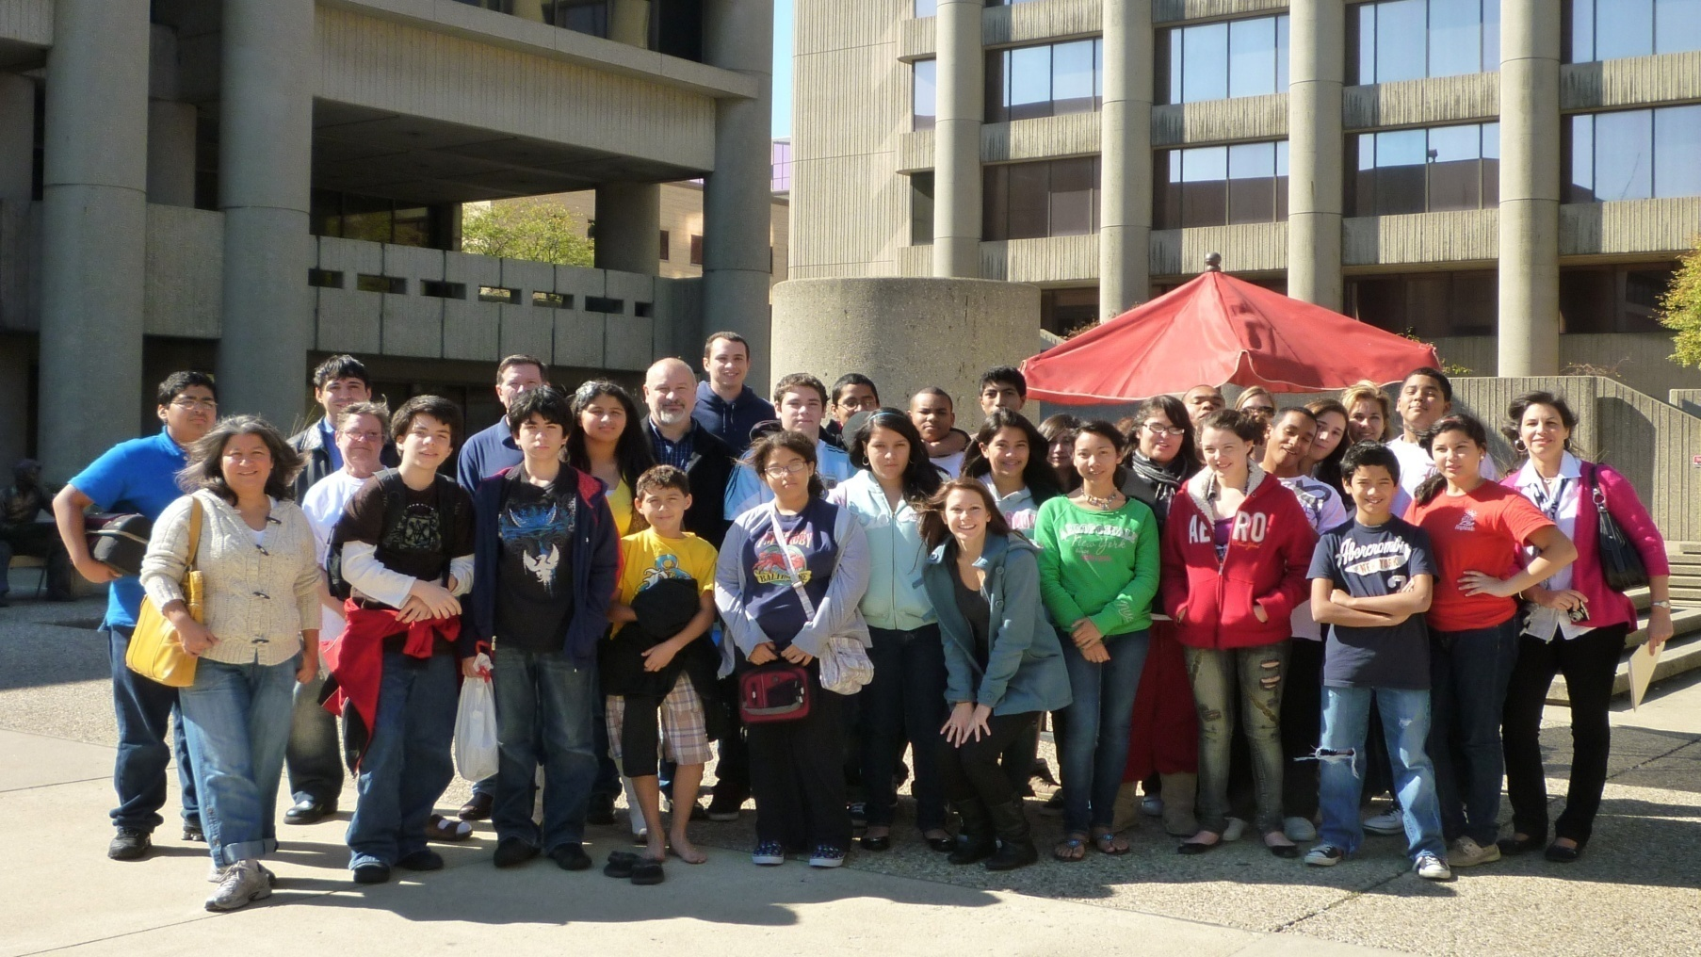
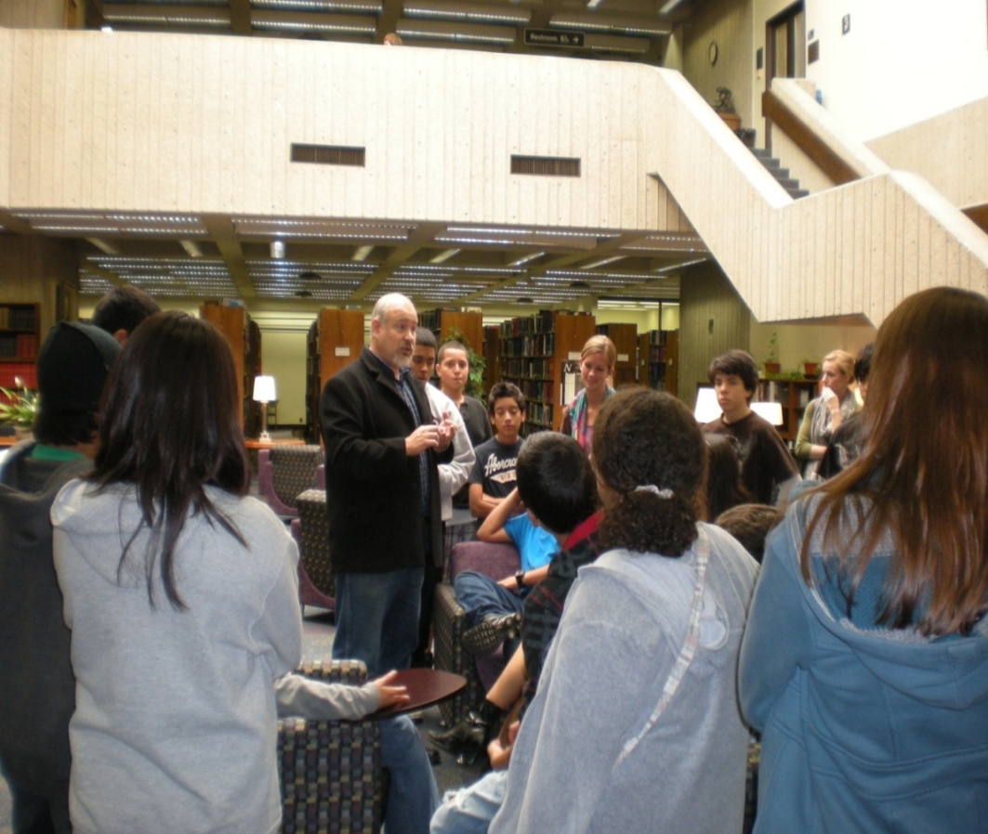
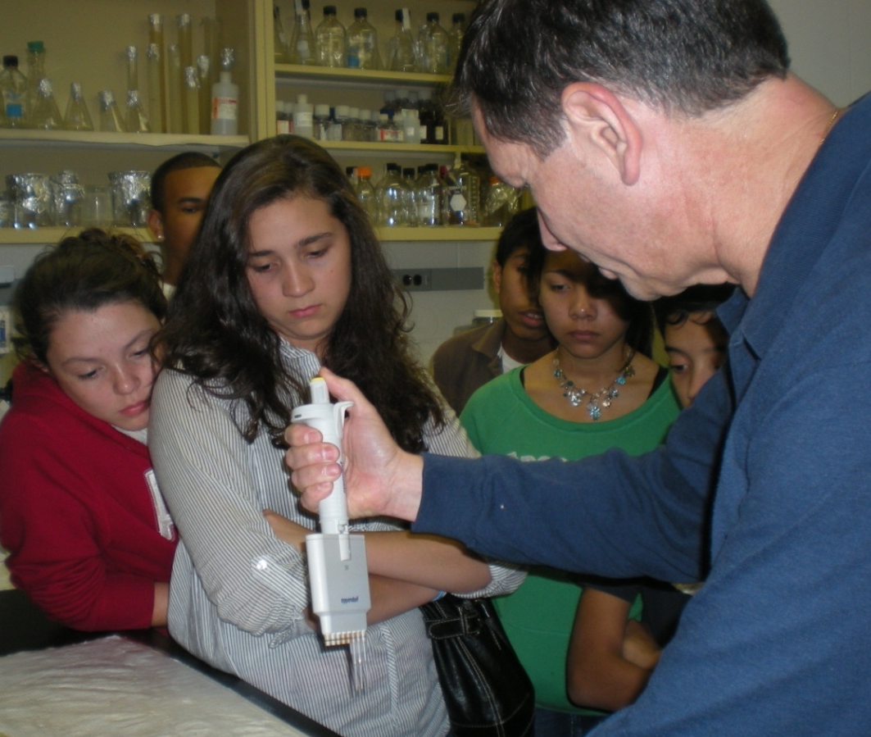
Encouraging Interest in Health Science Career: A Model for Hispanic Undergraduates Alex Marti¹; Rafael Fernandez-Botran, Ph.D²; Gilandra K. Russell, M.S.³; M. Fernanda Nota, MD⁴ Diversity Committee – School of Medicine - University of Louisville, Louisville, KY
1: School of Medicine
2: Department of Pathology
3: Department of Pharmacology & Toxicology
4: Department of Pediatrics
Pediatrics
Background
Methodology
Results
Nationwide Hispanics are 16% of the population yet represent only 3.6% of doctoral degrees. At the University of Louisville only 2% of the 22,031 enrolled students are Hispanic. A way to provide health care service that overcomes language and cultural barriers is ensure that our health care system addresses the needs of diverse communities by recruiting members of the latter into higher education health careers.
A two-day science career workshop was offered to “Adelante Hispanic Achievers”
“Adelante” members are Hispanic/Latino middle and high school students. The organization’s goal is to encourage post secondary-education achievement and professional careers.
Hispanic professionals from different U of L departments were invited to participate, a biologist/anthropologist,a biologist/paleontologist, an immunologist, a physiologist, a registered nurse and two physicians. Also third-year medical students were actively involved and collaborated with the activity; one of them as presenter.
Each professional spent 30 min to share with the undergraduates their unique stories of why they chose a science/medical career, discussed specific jobs and provided information about education requirements.
The second day was devoted to medical/nursing careers. Students gathered at a community center where medical/nursing activities were developed.
Pre and Post activity anonymous surveys were obtained from 26 students on the first day of the workshop, and from 15 on the second day.
Science was chosen in 23% (6/26) and in 46% (7/15) in pre and post activity surveys respectively. Interest in science increased by 23% post intervention; P value 0.2243 (Chi-square).
Blood Pressure Measurement
Objective
Increase interest and recruitment of Hispanic undergraduates in science careers.
Methodology
Carolina Imhoff , RN
A two-day science career workshop was offered to a local Hispanic youth group conducted by Hispanic professionals from different University of Louisville departments. Students participated on hands-on activities related to each professional area of expertise.
Auscultation of Heart and Lungs
Results
Claudio Maldonado, PhD
Claudio Maldonado, PhD
Pre and Post activity anonymous surveys were obtained. Interest in science increased by 23% post intervention, P value 0.2243 (Chi-square).
Conclusions
The change of interest in science after the intervention was not statistically significant, likely due to our small sample. However the survey helped to assess which factors our Hispanic undergraduate students see as barriers to obtaining higher education degree. We believe our multidisciplinary career day workshop is a good model to encourage Hispanic youth interest in higher science education careers.
Undergraduates expressed their interest in science lessons and experiments at school and agree that science is useful in everyday life.
Barriers to achieve career degree include: Money problems 84%, “not being smart enough” 15%, family problems 7%; work before studies 4%, being Hispanic 7%.
Alex Marti
Alex Marti
Changes in Pulse Before and After Activity
Fabian Crespo, PhD
Guillermo Rougier, PhD
“Adelante Hispanic Achievers”
Health Science Center – U of L
The first day was dedicated to basic science careers, and students were given a tour of U of L Health Science Center, where they visited two laboratories, and the Medical School library. They participated on hands-on activities related to each professional’s area of expertise.
Fernanda Nota, MD
Emily Tan, MD
Working with Growth Charts
Acknowledgements
Pre and post activity anonymous surveys were obtained. Surveys included: Grade in school, areas of interest, interest in reading science books or watching science TV shows, and barriers to achieve career degree.
Fabian Crespo,PhD: Dept. of Anthropology
Carolina Imhoff, RN: Norton Health Care
Claudio Maldonado,PhD: Dept. of Physiology & Biophysics
Guillermo Rougier,PhD: Dept. of Anatomical Sciences & Neurobiology
Emily Tan,MD: Dept. of Pediatrics
A special thank you to Mara Maldonado, Director; and Hannah Mael, Volunteer Coordinator/Community Liaison of “Adelante Hispanic Achievers” for making this project possible, and their commitment and genuine advocacy to the Hispanic/Latino youth in Louisville.
Guillermo Rougier, PhD
Rafael Fernandez, PhD
Natalia Paez & Agustin Ramirez: Third Year Medical Students

