Slide 1
Finding the “Perfect Postdoc” For You

Slide 2
Finding the “Perfect Postdoc” For You
Carol L Manahan, Ph.D.
From NPA
“Hi my name is Tom – I’m looking for a postdoc”
  It’s a 12 step self- help program
National Postdoctoral Association (http://www.nationalpostdoc.org/ )

Slide 3
Finding the “Perfect Postdoc” For You
Carol L Manahan, Ph.D.
From NPA
Step 1- Decide WHY you want to do a postdoc
Step 2- Determine the field in which you would like to study.
Step 3- Talk with your advisor and others to identify laboratories.
Step 4- Investigate the labs/Pis..
Step 5- Finish papers/experiments. Publish! Write/update CV.
Step 6- Ask your advisor and three other faculty members for letters of recommendation.
Step 7- Prepare for the interview: seminar and questions for the lab.
Step 8- Send out CVs and arrange meetings with prospective labs
Step 9- Read more papers from labs that you are visiting. Learn about benefits at institution.
Step 10- Practice, practice, practice your presentation.
Step 11- Go on the interview(s). Ask lots of questions.
Step 12- Decide which offer to take.

Slide 4
Why do a Postdoc?
What is a Postdoc?
From the NPA
A postdoctoral scholar ("postdoc") is an individual holding a doctoral degree who is engaged in a temporary period of mentored research and/or scholarly training for the purpose of acquiring the professional skills needed to pursue a career path of his or her choosing.”

Slide 5
What is a Postdoc
From interview w Cathy Phillips
former Executive Director of the NPA
“Don't look at the postdoc as just a period of advanced research and increasing knowledge of a discipline. Also look at it as a time of professional development and growth in regard to lifelong learning and critical skills such as communication, professional etiquette, leadership and management, and responsible conduct of research.”

Slide 6
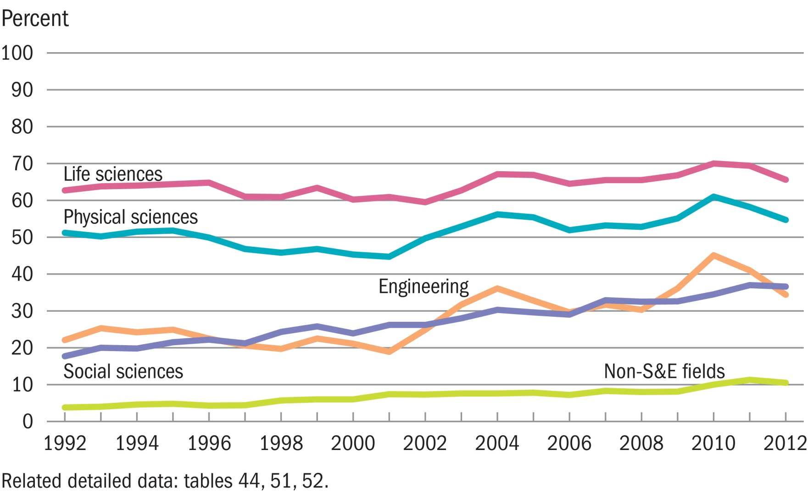
Postdoc rate, by field of study: 1992–2012
NSF
“Historically, postdoc positions have been a customary part of the early career paths of doctoral scientists in the life sciences and physical sciences; such positions re becoming increasingly prevalent in engineering and social sciences fields as well”

Slide 7
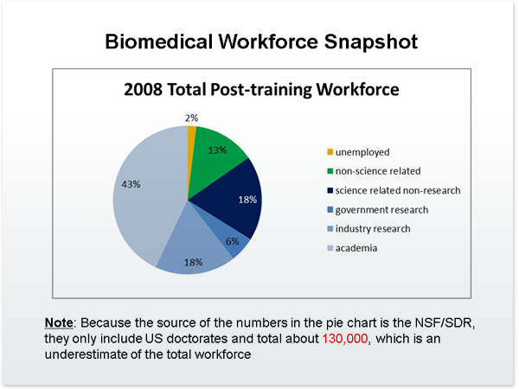
70% from PhD to Postdoc
30% direct to workforce
23% tenured or tenure track in biomedical research institutions

Slide 8
How many postdocs are there?
NSF estimates 30,800 – 63,400
“According to Science and Engineering Indicators there are 44,000 S&E doctorate holders in academic postdocs in 2011” - NPA Fact sheet
Why don’t we have a better handle on this?

Slide 9
Flavors of Postdoc
Postdoc
  Postdoctoral associate
  Postdoctoral fellow
  Postdoctoral scholar
  (multiple other variants)
Research Associates
  Research Associate
  Research Associate Sr.
Visiting Scientist
Research Scientist
Instructor
Research (Assistant) Professor
TRAINING POSITIONS
TRAINING/non-training
NON-Training

Slide 10
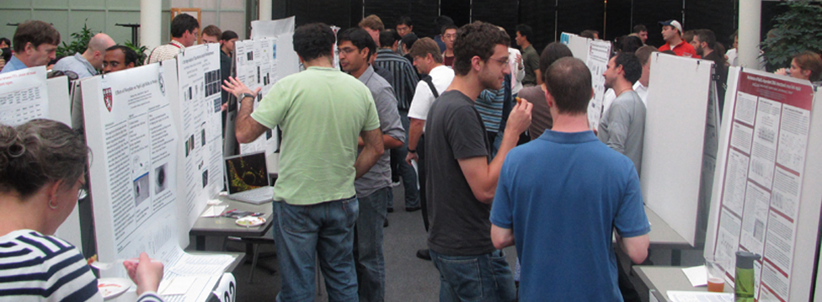
Harvard Medical School Facts & Figures:
Est. 1782
11,951 faculty
9 Preclinical Departments & 17 Affiliate Hospitals
$285M in grants and contracts FY12
Postdoc Demographics
Total ~850

Slide 11

Facts & figures:
22,529 students, 391 PhD students, 112 Postdocs,
Medical School, ~600 medical students, 141 PhD students, 98 Postdocs
Postdoctoral trainees
International
(temp visa)
US
LPR
Total 161

Slide 12
How does it differ from Graduate education?
  Education/Training continuum
  (undergrad---PhD---postdoc……..)
Post-doc transition to career independence
  Graduate School
    Focused on education
      broad based education in discipline
      Develop research/scholarly activity skills
      specific research training with expectations for some productivity
  Postdoc - training
    Focused on skills needed to became an independent practitioner - learning what it takes to be successful
      Narrow focus
      Training towards independence
      High expectation of research productivity
Life-long learning

Slide 13

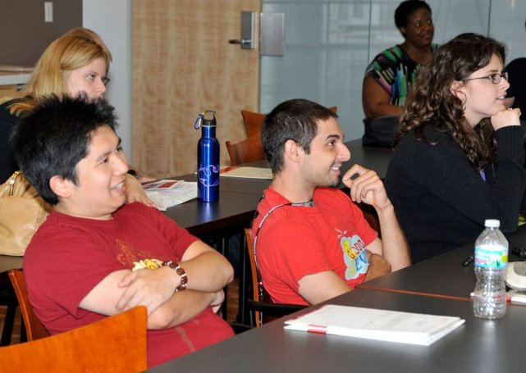
Graduate Students

Slide 14
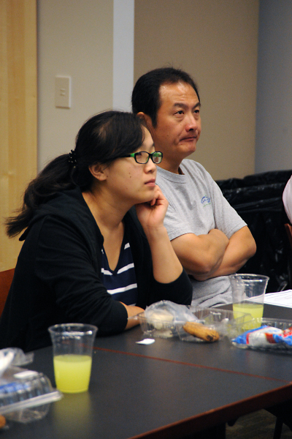
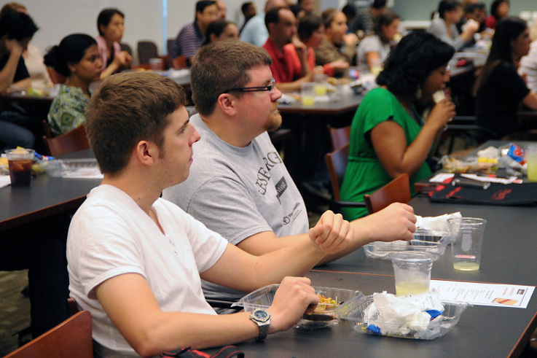


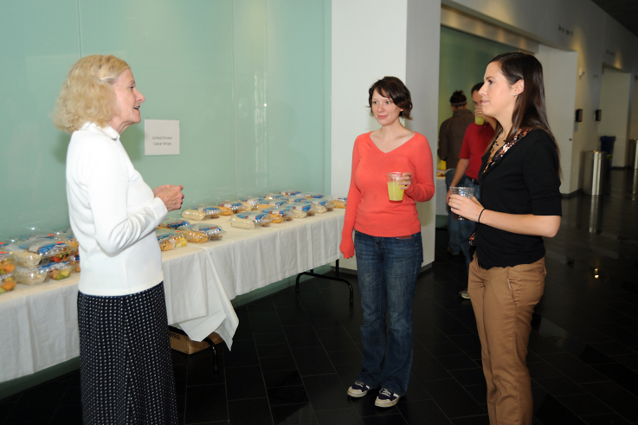


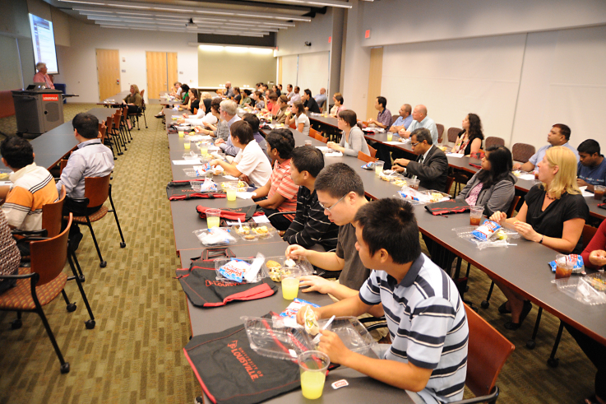
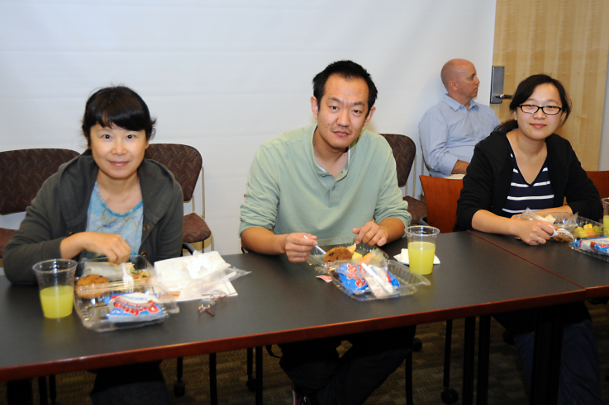
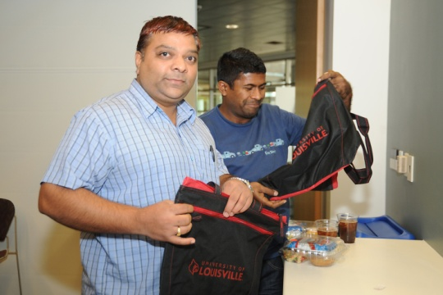

Slide 15
What is a postdoc supposed to learn?
Core Competencies NPA

Slide 16
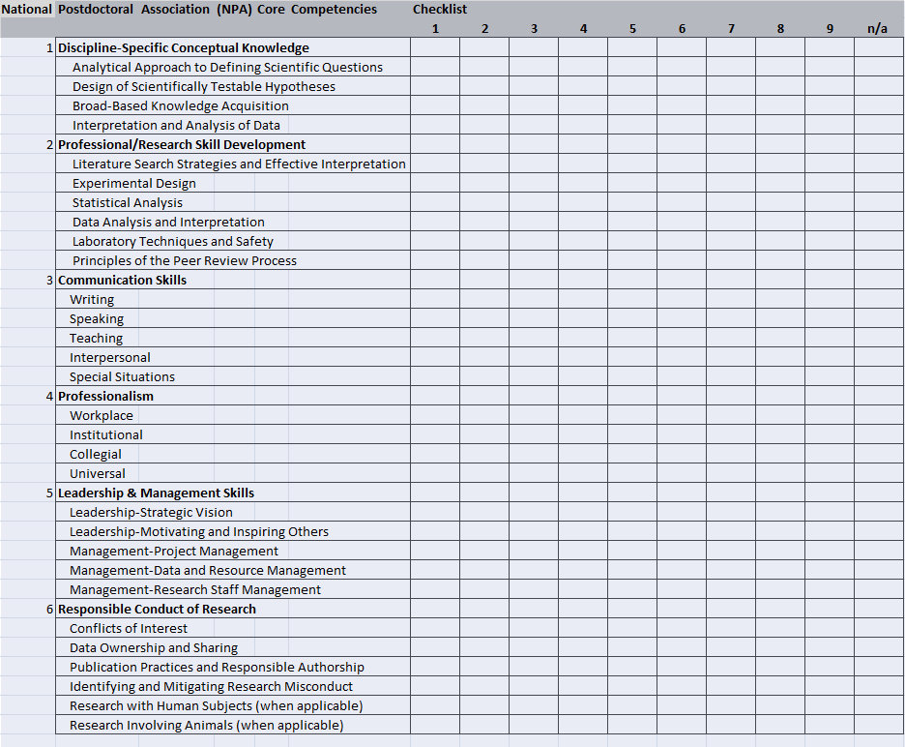

Slide 17
IDPs
Individual Development Plan (myIDP)
career development tool
  Self-assessment
  Assessment by mentor

Slide 18
Why do a postdoc?
Post-doc increases your skill set
Post-doc focuses your career choice
    During postdoc – still choose multiple career paths
    Longer you go in a postdoc(s) – more focused your career choice becomes
Postdoc: A postdoctoral scholar ("postdoc") is an individual holding a doctoral degree who is engaged in a temporary period of mentored research and/or scholarly training for the purpose of acquiring the professional skills needed to pursue a career path of his or her choosing.”

Slide 19
Anecdotal information (I have no statistics to back this up)
  Grad school ---postdoc
    Stay in same research area
    Move slightly away from research area (change model systems)
    Move into entirely new area
  Most people work in the specific area in which they did their postdoc

Slide 20
How do you find a postdoc
No secret
  Wait for offer to come to you
    (Great when it happens – but don’t expect it)
  Go out and find one
    Networking connections (mentor and other faculty)
    LinkedIn
    National meetings
    Cold call - preselected group based on interests
      emails/letters
      NIH funding status (Reporter)

Slide 21
Finding the “Perfect Postdoc” For You
Carol L Manahan, Ph.D.
From NPA
Step 1- Decide WHY you want to do a postdoc
Step 2- Determine the field in which you would like to study.
Step 3- Talk with your advisor and others to identify laboratories.
Step 4- Investigate the labs/Pis..
Step 5- Finish papers/experiments. Publish! Write/update CV.
Step 6- Ask your advisor and three other faculty members for letters of recommendation.
Step 7- Prepare for the interview: seminar and questions for the lab.
Step 8- Send out CVs and arrange meetings with prospective labs
Step 9- Read more papers from labs that you are visiting. Learn about benefits at institution.
Step 10- Practice, practice, practice your presentation.
Step 11- Go on the interview(s). Ask lots of questions.
Step 12- Decide which offer to take.

Slide 22
Selection
Location:
  do I really want to do a postdoc in Nome Alaska?
Do I really want to work on a ------ project?

Slide 23
When and how do I look?
See light at the end of the dissertation tunnel, but don’t wait till you get there!!
Give journal club/seminar/lab presentation on prospective mentor’s work
Don’t be afraid to contact potential mentors!
  Email/letter/phone call
  Talk to members of lab
Attend and NETWORK at national meetings

Slide 24
Getting close
Have a well constructed CV
  Let colleagues look at it!!!
Have a letter of introduction / interest ready
  Don’t spam email
  Contact should be short but specific
Be prepared to go on interviews
  Come with some prepared (but not rehearsed) questions
  Short seminar (not necessarily your whole dissertation)

Slide 25
Questions to ask?
Professional development
Expectations
Are past postdocs/students from the PI successful?
Senior vs Junior investigator
Are there opportunities for professional development?
  is there a postdoc office?
Does the “culture” mesh with my personal style?
  Is it a good fit
Do the expectations of the “PI” fit with my career development expectations?
Are there programs that allow for career exploration (IRACDA)

Slide 26
Questions to ask?
compensation
Living questions
Are postdocs considered staff for purposes of compensation?
What benefits do postdocs have?
Is the salary commensurate with national/local norms?
Is there a parental leave or other family-friendly policies?
Are there opportunities/requirements for extramural funding?
What is the cost of living?
What is the community like?
The broader the net you cast the more likely you will find a professionally rewarding position

Slide 27
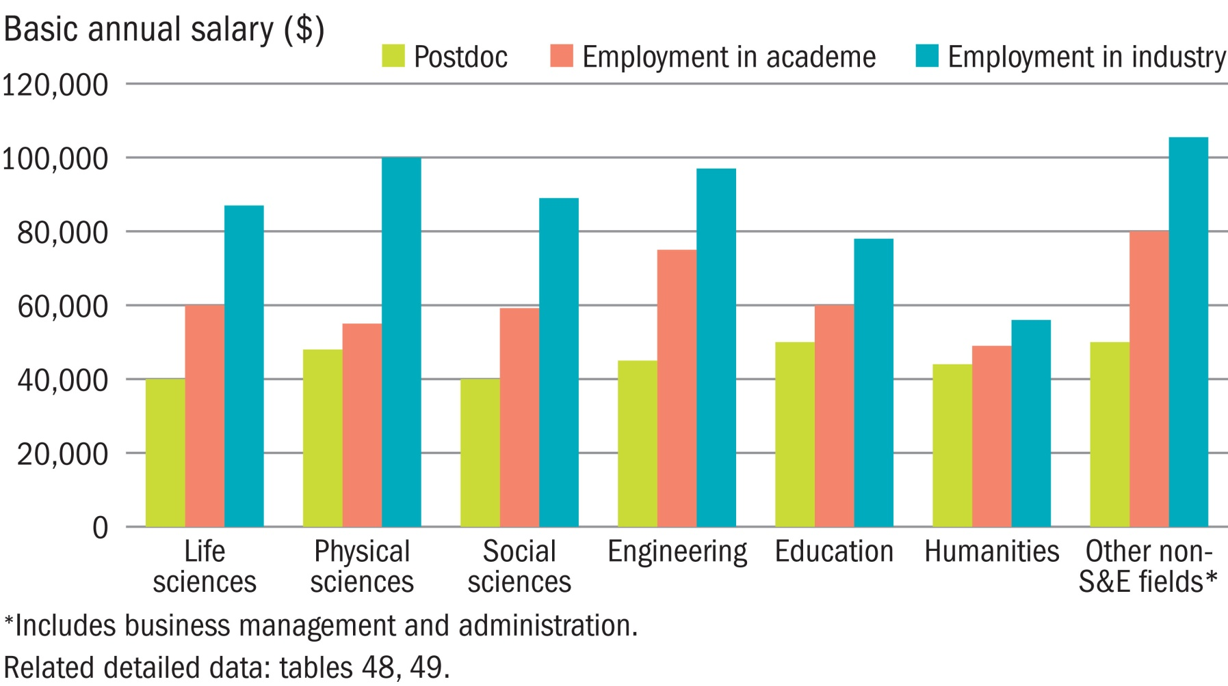
Median basic salary of doctorate recipients with definite commitments in the United States, by position type and field of study: 2012

Slide 28
NIH
NRSA (F32) Postdoc fellowship awards
(2014)
Career Level Postdoctoral
Years of Experience Stipend for FY 2014 Monthly Stipend
0 $42,000 $3,500
1 $43,680 $3,640
2 $45,432 $3,786
3 $47,244 $3,937
4 $49,128 $4,094
5 $51,096 $4,258
6 $53,148 $4,429
7 + $55,272 $4,606

Slide 29
How do I decide?
Consider mentor’s style and expectations

Slide 30
Types of Postdoc Mentors and Models
Collaborator
  Lab works as a team
  Focus on productivity more than individual training
Hands-off
  Allows trainees wide latitude
  More tolerant of mistakes
  Less demanding in terms of productivity
Senior scientist - advisor
  many other commitments
  High-quality attention but hit and miss
  Expectation – develop independence
Didactic model
  “listen to me”
Apprentice model
  “follow me”
Collegial model
  “be my junior colleague”
Friendship model
  “be my friend”

Slide 31
What expectations should a Postdoc mentor have for her/his trainee?
Active participation in lab activities
Work ethic
Actively work toward professional skills & independence as an investigator
Communicate honestly with mentor regarding research progress
Foster collegial relationship with mentor

Slide 32
What things should a Postdoc mentor discuss with a trainee?
Authorship
Ownership of data (and patents)
Expectations for when postdoc will be around
Participation in other research projects and authorship on those
Mentors availability
Potential for funding for stipends, research, travel, etc.

Slide 33
What are the characteristics of a successful mentor-trainee relationship?
Demonstrate style/methodology of doing research
Develop and foster an analytical approach to doing research
Discuss concepts of any sub-discipline, and evolution of those concepts over time
Explore and evaluate literature of the discipline and important broader knowledge
Discuss ethical basis of scientific research

Slide 34
What are the characteristics of a successful mentor-trainee relationship, Cont’d
Demonstrate how to consider, analyze and evaluate the work and conclusions of colleagues
Transmit by example and discussion, the skills required for successful scientific writing
Evaluate and critique research and teaching
Facilitate socialization and access to research community in the discipline
Strive for a relationship characterized by mutual trust
Foster interpersonal skills needed to become a scientist

Slide 35
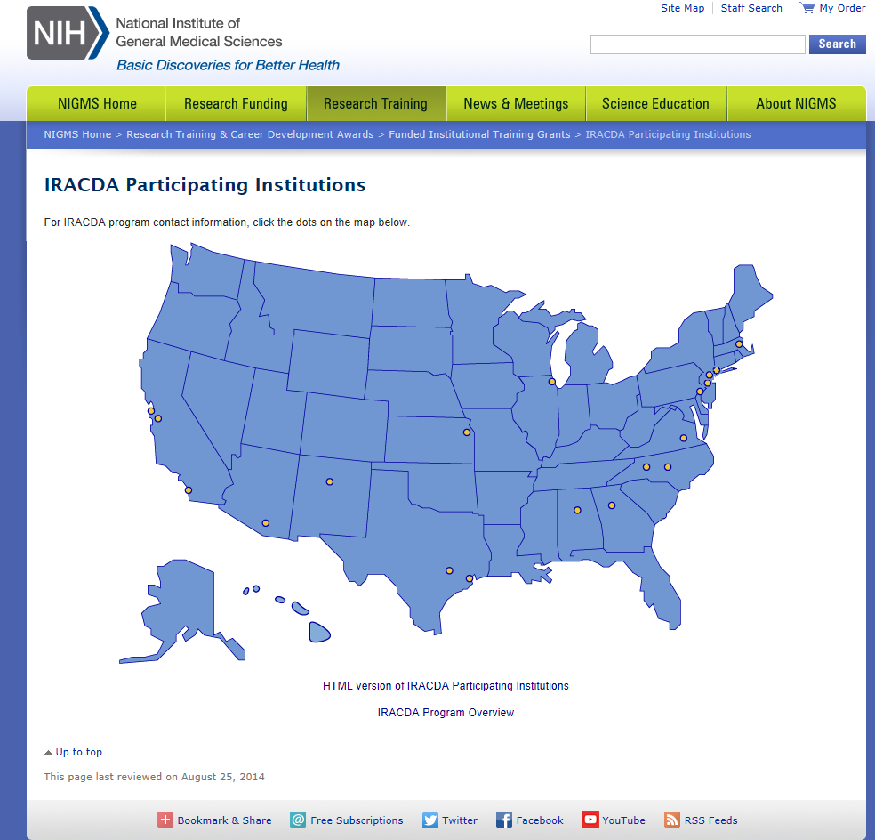
IRACDA
Institutional Research and Academic Career Development Awards (IRACDA) (K12)
Career development program from NIGMS
traditional mentored postdoctoral research experience combined with opportunity to develop academic teaching skills at a partner institution

Slide 36

Warning signs
Other postdocs/graduate students in the group won’t talk with you
Former postdocs are no longer active in discipline
Expectations don’t match reality
  “I want each postdoc to publish 2 papers per year in high impact journals…”
  Reality has 1 high impact paper in past 5 years
Constrained funding situation – expectations of minimum support periods with no expectation of future support

Slide 37
Evidence-based decision
seek evidence of mentors productivity and reputation
  Publishes in good journals
  Read papers
  Evidence of grant support (NIH)
Communicate with others
Give Journal club on prospective mentor’s work

Slide 38
Consider your long-term goals prior to deciding
Career guides - myIDP

Slide 39
Final Thoughts
A Good Mentor is:
Advisor
Critic
Advocate
Instructor
Role model
Scientific ‘parent’
Useful References:
Macrina, F. L. (2000) Scientific Integrity: An Introductory Text with Case Studies, ASM Press, Washington, DC
NAS (1995) On Being a Scientist, 2nd Edition, National Academy Press, Washington, DC
NAS (1997) Adviser, Teacher, Role Model, Friend, National Academy Press, Washington, DC

