Slide 1
Writing a Fellowship Application

Slide 2
Research Grants vs. Fellowships
Research Grant
Fellowship
Research is primary focus
Research
Applicant
Mentor
Institutional Environment
Training/Career Plan

Slide 3
Review Criteria
Research
Fellowship
Significance
Innovation
Investigator
Approach
Environment
Research
Applicant
Sponsor
Collaborators/Consultants
Research Training Plan
Training Potential
Institutional Environment/Commitment

Slide 4
Pre- vs. Post-Doctoral Fellowships
Pre-
Post-
Level of research experience
More of a training or learning experience
More training experience towards independence
More sophisticated research plan

Slide 5
Applicant
Market yourself
Level of research experience
Academic standing and background
Strengths
Weaknesses- and how you propose to overcome these
Be passionate about your research and research potential
Value of fellowship to career development

Slide 6
Sponsors, Collaborators, and Consultants
Should be respected scientists
Important that they be funded
Prior experience with training pre- and post-docs
If selecting a junior faculty mentor, make sure you have a co-mentor or mentoring team with more experience

Slide 7
Training Plan vs. Training Potential
Plan
Potential
Is research of high scientific quality?
Do you have the skills and knowledge to do the research?
Be sure to delineate between your mentor’s research and your research training plan
Is the research plan commensurate with your level of career development?
How will the research advance your career and independence?

Slide 8
Institutional Environment and Commitment
Show how the institution values training
Institution has the faculty that can serve as mentors
Laboratory space, equipment, supplies, and funding
Track record of developing and mentoring researchers into independent careers

Slide 9
Starting the Process
Do an assessment
What opportunities are there for collaborations?
What are your strengths and weaknesses?
What is the added value of a fellowship as opposed to working under your mentor’s R01 grant?
Read the RFP carefully
Send a brief email (2-3 paragraphs) to the program officer including where you are in your academic career, what you want to accomplish, and what your research plan is

Slide 10
Cont.
Be sure in your initial email to request a follow-up phone conversation– it helps to develop a rapport with your program officer
Allow at least three months to develop your proposal
Know the culture of the agency to which you are applying

Slide 11
Pen to Paper
Hone in on a suitable hypothesis for your research
Does your hypothesis make good sense?
Can you develop specific aims based on this hypothesis?
Can you design experiments to prove or disprove your hypothesis?
Be careful not to propose too much—most fellowships are for 2-3 years
Use charts and graphs and effective use of white space

Slide 12
Cont.
Since there is a statement from your mentor(s), collaborators, and consultants, make sure that this jibes with your own statement.
Abstracts should be fairly non-technical since some of the reviewers may not have your breadth of knowledge
Strictly adhere to all formatting guidelines
Font size
Margins
Page limitations

Slide 13
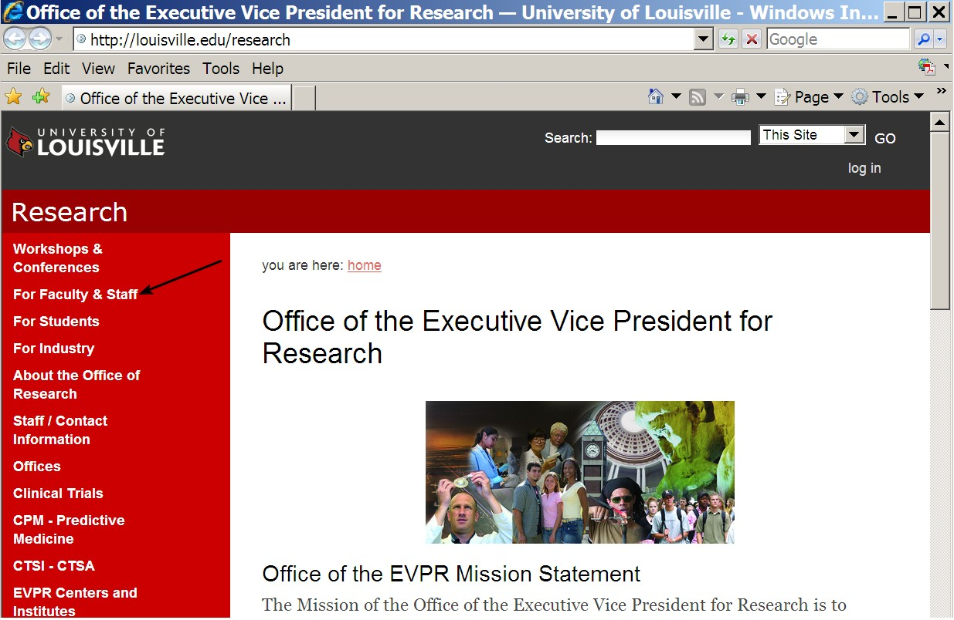

Slide 14
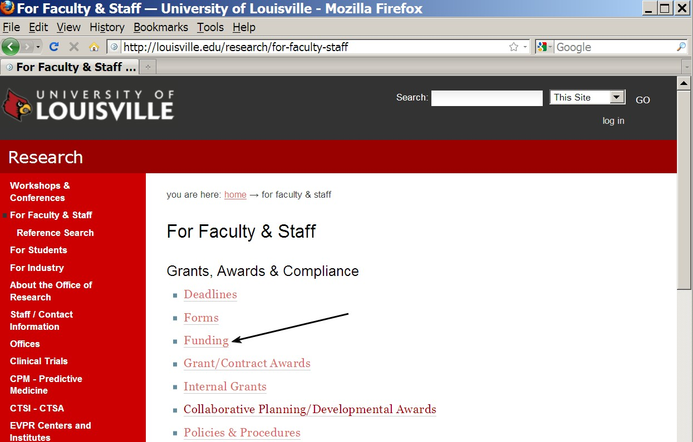

Slide 15
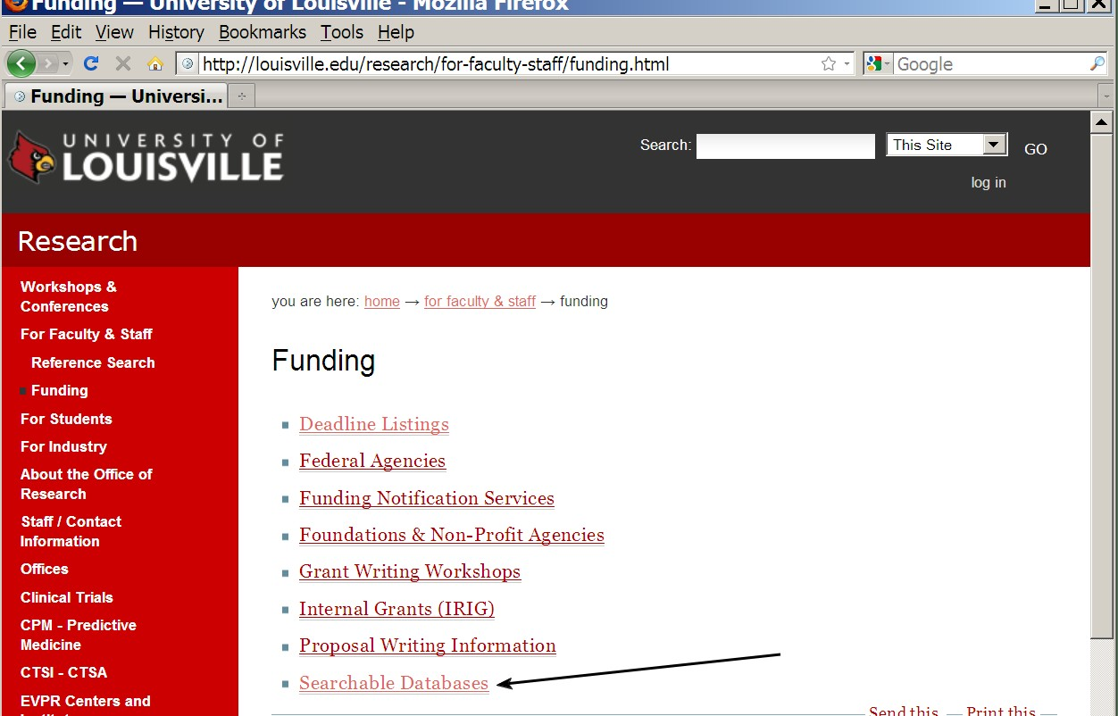

Slide 16
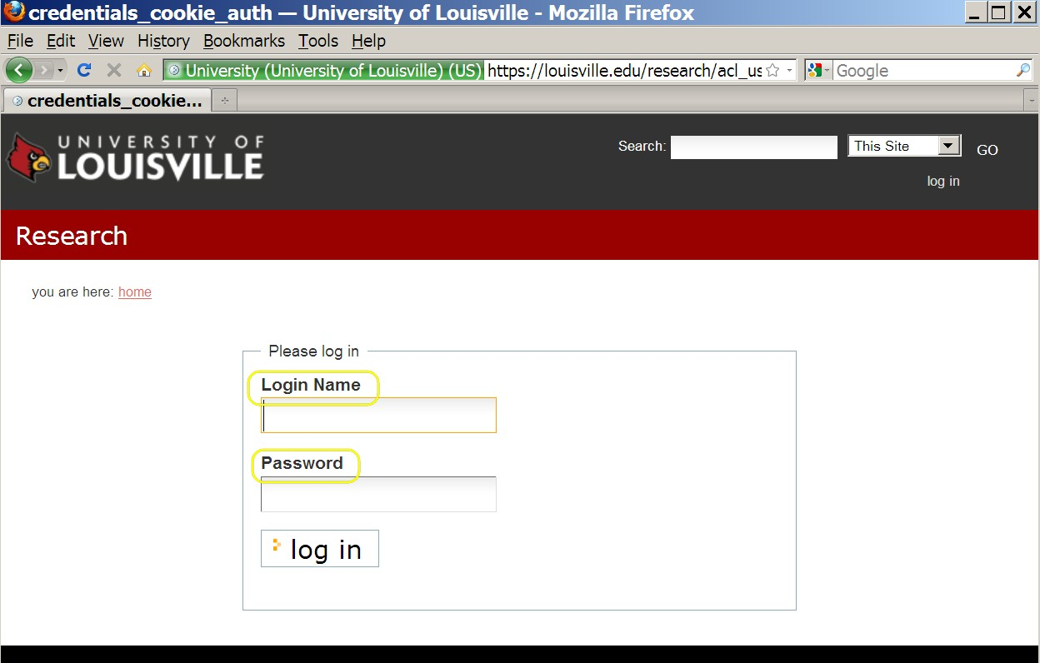

Slide 17
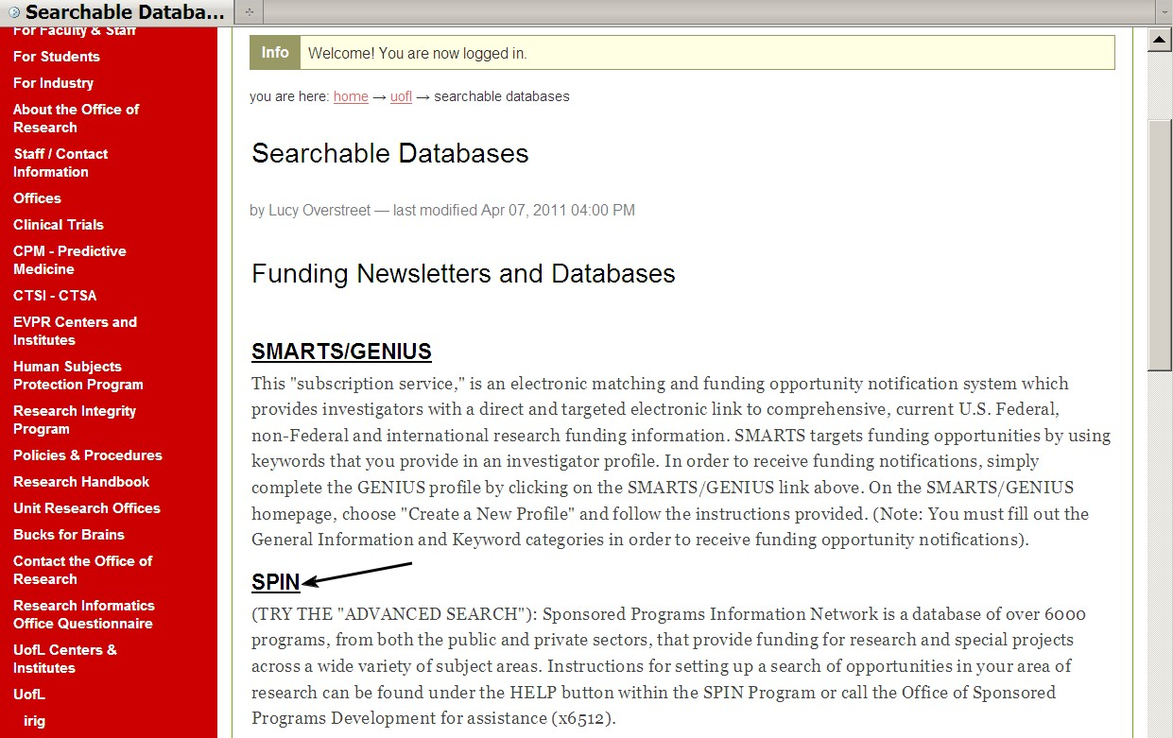

Slide 19
John Jaynes
Asst. Director Sponsored Programs Development
852-8363
jhjayn01@louisville.edu

