Slide 1
GSC Travel Grant Tutorial
GSC Meeting
September 8th 2016
Drew Skidmore
Director of Travel

Slide 2
Going Somewhere??
Apply for a GSC Travel Grant!
GSC is able to offer funding for travel to conference or other academic/professionally related events
$200 if not presenting
$350 if presenting
GSC funds 180 to 300 students per academic year

Slide 3
Easy Steps to obtain a travel Grant
1- Apply for funding
2- Receive award letter
3- Travel/present/enjoy yourself!
4- Gather required documentation
5- Submit documentation
6- Sit back, relax, and let the funds roll in….

Slide 4
Step 1- Applying for a travel grant

Slide 5
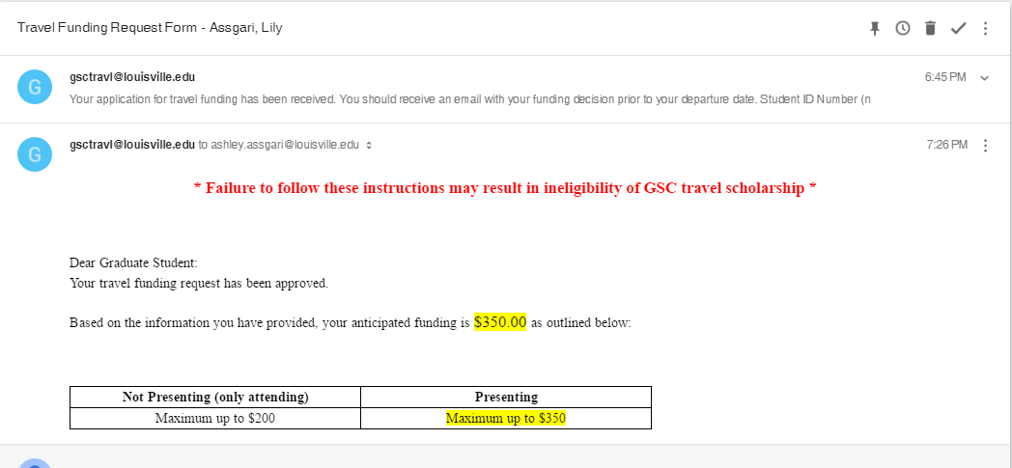
Step 2- Receive travel grant letter

Slide 6
Step 3- Travel/Present/Enjoy Yourself
BUT!!!.. Make sure you are gathering/keeping your receipts
Hotels
Rental car/ taxis/ Lyfts/ Ubers
Conference registration
Other travel related costs
Sometimes.. food*

Slide 7
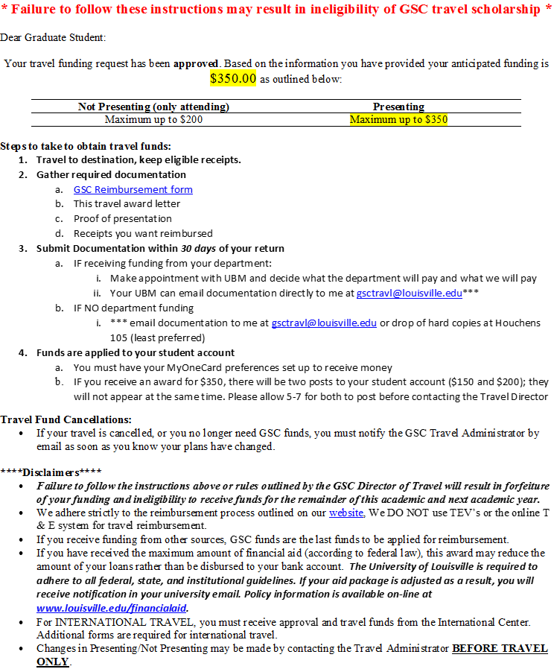
Step 4- Gather required documents
GSC Reimbursement Form
Travel Award Letter
Proof of Presentation (if you presented)
Abstract Acceptance email
Screenshot of a conference program with your name
Receipt(s) that you want GSC to reimburse
Scanned copies and PDFs work well!

Slide 8
Step 5- Submit documentation
Do you have departmental funding?
YES!!
Submit all documentation to your unit business manager (UBM)
They will determine what they will pay and what we will pay
Our funds should be applied last!
UBM should submit documentation on your behalf**
No ☹
**Scan and email required documentation directly to me (gsctravl@louisville.edu)

Slide 9
Step 6- Sit back, relax, and let the funds roll in….
Applied to your student account
BankMobile- how financial aid disburses refunds
What does this mean for financial aid?
If you have the full amount of loans possible, your refund will be applied to those loans
If you get $350, there will be two deposits!
$200 and $150, will not hit at the same time
Only one deposit for $200 or less

Slide 10
reasons for Denial of Funding
Inactive department
Already funded this fiscal year
Students can only receive one GSC Travel Grant per fiscal year
Failed to follow instructions when applying in the previous year or did not claim funding in a previous year without notice

Slide 11
Questions?

