Slide 1
Graduate Program Directors
www.louisville.edu/internationalcenter/isss

Slide 2
International Student & Scholar Services Office (ISSS)
Dr. Mordean Taylor-Archer, Vice Provost for Diversity and Int’l Affairs
Associate Director – Int’l Student & Scholar Services: Sharolyn Pepper
International Student Coordinators: Barbara Jones and Thomas Beard
International Student Advisor:
Connie Martinez
Program Assistant Sr.: Beverly Cooper

Slide 3
International Student and Scholar Services Office (ISSS)
Belknap Campus Office
9 a.m. to 4:30 p.m. Monday – Friday
Phone: 502-852-6604
Email: intcent@louisville.edu
Health Sciences Campus Office
Every Tuesday from 10 a.m. to 4 p.m.
HSC Instructional Building, Room 120
Phone: 502-852-7124
Web address:
http://www.louisville.edu/internationalcenter/isss

Slide 4
Who is a non-immigrant?
Student and Scholar Information
A non-immigrant is an individual who is currently in the United States on a temporary visa pursuing a specific objective.
F-1 Student: Individuals in the US engaging in a full course of academic study in an accredited educational program that has been certified by Department of Homeland Security. 60 day grace period after completion
J-1 Exchange visitors, student, professor, researcher, physician, intern: Individuals in the US as visiting researchers, professors, short-term scholars, specialists, trainees, interns, or alien physicians under the sponsorship of an exchange visitor program certified by the Department of State. 30 day grace period after completion
H-1B Temporary Worker: University Legal Counsel processes/Employer
Other Visa Types -- A-Z-- Non-Immigrant Visa Classifications Chart
*Note: A visa is only permission to enter the United States.
-Status is maintained with immigration document

Slide 5
Int’l Student and Scholar Services (ISSS)
Student and Scholar Information
Serve as Principal Designated School Official (PDSO or DSO) to ensure institutional compliance with federal government regulations through the Student Exchange Visitor Information System (SEVIS)
Issue immigration documents in SEVIS to students, exchange visitors, scholars and dependents (forms I-20 or DS-2019) Use Peoplesoft
Advise international students and scholars on admission, adjustment, financial, and maintenance of status issues.
Collaborate on programming efforts with on and off campus offices and organizations to enhance opportunities for non-immigrant students, scholars and their dependents
Notes:
Do this using Peoplesoft
Maintenance of status – passport valid, not work without permission, pursue objective of immigration document

Slide 6
What our office does after student admitted by Department & SIGS
ISSS receives a referral from Graduate Admissions
Review the referral to:
Establish funding source (University funding) for F or J student
Visa status
Program Information
Email the student (sample letter) for three required items:
Financial support if not provided by the University ($35000 for two semesters) Economic Hardship
Passport – State Department Name Standardization - Dependents
Shipping Information
Students in the United States
Transfer in or out of UofL
Students in another visa status – F2 & J2 part time – Funding for other visas
Students changing level or degree at UL or another institution
Students on OPT at UL or another institution
Sponsored students

Slide 7
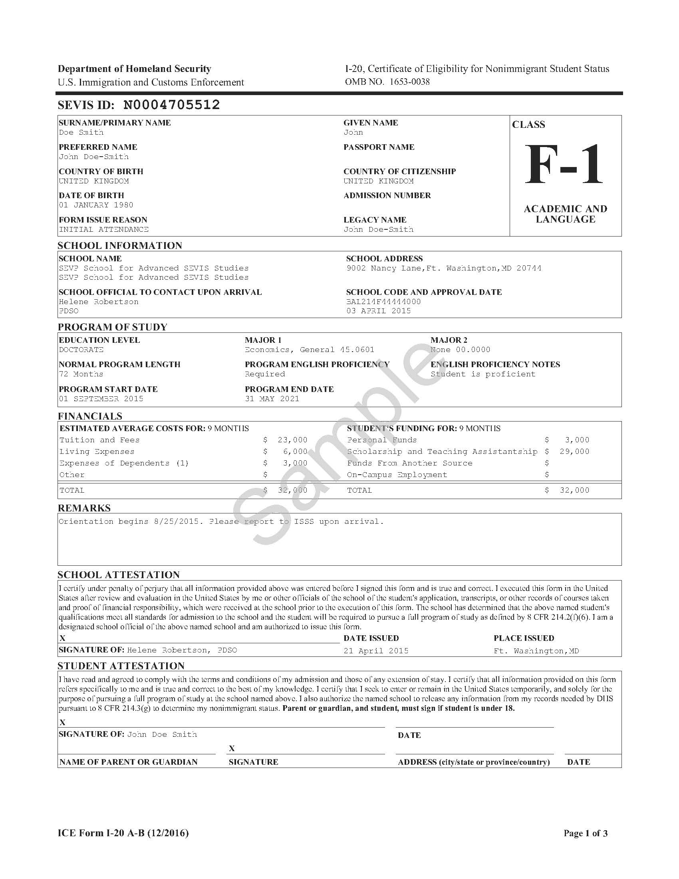
Sample SEVIS I-20
New International Student Orientation

Slide 8
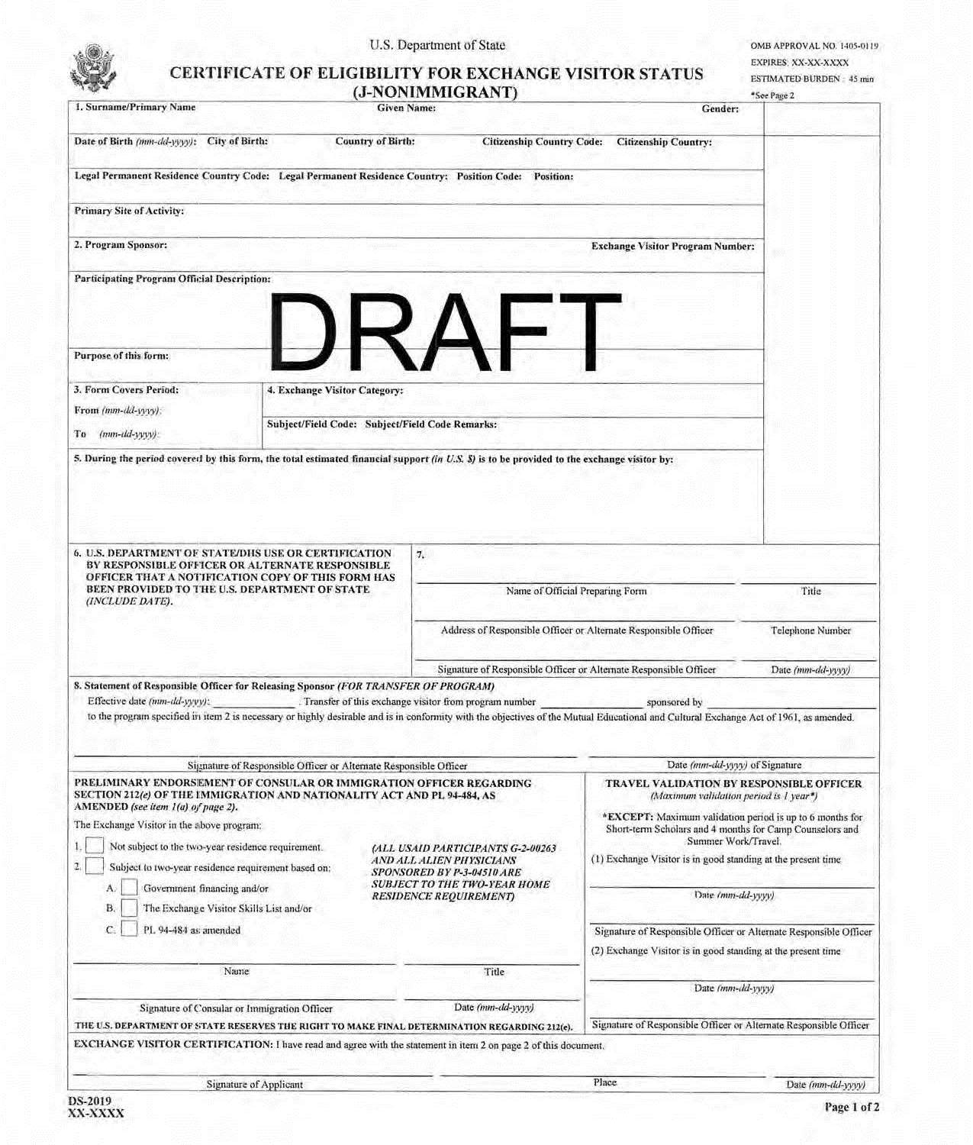
Sample SEVIS DS-2019
New International Student Orientation

Slide 9
Advising International Students
Initial – Enter US no more than 30 days before program start date
Full-time vs. Part-time enrollment
Online study
Holds on accounts
Program Extension
Probation/Dismissal/Resignation – No Grace Period - completion 30 or 60
Change of Level or major/Transfer
Employment issues – on campus, CPT, OPT
Notes:
Discuss on campus employment, curricular practical training and optional practical training
Discuss differences in educational systems as well as cultural – informal versus formal, application, test taking ‘ quote from student’

Slide 10
Support Services
Student and Scholar Information
Airport pick up,, new student orientation, housing
Social Security Number
Driver’s License
Banking
Safety
Health Insurance
English Language Classes
Food
Religious Holidays
Cultural Adjustment, ex. reluctant to admit their hardships
Cultural Differences, ex. Time
Academic Issues, ex. Plagiarism
Dependents

Slide 11
Professional Organization: www.nafsa.org
Student and Scholar Information
Department of State
Department of Homeland Security (DHS)
Study in the States
United States Customs and Border Protection (CBP)
United States Immigration and Customs Enforcement (ICE)
Student and Exchange Visitor Program (SEVP)
United States Citizenship and Immigration Services (USCIS)

Slide 12
Questions, Comments or Concerns
International Student and Scholar Services
www.louisville.edu/internationalcenter/isss
502-852-6604

