Slide 1
Non-Resident Tuition Exception
Graduate

Slide 2
Website for Access to Form (Testing in USER)
https://onbaseuser.louisville.edu/onbase/UnityForm.aspx?d1=AWUE%2b2WHQrqRFoPNXK5uDTdpugc83cjB%2b2Zj8xvC1A9XzM%2fFTrD5tKJjTfV2%2btOmqBX5qxksNH4oF%2fbIxbuYxE0o8L971We97iL43Lqj9RmvZN5VwRkfH8LwvLhrKBa5EX%2f2jtbBdpuXaxxWBHTHNJgX8TrUOVUR36WDIkqunvgz
This website link will change when we move to Production and will also be posted to the SIGS Website.
Being that browsers are not standardized at this time, you may need to test which browser works best for you.

Slide 3
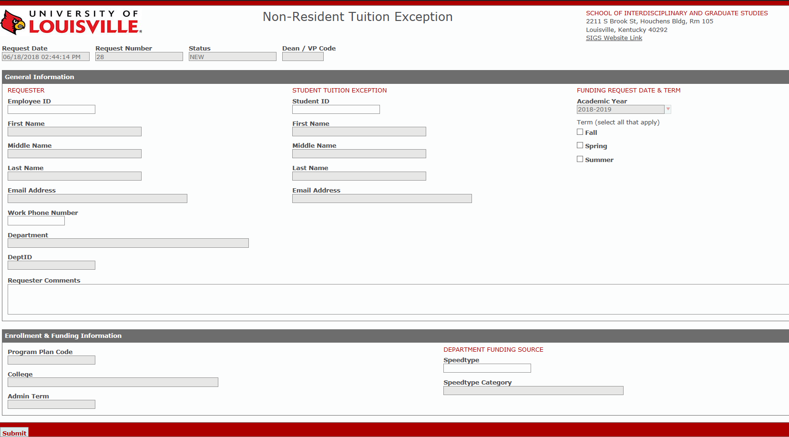
What the Form Looks Like

Slide 4
Section 1 – Pre-Populated Items
Date and time entered
Each request is individually numbered
Status updates as it moves through each workflow step
Code updated by department id

Slide 5
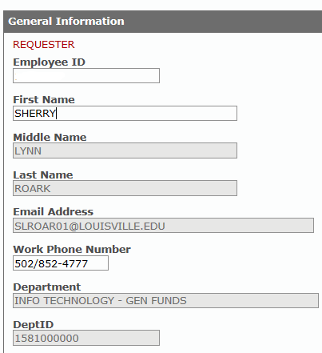
Section 2 – Requester Information
Enter your Employee ID
1234567
Your information will be automatically filled-in
Enter your phone number (If you don’t have your number in PeopleSoft)
Add any comments you want to communicate

Slide 6
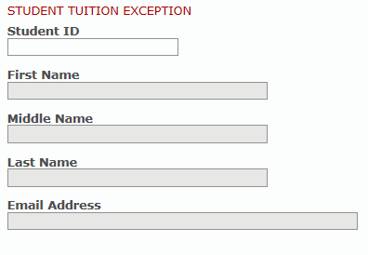
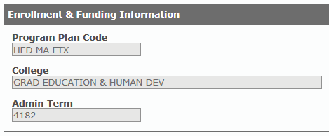
Section 3 – Student Information
1234567
Enter requested graduate student for non-resident tuition status
Billy
Bob
Smith
Student and enrollment information will be automatically filled-in
BBSmith01@Louisville.edu

Slide 7
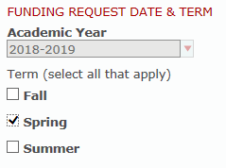
Section 4 – Funding Request Date & Term
Academic Year will be defaulted to this year. In the future we will have more dates to select.
Check what term (multiple terms can be selected for funding)

Slide 8
Section 5 – Department Funding Source
Enter speedtype that will be funding this student
BR549
Speedtype category will automatically populate

Slide 9
Section 6: Submit
BR549
Once your form is complete select the “Submit” button to start the workflow process

Slide 10
Requester Confirmation Email
Confirmation using email address of services account
Billy Bob Smith

Slide 11
Approval Process
SIGS - Department

Slide 12
SIGS Department Process
SIGS department receives email notification –
Click hyperlink to view the request or use the work queue when moved to production
Review the Non-Resident Tuition Request Form.
Select one of the workflow options available to you.

Slide 13
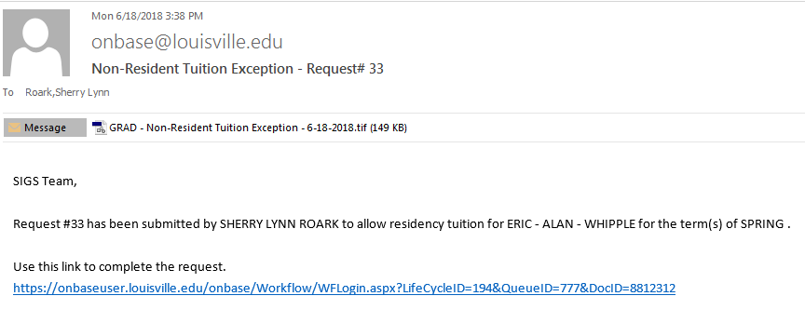
SIGS Approval – Email notification
Billy Bob Smith
Select the hyperlink to access the form
Notes:
PI receives email with link.
Clicks on link.

Slide 14
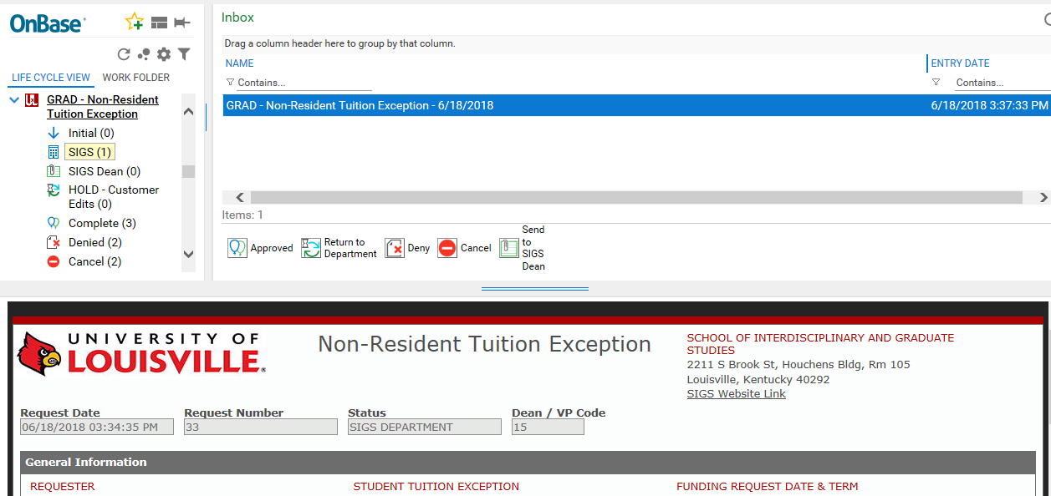
SIGS - Workflow Screen
Notes:
PI receives email with link.
Clicks on link.

Slide 15
SIGS - Workflow Options
Select one of the options in the middle of the workflow screen
Notes:
PI receives email with link.
Clicks on link.

Slide 16
SIGS - Workflow Options
Return to Department, Deny, and Send to SIGS Dean gives you the option of entering comments to the customer or SIGS Dean via email
Notes:
PI receives email with link.
Clicks on link.

Slide 17
SIGS - Comment
Enter comments and then “Submit”…
EVEN IF YOU DON’T HAVE COMMENTS TO ENTER YOU MUST SELECT SUBMIT TO MOVE FORWARD WITH WORKFLOW.
Notes:
PI receives email with link.
Clicks on link.

Slide 18
Approval Process
SIGS Dean

Slide 19
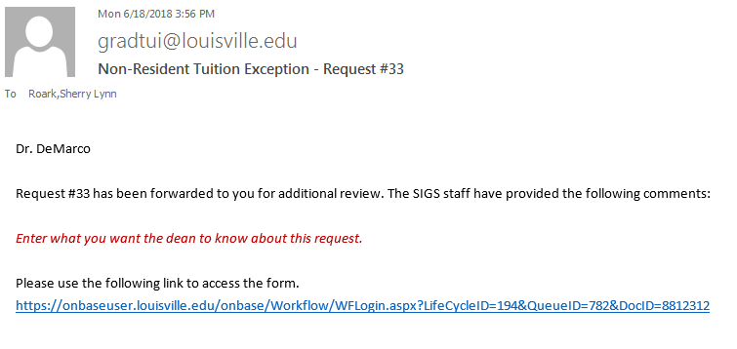
SIGS Approval – Email notification
Select the hyperlink to access the form
Notes:
PI receives email with link.
Clicks on link.

Slide 20
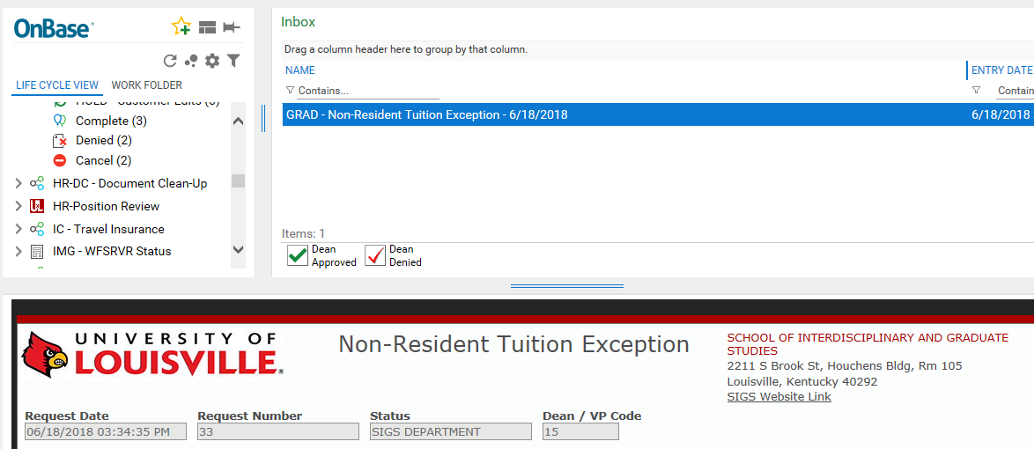
SIGS Dean Workflow Screen
Notes:
PI receives email with link.
Clicks on link.

Slide 21
SIGS Dean - Workflow Options
Select one of the options in the middle of the workflow screen
Notes:
PI receives email with link.
Clicks on link.

Slide 22
SIGS Dean - Comments
Enter comments and then “Submit”…
Both the Denied and Approved by Dean have a comments box.
EVEN IF YOU DON’T HAVE COMMENTS TO ENTER YOU MUST SELECT SUBMIT TO MOVE FORWARD WITH WORKFLOW.
Notes:
PI receives email with link.
Clicks on link.

Slide 23
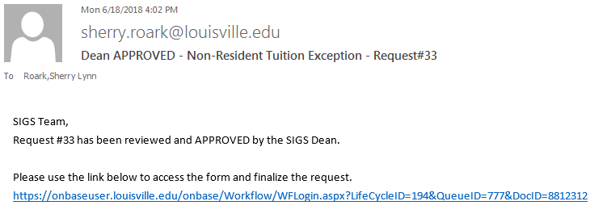
SIGS Department – Receives Email from Dean
Email will be from SIGS Dean email
Subject will say either “Approved” or “Denied”
Link to form needing to be finalized by SIGS Department
Notes:
PI receives email with link.
Clicks on link.

